Slide 1
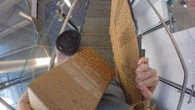
Slip, Trip & Fall Prevention at Berkeley Lab

Slide 2
Walking Injuries:
All Walking Injuries + Walking Injuries Involving Stairs

Slide 3
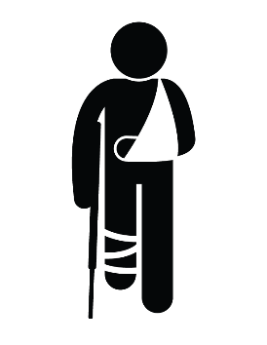
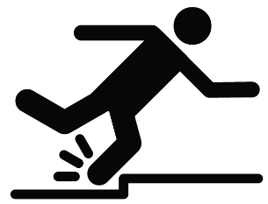
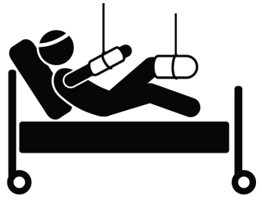
Our colleagues have been seriously injured.
Slip, Trip & Fall Prevention at Berkeley Lab
Please walk cautiously.
Injuries resulting from falls in the last three years include:
Detached Fingernail
Wrist Laceration
Broken Jaw
& Tooth
Wrist & Knee Fracture
Ankle Sprain & Concussion

Slide 4
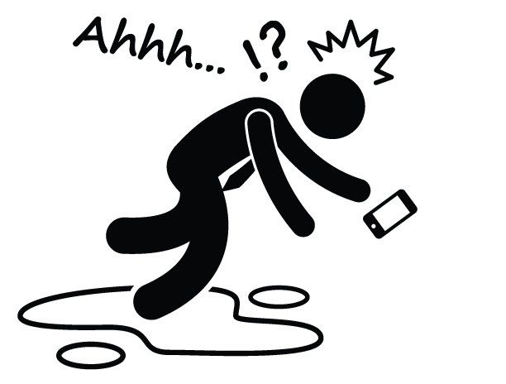
Falling While Walking
at Berkeley Lab in FY18
Cases
20
7
Recordable Cases
199
Restricted Days
10
Lost Days
FY18 had a 192% increase in the restricted work days & 96% reduction in # lost work days from FY17 in walking related injuries!
35%
Required Medical Treatment

Slide 5
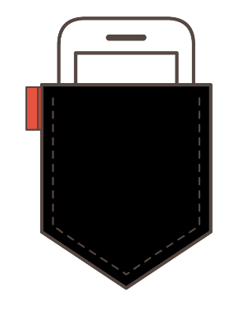
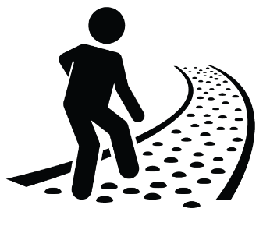
Pocket Your Phone
Hold Hand Rails
Make Sure One Hand is Always Free
Be Aware of Your Surroundings
Takeaways
..including uneven walking surfaces and debris on walkway.
Look out for Each Other
Speak Up
Clean Up, Report, and/or Block Off Any Spills
Immediately Report Unsafe Walkways & Broken Handrails
…when you observe someone not walking mindfully.

