Slide 1
20 T hybrid future activities
P. Ferracin
20 T hybrid Meeting
October 1st, 2024

Slide 2
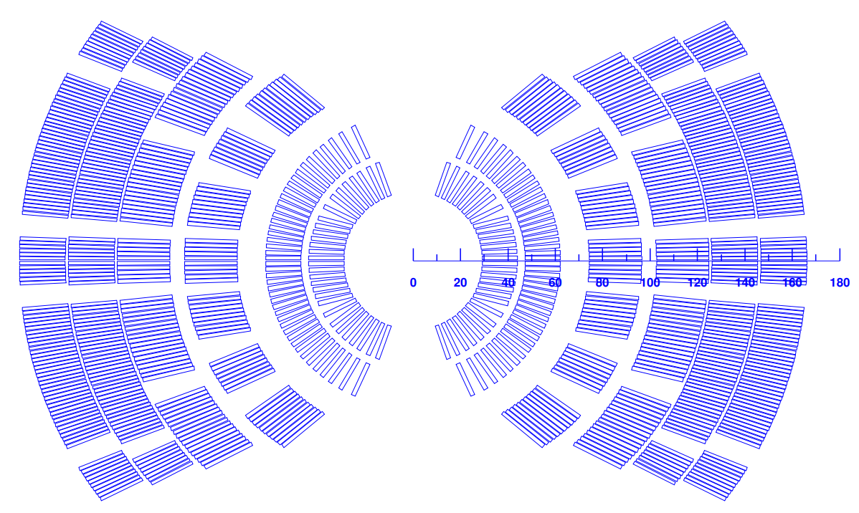
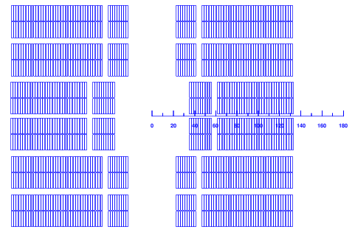
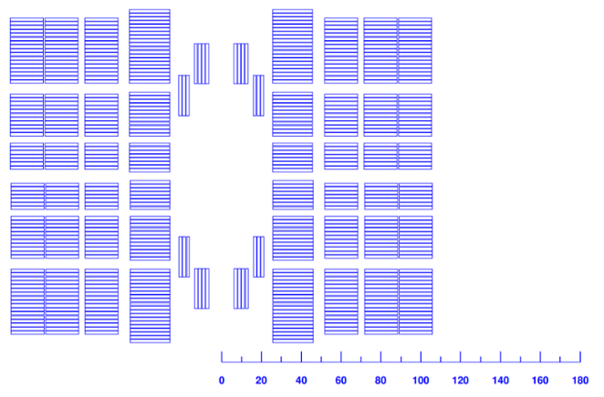
Towards 20 T hybrid magnet Overview
HTS
LTS
HTS
LTS
LTS
HTS
Three options considered (Cos-Theta, Block, Common-coil), all with a Bi2212 insert
Iterative process: magnetic, mechanical, and QP analysis
More focus on Cos-theta: MDP inserts and outserts current design
…and on common coils
Only preliminary design with block
Quench protection of the 3 designs carried out
Quench protection ok for 1+ m long magnet, for the 10-15 m length new solutions to be considered
R. Gupta and D. Martins Araujo, et al., 4LOr2B-02
Emmanuele Ravaioli, , et al., 4LOr1B-06

Slide 3
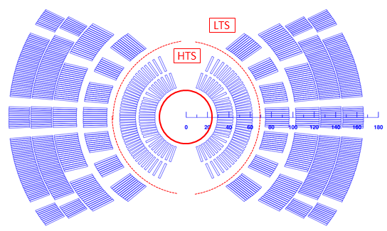
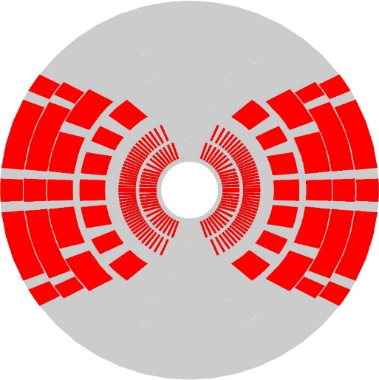
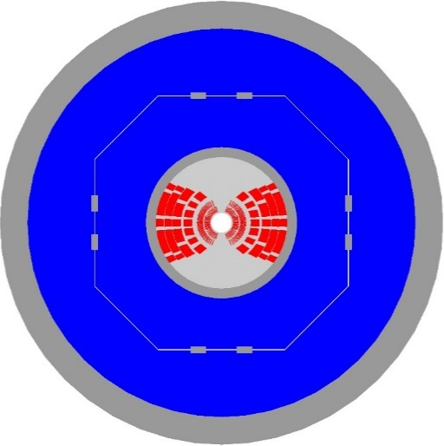
Towards 20 T hybrid magnet Cos-theta option
Magnetic:
2 layer HTS, 4 layer LTS, field quality and margin in spec, OR coil: 165 mm
Mechanics:
Stress management required in all directions
First 2 layers (HTS) with single cable in grove, second 2 layers (LTS) with single block in grove, last 2 layers traditional CT
Coil stress acceptable, but very high stress in the mandrel (Inconel or Nitronic?)
Large mechanical structure: 1120 mm.
Pre-load provided by bladder and key support structure to reduce peak field in conductor.
Marika DAddazio, , et al., 4LOr2B-03

Slide 4
Next steps
Fine tune of CT cross-section
Reduce stress in some coil corners by splitting blocks
Continue mechanical analysis support structure
Optimization key positions…..

Slide 5
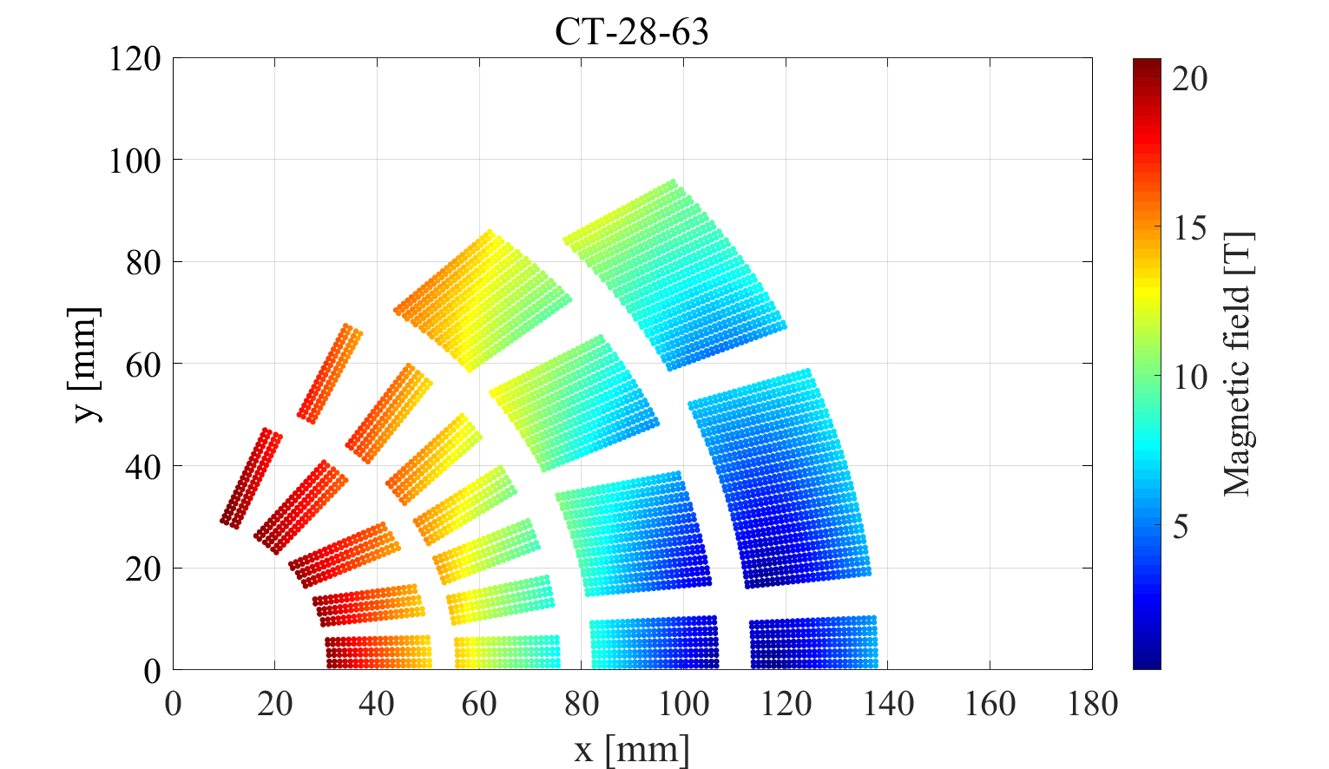
Next steps
Continue exploring CT 4 or 5 layer option
The idea is to minimize the overall coil area

Slide 6
Next steps
Baseline CT option with ESC
Thick Cu ring between layer 2 and 3

Slide 7
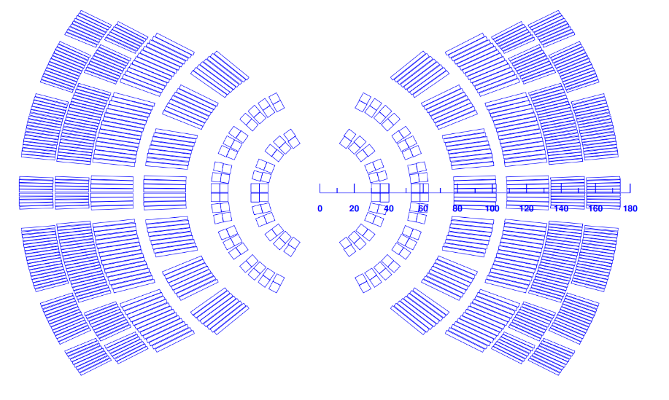
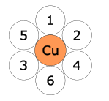
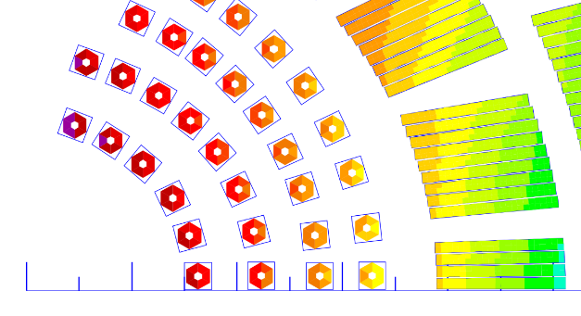
Next steps
Hybrid with CORC/STAR

Slide 8
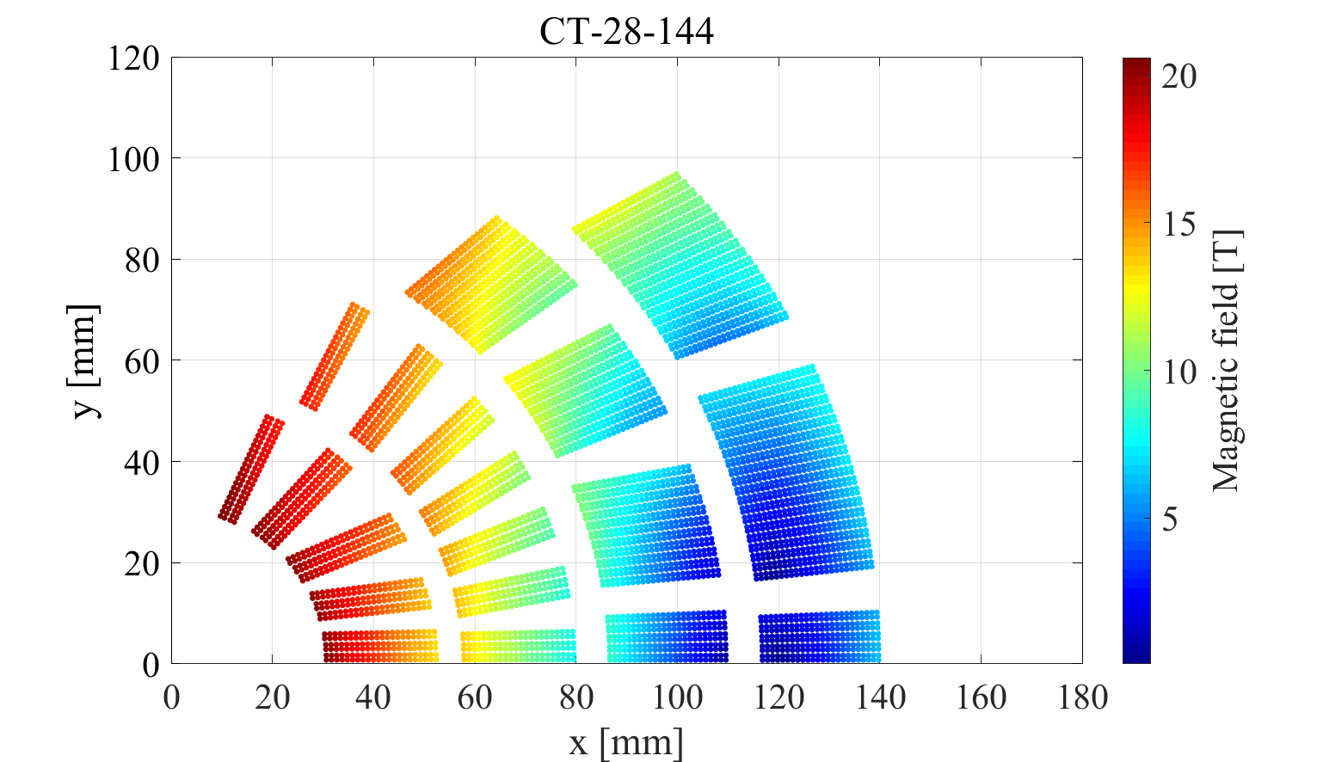
Next steps
All HTS with Bi2212 Rutherford cable and CORC/STAR

Slide 9
Common coil
HTS
LTS
Still some high stress in the baseline design
Xplore asymmetric option

Slide 10
Block design
HTS
LTS
Study what we could do with TFD as an outsert

Slide 11
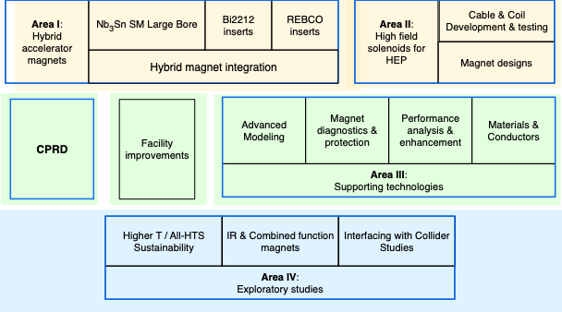
Updated roadmap (work in progress)

