Slide 1
The 14th US MDP 2212 WG meeting, Sept/Oct 2024
US MDP 2212 WG meeting, Sept/Oct 2024
2024/10/01
Meeting series: https://conferences.lbl.gov/category/100/

Slide 2
ASC2024 presentations
Daniel Davis

Slide 3
Status of each lab’s 2212 MDP program
News from LBNL CCT program.
(1) BIN5-CCT5 test preparation intensified. Test targeted Dec, 2024.
News from the ARDAP project. (1) Four billets fabricated. Three billets characterized. (2) Cable solenoid test at 31 T (Davis). (3) BIN5E heat treatment?
Facilities: (1) RENEGADE OP furnace. (2) DELTECH OP furnace.
News from NHMFL solenoid program.
News from FNAL SMCT program.

Slide 4
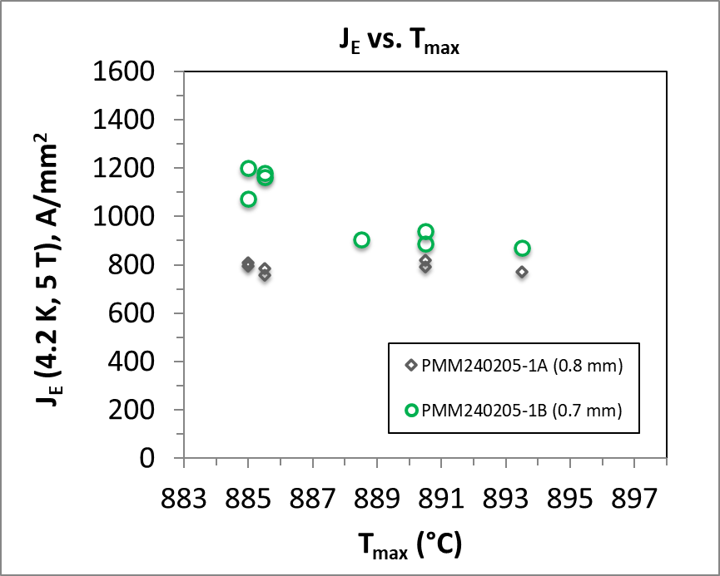
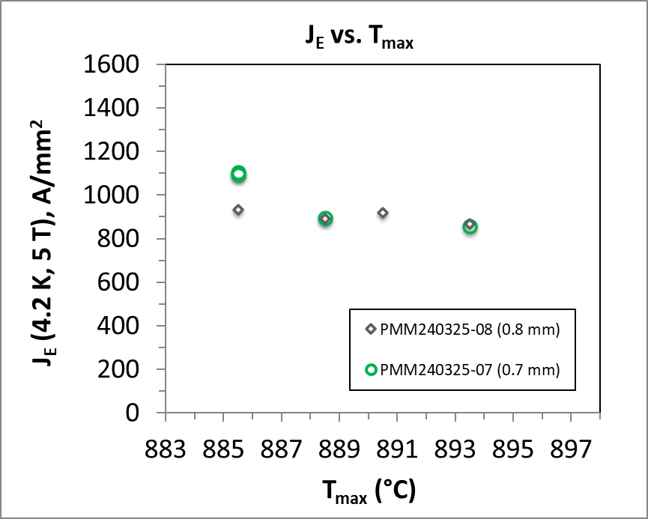
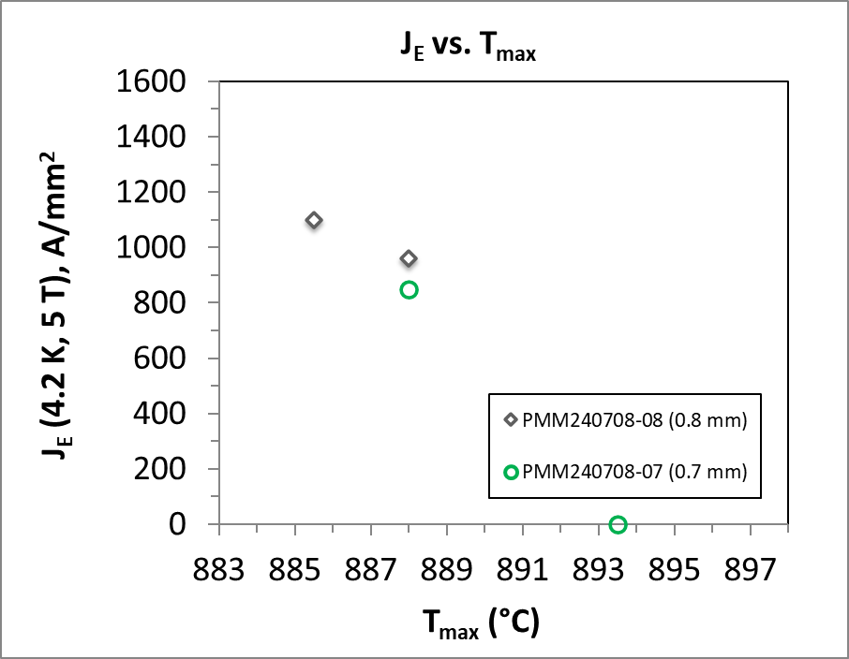
Three wire billets have been produced, with okay performance
ARDAP billet #1
(505 m in 0.7 mm)
ARDAP billet #2
(510 m in 0.7 mm)
ARDAP billet #3
(0.8 mm)
Performance Target
Performance Target
Performance Target
All 37 x 18.
J. Jiang, NHMFL, leads heat treatment and I_{c} characterization

Slide 5
What to do with three 10 kg billets in the inventory?
PMM220329
1.0 mm, 55 x 18, at LBNL
PMM191004
0.8 mm, 55 x 18, at LBNL
PMM161111
0.8 mm, 55 x 18, at Fermilab
Request to fabricate 17-strand Rutherford cables
For LBNL and Fermilab (15 m piece length).
Request to fabricate 9-strand Rutherford cables
NHMFL cable solenoids (65 meters cables to achieve 20 T).
Length divisions – 1100 m and 1100 m.
Two cables have been made (LBNL 2005 (9-strand, ~100 m)
and LBNL2006 (17-strand, ~50 m).
Both with planetary twisting so the strands were NOT
twisted during cabling.
Note: PMM211105, 1.0 mm, 55 x 18 has been used to fabricating the first cable for Bi-CCT2.
Cable fabricated. Winding trial to start.
Infuse project with PPPL – what lengths and what cables?
Yuhu Zhai presented at our WG meeting.

Slide 6
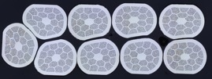
ARDAP
MDP
9 strands
Y81OL2005
17 strands
Y82OL2006
23 strands
Y84OL2009
6 strands
R80OL2007
R80OL2008
By JF

Slide 7
Additional items.
CPRD conductor requests. – Do we want to place a conductor request in and what would be the length/performance/diameter/billet size?
Follow-up on items discussed during our two last meetings including conductor usage, Alex Otto presentation, and Yuhu’s presentation.
A CPRD proposal to buy powder (2 kg), split into two halves and have both Bruker OST and SMS to fabricate wires (2 x 2 kg billets x 2 companies). The purpose is to develop a new vendor.
Are you in favor or against this, and why?
If you are in favor, do you have a coil/magnet in mind that can use these wires and if yes, what specification would you ask for?
Feedback from 2212 WG: (1) Use mixed powder. (2) Hold at 1.0 mm. (3) 55 x 18.

Slide 8
The CPRD contract to SMS (LBNL PO 7724688)
Deliver two billets, ~2 x 200 m max total at 1 mm.

Slide 9
Not yet part of CPRD contracts but they are available for purchase at a discount, through CPRD.

Slide 10
The billet / wire ID is WB12 / DE67. 1 mm diameter wire, 57x18 thick wall design. Only 6 m available.
If you want for comparison, there is a thin walled 56x18 WB11 / DE53. Also 1 mm. 14 m available.
Might be useful for leakage studies, but the external wall is Ag, not Ag-Mg.

Slide 11
CPRD conductor order request
Dear Tengming,
Please keep me informed of the MDP Bi-2212 WG's conductor needs, both short pieces for R&D (e.g. Emanuela's request using Alex Otto's inventory) and long pieces for magnet fabrication. On the latter, this is to address the "repository" / "inventory" request for future use, so the wire design and specifications must be valid generally.
It's okay if there are no presently identified needs -- CPRD keeps a balanced profile and can carry some funds forward for 2212 in FY25.
With compliments,
Ian.

