Slide 1
UV Exposure Incident

Slide 2
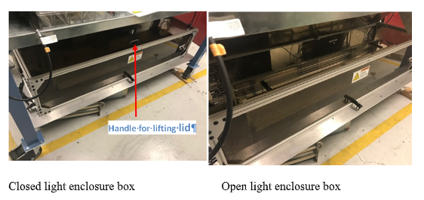
Researcher exposing samples to ultraviolet light from a mercury lamp for 5 minute intervals (9 exposures)
Inside were three germicidal 40 watt lamps, each with 11 watts of UV-C which remained on during the operation.
For each exposure, the worker to opened the cover, inserted or removed a cuvette and closed the cover.
Hazard warning labels had been lost when system was reconfigured.
The employee was not wearing protective eyewear.

Slide 3
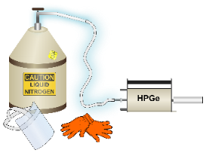
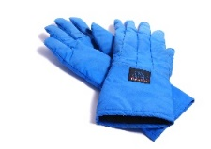
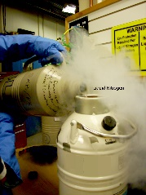
LBNL Activity-based WPC
Activity Development
Implementation
Define work
Identify hazards
Develop controls
Line management approval
Authorize workers
Work within controls
Hazard and controls had originally been correctly identified.
Important control was missing after reconfiguration (hazard warning)
Workers not properly trained to recognize the hazard.

