Slide 1
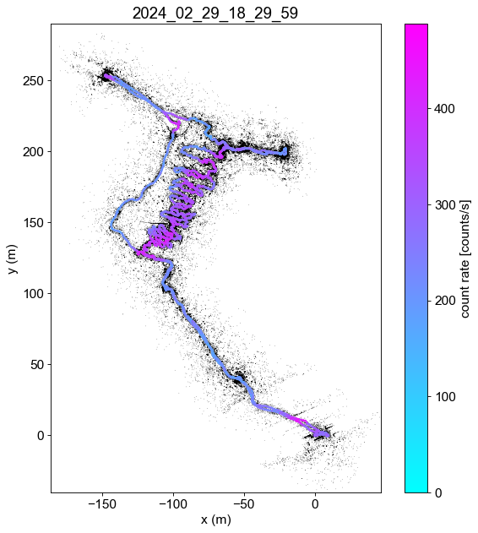
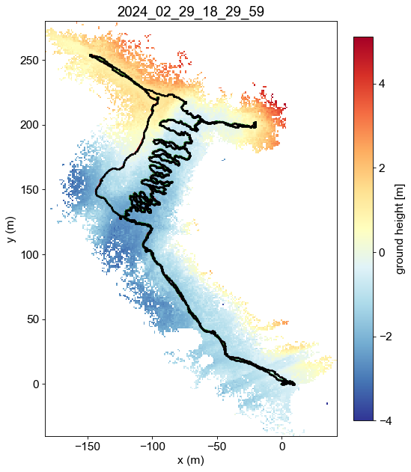
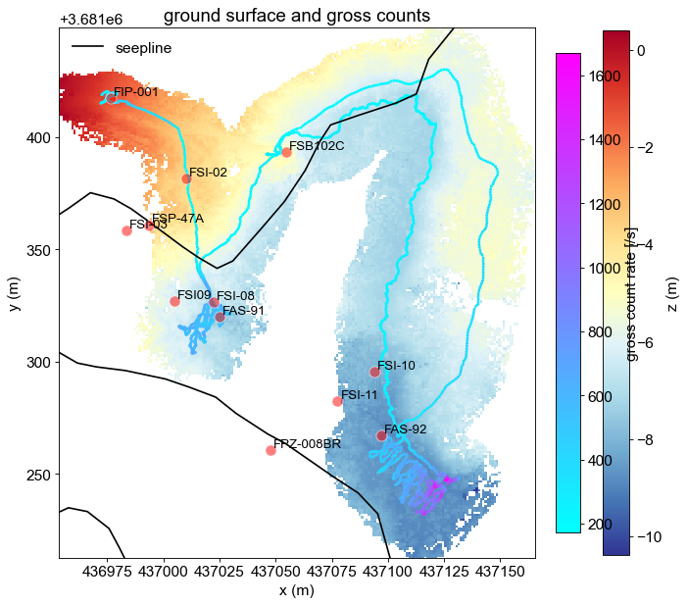
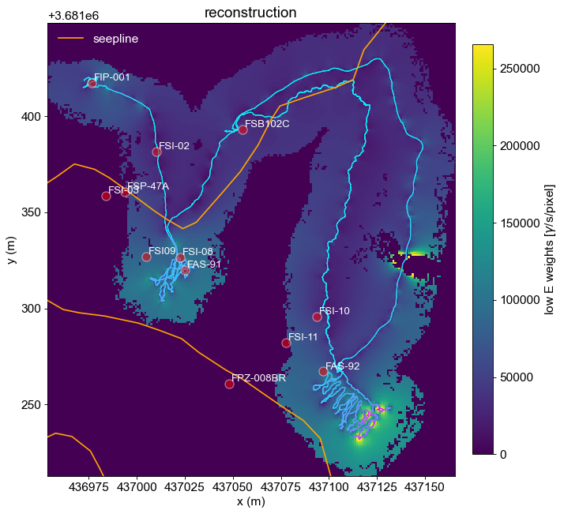
Work flow diagram of rad mapping in context of BUQ
Raw data: radiation detector counts associated with LiDAR data
A continuous geometry map is generated from LiDAR data. (LiDAR data are discrete point cloud data)
Image reconstruction to obtain radiation intensity distribution
Missing pixels may appear due to artifacts
Need to fill in missing pixels by image inpainting
intensity concentrated to edge of missing area
Goal for reconstruction:
High fidelity but with low computation cost
Obtain uncertainty quantification map
Methods:
Image upscaling
Bayesian approach: fast MCMC sampler (reconstruct within several mins)
λ^{[I×1]} = V^{[I×J]} ⋅ W^{[J×1]}
W^{[J×1]}: radiation intensities (e.g., J=96*96)
V^{[I×J]} : system matrix (e.g., I= 24*24)
λ^{[I×1]}: forward projected mean counts
x^{[I×1]} : actual measured counts that follow Poisson distribution with mean λ^{[I×1]}

