Slide 1


Design of a 20 T cosθ dipole hybrid magnet
Cross section update
M. D’Addazio
10/28/2024

Slide 2
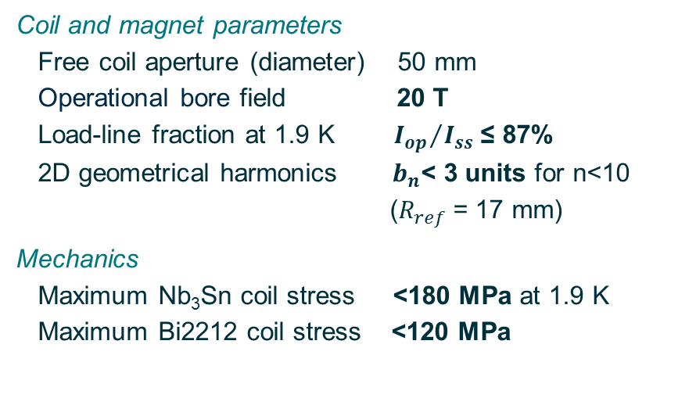
Summary of the main parameters
Main conductor parameters
 | L1-L2 | L3-L4 | L5-L6
Superconductor/Stabilizer | Bi2212/Ag | Nb3Sn/Cu | Nb3Sn/Cu
Number of strands (-) | 32 | 50 | 50
Strand diameter (mm) | 0.90 | 0.80 | 0.70
Cu/noCu or Ag/noAg ratio(-) | 4.00 | 0.90 | 2.00
Cable width (mm) | 14.87 | 22.16 | 19.39
Cable average thickness (mm) | 1.70 | 1.52 | 1.33
Insulation thickness (mm) | 0.15 | 0.15 | 0.15
Coil and magnet parameters
  Free coil aperture (diameter) 50 mm
  Operational bore field 20 T
  Load-line fraction at 1.9 K ${I_{op}}/{I_{ss} }$≤ 87%
  2D geometrical harmonics $b_{n}$< 3 units for n<10
  ($R_{ref}$ = 17 mm)
Mechanics
  Maximum Nb₃Sn coil stress <180 MPa at 1.9 K
  Maximum Bi2212 coil stress <120 MPa

Slide 3
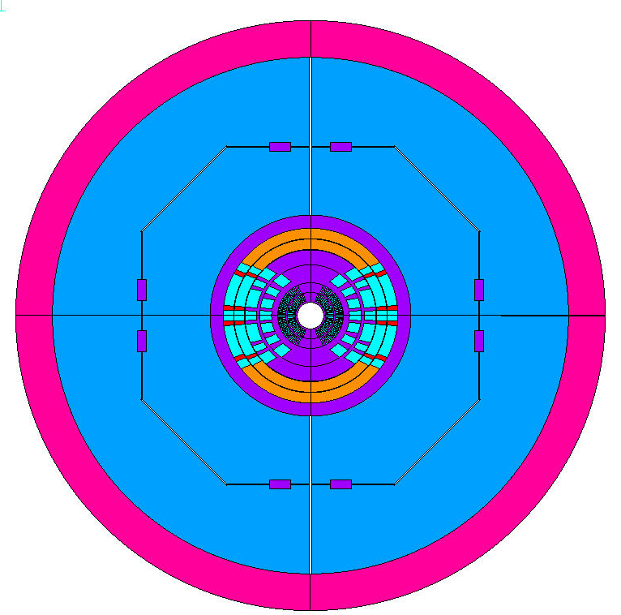
Structure design
Thickness:
  Stain. Steel Collar – 25 mm
  Iron pad – 130 mm
  Iron yoke – 170 mm
  Aluminum shell – 70 mm
  Overall diameter: 1.12 m
The structure still needs to be optimized in terms of key position and shape of the iron components.
Notes:
Separation and sliding are allowed in the coils.
Bonded only the thin interlayers that represent the insulation in layers 5 and 6.
For the wedges, the nodes are coupled (cpintf).

Slide 4
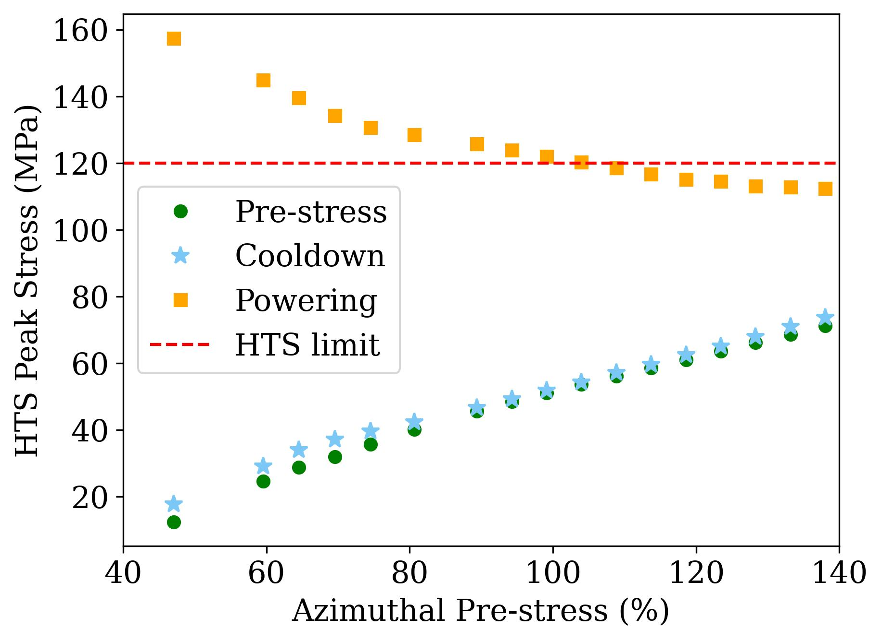
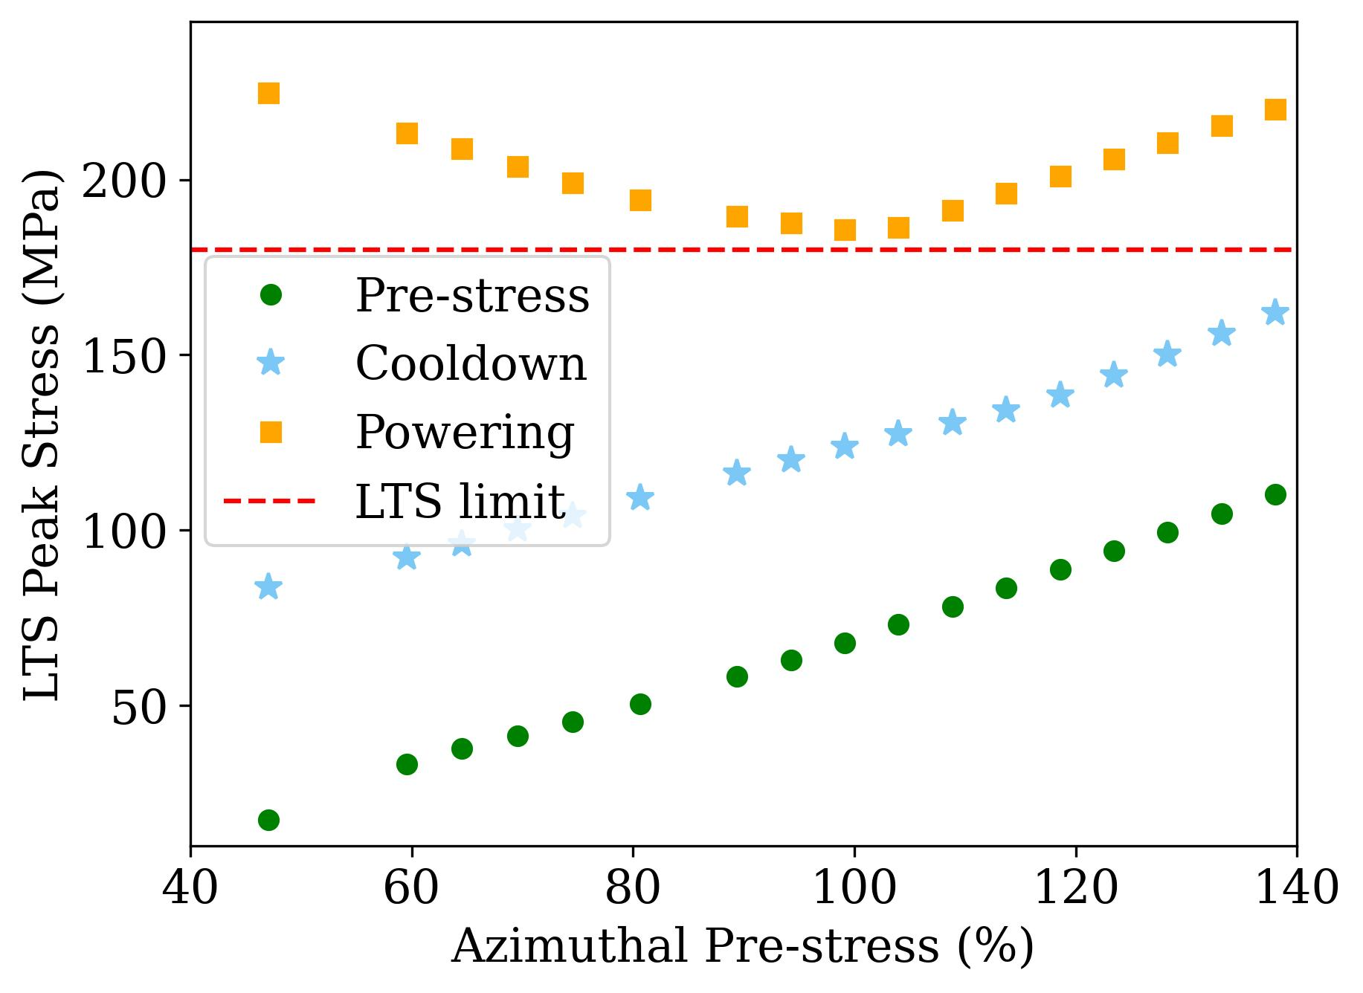
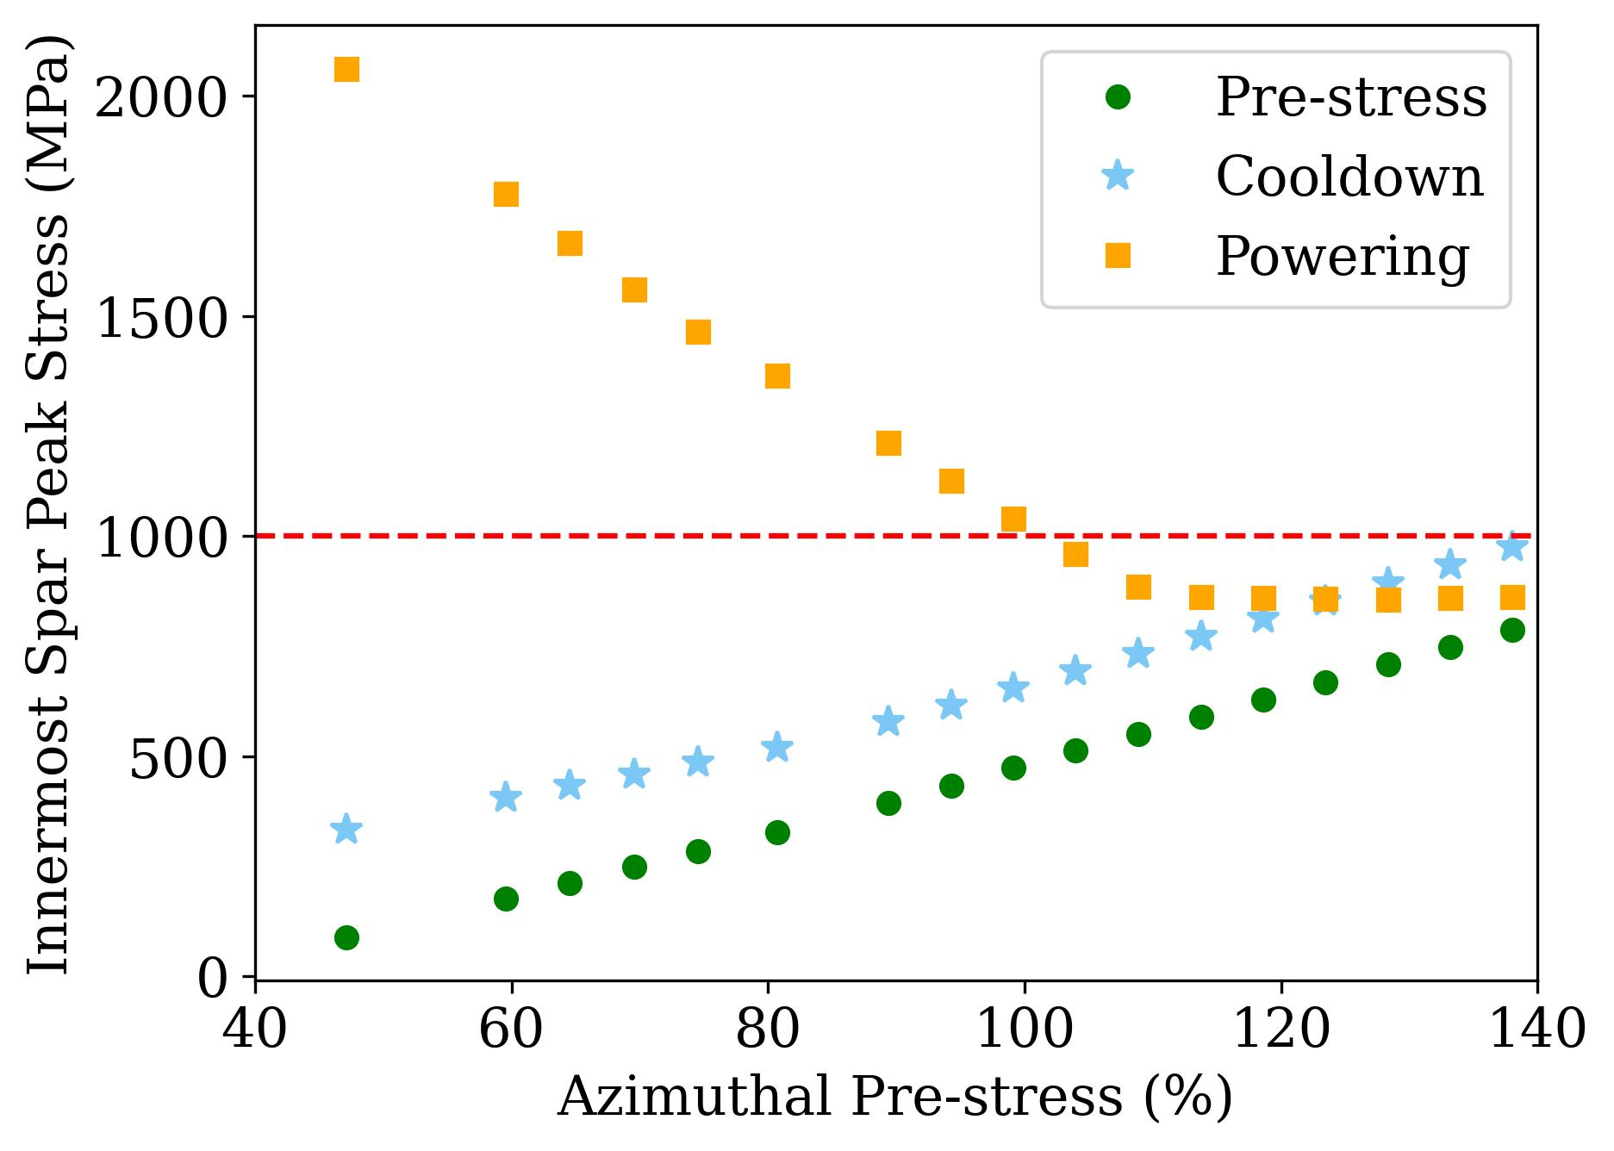
Azimuthal prestress
In these plots, the thickness of the iron pad and yoke is considered equal to 300 mm and the shell thickness is equal to 70 mm.
The dashed black line shows that with an azimuthal prestress of 100% of the EM forces is possible reaching a value of the stress comparable to the considered limit.

Slide 5
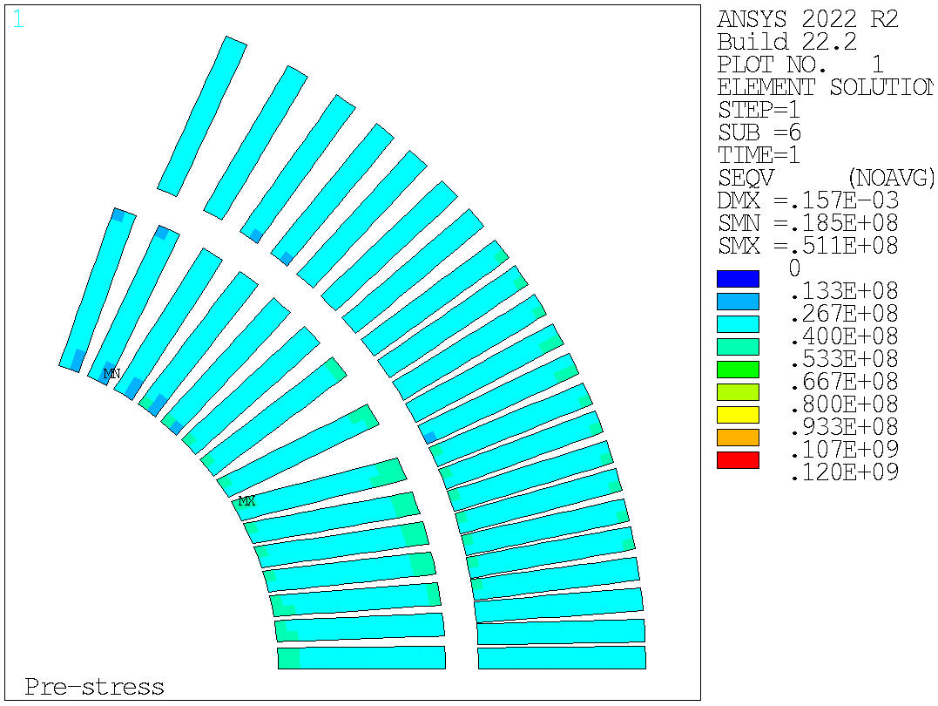
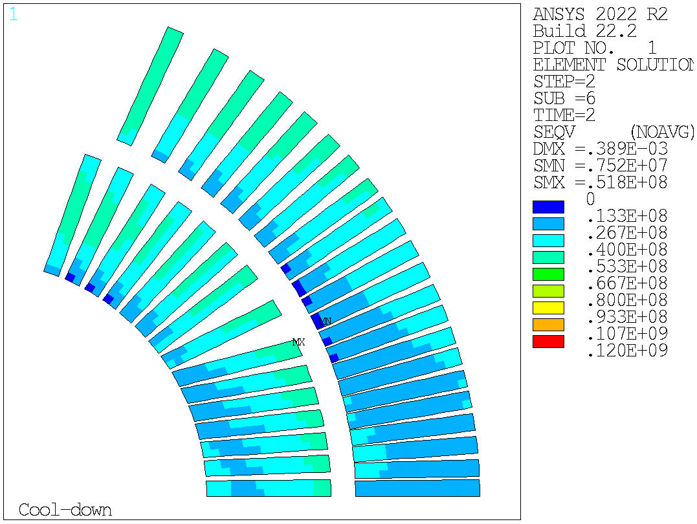
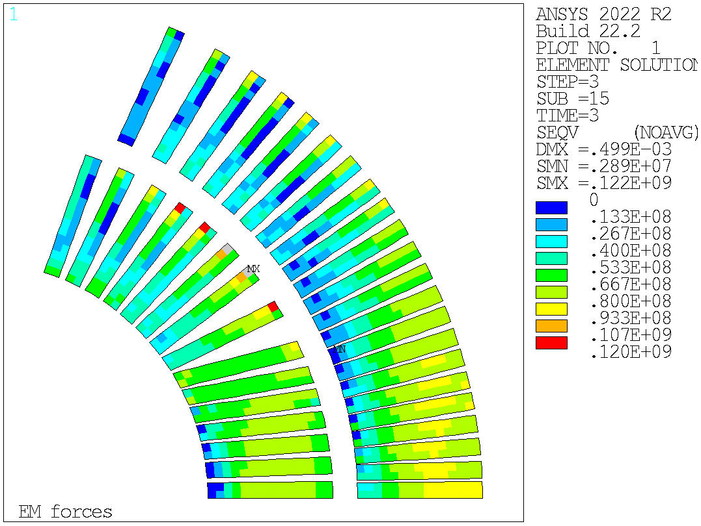
Equivalent stress – HTS
For the HTS conductors:
The peak stress after energization is equal to 122 MPa and the maximum is concentrated in a small corner of layer 1.
Stresses at prestress and cooldown are below the limit.
Prestress | Cooldown | Energization
51 MPa
52 MPa
122 MPa

Slide 6
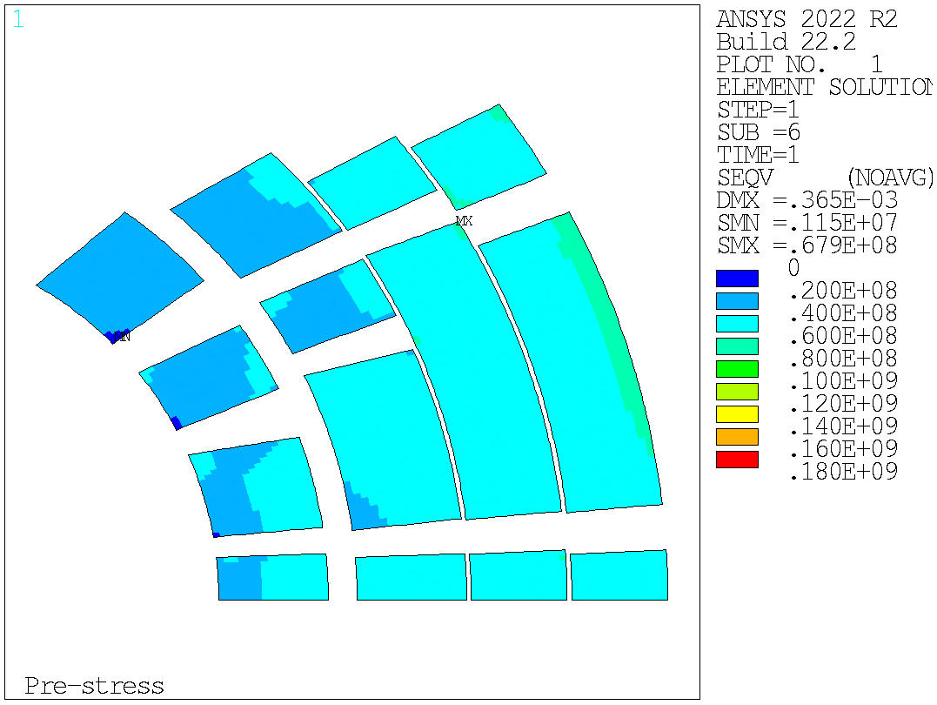
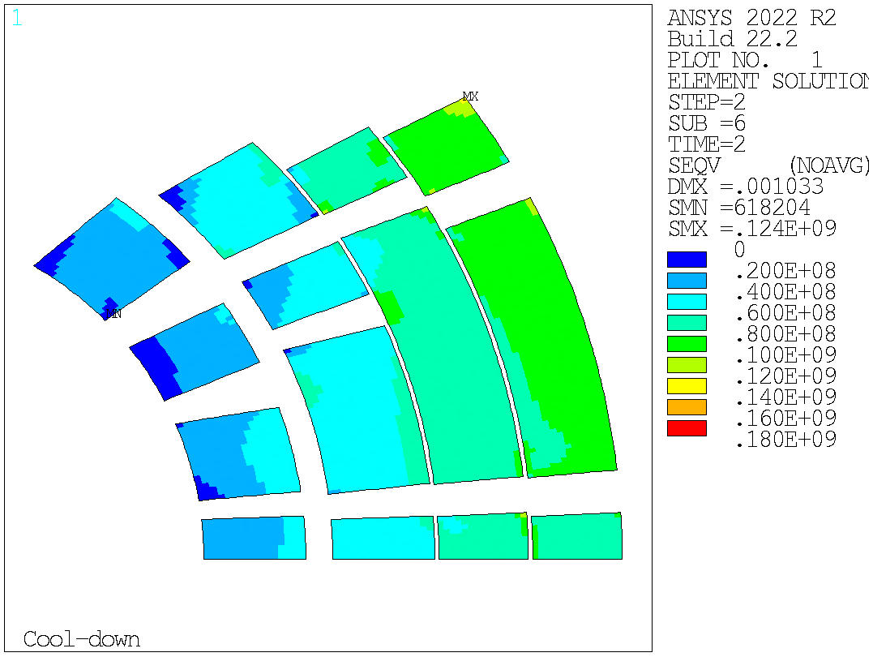
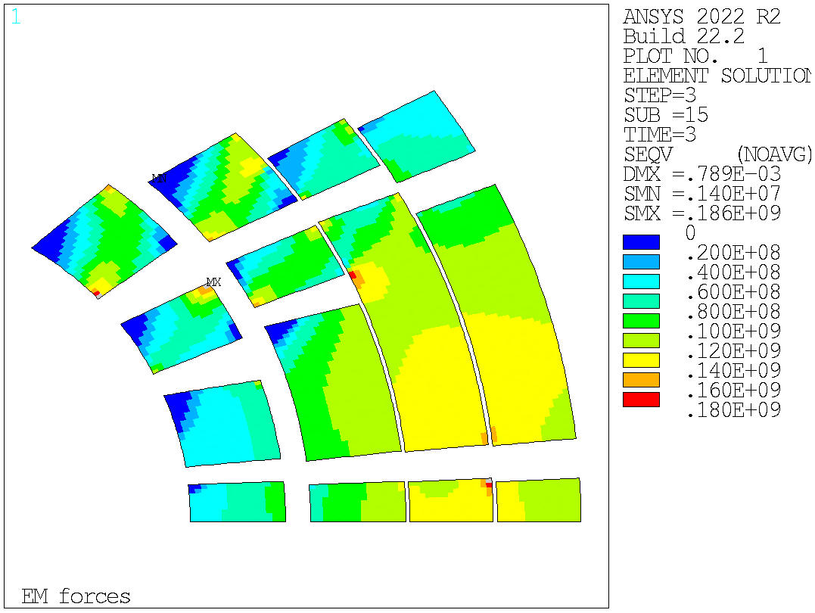
Equivalent stress – LTS
For the LTS conductors:
The peak stress after energization is equal to 186 MPa and the maximum is located in the corner of the third block of layer 3.
The peak stresses are also verified during pre-stress and cooldown.
Prestress | Cooldown | Energization
68 MPa
124 MPa
186 MPa

Slide 7
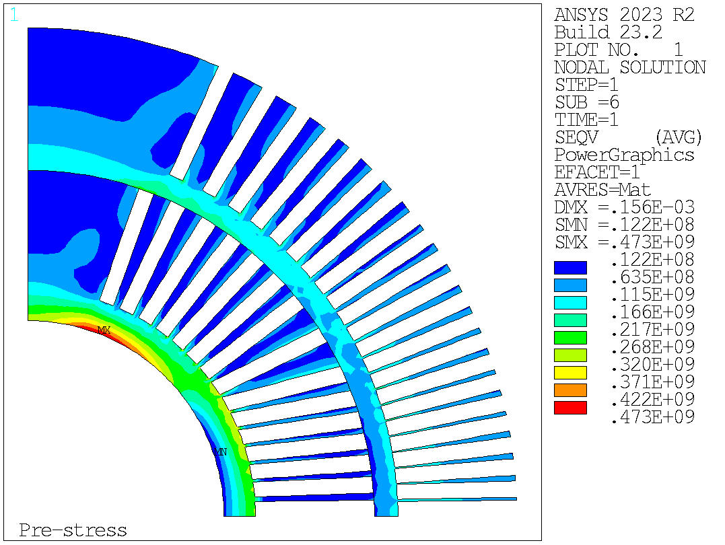
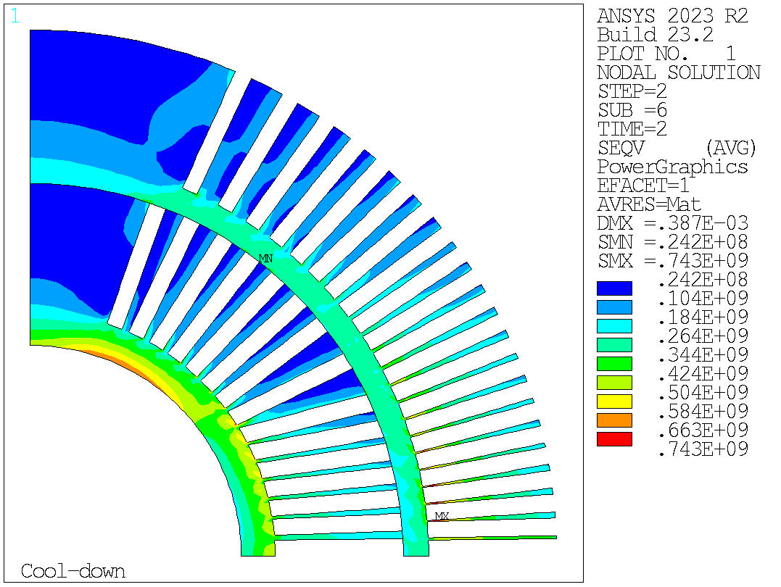
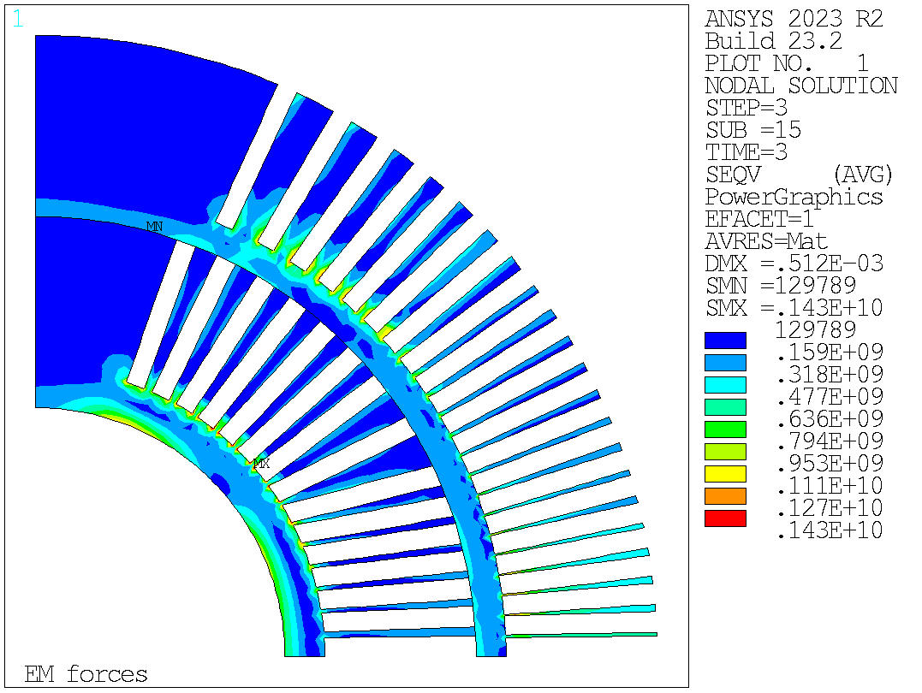
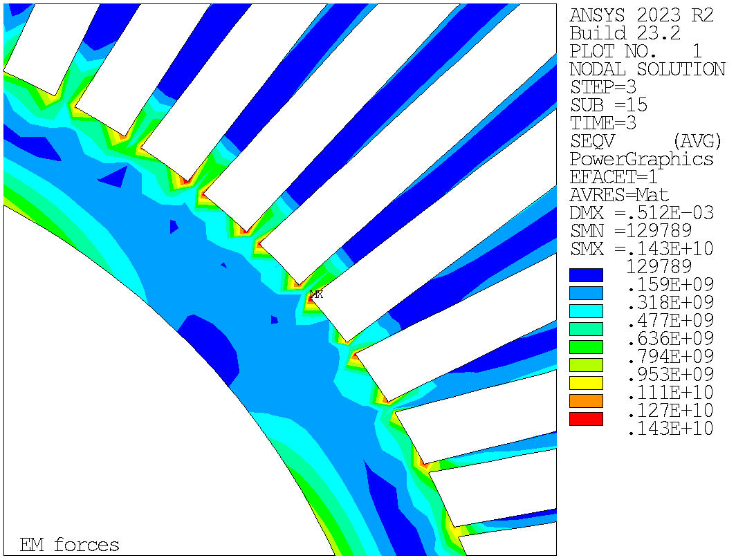
Equivalent stress – Mandrel L1-2
The stress management design is used in layers 1 – 4.
Bending in the spar of layer 1.
Stress linearization procedure still under evaluation for the ribs.
Prestress | Cooldown | Energization
473 MPa
743 MPa
1430 MPa

Slide 8
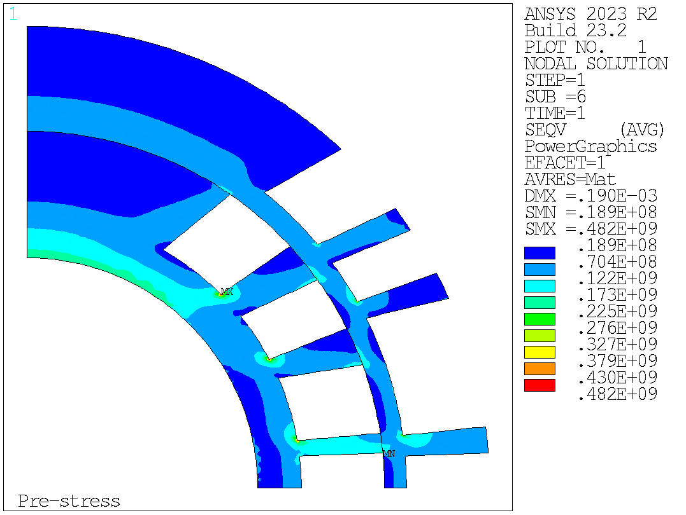
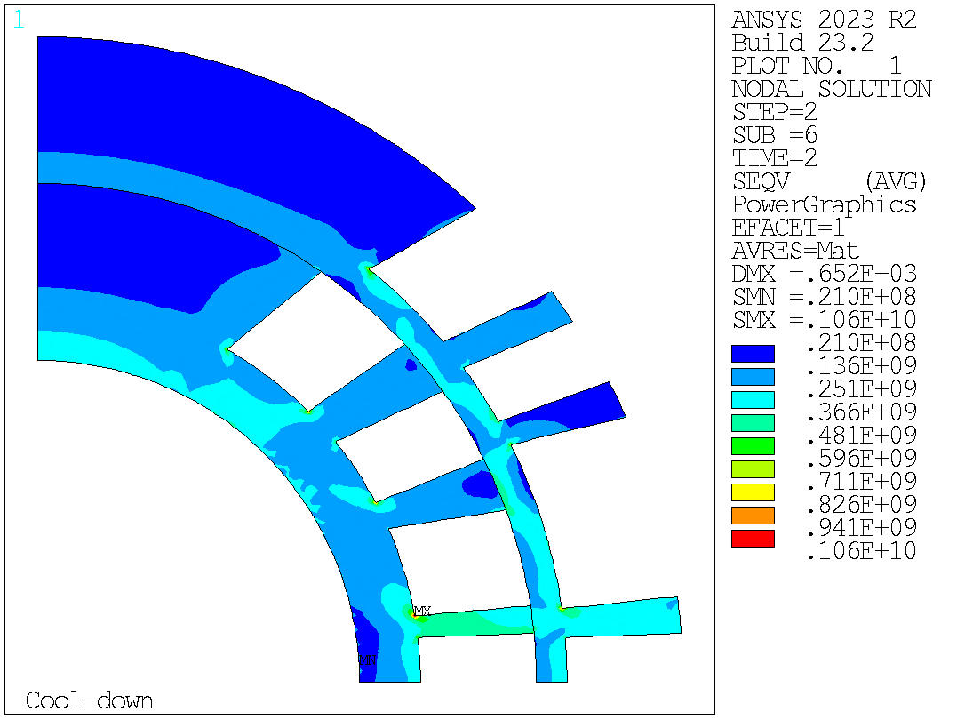
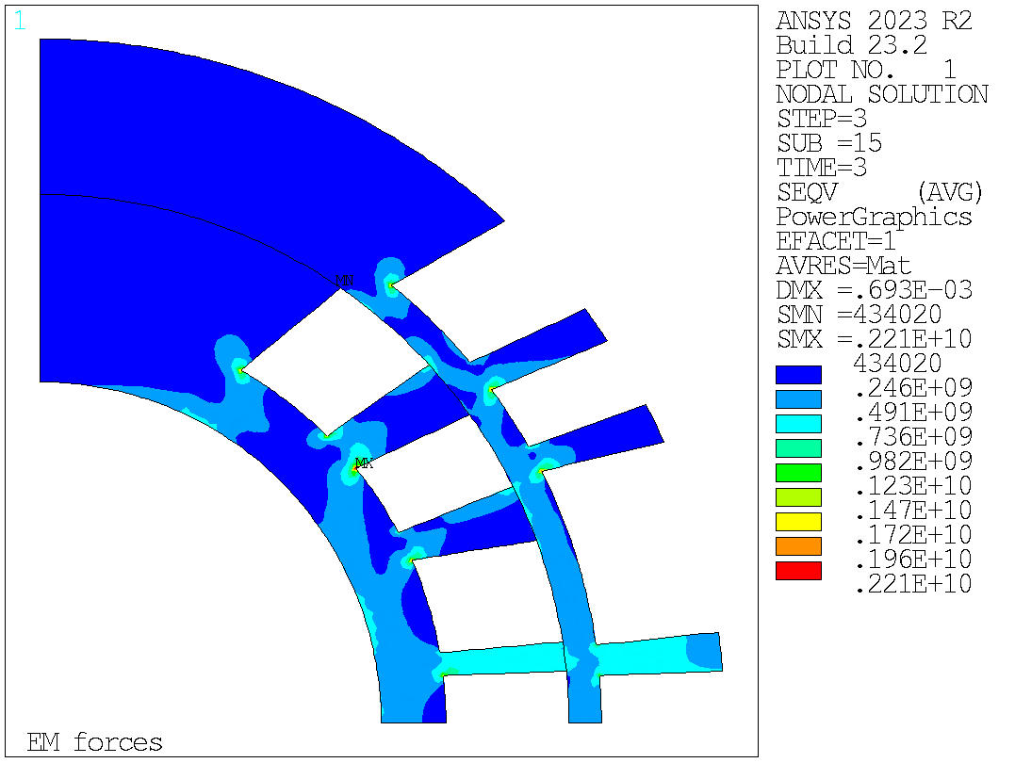
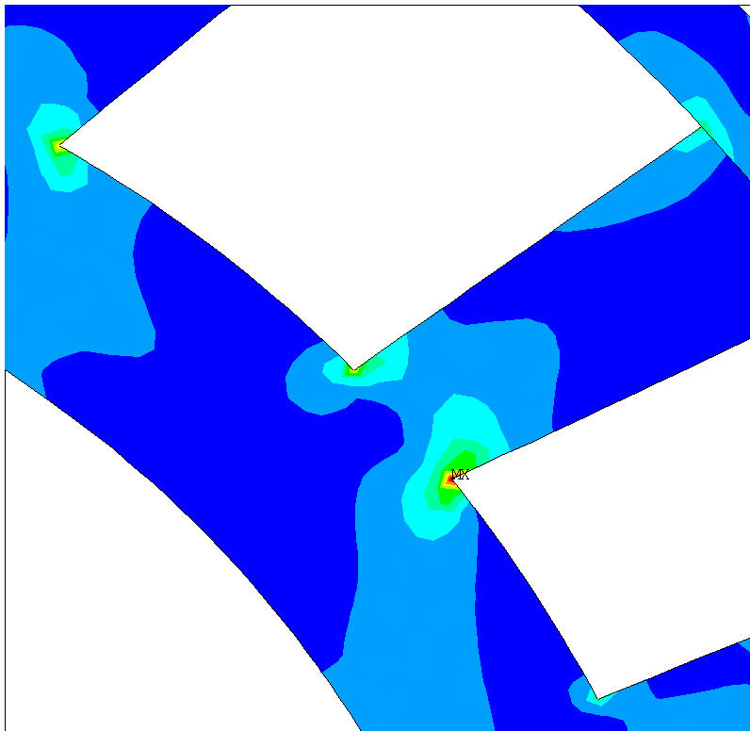
Equivalent stress – Mandrel L3-4
The stress management design is used in layers 1 – 4.
Stress linearization procedure still under evaluation for the ribs.
Prestress | Cooldown | Energization
482 MPa
1060 MPa
2210 MPa

