Slide 1
Bi-2212 Multiscale Modeling Update
Alessio D’Agliano, PhD student 11/05/2024

Slide 2
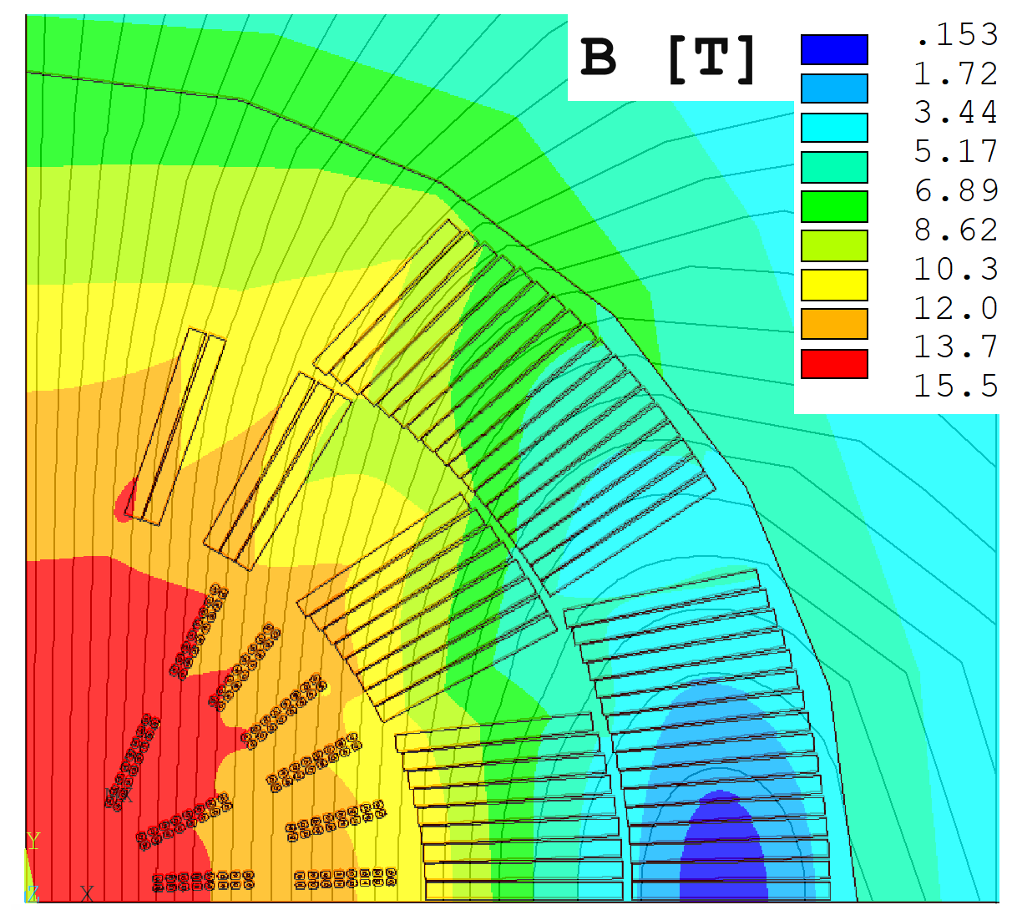
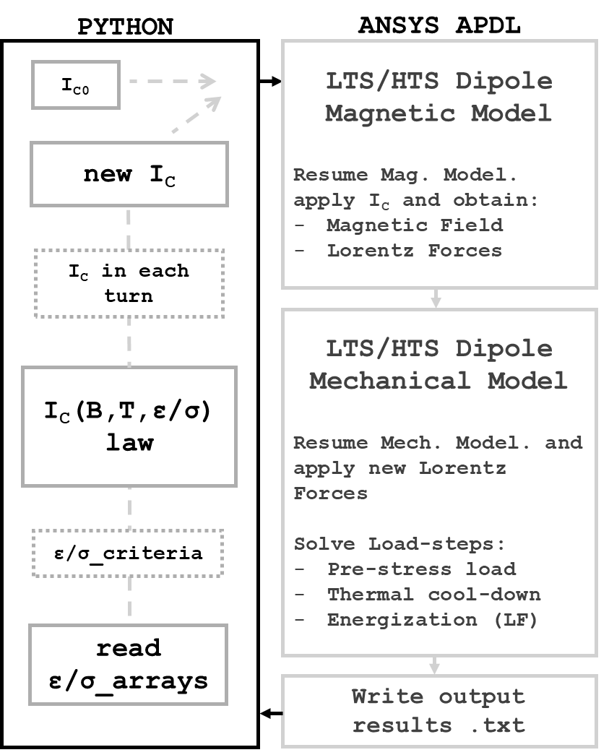
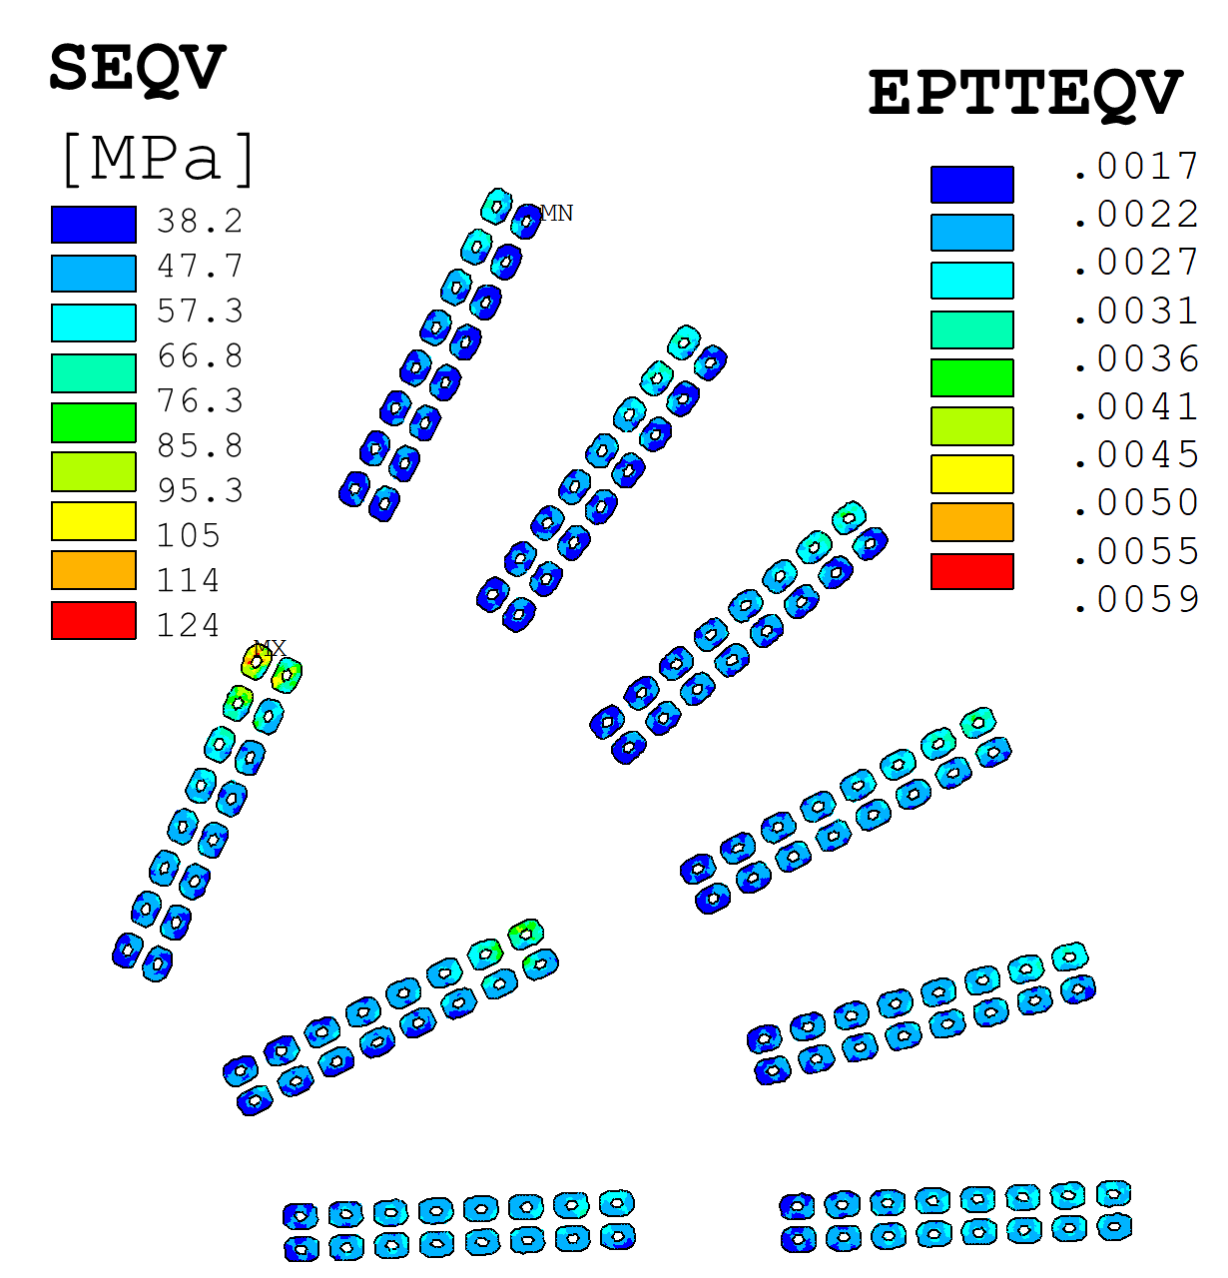
LTS/HTS Hybrid Dipole Analysis – Current Degradation
Bi-2212 is the best superconductor in terms of J_{C} at a high external magnetic field, but it’s prone to stress and strain-induced current degradation. The FEM analysis performed on the hybrid cos-theta coil (linked with .py code) investigates this aspect.
Bolt – SS304
Shell – SS304
Clamp – Aluminum
Yoke – Iron
Coil L3, L4 – Nb₃Sn
Coil L1, L2 – Bi-2212
Poles – Titanium
Wedges – Brass
Mandrels – Inconel 718
Impregnation – G10
Skin – SS304
Gr.Ins. – Kapton

Slide 3
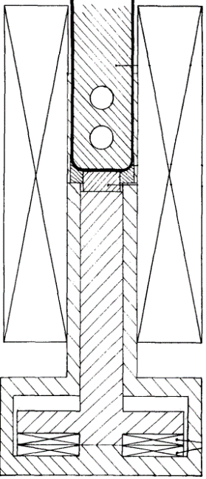
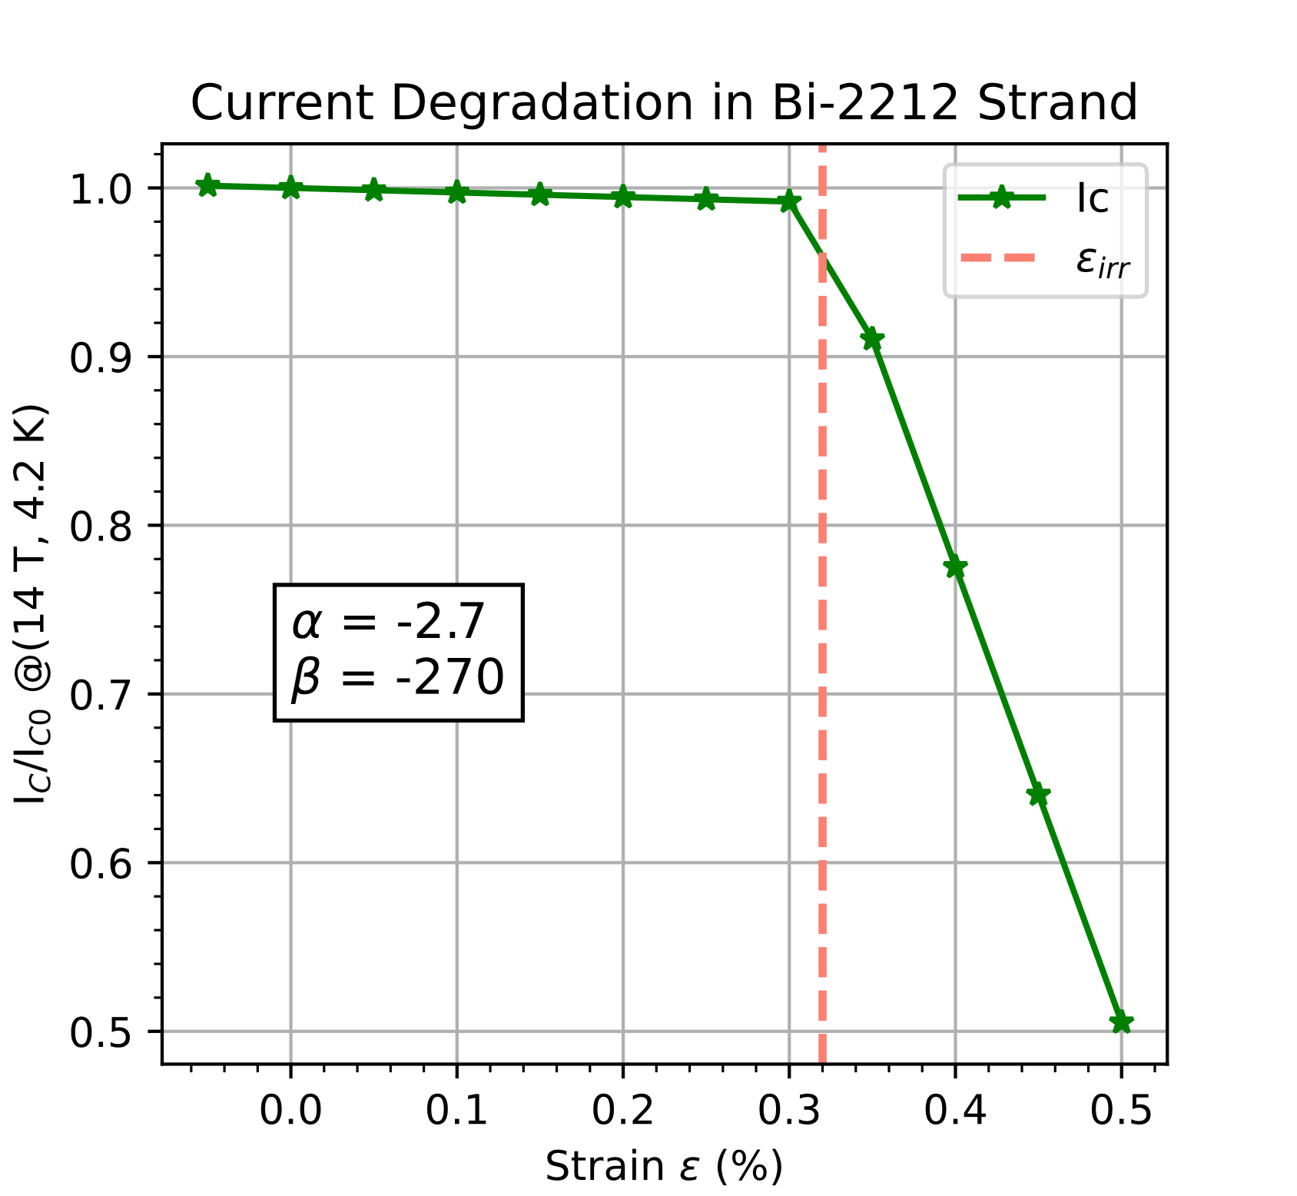
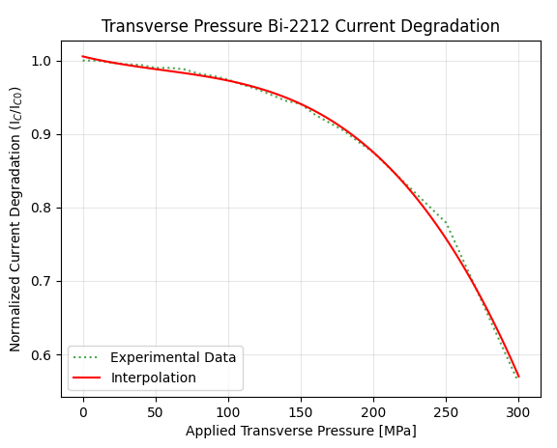
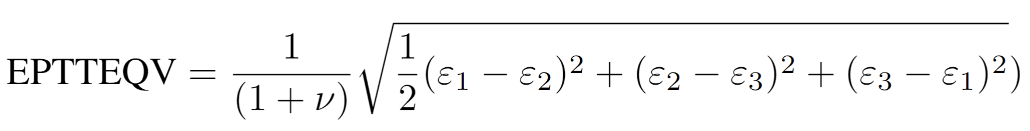
LTS/HTS Hybrid Dipole Analysis with Current Degradation
The strain-induced current degradation is straightforward. The stress-induced current degradation is possible to obtain translating stress state in the Rutherford cable under applied transverse pressure.
Strain ε (left) and stress σ (right) current degradation laws were implemented in the simulation code to evaluate the overall decrease of current in the magnet.
Bi-2212 Rutherford cable under transverse pressure (11 T), University of Twente
Strain/stress criteria, ANSYS output:
From: “Reversible effect of strain on transport critical current in Bi2Sr2CaCu2O8+x superconducting wires: a modified descriptive strain model”, N Cheggour, X F Lu, T G Holesinger, T C Stauffer, J Jiang and L F Goodrich
From: “Transverse pressure dependence of Bi-2212 Rutherford cables” Anna Kario presentation at US-MDP Collaboration meeting 2024

Slide 4
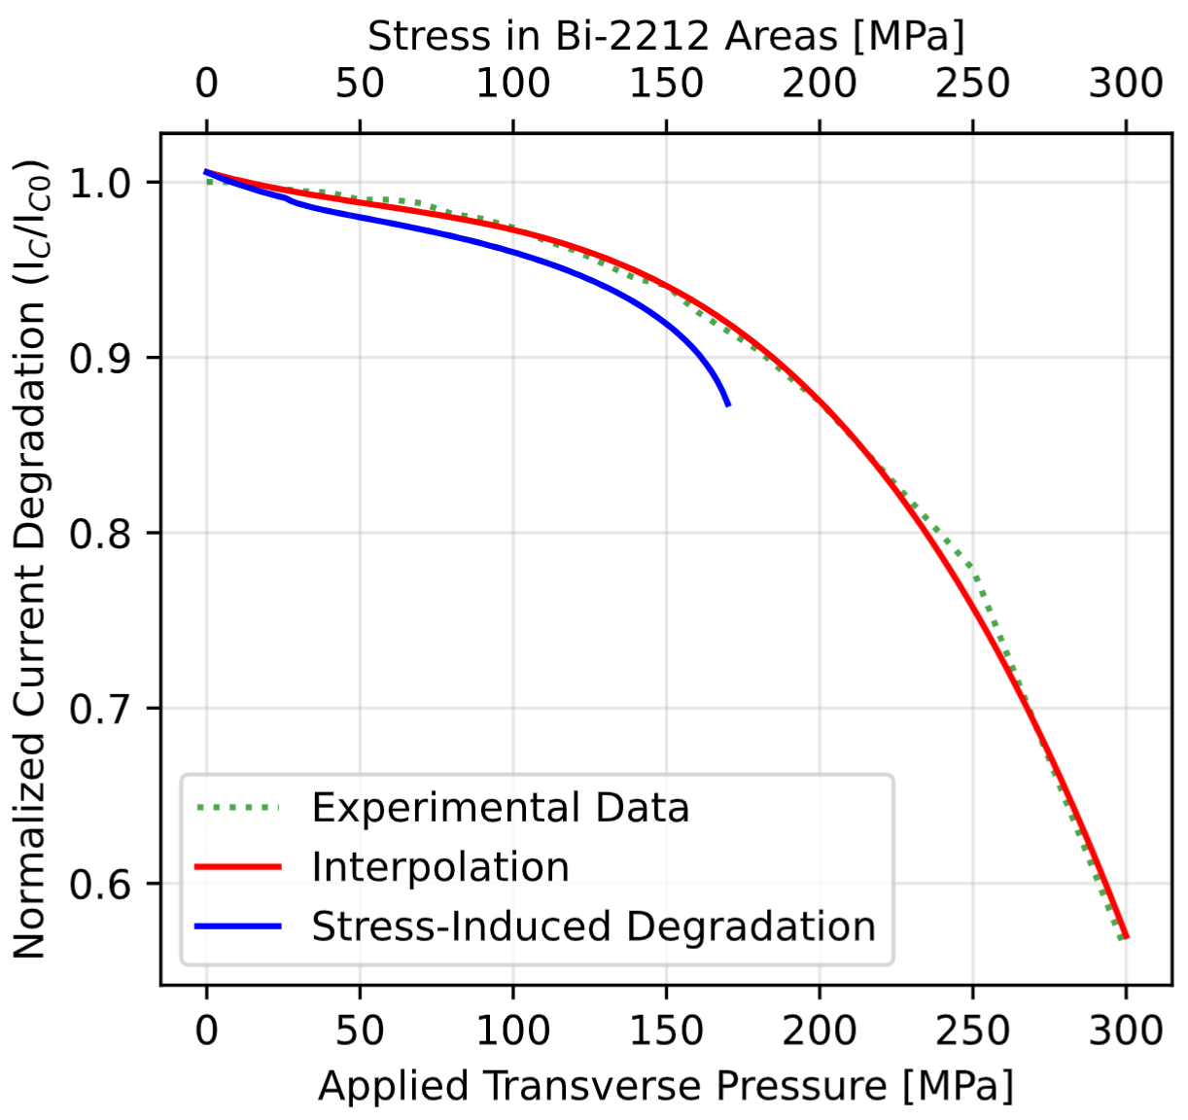
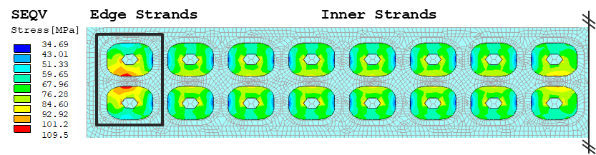
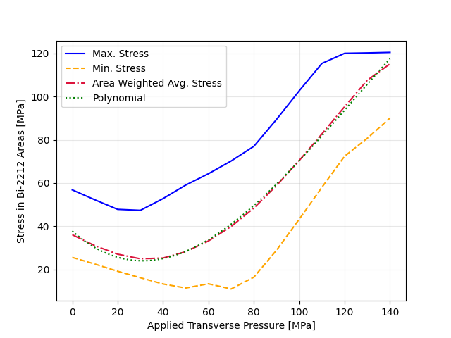
Stress-Induced Bi-2212 Current Degradation Law
What we have:
What we want:
From measurements (University of Twente):
Transverse Pressure Curr. Degradation
From Hybrid Magnet Analysis:
Bi-2212 Stress State Curr. Degradation
From ten-stack Analysis:
Transverse Pressure Bi-2212 Stress State
Half Bi-2212 ten-stack model with applied transverse pressure and stress results at 100 Mpa.
From: “Transverse pressure dependence of Bi-2212 Rutherford cables” Anna Kario presentation at US-MDP Collaboration meeting 2024
Mechanical results from the hybrid dipole configuration must be interpret accordingly to the current degradation law. The blue line is the one use in Python code.

Slide 5
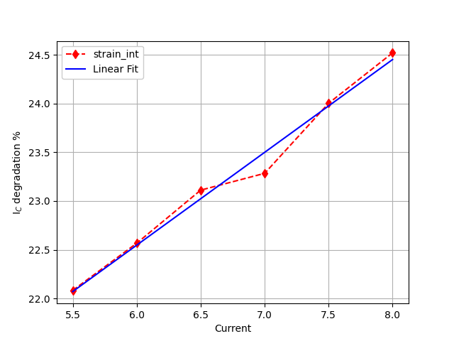
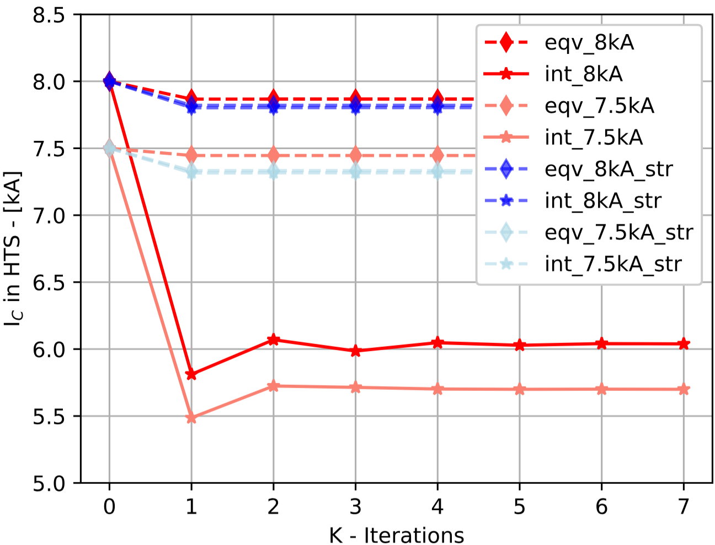
LTS/HTS Hybrid Dipole Analysis – Current Degradation
Considering the most conservative ε criteria, the average current degradation is around 23.6 % (24.5 % at 8 kA and 22.6 % at 6 kA). In all the other ε/σ criteria, the analysis gives as results an I_{C} degradation from 1.6 % (ε_{eqv} criteria) to 2.5 % (σ_{int} criteria).
Curves for the Hybrid LTS/HTS Cos-theta Dipole
Progressive Current Degradation at Different Current Initial Values

Slide 6
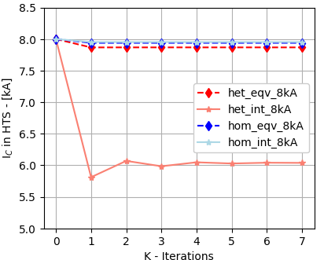
Hybrid Dipole with Homogeneous Cable Model
Same structure, same pre-stress, same current powering of heterogeneous model hybrid dipole analysis.
Homogeneous cable model, anisotropic material properties for both Bi-2212 and Nb3Sn cables, proper elem-CS.
Hom. model results underestimate the critical current degradation: 0.75 % (ε_{eqv} criteria), 0.6 % (ε_{int} criteria).

Slide 7
Conclusions
Take away concepts:
Consistent amount of simulation were performed using stress and strain Von Mises and Intensity criteria, for both homogeneous and heterogeneous models starting at different critical currents.
The heterogeneous model was necessary to study the current degradation accurately, huge difference with homogeneous model.
The current degradation is modest in all configuration except with strain intensity criteria.
Next steps:
Map more points of the analysis, current degradation with different criteria and various initial I_{C} for both cable models.
Consider to reproduce University of Twente measurement set-up on ANSYS, to be able to translate in a more consistent way the transverse pressure current degradation effect into the stress-state induced one.
Finalize 3D Bi-2212 Rutherford cable model on APDL.

