Slide 1
Pronoun use at LBNL
Tom Gallant
Program Manager
March 19, 2019

Slide 2
Why are we talking about pronouns?
As of January 1, 2019, California Senate Bill 179 added the requirement that state documents allow for a non-binary gender marker.
The law defines nonbinary as an “umbrella term for people with gender identities that fall somewhere outside of the traditional conceptions of strictly either female or male,” including but not limited to some transgender individuals and those born with intersex traits.

Slide 3
Why are pronouns important?
“The experience of being misgendered can be hurtful, angering, and even distracting. The experience of accidentally misgendering someone can be embarrassing for both parties, creating tension and leading to communication breakdowns across teams and with customers.”
“A culture that readily asks or provides pronouns is one committed to reducing the risk of disrespect or embarrassment for both parties.”
“... the bottom line is that everyone deserves to have their self-ascribed name and pronouns respected in the workplace.”

Slide 4
Why are pronouns important?
UC Davis Medical Center:
http://improvingoutcomesconference.com/whats-the-deal-with-gender-pronouns/
Human Rights Campaign:
http://assets2.hrc.org/files/assets/resources/TalkingAboutPronouns_onesheet_FINAL.pdf?_ga=2.206842128.2045556981.1552538129-1469618537.1552538129

Slide 5
The Lambda Alliance Employee Resource Group - Pronoun Project
The Lambda Alliance ERG is conducting a campaign to make pronoun use more commonplace at LBNL. The campaign, which is still under development, has four targeted areas for rollout.
E-mail Signature Lines
Event Nametags
Business Cards
LBNL Directory
There are ways that you can support this project now.

Slide 6
E-mail Signature Lines
The simplest way to show support is to add pronouns to your email signature file.
If you use the Google webmail interface:
Go to the gear in the top right corner
Scroll down to the signature section
Add your pronouns in the way you think best fits
Click the save changes button at the bottom of the screen

Slide 7
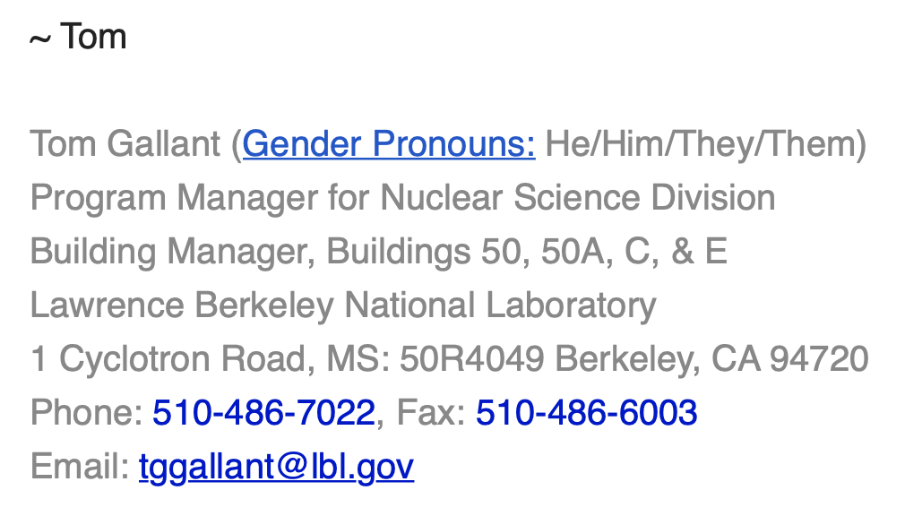
E-mail Signature Lines
If you want to give people an opportunity to explore why pronouns are important, you can add a link to one of the helpful explanations available at the beginning of these slides.

Slide 8
Event Nametags
Currently, displaying pronouns on nametags is a one-off request that is often overlooked. It is an option that should be considered prior to opening registration so that an optional field can be added to collect this data.
At LBNL we use both administrative and Conference Services support to make nametags for events. The Lambda Alliance is working with Conference Services to add this as part of their normal procedure.
To use pronouns on nametags for events organized by your administrative staff, just ask.

Slide 9
Event Nametags
Nametag design is usually left to the administrative staff, but they should be working with the event organizer to discuss the design.

Slide 10
Business Cards
Creative Services does not yet have a standard format for including pronouns on official business cards. The plan is that you will be able to choose a dedicated field to list your choices.
It is possible to add pronouns to your business cards now, by use of a workaround.

Slide 11
Business Cards
To add pronouns to your business card, you need to repurpose an existing field such as the fax line.
Until the process is standardized, should Creative Services have an issue with the request, please reach out to Lady Idos (LVIdos@lbl.gov).

Slide 12
LBNL Directory
Adding pronouns to the directory is a much more complex item to tackle and will take resources from both HR and IT. The HR system is currently assessing the impact of migrating with UC Path so the Lambda Alliance is working with all parties to gauge the ability to add pronouns to the directory. We envision that it will be an optional field much like adding your homepage.

