Slide 1
MDP Advanced Modelling Area
Status Update
G. Vallone
on behalf of the
Modeling working group
11/21/2024 - MDP General Meeting

Slide 2
Outline
Overview – Objectives and Milestones
Ongoing activities overview
Summary

Slide 3
Milestones
&
Workflow

Slide 4
Workflow
Other Areas
Magnet Design
Target
Experiment
Magnet
Test
Design Tools
Experiment
Model
Magnet
Model
Development of Design Tools
Fundamental Understanding
Performance
Limitation
Studies

Slide 5
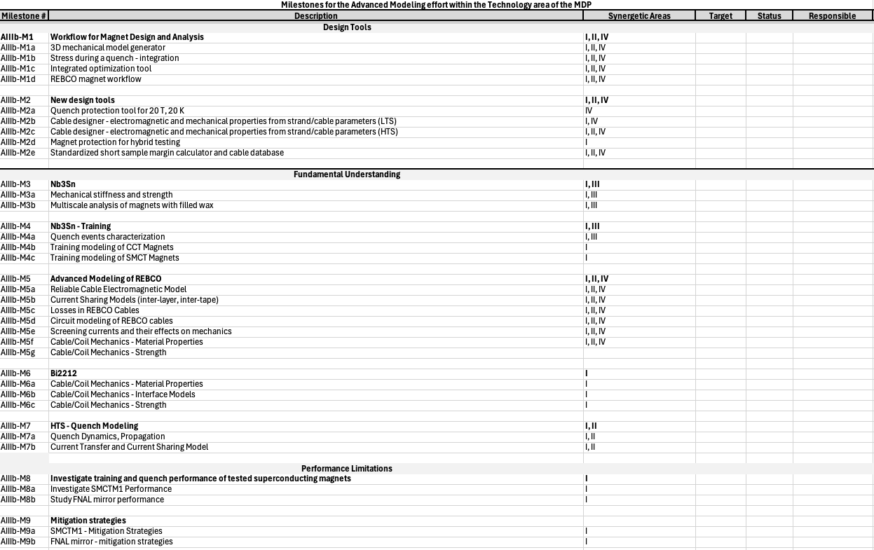
Milestones - Overview
Milestone list (details later) defined in collaboration with other areas
    See https://conferences.lbl.gov/event/1803/ and …/event/1812
    Divided in the three ‘groups’ (design tools, fundamental understanding, performance limitations)
    Each one with synergetic areas, target data, and… responsible/key developer
      Not really defined for the moment
      Might coordinate with synergetic areas to gather ‘resources’

Slide 6

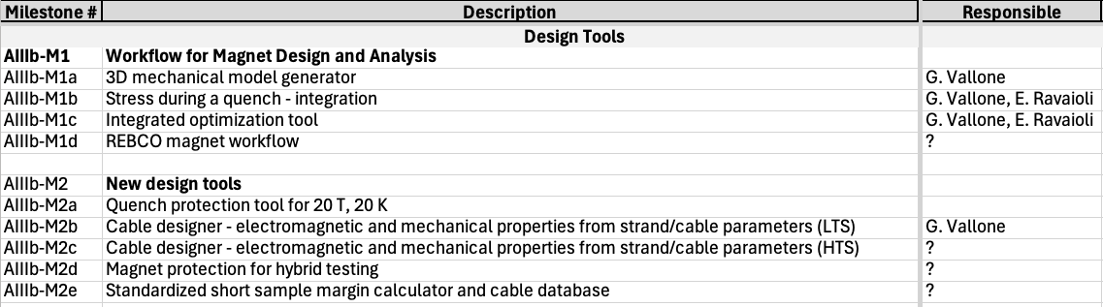
Milestones (1)
Many activities would be very useful for other working groups, but are not started and have nobody working on it
    Effort here can be precious… it might reduce the work we need to do in the future and free ‘time’ for more advanced things

Slide 7

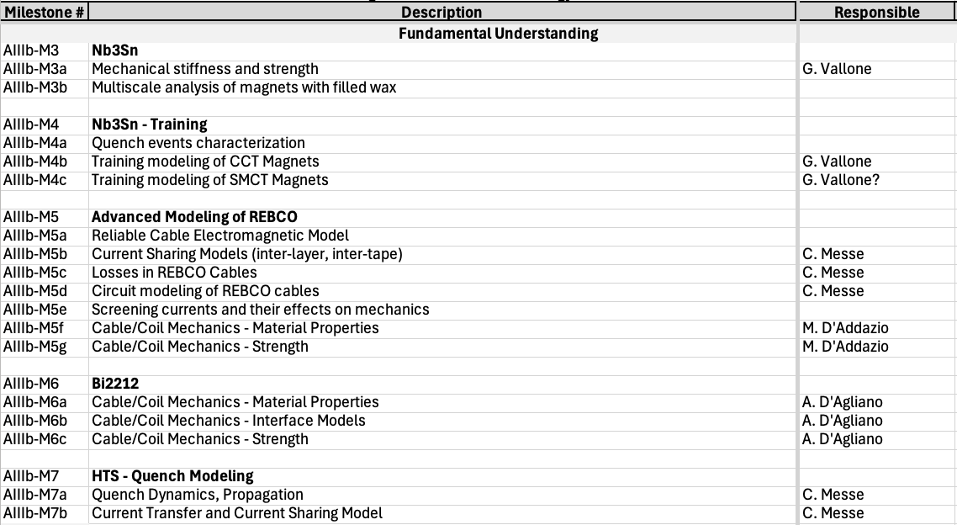
Milestones (2)
Most activities here are already started
Many are individual efforts with limited resources

Slide 8

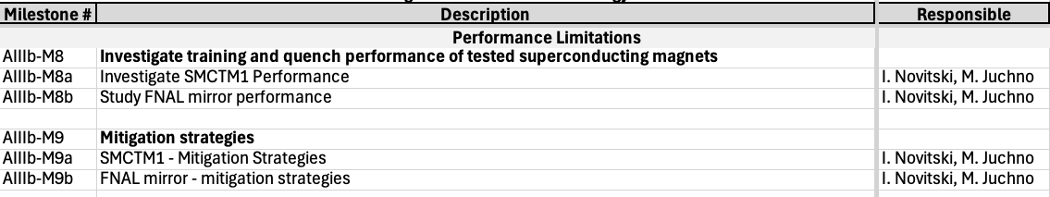
Milestones (3)
Work on-going on FNAL dipoles, update later
Also the work on CCT training can be considered part of this group

Slide 9
Ongoing activities
Overview

Slide 10
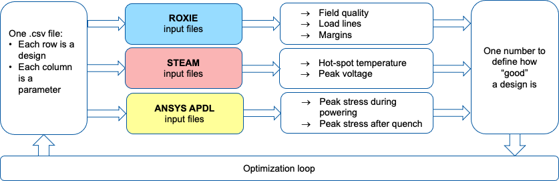


Magnet Integrated Optimization
  Work in progress
    Bulk of the code is ready
    Missing some links and automation

Slide 11
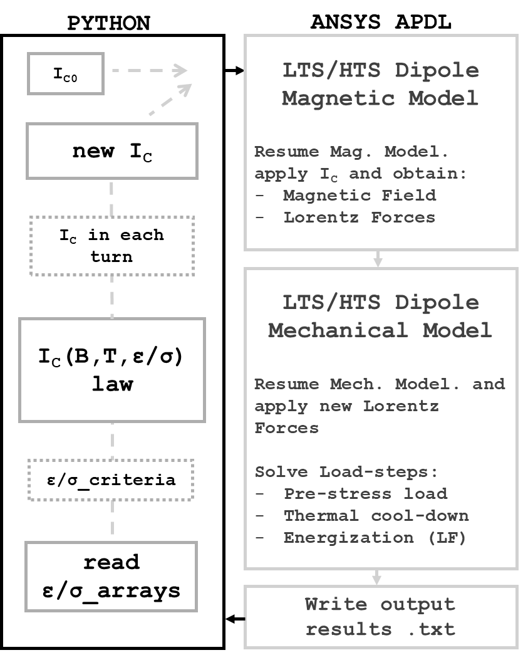
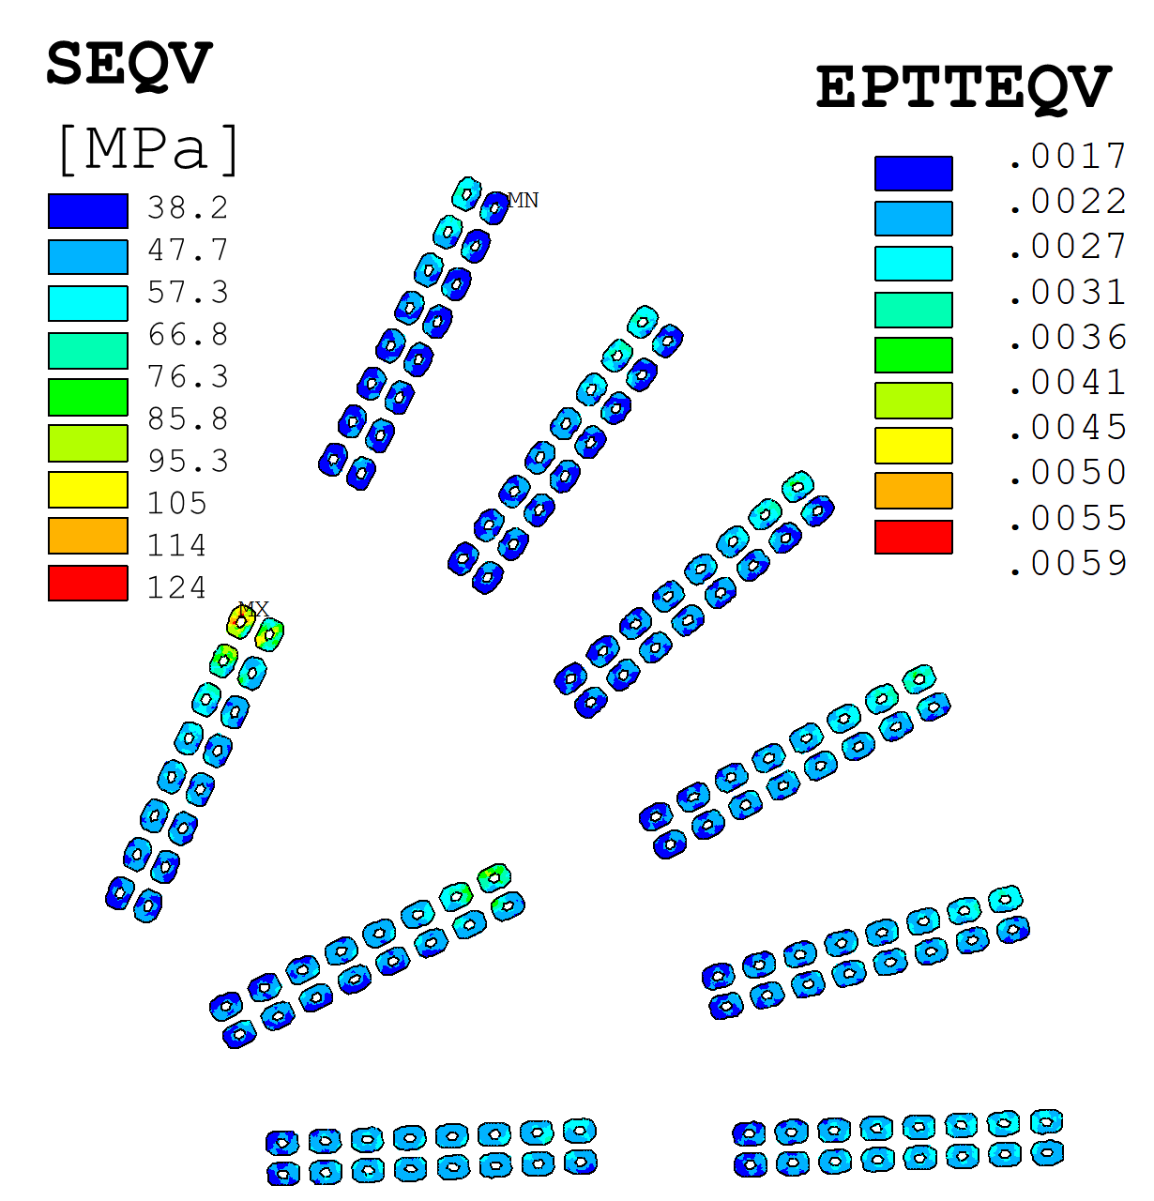
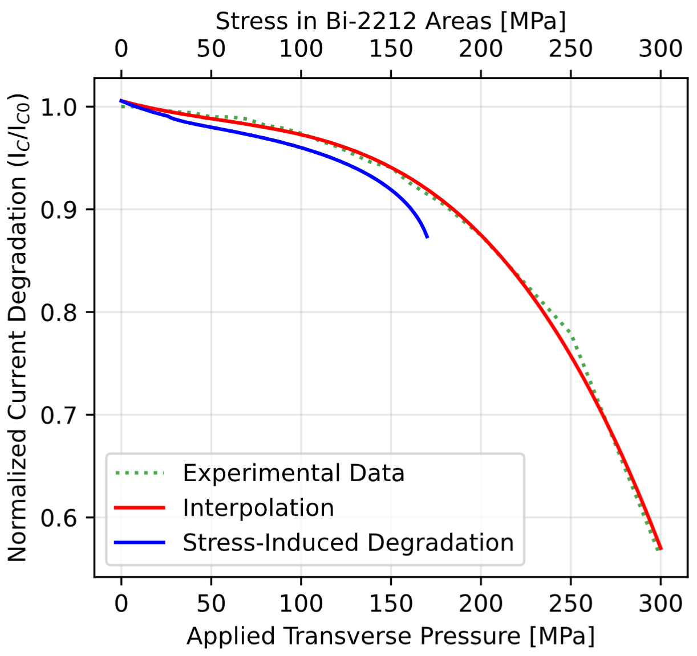
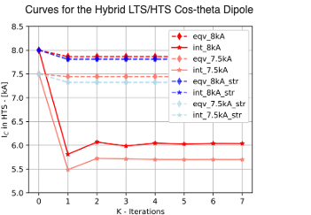
Bi2212 – Strain Effects On I_{c}
From: “Transverse pressure dependence of Bi-2212 Rutherford cables” Anna Kario presentation at US-MDP Collaboration meeting 2024
Scope: predicting potential Ic degradation as function of the applied stress/strain in Bi2212 magnets
Multi-physics, multi-scale methodology developed in Python and ANSYS APDL
Critical current limits from measurements on strands, cables
      Would benefit from ‘validation’ on Twente data
For more info, see: https://conferences.lbl.gov/event/1899/

Slide 12
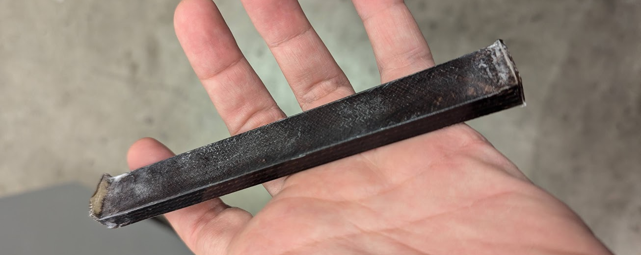
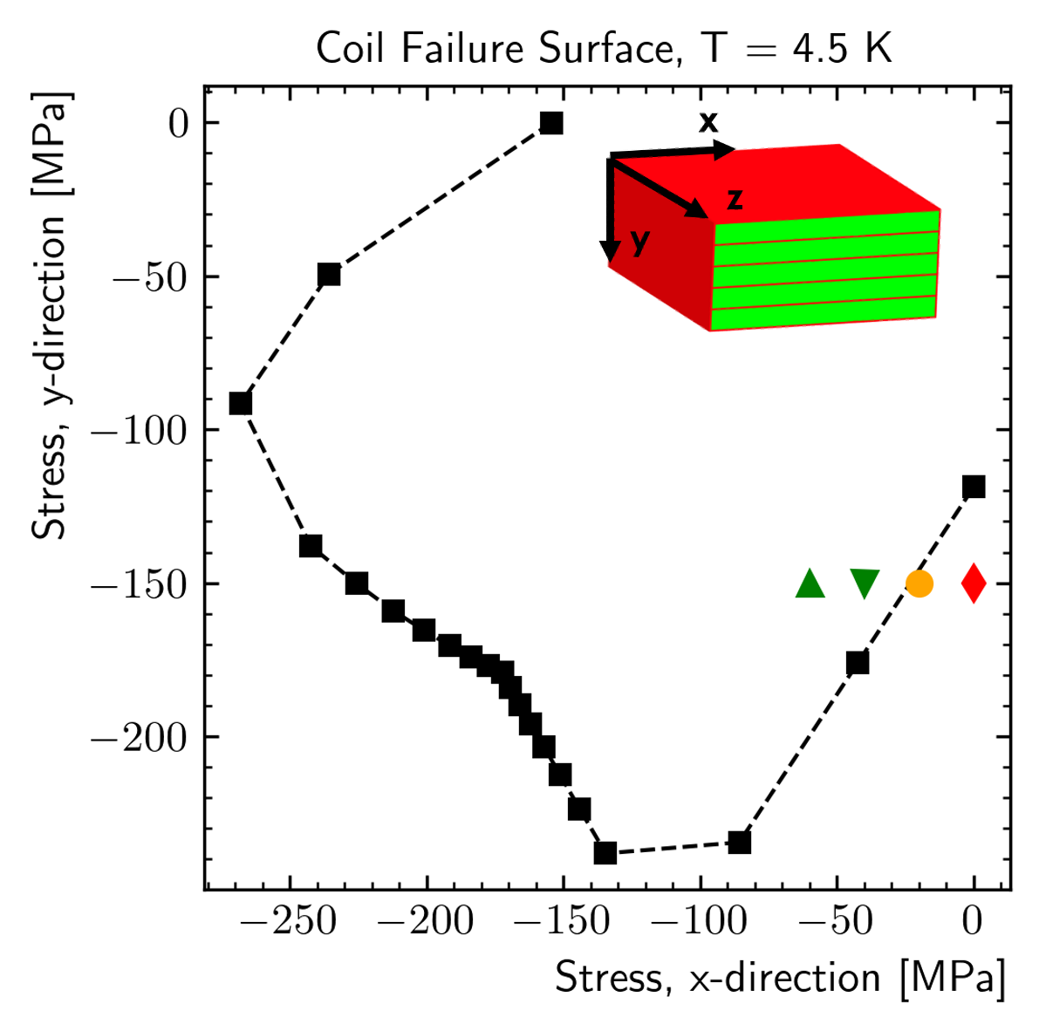
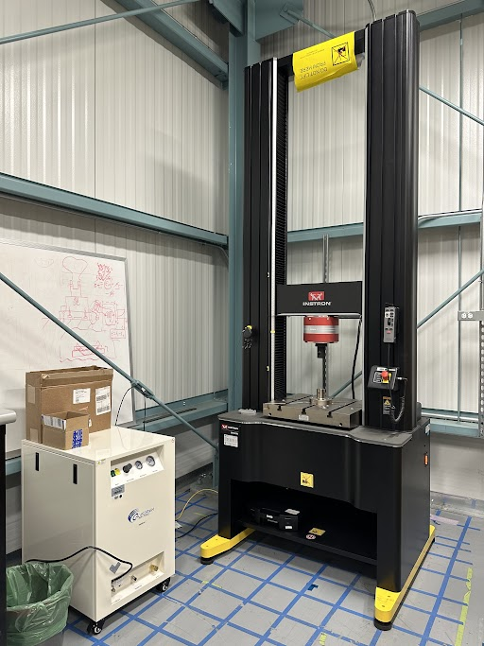
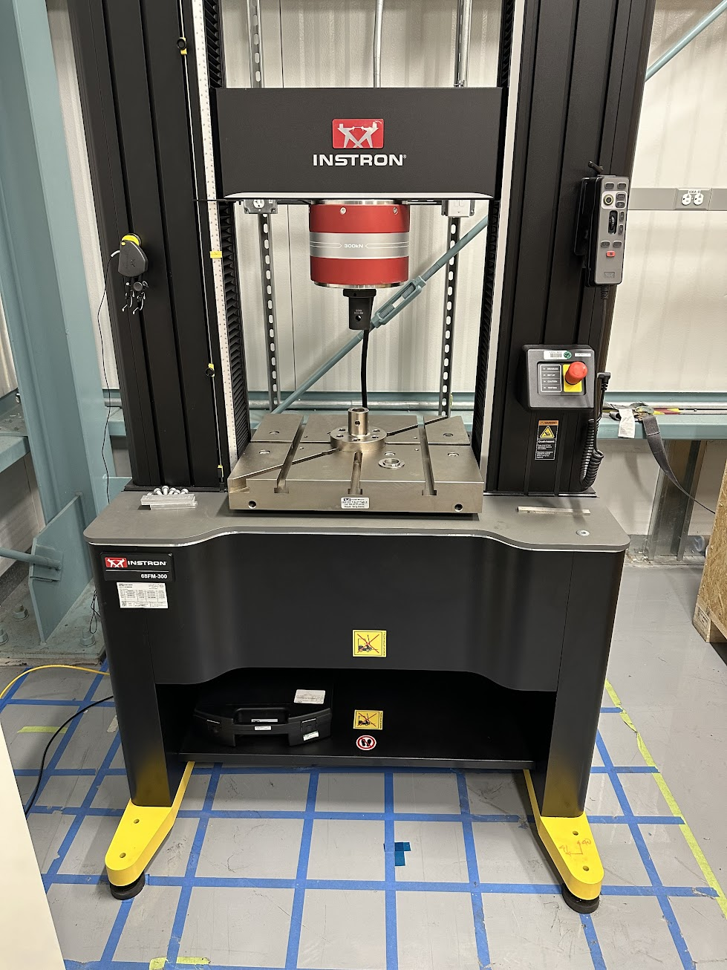
Nb₃Sn – Mechanical Strength
Failure Surface
New Stacks
New Instron @ LBNL
Current work (in collaboration with meas. area) focuses on:
    Collect more data on ‘failure’ of Nb₃Sn:
      Sample more points on the failure surface
      Understand relationship between ‘radial’ and ’longitudinal’ cracks
Status:
    Fresh batch of stacks manufactured, getting cut as we speak
    New 200 kN testing machine installed at LBNL
    Measurements will be performed soon
      We need some help on this activity to achieve the full scope

Slide 13
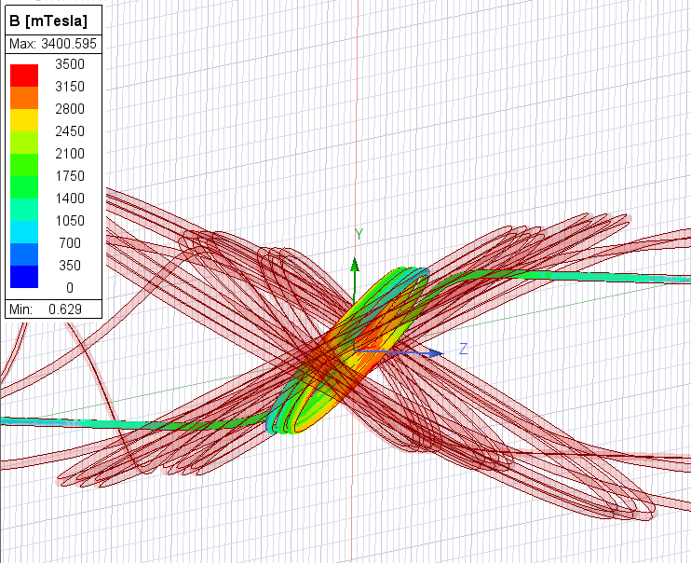
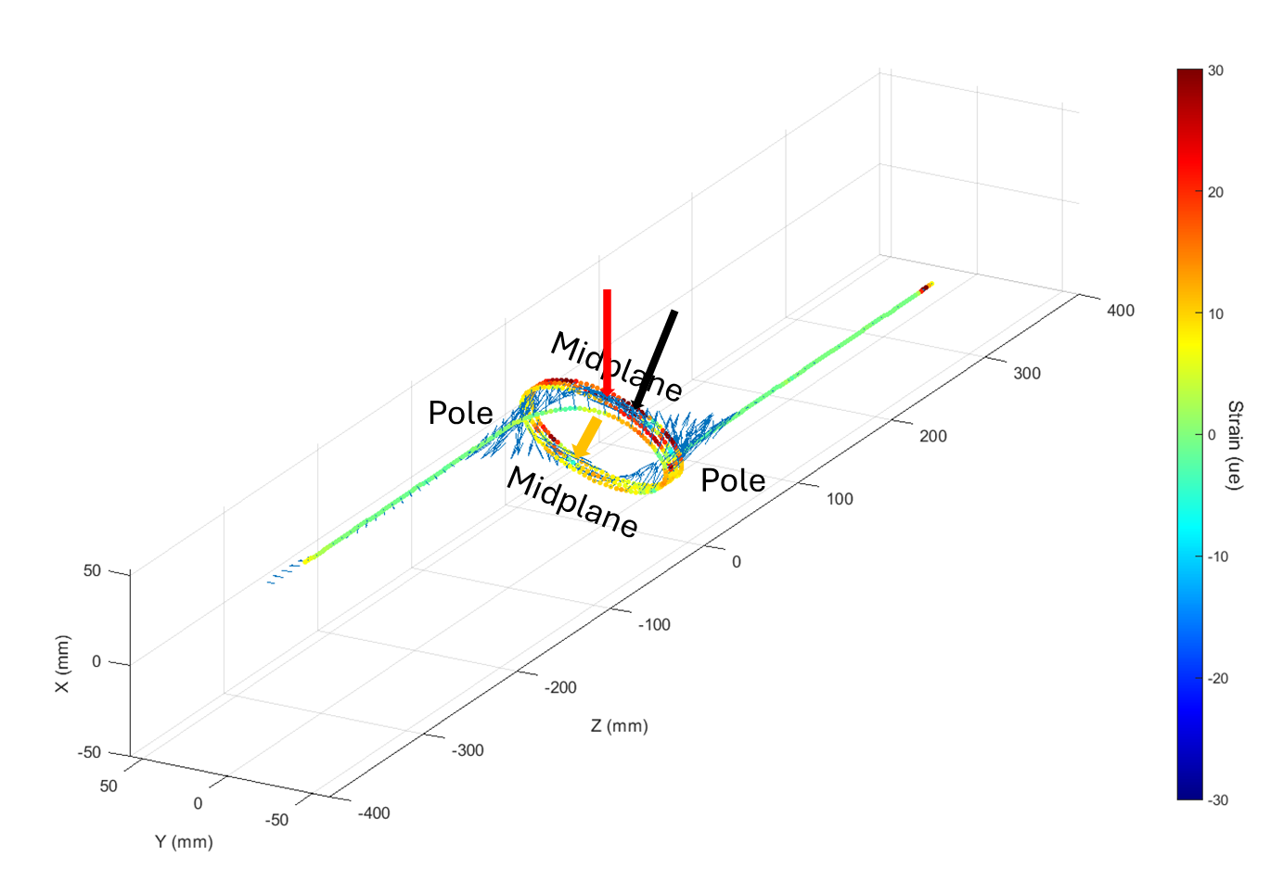
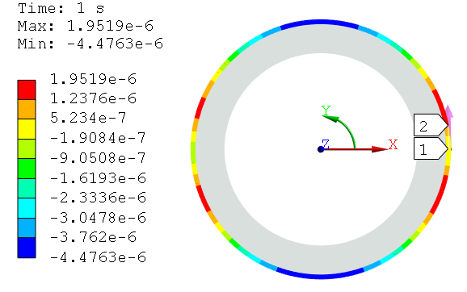
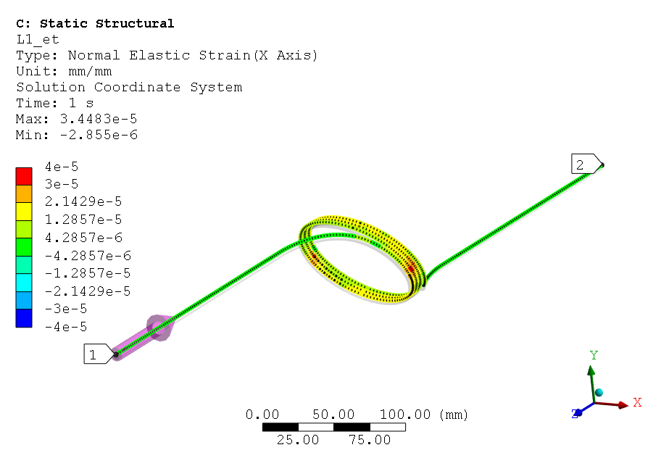
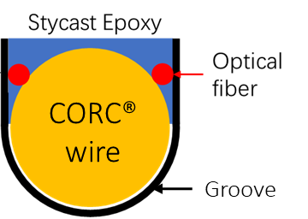
CORC – C3a Model
Shell Strain
Cable Strain
Magnetic Field in Maxwell
  Work on mechanical modeling of CORC magnets
    Attempt to understand ‘correct’ assumptions to predict the overall ‘magnet’ mechanical behavior
    Nice occasion from extremely clean FBG measurements on the 3 turns prototype C3a
    Developed model is qualitatively matching the measurements

Slide 14
BELFEM – Timeline

Slide 15
BELFEM – Goals

Slide 16
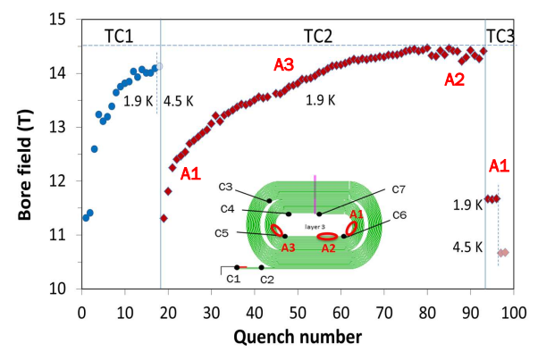
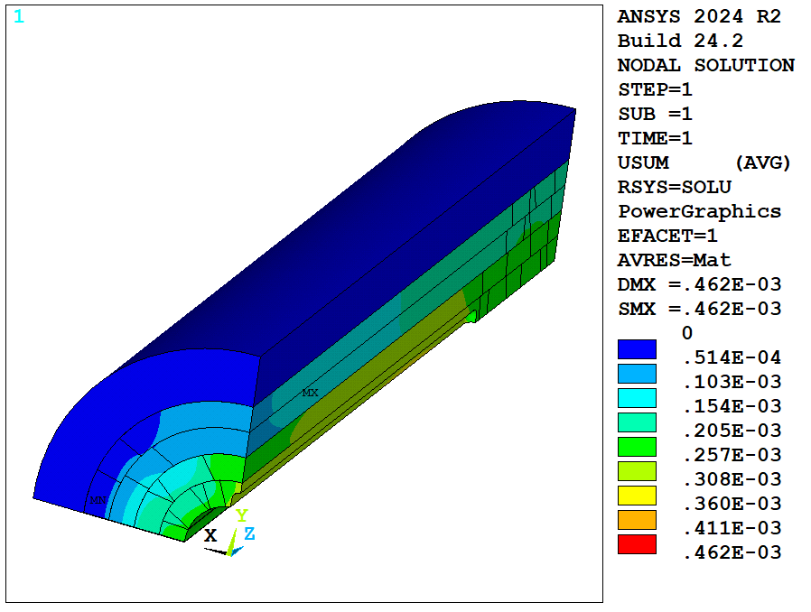
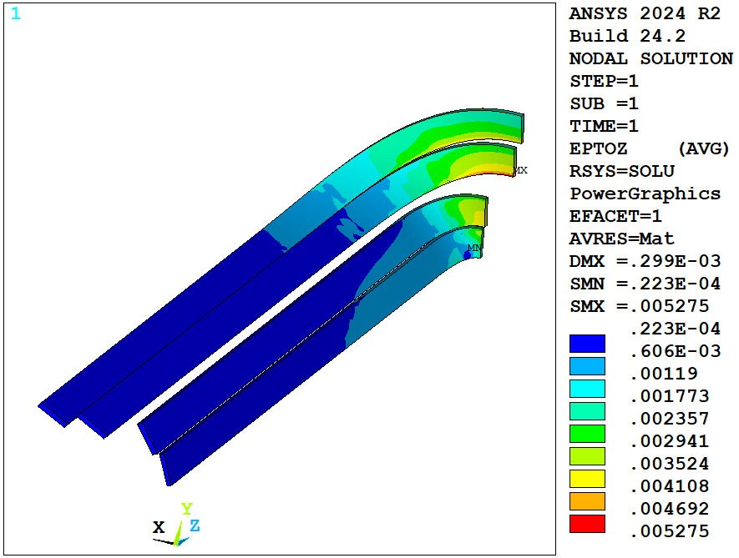
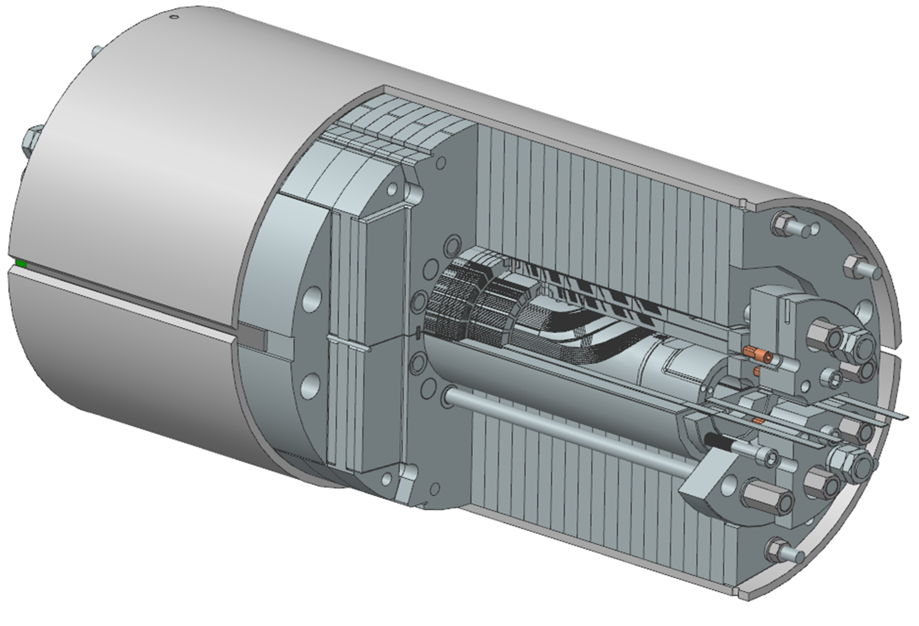
MDPCT1 – Mechanical Analysis
Scope: study MDPCT1 and Mirror performances
    Initial investigation with rigid boundary outside the coil (MDPCT1)
      Trying to define ‘dangerous’ prestress regions
      Very preliminary results show strain peak in layer 3 with no prestress (azimuthal and longitudinal)
      Points at detachment in this extreme case
      Next: include open contacts in the coil
    Model with structure in progress – necessary to evaluate actual prestress provided before/after thermal cycles

Slide 17
Summary

Slide 18
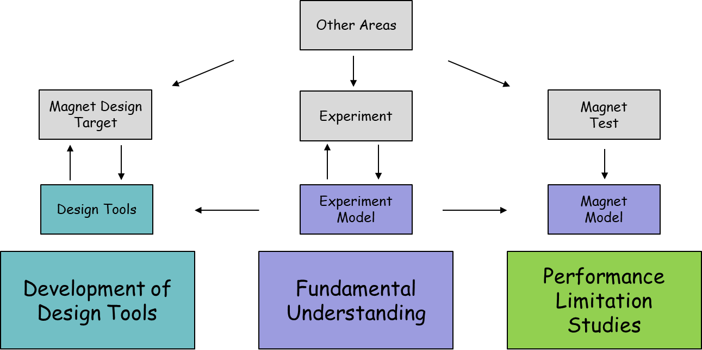
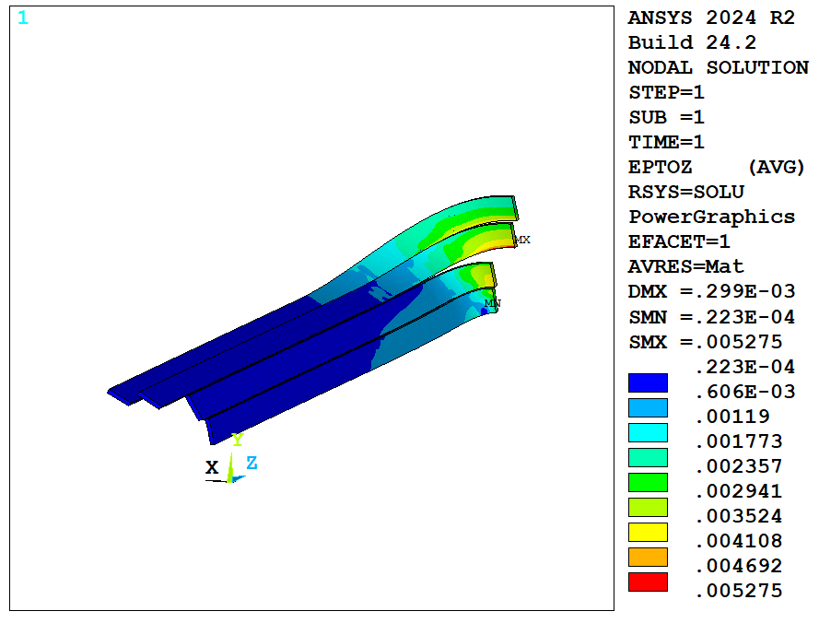
Summary
We have proposed a milestone plan
      Some activities missing ‘developers’
      Volunteers accepted!
  Reported progress and plans on current ongoing activities
      Developments on Nb₃Sn, Bi2212, REBCO

Slide 19
Extra

Slide 20
Working Group Scope - A Proposal
Development of Design Tools
Fundamental Understanding
Performance
Limitation
Studies
We can imagine different scopes for the working group
I would propose focusing on three ‘areas’:
    Development of design tools
      The actual design tasks would remain within other groups
    Fundamental understanding
      Can change the name…
      In general, these tasks should greatly benefit from dedicated measurements
    Performance limitation studies
      Investigate test data, using advanced modeling tools, to understand better limitations encountered during magnet testing
Do the other working groups needs/challenges/proposals fit well within this idea?

Slide 21
Some Risks - Again
The milestone plan is ambitious
Potential challenges/risks:
1. Poor communication and coordination with experimental activities
      E.g. if you only had placed that sensor there…
    Might be avoided with continuous communication with other activities
2. Many request/tasks, with limited ‘resources’, often busy on other tasks
    If we manage to bring together modeling efforts from different working groups areas, I personally think we can do a lot
      E.g. modeling efforts on other groups can be extended/pushed towards a more general tool
      Possibly ‘shareable’ (and user-friendly..), which might require additional work in documentation and/or user interface development
    In this organization, the working group can be seen as a ‘forum’
      The blocks describe the topics discussed in the forum

