Slide 1
Conceptual Structural Design and Analysis of a 20 T Hybrid Cosθ Dipole Design for Future Particle Colliders
MDP General Meeting
11/20/2024
M. D’Addazio ^{[1,2]}, P. Ferracin ^{[1]}, V. Marinozzi ^{[3]}, E. Ravaioli ^{[4]}, G. Vallone ^{[1]}, L. Savoldi ^{[2]}
[1] LBNL, [2] POLITO, [3] FNAL, [4] CERN

Slide 2
Goals and Motivations
Main design criteria
Conductors and structure properties
Introduction
Preliminary study
Problem approach
Multi-parameters analysis
Optimization process
Outline
Rigid simulation with the “donut” yoke
Real structure overview
Bladder and key technology
Results and challenges
Analysis of the sub-model
Real structure
Summary
Next steps
Conclusion

Slide 3
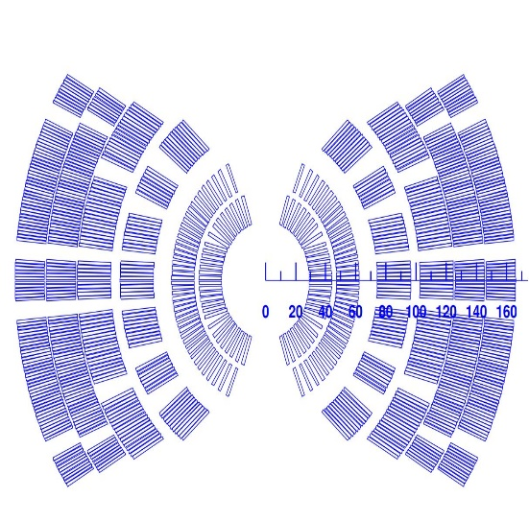
Introduction
Goals and Motivations
Main design criteria
The US Magnet Development Program (MDP) is carrying out R&D on the next generation of superconducting magnets for future particle accelerators.
One of the current conceptual design is a 20 T hybrid cosθ design.
Coil and magnet parameters
Free coil aperture (diameter) 50 mm
Operational bore field 20 T
Load-line fraction at 1.9 K ${I_{op}}/{I_{ss} }$≤ 87%
2D geometrical harmonics $b_{n}$< 3 units for n<10 ($R_{ref}$ = 17 mm)
Mechanics
Maximum Nb₃Sn coil stress <180 MPa at 1.9 K
Maximum Bi-2212 coil stress <120 MPa
Why a 20 T hybrid magnet?
The 20 T field is beyond Nb₃Sn practical limits (15-16 T for accelerator magnets)
The target field can be achieved with HTS superconductors in the high field region of the coil and Nb₃Sn in the lower field region $→$ hybrid approach.
HTS
LTS
Conceptual Structural Design and Analysis of a 20 T Hybrid Cosθ Dipole Design for Future Particle Colliders | M. D’Addazio
3

Slide 4
Introduction
Conductors and structure properties
Conductor material properties
The magnet has 6 layers:
Bi-2212 Rutherford cable as HTS conductor in layers 1 – 2
Nb₃Sn Rutherford cable as LTS conductor in layers 3 – 6
Same non-linear properties for Nb₃Sn and Bi-2212 conductors.
Elastoplastic and isotropic hardening from RVE model.
Coils modeled as uniform material (block model).
Conductor material properties
 | Room temperature | 4 K
E_{x} (GPa) | 37.4 | 36
E_{y} (GPa) | 52.6 | 48
G_{xy} (GPa) | 17.7 | 18.8
$$ν$$ | 0.3 | 0.3
$α_{x}$ (mm/m) | 4.438 | 4.438
$α_{y}$ (mm/m) | 4.03 | 4.03
$σ_{y}$ (MPa) | 30 | 33
E_{t} (GPa) | 12 | 12
Structural limits
Reference table for structure material properties:
G. Vallone et al., A Review of the Mechanical Properties of Materials Used in Nb₃Sn Magnets for Particle Accelerators, IEEE Transactions On Applied Superconductivity, 2023
Conceptual Structural Design and Analysis of a 20 T Hybrid Cosθ Dipole Design for Future Particle Colliders | M. D’Addazio
4

Slide 5
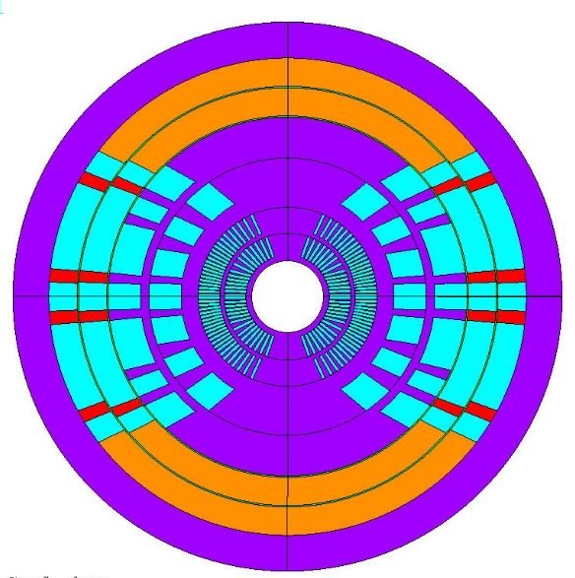
Optimization process
Preliminary study
Initial magnetic design provided good field quality and margin, however problematic peak stresses in an infinitely rigid structure.
High peak stress can be reduced by intercepting the EM forces (Stress Management Design).
Based on azimuthal and radial stresses, Stress Management Design (spar and ribs $→$ mandrel) introduced in layers 1 – 4.
Spar
Rib
Infinitely rigid boundary
First test
Layer 1-2: 1 turn
Layer 3: 5 blocks
Reference: V. Marinozzi et al., Conceptual design of a 20 T hybrid cos-theta dipole superconducting magnet for future High-Energy particle accelerators, 2022
Conceptual Structural Design and Analysis of a 20 T Hybrid Cosθ Dipole Design for Future Particle Colliders | M. D’Addazio
5

Slide 6
Optimization process
Problem approach
Development of a python-based tool to optimize the hybrid dipole design across magnetic, mechanical and quench protection analysis.
One .csv file:
Each row is a design
Each column is a parameter
ROXIE
input files
Field quality
Load lines
Margins
One number to define how “good”
a design is
STEAM
input files
Hot-spot temperature
Peak voltage
ANSYS APDL
input files
Peak stress during powering
Peak stress after quench
Optimization loop
Under development by E. Ravaioli (CERN) and G. Vallone (LBNL)
Conceptual Structural Design and Analysis of a 20 T Hybrid Cosθ Dipole Design for Future Particle Colliders | M. D’Addazio
6

Slide 7
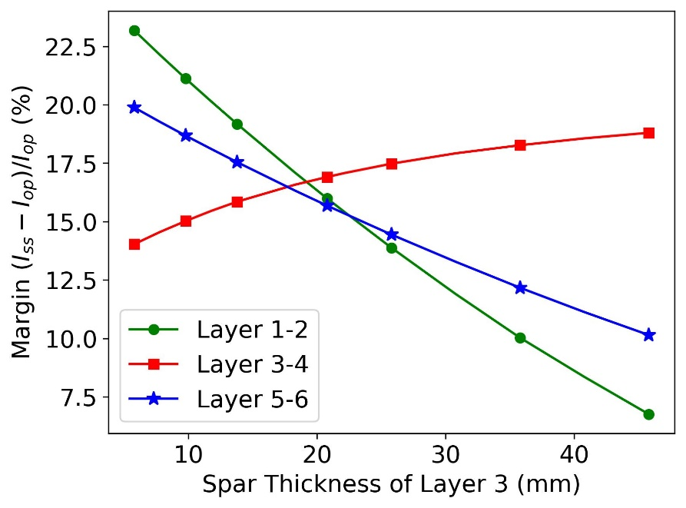
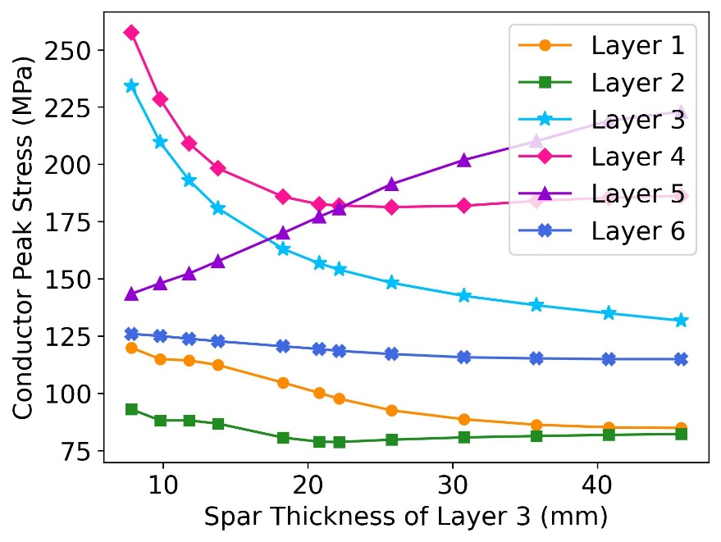
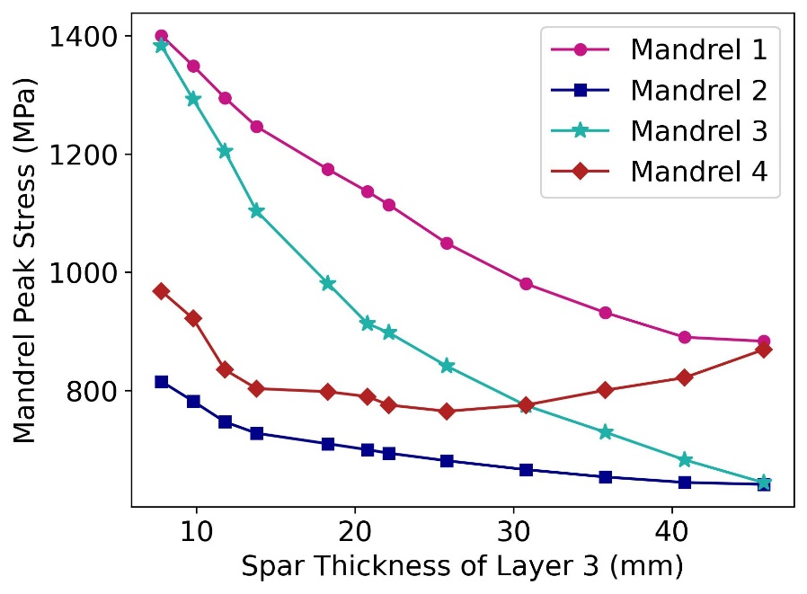
Optimization process
Spar
Multi-parameters analysis
Rib
Effect of the layer 3 spar thickness
For a given cross-section, spar thickness of layer 3 that maximizes the margin.
Increasing the spar thickness, decreases the conductor stress of layer 1-4 as well as the structure stress in layer 1-3.
Conceptual Structural Design and Analysis of a 20 T Hybrid Cosθ Dipole Design for Future Particle Colliders | M. D’Addazio
7

Slide 8
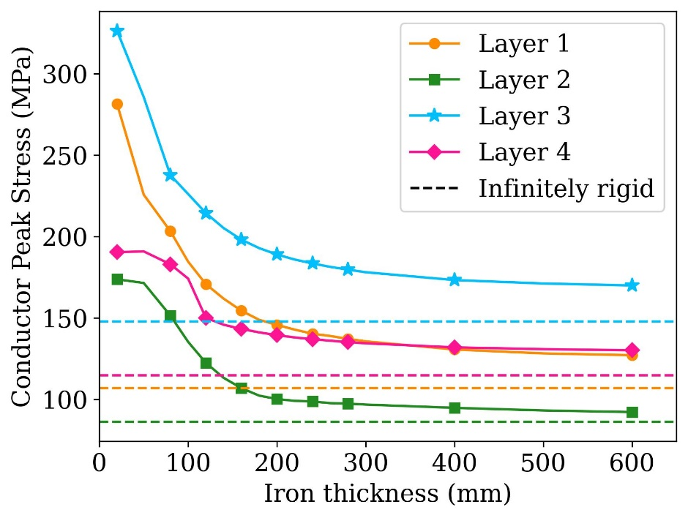
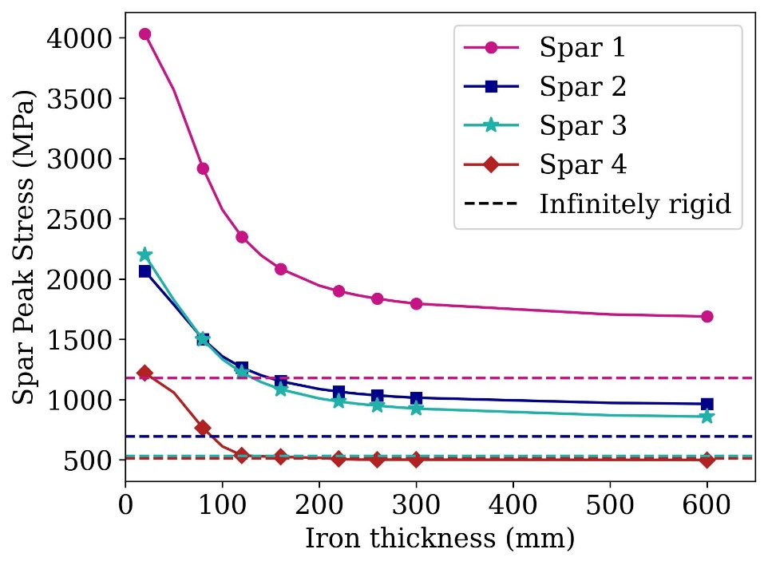
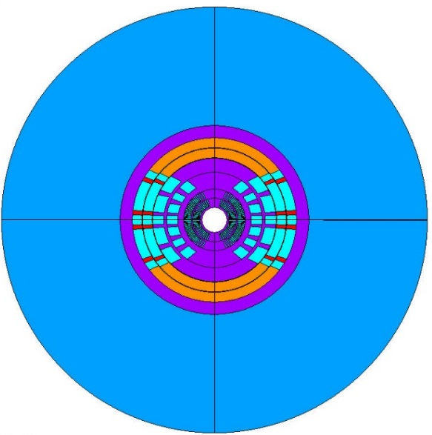
Towards the real structure
Rigid simulation with the “donut” yoke
External structure simplified with cylindrical ring of iron $→$ more realistic boundary condition. In these simulations, only the Lorentz forces are applied.
Conductors and mandrels peak stresses are higher than infinitely rigid structure.
The results are useful to understand how stiff the structure should be to be closer to the infinite rigid one.
Conceptual Structural Design and Analysis of a 20 T Hybrid Cosθ Dipole Design for Future Particle Colliders | M. D’Addazio
8

Slide 9
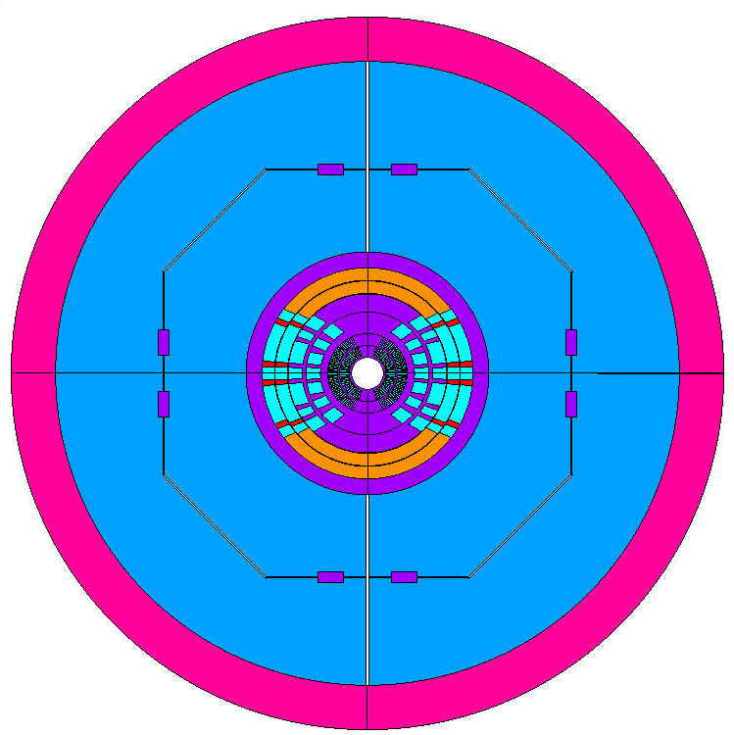
Real structure
Real structure overview
Main structural components:
stainless steel collar;
magnetic steel pad and yoke;
aluminum shell.
Three sequential load steps are considered: pre-stress at room temperature, cooldown to cryogenic temperature and introduction of Lorentz forces.
Bladder and key technology to apply pre-stress at room temperature.
Iron yoke surrounded by aluminum shell to further increase the pre-stress during the cooldown.
Components dimensions defined to comply with material limits and pre-stress requirements.
Aluminum shell
Iron yoke
Iron pad
SS keys
SS collar
0.166 m
1.12 m
Conceptual Structural Design and Analysis of a 20 T Hybrid Cosθ Dipole Design for Future Particle Colliders | M. D’Addazio
9

Slide 10
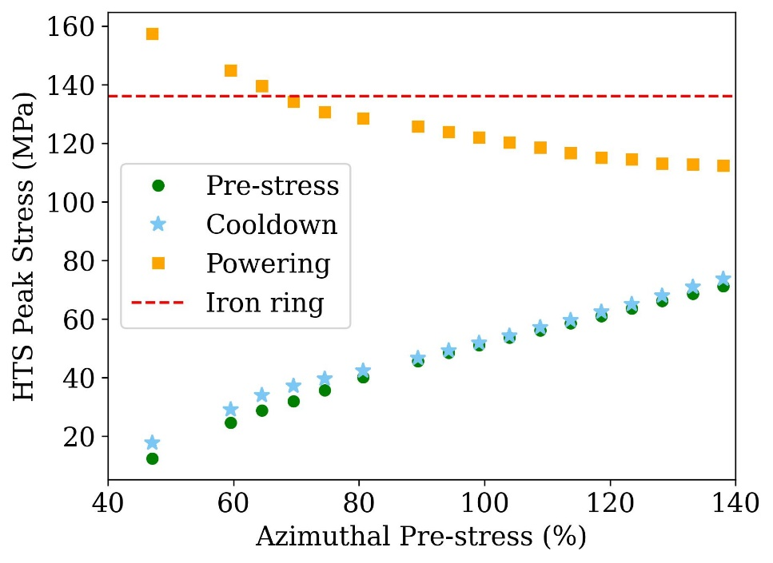
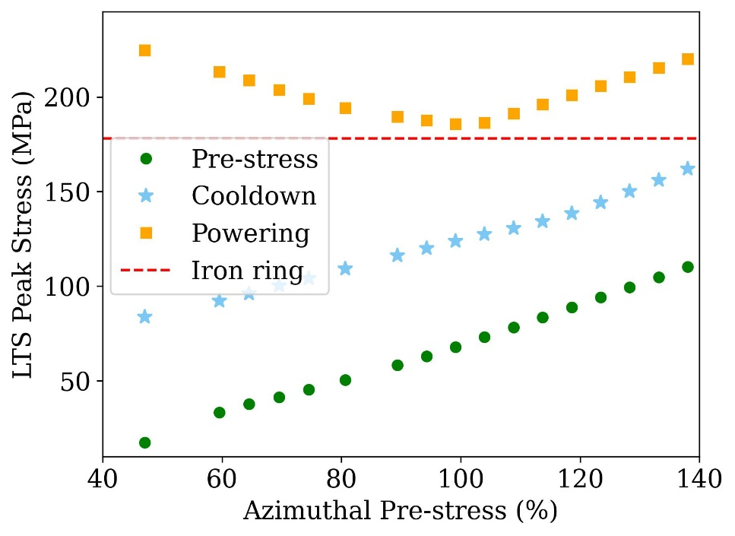
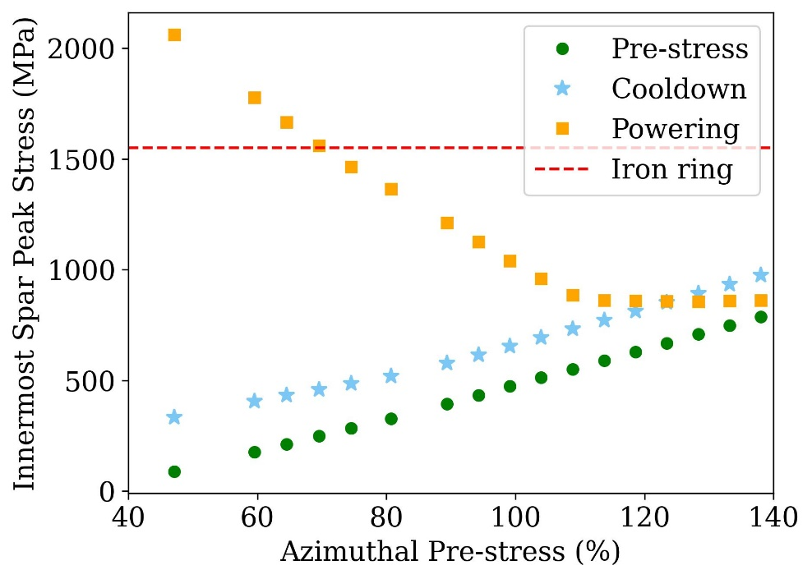
Real structure
Bladder and key technology
Starting from the minimum yoke thickness needed to guarantee low stresses, a parametric analysis was performed.
An optimum stress value might be reached with an azimuthal pre-stress in the range of 95-100% of the EM forces.
Possible to reach the same stress level of the “donut” yoke for conductors and innermost spar.
Conceptual Structural Design and Analysis of a 20 T Hybrid Cosθ Dipole Design for Future Particle Colliders | M. D’Addazio
10

Slide 11
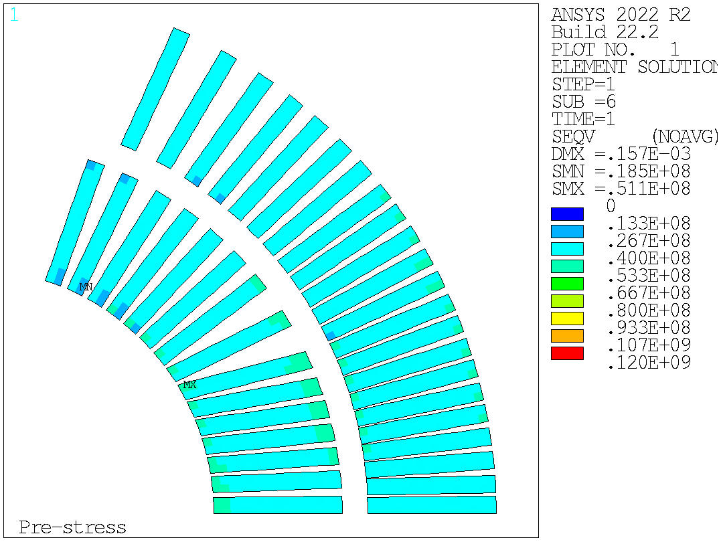
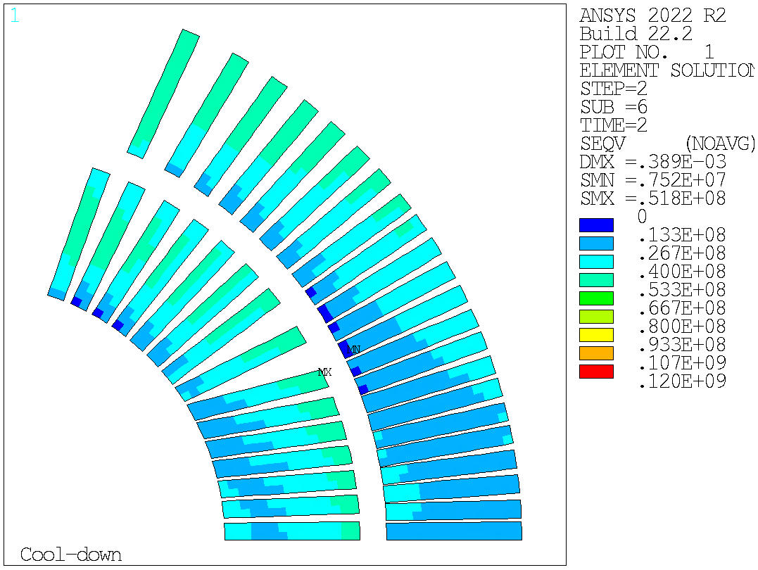
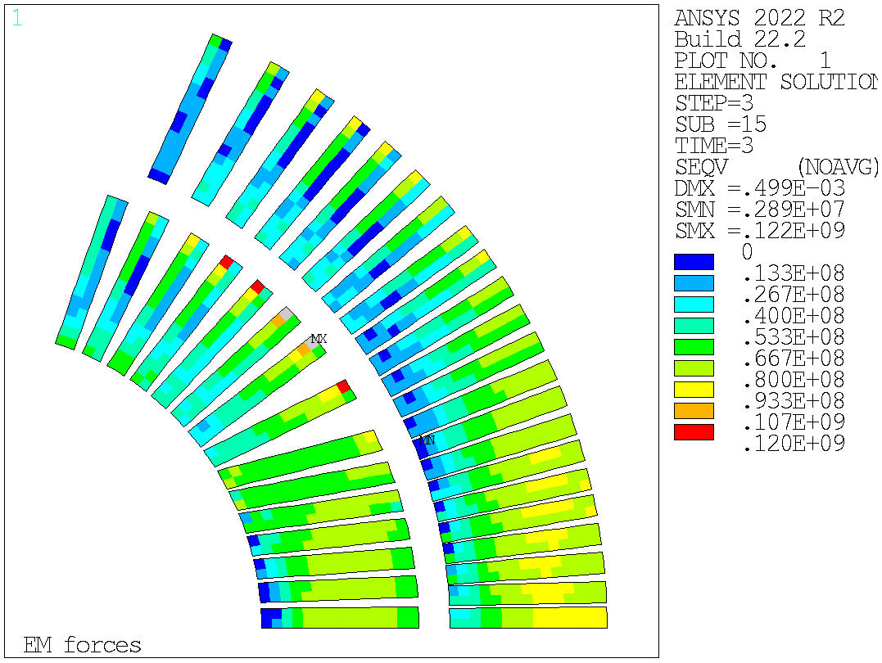
Real structure
Equivalent stress in the HTS conductors
Peak stress after energization is equal to 122 MPa and the maximum is concentrated in a small corner of layer 1.
Stresses at pre-stress and cooldown are below the limit.
Prestress | Cooldown | Energization
51 MPa
52 MPa
122 MPa
Conceptual Structural Design and Analysis of a 20 T Hybrid Cosθ Dipole Design for Future Particle Colliders | M. D’Addazio
11

Slide 12
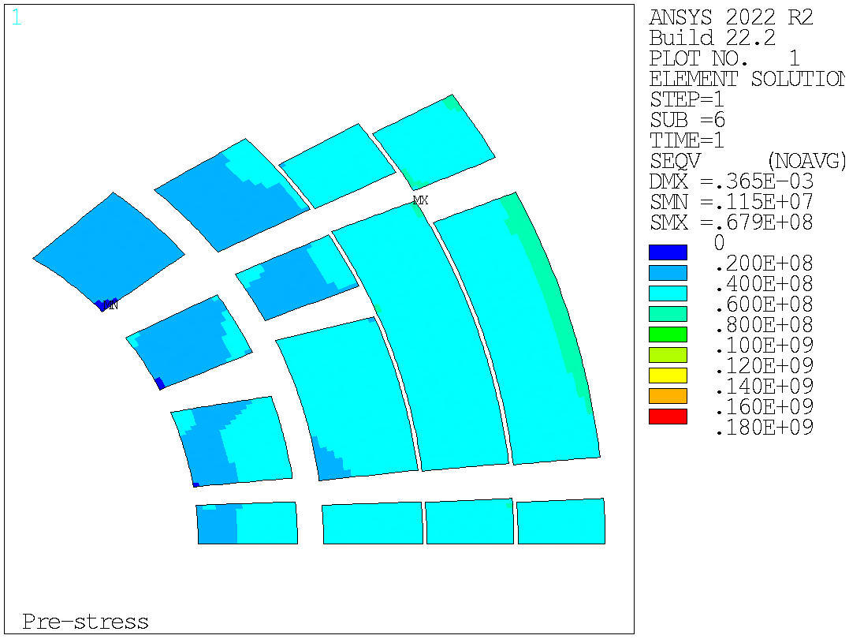
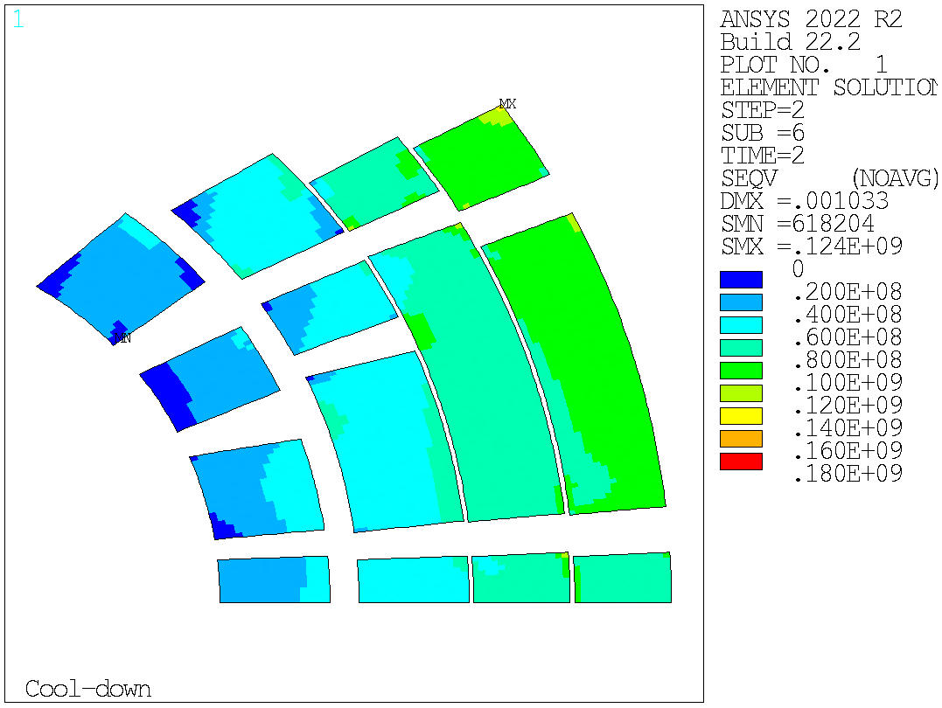
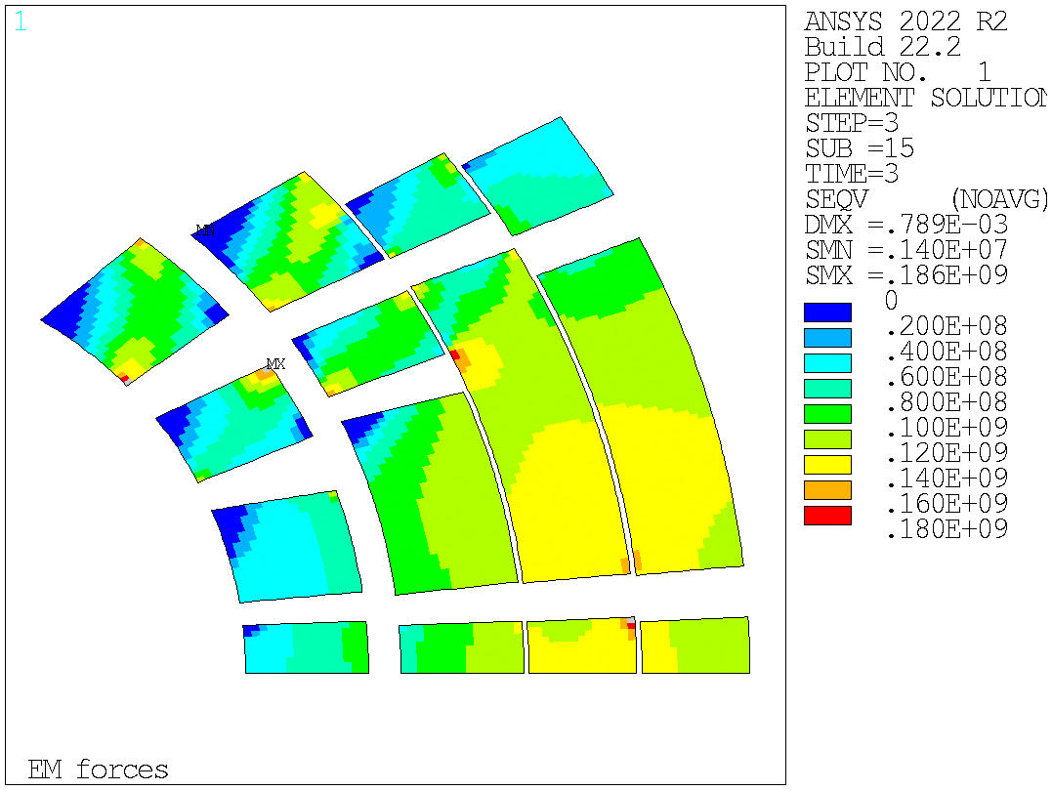
Real structure
Equivalent stress in the LTS conductors
The peak stress after energization is equal to 186 MPa and the maximum is located in the corner of the third block of layer 3.
The peak stresses are also verified during pre-stress and cooldown.
Prestress | Cooldown | Energization
68 MPa
124 MPa
186 MPa
Conceptual Structural Design and Analysis of a 20 T Hybrid Cosθ Dipole Design for Future Particle Colliders | M. D’Addazio
12

Slide 13
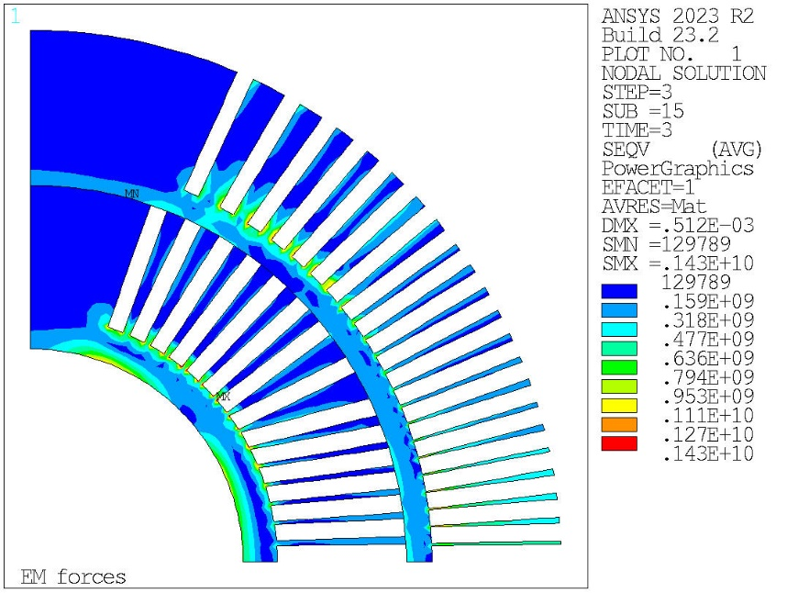
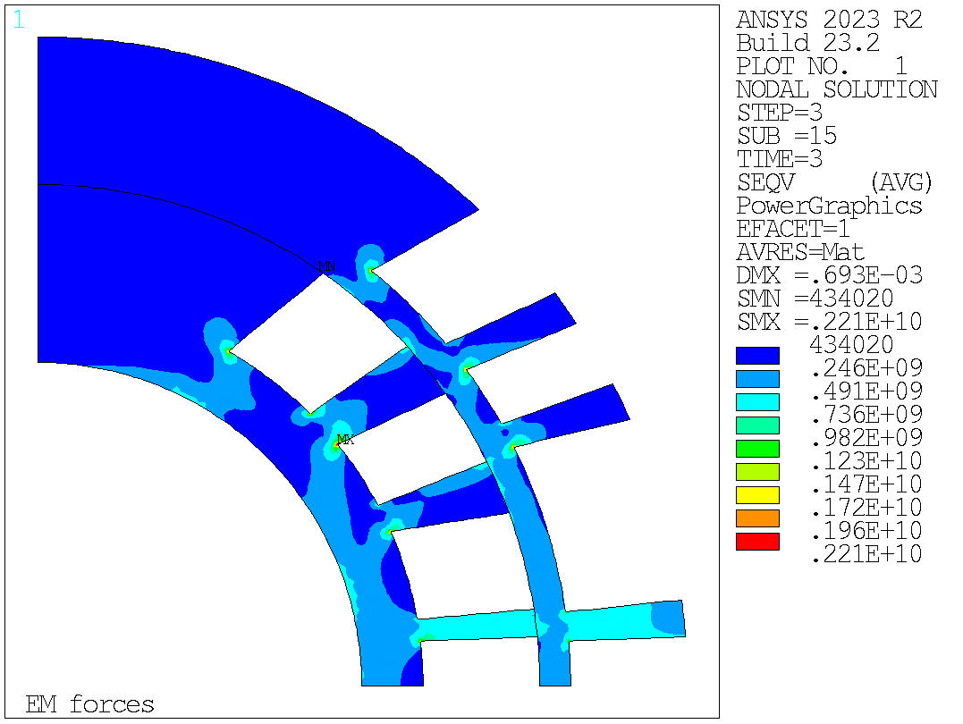
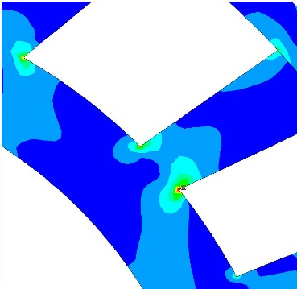
Real structure
Challenges
The main issue is the high stress in the spar/ribs of the layers 1-4.
One possible solution is using a high strength stainless steel (as an example Nitronic 40) or Inconel. In this case, the machining process can become challenging.
Mandrel Layer 1-2 after Energization | Mandrel Layer 3-4 after Energization
1430 MPa
2210 MPa
Conceptual Structural Design and Analysis of a 20 T Hybrid Cosθ Dipole Design for Future Particle Colliders | M. D’Addazio
11

Slide 14
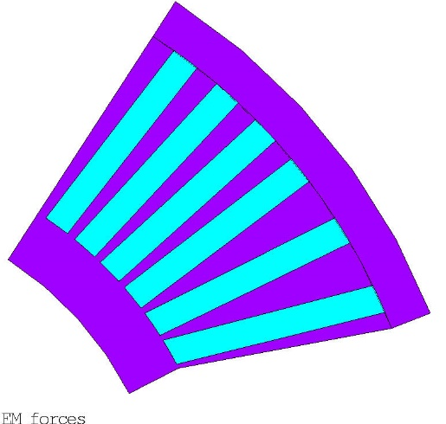
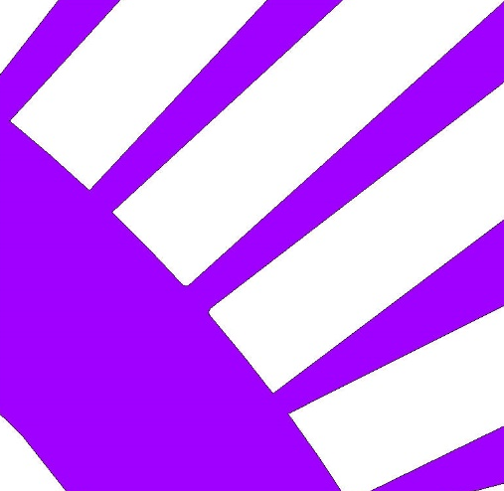
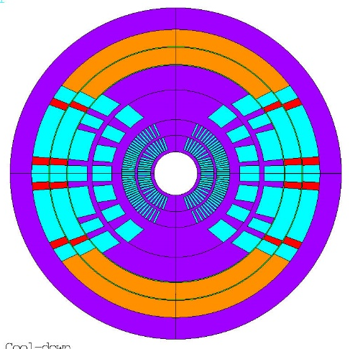
Real structure
Analysis of the sub-model
Magnet
cross-section
Full sub-model
Zoom on the selected rib
Main assumptions:
Rounded edges of the rib;
Boundary condition interpolated from global simulation;
Lorentz forces evaluated on average in each turn from global simulation;
Elastic + perfect plastic material model (assuming the plastic modulus ~0)
Elastoplastic Properties (Isotropic hardening) - Mandrel
 | E_{x} (GPa) | $$ν$$ | $α_{x}$ (mm/m) | E_{t} (MPa) | $σ_{y}$ (MPa)*
RT | 200 | 0.28 | 2.834 | 1 | 1172
4 K | 200 | 0.28 | 2.834 | 1.1 | 1408
*Inconel 718
Conceptual Structural Design and Analysis of a 20 T Hybrid Cosθ Dipole Design for Future Particle Colliders | M. D’Addazio
12

Slide 15
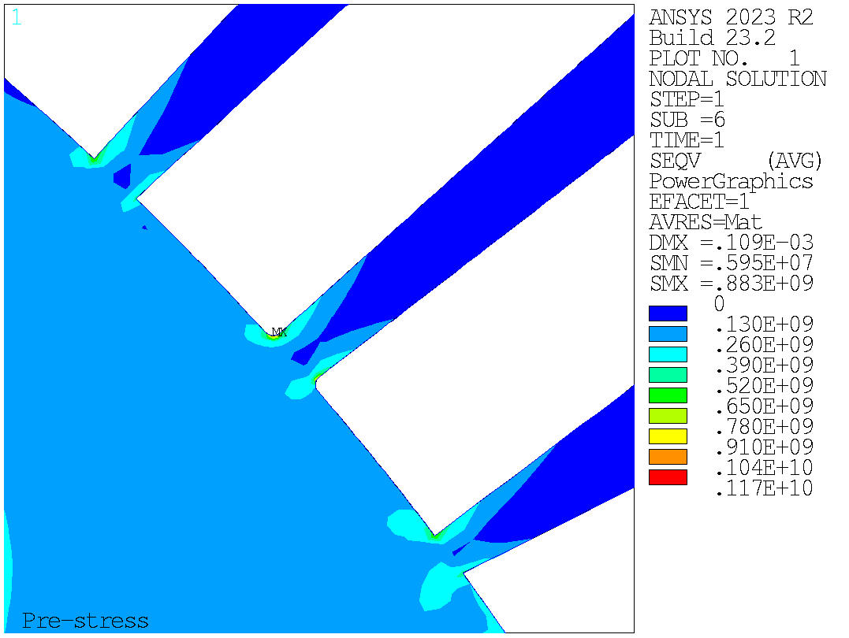
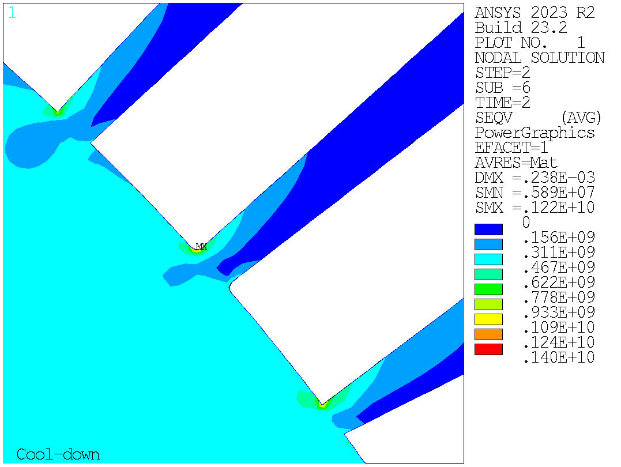
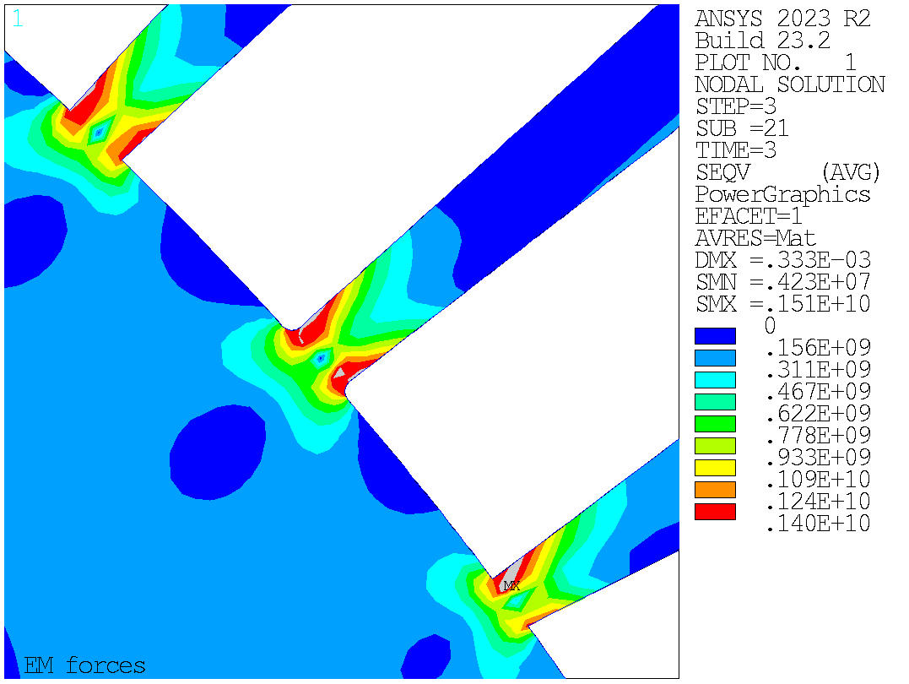
Real structure
Results of the sub-model
Rib subjected to high stresses:
Almost complete plasticization of the area
Difficult to withstand the forces involved
A possible solution could be to increase the thickness of the ribs and change the cross section of the magnet.
Prestress | Cooldown | Energization
Conceptual Structural Design and Analysis of a 20 T Hybrid Cosθ Dipole Design for Future Particle Colliders | M. D’Addazio
13

Slide 16
Conclusion
Summary
The conceptual mechanical design of a 20 T hybrid cosθ dipole has been analyzed.
The optimization process of the 2D cross-section design produces a result that satisfies the current requirements considering an infinitely rigid structure.
The stress condition get worse when a non-ideal structure (the “donut” structure) is introduced.
However, by applying a sufficient azimuthal pre-stress at least equal to 95-100% of EM forces, it is possible to reach in the conductors and in the innermost spar a peak stress even better than the one evaluated with the “donut” structure. In this case, the peak stress in the HTS is equal to 122 MPa and in the LTS is 186 MPa.
Regarding the real mechanical structure, an effort has been made to keep the structure as compact as possible while preserving its integrity. The current overall diameter is equal to 1.12 m.
The stress in the mandrels needs to be carefully evaluated, therefore a sub-model of this critical area has been studied.
The sub-model analysis shows that the ribs are subjected to high stresses difficult to manage.
Next steps
To improve the stress in the mandrel, a further optimization of the ribs is under discussion.
Moreover, study the effect of all the available parameters, such as the key position and the shape of the iron components, is also in the future plans.
Conceptual Structural Design and Analysis of a 20 T Hybrid Cosθ Dipole Design for Future Particle Colliders | M. D’Addazio

Slide 17
Acknowledgment
The work performed at Lawrence Berkeley National Laboratory was supported by the Office of High Energy and Nuclear Physics, U. S. Department of Energy, under contract No. DE-AC02-05CH11231.
This presentation is part of the project PNRR-NGEU which has received funding from the MUR – DM 118/2023.
Conceptual Structural Design and Analysis of a 20 T Hybrid Cosθ Dipole Design for Future Particle Colliders | M. D’Addazio
Notes:
Ringraziare

Slide 18
Thank you for your attention!

Slide 19
Backup slides

Slide 20
Summary of the cross-section parameters (1)
HTS
LTS
Main conductor parameters
 | L1-L2 | L3-L4 | L5-L6
Superconductor/Stabilizer | Bi2212/Ag | Nb3Sn/Cu | Nb3Sn/Cu
Number of strands (-) | 32 | 50 | 50
Strand diameter (mm) | 0.90 | 0.80 | 0.70
Cu/noCu or Ag/noAg ratio(-) | 4.00 | 0.90 | 2.00
Cable width (mm) | 14.87 | 22.16 | 19.39
Cable average thickness (mm) | 1.70 | 1.52 | 1.33
Insulation thickness (mm) | 0.15 | 0.15 | 0.15
Engineering current density (A/mm²) | 569 | 461 | 602
Main parameters
Bore magnetic field (T) | 20
Bore diameter (mm) | 50
Operating temperature (K) | 1.9
Operating current (A) | 11593
Margin ${I_{op}}/{I_{ss}}$ (-) | 84%
Conceptual Structural Design and Analysis of a 20 T Hybrid Cosθ Dipole Design for Future Particle Colliders | M. D’Addazio

Slide 21
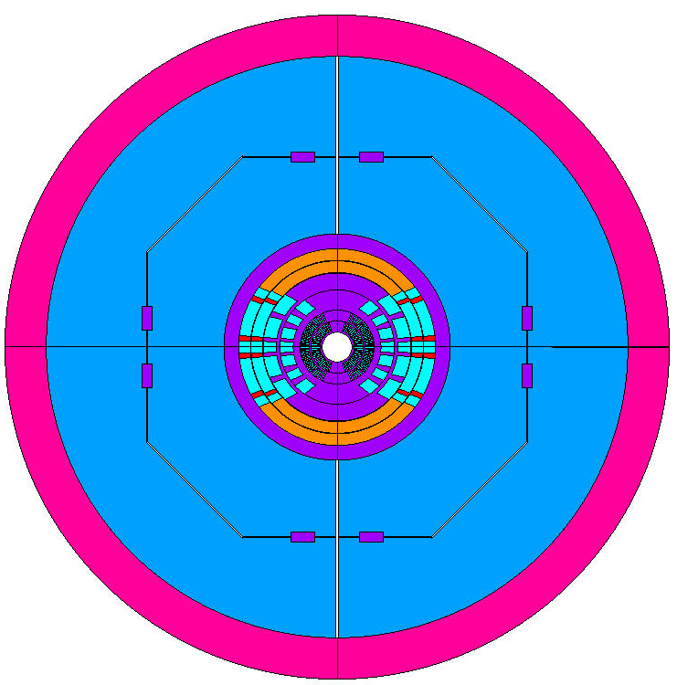
Summary of the cross-section parameters (2)
Simulation assumptions:
Separation and sliding in the coils
Thin interlayers bonded in layers 5 – 6 (represent the insulation)
Coupled nodes in the wedges
Coil element size: 1 mm
Not frictionless
Aluminum shell
Iron yoke
Iron pad
Stainl. steel keys
Stainl. steel collar
Structure components thickness:
Collar – 25 mm
Pad – 130 mm
Yoke – 170 mm
Shell – 70 mm
0.166 m
1.12 m
Conceptual Structural Design and Analysis of a 20 T Hybrid Cosθ Dipole Design for Future Particle Colliders | M. D’Addazio

Slide 22
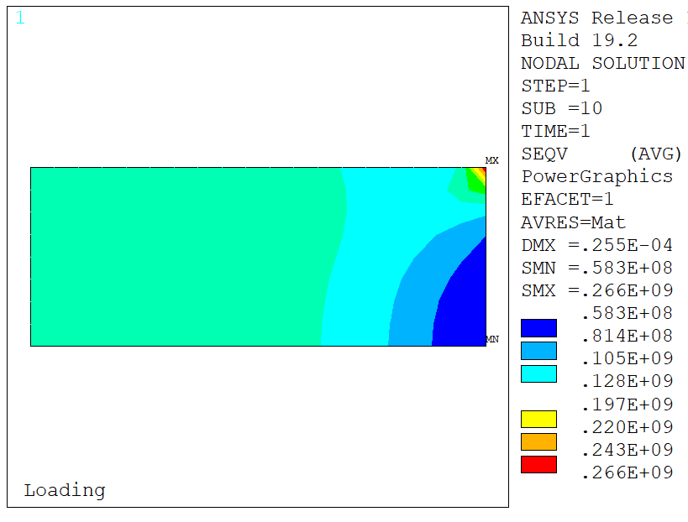
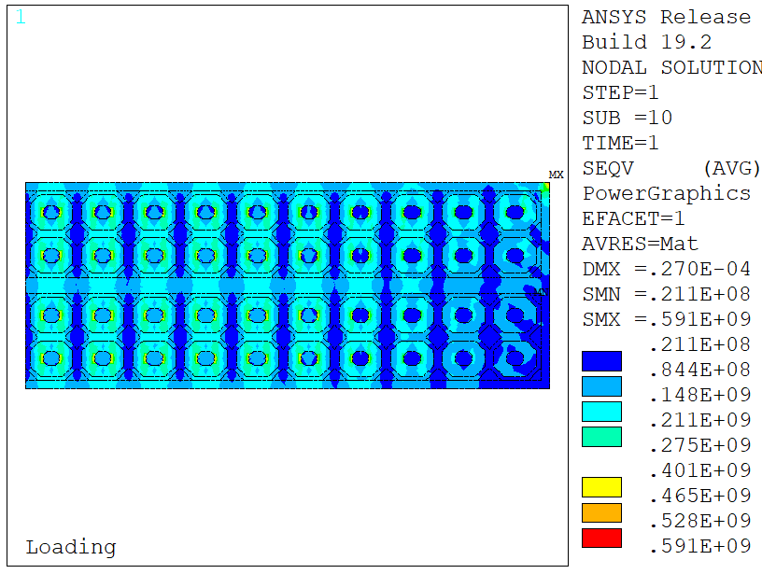
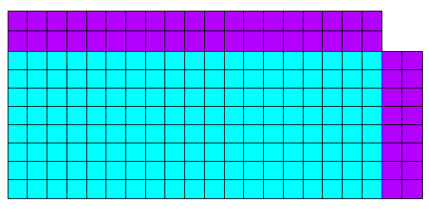
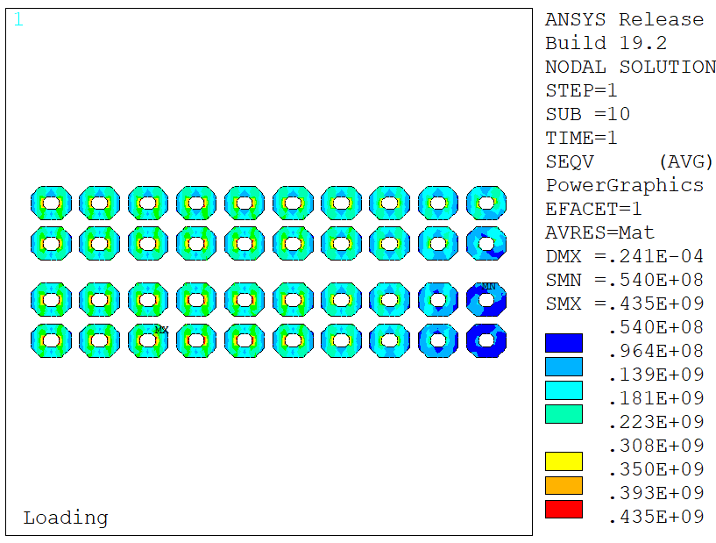
Element solution for stresses (1)
Sliding
Bonded
Fixed x
Stresses in a ‘corner-test’ model:
Block model goes to 266 MPa equivalent stress in the corner;
Strand model goes to 591 MPa (smaller elements) in the insulation;
No trace of this appears in the Nb₃Sn region stresses.
Conceptual Structural Design and Analysis of a 20 T Hybrid Cosθ Dipole Design for Future Particle Colliders | M. D’Addazio

Slide 23
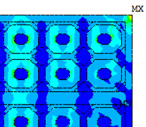
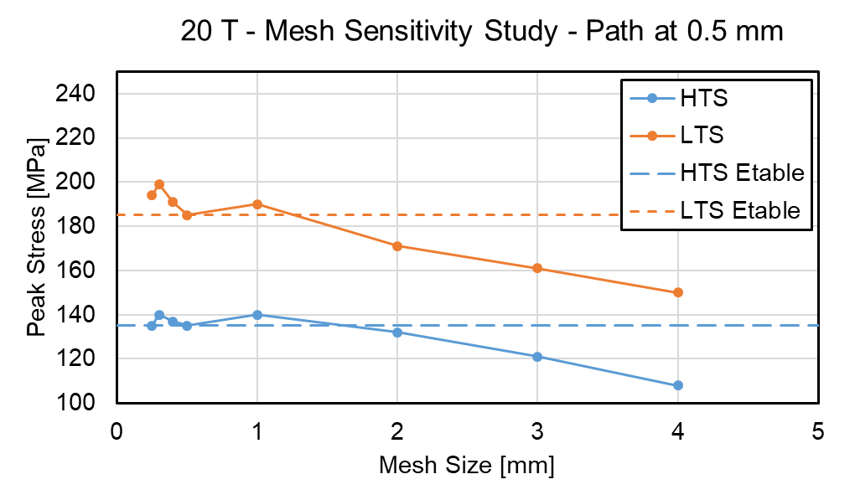
Element solution for stresses (2)
Explicitly modeling the insulation might increase significantly the model size.
One feasible approach could be extract the strain/stress at the strand location and this is similar to neglect 1 mm for insulation wrap and cable insulation.
In the 20 T CT model, an element size of 1 mm (linear) is used in order to find a compromise between computational load and accuracy.
Conceptual Structural Design and Analysis of a 20 T Hybrid Cosθ Dipole Design for Future Particle Colliders | M. D’Addazio

Slide 24
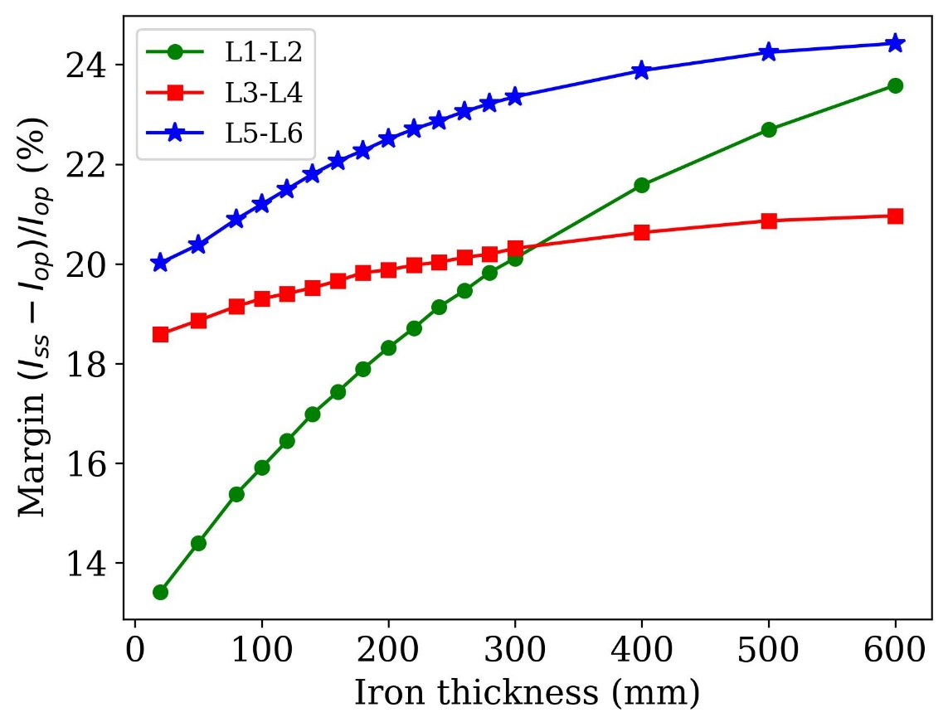
Analysis of the load-line margin (1)
What: check the variation of the load-line margin by varying the thickness of the iron yoke and maintaining the bore field at 20 T.
Why: understand the amount of load-line margin lost by reducing the yoke thickness.
Starting yoke thickness: ~ 240 mm
The dipole cross-section was designed to fulfill the requirement of 15% of the load-line margin evaluated as:
$$Margin (\%)=\left({J_{ss}}/{J_{op}}\right)−1$$
Selecting the yoke thickness equal to 200 mm, the load-line margin is about 1% less than the reference margin percentage evaluated with a yoke thickness of 240 mm.
Conceptual Structural Design and Analysis of a 20 T Hybrid Cosθ Dipole Design for Future Particle Colliders | M. D’Addazio

Slide 25
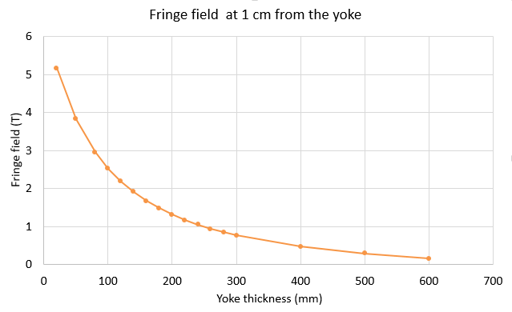
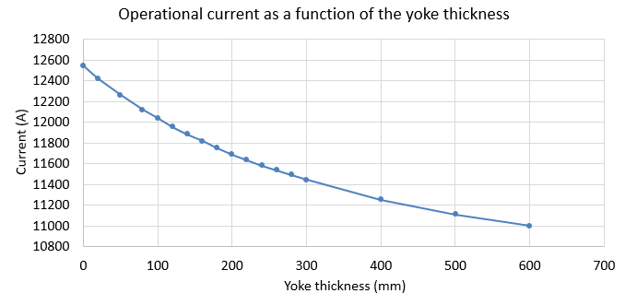
Analysis of the load-line margin (2)
Plot of the Operational Current (A) as a function of the yoke thickness (mm) to confirm the non-linear contribution of the field due to iron saturation.
Evaluation of the fringe field (T) at 1 cm from the yoke.
The value of the fringe field at around 200 mm yoke thickness is around 1 T.
Conceptual Structural Design and Analysis of a 20 T Hybrid Cosθ Dipole Design for Future Particle Colliders | M. D’Addazio

Slide 26
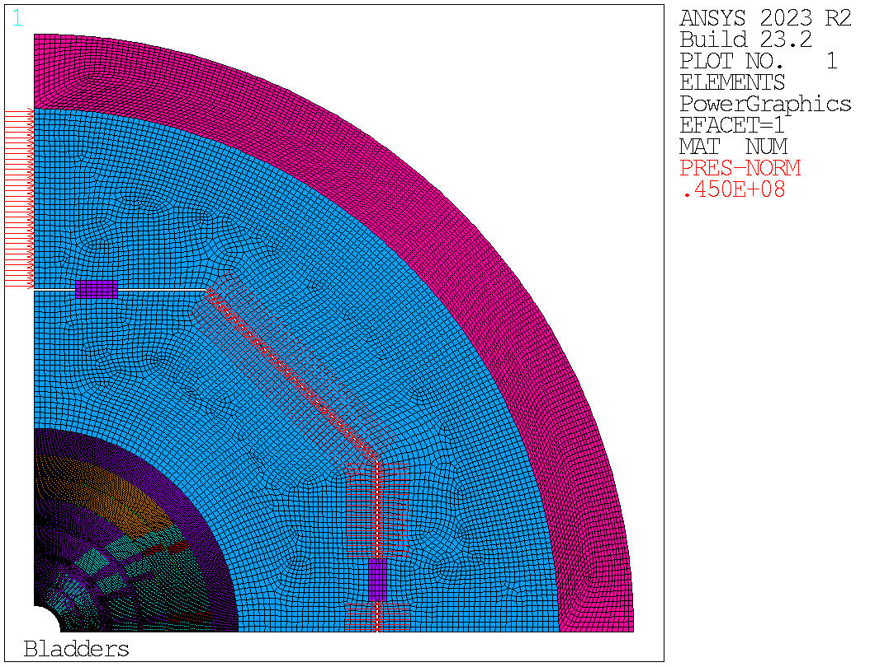
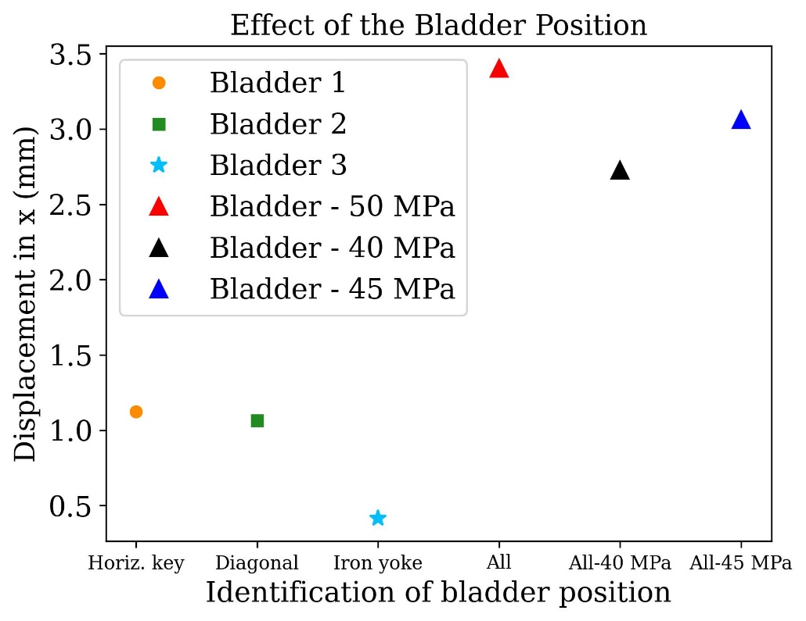
Bladder Pressure Analysis (1)
Position of the bladder in the model.
In this case, the bladder pressure was set at 45 MPa.
The plot shows the results in terms of displacement in the x-direction (mm) considering the single contribution of the each bladder and the total contribution.
Conceptual Structural Design and Analysis of a 20 T Hybrid Cosθ Dipole Design for Future Particle Colliders | M. D’Addazio

Slide 27
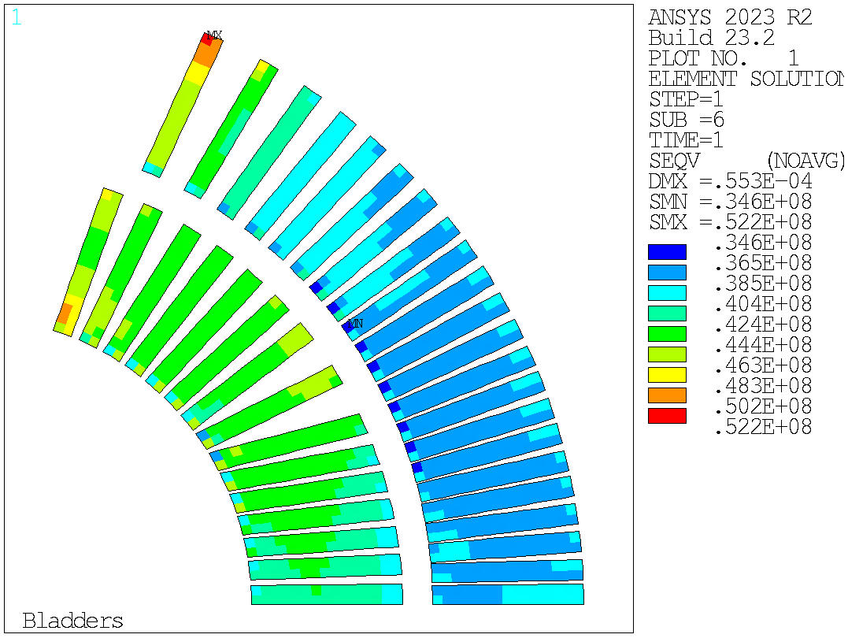
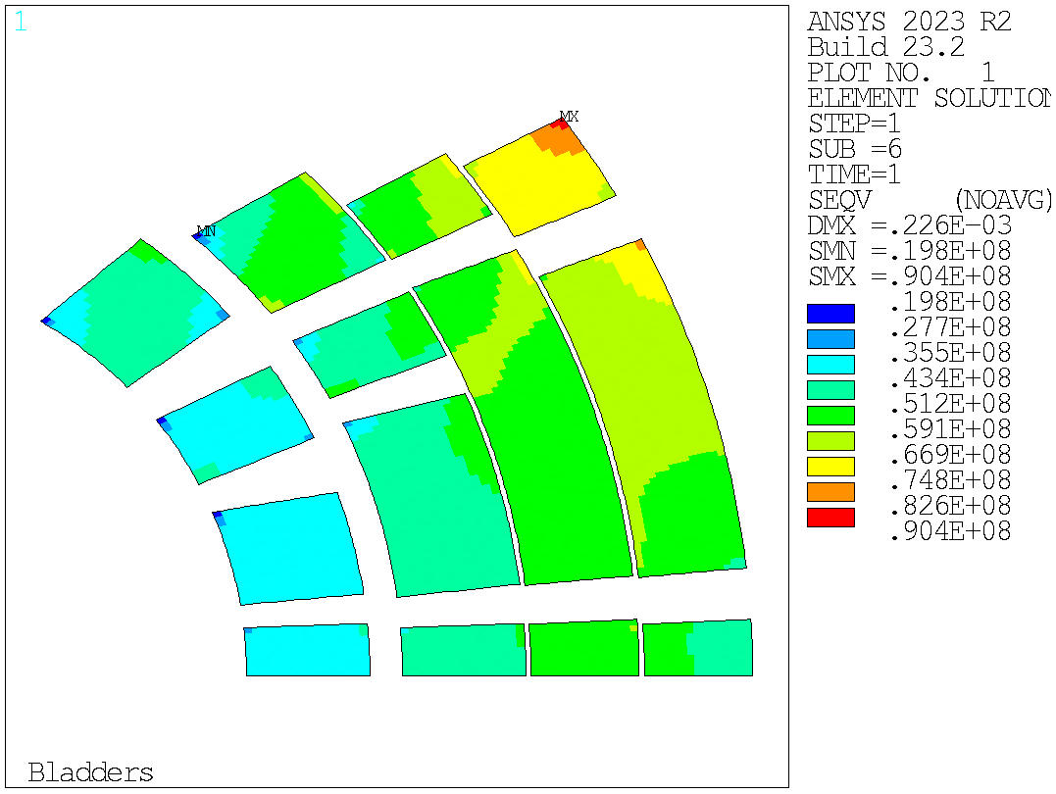
Bladder Pressure Analysis (2)
Equivalent stress in the HTS and LTS conductors after the bladder operation.
52 MPa
90 MPa
Conceptual Structural Design and Analysis of a 20 T Hybrid Cosθ Dipole Design for Future Particle Colliders | M. D’Addazio

