Slide 1
Updates on 20 T working group activities and next steps
P. Ferracin
MDP General Meeting
November 20th, 2024

Slide 2
Acknowledgement (20 T working group)
Members US MDP 20 T working group
LBNL: D. Arbelaez, L. Brouwer, M. D’Addazio, L. Garcia Fajardo, J.L. Rudeiros Fernandez, M. Juchno, S. Prestemon, T. Shen, R. Teyber, G. Vallone, X. Wang
FNAL: G. Ambrosio, M. Baldini, E. Barzi, S. Gourlay, V. Kashikhin, V. Marinozzi, I. Novitski, G. Velev, A. Zlobin
NHMFL: L. Cooley, D. Larbalestier
BNL: K. Amm, M. Anerella, J. Cozzolino, R. Gupta, F. Kurian, B. Yahia
European Contributors
Emmanuele Ravaioli (CERN)
Douglas Martins Araujo (PSI)
Etienne Rochepault (CEA)

Slide 3
Introduction Bi-weekly meetings (but recently weekly…)
69 meetings so far
https://conferences.lbl.gov/category/100/

Slide 4
Introduction Goals of working group
Conceptual design of a 20 T hybrid HTS-LTS magnet
Comparative analysis of different design options for a 20 T hybrid
Cosϑ design and its stress-management options
Block-type coil design (block with flared ends)
Common-coil design (block with racetrack coils)
Review and follow-up of current work on hybrid magnets
Collect and organize information to provide inputs for 20 T hybrid design and feed-backs to hybrid program

Slide 5
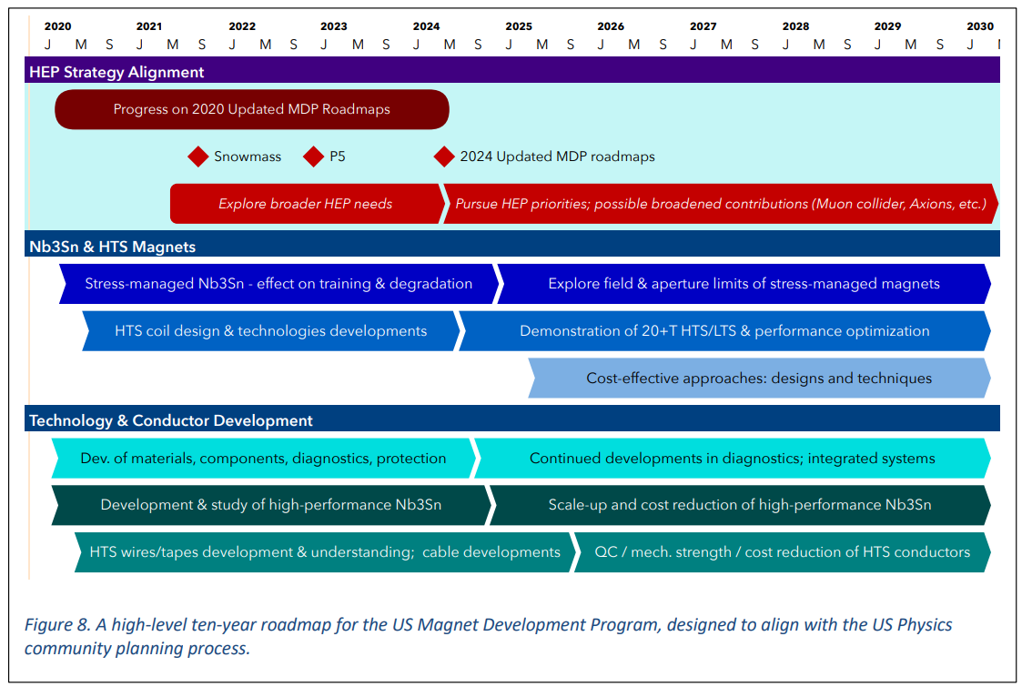
US Magnet development program roadmap
Road-map updated in 2020
and to be updated again in by the end 2024
https://arxiv.org/abs/2011.09539

Slide 6
Outline
Conceptual design of a 20 T hybrid HTS-LTS magnet
Comparative analysis of different design options for a 20 T hybrid
Cosϑ design and its stress-management options
Block-type coil design (block with flared ends)
Common-coil design (block with racetrack coils)
Review and follow-up of current work on hybrid magnets
Collect and organize information to provide inputs for 20 T hybrid design and feed-backs to hybrid program

Slide 7
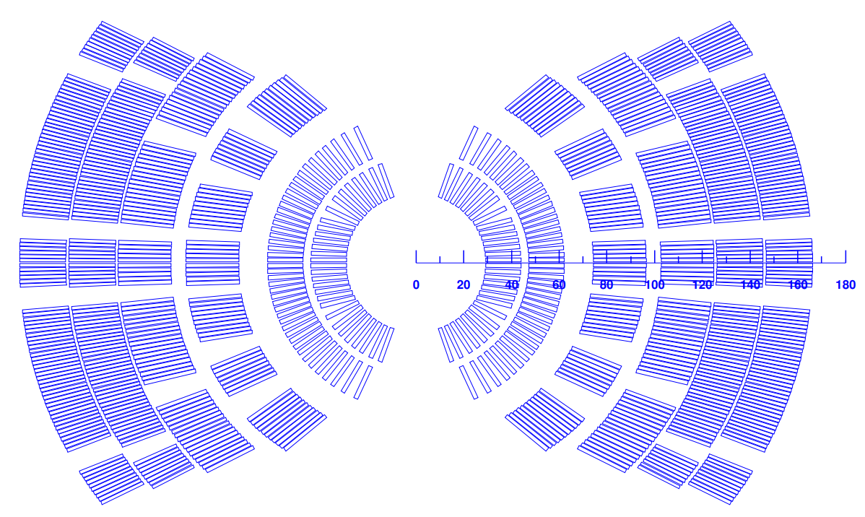
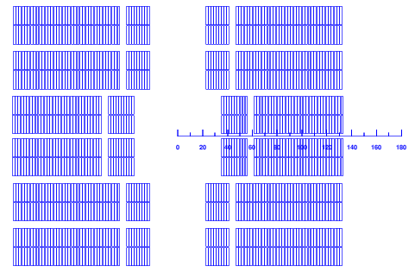
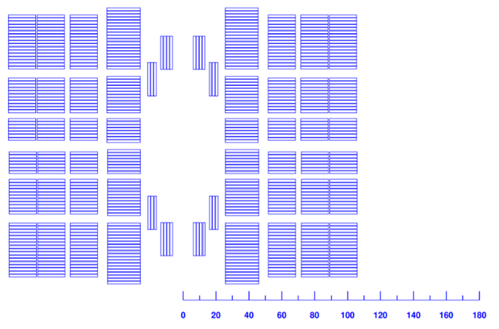
From ASC, Sept. 2024 Towards 20 T hybrid magnet: overview
HTS
LTS
HTS
LTS
LTS
HTS
Three options considered (Cos-Theta, Block, Common-coil), all with a Bi2212 insert
Iterative process: magnetic, mechanical, and QP analysis
More focus on Cos-theta: MDP inserts and outserts current design
…and on common coils
Only preliminary design with block
Quench protection of the 3 designs carried out
Quench protection ok for 1+ m long magnet, for the 10-15 m length new solutions to be considered
R. Gupta and D. Martins Araujo, et al., 4LOr2B-02
Emmanuele Ravaioli, , et al., 4LOr1B-06

Slide 8
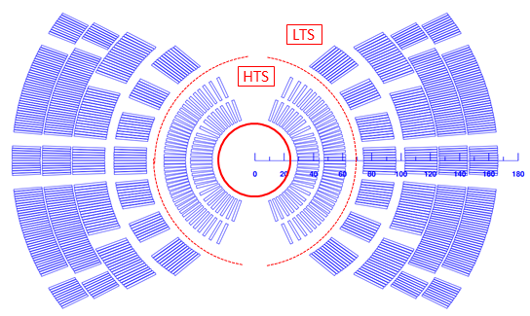
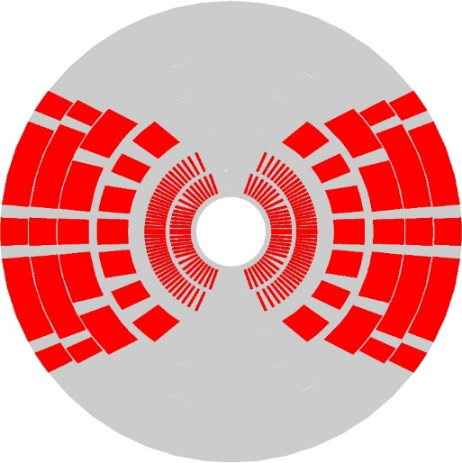
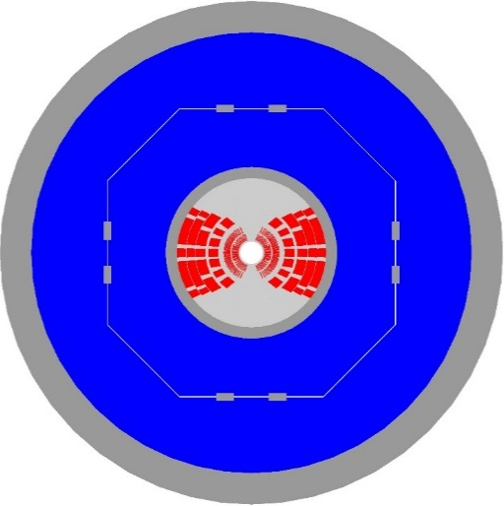
From ASC, Sept. 2024 Towards 20 T hybrid magnet:Cos-theta option
Magnetic:
2 layer HTS, 4 layer LTS, field quality and margin in spec, OR coil: 165 mm
Mechanics:
Stress management required in all directions
First 2 layers (HTS) with single cable in grove, second 2 layers (LTS) with single block in grove, last 2 layers traditional CT
Coil stress acceptable, but very high stress in the mandrel (Inconel or Nitronic?)
Large mechanical structure: 1120 mm.
Pre-load provided by bladder and key support structure to reduce peak field in conductor.
Marika DAddazio, , et al., 4LOr2B-03

Slide 9
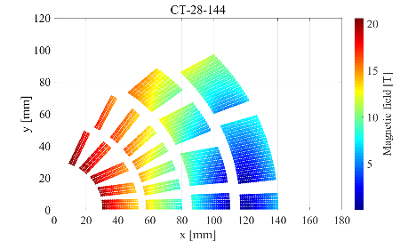
Next steps for 20 T hybrid design / comparison
Complete design of a Cos-theta 20 T Bi2212 hybrid design
Include in the design the ESC quench protection coil → extendable to 10-15 m
Investigate a 5-layers option
Design of a REBCO (CORC/STAR) 20 T hybrid design
Design and comparison of all HTS 20 T design with Bi2212 and REBCO (CORC/STAR), in collaboration with area IV

Slide 10
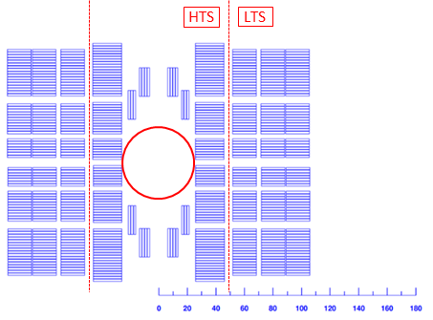
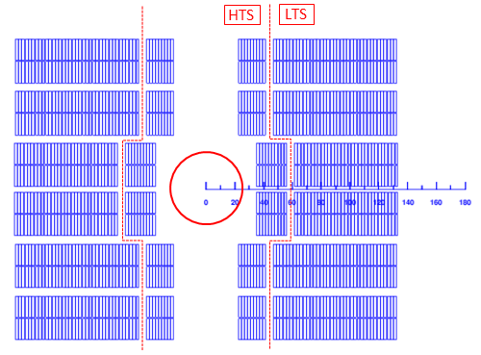
Next steps for 20 T hybrid design / comparison
Lower (…or much lower) priority
Common-coil design option
Still some high stress in the baseline design
Explore asymmetric option
Block design option
Study of possible use of TFD with HTS inserts?

Slide 11
Outline
Conceptual design of a 20 T hybrid HTS-LTS magnet
Comparative analysis of different design options for a 20 T hybrid
Cosϑ design and its stress-management options
Block-type coil design (block with flared ends)
Common-coil design (block with racetrack coils)
Review and follow-up of current work on hybrid magnets
Collect and organize information to provide inputs for 20 T hybrid design and feed-backs to hybrid program

Slide 12
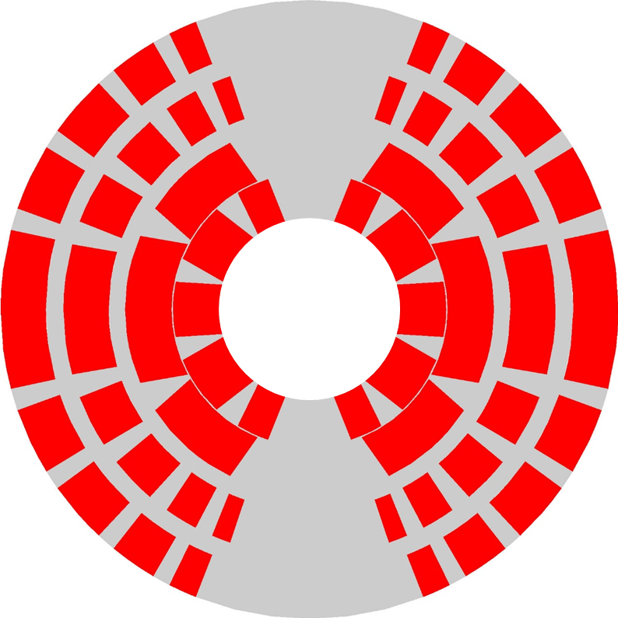
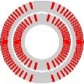
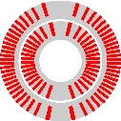
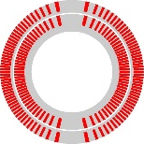
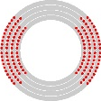
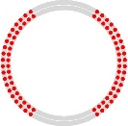
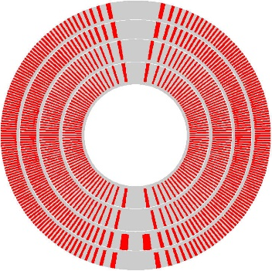
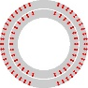
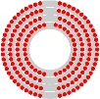
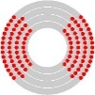
From ASC, Sept. 2024 Summary of inserts and outserts
BiSMCT
Bin5
BiCCT1
BiCCT2
SMCT+ MDPCT1
CCT5
COMB-STAR1
COMB-STAR2
COMB-CORC-1
SMCT
S1
C4 (cct, e-cct, uni-layer)
CCT6

Slide 13
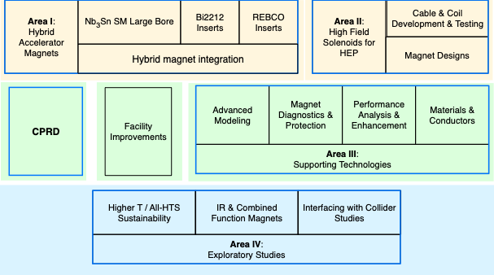
Possible plans for the 20 T design working group
Transition towards an “hybrid magnets working group”
What used to be the second goal of the “20 T hybrid working group”

Slide 14
Possible plans for the hybrid magnets working group
Challenges to be addressed
Engineering design
Integrated design of inserts and outserts coils for optimal operation in hybrid configuration
Compatibility of dimensions, in particular radii and lengths, of LTS and HTS coils
Location and extension of high field region and of the leads, design of the splices
Mechanical analysis
Mechanical support and assembly process of insert coils inside outsert aperture
Design of the radial and azimuthal support components to prevent motion and excessive strain both in the insert and in the outsert under the action of the Lorentz forces
Define tooling and procedures to guarantee mechanical contact between insert and outser coils, at the same time ensuring reliable assembly and disassembly operations.
Test
Define test set-ups, powering configurations and protection schemes for hybrid magnets during powering tests
Conceptual design and analysis
Evaluate maximum achievable fields, given the current HTS and LTS conductor properties and coil technology
Conceptual design of a 20 T hybrid magnet
Comparative analysis of CCT and SMCT and UL designs

Slide 15
Possible milestones

