Slide 1
The 16th US MDP 2212 WG meeting, Nov 2024
US MDP 2212 WG meeting, Nov 2024
2024/11/26
Meeting series: https://conferences.lbl.gov/category/100/

Slide 2
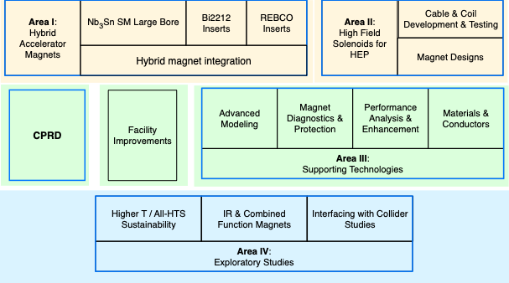
US MDP plan update – need your critical inputs
From US MDP Vision, Goals, and Structure-version 1.docx

Slide 3
US MDP plan update – need your critical inputs
Develop the following:
a) identify a few (say ~3-6) near term challenges and/or driving questions that further guide and focus your area’s plans. Our new roadmaps should be looking out about 10 years, but the near term challenges should identify research that you think can be at least partially addressed in the next 4-5 years.
b) draft Area thrusts and associated milestones; here we want to be both aggressive yet also “realistic” in terms of the investment required. Of course the stronger the impact you feel a development can/will have, the more aggressive you can be in the proposes development plan. In all cases, plans should envision reasonable development steps that are quantitative, so they can act as gates to justify further investments. Again, we want more detail and specifics on the 4-5 year timeline, but identifying a few major milestones on the 10 year scale are also helpful.
c) you are welcome to suggest edits to the synopsis in order to improve the framing of the area/sub-area. Identifying relevant references would also be helpful, as this document will become the foundation for the final new Roadmap document, and for that we will want some critical references that help frame the program.

Slide 4
US MDP plan update – need your critical inputs
Sub-area I.b: Bi2212 insert dipoles
The DOE-OHEP has invested significantly in Bi2212, an isotropic, round-wire conductor with built-in current sharing, over the last decade. Bi2212 performance continues to evolve based on deeper understanding of the conductors, which has encouraged and enabled new powder suppliers and wire manufacturers to appear. The accelerator dipole technology has advanced, with multiple magnets demonstrating overcoming of key challenges, e.g. insulation, overall Jc, over-pressure reaction, etc. that encourage advance to the next stages. MDP is poised to perform the first hybrid test using a Bi2212 insert in a 90mm bore Nb₃Sn magnet, and coils have been fabricated in preparation for testing in the flagship 12-14T, 120mm bore dipoles currently under development. The program will now focus on the development and testing of Bi2212 dipoles in high-field, where challenges of quench protection and strain management will need to be addressed.
Near term challenges:
Resolve the leakage issue that plagues Bi2212 Rutherford cables
Commissioning of the large furnace
Arresting the recent degradation of Jc from BOST wire using EnGimat powder
…

Slide 5
A draft: https://docs.google.com/document/d/1E1XpcVGKRfbqQHO6hv5jr7Tt83Xs74JyvrOzus2ImOI/edit?tab=t.0#heading=h.gnax877thgv0
Timeline: December 10th, 2024 for a decent version to be sent to MDP management.

Slide 6
Near term challenges
Understand the industrial process and wire performance relationships to push the industrial wire plateau J_{E}(4.2 K and 5 T) to be consistently greater than 1100 A/mm². Currently, there are many billets with J_{E}(4.2 K and 5 T) to be in the range of 800 – 1000 A/mm².
Understand causes of leakage in the Bi-2212 Rutherford cable based coils, factors that control it, and develop methods to remove it. This includes the external leakage that is visible after a chemical reaction with insulation materials and internal leakage that has Bi-2212 leak into the interface between Ag-0.2wt.Mg% sheaths and is not visible but nonetheless is harmful to wire performance.
Work with industry to address the recent wire degradation issues that arise from wire twisting.
Understand the science and technology of Bi-2212 Rutherford cables and optimize their fabrication.
Commission the overpressure processing facility RENEGADE furnace to react solenoids relevant for NMR and industry and the 85 cm long canted cosine theta Bi-CCT1 and Bi-CCT2 coils to be tested as insert coils in the 120 mm bore, 12 T CCT6 Nb₃Sn dipole magnet.
Fabricate and test the 85 cm long canted cosine theta Bi-CCT1 and Bi-CCT2 coils. Examine their performance in the standalone situation.
Explore fabrication of canted-cosine-theta Bi-2212 coils with 3D printed Inconel mandrels to prepare their use in a high stress environment such as a 20 Tesla dipole magnet. Measure materials properties of the Aluminum Bronze 954 (now being used to build canted cosine theta Bi-2212 cols) and Inconel 718, after Bi-2212 heat treatments at low temperatures. It is known that materials would have their yielding stress reduced due to high temperature annealing.
Integrate Bi-CCT1 and Bi-CCT2 coils as insert coils in the 120 mm bore, 12 T CCT6 Nb₃Sn dipole magnet.
Build prototypes of stress-management cosine-theta Bi-2212 coils to establish fabrication know-hows and benchmarked performance.

Slide 7
Longer term challenges
Understand the industrial process and wire performance relationships to push the industrial wire J_{E}(4.2 K and 5 T) to be consistently greater than 1400 A/mm². Key to this will be the drive to understand the underlined materials science that underpins the critical current density of the round multifilamentary round wires. This research is being led by NHMFL with support from the US DOE OHEP through GARD university grant.
Retire magnet challenges from coil fabrication to protection to enable a healthy market for Bi-2212 conductors.

Slide 8
Possible milestones coupled with hybrid magnet program
Paolo Ferracin, US-MDP General Meeting, 11/20/2024

