Slide 1
Laboratory Safety Improvement Plan (LSIP) Effectiveness Review Briefing

Slide 2
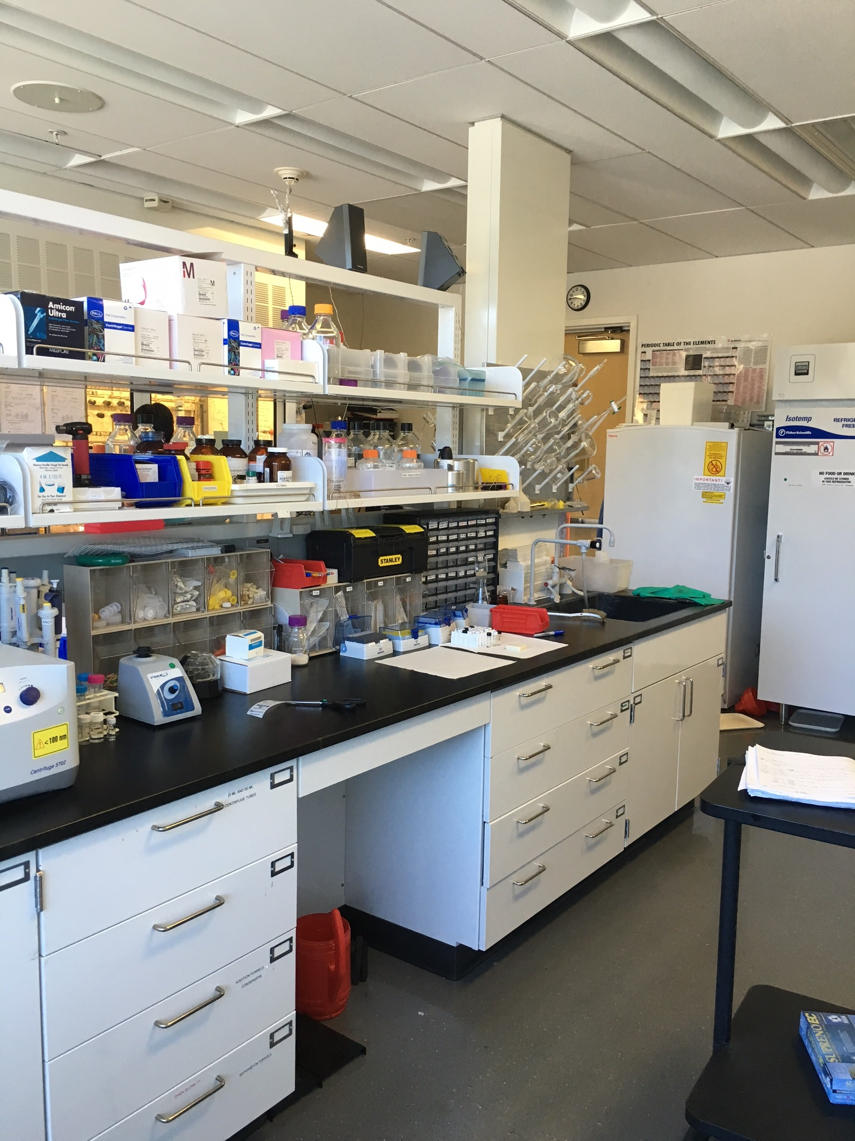
Quick Background: Inspections & LSIP
Three NFPA 45 inspections were conducted by the DOE
11/15, 5/16 and 10/16
LSIP was initiated based on CAs from the 11/15 inspection
Starting in 3/16
LSIP Team met weekly or biweekly
3/16 through 11/18
A Laboratory Safety Advisory Board oversaw process

Slide 3
Some comments before we get going…
This will be a formal effectiveness review.
It will not be an inspection.
We requested it. It is not being imposed.
It will help determine whether LBNL’s corrective actions are effective, sustainable and robust in addressing the findings of the NFPA 45 inspections.
It will assist BASO in determining the overall performance of LBNL’s chemical safety program.

Slide 4
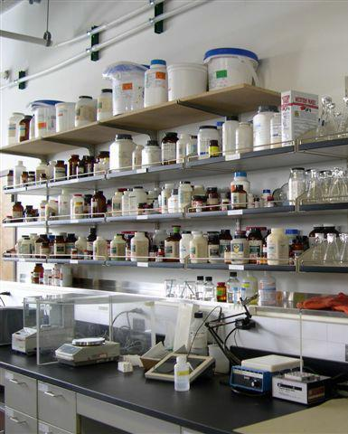
When will the effectiveness review
be conducted?
April 29th through May 3rd
No NSD space is planned to be reviewed

Slide 5
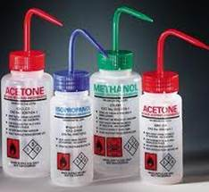
Who will perform the ER?
The review team will be comprised of reviewers from DOE - Bay Area Site Office, DOE - Integrated Service Center, and LBNL.

Slide 6
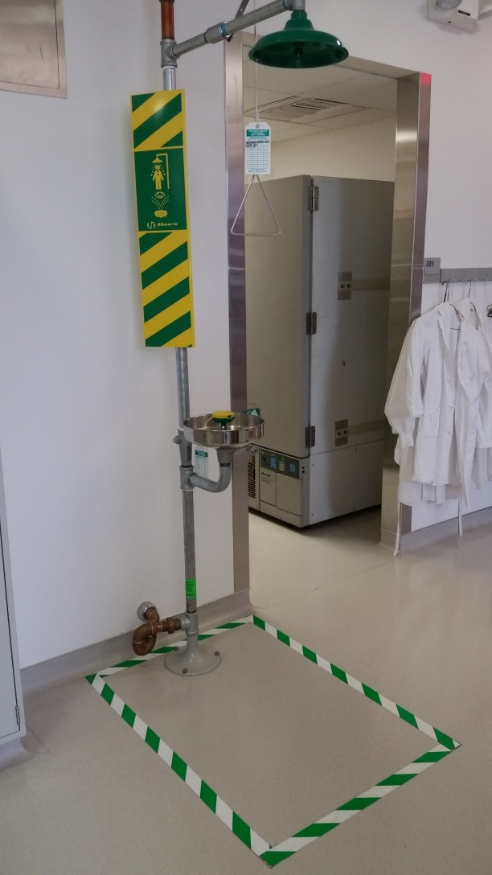
How will the effectiveness review
be implemented?
Per a formal inspection plan and line of inquiry.
Three days of walkthroughs, interviews and doc reviews.
Customary in-brief and out-brief.
Evaluation: effective / partially effective / ineffective .
Interviews:
Laboratory and Chemical Safety Subcommittee members.
PIs, Activity Leads and workers.
EHS staff (LSIP Team members).

Slide 7
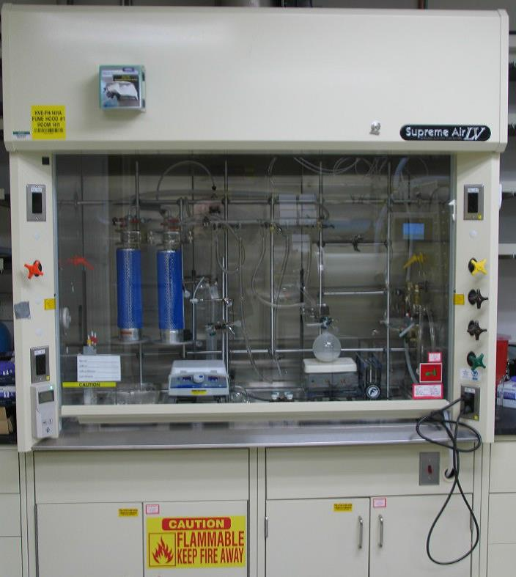
Top Focus Areas
Common chemical segregation issues (e.g., purely alphabetical storage).
Proper storage of flammable/combustible liquids not in use or staged for use, properly self-closing flammable cabinets, and secondary containment for squeeze bottles on bench tops.
Time-sensitive chemical and peroxide forming chemical use
Secondary container labeling (name and hazards, at a minimum).

Slide 8
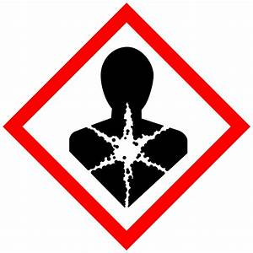
Your Top 10 Focus Areas (6-10)
X
Familiarity with GHS and that signage is not outdated (e.g., references to MSDS vs SDS).
Ensure that open flame operations/Bunsen burners have appropriate permits, are covered by WPC activities/hazards & controls, and clear space for operation.
Unattended heating operations involving materials that pose a fire or explosion hazard and ensure appropriate over-temperature control.
Other known challenge areas: such as housekeeping and clutter, seismic restraint, cylinder chains, refrigerator labeling, etc.

Slide 9
UNIVERSITY OF
CALIFORNIA

