Slide 1
Advanced Machine Learning and Intelligent Control Systems for Optimizing Laser Plasma Accelerators at the BELLA Center
Chetanya Jain
Controls Software Engineer
Lawrence Berkeley National Laboratory
LPA Special Workshop on Intelligent Systems
January, 2025

Slide 2
Contributors
On behalf of
Alex Picksley
Alessio Amadio
Anthony Gonsalves
Christopher Doss
Curtis Berger
Dan Wang
Finn Kohrell
Hai-En Tsai
Kei Nakamura
Kyle Jensen
Mahek Logantha
Neel Rajeshbhai Vora
Qiang Du
Qing Ji
Raymond Li
Russel Wilcox
Samuel Barber
Tong Zhou
Zak Eisentraut
Guillaume Plateau
Stephen Coleman
Nathan Cook
Jonathan Edelen
Jens Osterhoff
Carl Schroeder
Jeroen van Tilborg
Eric Esarey
Cameron Geddes
This work was supported by the Director, Office of Science, Office of High Energy Physics, of the U.S. Department of Energy under Contract No. DE-AC02- 05CH11231, the Defense Advanced Research Projects Agency, and used the computational facilities at the National Energy Research Scientific Computing Center (NERSC).

Slide 3
Overview
Overview of the BELLA Center
Bayesian Optimization for LPA experiments
GEECS Control system and Xopt
Example optimizations
Laser stabilization
PID Loop Laser transverse and longitudinal Stabilization for FEL
ML-based Transverse Laser Stabilization at BELLA PW
ML enabled Coherent Recombination in Fiber Laser

Slide 4
Overview
Overview of the BELLA Center
Bayesian Optimization for LPA experiments
GEECS Control system and Xopt
Example optimizations
Laser stabilization
PID Loop Laser transverse and longitudinal Stabilization for FEL
ML-based Transverse Laser Stabilization at BELLA PW
ML enabled Coherent Recombination in Fiber Laser

Slide 5
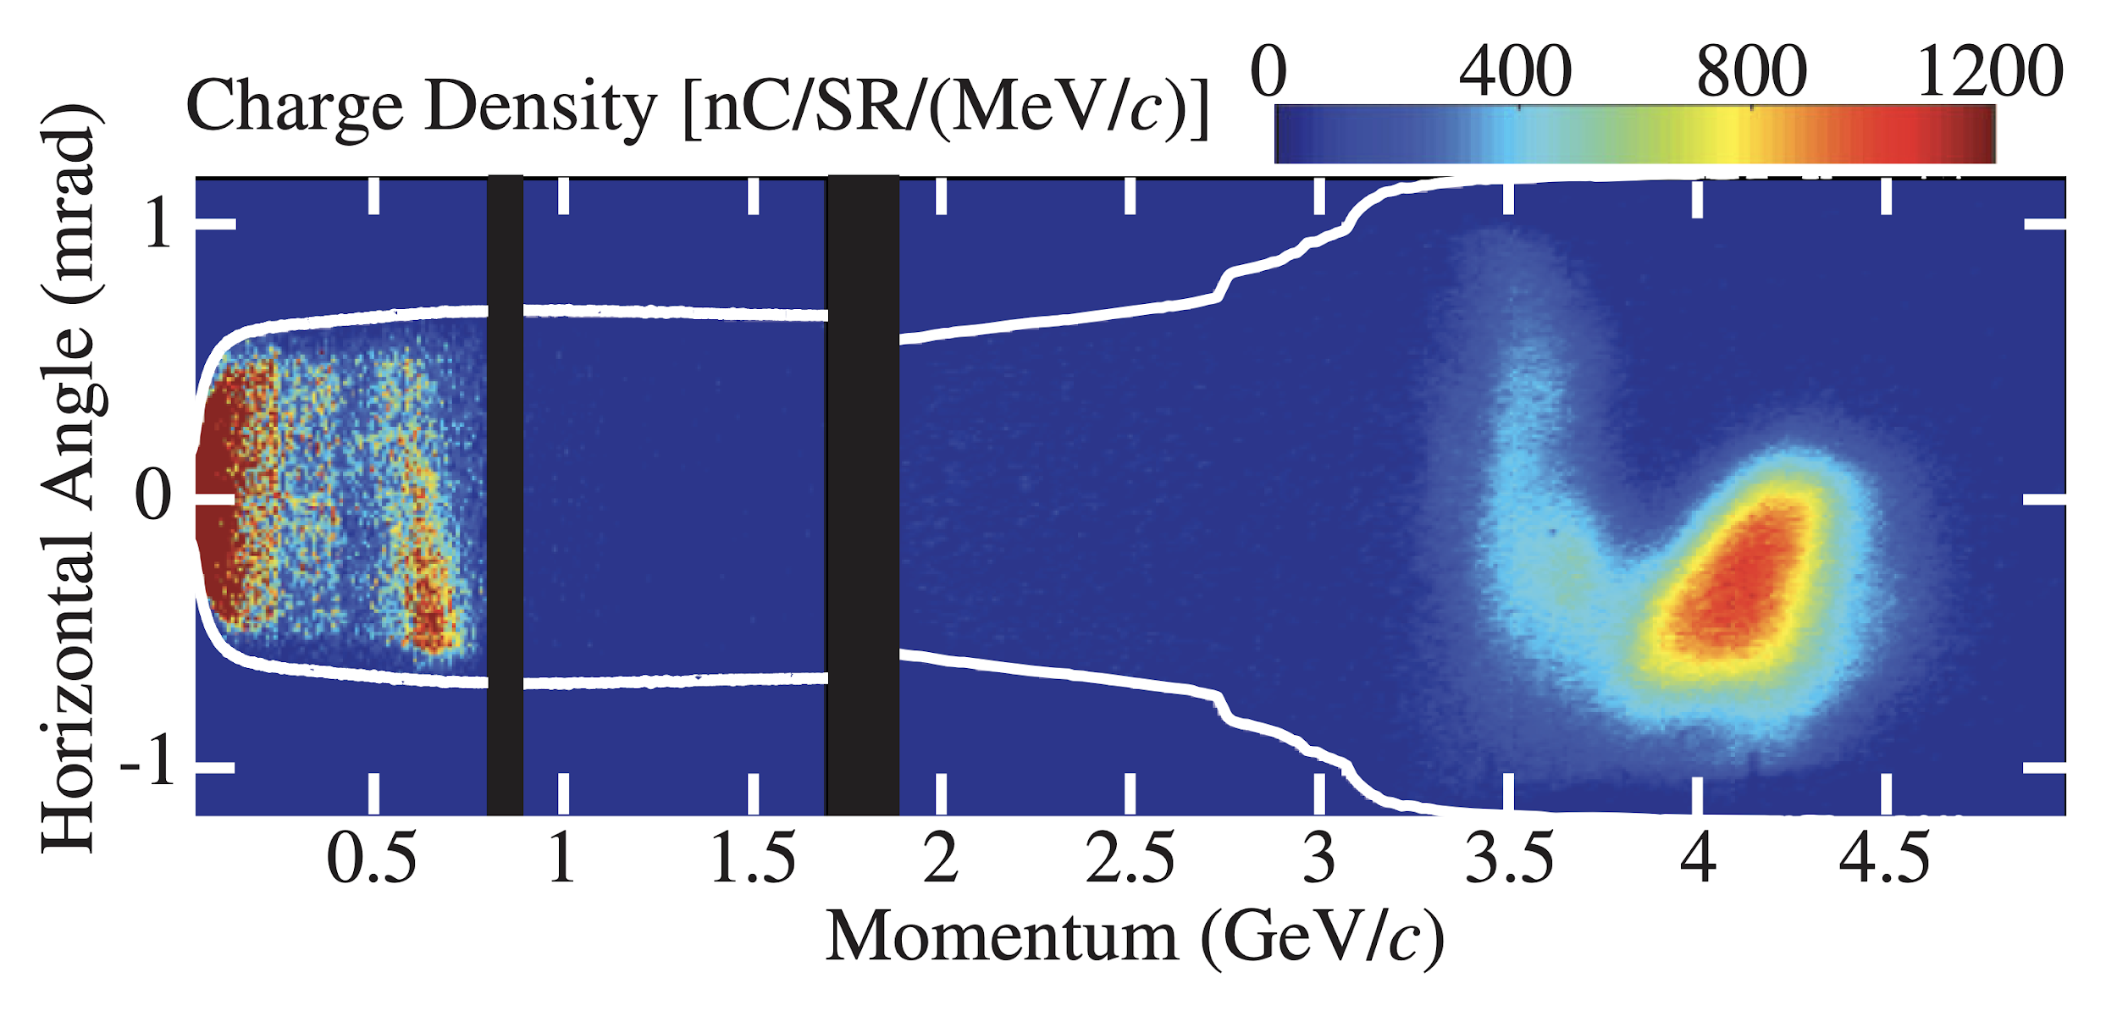
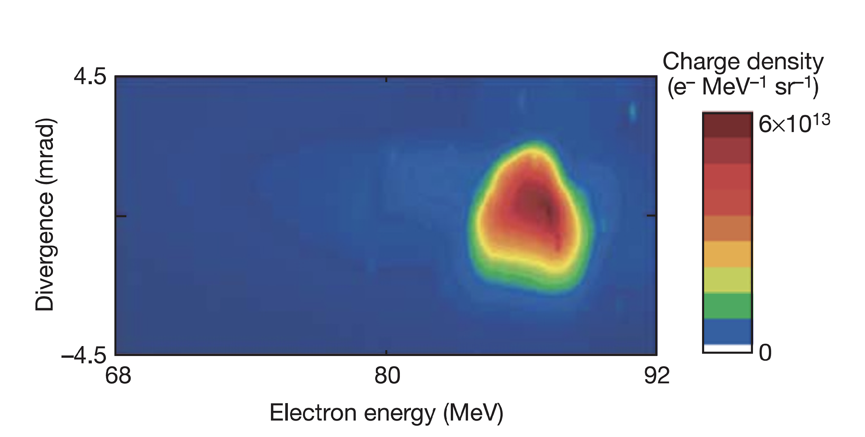
BELLA Center Mission is to Develop Laser Plasma Accelerators
and Related Technologies
2024:
10 GeV
2019:
8 GeV
Dec, 2024
2014:
4 GeV
2006:
1 GeV
2004:
86 MeV
https://doi.org/10.1103/PhysRevLett.133.255001
Notes:
The BELLA center has always been at the forefront of high-power lasers and laser plasma accelerator performance. Over the past two decades, we have pushed the technology from the tens of MeV range (the so-called “Dream Beam” work published in Nature in 2004), through to the first GeV beams demonstrated in 2006 using a 40 TW laser system. And our most recent work that was just published in PRL demonstrated controlled injection and acceleration to the 10 GeV level using the BELLA Petawatt laser system.

Slide 6
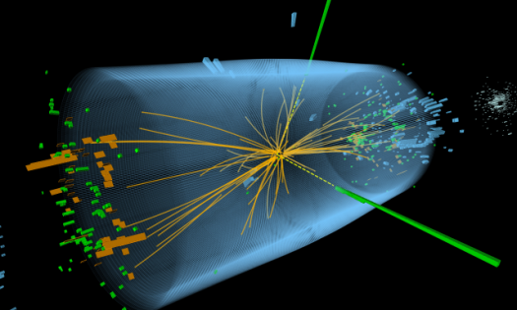
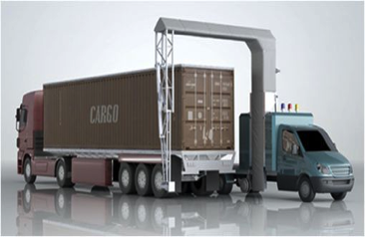
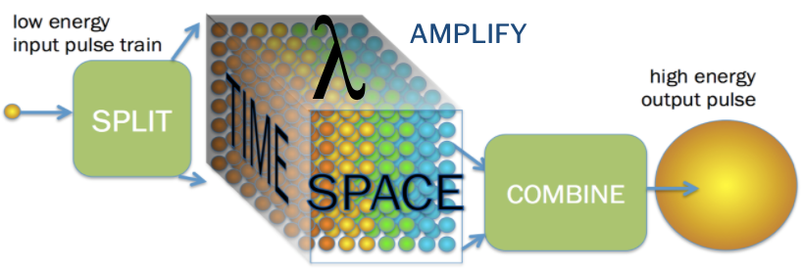
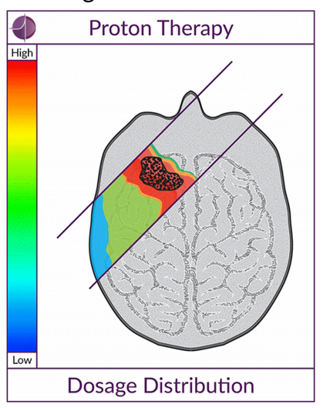
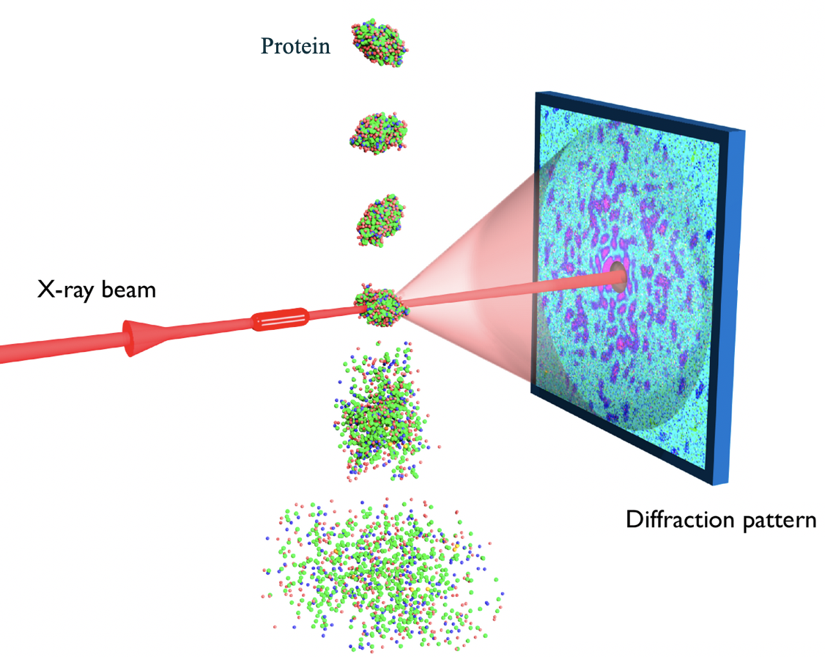
BELLA Center houses multiple LPA facilities, each requiring a flexible & distributed control system
BELLA-PW
40 Joule in 30fs (1 PW)
Multi GeV acceleration, Staging
BELLA-HTT
3 Joule in 30fs (100 TW)
Mono-chromatic gamma rays
BELLA-Fiber
BELLA-iP2 at BELLA-PW
40 Joule in 30fs (1 PW)
Proton & ion acceleration
BELLA-HTU
3 Joule in 30fs (100 TW)
FEL
BELLA-kHz
Few mJ in 5fs (TW)
MeV acceleration
Examples of what needs to be controlled
Laser (alignment, energy…)
Targets (position, density…)
Diagnostics (plasma, electron beam…)
Example scale of controls: BELLA-PW
~90 computers
~300 devices
~60 cameras
>1000 process variables
≦1Tb/day data saved (1Hz)
Notes:
HTT > Has 2 beamlines, Open to users by LasernET and BeamNET US
Fiber > 200mJ, multi KW Demostrator for future high rep rate
HTU > E beam Line and Udulators for FEL
Bella iP2 > Primarily for proton and High Energy Density Science

Slide 7
Overview
Overview of the BELLA Center
Bayesian Optimization for LPA experiments
GEECS Control system and Xopt
Example optimizations
Laser stabilization
PID Loop Laser transverse and longitudinal Stabilization for FEL
ML-based Transverse Laser Stabilization at BELLA PW
ML enabled Coherent Recombination in Fiber Laser

Slide 8
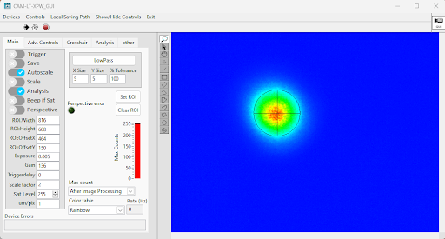
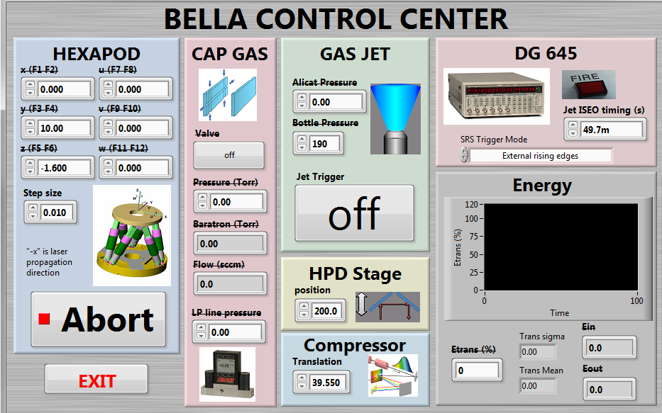
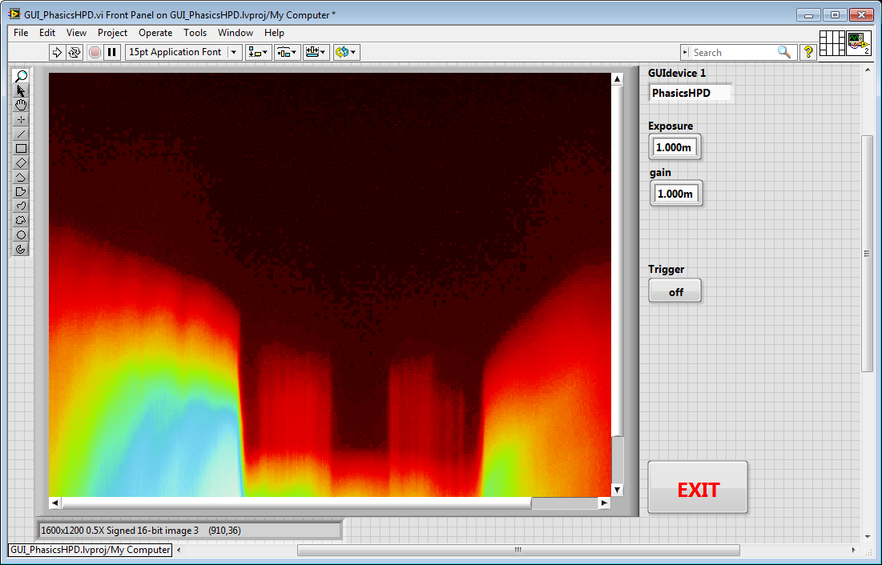
Generalized Equipment and Experiment Control System (GEECS)
Giving Science Time back to Scientists
Developed in Bella Center, A. Gonsalves et.al.
Example: Zero Programming GUI Creation
KEY
USER REQUIREMENTS
KEY PROGRAMMER REQUIREMENTS
Distributed & Real-time
Control, Analysis and Visualization
Easy-to-Use
Efficient Code Reuse via Object Oriented Programming
Parameter Logging
Fast Configuration Startup
User’s “code”
GUI
Code Abstraction
Ease of Use with No Programming Requirement
Open Source
Interface with Common Programming Languages
Single Click Startup and shutdown
Based on Standard Principles
Control & viewing without “programming” in minutes
Multi Facility Support
Installation Guide | https://github.com/GEECS-BELLA/
Notes:
Specific GUIs
E.g. a GUI that communicates with multiple devices (system maps etc)
Written by users
Almost no programming knowledge required
Can be written in a few minutes
Heavy abstraction
No code for device communications
No direct hardware interface
Device code can change multiple times without affecting guis
Front panel example

Slide 9
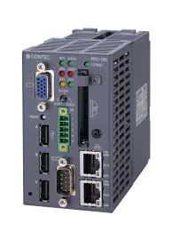
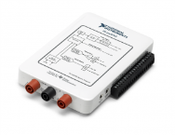
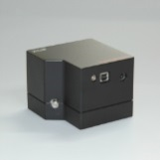
GEECS framework is modular, flexible, & uses hardware abstraction to minimize coding effort
GUIs
Configuration Data Storage
Measurement Data Storage (scans with synchronization)
Measurement Data Storage (continuous logging)
PLOTTERS
LOGGERS
DB
File Server
Analysis Server
DB
Master Control
Code reuse in GUIs:
All GUIs have same communication layer
I. Coms
I. Coms
DB editor
I. Coms
Measurement Data
Configuration Data
Control Commands
Computer A
Computer B
Computer C
Computer D
Code reuse in device drivers (e.g. camera):
Base device class
Camera class
Thorlabs Camera class
Basler Camera class
Single executable for all devices (Base device class), plugin architecture calls device specific code
Common exe
Publisher
Common exe
Common exe
Common exe
Common exe
Publisher
Publisher
D. Coms
D. Coms
Common exe
Common exe
D. Coms
Publisher
Device Specific
Device Specific
Device Specific
Device Specific
Device Specific
Device Specific
Device Specific
Analysis

Slide 10
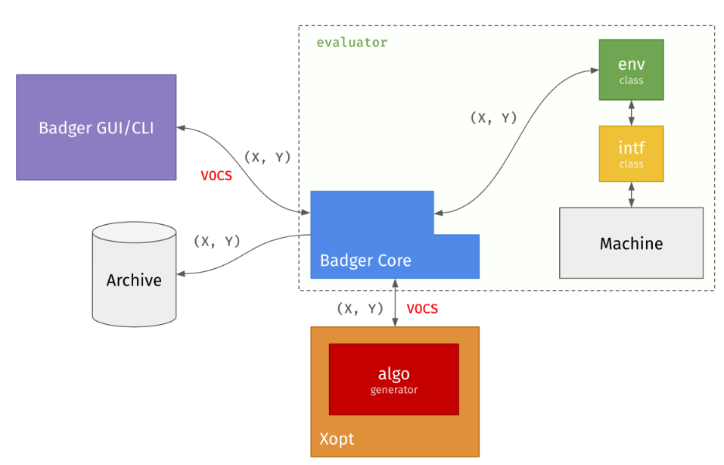
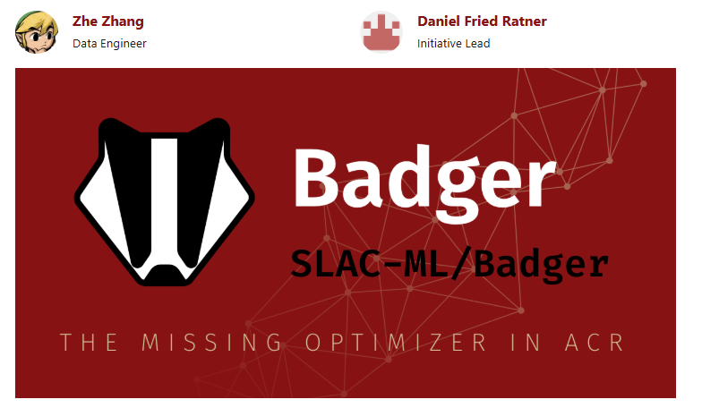
Unlocking Optimization Potential with Xopt
Created by our friends at SLAC
Developed for Accelerator Control Rooms (ACR):
Created to optimize machine operations in ACRs.
Supports GUI, CLI, and API modes to streamline user interaction with optimization processes.
Powered by Xopt Optimization Library:
Features a plugin system for quick integration of optimization problems, efficient task reruns, and comprehensive data handling.
User-Friendly and Extensible:
Offers state recovery and constraint support.
Includes advanced data analysis/visualization extensions
Zhang, Z., et al. "Badger: The missing optimizer in ACR", in Proc. IPAC'22, Bangkok. doi:10.18429/JACoW-IPAC2022-TUPOST058
R. Roussel., et al., "Xopt: A simplified framework for optimization of accelerator problems using advanced algorithms",
in Proc. IPAC'23, Venezia.doi:https://doi.org/10.18429/JACoW-14th International Particle Accelerator Conference-THPL164
https://xopt-org.github.io/Badger/docs/intro

Slide 11
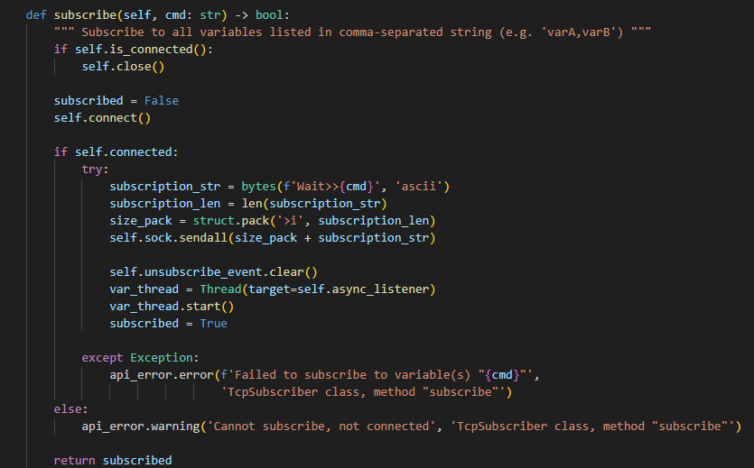
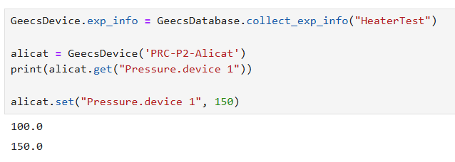
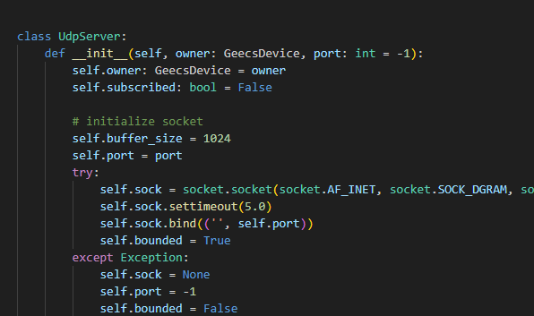
Python GEECS API enables use of community codes like Xopt
GEECS-Python-API allows for easy acquisition and control in Python
TCP Subscriber
UDP Listener
Easy to setup get/set commands
LabView Device Drivers configure the device
….. other backend code
Users have been using it for
Faster experiment setup with optimization
Integrating machine learning
Guillaume Plateau (Tau Systems)
Notes:
LV has not kept up with ML, it has python calls but it is insufficient. Python opens up possibilities

Slide 12
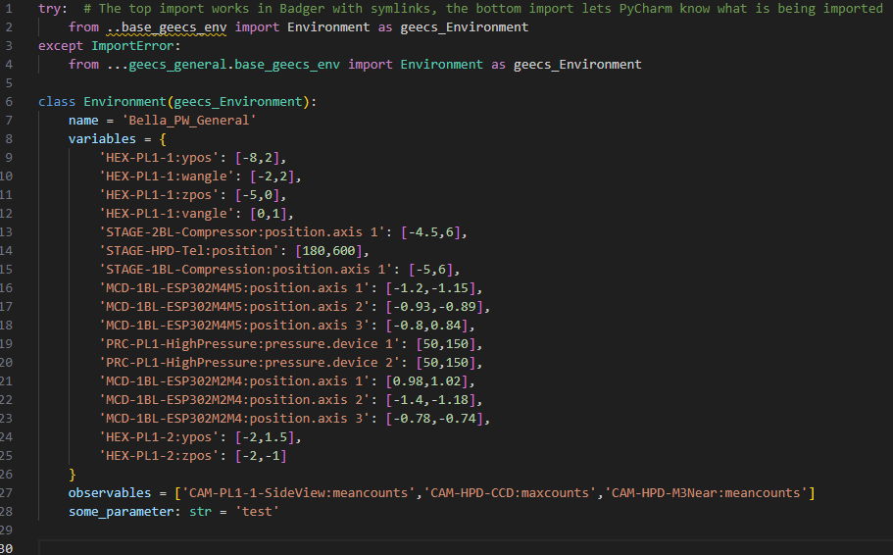
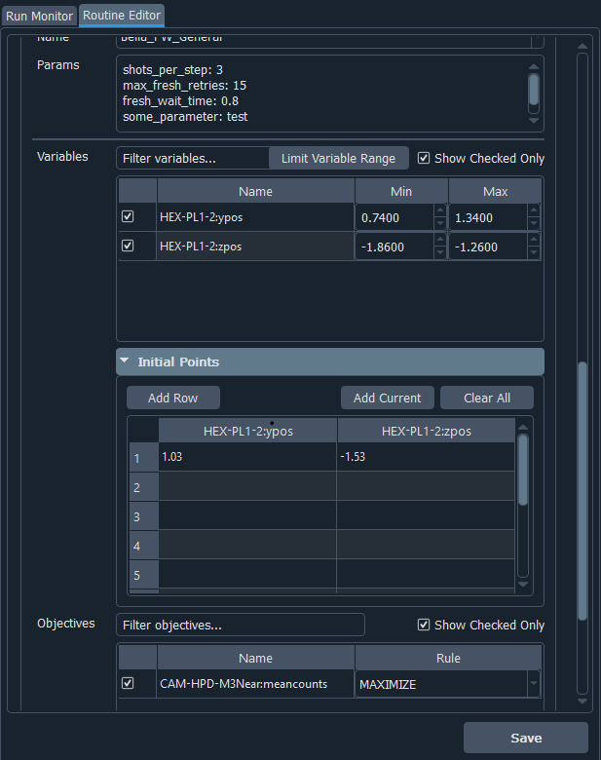
X-Opt GEECS Integration allows for fast optimization setups without any programming requirement
Using GEECS python api as the environment
Adding the variables you want to change
Add observable variables or custom functions
One configuration for easy setup.
Users can add variables and observables without any need for programming.
Abstraction from all Xopt and GEECS backend.
Ability to write custom functions.
Seamless GUI integration with Badger to create routines.
Zhang, Z., et al. 2022, Barber S. et. al

Slide 13
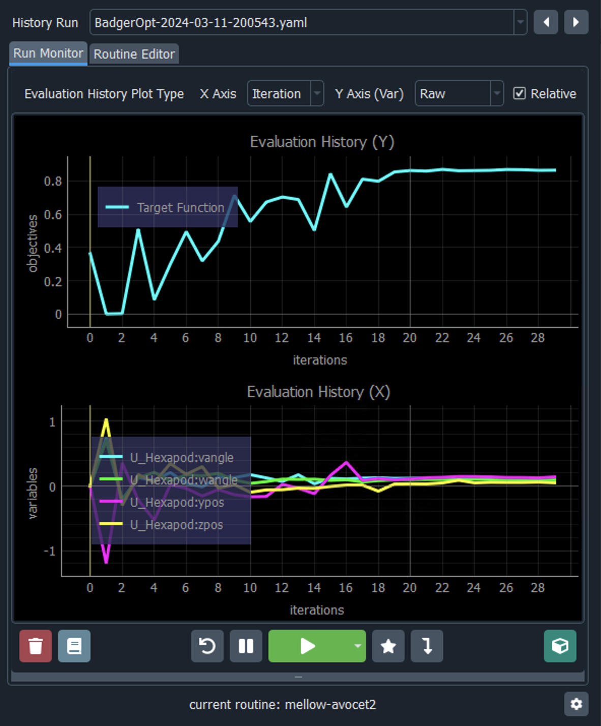
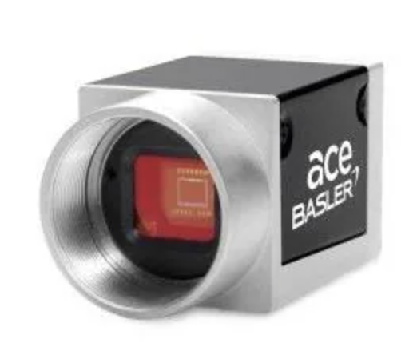
Xopt Badger Reduces PMQ Alignment Time from 3 hours to 5 minutes
Camera
Hexapod w 6 degrees of freedom
Target Function - Mean Counts on Camera
Successfully used Badger to optimize PMQ triplet alignment instead of manual 4D scan.
Maximized diode laser transmission through dual-pinhole system.
Future use is the alignment of 12 downstream magnets for steering and focussing.
4 Independent Variables on Hexapod
Other Examples Include-
Alignment of plasma channel with drive laser across 2D space in BELLA PW system.
Target and focal position alignment in BELLA
Barber S. et. al
Notes:
What it is:
PMQ = Permanent Magnet Quadrupole (magnetic lenses for focusing particle beams) > If the alignment is not good then the e beam might be dispersed
Triplet = Three PMQs in sequence
Critical for focusing particle beams in accelerators
The Alignment Challenge:
PMQs must be precisely aligned to maintain beam quality
Multiple degrees of freedom (position, angle) must be optimized
Traditionally requires manual, time-consuming adjustment
Badger's Solution:
Used laser transmission through two pinholes as alignment metric
Hexapod stage provided precise 6D motion control
Bayesian optimization algorithm automatically found optimal alignment
Maximized transmission = best alignment

Slide 14
Overview
Overview of the BELLA Center
Bayesian Optimization for LPA experiments
GEECS Control system and Xopt
Example optimizations
Laser stabilization
PID Loop Laser transverse and longitudinal Stabilization for FEL
ML-based Transverse Laser Stabilization at BELLA PW
ML enabled Coherent Recombination in Fiber Laser

Slide 15
BELLA-HTU
3 Joule in 30fs (100 TW)
FEL
Notes:
HTT > Has 2 beamlines, Open to users by LasernET and BeamNET US
Fiber > 200mJ, multi KW Demostrator for future high rep rate
HTU > E beam Line and Udulators for FEL
Bella iP2 > Primarily for proton and High Energy Density Science

Slide 16
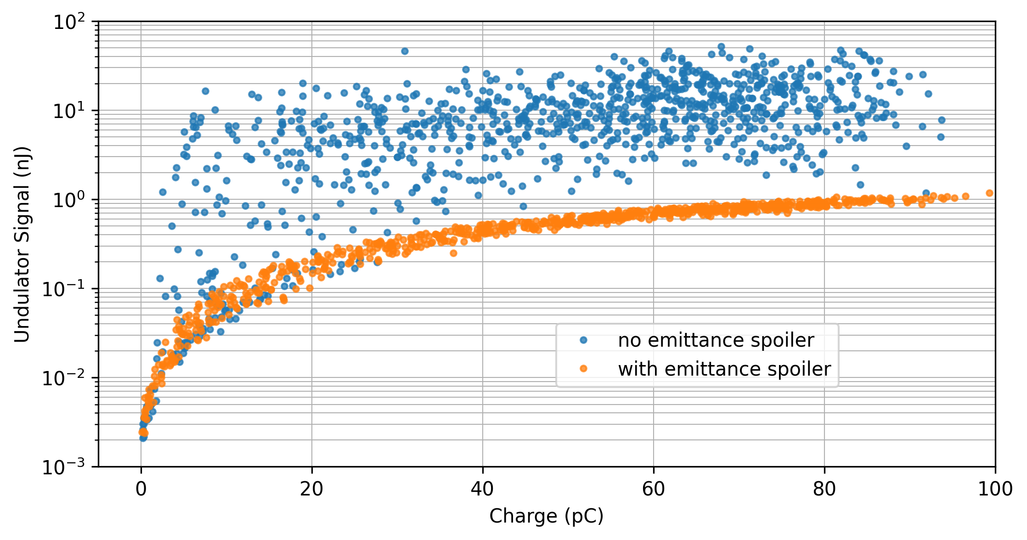
Strong coherent enhancement of undulator radiation (FEL gain) at BELLA HTU
Optical
spectrometer
0th order
1st order
e⁻
Laser
LPA
ICT
Undulator
ICT
triplets, chicane, steering, etc.
Retractable spoiler pellicle
Exit Pickoff Pellicle
0
100
200
300
400
500
wavelength (nm)
100 MeV electrons, transported through quadrupoles & chicane, to 4-meter strong-focusing undulator
Coherent gain over incoherent undulator radiation on >90% shots
Ratio FEL to incoherent: 200-300x (max), 50-100x (average)
Result enabled by feedback systems for stable e beams
S. Barber et al. in preparation

Slide 17
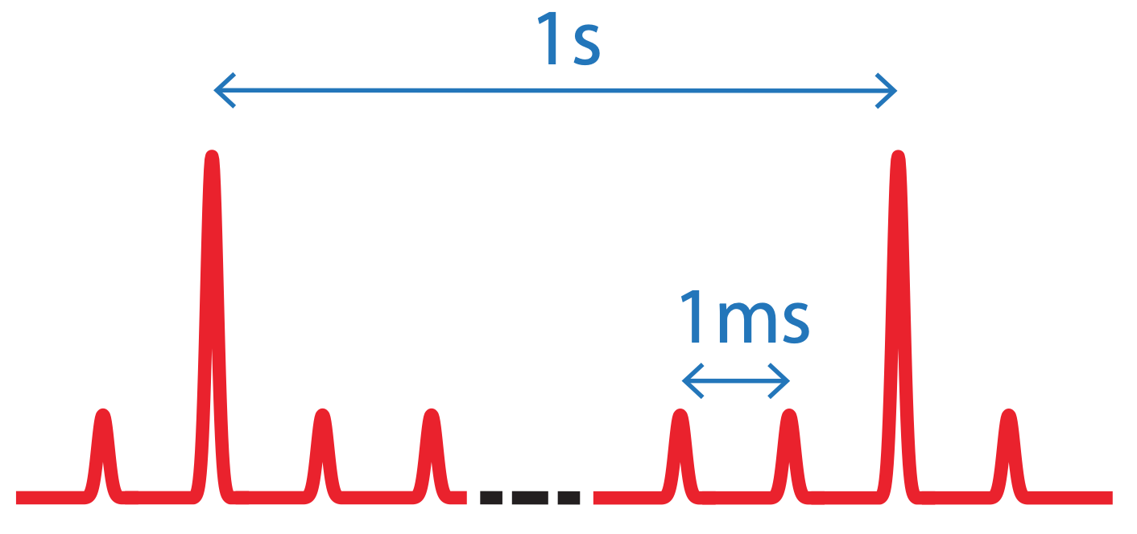
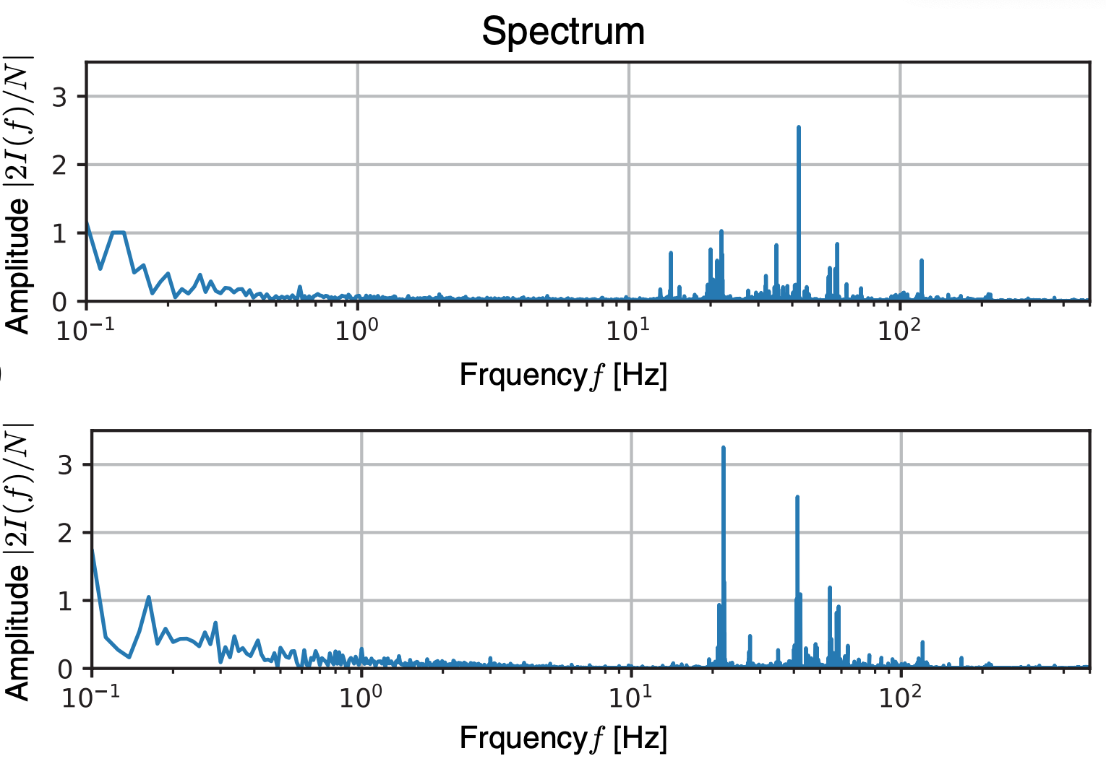
Developed non-perturbative high-power
laser focus monitoring system
Non-destructive diagnostic
Laser
Noise spectra of laser position at focus
cam1
LPA
Ghost
focus
High-power
focus
Horizontal
1Hz amplified
kHz unamplified
Parabola
Vertical
Concept:
Use wedged optic to create spatially-separated, low-power, correlated copy (ghost beam) of high-power main laser beam, to be monitored non-destructively
Witness beam
kHz pulse train provides sampling bandwidth to correct ~100 Hz sources
Key demonstration showed excellent correlation between high power beam and background kHz train*
Wedge
*F. Isono et al, High Power Laser Sci. Eng. 9, e25 (2021)

Slide 18
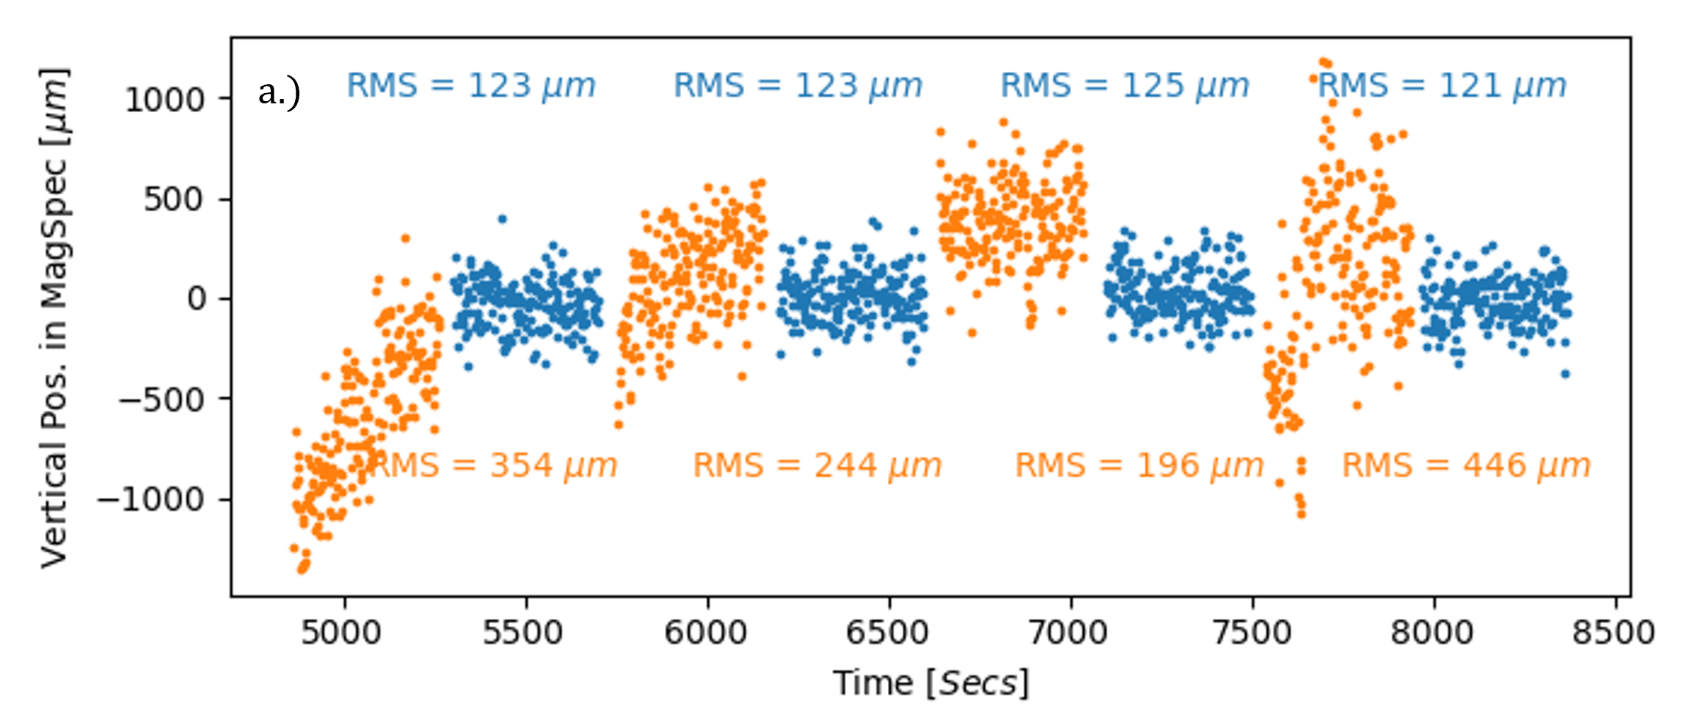
Up to 70% reduction in E Beam Position RMS with
Transverse Focus Stabilization
PID Control for Transverse Stabilization
• First corrective optic (upstream): Primarily controls angle at focus
• Second corrective optic (downstream): Primarily controls position at focus
E-beam position with transverse stabilization off and on
Laser stabilization system reduced variation in the electron beam source location from ∼ 12 to 3 μm and reduced the dispersion jitter of the electron beam by 20%.
Target Chamber
Transverse Beam Stabilization
Berger, C. et al. PRAB, (2023).

Slide 19
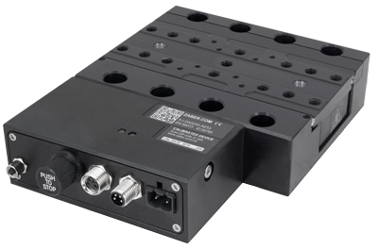
Longitudinal Focus Stabilization uses adjustable Telescope and Wavefront Sensor
Stabilization Workflow
Wavefront sensor measures wavefront of focused beam
Acquisition rate: ~30.3 Hz
Radius of curvature is fit from measured wavefront
Corrections to beam collimation are determined via calibrated PID loop
PID variables tuned using Ziegler-Nichols method and minimizing overshoot
Corrections are streamed to variable telescope stage
Stage constantly moving towards updated target position rather than queueing moves to be completed
Variable Telescope
Thorlabs WFS20-7AR
Correction
Wavefront measurement
Zaber Motion X-LDA-A
Software build in Python and supports use of FPGA-based co-accelerator on custom hardware platform (AMD Xilinx ZCU102)
Python wrappers provide direct interface to WFS driver
Instrument management and configuration is accessible
Streamlines aperture/acquisition parameterization through a single YAML file
Jensen K. et. al. Submitted.
Notes:
Closed-loop stabilization of the longitudinal focal position is established by deploying an actuated transmissive telescope responsible for focal position corrections, a WFS located on a ghost beamline with the same focus as the main beamline, and an optimized PID controller responsible for assigning corrective moves to the telescope configuration at a rate optimized for the motion stage on the telescope.

Slide 20
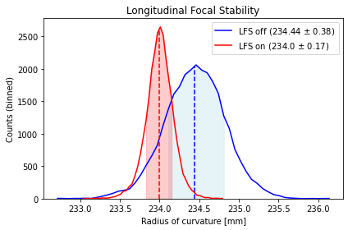
Reduced 1𝛔 (rms) focal deviation of amplified pulse by ~40%
 | Stabilization OFF | Stabilization ON
Total Charge (pC) | 19.4 ± 17.9 | 40.4 ± 20.4
Average Energy (MeV) | 120.3 ± 18.9 | 111.1 ± 9.1
Energy Spread (%, rms) | 5.3 ± 3.0 | 4.3 ± 1.9
Correlation (ROC, Charge) | 0.40 | 0.20
Empty Shots (<5 pC) | 145 (29%) | 32 (6%)
• 45% less shot-to-shot variation
• Energy spread reduced
• 80% Reduction in missed shots
Focal deviation rms of amplified pulse reduced from 0.46mm 0.28mm
Jensen K. et. al. Submitted.
Notes:
LFS data: 07/11/24 scans 16 (on) and 17 (off)

Slide 21
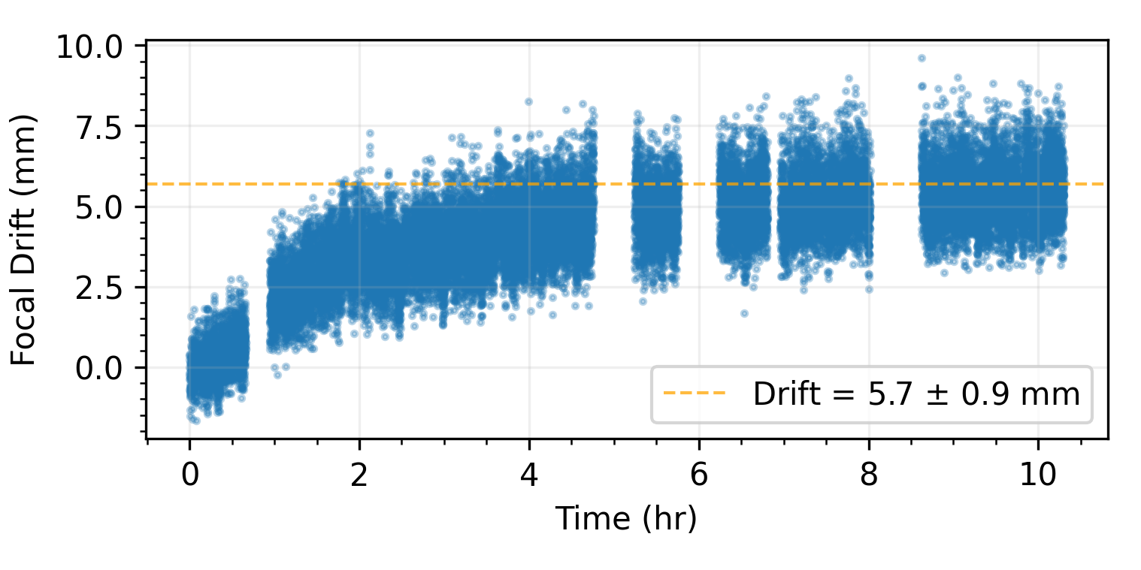
Stabilization efforts are critical to stable FEL operation
Decoupling Electron Beam Pointing from Laser Position and Angle helps meet tight tolerances.
FEEDBACK OFF
FEEDBACK ON
Eliminating Focal Drift Enables Longer and more Complex experiments
Less Shot to Shot Variation
in Electron Beam Energy and Charge
More Shots per Experiment
Berger, C. et al. PRAB, (2023); Jensen K. et. al. Submitted.
Notes:
Technically, you aren't truly decoupling the electron beam properties from the laser properties because the physics that established the relationship in the first place is still valid. What you are doing is reducing the shot-to-shot fluctuations in laser properties enough that the correlated trend (which still exists) in e beam properties becomes insignificant.
The independence between e-beam dispersion and drive-laser angle is crucial for LPAs because it:
1. Improves beam quality and stability
2. Allows more flexible operation and parameter tuning
3. Reduces emittance growth and energy spread
4. Makes the system more reliable for practical applications
5. Simplifies overall system design and control

Slide 22
Overview
Overview of the BELLA Center
Bayesian Optimization for LPA experiments
GEECS Control system and Xopt
Example optimizations
Laser stabilization
PID Loop Laser transverse and longitudinal Stabilization for FEL
ML-based Transverse Laser Stabilization at BELLA PW
ML enabled Coherent Recombination in Fiber Laser

Slide 23
BELLA-PW
40 Joule in 30fs (1 PW)
Multi GeV acceleration, Staging
Notes:
HTT > Has 2 beamlines, Open to users by LasernET and BeamNET US
Fiber > 200mJ, multi KW Demostrator for future high rep rate
HTU > E beam Line and Udulators for FEL
Bella iP2 > Primarily for proton and High Energy Density Science

Slide 24
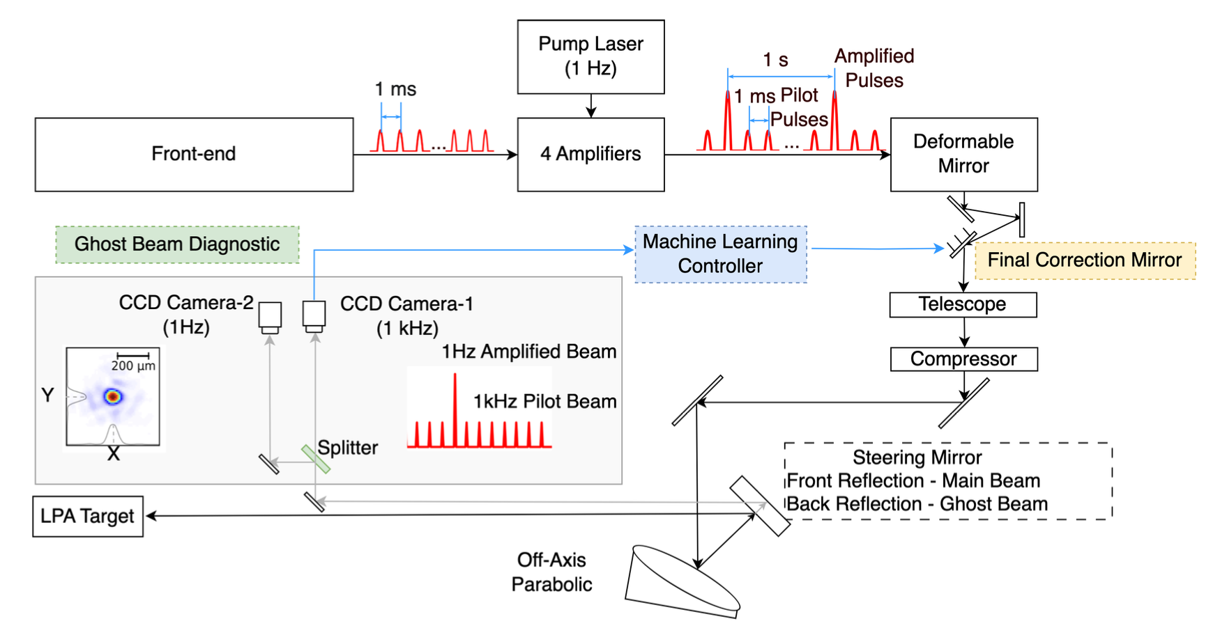
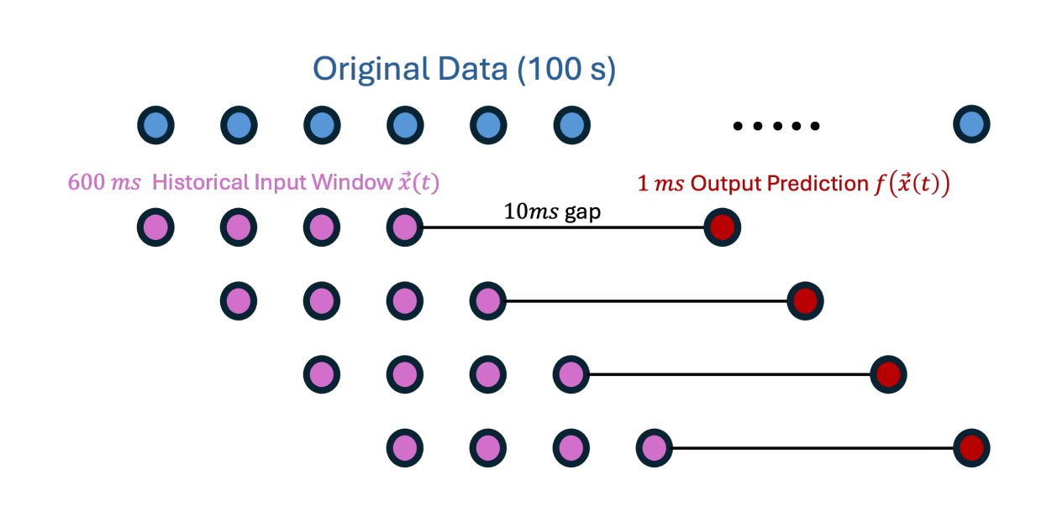
Time Series forecasting for Feed Forward Stabilization Breaks Traditional Bandwidth Barriers
For BELLA PW, motorized mirror supports bandwidth <50 Hz due to 20ms mechanical response time, while laser noise extends to 100Hz, creating significant bandwidth gap
Simulation
Schematic showing PW laser system: 1kHz pulse train splits into amplified and pilot pulses, routed through optics to final focus, with ghost diagnostics capturing beam position data via CCD camera.
Amplified beam position prediction with MLP NN shows jitter reduction of 77.4% in X and 57.5% in Y over 1200 shots
Berger C.. et. al, Submitted; Amodio A. et. al, Submitted
Time series showing how sliding windows of past data (purple) predict future points (crimson) across the full dataset (blue)
Notes:
ML prediction using 1kHz pilot beam data enables pre-emptive mirror positioning, bypassing mechanical bandwidth limitations
ML model trained on 100-second pilot beam data using sliding window technique showing strong agreement between ML predictions and actual measurements.

Slide 25
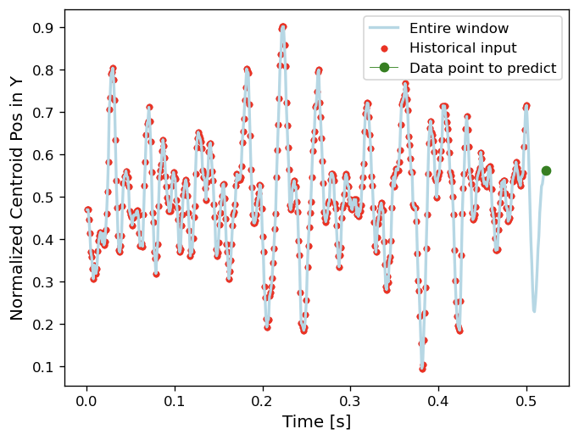
Deterministically compensating for the system error using a correction mirror at ~20 ms latency
Amodio A. et. al, Submitted
Notes:
Inertia Limitation: The main constraint on the feedback control loop bandwidth is the inertia of the final correction mirror, which takes approximately 20 ms to stabilize, limiting noise suppression to below 5 Hz.
Noise Spectrum Challenge: The noise spectrum ranges from tens of Hz to 100 Hz, making traditional PID controllers insufficient for eliminating shot-to-shot pointing errors in LPA systems.
ML Integration: Machine learning (ML) is utilized to predict laser pointing oscillations, enabling preemptive mirror adjustments and shot-to-shot stabilization of the 1 Hz/PW beam.
Model Evaluation: Various ML models, including LSTMs, RNNs, and MLPs, were evaluated, with MLPs showing comparable performance to sequential models after proper preprocessing and feature engineering.
MLP Advantages: The simplicity and computational efficiency of MLPs make them suitable for real-time applications and integration into FPGA-based control loops, highlighting the importance of proper data scaling for effective training and correction.

Slide 26
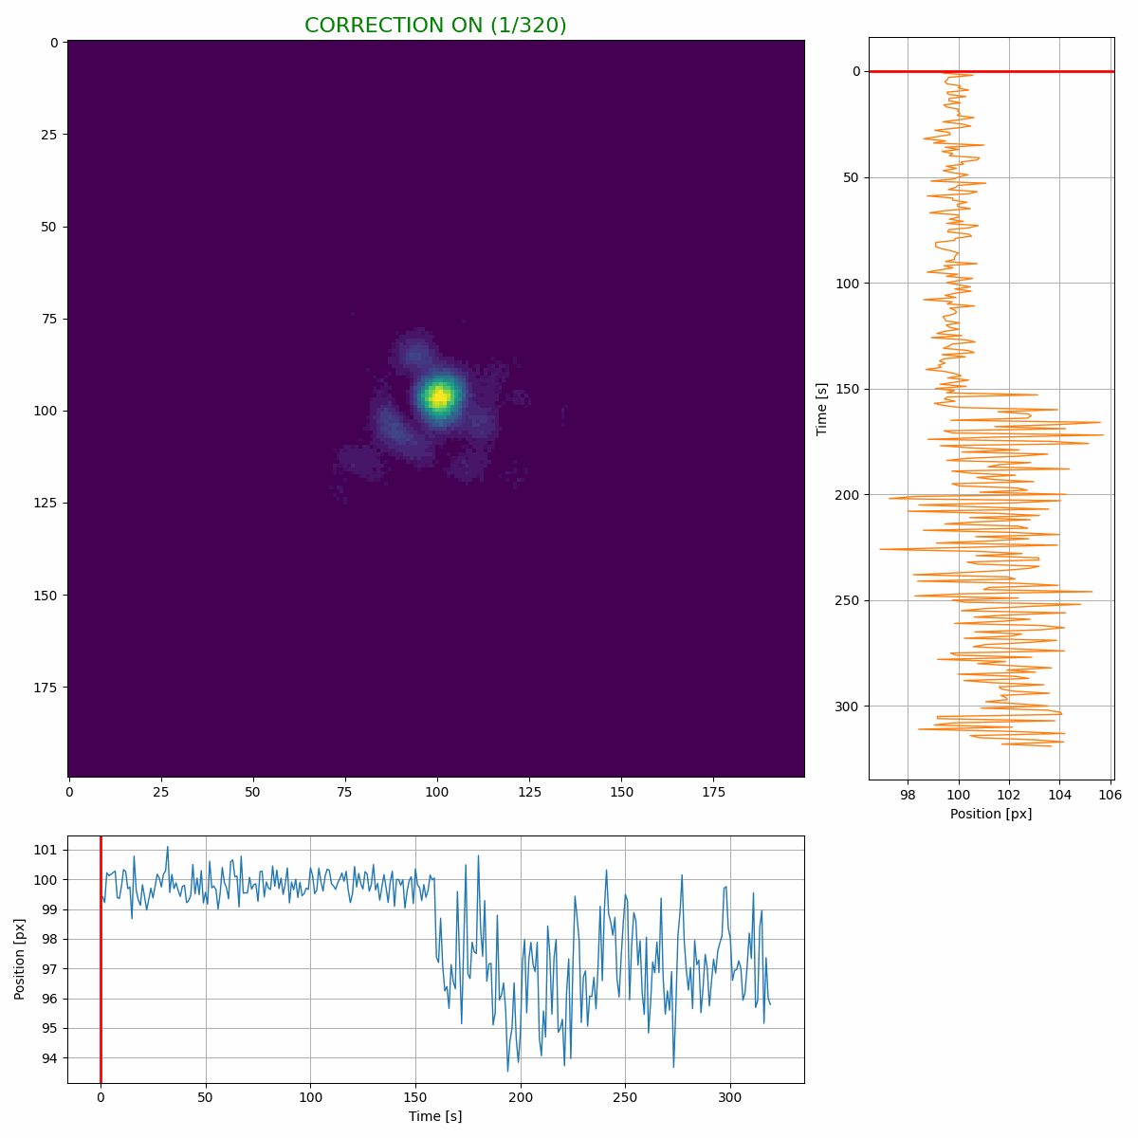
Real-Time ML control Achieves up to 65% Jitter Reduction: From 13µm to 4.6µm in Continuous Operation
Axis | No correction | With correction | Reduction
X (RMS) | 13.1 µm | 4.6 µm | 64.9%
Y (RMS) | 14.8 µm | 7.9 µm | 46.9%
Amodio A. et. al, Submitted
Notes:
Inertia Limitation: The main constraint on the feedback control loop bandwidth is the inertia of the final correction mirror, which takes approximately 20 ms to stabilize, limiting noise suppression to below 5 Hz.
Noise Spectrum Challenge: The noise spectrum ranges from tens of Hz to 100 Hz, making traditional PID controllers insufficient for eliminating shot-to-shot pointing errors in LPA systems.
ML Integration: Machine learning (ML) is utilized to predict laser pointing oscillations, enabling preemptive mirror adjustments and shot-to-shot stabilization of the 1 Hz/PW beam.
Model Evaluation: Various ML models, including LSTMs, RNNs, and MLPs, were evaluated, with MLPs showing comparable performance to sequential models after proper preprocessing and feature engineering.
MLP Advantages: The simplicity and computational efficiency of MLPs make them suitable for real-time applications and integration into FPGA-based control loops, highlighting the importance of proper data scaling for effective training and correction.

Slide 27
Overview
Overview of the BELLA Center
Bayesian Optimization for LPA experiments
GEECS Control system and Xopt
Example optimizations
Laser stabilization
PID Loop Laser transverse and longitudinal Stabilization for FEL
ML-based Transverse Laser Stabilization at BELLA PW
ML enabled Coherent Recombination in Fiber Laser

Slide 28
BELLA-Fiber
Notes:
HTT > Has 2 beamlines, Open to users by LasernET and BeamNET US
Fiber > 200mJ, multi KW Demostrator for future high rep rate
HTU > E beam Line and Udulators for FEL
Bella iP2 > Primarily for proton and High Energy Density Science

Slide 29
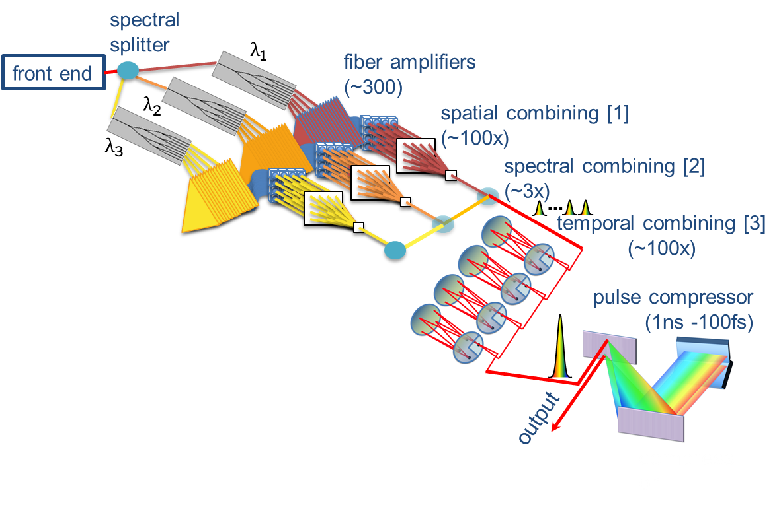
Fiber Laser Architecture Drives LPA Toward Practical Applications Through >kHz Operation
Advanced Laser Systems are required for > kHz LPAs for high wall plug efficiency and high average power.
Limitations of Ti:Sapphire Lasers
Low wall plug efficiency
Limited Thermal handling
Solution - Fiber Lasers
Efficient, high power
Compact
Robust
T. Zhou et al. Optics Express 23 (2015)

Slide 30
Multi-Channel Fiber Recombination Must Overcome Phase Control Challenges to Meet LPA's High-Power Demands
Future Lasers require > kHz LPAs for high wall plug efficiency and high average power.
Challenges!!
<1 mJ per fiber
>100 fs
Spatial Recombination
Combine 100s of fiber in Space for Joule Range energy
Temporal Recombination
Stack 100s of pulses per fiber for >10 mJ Range energy
Spectral Recombination
Combine Spectral Channels for 10s fs pulses

Slide 31
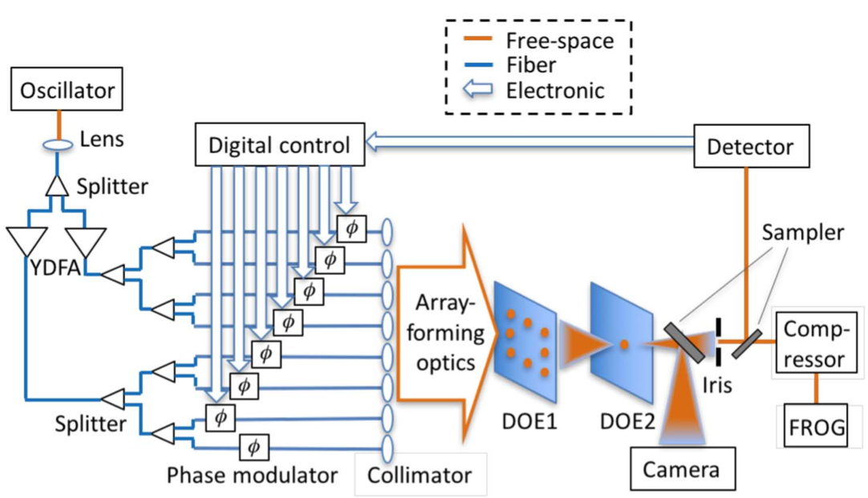
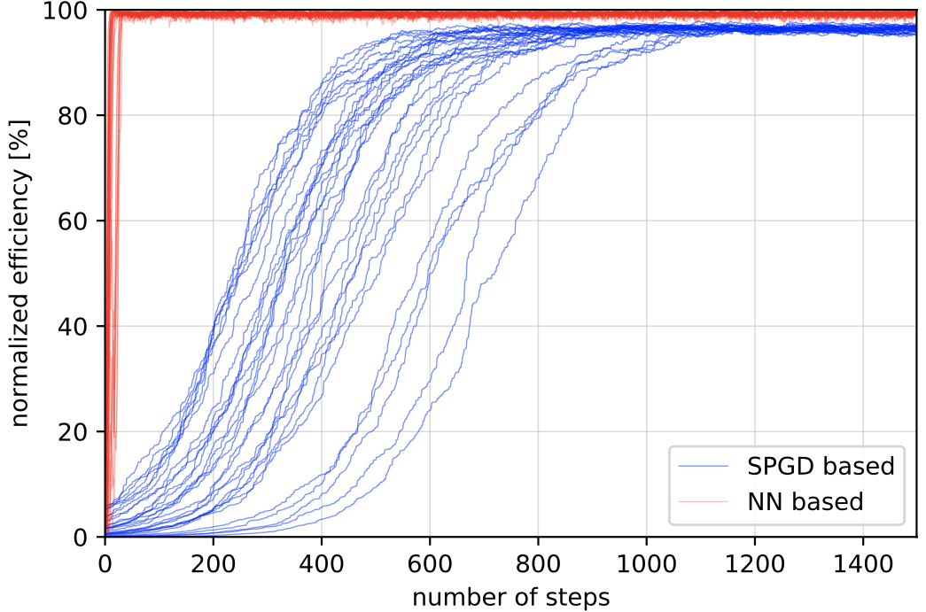
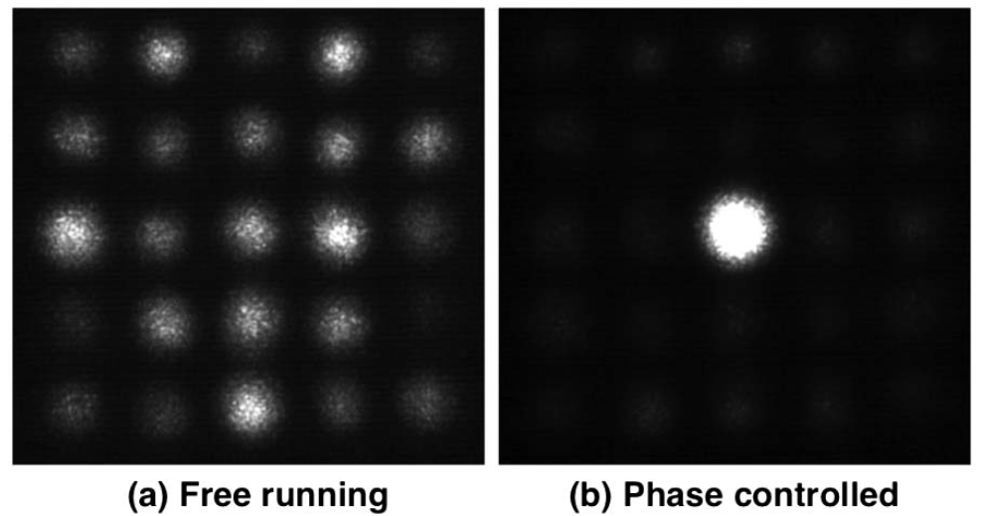
Traditional methods demonstrate combination stabilization but are insufficient for a large number of channels
The SPGD (Stochastic Parallel Gradient Descent) approach is a dither and search algorithm.
Convergence time scales poorly with number of channels (N²)
Requires constant dithering even at steady state
Simulation on 9x9 (81) input beams
Traditional approach (SPGD)
D. Wang, IEEE Journal of Quantum Electronics, 3204437, (2022), Opt. Lett. 42, 4422 (2017), Opt. Lett. 43, 3269 (2018)
Notes:
Describing the physics understanding of spatial combining where the DOE 1 pattern is 2D convoluted with DOE2 pattern to show the phases in the larger matrix. The eight position that are in the box give you information about the different beams which is then used for control. This is the SPGD approach which is slow and not scalable. Instead ML puts it all in a black box.
Iterative optimization algorithm that randomly perturbs phase values
Measures system response (combined beam quality/power)
Updates phases based on whether perturbations improved or degraded performance SPGD (Stochastic Parallel Gradient Descent) in fiber spatial combining works as follows:
Key Principles:
Iterative optimization algorithm that randomly perturbs phase values
Measures system response (combined beam quality/power)
Updates phases based on whether perturbations improved or degraded performance
Process:
Randomly applies small phase shifts to all channels simultaneously
Measures resulting combined beam metric
Correlates changes in metric with applied perturbations
Updates phase values in direction of improvement
Repeats process continuously
Limitations:
Convergence time scales poorly with number of channels (N²)
Only explores local optimization space
Requires constant dithering even at steady state
Performance degrades with increasing array size
This is why it's being replaced by ML approaches that can:
Learn global optimization patterns
Scale more efficiently with channel count
Achieve faster convergence
Maintain stability without continuous perturbation
So the key is to find and stabilize the phasing condition.
Previously we have done that on a 3x3 array by characterizing its DOE, which is a complex discrete function that convolutes with input beams to create the diffraction pattern that can be captured by a camera.

Slide 32
ML Approach demonstrates Efficient and Scalable
Spatial Recombination
This is why it's being replaced by ML approaches that can:
Learn global optimization patterns
Scale more efficiently with channel count
Achieve faster convergence
Maintain stability without continuous perturbation
Simulation on 9x9 (81) input beams
ML
Traditional approach (SPGD)
Traditional approach (SPGD)
D. Wang, IEEE Journal of Quantum Electronics, 3204437, (2022), Opt. Lett. 42, 4422 (2017), Opt. Lett. 43, 3269 (2018)
Notes:
Describing the physics understanding of spatial combining where the DOE 1 pattern is 2D convoluted with DOE2 pattern to show the phases in the larger matrix. The eight position that are in the box give you information about the different beams which is then used for control. This is the SPGD approach which is slow and not scalable. Instead ML puts it all in a black box.
Iterative optimization algorithm that randomly perturbs phase values
Measures system response (combined beam quality/power)
Updates phases based on whether perturbations improved or degraded performance SPGD (Stochastic Parallel Gradient Descent) in fiber spatial combining works as follows:
Key Principles:
Iterative optimization algorithm that randomly perturbs phase values
Measures system response (combined beam quality/power)
Updates phases based on whether perturbations improved or degraded performance
Process:
Randomly applies small phase shifts to all channels simultaneously
Measures resulting combined beam metric
Correlates changes in metric with applied perturbations
Updates phase values in direction of improvement
Repeats process continuously
Limitations:
Convergence time scales poorly with number of channels (N²)
Only explores local optimization space
Requires constant dithering even at steady state
Performance degrades with increasing array size
This is why it's being replaced by ML approaches that can:
Learn global optimization patterns
Scale more efficiently with channel count
Achieve faster convergence
Maintain stability without continuous perturbation
So the key is to find and stabilize the phasing condition.
Previously we have done that on a 3x3 array by characterizing its DOE, which is a complex discrete function that convolutes with input beams to create the diffraction pattern that can be captured by a camera.

Slide 33
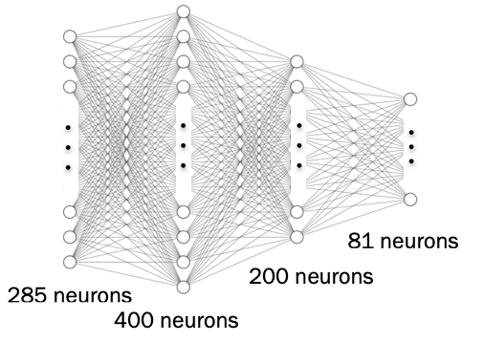
ML Control Achieves High Stability and Fast Convergence of 3X3 Spatial Combining
Power
Measured results on 3x3 spatial combining achieves 0.4% stability & 95% efficiency.
Free Run
Locked
Control Variables
D. Wang, et al., IEEE Journal of Quantum Electronics, 3204437, (2022)
Q. Du, et al., Optics Express. Apr 11;30(8):12639-12653, (2022)
D. Wang, et al., Optics Express, vol. 29, no. 4, pp. 5694–5709, (2021)
Q. Du, et al., Optics Express,, (2021)
D. Wang, et. al.,U.S. appl.ser.no. 18/607,954 filed Mar-2024
Notes:
Power Graph - Here is the Red line indicates the side beam power and blue line indicates the central beam power. Once the CV (Control Variables) are turned on, the central beam power is maximized. Very efficient and stable

Slide 34
Conclusion and the Future
Our current and previous work lays a solid foundation for our goal of bypassing bandwidth limitations inherent in traditional PID feedback systems.
This ML-based approach will provide improved stability for next-generation laser-plasma accelerators and laser-driven particle & photon sources.
The future work includes
Expand functionality and use cases of optimization systems.
Using FPGAs to provide low-latency processing (microsecond-scale) essential for real-time beam correction between laser shots empowered by MLP architecture.
Develop user-friendly software packages that abstract the technical complexities allowing scientists to easily implement these stabilization tools in their own laser systems.

Slide 35
Thank you
Contact: chetanyajain@lbl.gov

