Slide 1
Assisted listening devices
The B50 auditorium is equipped with assisted listening devices. We have nine receivers available and they are usually placed at the back of the room next to the door. Batteries should be good for about four hours. For full day events, batteries may need to be charged midday or swapped for a fully charged unit.
Additional locations with assisted listening devices:
B59 (Wang Hall) – two sets of assistive listening devices are available for use, each with one transmitter and one receiver.
B66 (Auditorium) – Pending installation.
B90 – One transmitter with three receivers.

Slide 2
Assisted listening devices (cont.)
Speakers, please be sure to use the microphone during your presentation. During Q&A please make sure questions are asked through a handheld microphone or, failing that, ensure that you repeat the question through your microphone.
For tips on how you can make meetings more accessible, please visit:
https://allaccess.lbl.gov/archives/127

Slide 3
Hearing aid battery program
This program was designed to provide emergency replacement batteries for those that have failed. Batteries are available at one of three Lab locations:
  Health Services: Bldg. 26
  DOE Joint Genome Institute (JGI)
  Office of the Chief Financial Officer (OCFO) - Bldg. 971
They are provided for extenuating circumstances only and are not intended to be the main source for hearing aid battery needs. This program is monitored for abuse and will be discontinued if abused.

Slide 4
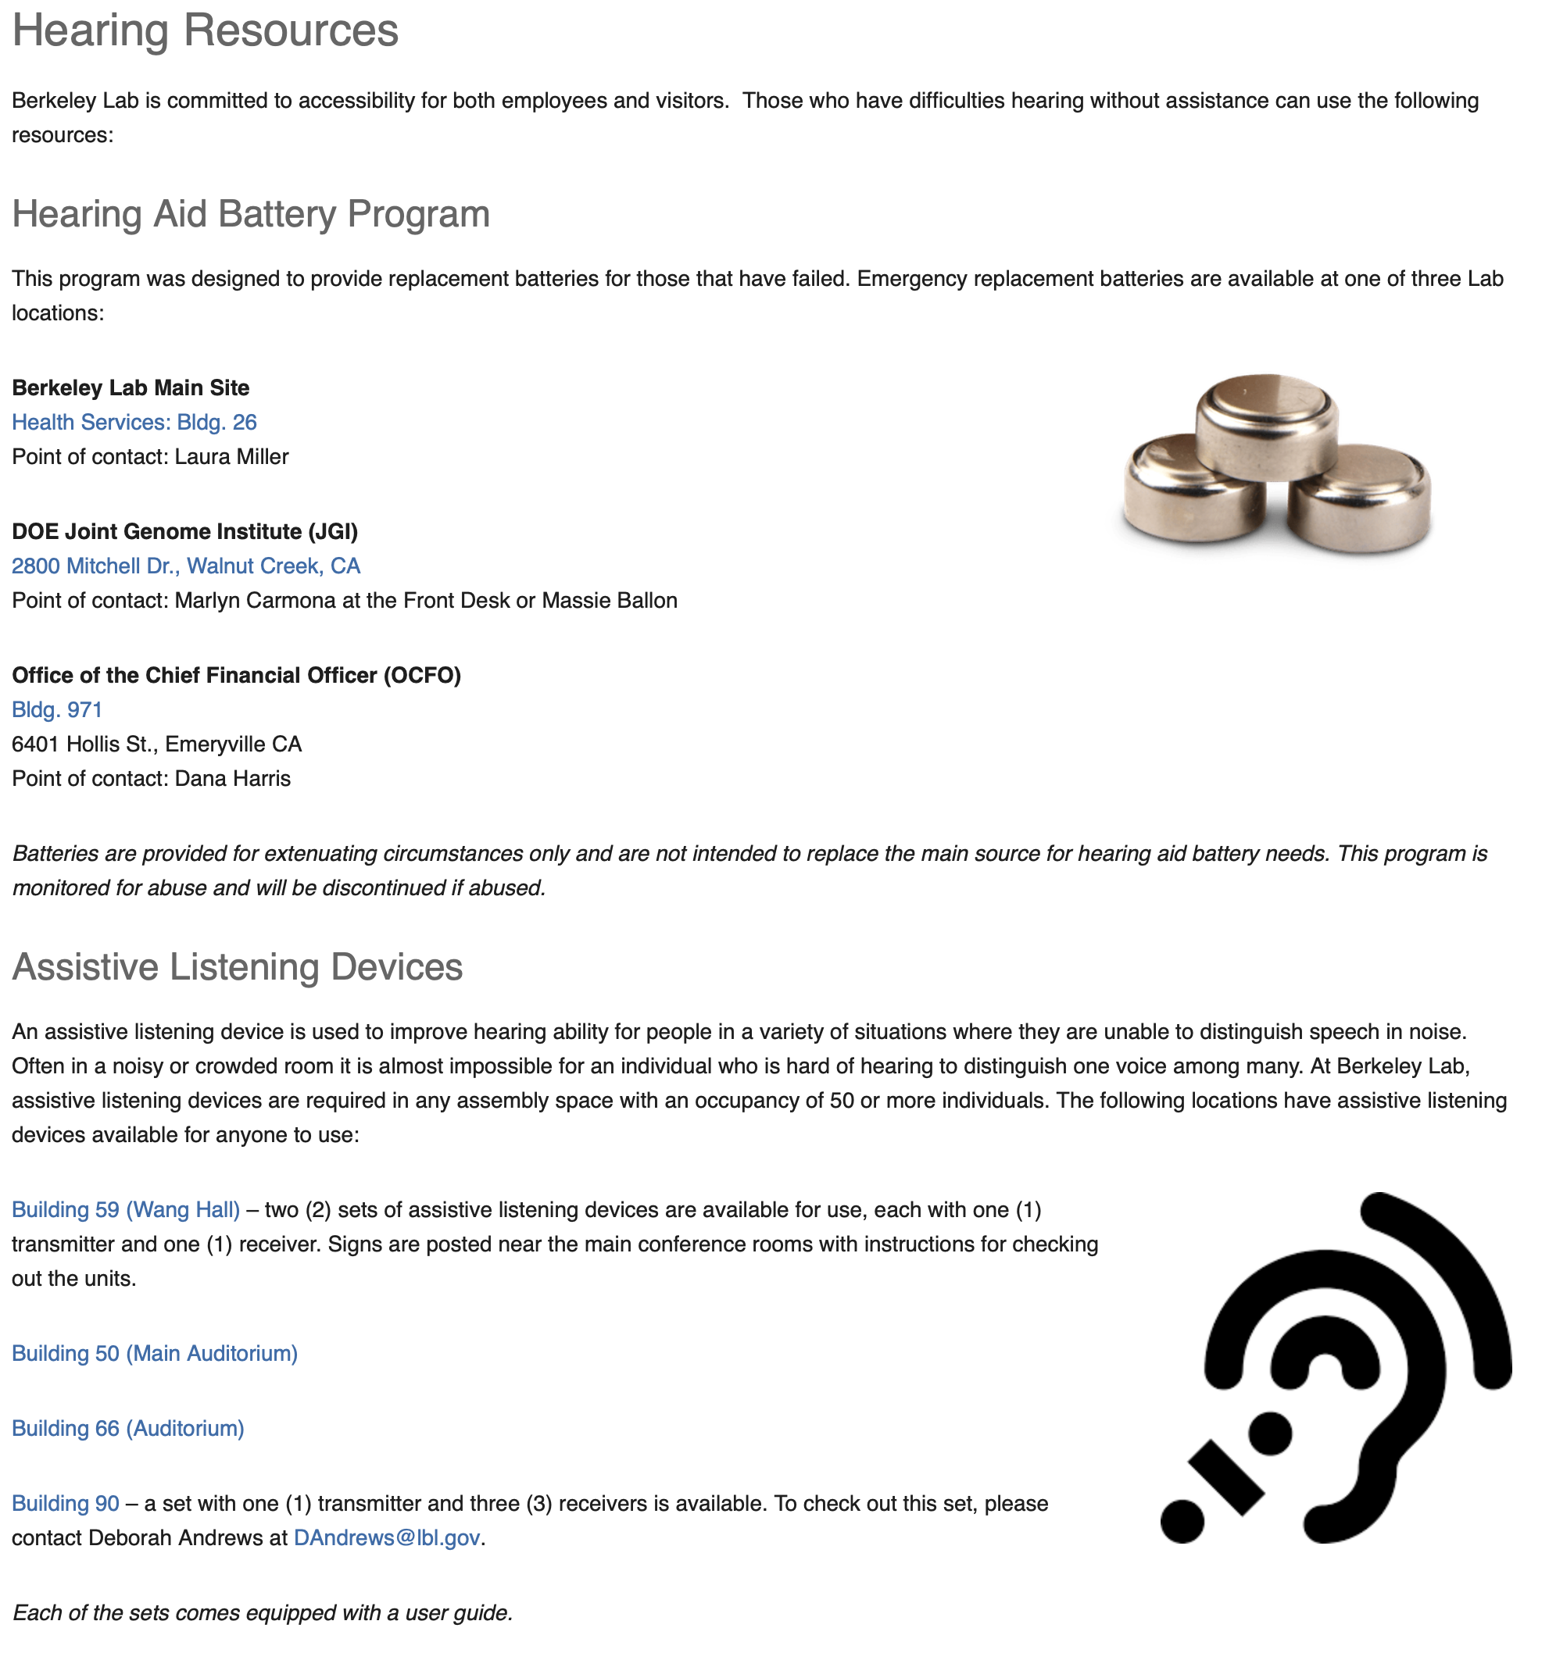
Hearing resources
Access Employee Resource Group (ERG)
For a list of the available hearing resources, please visit the All Access Employee Resource Group (ERG) page at: https://allaccess.lbl.gov/resources/hearing-resources

