Slide 1
An Experiment to Study Training in Impregnated Nb₃Sn Cables
Chris Kovacs, Emanuela Barzi, Daniele Turrioni,
Alexander Zlobin
OSU PhD Advisor: Michael Sumption
US Magnet Development Program
Fermi National Accelerator Laboratory

Slide 2
Outline
Introduction
  Insulation in Nb₃Sn accelerator magnets
  Impregnation in Nb₃Sn accelerator magnets
  Training
Proposal for sub-scale training experiments
  Qualify expected training in current materials
  Qualify expected training in other materials
Summary

Slide 3
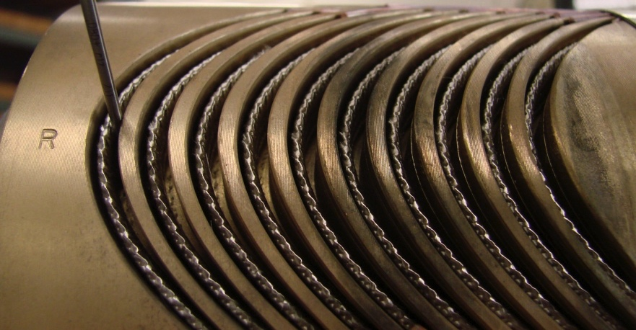
Nb₃Sn Magnet Insulation Function
Gaps After Heat Treatment
Electrical insulation
  Shorting
  Quench Voltages
  Space filling
Mechanical stabilization
  Lorentz forces and stress delocalization
Winding and Binder → Formation → Instrumentation → Impregnation → Operation
  CTE during reaction down to operation temperature
  Extra space from pre-reaction to post-reaction
“US Magnet Development Program” PPT (2017)

Slide 4
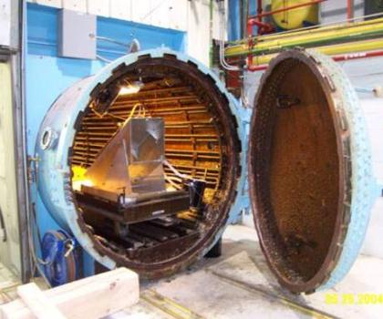
Nb₃Sn Magnet Insulation and Impregnation Specifications
S-glass braid
  Flexible and conformable
  Holds up to Nb₃Sn formation temps
  High dielectric strength
  High tensile strength
  Maintains winding gaps
  Epoxy can impregnate through to fill voids
Impregnation with desired properties:
  High dielectric breakdown strength
  High modulus
  High fracture toughness
  Low CTE mismatch
  Low toxicity
  Radiation resistance and safety
“FNAL Technological Choices: Cable Insulation and Coils” PPT (2015)

Slide 5
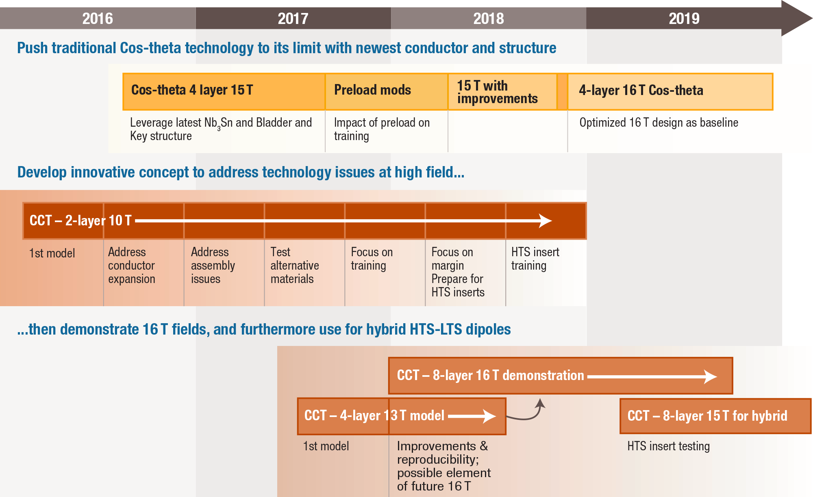
Nb₃Sn Magnet Plan
Training issues are still unresolved

Slide 6
Nb₃Sn Accelerator Magnet Training
Causes
  Impregnation cracking
  Conductor mechanical motion
  Reduced I_{c} and relief of strain on conductor
Costs and Production Rate
  Prohibiting MDP pathway
Need for more knowledge and ability to test cost effective sub-scale solutions to study training
“US Magnet Development Program” PPT (2017)

Slide 7
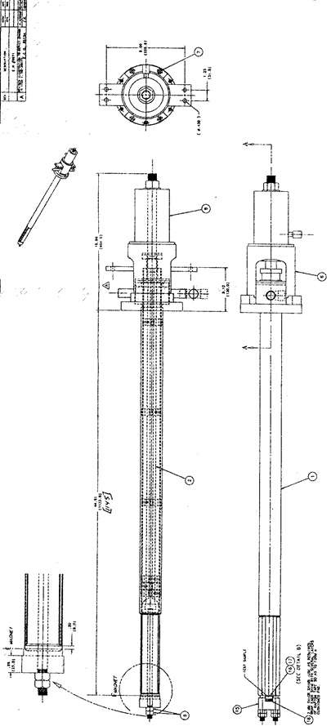
Sub-Scale Training Experiments:
TPI Probe
Cable level measurement
FNAL ready to use Transverse Pressure Insert (TPI) probe
  Commissioned in 2002
  Transverse pressure up to 200 MPa at 4.2 K
Applied Fields up to 14-16 T
Single-strand excitation
  Strand embedded in cable stack
  2000 A max

Slide 8
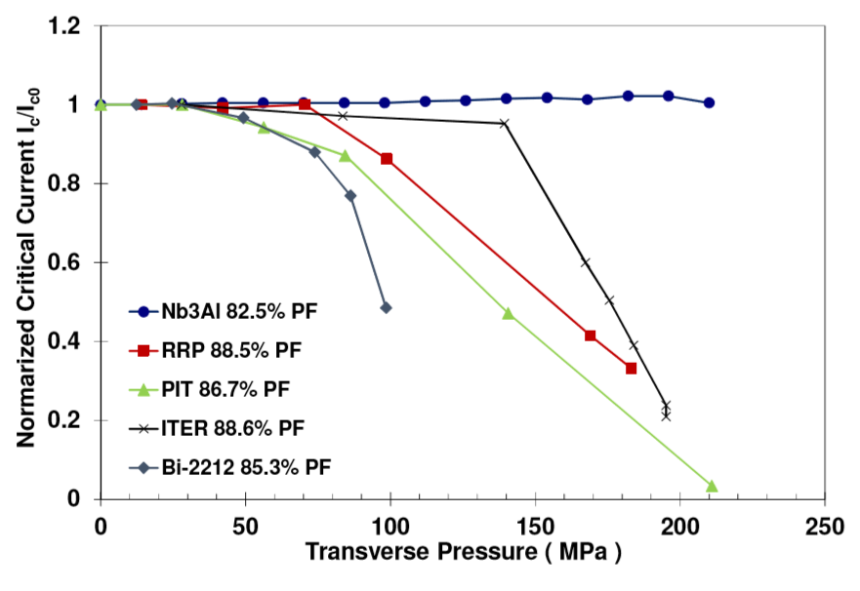
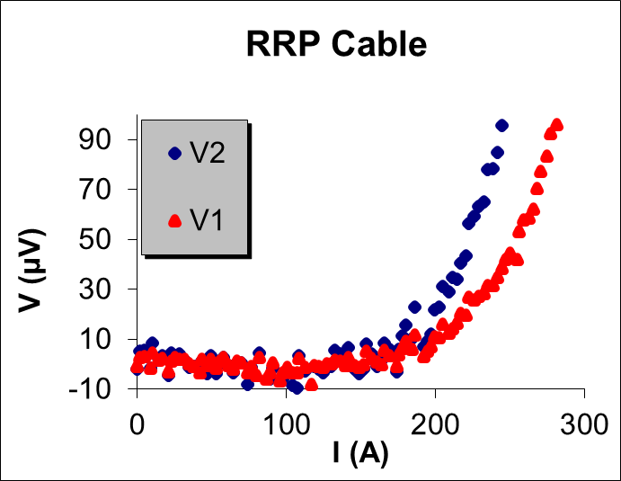
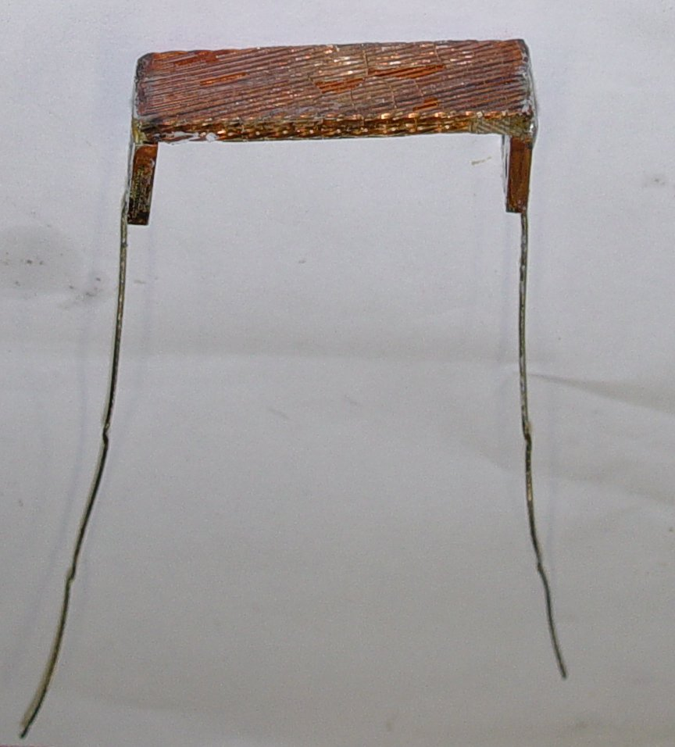
Sub-Scale Training Experiments:
TPI Probe Data and Analysis
Previous data was collected for impregnated cable stacks of BSCCO, Nb₃Sn, and Nb₃Al conductors
Data collected at fixed pressure and applied field
  I-V measurement then performed
  Possible to follow load line values though.
I-V data analyzed to demonstrate I_{c} degradation
I-V data can also reveal training like signatures due to similar conditions to that in a magnet.
V₁
V₂

Slide 9
Sub-Scale Training Experiments:
Qualify Impregnation Materials
Differences in mechanical and thermal properties between samples should be realized from differences in simulated training cycles, i.e. the excited strand is the sensor to detect training
Using TPI probe, qualify S-glass insulated identical Nb₃Sn cable stacks impregnated with:
  CTD-101K
  Matrimid
  Thermoplastics
  NHMFL Mix 61
  Other

Slide 10
Sub-Scale Training Experiments:
Experimental Details
EXPERIMENTAL METHOD
  Record voltage patterns at increasing pressure while at a fixed I/I_{c} and fixed applied field. Data will include:
    Pressure onset of voltage spikes
    Threshold peak frequency
    Voltage peak amplitude
I/I_{c} will be above flux-jump region
  training regimes typically > 0.5 I/I_{c}
I-B below and up to magnet load-line
Data Acquisition Specifications:
National Instruments SCXI-1000 with SCXI-1125 module
  10 kHz, 16-bit, ~80 uV noise
NI-Compact RIO with NI-9238 is another option
  50 kHz, 24-bit, -4 uV noise

Slide 11
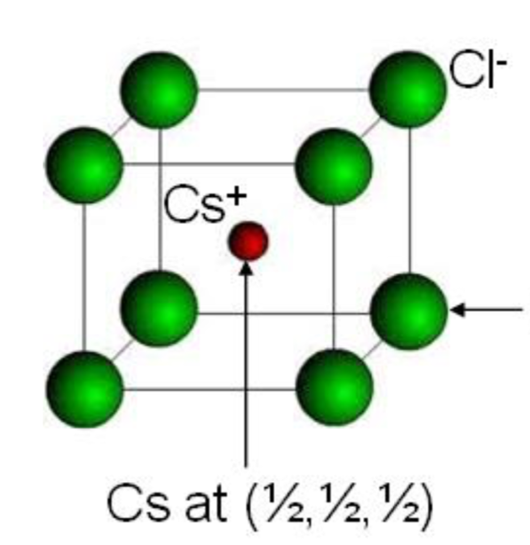
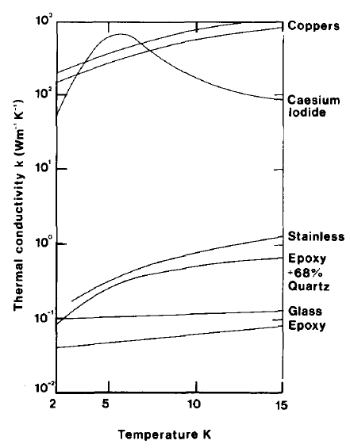
Sub-Scale Training Experiments:
Example of Other Impregnation Material I
In the “other” category lies very high thermal conductivity inorganic materials [Wilson 1991]
Initial Experiment: Cesium Iodide
Other salts and salt mixtures exist to test with very low melting points
Can this reduce training while maintaining performance?

Slide 12
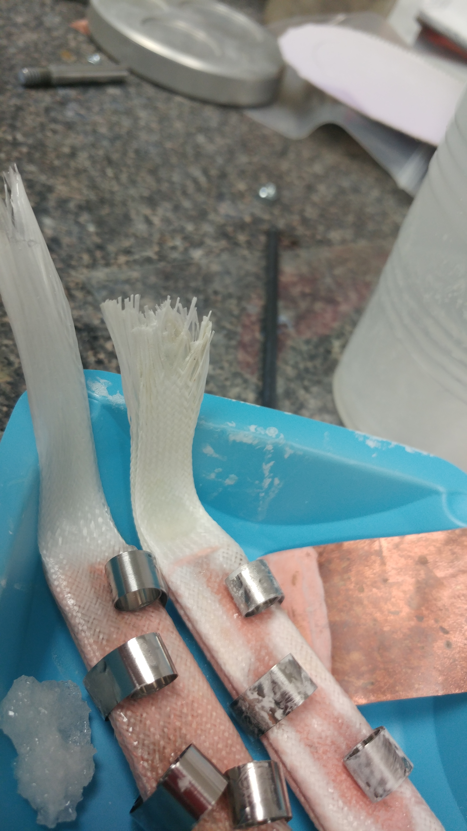
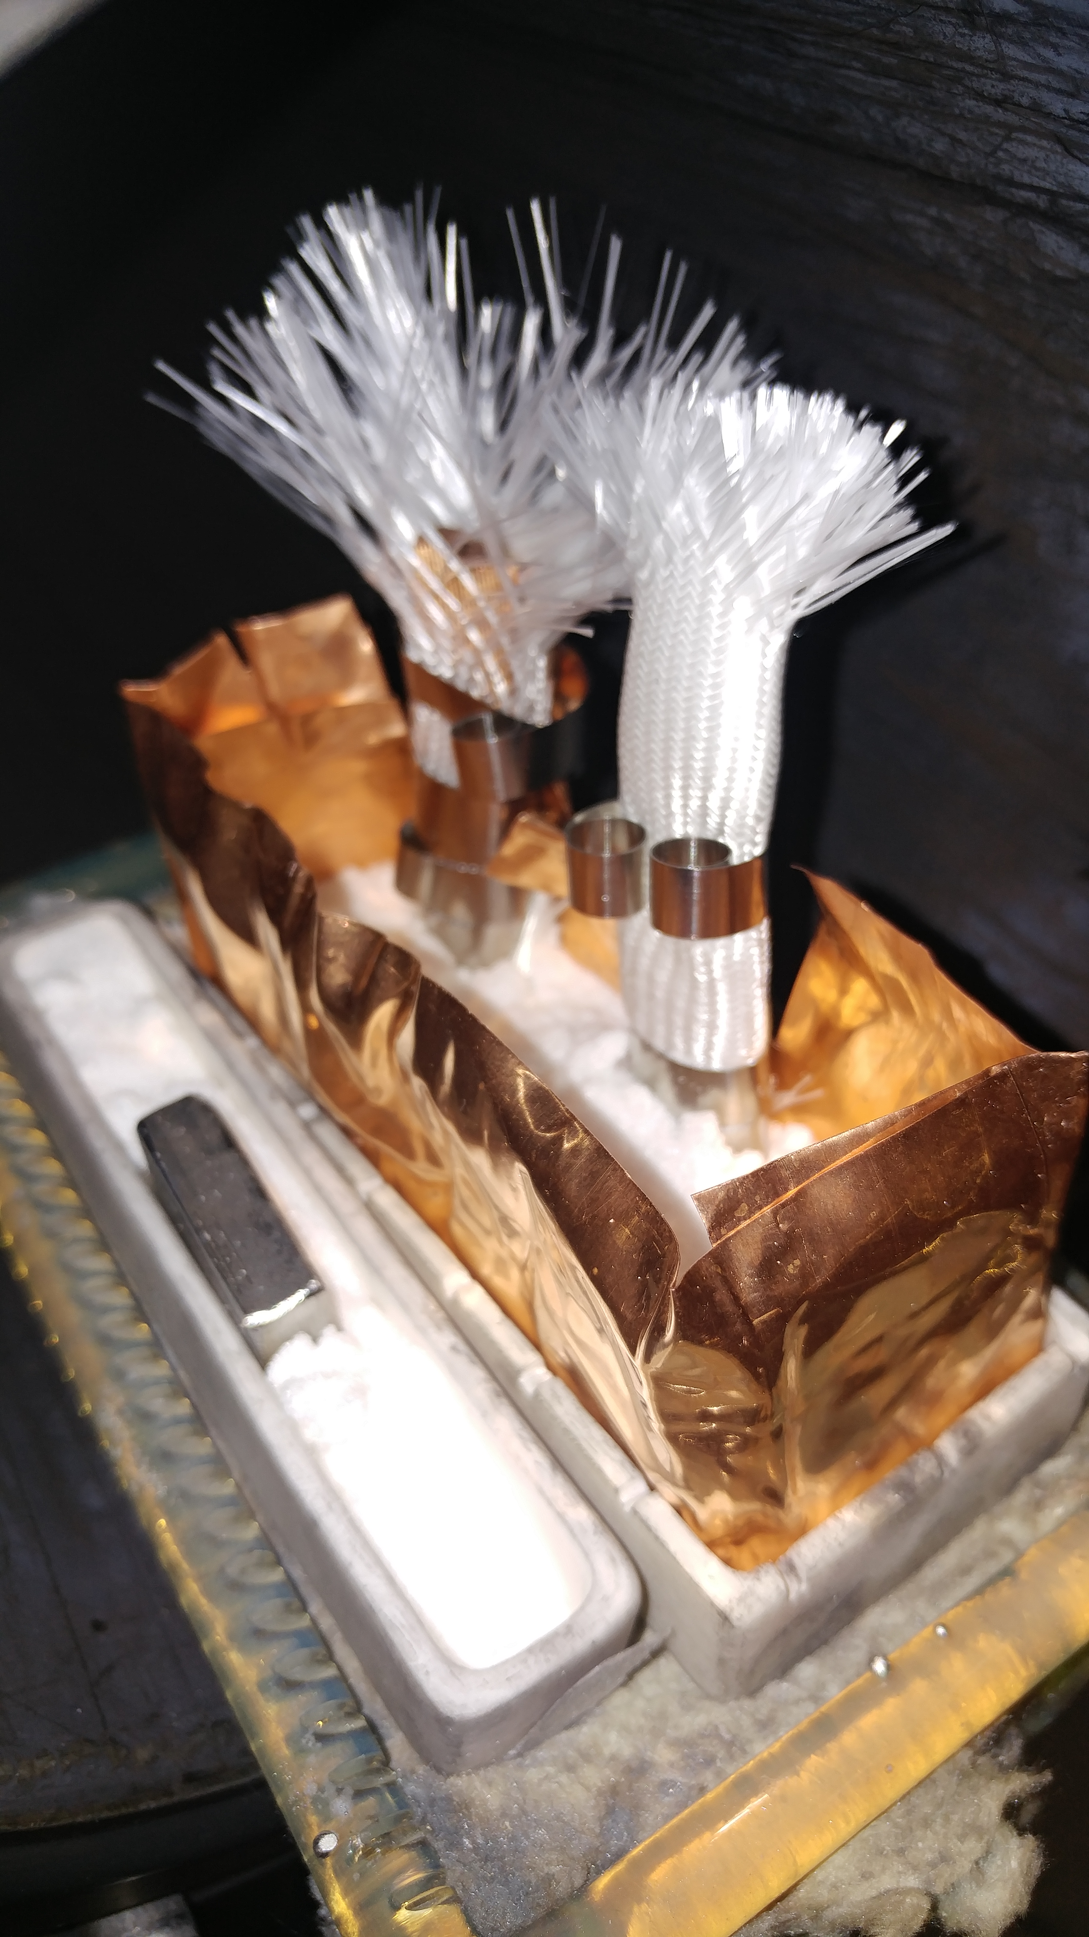

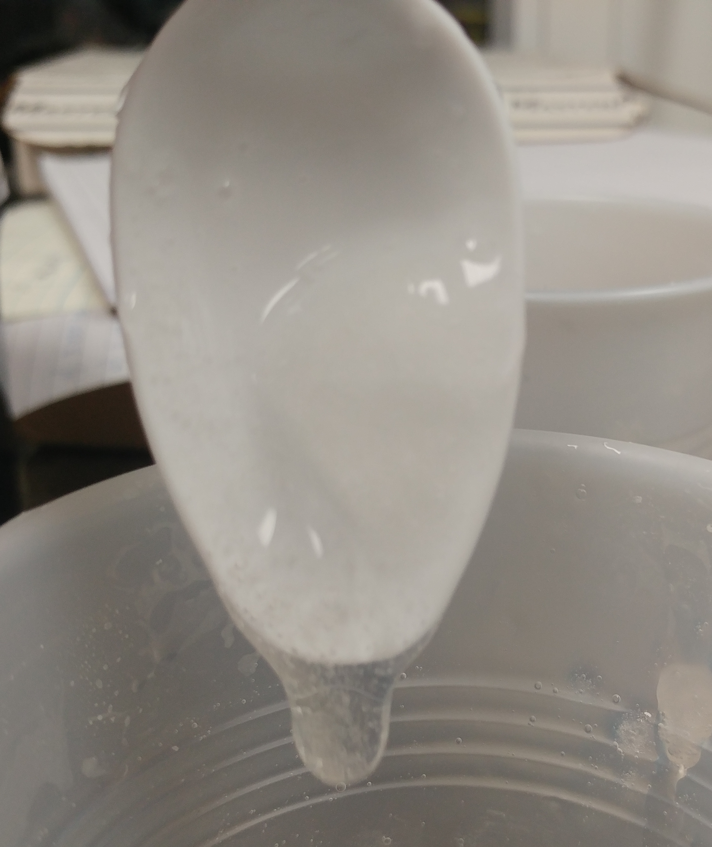
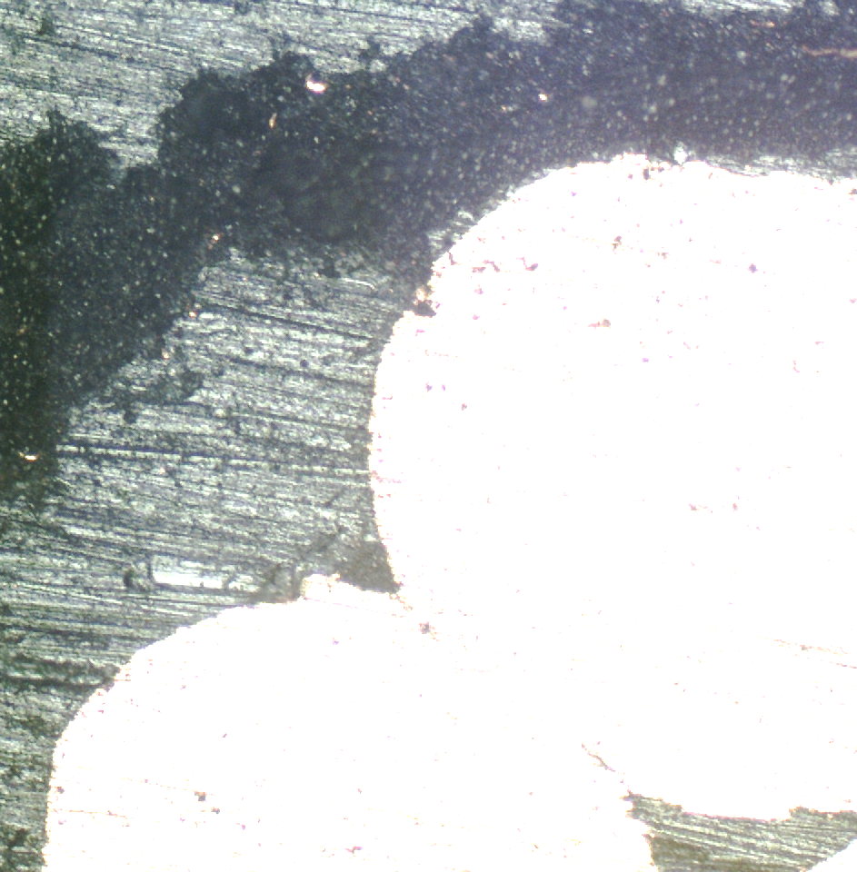
Sub-Scale Training Experiments:
Example of Other Impregnation Material II
Cesium Iodide Spec Checklist
  High dielectric breakdown strength
  High modulus
  High fracture toughness
  Low CTE mismatch
  Low toxicity
  Radiation resistance and safety

Slide 13
Summary
FNAL has the capability for fast turnaround sub-scale measurements to qualify and predict training in different conductor-insulator composites
These sub-scale measurements can speed up the process of successful magnet testing and material R&D
Results from these measurements can go towards reducing training to levels acceptable for large scale manufacturing and distribution
All of this goes towards preventing excessive stretching of the MDP task-line and budget

Slide 14
Thank you from the folks at Fermilab!

