Slide 1
Opening Remarks for the Workshop for Applied Nuclear Data Activities (WANDA)
January 22-24, 2019

Slide 2
It has been 80 years, almost to the day, on this very campus that Fermi and Bohr, announced:
“..the successful disintegration of uranium into barium with the attendant release of approximately two hundred million electron volts of energy per disintegration”
In many ways, that could be considered the start of the “atomic age”.

Slide 3
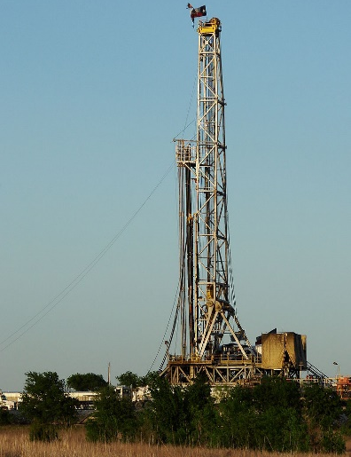
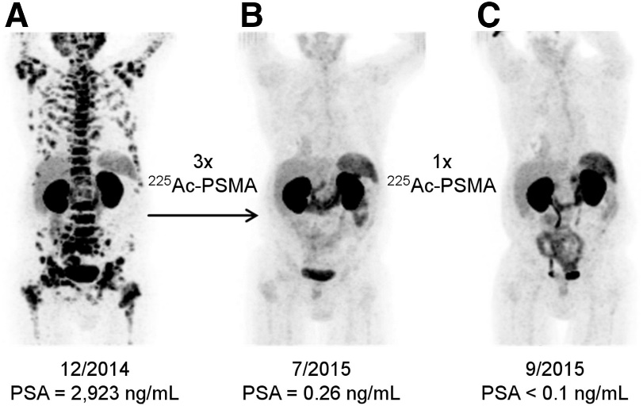
Eighty Years is Not a Long Time…. But Look Where That Has Led…
Fantastic Progress
Nuclear plants generate nearly 20% of the nation’s electricity overall and 63% of its carbon‐free electricity
Nuclear deterrence has been a major factor in sustaining world peace for almost 75 years.
Fission (and isotopes in general) plays an important role in commercial interests
Alpha-emitting isotopes are being used to treat late-stage metastasized prostate cancer

Slide 4
And Yet…Despite a great Deal of Great Earnest Work…
One can readily point to instances where, due to lack of opportunity or the lack of better technology in the past :
Discovery research is being hindered or compromised by a lack of nuclear data …
Nuclear medicine is sometimes hampered by incorrect nuclear data (e.g., branching fractions)…
Development of new nuclear power technologies could be facilitated by better nuclear data…
Better nuclear data are needed for a variety of federal missions.....to name a few things…
My take-away
The compelling nature of our work on nuclear data is clear….
This is not your grandfather’s nuclear data….
WANDA is a forum for identifying priorities and setting the stage for important next steps….
The agencies are here AND THEY ARE LISTENING.

