Slide 1

15 min
Nuclear Data Required for Development of Detection and Measurement Technologies for Nuclear Non-proliferation and Security at JAEA
Integrated Support Center for Nuclear Nonproliferation and Nuclear Security
Japan Atomic Energy Agency
Mitsuo Koizumi and Douglas C. Rodriguez
Workshop for Applied Nuclear Data Activities (WANDA)
22-24 January 2019 , Washington, DC, USA
Notes:
ご紹介いただきましたJAEAの直井でございます。
それではさっそくJAEAの取り組みについてお話をさせていただきます。

Slide 2
Contents
1. Introduction
Activities of technological development of JAEA
2. Development Projects for Detection and Measurement of NM for Nuclear non-proliferation and Security

Slide 3
1. Introduction
Activities of technological development of JAEA

Slide 4




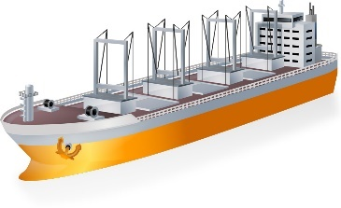
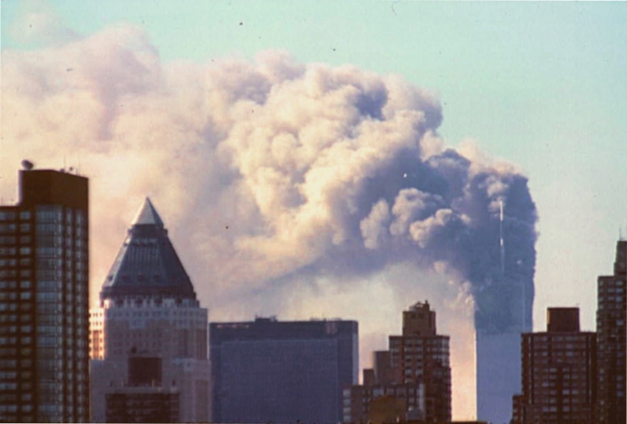

Measurement and Detection of Nuclear Material for peaceful use
Physical Protection
materials out of regulation
Nuclear security
Nuclear safeguards
(non-proliferation)
Each state have to prevent malicious act of terrorists
IAEA monitors the flow of nuclear materials to prevent from being used as nuclear weapons

Slide 5

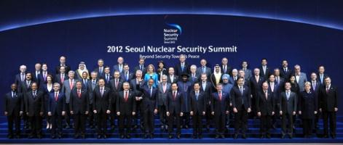
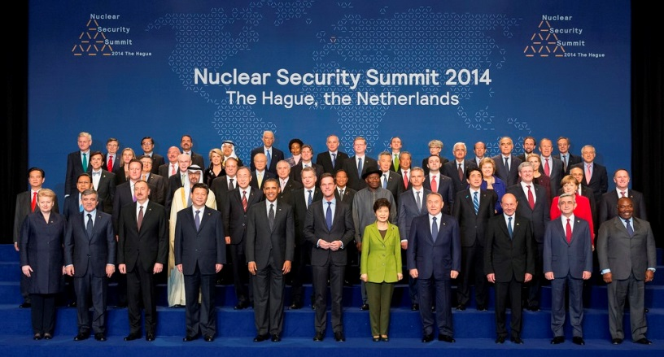
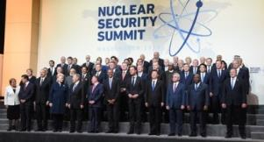
Activity of detection and measurement technology development of JAEA (Establishment of ISCN)
Japan’s National Statement at 2010 Nuclear Security Summit : Establishment of an integrated support center for nuclear nonproliferation and nuclear security in JAEA and development of technology related to measurement and detection of nuclear material and nuclear forensics based on international cooperation
On December 27, 2010, ISCN was established in JAEA.
Japan PM Speech at 2012 Nuclear Security Summit
“In particular, through our "ISCN" established in late 2010, Japan will expand its hosting and training of human resources. “
Japan PM Speech at 2014 Nuclear Security Summit
We will further promote research and development activities for leading-edge technologies including nuclear forensics and nuclear detection capabilities at JAEA.
U.S.-Japan Joint Statement at 2016 Nuclear Security Summit
The United States especially applauds the indispensable role which the JAEA’s ISCN is playing in the capacity building of personnel from other countries, particularly those from Asian countries, and expects ISCN to continue to serve as a leading Center of Excellence in this area.
Notes:
私共、核不拡散・核セキュリティ総合支援センターISCNは、核不拡散・核セキュリティに関わる人材育成支援活動と同分野の技術開発を行って成果を発信し、国際貢献をするという2010年の核セキュリティサミットの日本政府のコミットメントに基づき設立をされたセンターです。
このような活動はJAEAが発足した2005年からスタートさせておりまして、核不拡散科学技術センターという部門が、ISCNの母体となり、一旦は2010年のISCN設立時には2つの部門で活動しておりましたが、2014年からは一体となって活動をしております。

Slide 6
Structure of technology development activities
MEXT (Japanese government)
support of subsidiary
Collaborations
JAEA
ISCN
International
Capacity building
US/DOE
Nuclear forensics
EC-JRC
Nuclear detection/
Domestic
measurements
QST
Others
Universities
Others
research sectors in JAEA
IAEA
NSEC, J-PARC, etc.
NSEC (Nuclear science and engineering center of JAEA)
QST (national institutes of quantum science and technology)

Slide 7
Basic concepts for technological development
Technological developments is based on JAEA’s advantages, such as knowledges, experiences, basic technologies, nuclear and radioactive materials, and facilities.
Topics and needs are chosen by using international survey and its analysis.
Technological development are implemented basically under an international collaboration with the partner DOE-NNSA (US National Laboratory under DOE) or EC-JRC.
The topics of are chosen for relatively large scale development and those of low technology readiness level
R&D are on ...
  core technology development
  model system development
  performance test and demonstration experiment
  nuclear data measurement (not yet implemented)

Slide 8
operator
operation
IAEA, etc.
easy to handle
robust
product development
compact
company
cost effective
performance test
etc.
demonstration
model system
research institute
development
core technology
university
feasibility study
basic technology
research

Slide 9
Important development tasks
Nuclear nonproliferation (safeguards)
NDA technologies for high-radioactivity NM samples
fuel with MA
spent fuel
samples from reprocessing facility
Decommissioning
Accountancy of NM in a decommissioning facility
Survey of trace nuclear material in waste
Nuclear security
detection of nuclear materials in a heavy shield
detection of dirty bomb
system against CBRNE
(chemical, biological, radiological, nuclear, and explosive)
wide range monitoring system
Nuclear forensics
Evaluation of NM attractiveness

Slide 10
2. Development Projects for Detection and Measurement of NM for Nuclear non-proliferation and Security
Active Interrogation Nondestructive Assay (NDA) Methods
incident particle
irradiation
sample
Incident particle | Developing methods | Current purpose
photon (γ-ray) | nuclear resonance fluorescence (NRF) | NM detection hidden in a shield
neutron | active neutron NDA techniques | NM measurement of a low- and high-dose radiation sample

Slide 11
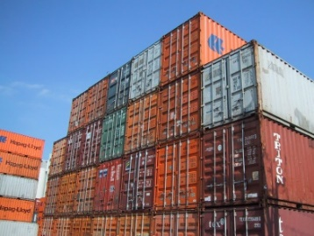
collaboration of QST, Univ. Hyogo, KEK, and JAEA-ISCN
Development of Nuclear Resonance Fluorescence (NRF) NDA Technology
Laser Compton Scattering (LCS)
Generation of high-intensity quasi-monochromatic γ-ray beam
Nuclear Resonance Fluorescence (NRF)
Strong penetration of γ-ray
Nuclide specific detection
No further radio activation
R.Hajima, et al., J. Nucl. Sci. Tech. 45, 441 (2008).
Level information (energy, spin, parity) and transition probability are required
QST (national institute for Quantum and Radiological Science and Technology)
KEK (Inter-University Research Institute Corporation high Energy Accelerator Research Organization)
Notes:
続いて、輸送コンテナの中等に遮蔽物に隠匿された核物質を検知するための技術開発です。
核分裂性の核物質であるU-235は自身から放出されるガンマ線を測定することによって検知しますが、数mmの鉄板でガンマ線が遮蔽がされ検知ができなくなります。
JAEAが進めている研究開発は核共鳴蛍光という現象を使って、遮蔽されていても核物質を検知できる技術の開発です。
原子核はある特定のガンマ線を吸収して励起され、再び基底状態に戻るときに同じエネルギーのガンマ線を放出します。このガンマ線はそれぞれの核物質の同位体に特有で、例えばPu-239では2.143MeVのエネルギー、U-235では1.733MeVのエネルギーで励起されます。
JAEAではこのガンマ線を電子線加速器とレーザービームを使って作り出す研究開発からスタートさせました。

Slide 12
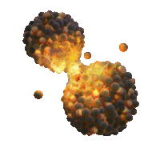
JAEA-NSEC, JAEA-ISCN and EC-JRC
Development of Active Neutron NDA Techniques
Neutron is used to induce nuclear reaction. Induced emission of neutrons and γ-rays are measured.
induced fission neutrons
DDA (differential die-away analysis)
neutrons
delayed γ-rays
（decay γ-rays from fission products）
γ-rays
Interrogation
Neutrons
DGA (delayed γ-ray analysis)
neutrons
transmission neutrons
NRTA (neutron resonance transmission analysis)
γ-rays
neutron capture prompt γ-rays
PGA (prompt γ-ray analysis)
NSEC (Nuclear Science and Engineering Center)
ISCN (Integrated Support Center for Nuclear Nonproliferation and Nuclear Security)

Slide 13
Four neutron interrogation techniques chosen to be developed
Technique | Reaction | Perouse
DDA (Differential Die-away Analysis) | fission (neutron) | ²³⁹Pu-effective
DGA (Delayed Gamma-ray Analysis) | fission (decay γ-ray from fission products) | ratio of ²³⁵U/²³⁹Pu/²⁴¹Pu
NRTA (Neutron Resonance Transmission Analysis) | all nuclear reaction (transmission of neutron) | Quantity of each of U and Pu nuclide
PGA (Prompt Gamma-ray Analysis) | neutron capture (capture γ-ray) | existence of specific nuclear species (eg., explosive etc. for security purpose)
Neutron interrogation techniques are used for NM analysis in a complementary way.
Basic technological developments are in progress.

Slide 14
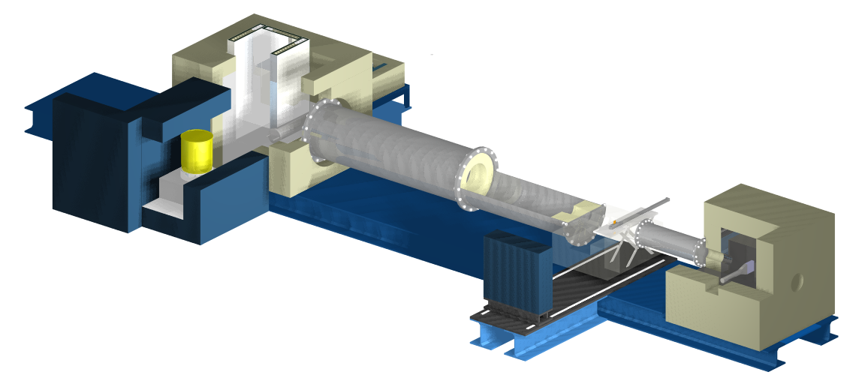
Development of active neutron NDA technique at JAEA
(1) Development of an Integrated system
DDA
Basic technological development of interrogation methods for complementary analysis.
DT neutron generator
PGA
NRTA
5 m neutron flight path
sample
(2) Development a practical DGA system
high-level radio active sample
(3) Development a laser driven neutron source for an NRTA measurement
hot cell
low energy γ-ray filter
compact NRTA system
γ-ray detector
neutron source
sample tube
neutron source
neutron detector
sample
neutron moderator
Development of a laser driven neutron source, for which short-pulse-neutron generation improves the accuracy in measurement of NRTA.
Development of a compact system equipped with a DD neutron generator or ²⁵²Cf neutron source.
Accurate nuclear data are required for designing devices by simulation and for analysis

Slide 15
Nuclear data used in the development of
active neutron NDA techniques
For designing a neutron interrogation system
neutron scattering cross section and scattering angular distribution
nuclear reaction cross section ...
method | nuclear data required
DDA | fission cross section fission neutron emission fission yield, branching ratio of delayed neutron ...
DGA | fission cross section, fission yield fission neutron emission nuclear structure data (decay mode, gamma-yield, half-lives ...) total and sub-reaction cross sections (interference) ...
NRTA | total neutron cross section (resonance parameters) ...
PGA | neutron capture cross section gamma ray emission probability ...

Slide 16
おわり
Thank you for your attention

