Slide 1
Electron- and photon-atomic reaction data at LLNL
WANDA, 2019
Ian Thompson
Mark Foord
January 24, 2019

Slide 2
Electron and Photon Interaction Cross-sections
LLNL has provided this EPICS data for several decades now
Including spectra from products after final relaxation process.
Evaluator - Red Cullen:
‘evaluated evaluations’ from various reaction models
Collated a uniform set for Z=1 – 100, E=10 eV – 100 GeV
Provided to LLNL in ENDL format, nationally in ENDF format: ENDF/B-VIII
Not validated to experiment data directly, only to other models.
For cold, neutral, isolated atoms
NOT: high temperatures, or ions, or molecules or liquids or solids
However, high density and low temperature conditions typically approach cold material properties.
Cullen has now retired.
Other LLNL codes can be adapted for this purpose
Experimental validations (eg. with extended EXFOR) still needed.

Slide 3
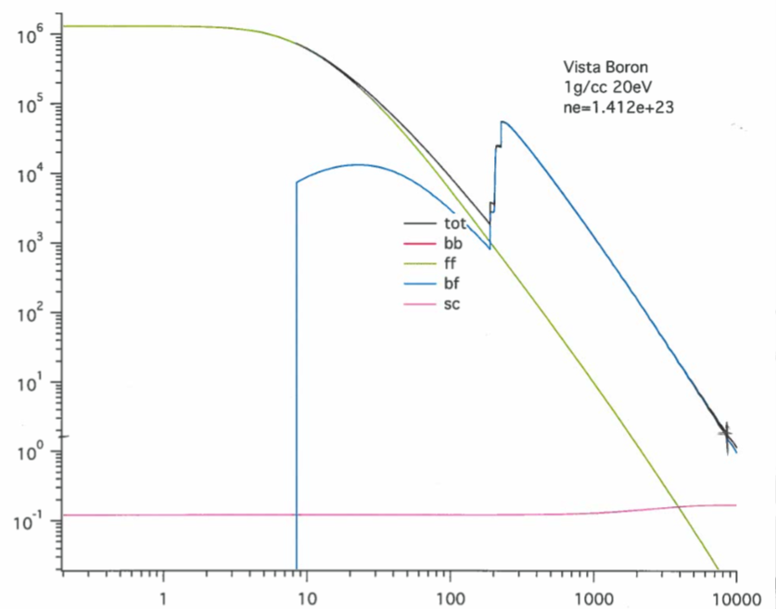
LLNL develops codes to model photon interactions with matter
Basic atomic cross-sections
Detailed line-accounting codes
Statistical line-accounting codes
Hybrid statistical/detailed codes
We are currently developing a new hybrid opacity code that utilizes modern machine architecture, parallelization, and UQ.
Photon absorption and scattering with
near-solid density Boron
Opacity (cm2/gm)
Main interest in high energy density (HED) and warm dense matter (WDM) conditions (X-rays).
Charged particle dE/dx in cold and plasma media.
However, high density and low temperature conditions typically approach cold material properties.
Photon Energy (eV)

Slide 4
Way Forward
Validate codes and library data by comparisons with differential experimental data. (atomic EXFOR would be useful).
See how other groups validate their evaluation libraries.
Translate existing libraries to modern GNDS format
Check completeness
Apply LLNL codes as needed for cold-neutral-isolated atomic data.

