Slide 1
Atomic data support in EXFOR
Boris Pritychenko
National Nuclear Data Center, BNL, Upton, NY 11973

Slide 2
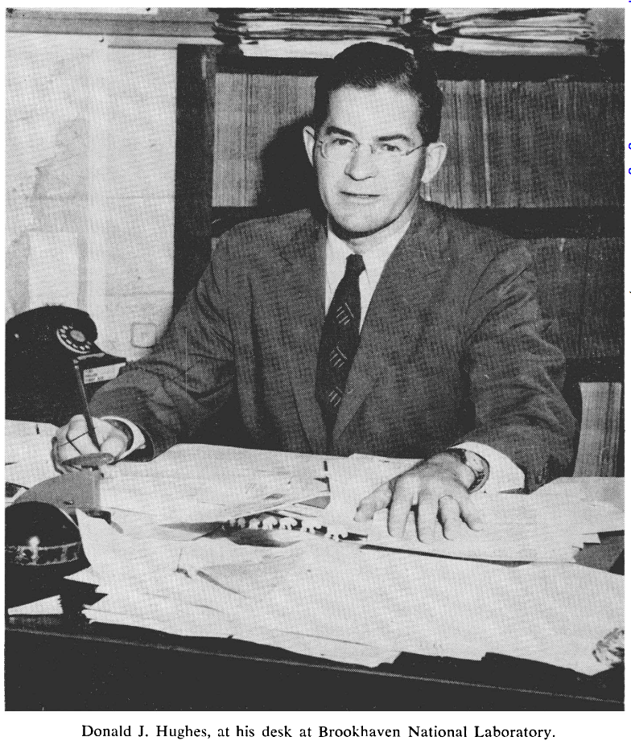
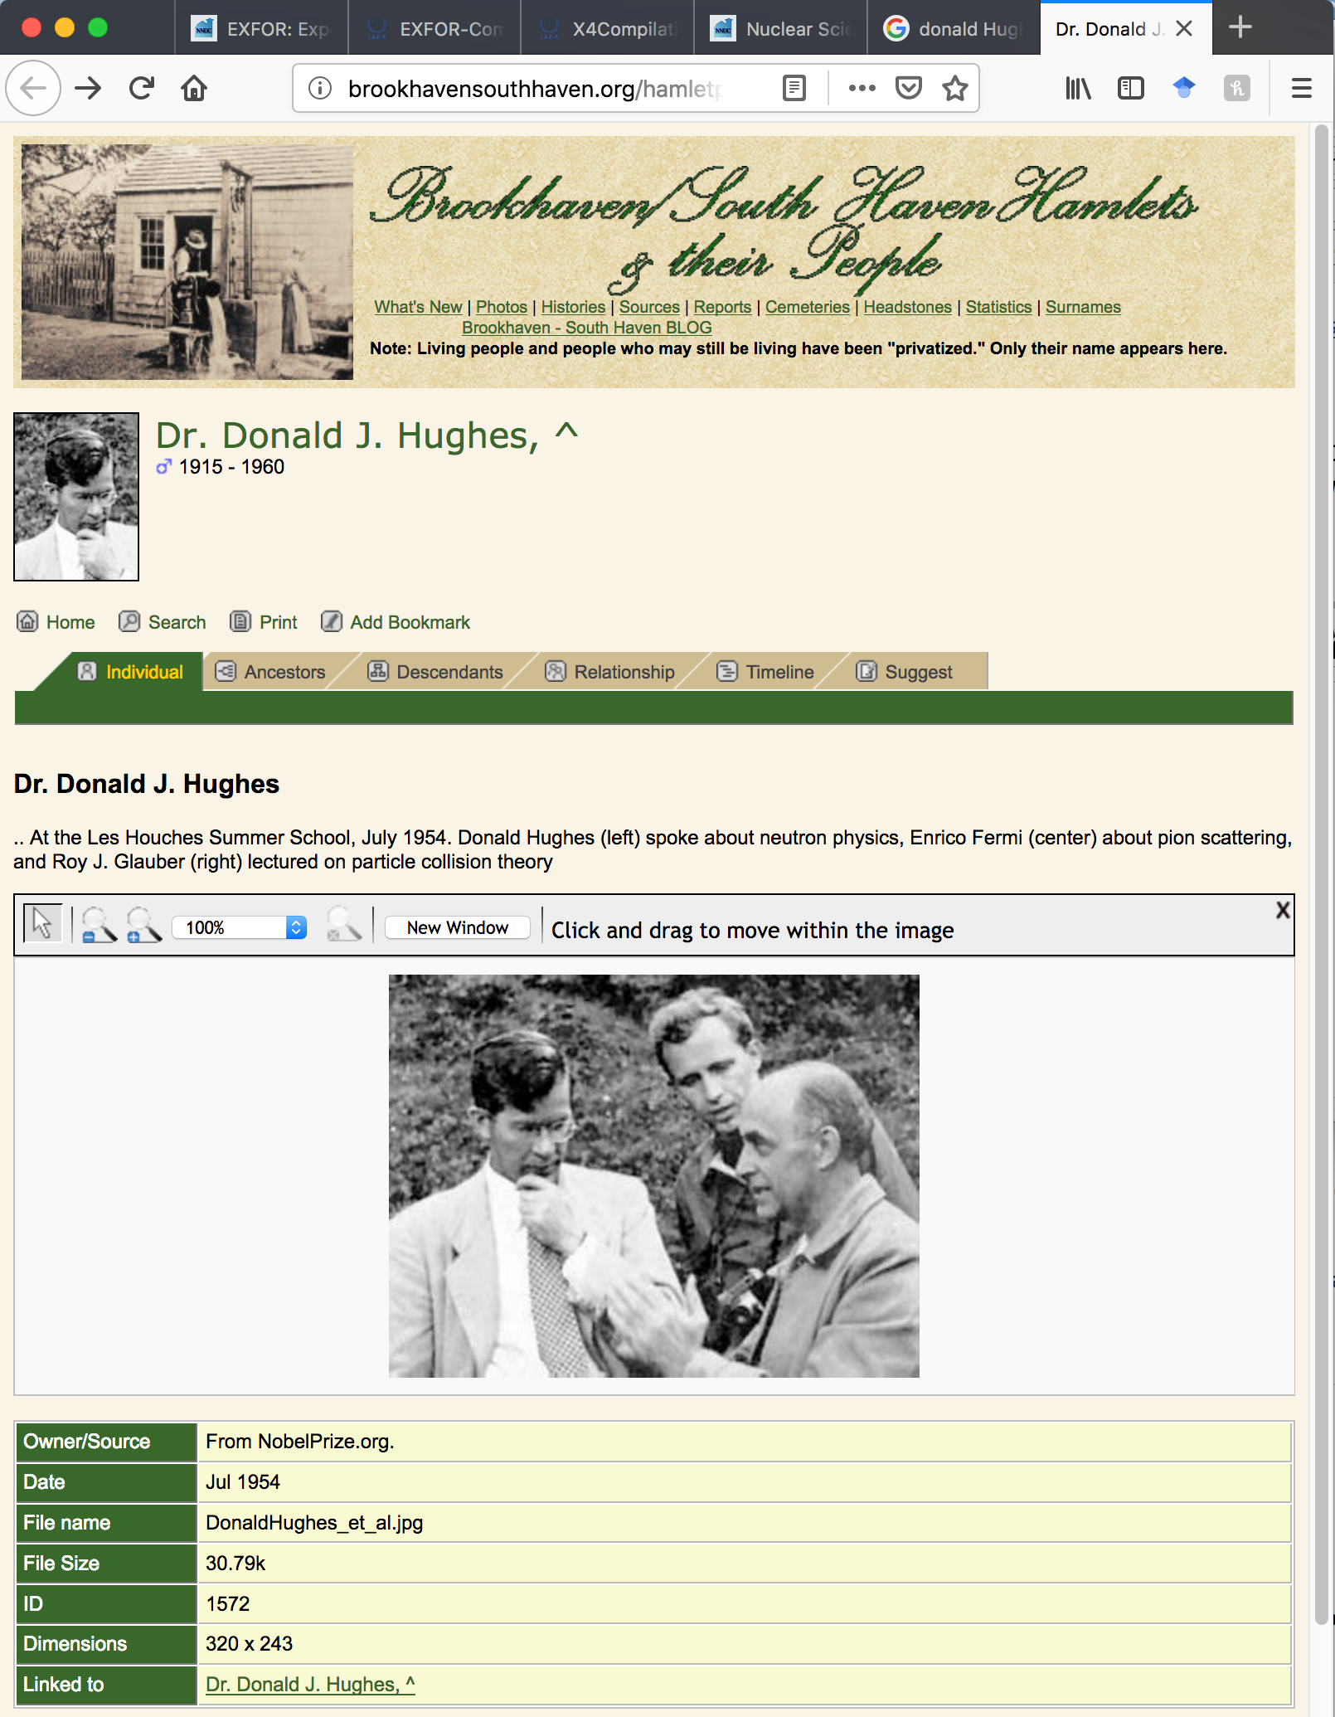
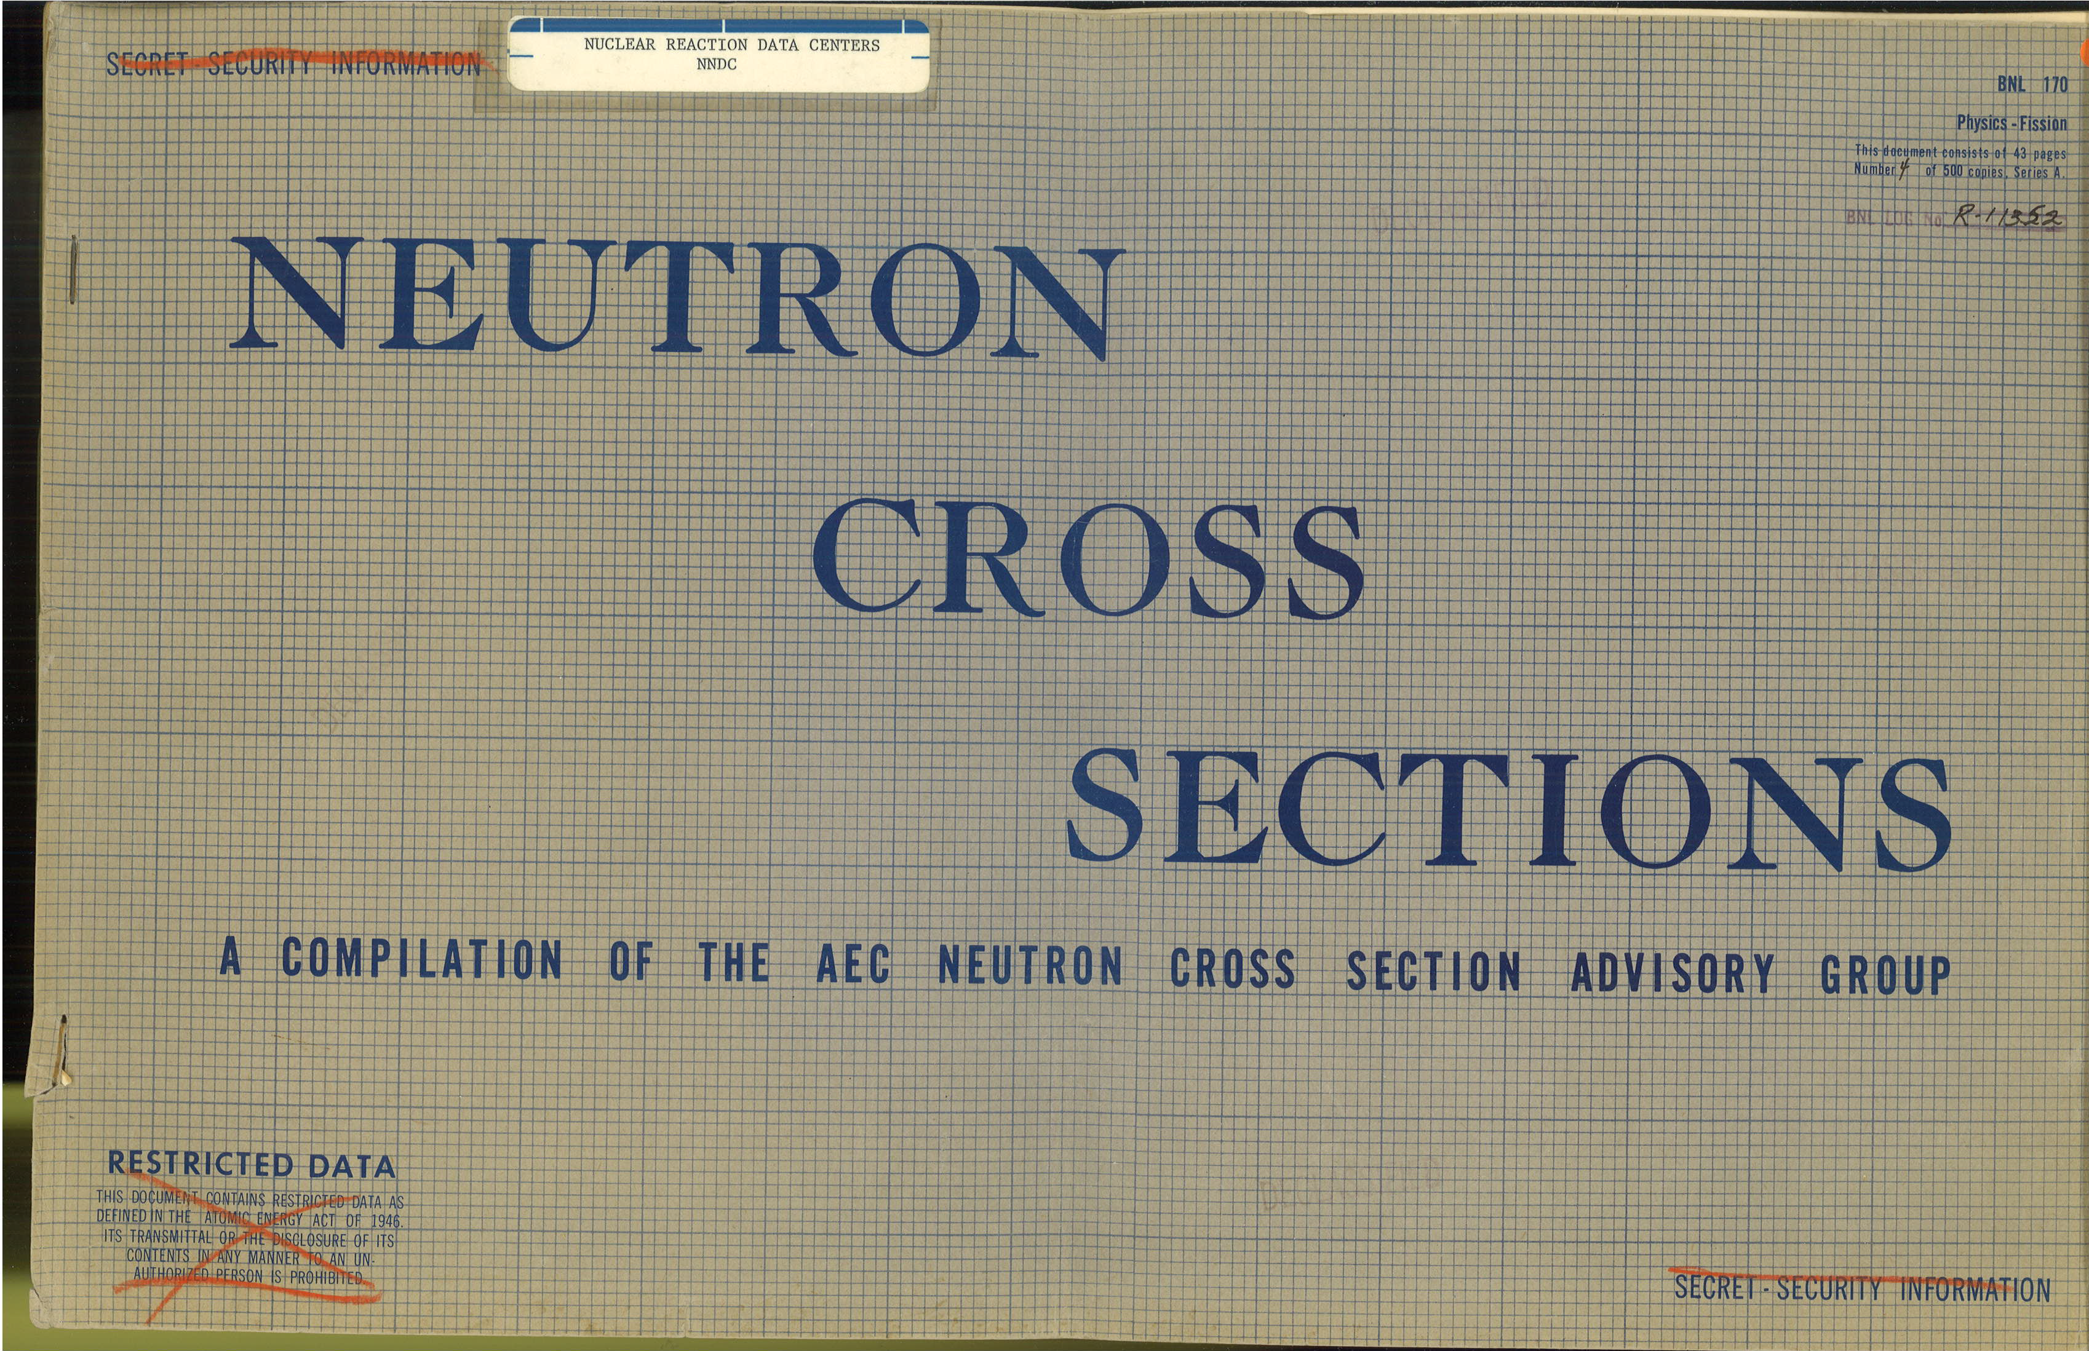
Nuclear Reaction Data Compilations
Experimental neutron reaction data compilations have been pioneered at Brookhaven National Laboratory.
Donald J. Hughes (1915-1960) compiled data since 1950.
BNL-170 was published in 1952; it is a precursor of BNL-325.
Second UN International Conference on Peaceful Uses of Atomic Energy, Geneva, 1958.
SCISRS (Sigma Center Information and Retrieval System) at BNL (1964) was a precursor of EXFOR.
Other data centers were created in Vienna, Austria (NDS-IAEA), Paris, France (NEA-Databank) and Obninsk, USSR (IPPE) in 1963-1964.
Data Centers Interchange Format (EXFOR) was introduced in 1970 and Nuclear Data Centres Reaction (NRDC) network was formed under the auspices of the IAEA.
NNDC EXFOR Team: B. Pritychenko, S. Hlavac, O. Schwerer, and V. Zerkin (IAEA) covers U.S. and Canada.

Slide 3
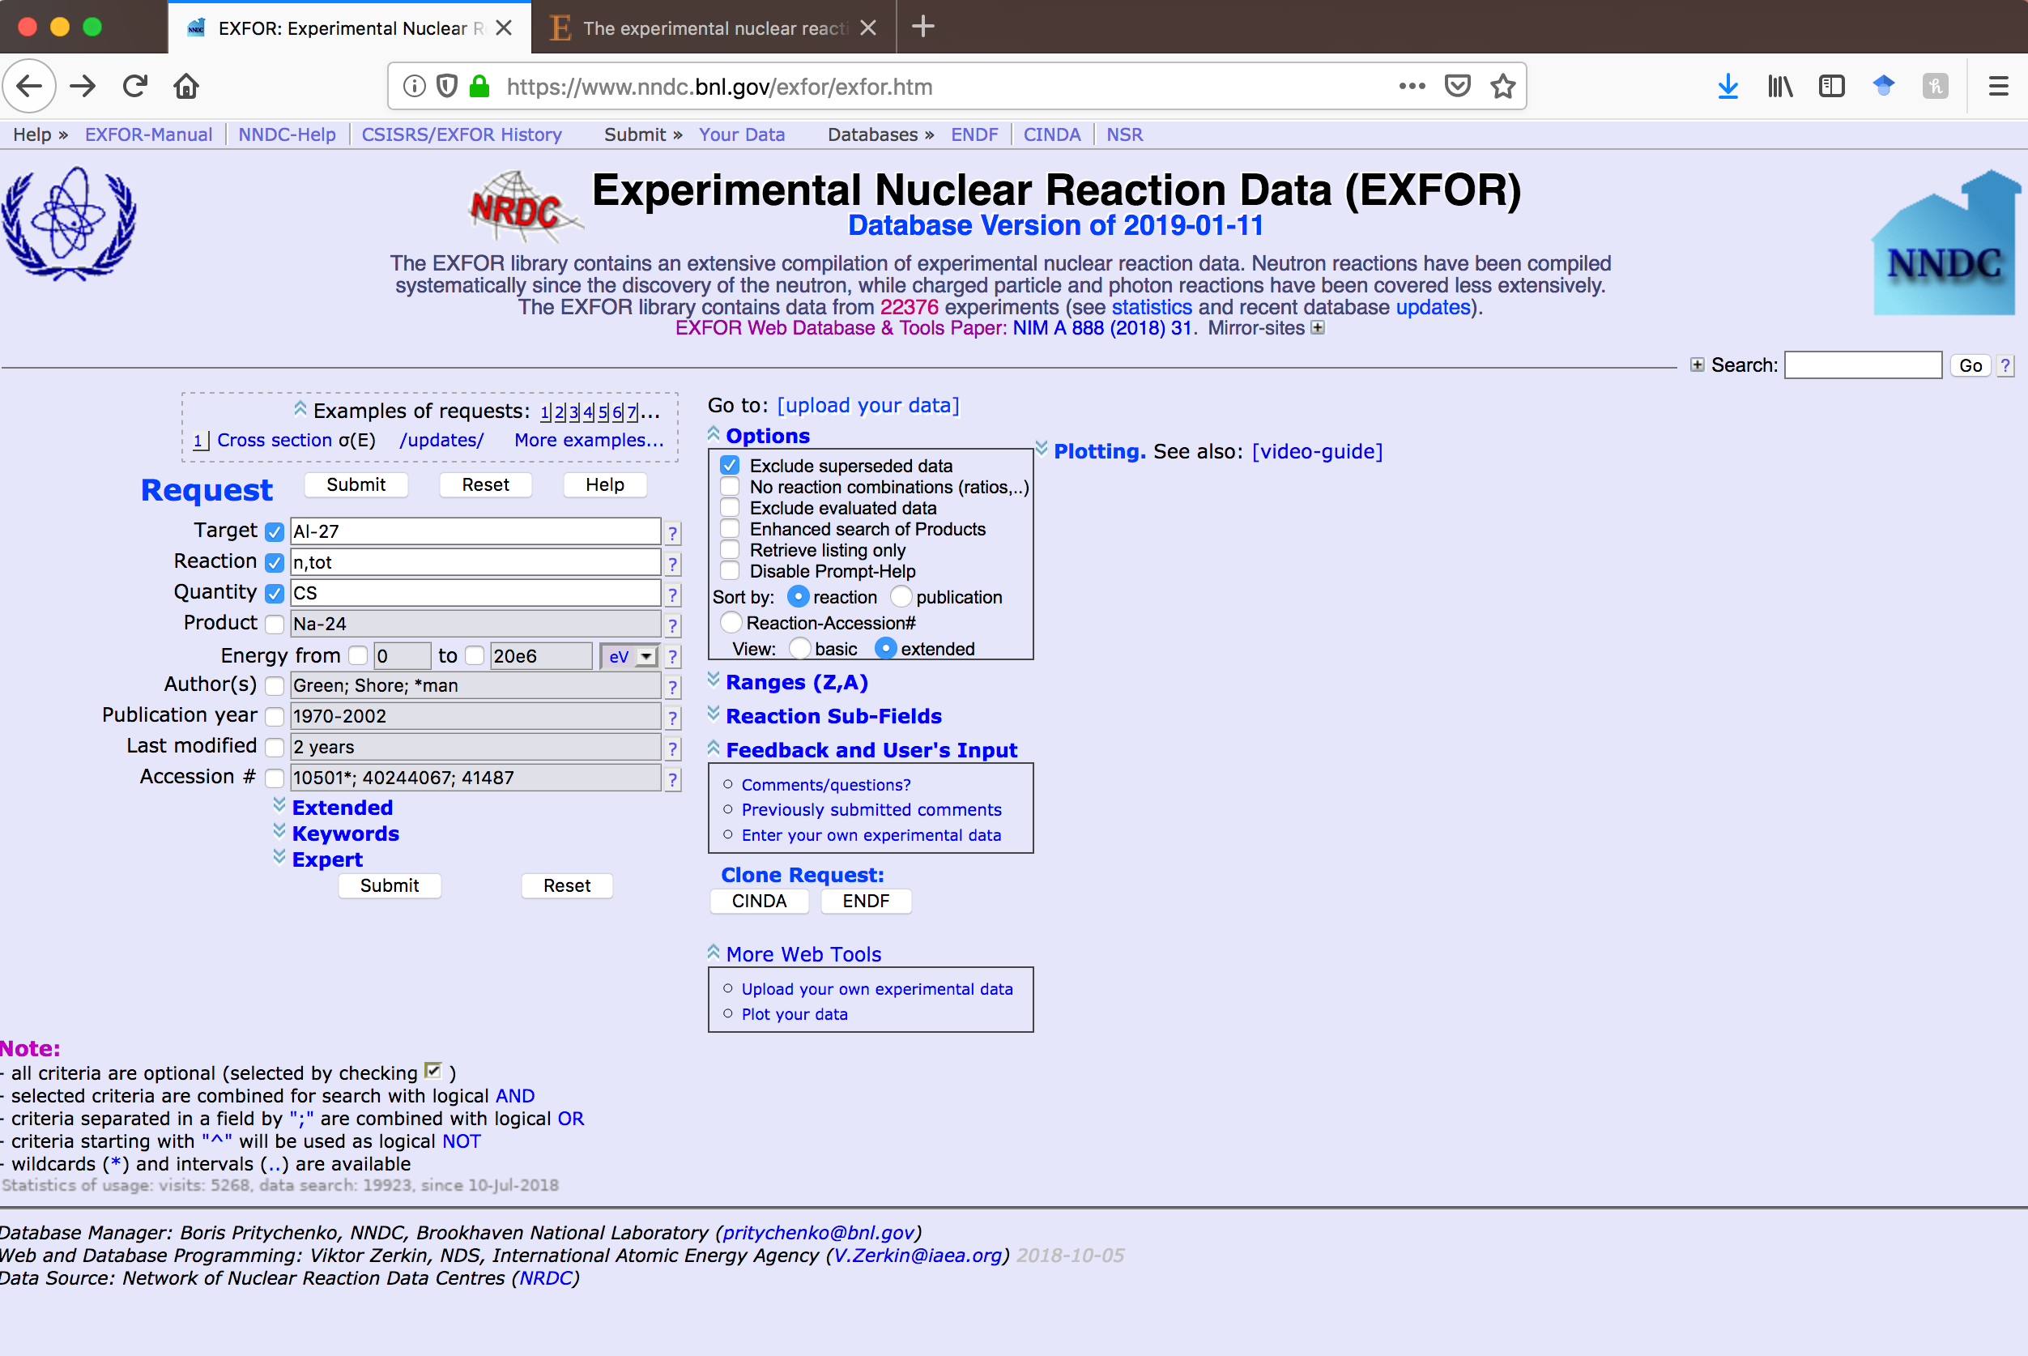
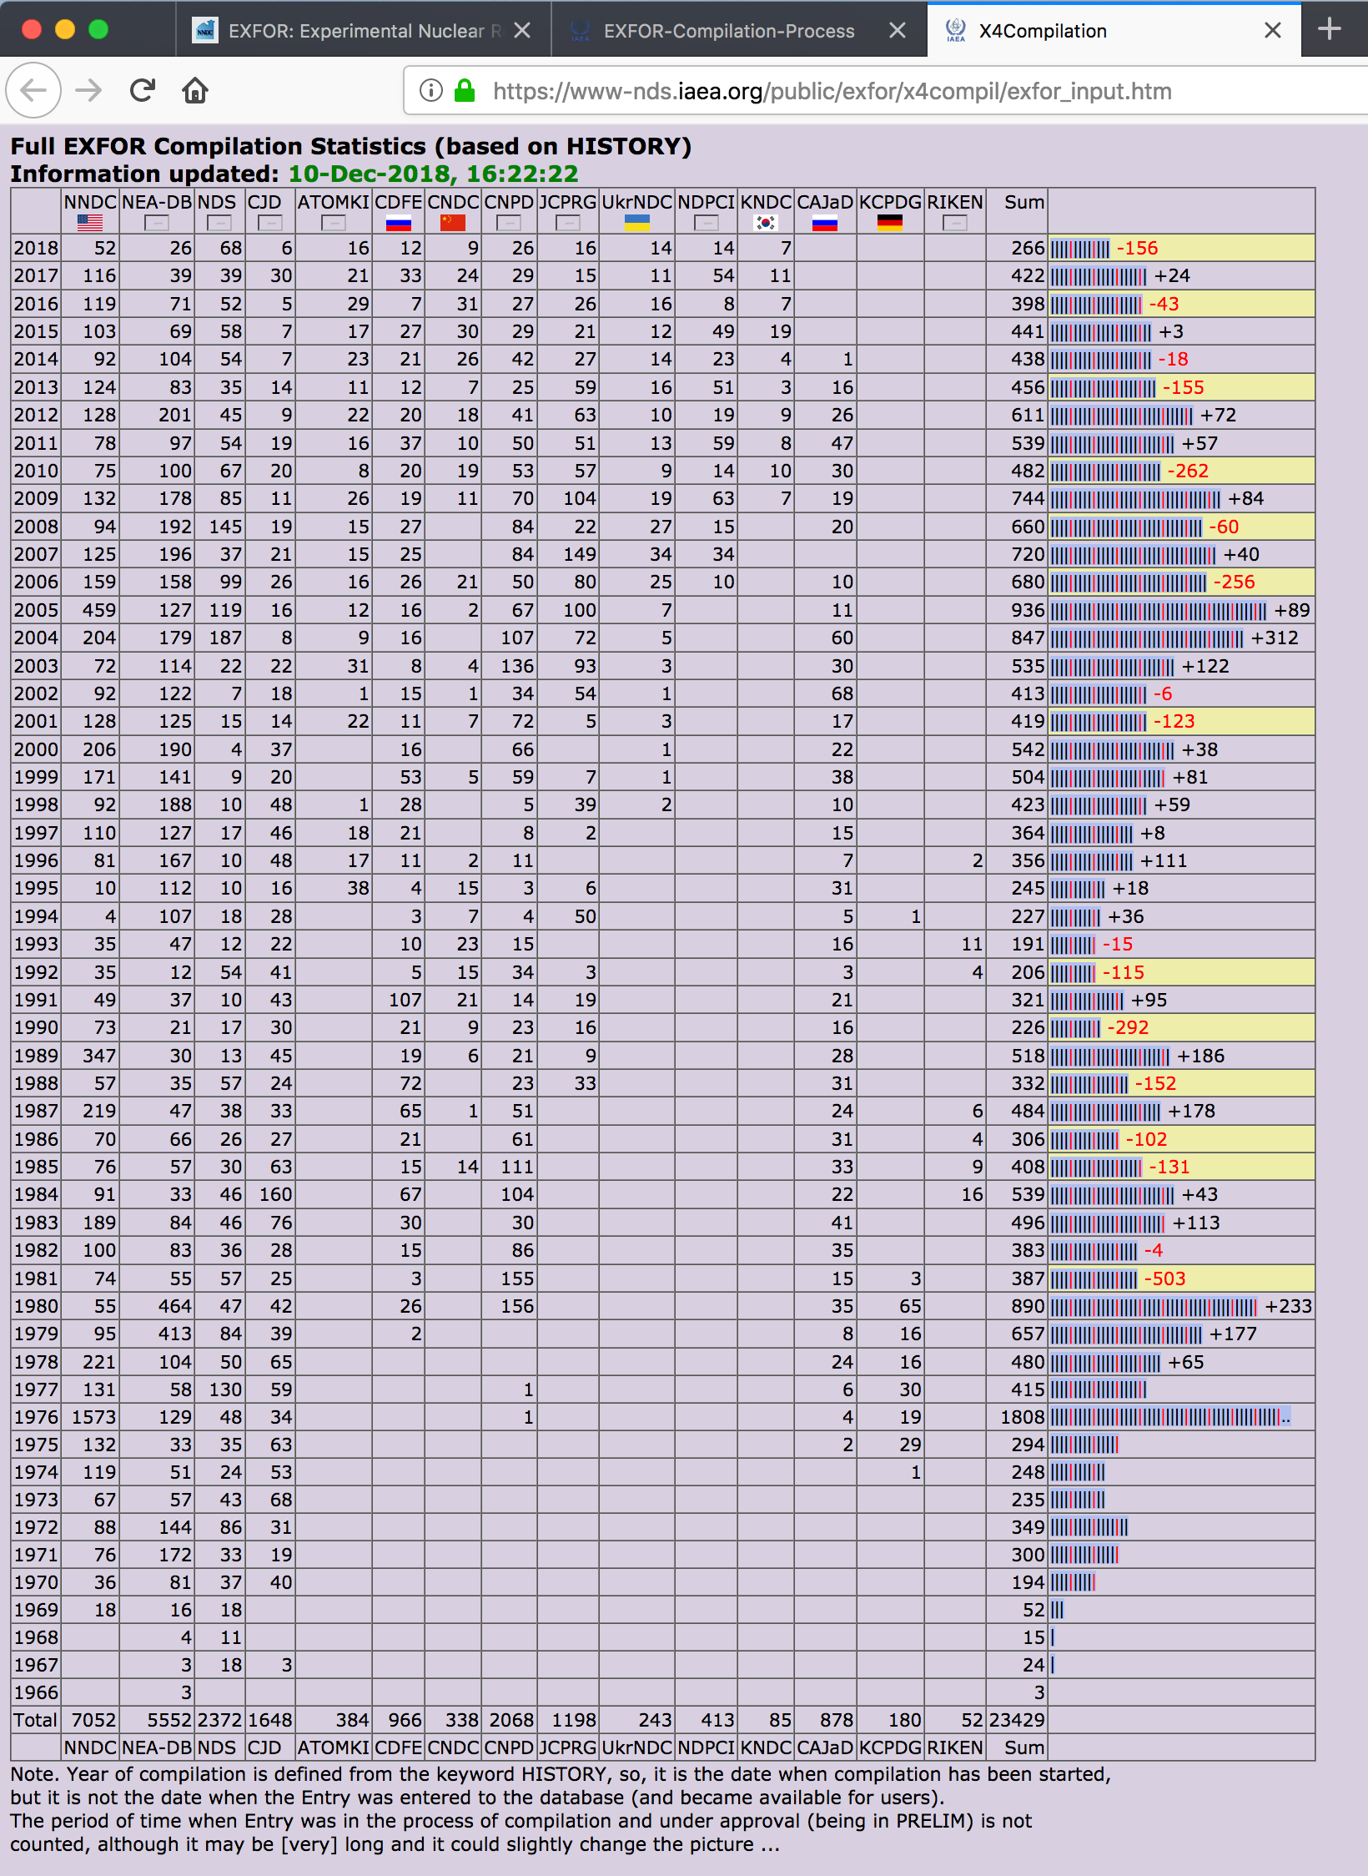
What is EXFOR???
The EXchange FORmat (EXFOR) experimental nuclear reaction database and format for low- and intermediate-energy physics
22,376 experimental works
172,641 reaction data tables
Total and differential cross sections, resonance parameters, fission yields, thick-target and product yields, multiplicities, ….
Originally neutron-induced reactions, charged particles and photons were added later.
All compilations go through a strict quality assurance process.
Available at https://www.nndc.bnl.gov/exfor and https://www-nds.iaea.org/exfor.
EXFOR statistics, the IAEA official count of compilations: https://www-nds.iaea.org/public/exfor/x4compil/exfor_input.htm.
Data compilations were started in United States, centers split data geographically. Therefore NNDC has the largest individual contribution to the EXFOR library followed by NEA-Databank (Paris), NDS-IAEA (Vienna) and others.

Slide 4
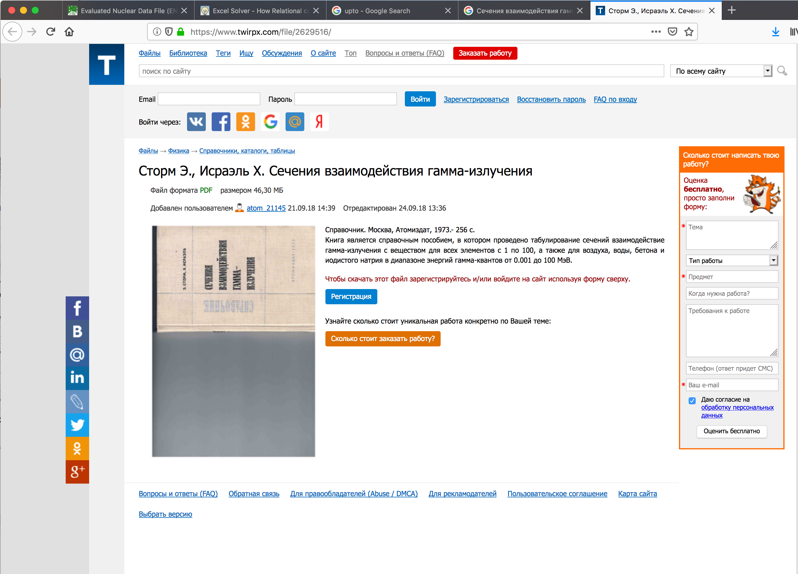
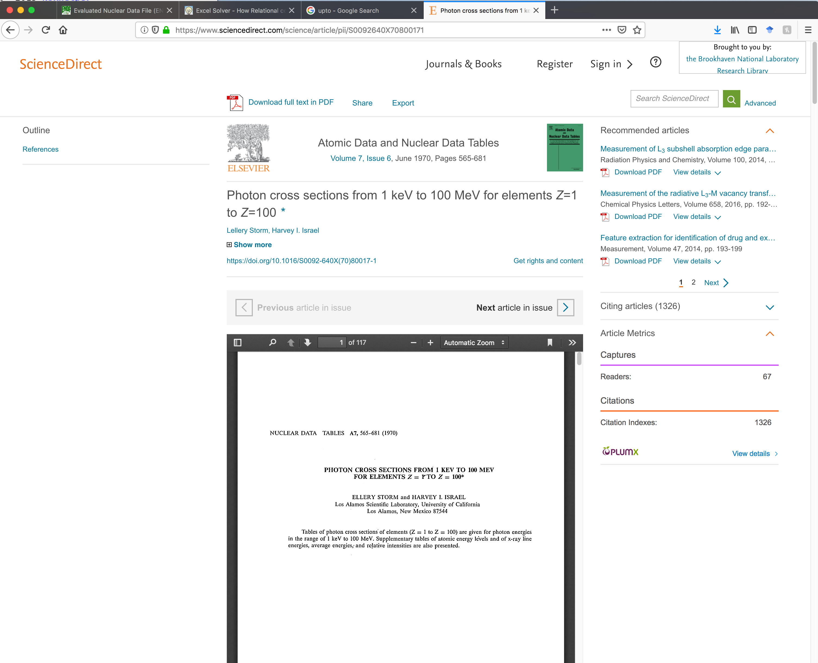
Value of Atomic Cross Sections
User perspective: In gamma-ray, neutron shielding and detector projects we use Photo, Compton and pair production cross sections.
Storm, E. and Israel, H., Proton Cross Sections from 0.001 to 100 MeV for Elements 1 through 100, New Mexico: Los Alamos Sci. Lab., 1967. Translated under the title Secheniya vzaimodeistviy gamma-izlucheniya. Spravochnik, Moscow: Atomizdat, 1973, p. 256.
Also published in Nuclear Data Tables (ADNDT) journal in 1970.
ENDF/B-VIII.0 contains a Photo-atomic sublibrary: describes the interaction of photons with matter as well the direct production of secondary photons and electrons.
ENDF/B-VIII.0 contains an Atomic relaxation sublibrary: describes the relaxation of atoms back to neutrality following an ionizing event. It describes the spectra of fluorescence photons from radiative transitions as an ionized atom returns to neutrality.
ENDF/B-VIII.0 contains an Electro-atomic sublibrary: describes the interaction of electrons with matter as well as the direct production of secondary electrons and photons.

Slide 5
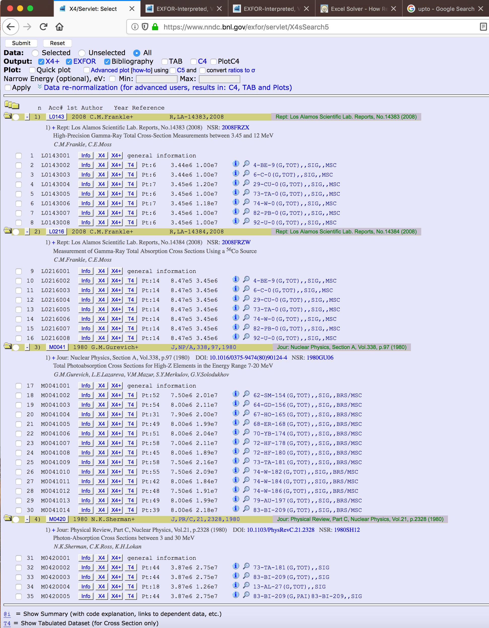
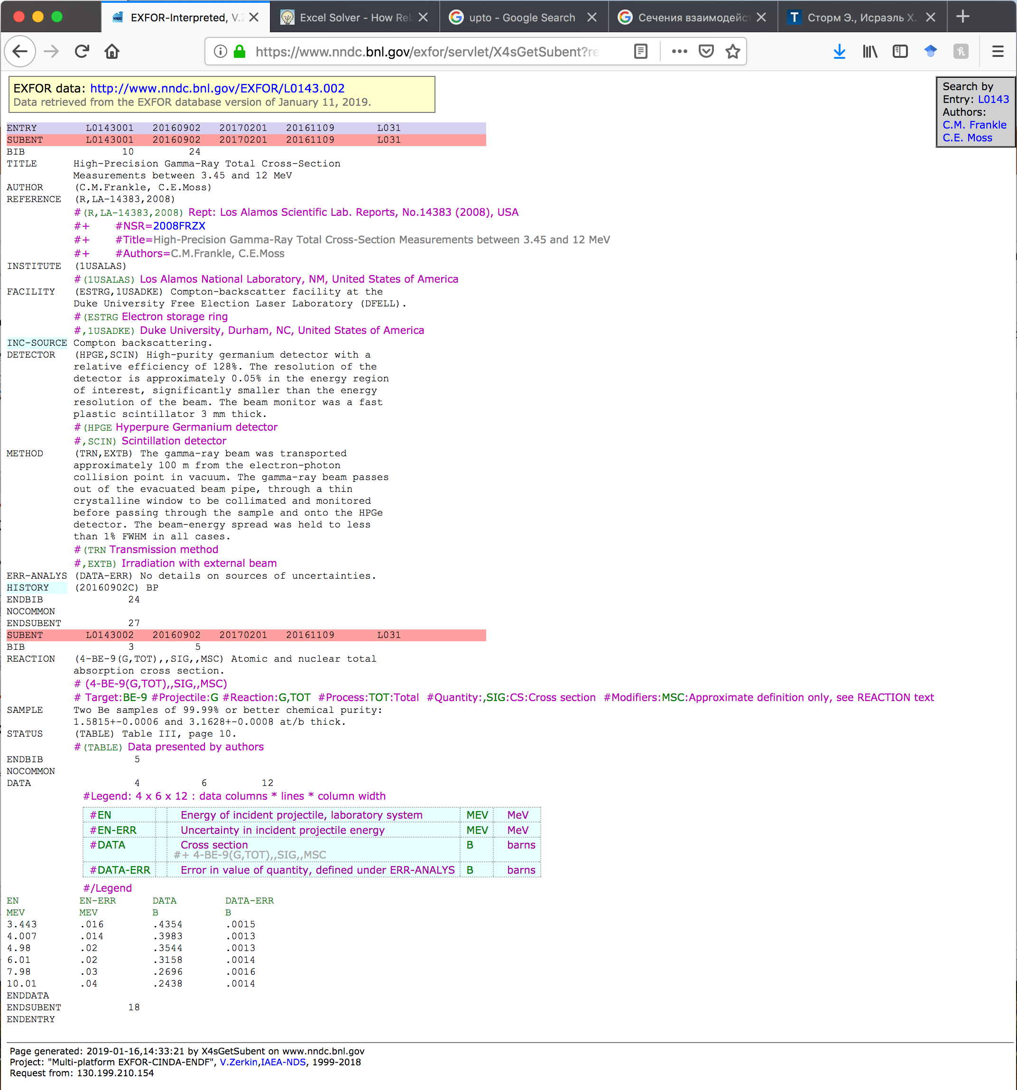
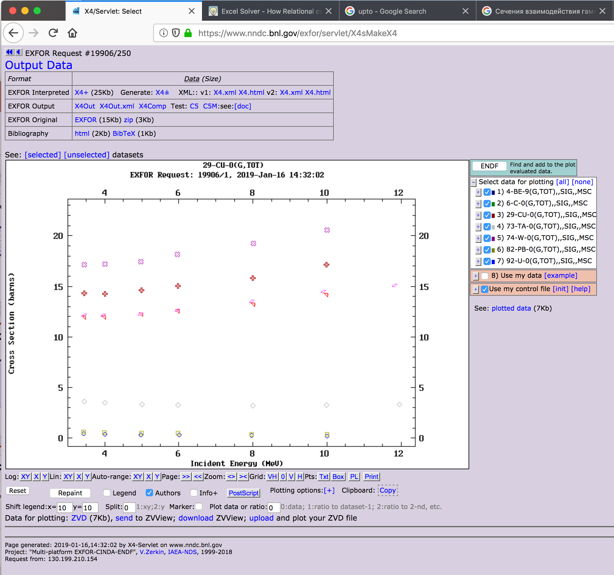
Atomic Cross Sections in EXFOR
No obligatory compilations for atomic data in EXFOR.
Request of M. White, LANL: L0143 (Compton backscattering, Free Election Laser Laboratory), L0216 (56Co, Decay Gammas) was processed by NNDC.
Other entries: M0041 (BRST), M0420 (TAGS) were added by CDFE (Moscow State University).
Reaction code in EXFOR is XX(G,TOT),,SIG,, MSC or XX(G,TOT),,SIG,,BRS/MSC or
XX(G,TOT),,SIG.
We have experimental cross sections in EXFOR for Be, C, Al, Cu, Sm, Gd, Ho, Er, Ta, Yb, Hf, Ta, W, Au, Pb, Bi, U.
"Total photoabsorption" cross section equal to sum of "total photonuclear" + "total photoatomic" cross sections. Atomic cross sections are in barns while nuclear in mb.
EXFOR is already contains complete infrastructure for atomic cross section compilations.

Slide 6
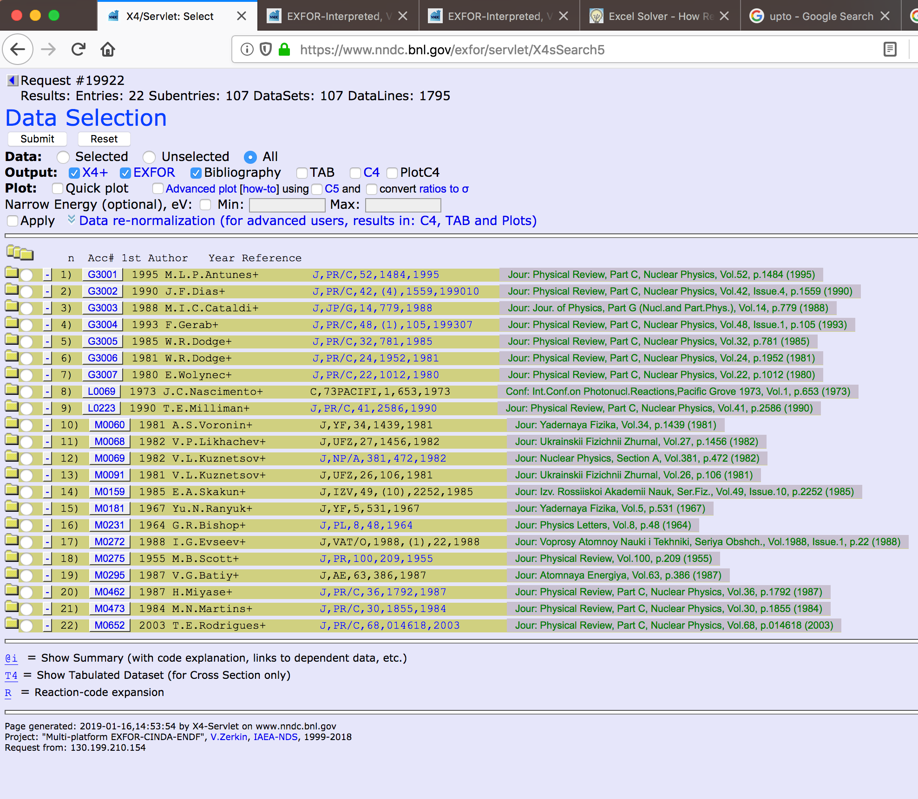
Electron Cross Sections in EXFOR
Limited data: 22 compilations.
Nuclear processes only.
Reaction code in EXFOR is XX(E,*),,SIG
Fast electrons energy losses are outside the EXFOR scope.
The famous Bethe-Bloch formula for ionization losses; bremsstrahlung or braking radiation. There are also transition and Cherenkov radiations. All these effects produce electron/ion, electron/hole pairs, light and phonons.
Ionization and X-ray cross sections are published in NIM/B, PR/A, Can. J. Phys. and ADNDT journals. Currently no ionization cross sections in EXFOR.
Bibliographic search of experimental papers to validate the calculated results.

Slide 7
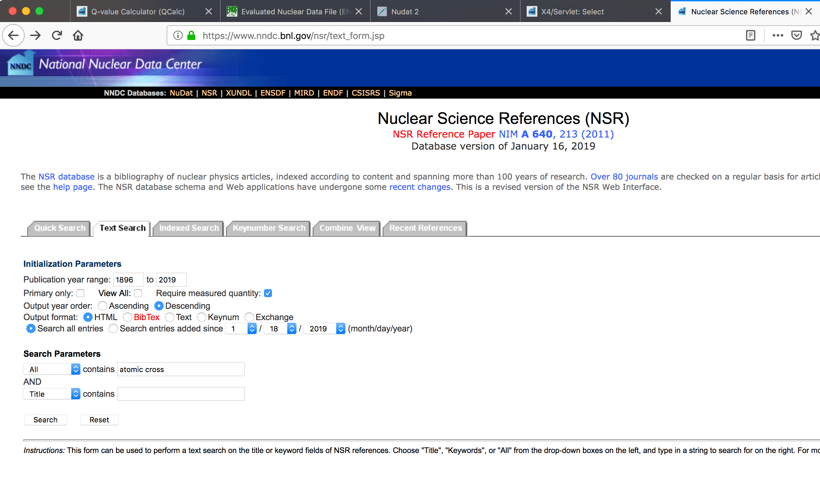
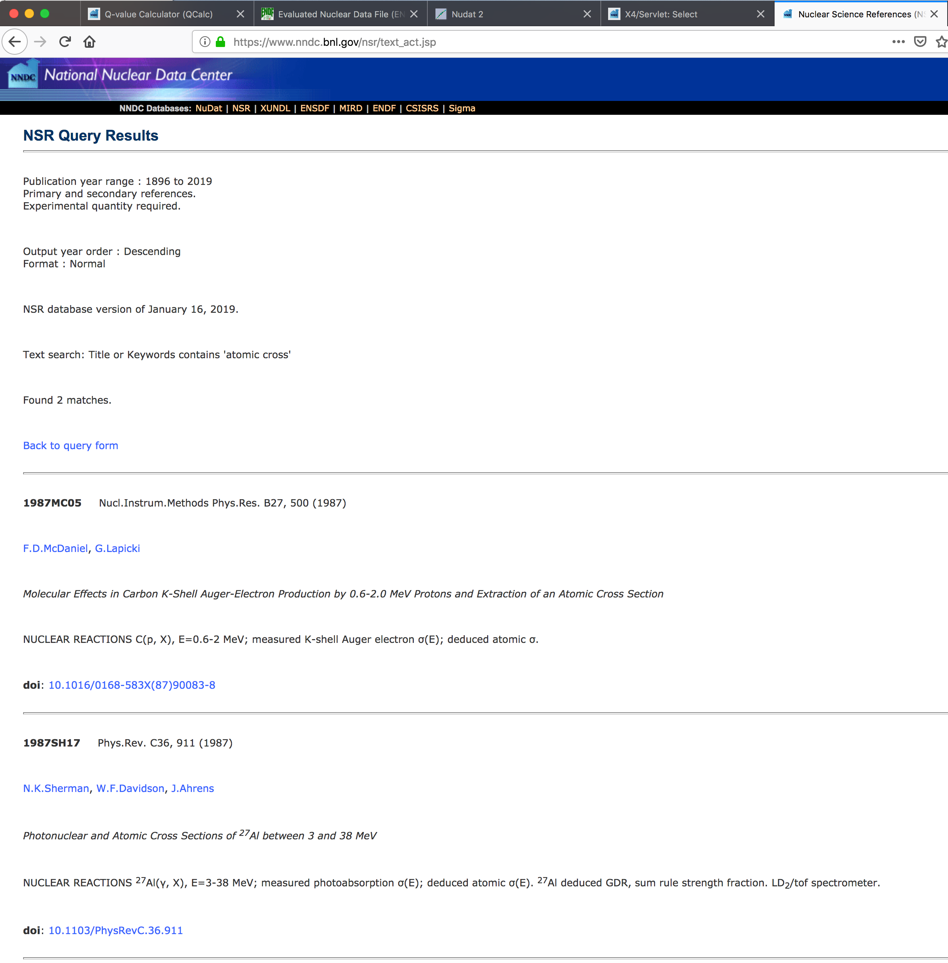
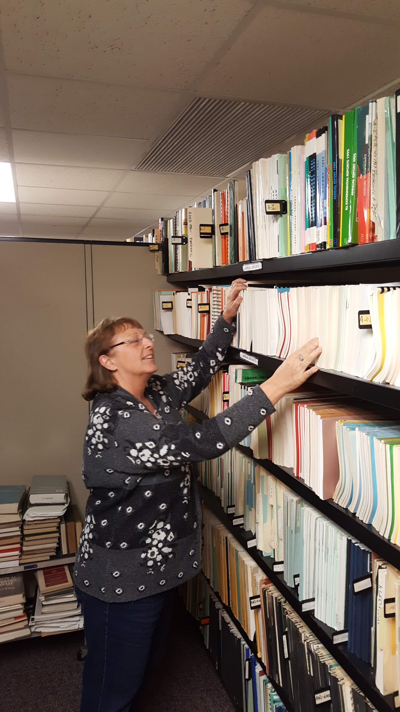
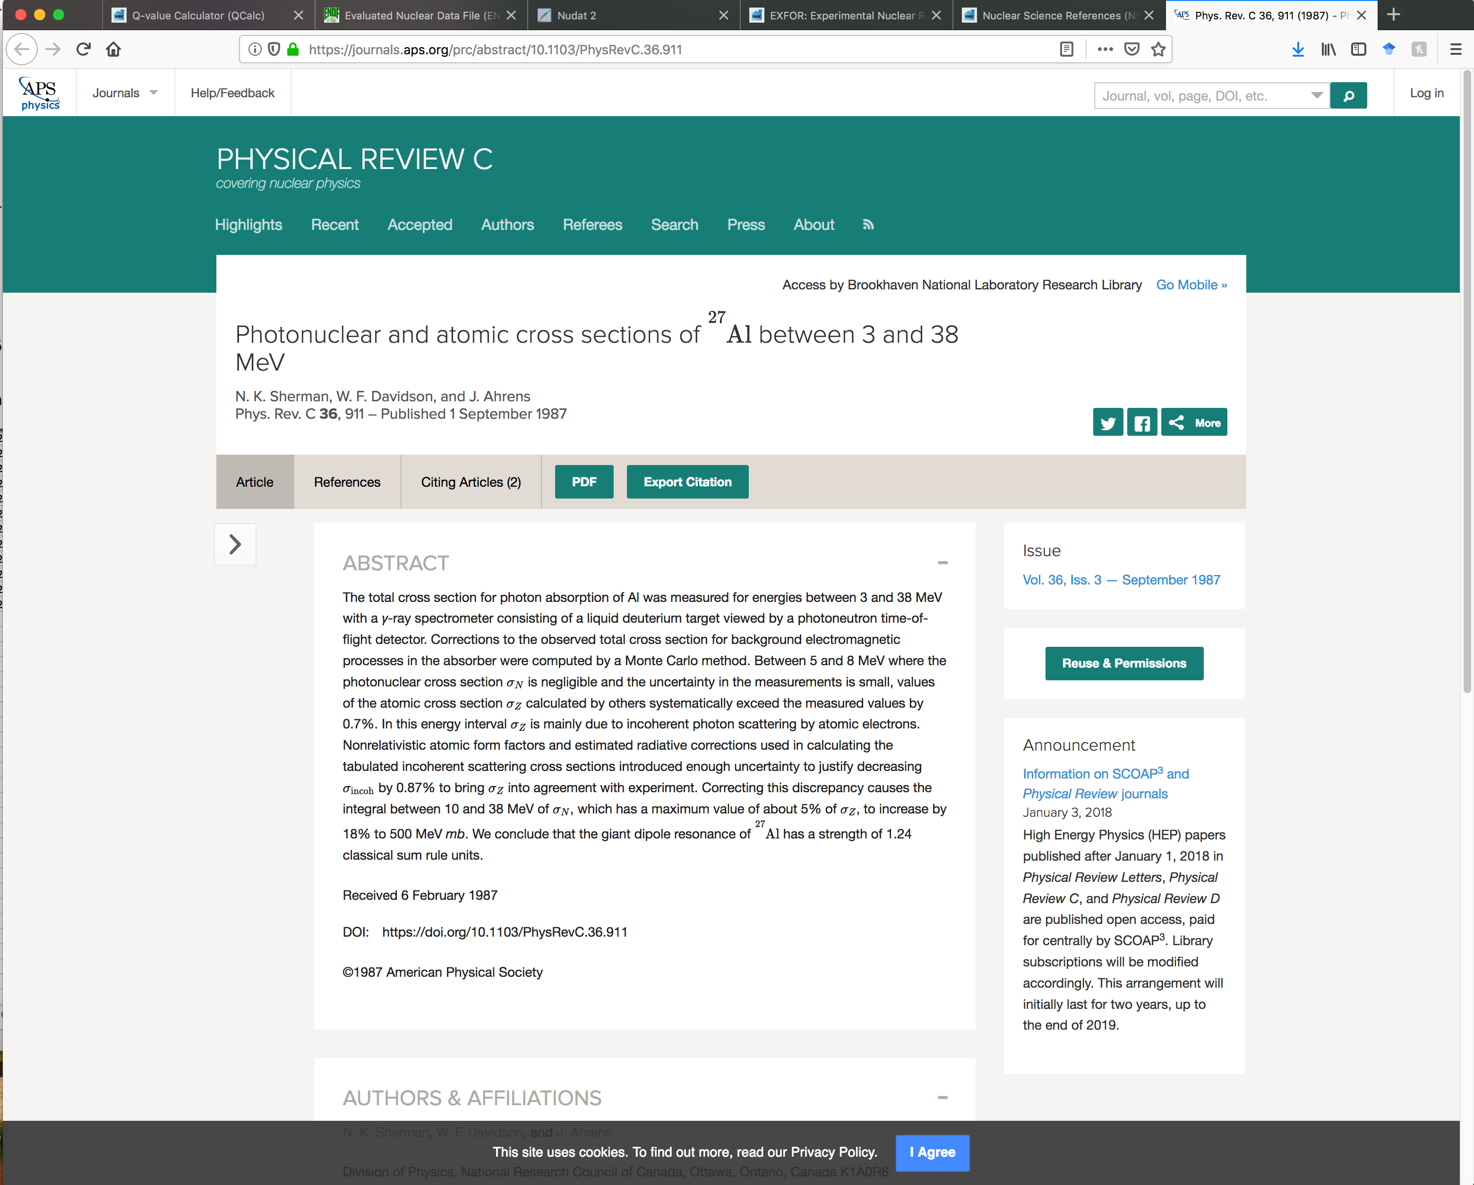
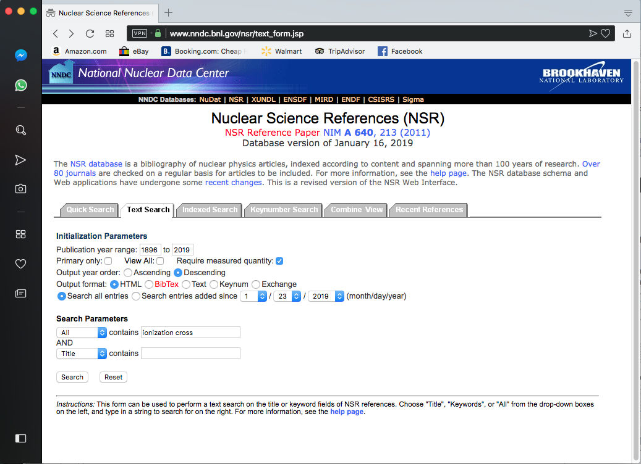
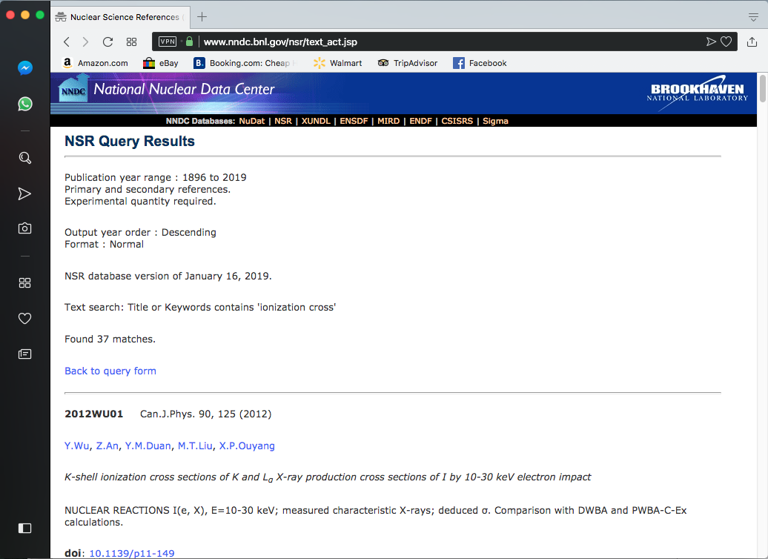
Complimentary Search with Nuclear Science References Database
NSR is a primary nuclear and atomic physics bibliography database
Total number of references is 230,432
Total number of nuclei is 7,211
Total number of reactions is 8,438
Total number of decays is 738
Simple text search for “atomic cross” produced two entries for a NUCLEAR REACTIONS topic.
These NSR entries will be added to EXFOR as C2358 and L0241.
Text search for “ionization cross” results in 37 experimental papers for NUCLEAR REACTIONS and ATOMIC PHYSICS topics.
Text search for “X-ray” and “Auger” result in 3255 and 262 experimental papers, respectively.
NNDC NSR team: B. Pritychenko, J. Totans, B. Singh, E. Betak, and V. Zerkin (IAEA).
Available at: https://www.nndc.bnl.gov/nsr and https://www-nds.iaea.org/nsr.

Slide 8
Conclusions
NNDC data compilation effort is complex and well-organized.
It based on direct interactions with research laboratories and universities in U.S. and Canada, and users worldwide.
We store different data, and atomic measurements could be one of them.
Historically, EXFOR compilations stayed away from atomic data; however, it is designed to support ENDF, and an argument can be made for complete support of reaction data sets in ENDF libraries.
We would be happy to collect recommendation from the WANDA 2019 attendees for atomic data compilations.

