Slide 1
Applications of Heavy Ion Linear Accelerator for Studies of Radiation Effects in Nuclear Fuel and Structural Materials
Jerry Nolen
Chemical & Fuel Cycle Technologies Division
Argonne National Laboratory

Slide 2
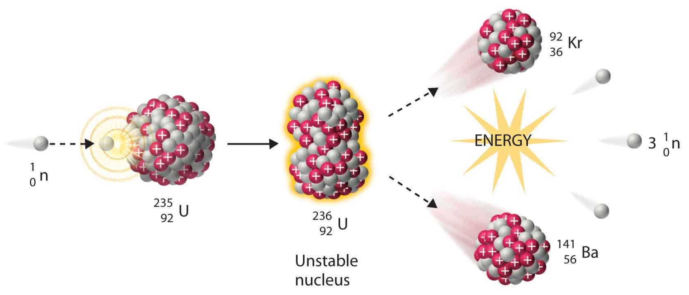
Advantages of High-Energy Ions
Simulate Fission Fragment Damage (Fuels)
    Each fission reaction produces ~200 MeV energy
      2~3 neutron: ~4.8 MeV
      Prompt gamma: ~7 MeV
      Delayed energy (decays): ~ 19 MeV
      2 Fission fragments: ~169 MeV (major source of radiation effects in fuels)
    Swift heavy ions replicate fission fragments (~100 MeV)
    Applicable to already neutron-irradiated fuel to achieve higher burnup level
    Implant gaseous/solid fission products
https://www.nuclear-power.net/nuclear-power/fission/
Notes:
The majority of the ion irradiation experiments are done using low-energy ions (< approximately 10 MeV). This is convenient become ion accelerators such as van der Graaf are inexpensive to procure and maintain. Thus, this kind of experiments can be done in many research institutes.
Although advanced accelerators such as linear accelerators (Linacs), which are less common and expensive to build and maintain, are required to increase the ion energy way beyond 10 MeV, ions with higher kinetic energy (e.g. 50~100 MeV) have several advantages for nuclear materials research.
For nuclear fuels, as mentioned before, the majority of the radiation effects come from fission fragments, which are pairs of heavy ions sharing ~169 MeV energy. These high-energy heavy ions can be exactly replicated by a high-energy ion accelerator. Thus, high-energy ion irradiation experiments are particularly suitable for nuclear fuel studies. In addition to solely using ion irradiation, it can also be used to irradiation fuels that have been pre-irradiation in reactor to reach higher burnup/dose level. Meanwhile, high-energy heavy ions can be used to implant nuclear fuels to simulate gaseous and solid fission products’ behavior in fuels.

Slide 3
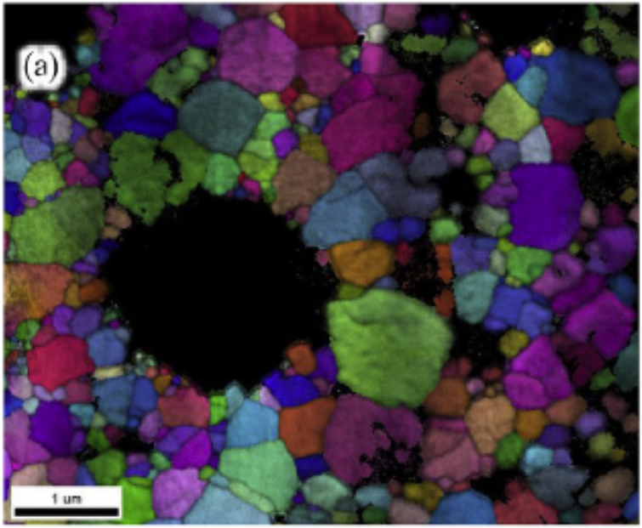
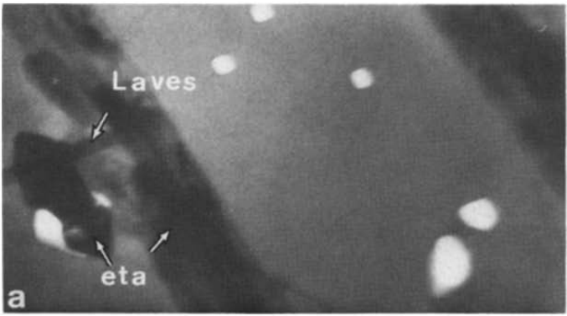
Radiation Effects in Nuclear Materials
Radiation Effects in Nuclear Fuels
    Major origin: fission fragments with ~100 MeV energy
    Energy deposition of fission fragments
      Point defects accumulation (dislocations, voids, etc.)
      Amorphization and decomposition
      Grain subdivision
    Accumulation of stopped fission fragments
      Fission gas bubbles
      Secondary phases and solid solution (solid fission products)
HBS in in-pile irradiated UO2 featuring nanocrystalline grains and micro-pores [1]
Radiation Effects in Structural Materials
    Major origin: neutrons
    Energy deposition of neutrons/secondary ions
      Point defects accumulation (dislocations, voids, etc.)
      Amorphization and decomposition
      Grain subdivision
    Neutron induced nuclear reactions
      He bubbles
Secondary phases and He bubbles in in-pile irradiated SS316 [2]
[1] T.J. Gerczak et al, JNM, 2018 [2] P.J. Maziasz et al, JNM, 1981
Notes:
Materials in nuclear reactors experience extreme radiation conditions.
In nuclear fuels, where fission reactions occur, the majority of the radiation effects originate from fission products, which are heavy ions with ~100 MeV energy. These energetic heavy ions are stopped within the fuel materials and deposit their high energy into the fuel. These deposited energy leads to a series of microstructural modifications in fuels:
point defects formed as the results of displacement cascades can cluster and evolve into dislocations and voids;
high density of radiation damage may cause amorphization and phase decomposition to lower the local free energy;
recrystallization or localized accumulation of dislocation arrays can also result in grain subdivision (nanocrystallization).
On the other hand, once these fission fragments are stopped in fuel, they become foreign atoms. Depending on their properties, they may form gas bubbles or secondary phase precipitates.
In structural materials that are free of fission reactions, the radiation effects are mainly caused by neutrons. Neutrons interact with structural materials and form secondary ions. These event will form similar microstructural modifications as mentioned early for fuels. Meanwhile, neutrons can react with atoms in structural materials and form foreign atoms. For instance, (n, alpha) reactions of Ni account for the formation of He bubbles in Ni alloys and stainless steels.
All these microstructural modifications alter the materials’ properties, and may cause degradation of material performance in reactor. Thus, the mechanisms and kinetics of these radiation-induced microstructural modification in both fuel and structural materials must be well understood to improve the performance of current nuclear fleet and support development of advanced reactors.

Slide 4
In-Pile Irradiation VS Ion Ion Irradiation
In-Pile Irradiation Tests
    Advantages:
      Simulate the real in-reactor operational environment: apple to apple comparison
      Provide necessary data for NRC licensing
    Disadvantages:
      High cost and long project timespan
      Severe radiation hazards due to neutron activation
Ion Irradiation Produced by Accelerator
    Advantages:
      Easy to access; low cost; time efficiency; no radiation hazards
      Capable of providing valuable information with well-designed experiments and proper data analysis/interpretation (support modeling and simulation)
      Useful for materials screening to select the best performance under irradiation
    Disadvantages:
      Need to understand implications of difference between neutron and ion irradiation:
        Dose rate effects (ion dose rate is much higher)
        DPA Interpretation (full cascade vs KP model)
Uncertainties Associated with Ion Irradiations
  Effects dose rate on simulating the neutron damage
  SRIM code calculations of DPA: cross sections and models uncertainties
  Beam profile distribution and energy uncertainties
    Ion irradiation is an ideal complementary method to in-pile irradiation
Notes:
In-pile irradiation experiments suffer high cost and long project timespan. In addition, as neutrons can activate materials, in-pile irradiated materials usually have very high radioactivity and therefore require special handling to control the radiation hazards.
On the other hand, ion irradiation can be used to simulate the microstructural modifications induced by in-pile neutron irradiation. Low-energy ions can be produced by accelerators that can be found in many institutes. Even for high-energy ion accelerators that are available in only a few research institutes, the cost and timespan of the irradiation experiments are still much lower than in-pile irradiation. More important, the energy threshold for ions to activate materials is much higher than that of neutron. So, ion irradiation experiments usually do not induce extra radiation hazards.
With well-designed experiment conditions and proper PIEs and data analysis methods, ion irradiation is capable of replicating or simulating a series microstructure modifications observed in in-pile irradiation materials and providing valuable information.
Although in-pile irradiation cannot be fully replaced, ion irradiation can be used to guide the in-pile irradiation experiment design and to help understand the phenomena observed in-pile irradiation experiments. Thus, it is a complementary methods to in=pile irradiation that can significantly facilitate nuclear material studies.

Slide 5
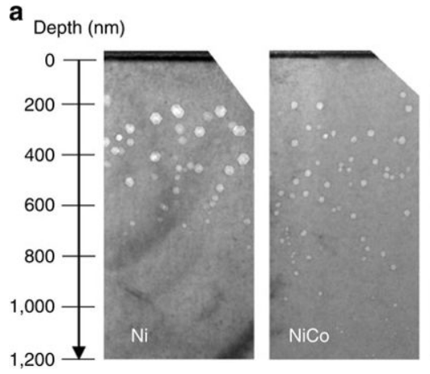
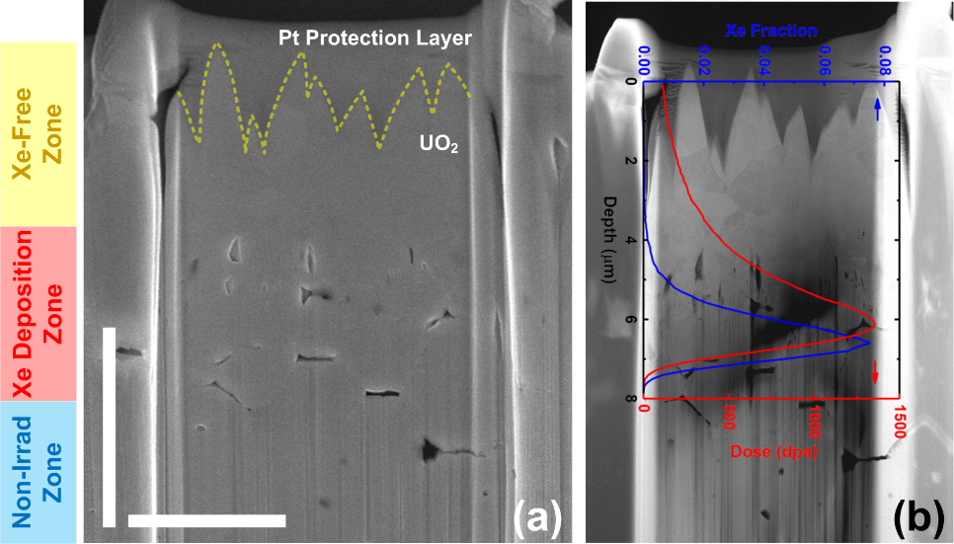
Advantages of High-Energy Ions vs. Typical Low Energy Ions
Deeper damage profile
    1~10 MeV ions → up to ~ 1 micron deep
    50~100 MeV ions→ up to ~10 micron deep
    A wider damage zone away from surface and free of added interstitials facilitate following:
      Mechanical properties (micro-mechanical tests by micropillar compression, nano indentation, etc.)
      Thermal properties
      Microstructure characterizations (more advanced techniques can be applies)
      Advanced characterizations: synchrotron micro-diffraction to examine the irradiated microstructures
~1 μm radiation affected zone in 1.5 MeV Ni ion irradiated Ni (alloy) [1]
~8 μm radiation affected zone in UO₂ irradiated by 84 MeV Xe, to high dose (1357 dpa) to replicate HBS features [2]
[1] C. Lu et al., Nat. Comm. 2016；[2] Y. Miao et al., Scripta Materialia, 2018
Notes:
For nuclear structural materials, the situation is different, since the radiation effects originate from neutrons instead of heavy ions.
However, neutrons interact with structural material atoms to form secondary ions (knock-on ions). These secondary ions further deposit energy in materials and cause radiation damages. Thus, self-ion irradiation can simulate this procedure.
Although high-energy heavy ions (self-ions) usually have a kinetic energy higher than typical secondary ions, they provide some extra advantages in structural material studies. Due to the high energy, it takes a much longer distance (ion range) to stop these high-energy ions. Thus, the radiation damage profile of high-energy ions go much deeper into the sample surface. Compared to ~1 micron profile created by conventional ion irradiation, high-energy ions can go as deep as ~10 micron into the surface. As we know, within a damage profile, microstructure evolution close to surface is affected by surface effect and needs to be averted. Likewise, the area near the ion range is interfered by added interstitial. Thus, only a fraction of damage profile in the middle is useful. Thus, we have a significantly larger useful region in high-energy ion irradiation experiments, as shown in these two SRIM calculation (use steel as an example).
The wider damage profile also facilitate microstructure characterization. As damage profile dimension is increased by ~10 times, microstructure characterization techniques with lower spatial resolution can be used now. For example, synchrotron X-ray can only be focused to submicron (e.g. ~0.4 micron at APS sector 34) level, which can be used for high-energy ion irradiated samples.
Last but not least, due to the surface sputtering effect, low-energy ion irradiation cannot reach ultra high doses (10^4 dpa), as surface sputtering will eventually remove the previously irradiated zone.

Slide 6
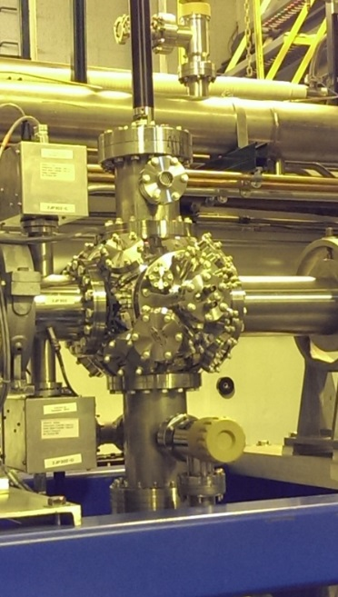
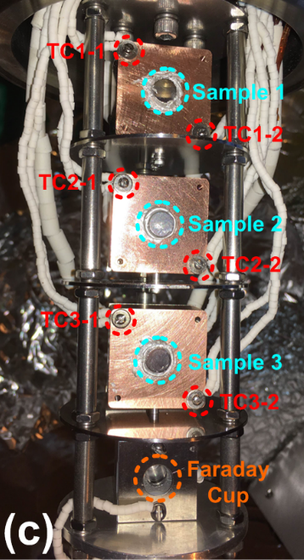
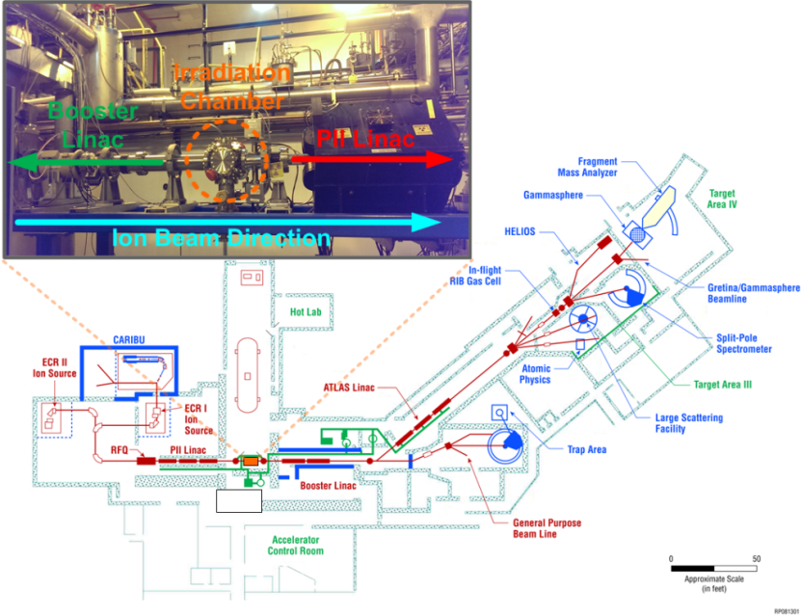
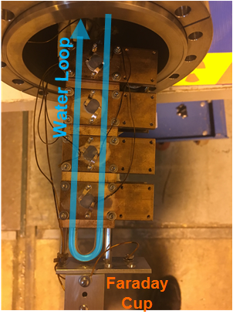
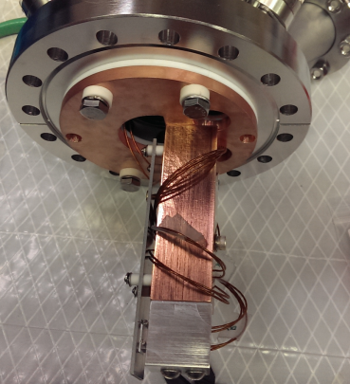
Ion Irradiation Chamber at ATLAS
Ion Irradiation Chamber Established at ATLAS
Irradiation Chamber
Hi-Temp Sample Stage
(>300C)
Features of the Chamber
  Between PII and Booster LINACs
  Up to 1.5 MeV per nucleon
  Ion type: proton to uranium
  (e.g. 56 MeV Fe, 131 MeV Xe, etc.)
  Up to 1 pμA ion current
  Multiple sample stages supporting irradiation temperature ranging from RT to 900C.
Active Cooling Sample Stage
(RT to 300C)
Passive Cooling Sample Stage
Notes:
In order to take use of ATLAS’s advantageous ion acceleration capabilities for nuclear material studies, we developed an ion irradiation chamber at ATLAS.
We do not need the full power of ATLAS. So we established the chamber between PIII and Booster Linacs at ATLAS. At this position, ATLAS can accelerate ions up to ~1.5 MeV per nucleon for ions from proton to uranium. (for instance, we can use 56 MeV Fe ions to irradiate steels or use 131 MeV Xe to implant fuels). The current can be as high as 1 particle nano ampere with a 2D Gaussian profile.
We developed multiple sample stages dedicated for different applications. Now we have both Hi-Temp and Lo-Temp stages that can holder multiple samples to save pumping time. The irradiation temperature can range from room temperature to 900C.

Slide 7
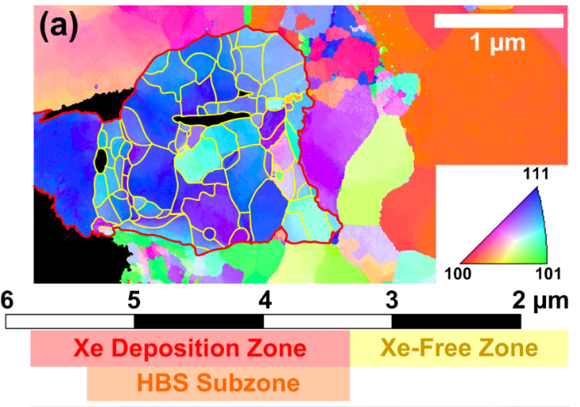
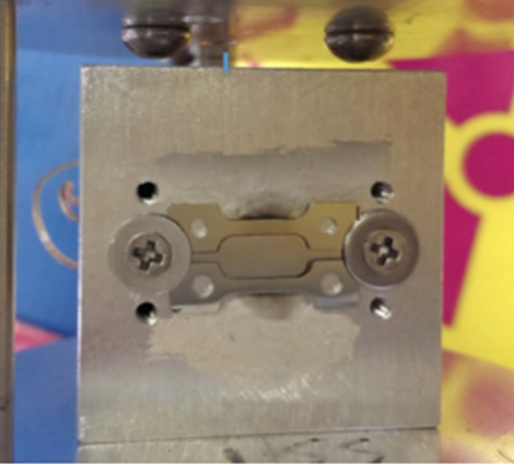
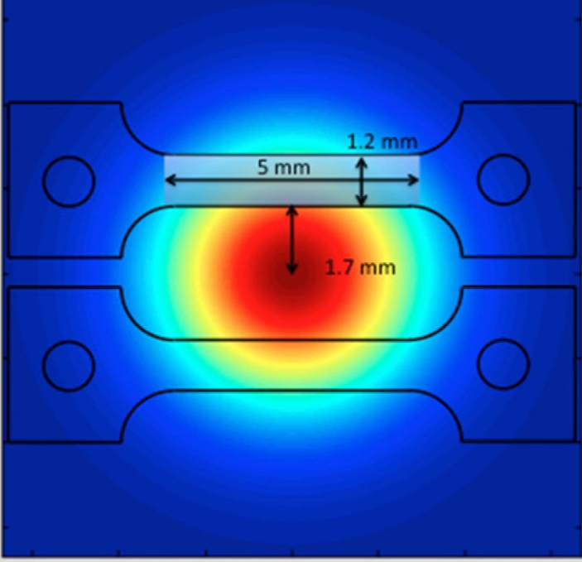
Nuclear Material Applications
Nuclear Fuel Materials
  Replicate ~100 MeV fission fragments (FPs)
  (e.g. Zr, I, Kr, Xe, etc.)
  FP irradiation → dislocations, grain growth, phase stability, etc.
  FP implantation → gaseous/solid FP behavior
  Examples:
    LWR fuels: UO₂, U₃Si₂ (ATF), etc.
    RERTR fuels: U-Mo, U₃Si₂, coated particles, etc.
    Fast reactor fuels: U-Zr
UO₂ irradiated by 84 MeV Xe to high dose (1357 dpa) to replicate HBS features [2]
Nuclear Structural Materials
  High-energy self-ion irradiation
  Deep damage profiles (up to ~10 μm)
  Microstructure evolution: dislocations, grain growth, secondary phase precipitation, etc.
  Examples:
    Advanced steels, e.g. HT9, MA957, NF709 (56 MeV Fe ions)
    Zirlo, Zry-2 (91 MeV Zr ions)
    SiC (28 MeV Si ions)
84 MeV Fe irradiated MA957 ODS steel for synchrotron investigations [1]
[1] K. Mo et al., Materials, 2016 [2] Y. Miao et al., Scripta Materialia, 2018
Notes:
Using these experiment setup at ATLAS, we have been working on a series of nuclear materials in the past few years.
For nuclear fuel studies, we used fission product ions to irradiate fuels to induce accumulation of defects. Also, we implanted Xe ions to study the morphology of fission gas bubbles and their evolution kinetics. We have worked on a series of nuclear fuel materials, including conventional ceramic fuel UO2, ATF concept fuel U3Si2, RERTR fuel for high-power research reactors U-Mo, and fast reactor fuel U-Zr.
On the other hand, we did self-ion irradiation for some structural materials to study the formation of radiation-induced microstructures and their impacts on mechanical properties.

Slide 8
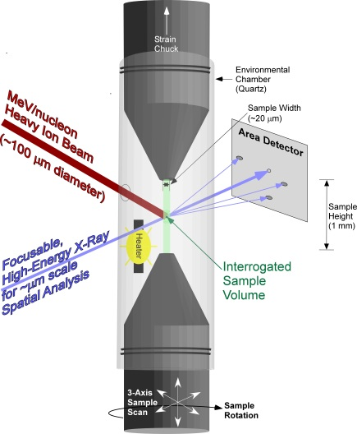
Proposal – eXtreme MATerials beamline (XMAT)
A new beamline at the Advanced Photon Source (APS) for in situ studies of materials under irradiation, temperature, stress, environmental, etc.
XMAT will provide x-ray probes for in-situ study of materials in simulated extreme radiation environments, enabling rapid evaluation of materials performance under extreme service conditions including structural materials and in particular for nuclear fuels.
XMAT is made possible by combining the technology of Argonne’s unique capabilities:
Energetic, Heavy Ion Beams (ATLAS)
Focusable, High Energy X-Rays (APS)
Multi-modal Imaging (APS)
In-situ monitoring the changes in mechanical properties, and microstructures during ion irradiations
Opportunity Window -> APS/ATLAS Upgrades
Notes:
Concept: We have come to expect materials subject to extreme environments to fail. This expectation leads to redundancy and inefficiency. No where is this more evident than in nuclear power generation where improved materials are needed to address almost all the grand challenges facing the industry including cost, lifetime extension, accident tolerance, and advanced reactor implementation.
Multi-modal imaging at the APS is shown in the figure; it includes absorption, WAXS and SAXS modalities. By rotating the sample about the vertical axis, 3D tomographic information can be obtained. While hard x-ray scattering is shown, additional x-ray studies including Exafs etc are all possible.
Testing new materials to the high radiation doses necessary can require many years if not decades hindering the development of new materials. Even waiting for induced radioactivity to wain can take years. We propose to combine two unique Argonne capabilities (ATLAS and APS) to test, understand and develop materials in the style of Argonne’s highly successful IVEM Tandem, but with dramatically enhanced capabilities.

Slide 9
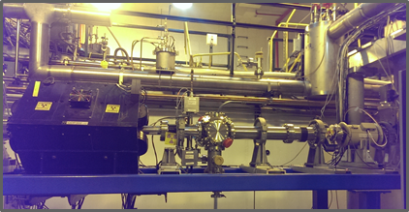
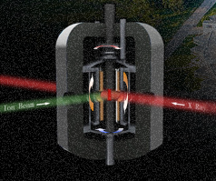
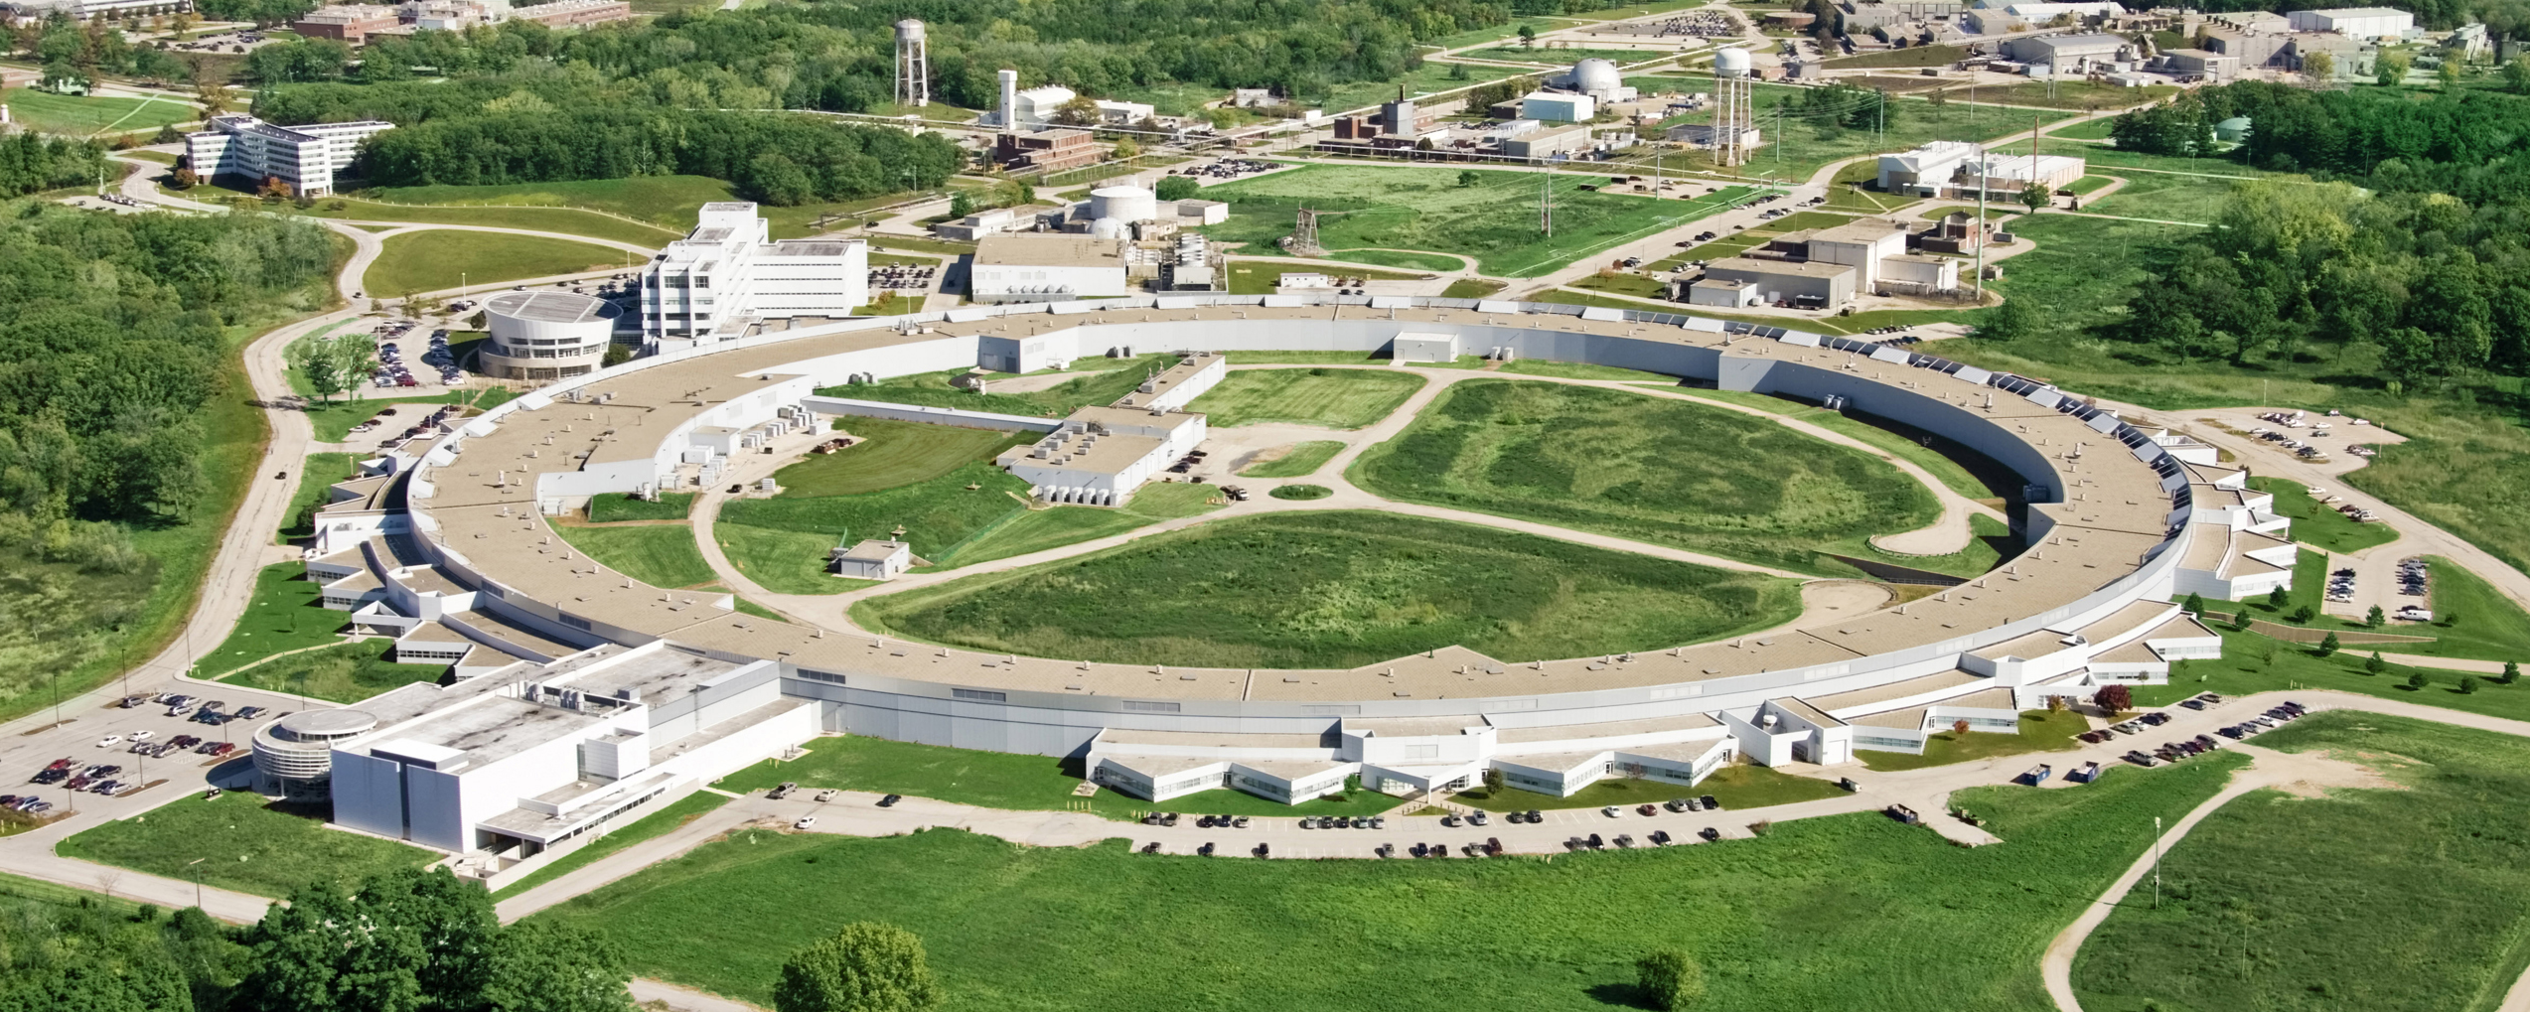
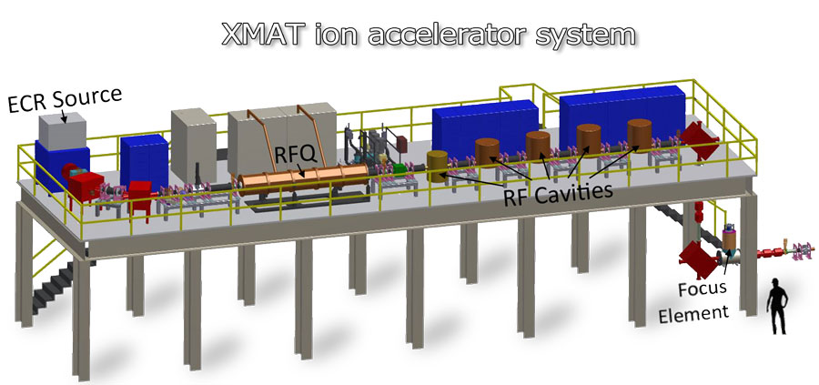
Timeline of XMAT
1st year
2nd year
3rd year
4th year
5th year
Beam Switcher Upgrade (AMIS) + Sample Station w/ T + Strain
Extended Beam Time for NE Users
XMAT
Full Capability
High-Energy Ion Irradiation
In-situ X-ray Investigation
Full Beam Availability
100% Specified Ion Beam
Hi-Relevance Applications
Rate-dependent processes
Microstructure evolution
200 hrs/yr
1,000~2,000 h/yr
Ex-situ Station
@ ATLAS
Current Capabilities
Ex-situ WAX/SAXS/Tomography/HEDM
APS Upgrade
Opportunity to Build In-situ Hutch
Coherent X-ray Beam
APS
User Proposal Based Allocation
XMAT Ion Accelerator
Build accelerator & acceptance facility
1 MeV/amu
In-situ Station @ APS
Notes:
XMAT has both an ex situ and an in situ irradiation station. The ex situ station will allow hundreds to thousands of samples to be irradiated for days to years. These samples can then be moved to any of a variety of analytical facilities ranging from SAX, WAXS, etc at the APS to FIB, SEM, TEM, EDAXS, etc. at microscope facilities. The in situ station will fully evaluate the three dimensional radiation rate dependence of a sample’s structural changes in concert with thermal or stress gradients. Surface corrosion can also be investigated in for instance gas reactor environments.
The construction timeline is 5 years. However, we propose to construct the ex situ sample station and provide high energy ions to the NE user community in the first year reaching 1000-2000 beam hours in the second through fifth year. These samples can studied with sequential x-ray analysis at the APS or elsewhere.
In concert an accelerator based on the ATLAS design will be constructed @ an extended high energy x-ray beamline to be constructed at the APS during its upgrade. This accelerator (optimized for radiation damage study) will include an ex situ station providing roughly an order of magnitude more high energy ion beam for NE sample irradiation.
It will also include an in situ station for combined APS study under irradiation. Crucially this will allow direct study of rate effects and its competition with thermal, stress and corrosion gradiants. Access here will be based on use proposals and on NE investments.
At CD1 stage upgrade
Planned for 2020 and will take one year
Current is 3 times highr than Atlas
Usyage is 3 times more
10 times utlization
More samples

Slide 10
Summary: Heavy Ion Irradiation Using a LINAC (ATLAS) for Radiation Effects Studies
High-energy ion irradiation produced by LINACs is capable of
replicating a series of microstructural modifications observed in in-pile irradiated materials to help understand the mechanisms;
  Fission gas bubbles in UO₂ and U-Mo
  Al-ZrN IL in U-Mo dispersion fuel with ZrN coated particles
  Radiation-induced dislocations in steels
providing microstructural modifications data of new nuclear materials before in-pile data are available;
  Bubble morphology and phase stability data of U₃Si₂
creating a deep radiation damage profile that enables the application of advanced characterization techniques;
  Phase stability in U-Mo and U₃Si₂ (μXRD)
  Effect of dislocations on mechanical properties (in situ synchrotron tensile test)
Future development: Proposed XMAT facility, combining the high-energy ion irradiation and synchrotron characterization capabilities at Argonne.

Slide 11
BACKUP

Slide 12
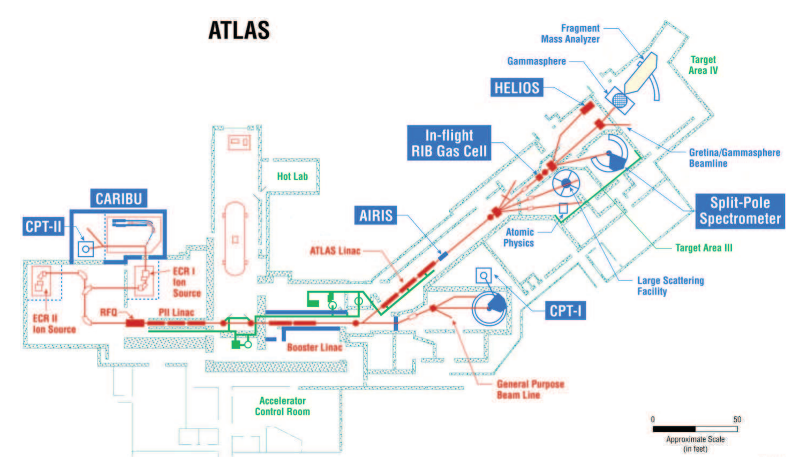
Argonne Tandem Linac Accelerator System (ATLAS)
ATLAS Capabilities
  Nuclear structure research facility
  Superconducting linear ion accelerator
  Energy: up to 17 MeV per nucleon capability
  Available Ions
    full range of all stable ions
    Some radioactive ions
    From proton to uranium
Notes:
High-energy ion irradiation can only be done in a limited number of facilities. Fortunately, we have ATLAS facility at Argonne.
ATLAS is a nuclear structure research facility supported by DOE. It has a series of linacs powered by superconducting technology. It is capable of accelerating ions up to 17 MeV per nucleon energy (~1000 MeV level). More importantly, it can accelerate full range of all stable ions from proton to lead. Some radioactive ions, such as uranium, can also be accelerated.

Slide 13
Key XMAT Advances
In comparison to most existing ion irradiation capabilities, the XMAT ion energies and currents are ~100 times higher. The increased ion irradiation energy (e.g., 133 MeV for xenon) enables several critical advances:
It provides a unique opportunity to simulate the effects of fission fragments in nuclear fuels, where ions of all elements can be accelerated to fission fragment energies, while being characterized in situ.
For cladding and structural materials, the increased penetration depth of energetic ions allows the “bulk behavior” to be examined, eliminating surface-sink effects, and allows understanding of individual physics of ion damage including electronic, collisional, & added interstitial
The in situ penetrating ability of the APS focusable hard x-rays, applied during ion irradiation, is another key advancement of XMAT that allows the interrogation of individual grains within solid material samples during irradiation.
With this information and related computational modeling, the differences between ion and neutron irradiation as well as the impact of fission products damage become much more understandable.
XMAT can close the design loop for the entire nuclear materials community in two ways:
It provides accelerated testing for hundreds to thousands of samples (24; 7)
It reveals the key “single” physics dependences required for accurate computational modelling
13
Notes:
It provides a unique (first-ever) opportunity to simulate the effects of fission fragments in nuclear fuels, where ions of all elements can be accelerated to fission fragment energies, while being characterized in situ. Moreover, the penetration depth of energetic ions allow peak damage levels exceeding the equivalent of 50% burnup to be achieved in fuel samples in only a few days. In this energy range all fission fragment damage mechanisms are accessible.
For cladding and structural materials, the increased penetration depth of energetic ions allows the “bulk behavior” to be examined, essentially eliminating surface-sink effects not representative of neutron damage. Moreover, distinct damage mechanisms are separated over ~10 micron ion penetration depth, with the collisional (neutron like) damage isolated both from the surface sink and from other ion processes such as added interstitials. This enables x-ray interrogation of the collisional damage, facilitating its correlation to actual neutron damage and revealing key fundamental parameters needed to improve computational modeling.
The in situ penetrating ability of the APS focusable hard x-rays, applied during ion irradiation, is another key advancement of XMAT that allows the interrogation of individual grains within solid material samples during irradiation. It reveals in a single sample many of the features of radiation damage, including the effects of added interstitials, swift ion effects, and the role of interstitial/vacancy trapping. With this information and related computational modeling, the differences between ion and neutron irradiation as well as the impact of fission products damage become much more understandable.
While constructing all parts are working on parallel already at some level there is minimal risk of success of the facity outcome

Slide 14
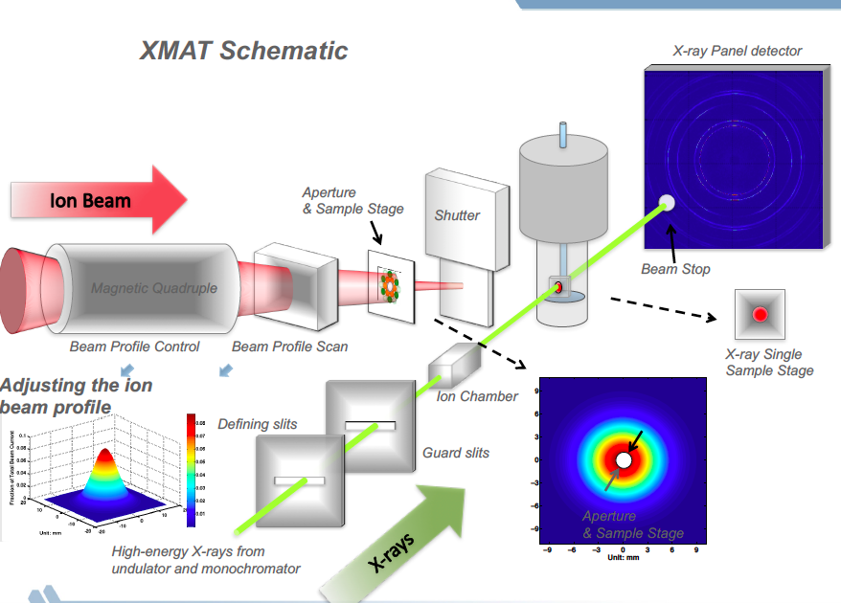

Slide 15
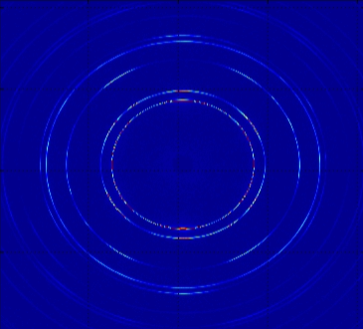

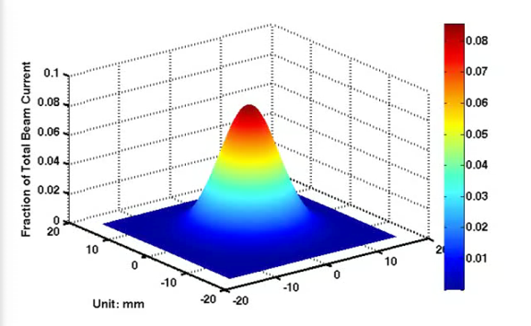
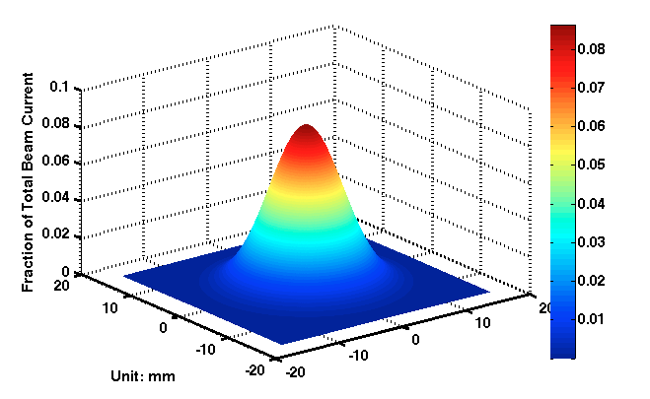

XMAT Schematic
X-ray Panel detector
Ion Beam
Aperture
& Sample Stage
Shutter
Beam Stop
Magnetic Quadruple
Magnetic Quadruple
Beam Profile Control
Beam Profile Scan
X-ray Single Sample Stage
Adjusting the ion beam profile
Ion Chamber
Defining slits
Guard slits
X-rays
Aperture
& Sample Stage
High-energy X-rays from undulator and monochromator

Slide 16
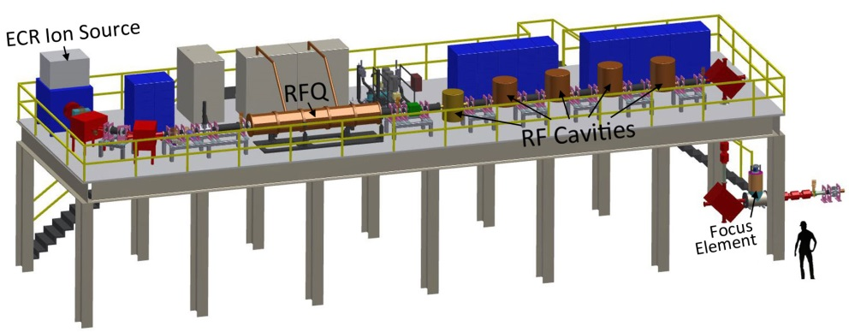
XMAT Layout
Ion
Source
Optics hutch: 500k/construct
Experimental hutch: 700k/construct
Front end
Undulator
(Short-period or SCU)
Filters and slits
Secondary HR mono
(optional)
*4 flat Si crystals
*DE/E ~5e-5
Beam conditioning system: 2x slits, ion chambers, focusing optics
Masks and collimators
2D focusing
optics
*refractive Si lenses
Sample manipulation systems
WAXS detector
SAXS detector
HE Mono *2 vertically bent Sixtals *Cryo cooled
*30>E>100 keV
Imaging detector
Notes:
Note that the APS hutches sit underneath the Ion Source. ANL has built already and recently both an energetic ion beam line (XMAT would utilize the front end of this design) and a hard xray beam line.

