Slide 1
Damage Correlation: Exposure vs. Material Damage
Roger E. Stoller (retired)
ORNL Materials Science and Technology Division
Workshop for Applied Nuclear Data Analysis
22-24 January 2019
Washington, DC
Primary objective is a brief discussion of why materials scientists are interested in nuclear data and how such data is applied..
Supported by the U.S. Department of Energy, Office of Fusion Energy Sciences

Slide 2
Radiation units and Radiation damage (w/ apologies to ICRU)
Common usage implies that exposure, fluence, and (absorbed) dose are near synonyms, they are highly correlated but units are different: charge/unit mass, particles/unit area, and energy/unit mass
Farther afield, the term damage is sometimes used as if it was the equivalent of {exposure, fluence, dose}, e. g, “… the materials were irradiated to a neutron damage level of 1x10²⁶ n/m² (E>0.1 MeV) … or 5 dpa …”

Slide 3
Radiation units and Radiation damage
Strictly speaking, neutron fluence (as an example) and damage are generally correlated but are quite different quantities
neutron (or photon) fluence is a calculable or measurable quantity of the radiation field, fully determined by time in the radiation field, e.g. neutron fluence (n/m²) – with minor caveats it is field dependent and material independent
like fluence, dose is calculable/measurable, however it dependents on both the field and material, but is largely independent of the state of the material
damage is a material quantity that is generally not calculable, but is observable (e.g. TEM, APFIM) and/or measurable (e.g. strength, density) – damage is dependent on the material and its condition, as well as other irradiation parameters such as temperature and exposure/fluence/damage rate
<< an illustration from the beach >>

Slide 4
What do the materials folks want?
they first need to determine what components of a given irradiation environment influence the damage that is formed
irradiating particle energy spectrum atomic displacement rates
gas (generally He, H) generation rates
then they rely on the nuclear data community to provide the necessary information to fully characterize the relevant parameters of the irradiation environment for a given material
reaction rates for primary and secondary reactions
reaction rates for elastic and inelastic reactions, e.g. scattering and (n,p), (n,α), (n, 2n), (n,γ) … on both initial and daughter material constituents, see e.g. work of Greenwood and co-workers
they want a magic correlation parameter to enable prediction of material response (damage) after irradiation for a given time in environment X, or based on information obtained in irradiation environment Y

Slide 5
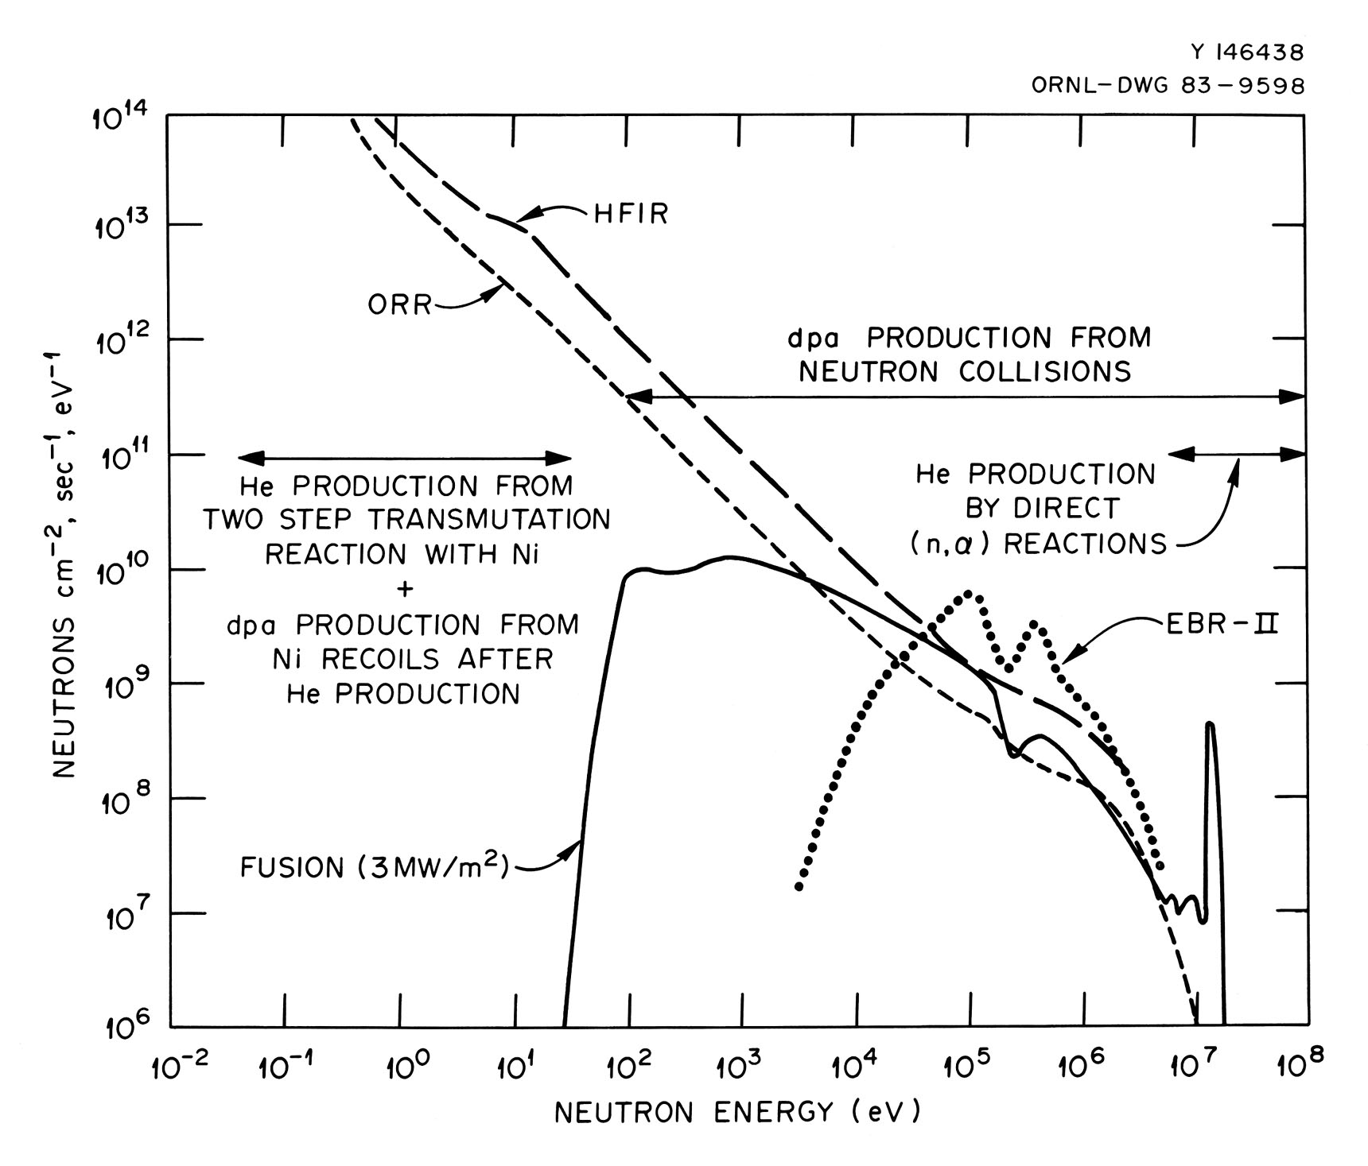
Correlation Parameters
historically: total neutron fluence, thermal fluence, fast fluence (E>1 MeV, 0.5 MeV, 0.1 MeV) have all been used to correlate observed neutron radiation effects in materials
based on assumptions about what part of neutron energy spectrum is primarily responsible for damage: high energy scattering move atoms around, thermal and very-high energy events lead to transmutations
if the neutron energy specta are sufficiently similar, any measure of neutron fluence could be a suitable correlation parameter
if, but reality intervenes …, in addition need to consider data from irradiation experiments using various charged particles

Slide 6
Correlation Parameters
"damage functions" were an early, pseudo-crosssection approach applied mainly to reactor pressure vessel steels, driven by use of test reactor data obtained under higher-flux, somewhat harder spectrum conditions
development of displacements per atom (dpa) (NRT, 1975) driven more by interest in fast reactors and fusion, and the use of charged particle irradiations to obtain high-dose data in short times
dpa is essentially an absorbed dose, "damage energy" (T_{d}), converted using a simple model to a ficticious number of stable Frenkel pair, ν_{NRT}:
T_{d} is the energy absorbed by the atomic lattice via nuclear scattering (i.e. not absorbed by the electronic system)
ν_{NRT}=T_{d}*(0.8/2/E_{d})

Slide 7
Example MD simulation of defect formation
average Fe recoil energy from elastic scattering with 2.3 MeV neutron

Slide 8
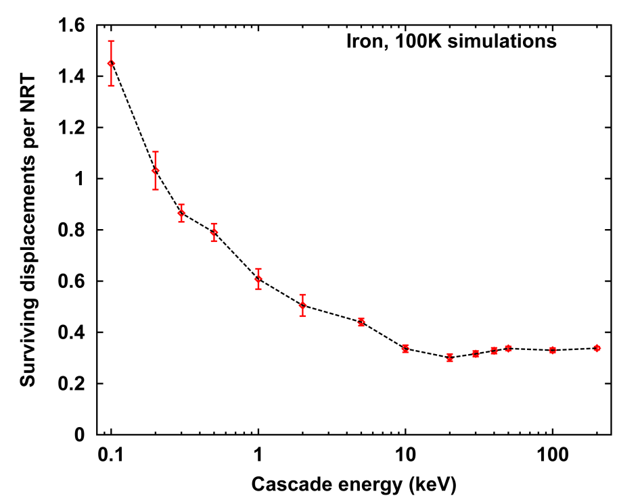
Spectrum-averaging of MD simulations
Results obtained using SPECOMP and SPECTER
MD simulations
Stoller and Greenwood (1998) comparing different irradiation environments

Slide 9
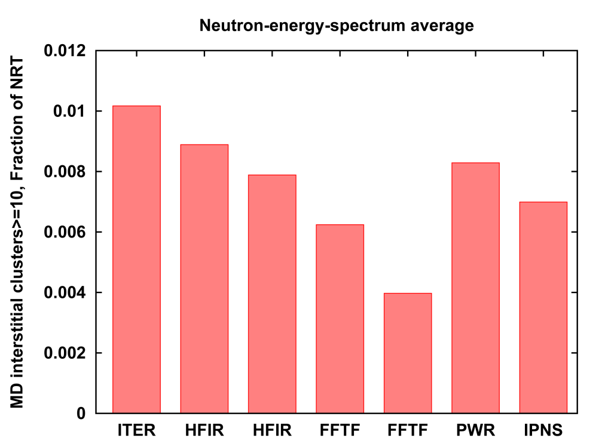
Spectrum-averaging of MD simulations
Some parameters are more spectrally dependent than others
Stoller and Greenwood results (1998) comparing different irradiation environments

Slide 10
Comparison of fast fluence and dpa
Change in yield stress in neutron irradiated A302B and A212B RPV steels
As a function of fast fluence (E>1.0 MeV) As a function of dpa
Heinisch, JNM 178 (1991)

Slide 11
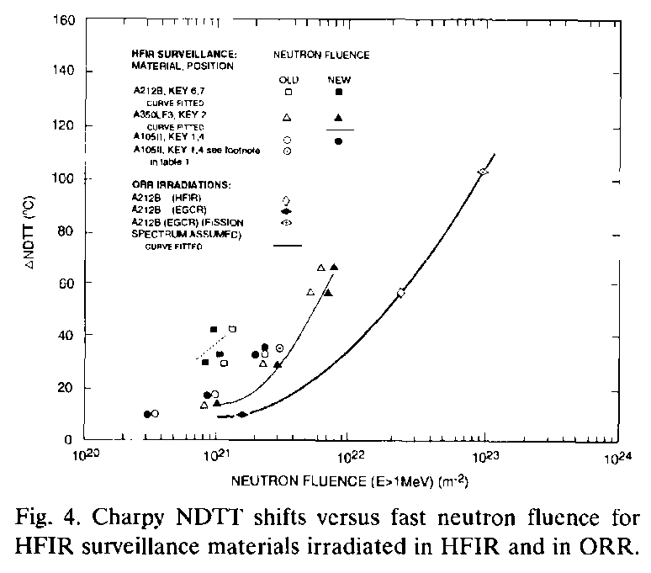
Comparison of fast fluence and dpa
Charpy transition temperature shift, HFIR reactor pressure vessel
dpa include γ (electron)-induced displacements
Remec, et al., JNM 217 (1994)

Slide 12
Questions or comments?
NRT dpa, one part nuclear data, one part material model is state of the art (but old) material damage correlation parameter
broadly successful, but does (can) not account for some important irradiation/material parameters, e.g. defect clusters vs Frenkel pair, gaseous and solid transmutations
nuclear data input for dpa, i.e. primarily elastic scattering, seems to be fairly solid, only limited changes in last few releases of ENDF
less certain about transmutations and secondary contributors to damage energy

