Slide 1
Background of Collaborative Nuclear Data Activities
Catherine Romano
Workshop for Applied Nuclear Data Activities
January 22-24, 2019
Washington, DC

Slide 2
Workshop for Applied Nuclear Data Activities
January 22 – 24, 2019
George Washington University, Washington, DC
Program focus on:
Nuclear Energy
Materials Damage
Isotope Production
Atomic Data
Safeguards
(n,x) reactions
Review of NDIWG FOA funded projects
Program updates by program managers

Slide 3
Recent Events in Nuclear Data
NDNCA whitepaper release (10/15)
Nuclear Data Interagency Working Group (PMs) (6,/16)
Nuclear Energy Starts Nuclear Data and Benchmarking Program 2018
USNDP Review (7/14)
Nuclear Data Exchange Meeting presentations to program managers (4/16)
NDIWG FOA Released
NP, NE, IP, DNN R&D, DNDO (4/17)
NDIWG FOA Released
NP, ASCR, NE, DNN R&D, DP (3/18)
Workshop for Applied Nuclear Data Activities (WANDA) (1/19)
Nuclear Data Needs and Capabilities for Applications (NDNCA) Workshop (5/15)
DNN R&D Nuclear Data Roadmapping Workshop (NDREW) (01/23-25/18)
NDREW Proceedings release (7/18)
Nuclear Data Working Group
DOE-NP, DOE-NE, NNSA, DTRA, DNDO
(11/15, 12/15, 2/16, 3/16)
https://www.nndc.bnl.gov/
Notes:
This is in your handout

Slide 4
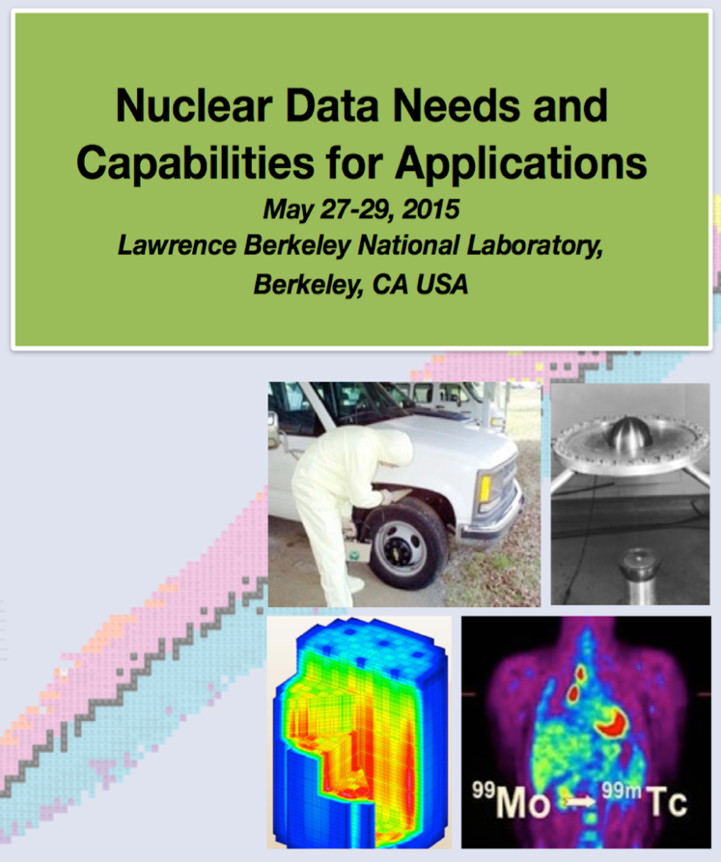
NDNCA Whitepaper: Compilation of Workshop Results and Needs from Current Literature
Cross-cutting needs
Dosimetry Standards: for E_{n} up to 60 MeV to support the International Fusion Materials Irradiation Facility (IFMIF), accelerator-driven systems (ADSs), and spallation sources
Fission: the “Mother of All Fission Experiments,” where TKE(A), n, g’s fragment yields for a range of actinides for E_{n}=thermal-20+ MeV
Decay Data and g-Branching Ratios: includes an International Atomic Energy Agency (IAEA) list of decay data for “certain medical isotopes”
Neutron Transport Covariance Reduction: particular need for actinide (n,x) cross sections from 1–1000 keV
Expanded Integral Validation: includes semi-integral data (e.g., pulsed sphere) to diagnose (n,n_{el}), (n,n_{inel}) shortcomings.
Antineutrinos from Reactors: includes a specific call for new data for ^{235,238}U and ^{239,241}Pu…fission yields for odd-odd nuclei and b-spectral measurements.
http://bang.berkeley.edu/events/NDNCA/whitepaper

Slide 5
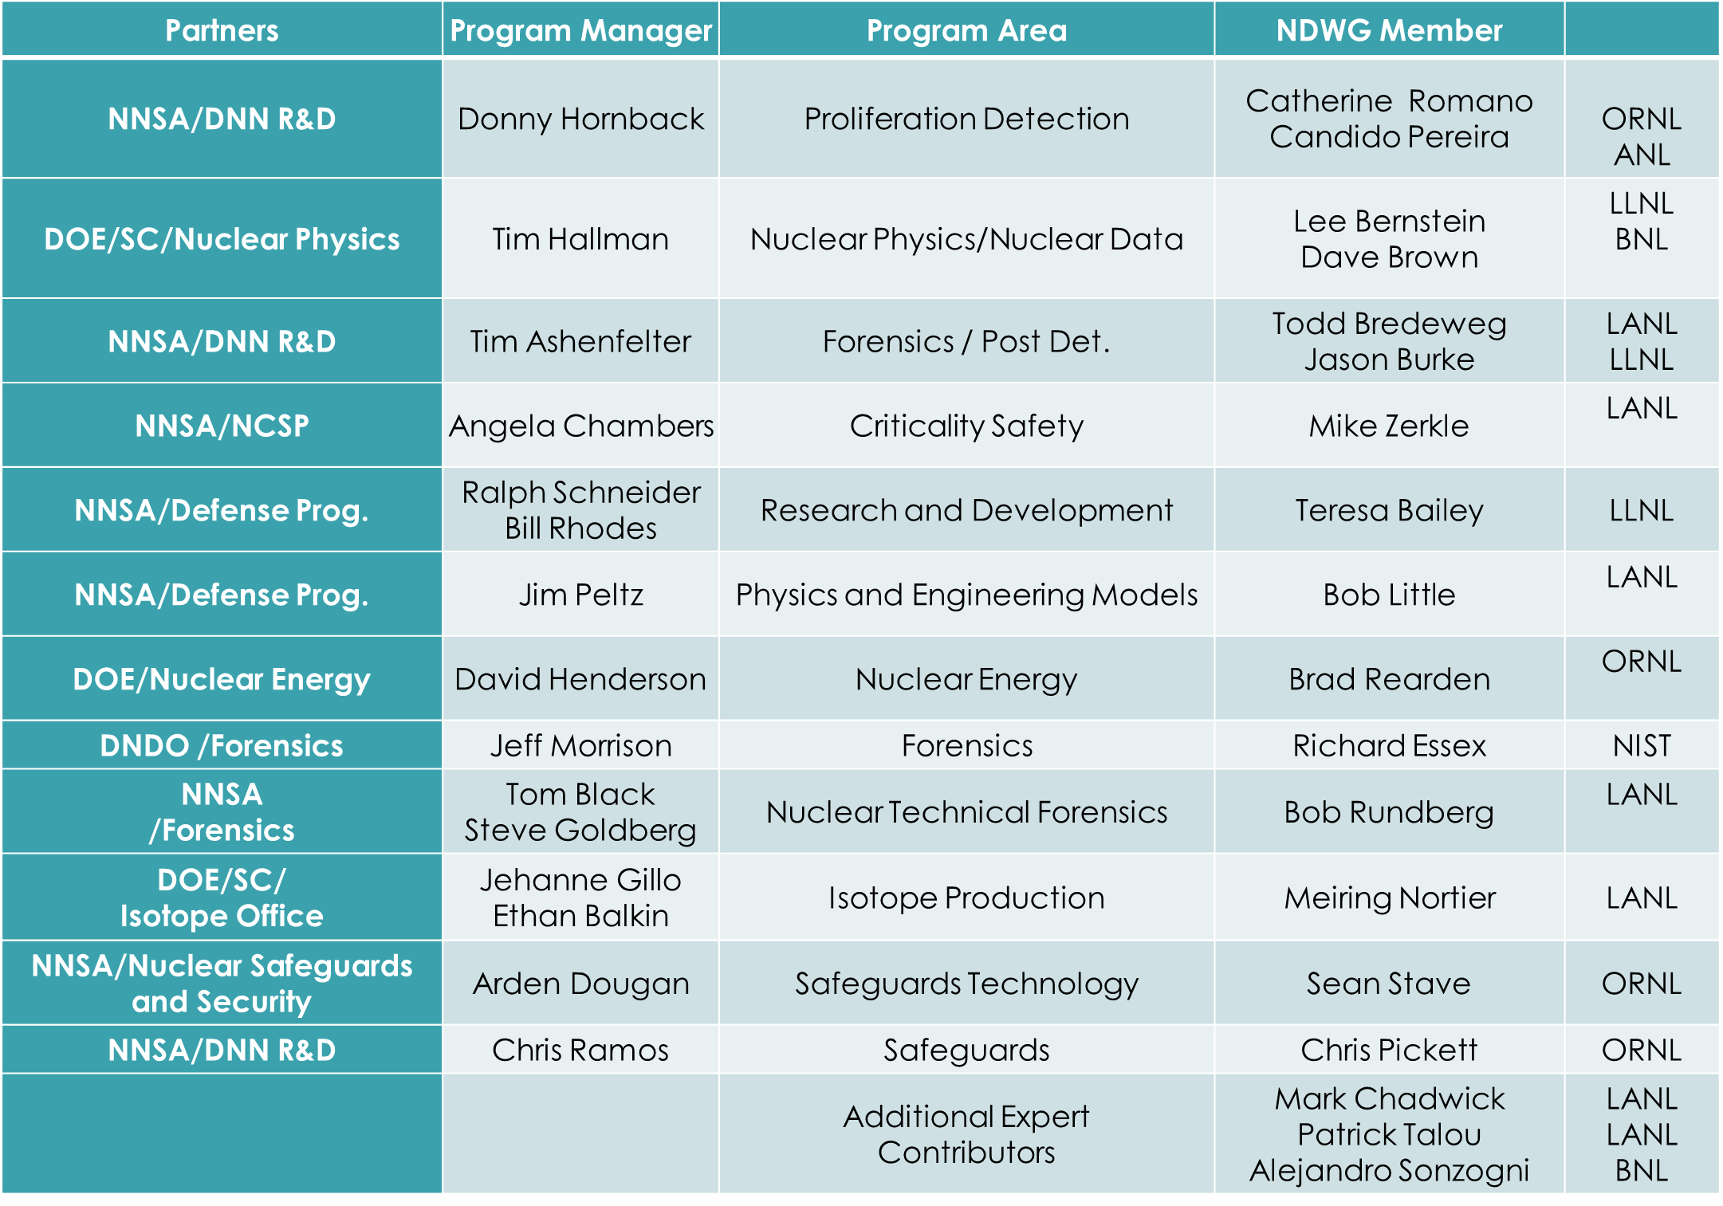
The Nuclear Data Working Group was Formed

Slide 6
FY 2016 NDWG Goal
Present a five-year experimental plan that best meets the needs of multiple programs while leveraging existing projects, facilities, and expertise to minimize costs

Slide 7
Result: 5-year, $50M plan to address cross-cutting nuclear data needs
NDEM: 25 federal representatives, including program managers from 7 DOE/NNSA offices, DTRA and DHS, Washington, DC (4/14/16)
Revitalize the Nuclear Data Pipeline
Expand Covariance Data and its use
Improve Inelastic Scattering Data for Neutron Transport
Upgrade Capture Gamma-ray Data in ENDF
Improve Theory, Modeling, Data and Evaluation of Fission Fragment Yields
Reestablishment of Actinide Target Production Capabilities

Slide 8
Interested program managers formed the Nuclear Data Interagency Working Group (NDIWG)
Led by the Office of Science, Office of Nuclear Physics (Tim Hallman)
Goal is to meet twice a year
Annual nuclear data “roadmapping” workshops
Annual collaborative NDIWG FOA
Benefits of participation in the NDIWG
Collaborative funding opportunities
Coordination of efforts
Incorporation of best practices in nuclear data funding
Increased probability of mission impact

Slide 9
DOE Nuclear Physics has now organized two Nuclear Data Interagency Working Group FOAs
$1.5 M/year, ≤5 years
$4.0 M, ≤5 years
Participants: DOE/SC-NP, NE, Isotopes, NA-221, 222 and 113

Slide 10
Nuclear Data Roadmapping and Enhancement Workshop (NDREW)
117 participants,
27 program managers/technical advisors
55 different institutions/organizations
9 government agencies:
DOE-Nuclear Physics
Nuclear Energy
Isotopes Program
DNN R&D (NA-22)
NA-113 (Defense Programs)
DHS/DNDO
DTRA
AFTAC
IAEA
Nuclear data users
NDA experts
Modeling and simulation experts
Nuclear data producers
Experimentalists
Evaluators
Validation and testing experts
Uncertainty quantification experts
Theorists

Slide 11
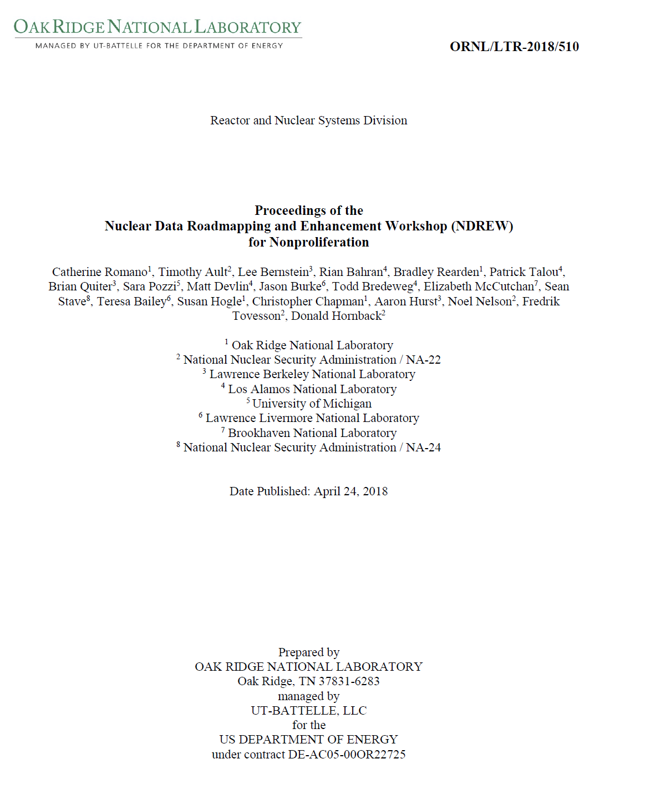
NDREW Proceedings
https://www.nndc.bnl.gov/

Slide 12
Communication is a Primary Benefit of Nuclear Data Workshops
USERS
Needs and
Impact
EVALUATORS/
PROCESSORS
Evaluation Code
Capabilities/Needs
EXPERIMENTALISTS
Experimental
Capabilities/Needs
PROGRAM MANAGERS
MISSION PRIORITIES
UNIVERSITIES
INTERNATIONAL
COLLABORATORS
Collaboration Opportunities
Coordinate efforts

Slide 13
Breakout Session Goals
Determine mission-driven nuclear data priorities with targeted uncertainties
Obtain user input
Determine all tasks required to ensure that nuclear data are available to users:
Measurements – differential and integral
Evaluations
Processing
Covariance data
Validation
Testing
Create a mechanism for peer reviewed ideas
Determine where needs overlap with other mission spaces
Capture opportunities to leverage or enhance existing funded/planned work
Think outside the confines of the typical funding mechanisms
What does it really take to get it done right?

Slide 14
Questions?

Slide 15
NDREW Format Included Facilitated Breakout Sessions
Panel speakers provided the user’s perspective
Goals:
Determine mission-driven nuclear data priorities
Determine all tasks required to deliver data to users
Create a mechanism for peer reviewed ideas
Capture opportunities to leverage or enhance existing funded/planned work
Proceedings Document
https://www.nndc.bnl.gov/

Slide 16
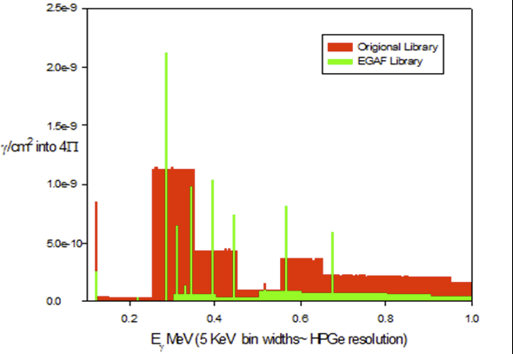
NDREW Session Summary
Data uncertainty, sensitivity, and covariance
Several tools are available or being developed that can be used to quantify nuclear data uncertainties and sensitivities
UQ/S studies can inform nuclear data priorities
Covariance data are lacking and sometimes not well quantified
Nuclear data end-use uncertainties must be defined
Brad Rearden, NDREW
Neutron capture/inelastic scattering and associated spectra
Much of the cross section data are available, but discrete gamma lines and yields are needed at neutron interrogation energies
Simulations do not provide discrete gamma emissions in a useful manner
Link ENSDF to ENDF?
Brad Sleaford, NDEM

Slide 17
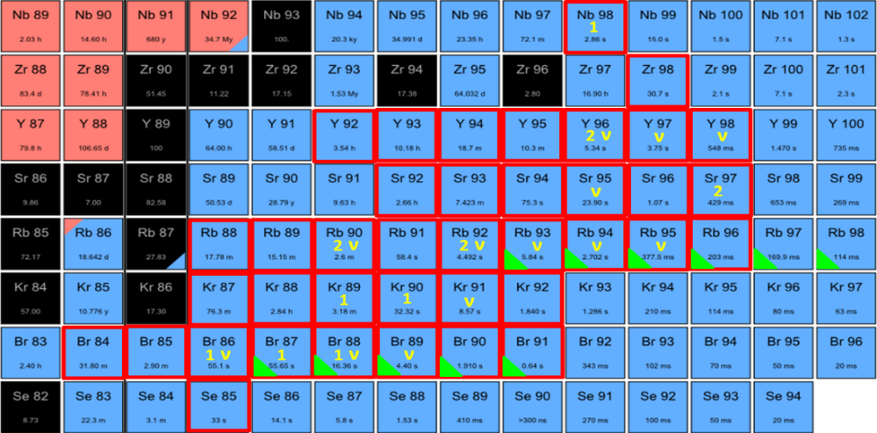
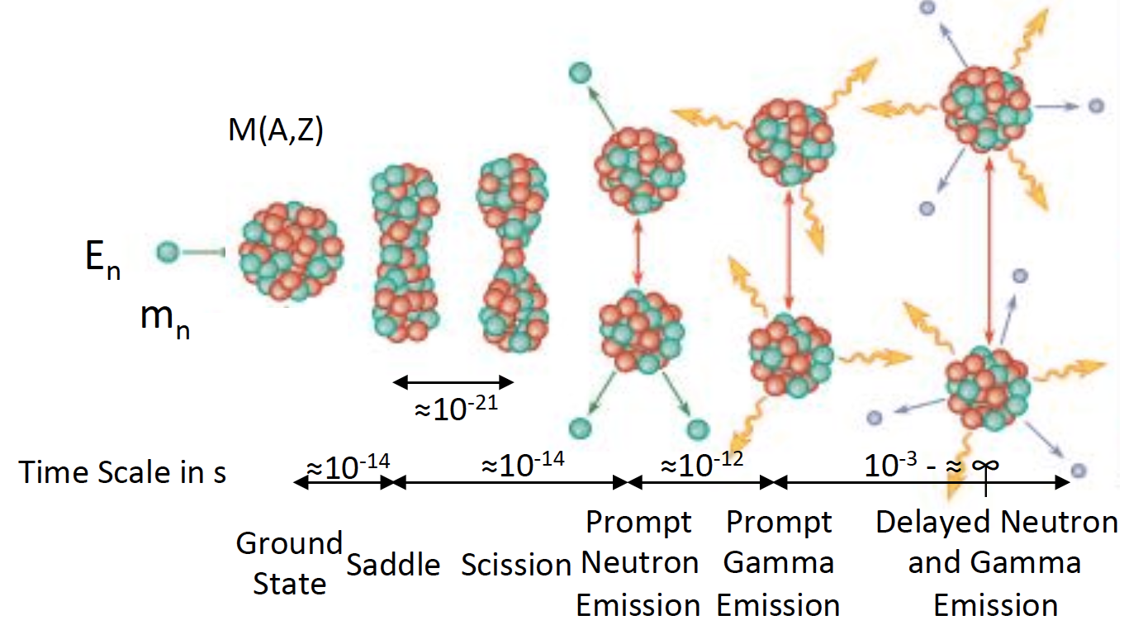
NDREW Session Summary
Fission-independent and cumulative fission yields, decay data
Large uncertainties exist in ENDF yields
Reevaluation of independent and cumulative yields is required
This effort requires correlated neutrons and gammas, and decay data
Upcoming IAEA CRP should be leveraged
MTAS β-γ
VANDLE β-n-γ
Krzysztof Rykaczewski, NDREW
Patrick Talou, NDREW

Slide 18
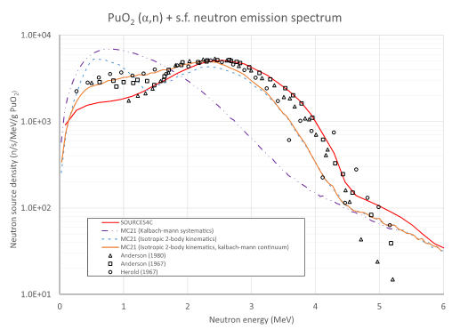
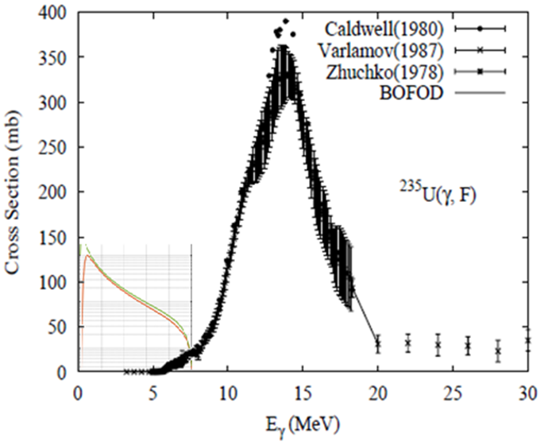
NDREW Session Summary
(alpha,n) reactions
A full upgrade of SOURCES4C would be useful to many programs
Reevaluate the cross sections
Measurements of neutron spectrum
Mike Zerkle (NNL), NDREW
Photofission
The photofission cross section varies greatly in the 6–9 MeV region of interest, causing large uncertainties
Detailed energy-dependent measurements are required
Brian Quiter, NDREW

Slide 19
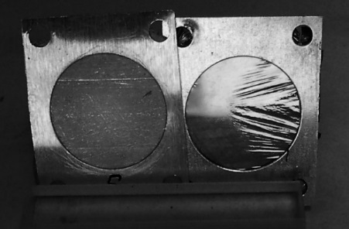
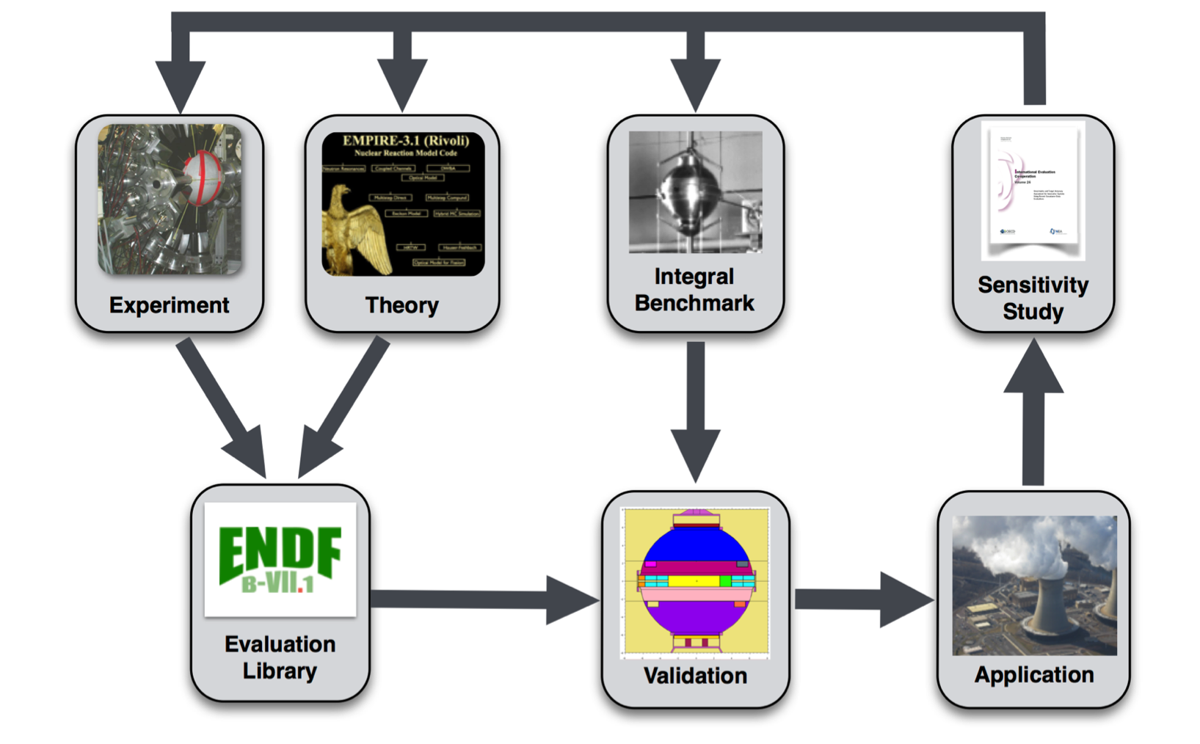
NDREW Session Summary
Targets, facilities, and detector systems
Target materials can be expensive or nonexistent
There are very limited target production capabilities in the United States for radioisotopes
Preserving neutron facilities in the United States is important
Leveraging existing science facilities for nuclear data should be examined
Benchmark development
Benchmarks are needed for problems relevant to nonproliferation to validate and test nuclear data and to identify deficiencies
All workshop topic areas pointed to the need for benchmark experiments
Tim Hallman, NDREW

Slide 20
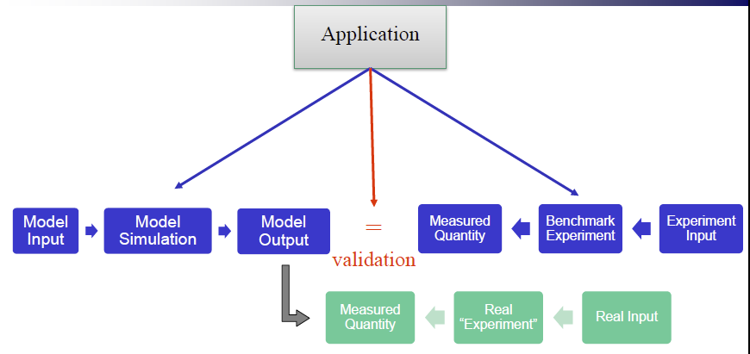
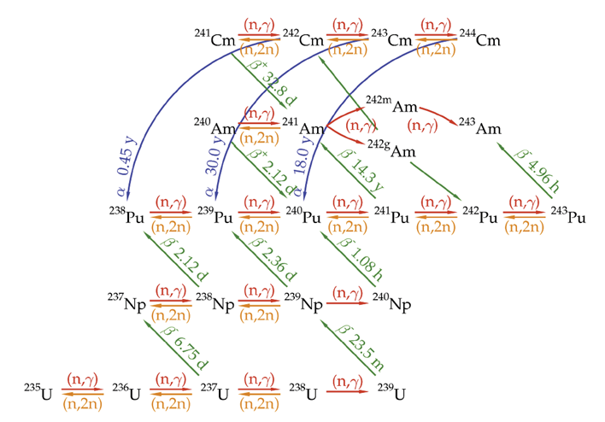
NDREW Session Summary
Data processing and transport code needs
Even if good quality data are available in ENDF, there are cases where the evaluation codes, data processing codes, or transport models cannot support the data
Code development will be required to support individual nuclear data projects
Teresa Bailey, NDREW
Actinide cross sections
The actinide “network” contains many short-lived actinides that are difficult to measure
Solution requires decay data, theoretical models and experiments
Measure well the long-lived isotopes to bound the solution of the short-lived isotopes
Susan Hogle, NDREW

Slide 21
Moving Forward
Annual NDIWG FOA is anticipated
Annual Workshop will provide input for the FOA
Challenges:
Prioritizing nuclear data needs when many are deemed necessary
Deconflicting between programs and international efforts
Staying mission-centric; ensuring that recommended work is relevant and necessary
Avoiding entropy by demonstrating mission impact

Slide 22
What WANDA offers
A venue to encourage communication between consumers and providers of nuclear data
A place to hear from PMs about their vision for their programs
A place to form new collaborations that ensure that data needs are addressed in an end-to-end fashion
Identified Need
Measure-ment
Compila-tion
Evalua-tion
Process-ing
Dissem-ination
The goal is a roadmap/plan for multiple sponsors to address nuclear data needs

Slide 23
Partners | Program Manager | Program Area | NDWG Member
NNSA/DNN R&D | Donny Hornback | Proliferation Detection | Catherine Romano Candido Pereira | ORNL ANL
DOE/SC/Nuclear Physics | Tim Hallman | Nuclear Physics/Nuclear Data | Lee Bernstein Dave Brown | LLNL BNL
NNSA/DNN R&D | Tim Ashenfelter | Forensics / Post Det. | Todd Bredeweg Jason Burke | LANL LLNL
NNSA/NCSP | Angela Chambers | Criticality Safety | Mike Zerkle | LANL
NNSA/Defense Prog. | Ralph Schneider Bill Rhodes | Research and Development | Teresa Bailey | LLNL
NNSA/Defense Prog. | Jim Peltz | Physics and Engineering Models | Bob Little | LANL
DOE/Nuclear Energy | David Henderson | Nuclear Energy | Brad Rearden | ORNL
DNDO /Forensics | Jeff Morrison | Forensics | Richard Essex | NIST
NNSA /Forensics | Tom Black Steve Goldberg | Nuclear Technical Forensics | Bob Rundberg | LANL
DOE/SC/ Isotope Office | Jehanne Gillo Ethan Balkin | Isotope Production | Meiring Nortier | LANL
NNSA/Nuclear Safeguards and Security | Arden Dougan | Safeguards Technology | Sean Stave | ORNL
NNSA/DNN R&D | Chris Ramos | Safeguards | Chris Pickett | ORNL
 |  | Additional Expert Contributors | Mark Chadwick Patrick Talou Alejandro Sonzogni | LANL LANL BNL

