Slide 1
R&D to Support Development and Deployment of Nuclear Technologies
Alice Caponiti
Director, Office of Nuclear Energy Technologies
Office of Nuclear Energy
2019 WANDA Workshop
January 22, 2019

Slide 2
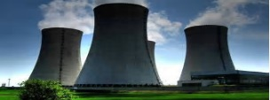



Office of Nuclear Energy – Mission Pillars
Advance nuclear power to meet the nation's energy, environmental, and national security needs.
Resolve technical, cost, safety, security and regulatory issues through research, development and demonstration.
Existing Fleet
Advanced Reactor Pipeline
Fuel Cycle Infrastructure
Global Competitiveness
Notes:
The Office of Nuclear Energy’s mission is to advance nuclear power to meet the nation’s energy, environmental and national security needs.
We do this by resolving the technical, cost, safety, security and regulatory issues through targeted research, development and demonstration.
Our work is centered on four mission pillars:
Preserving the existing fleet
Supporting the advanced reactor pipeline
Addressing challenges associated with front end and back end of the fuel cycle, to include availability of high assay LEU
And addressing barriers to global competitiveness

Slide 3
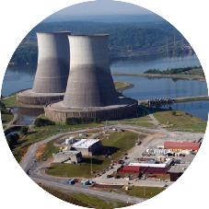





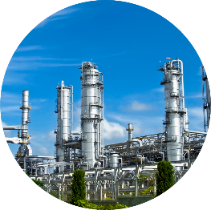

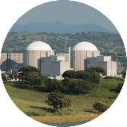
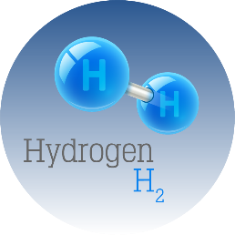
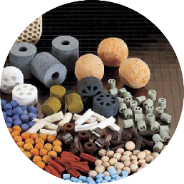

Nuclear Beyond Electricity – Advanced Reactors
NOW
Baseload Electricity Generation
FUTURE
Electricity
Large Light Water Reactors
Heat
Small Modular Reactors
e⁻
Industrial
Applications
GEN IV Reactors
Hydrogen Production
New Chemical Processes
Clean Water
Notes:
Nuclear energy provides 20% of the nation’s electricity capacity.
This represents the largest source – sixty percent – of carbon-free baseload electric power.
Our existing fleet of 99 reactors has enjoyed an enormously successful safety record.
The current landscape for nuclear energy is providing reliable baseload power for distributed grids.
[click]
The future energy landscape is expected to look quite different.
A combination of existing fleet and advanced nuclear plants, coupled with fossil and renewable sources, will provide heat and electricity for a range of useful energy products such as new chemical processes, water desalination and purification, hydrogen production and industrial applications.
Innovative advanced reactor concepts offer significant potential benefits, including improved economics for construction and operation, enhanced safety and security, greater resource utilization, and easier operation.
While the reactors in the current fleet are typically large for providing baseload power – on the order of a thousand megawatts of electricity output – new advanced reactor designs are being designed in a range of sizes – from hundreds of megawatts to as small as a couple of megawatts.

Slide 4
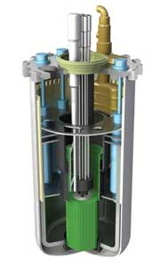
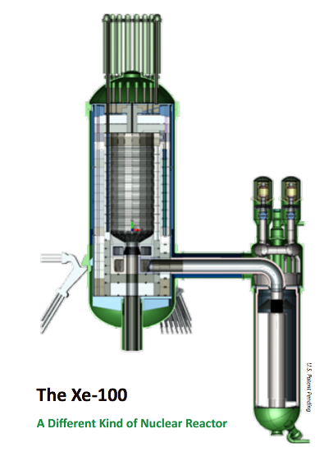
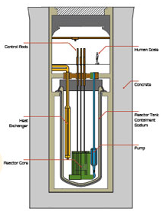
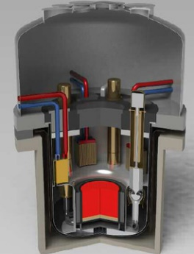
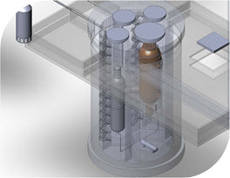
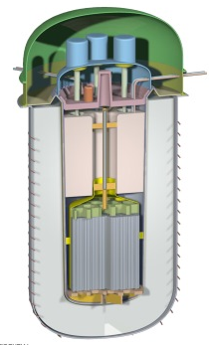
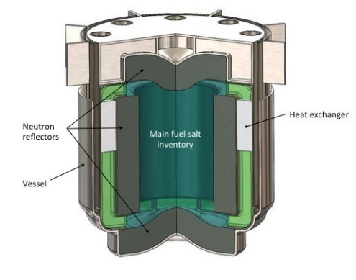
Examples of Different Advanced Reactor Designs Being Developed By Industry
Gas Reactors
Fast Reactors
ART, Advanced Materials R&D Program Review
June 6 and 7, 2017
Advanced Reactor Concepts LLC
ARC-100
X-Energy
Xe-100
Framatome
SC-HTGR
GE Hitachi
PRISM
TerraPower
TWR
Molten Salt Reactors
Terrestrial Energy USA IMSR
Kairos Power
UCB PB-FHR
TerraPower
MCFR
Elysium USA
MCSFR
Notes:
So what do these commercial advanced reactor concepts look like?

Slide 5
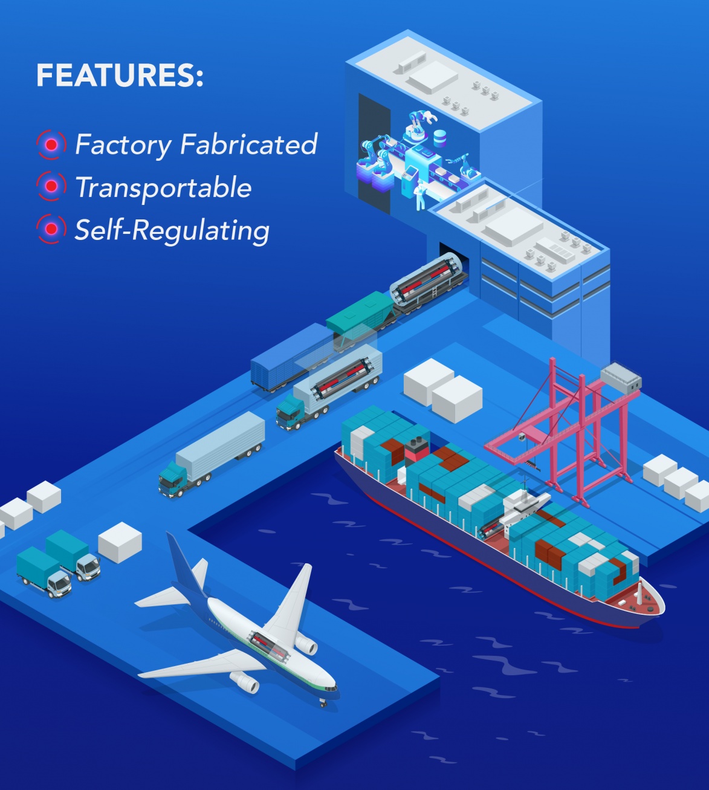
Micro-reactors for Specialized Applications
Plug-and-play reactors able to produce 1-20 megawatts of thermal energy that can be used directly as heat or converted to electric power
Benefits:
Small Size
Fits on the back of a semi-truck and can be deployed to remote locations and military bases for reliable heat and power.
Simple Design
Fail-safe and self-regulating designs that require fewer components, maintenance and operators.
Fast On-site Installation
Can be connected and generating power within a week of arriving on site.
Notes:
Micro-reactors are a class of nuclear reactors with power levels targeted for non-conventional nuclear markets including defense sites, remote communities, mining sites, and for back-up generation for nuclear power plants and other sites.
Such applications face economic and energy security challenges that can be uniquely addressed by these innovative nuclear reactors.
Generally, micro-reactors are differentiated from other classes of reactors by features such as factory fabrication, transportability by truck, rail or aircraft, and simplicity of design features, particularly those related to reactor control and safety.

Slide 6
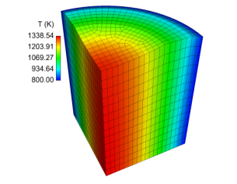
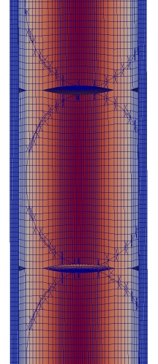
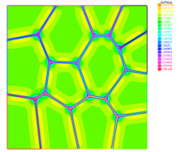


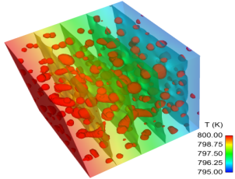
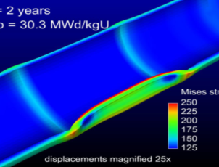
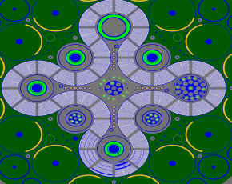
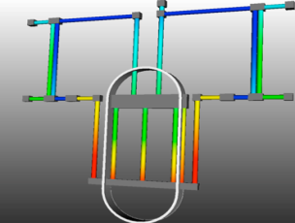
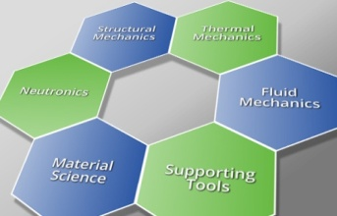
Advanced Modeling and Simulation
Fuels Toolkits – computational technology and computer hardware to support R&D needs
  Advanced fuel designs
  Accident-tolerant fuels research
Reactors Toolkits – high-fidelity, coupled-physics simulation capability for advanced reactors
  Complex, coupled phenomena
  Conceptual design on advanced reactors of all types
  Safety transients using high-fidelity, coupled neutronics, thermal-fluids, thermal-mechanics, and fuel models
  Code-to-code comparisons with lower-fidelity models
  Advanced validation and uncertainty quantification
Pellet
MARMOT
Pin
BISON
Core
SHARP
Plant
RELAP-?
Notes:
Our advanced modeling and simulation programs are developing the computational tools to support design of advanced fuels and reactors.
These include development of predictive computational tools for nuclear fuel performance analysis and design – including advanced fuel designs and accident tolerant fuels research.
Reactors toolkits are providing high-fidelity, coupled physics simulation capabilities to support conceptual design of advanced reactors.

Slide 7
High Assay Low Enriched Uranium (HALEU)
Many advanced reactor concepts require enrichments above 5%
High-assay LEU (up to 20%) is not commercially available in the U.S.
  Capability will entail design and licensing of new facilities and transportation packages.
DOE recently announced initiation of a 3-year demonstration program to build HALEU production capability.
  Demonstrate existing U.S.-origin enrichment technology
  Provide small quantity of HALEU beginning in 2020 for civilian nuclear energy R&D needs
DOE is also considering repurposing used fuel from the U.S. Navy and a national laboratory test reactor as two temporary options.
Notes:
DOE is also looking into new ways of producing high assay low-enriched uranium, also known as HALEU.
HALEU is required by many advanced reactor concepts to achieve smaller designs that get more power per unit of volume.
The industry anticipates it will need nearly 600 metric tonnes of HALEU by 2030 to get new reactor designs to market.
An HALEU production capability does not commercially exist in the United States and will require the design and licensing of new facilities and transportation packages, including the need for criticality benchmarks.
DOE recently announced (January 7, 2019) it is initiating a 3 year demonstration program to build a high assay low enriched uranium production capability.
DOE plans to contract with American Centrifuge Operating LLC (ACO), a subsidiary of Centrus Energy Corp., for the demonstration of high assay low enriched uranium (HALEU) production to support DOE research and development activities and programs.
DOE is also considering repurposing used fuel from the U.S. Navy and a national lab test reactor as two temporary options.
Additional background:
The HALEU Demonstration Program has two primary objectives: (1) Deployment of a 16 machine AC-100M HALEU Cascade producing a 19.75% U-235 enriched product by October 2020; and (2) Demonstration of the capability to produce HALEU with existing U.S.-origin enrichment technology, and provide DOE with a small quantity of HALEU beginning in 2020 for use in its research and development for the advancement of civilian nuclear energy and security, and other programmatic missions.

Slide 8
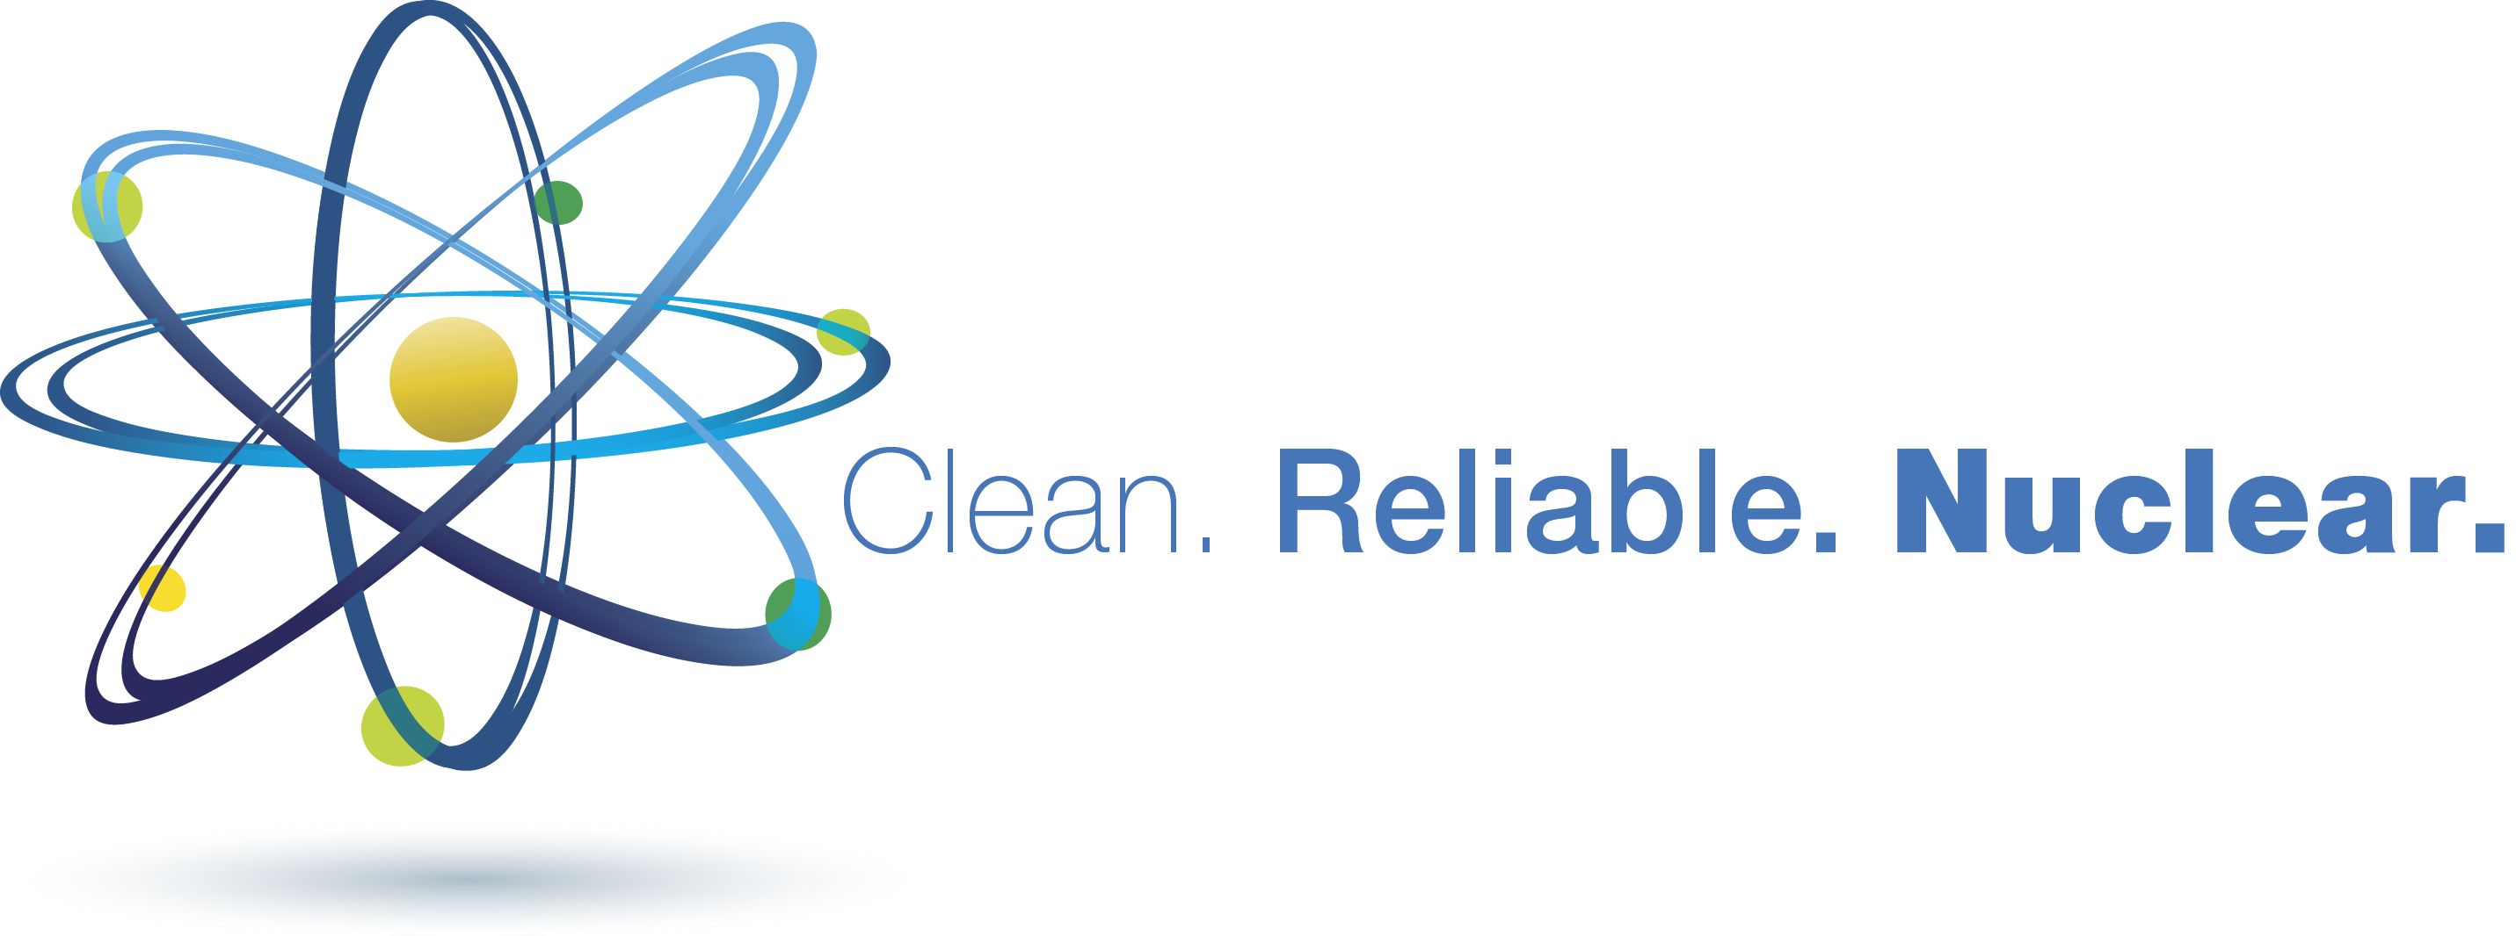
Questions?

