Slide 1
Defense Nuclear Nonproliferation
Research & Development (DNN R&D)
Office of Proliferation Detection
PM: Donald Hornback
TA: Fredrik Tovesson
Office Director: Craig Sloan

Slide 2
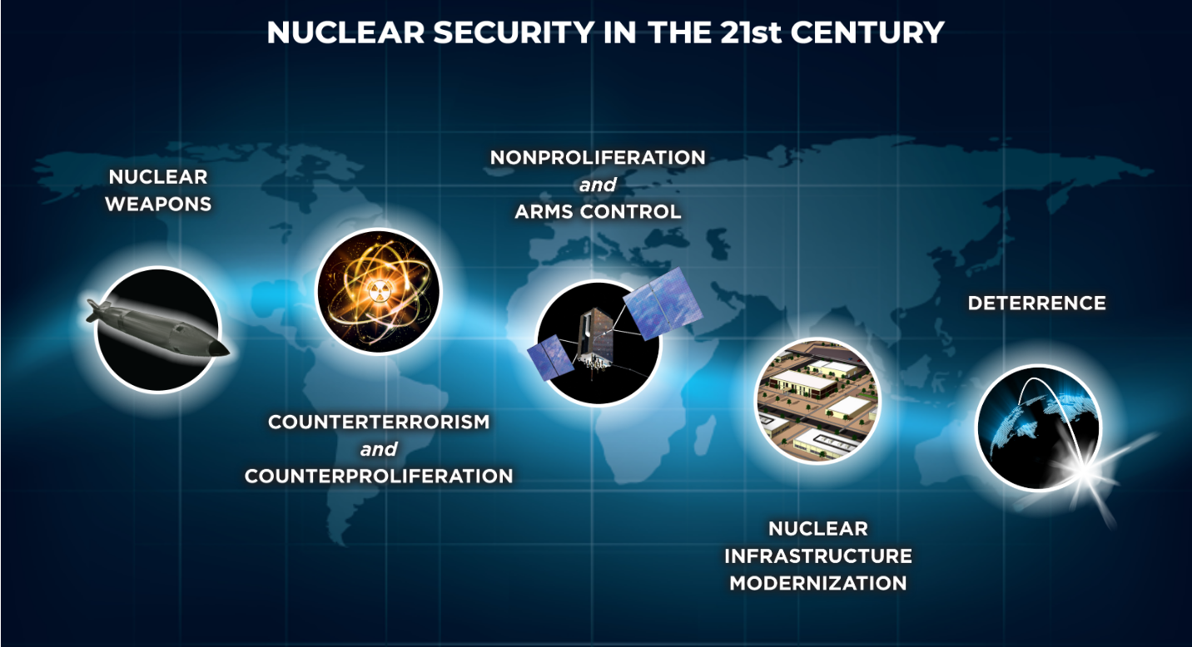
Department of Energy - National Nuclear Security Administration
https://www.energy.gov/nnsa/nuclear-security

Slide 3
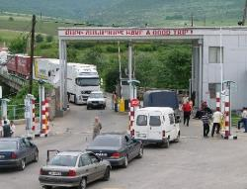
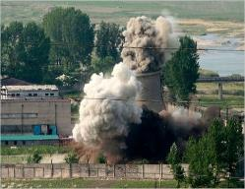
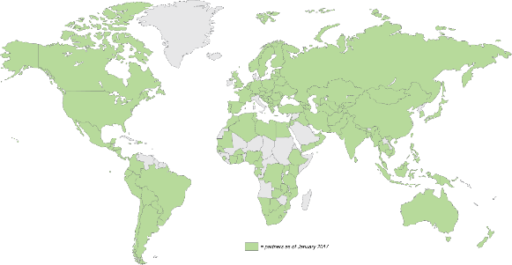
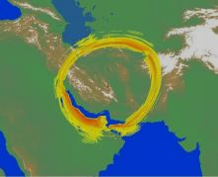
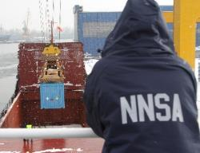
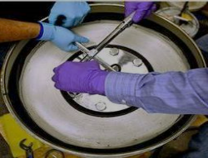
Defense Nuclear Nonproliferation
Countering Nuclear
Smuggling
Countering State
Nuclear Ambitions
Mission: Develop and implement policy and technical solutions to eliminate proliferation-sensitive materials and limit or prevent the spread of materials, technology, and expertise related to nuclear and radiological weapons and programs around the world.
Research &
Development
Vision: We are committed to making the world a safer place by reducing nuclear and radiological dangers.
Minimizing Nuclear and
Radiological Materials
Securing Nuclear and
Radiological Facilities
Notes:
DNN R&D provides direct support to other DNN offices, but …
National level program providing capabilities exploited across the USG

Slide 4
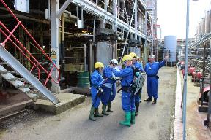
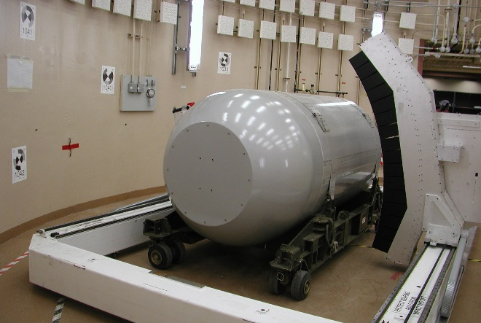
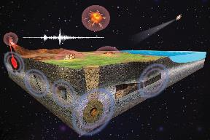
DNN Research & Development
Develop advanced technical capabilities in support of U.S. national nuclear security and nonproliferation goals
Nuclear Proliferation Detection
Strengthen U.S. capabilities to detect and characterize foreign nuclear programs.
Nuclear Security Applications
Advance U.S. capabilities to strengthen nuclear security across the threat spectrum.
Nuclear Explosion Detection
Improve U.S. capabilities to detect and characterize nuclear explosions.

Slide 5
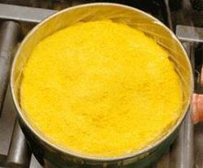
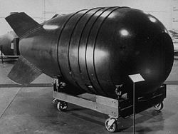








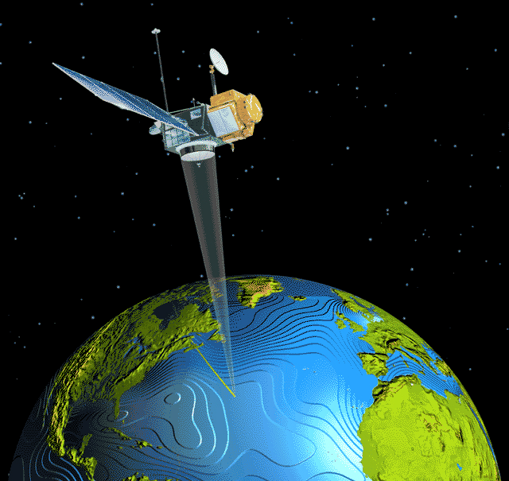





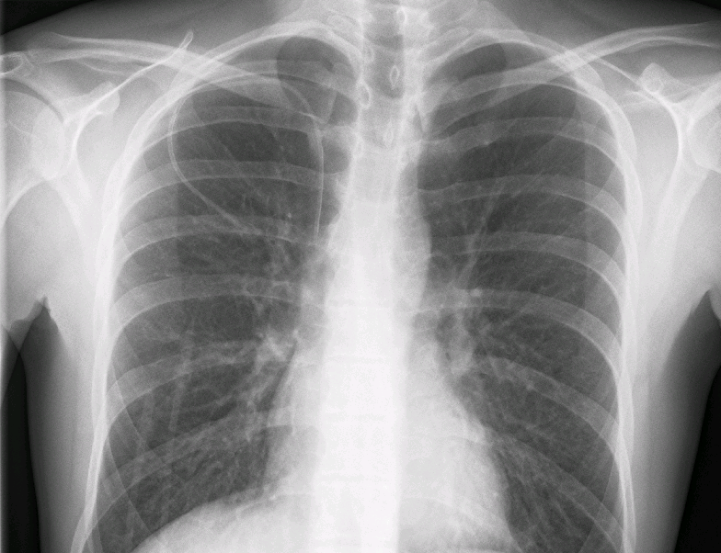
Proliferation Detection Research Portfolios
Office of Proliferation Detection Mission:
Advance U.S. capabilities for global detection of nuclear weapons development activities, including material production, movement, weaponization, and the characterization of nuclear explosions.
Material Production Detection and Monitoring
Nuclear Weapons Development Detection and Material Security
Nonproliferation Enabling Capabilities
Uranium Production Detection
Weapons Development Detection
Innovation
Plutonium Production Detection
Emergency Response
Near-field Detection
International Safeguards
Nuclear Test Detection
Remote Detection
Data Science
Other Nuclear Processes
Warhead Verification and Monitoring
Signature Physics
Radiological Source Replacement

Slide 6
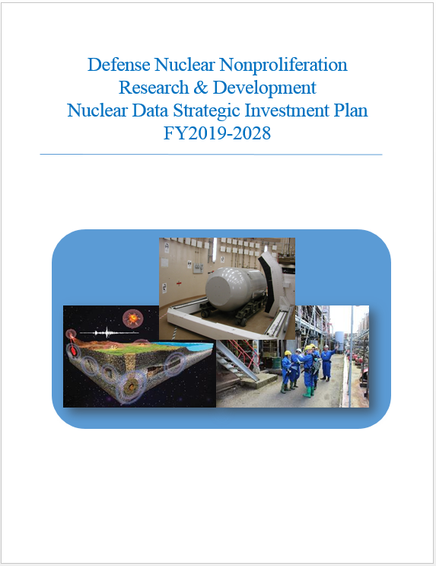
DNN R&D support to improve nuclear data…
FY09-FY19, Experimental and theoretical investments to improve nuclear data capabilities total ~$70M.
Investments made by:
  NA-222 - Forensics
  NA-221 - Emergency Response, Safeguards, and Near-field Detection.
Participation in the Office of Nuclear Physics Interagency FOA in FY 18&19(&20&…)
NDREW (2018) provided input for DNN R&D collectively organize nuclear data efforts

Slide 7
Improving the Nuclear Data on Fission Product Decays at CARIBU
FOA: LAB 17-1763
Lead lab: ANL
PI: Savard, Guy (ANL)
Additional senior staff: Scielzo, Nicholas (LLNL), Carpenter, Michael (ANL), Kondev, Filip (ANL)
Funding: NP and DNN R&D - 5 years
Summary:
  Published “β-decay half-lives of Sb-134,134m and their isomeric yield ratio” in PRC
  Ongoing: 95Zr b-decay branching ratios
  Plans for future measurements of 156Eu, 161Tb, 111Ag, 127Sb, 91Y, and 115mCd
Sample harvested at CARIBU
β-γ coincidence measurement

Slide 8
Novel Approach for Improving Antineutrino Spectral Predictions for Nonproliferation Applications
FOA: LAB 17-1763
Lead lab: ANL
PI: Kondev, Filip (ANL)
Additional senior staff: Carpenter, Michael (ANL), Savard, Guy (ANL)
Funding: Evenly split between NP and DNN R&D over 3 years
Summary:
  Nuclear data for fission products (FP) needed to reliably predict reactor antineutrino spectra
  FP beams provided by the CARIBU facility at ANL
  Gammasphere: Discrete g-ray spectroscopy and Total Absorption Spectroscopy (TAS)
The new Gammasphere target chamber has been manufactured and delivered (Right)
The construction of the tape-moving system is proceeding
The design of the beta-particle detector array (left) has been completed
Successful commissioning experiment of the whole system in December 2018

Slide 9
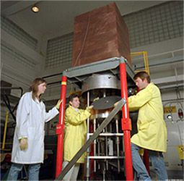
Integral Measurements of Independent and Cumulative Fission Product Yields Supporting Nuclear Forensics and Other Applications
FOA: LAB 18-1903
Lead lab: LANL
PI: Bredeweg, Todd
Additional senior staff: Burke, Jason (LLNL); co-PI Friese, Judah (PNNL)
Funding: DNN R&D (Forensics)
Summary:
Extend both CFPY and IFPY measurements with an emphasis on ²³⁹Pu in thermal, fission spectrum and 14 MeV neutron fields.
Subset of new/confirmatory measurements of ²³⁵U, ²³⁸U, ²³³U and ²³⁷Np.

Slide 10
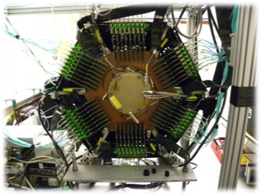
Measurements of Independent Fission Product Yields
FOA: LAB 18-1903
Lead lab: LANL
PI: Duke, Dana
Additional senior staff: Snyder, Lucas (LLNL); co-PI Wood, Lynn (PNNL)
Funding: NA-113, DNN R&D support for PNNL
Summary:
Carry out FGIC measurements of 233U, 234U, 239Pu, and 237Np
2E analysis of existing fissionTPC data 238U, 235U, and 239Pu data
Develop a Bragg curve analysis method to improve amu, A, and Z determination in the fissionTPC

Slide 11
Energy Dependent Fission Product Yields
FOA: LAB 18-1903
Lead lab: LLNL
PI: Tonchev, Anton
Additional senior staff: Gooden, Matthew (LANL); Bernstein, Lee (LBNL); Stoyer, Mark (LLNL)
Funding: NA-113, DNN R&D support for LBNL
Summary: FPY data for ²³⁵U, ²³⁸U, and ²³⁹Pu isotopes using monoenergetic and pulsed neutron beams with energies from 0.5 to 15.0 MeV
Monoenergetic neutron beams at the Triangle Universities Nuclear Laboratory (TUNL) Tandem accelerator
Neutron flux monitored by fission ionization chambers
Automatic target-transfer system for short-lived fission products
Two shielded HPGe Clover detectors to study the delayed g-ray history of the short-lived FPYs from actinide targets

Slide 12
Evaluation of Energy Dependent Fission Product Yields
FOA: LAB 18-1903
Lead lab: LANL
PI: Kawano, Toshihiko
Additional senior staff: Talou, Patrick (LANL); Sonzogni, Alejandro (BNL); McCutchan, Elizabeth (BNL)
Funding: DNN R&D, 5 year effort
Summary: Provide new high-quality evaluations of FPY data to the user communities by combining modern fission model developments and careful collection and evaluation of available experimental data.
Compilation and evaluation of available experimental data, including updated decay data
Development of a consistent fission fragment decay model from thermal up to 20 MeV incident neutron energy
Production of updated FPY data files for important actinides

Slide 13
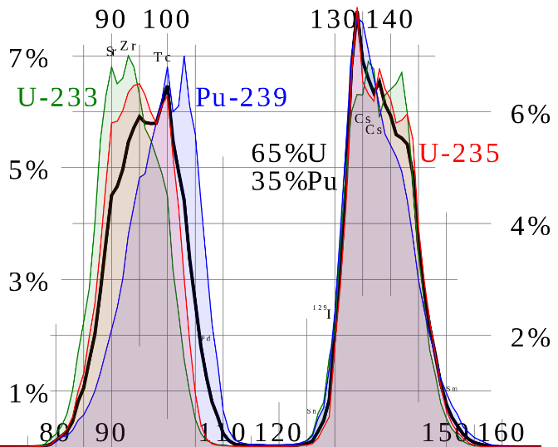
NNSA fission yield topic in LAB 18-1903
 | FY19 | FY20 | FY21 | FY22 | FY23
Differential Experiments | Ongoing & New Starts
Integral Experiments | New Starts
Theory Development | Ongoing Efforts
Evaluation, Processing, & Benchmarking | New Starts
Code Development
Preparation
Completion

Slide 14
Current and Future Interagency FOA efforts
FY18 – Partnered with DOE/SC/NP on two experimental projects
FY19 – Partnered with NNSA/NA-113 on two experimental projects. Began support for a five year effort to provide a comprehensive evaluation update on fission product yield.
FY20 – Multiple feasibility/sensitivity studies: neutron-induced emission, (alpha,n), gamma induced emission, non-actinide reaction network, etc.
FY21 – New start(s) based on feasibility study; new topic feasibility study as identified in DNN R&D Strategic Roadmap
FY22 & beyond: etc. etc.

