Slide 1
Inter-Agency Efforts on Nuclear Data
January 22-24, 2019

Slide 2
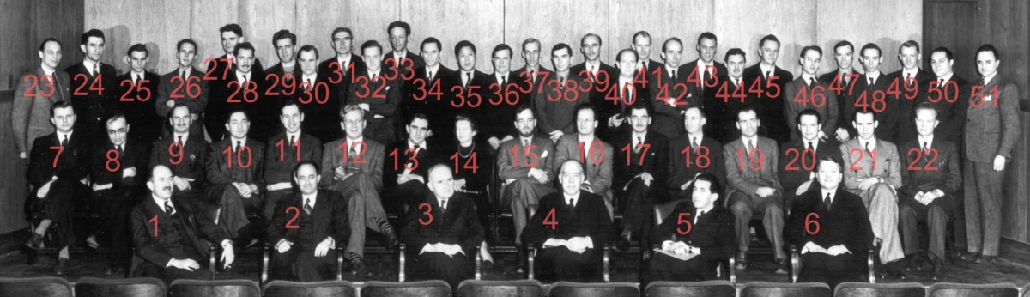
The Time and Place of The WANDA Meeting is Symbolic
January 26, 1939
Fifth Washington Conference on Theoretical Physics
George Washington University
Attendees included: L. Adams, G. Gamow, ?. Lord, C. Starr, D. Andrews, M. Goeppert-Mayer, ?. Mahan, O. Stern, ?. Baroff, H. Grayson-Smith, R. Myers, E. Teller, H. Bethe, L. Hafstad, H. O'Bryan, M. Tuve, F. Bitter, M. Hebb, E. Posnjak, G. Uhlenbeck, N. Bohr, K. Herzfeld, I. Rabi, H. Urey, G. Breit, J. Hibben, L. Rosenfeld, J. Van Vleck, F. Brickwedde, J. Hoge, ?. Rossini, ?. Vestine, E. Condon, D. Inglis, A. Ruark, C. Critchfield, ?. Jacobs, R. Scott, G. Diecke, F. Keyes, R. Seitz, E. Fermi, F. Kracek, ?. Silsbee, J. Fleming, F. London, C. Squire

Slide 3
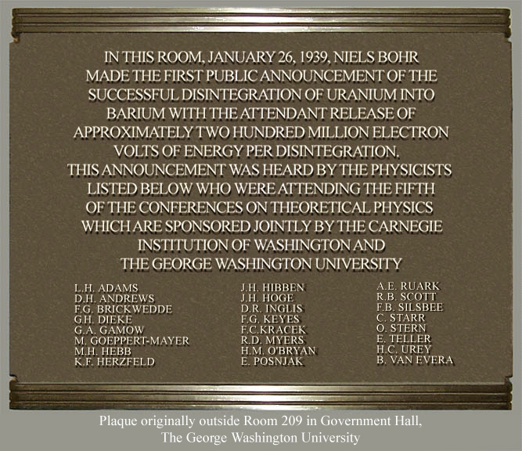
The Beginning of the Atomic Age

Slide 4
There is a long-standing stewardship of Nuclear Data in NP, which is integral to the success of NP-supported research and aligns strongly with NP program priorities for R&D integration. It also aligns strongly with DOE S4 priorities in the areas of QIS/QC, Artificial Intelligence, Accelerator R&D, SRF, and isotopes.

Slide 5
The DOE NP U.S. Nuclear Data Program
Nuclear Data activities date back to the Manhattan Project. They started at BNL in 1952 under the Brookhaven Neutron Cross Section Compilation Group, changed to the Sigma Center in 1961, which became the National Neutron Cross Section Center in 1967, and finally the NNDC in 1977.
Combines the efforts of approximately 50 researchers at 7 national laboratories (Argonne, Brookhaven, Los Alamos, Lawrence Berkeley, Lawrence Livermore, the National Institute of Standards and Technology, and Oak Ridge) and 6 universities (Duke, McMaster, Michigan State, North Carolina State, Texas A&M, and University of California-Berkeley). Leadership for the USNDP at the national level is provided by the National Nuclear Data Center (NNDC) at Brookhaven National Lab (BNL).
Collects, analyzes, evaluates, and disseminates nuclear physics data for basic nuclear research and for applied nuclear technologies with emphasis on nuclear structure and low energy nuclear reactions.
NP and other Interagency partners believe that having reliable nuclear data that are comprehensive in key areas is a very high priority, and that currently, despite valiant efforts over decades, nuclear data compilations have significant and sometimes dangerous gaps where that is not the case.
WANDA Nuclear Data meeting
January 22-24, 2019

Slide 6
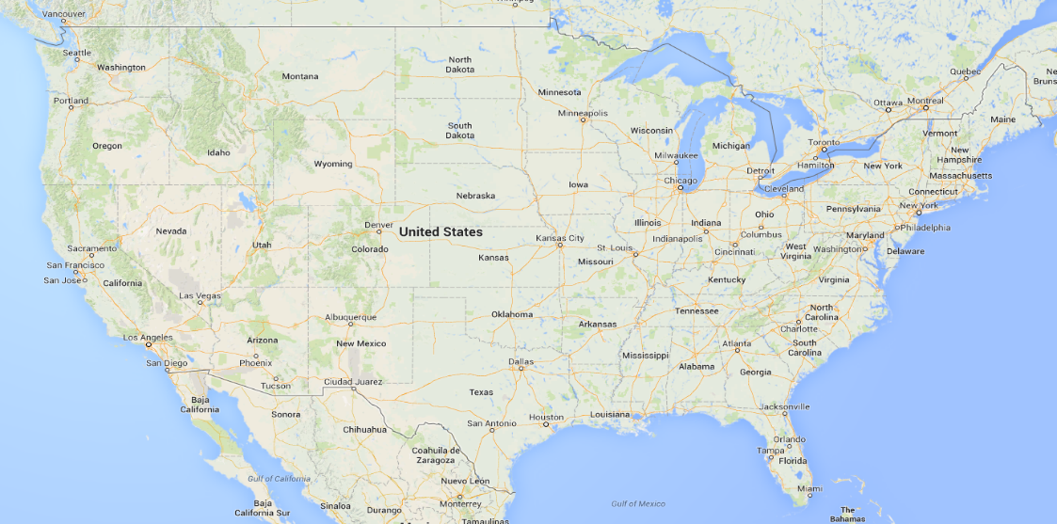
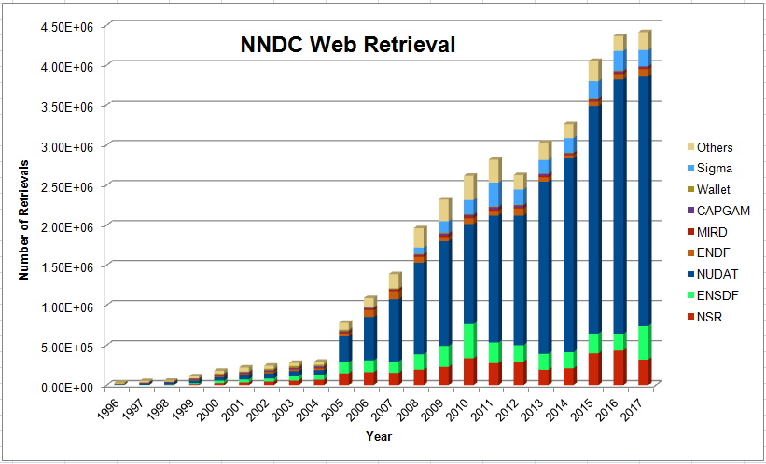
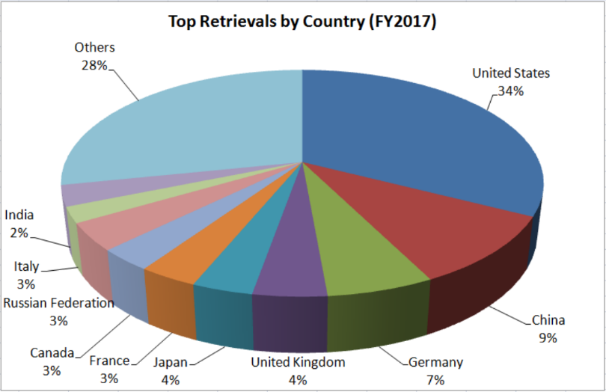
The DOE NP U.S. Nuclear Data Program (Established 1952)
DOE NP US Nuclear Data Program Groups
Nuclear Science References (NSR)
Articles indexed according to content
EXFOR
Compiled nuclear reaction data
XUNDL
Compiled nuclear structure and decay data
Evaluated Nuclear Structure Data File (ENSDF)
Recommended nuclear structure and decay data
ENDF
Recommended particle transport and decay data, emphasis on neutron- induced reaction data
Nuclear Data Sheets
Journal devoted to the publication of nuclear data
MSU
McMaster
LBNLUCB
ANL
NNDC
∼ 25 FTEs or ∼ 50 heads
NIST
TAMU
TUNL
LLNL
LANL
ORNL
WANDA Nuclear Data meeting
January 22-24, 2019

Slide 7
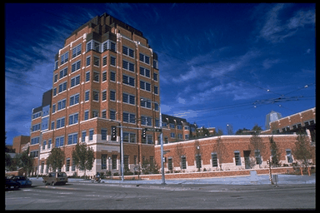
Nuclear Theory Program
The Nuclear Theory program (NT) provides the theoretical support needed to interpret the wide range of data from the experimental programs and to advance new ideas that identify potential areas for future experimental investigations. NT addresses all three of NP’s scientific thrusts:
Quantum Chromodynamics (“cold” and “hot”)
Nuclei and Nuclear Astrophysics
Fundamental Symmetries and Neutrinos
University Program
84 University Theory Grants
Nuclear Theory Topical Collaborations
National Lab Theory Program
Round 1: completed in FY 2015
7 National Lab Nuclear Theory Groups
Round 2: started in FY 2016
Institute for Nuclear Theory Center of Excellence
FIRE Topical Collaboration:
Main goals:
Improve description of fission
Address r-process conditions
Programs, workshops
Jointly funded: Nuclear Theory
Nuclear Data
NA-22 NNSA
~ 400 visitors/year
NP
WANDA Nuclear Data meeting
January 122-24, 2019

Slide 8
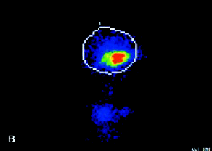
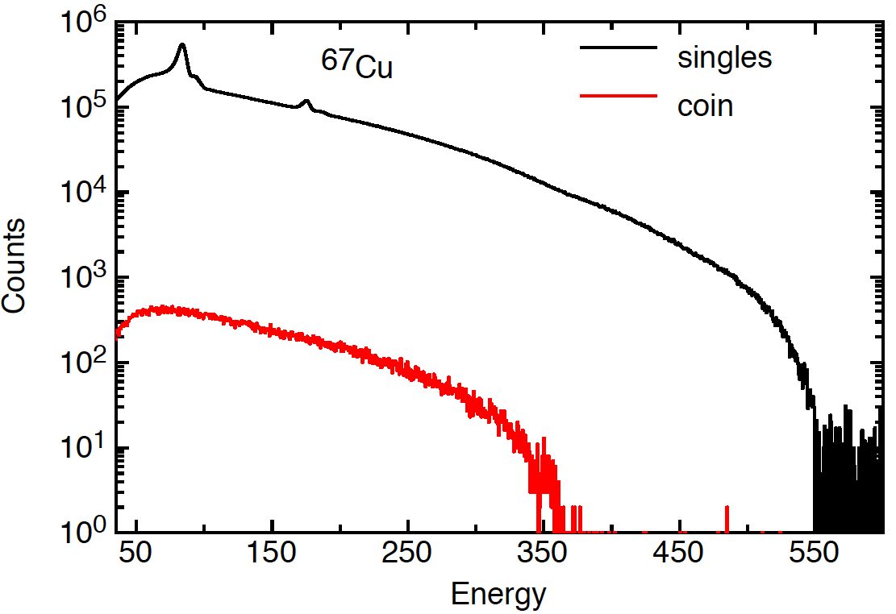
A Gap Example: Nuclear Data for Nuclear Medicine: ⁶⁷Cu
excellent NP properties for medical applications:
  therapeutic (β− emitter)
  diagnostic (SPECT): 93 keV & 184 keV γ rays
  matching pair: ⁶⁴Cu(PET)/⁶⁷Cu
ND issue – absolute β− and γ−ray emission probabilities from a single (inaccurate) measurement in 1953 H. Easterday, Phys. Rev. 91 (1953)
Hughes et al. J. Clin. Oncol. 18, 363 (2000)
New measurements & evaluation at ANL
I_{γ} (184 keV) = 44.2 (6)%, compared to 48.7% previously
I_{β−,0} = 27.4 (5)% compared to ~20% previously
⁶⁷Cu is produced more than previously anticipated!
Impact:
considering only 1% of the cancer cases that can be treated with ⁶⁷Cu in US – more than $8M per year savings, assuming 260 mCi per patient (I. Novak-Hofer & P. A. Schubiger, Eur.J. Nucl. Med. 29, 821 (2002)) and $295 per mCi (NIDC-DOE)
WANDA Nuclear Data meeting
January 22-24, 2019

Slide 9
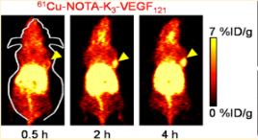
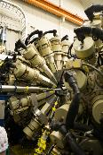
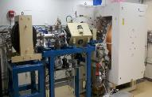
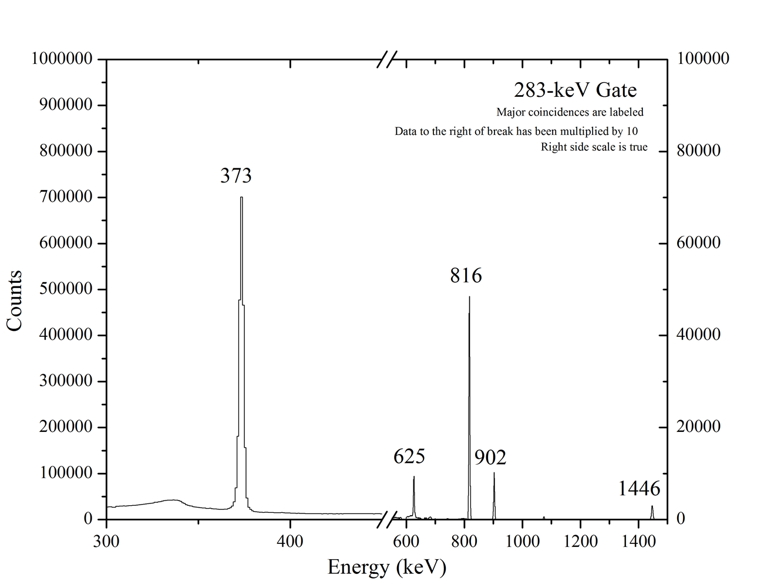
Another Nuclear Data Example for Nuclear Medicine: ⁶¹Cu
⁶¹Cu promising PET radioisotope
In just past 2 years, over 10 publications on cross section measurements to investigate ⁶¹Cu production
– all relying on gamma-ray intensities
But… from IAEA report (INDC-0717 (2017))
Y. Zhang et al., Mol. Pharm. 9, 3586 (2012)
Source produced at U. of Wisconsin and assayed in Gammasphere (ANL)
Energy (keV) | ENSDF Intensity | Present Intensity | %Diff
373 | 17.6(4) | 17.1(1) | 3%
656 | 88.3(15) | 81.1(3) | 7%
908 | 9.0(2) | 7.7(1) | 14%
WANDA Nuclear Data meeting
January 22-24, 2019

Slide 10
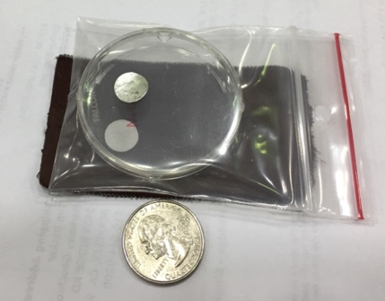
Nuclear Data can aid in the design of nuclear energy systems: the ³⁵Cl(n,p) cross section for molten salt reactors
The ³⁵Cl(n,p) cross section is thought to be too large at fission energies (≈1 MeV) to allow for natural salt to be used in molten salt reactors, but there are no measurements between 100 keV and 14 MeV
The first measurement of the ³⁵Cl(n,p) and (n,a) cross sections were performed via activation in ratio to ¹¹⁵In(n,n’) at 2.7 MeV at the UC High Flux Neutron Generator (HFNG).
This work
^{nat}In + NaCl samples mounted in the HFNG
The cross section is approximately a factor of 7 below the evaluation
HFNG Measurement
MSR
spectrum
Thanks to J.C. Batchelder and S.A. Chong
HFNG
WANDA Nuclear Data meeting
January 22-24, 2019
10

Slide 11
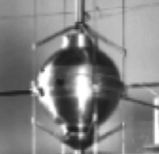
Another Example: Compensating Errors in ²³⁹Pu(n,n)*
Reaction evaluations were performed in the US (ENDF) and France (BRC09) and validated against the Jezebel ²³⁹Pu critical assembly.
Both evaluations predict criticality (k_{eff} = 1.00083(11) vs. 1.00060(12) )
Swapping one cross section at a time from BRC09 for one from ENDF produced small changes in k_{eff} for well-known and small cross sections like (n,f) and huge changes for cross sections with a lack of good data such as (n,n_{el}) and (n,n’)
Fission
Spectrum
-0.16%
(n,f)
-0.122%
(n,γ)
+0.275%
(n,n’)
+0.522%
(n,n_{el})
-0.638%
(n,2n)
-0.14%
*E. Bauge et al.,
Eur. Phys. J. A (2012) 48: 113
Data deficiencies lead to compensating errors that introduce unknown uncertainties into the interpretation of pre- and post-det forensics
WANDA Nuclear Data meeting
January 22-24, 2019
11

Slide 12
NP/NDIWG Experimental Research Program
In 2017, working with the USNDP and the NNDC, NP and other interested federal offices initiated a pilot program of nuclear data experiments under a Nuclear Data Interagency Working Group (NDIAWG), with the goal of extracting high priority nuclear data of great importance to applications or to research that might otherwise not be addressed in the course of existing research programs. This program stipulates that the experiments supported have participation from the USNDP, so the results will be transferred to NNDC databases in a timely manner.
NP Projects funded under the first Nuclear Data Experiment Funding Opportunity Announcement (FOA), LAB 17-1763:
1. Title: Improving the Nuclear Data on Fission Product Decays at CARIBU
PI: Savard, Guy (ANL); Start date 10/15/2017, Funding: NA-22 and NP
2. Title: Novel Approach for Improving Antineutrino Spectral Predictions for Nonproliferation Applications
PI: Kondev, Filip (ANL); Start date 11/01/2017, Funding: NA-22 and NP
3. Title: 238U(p,xn) and 235U(d,xn) 235-237Np Nuclear Reaction Cross Sections Relevant to the Production of 236gNp
PI: Fassbender, Michael (LANL); Start date 4/01/2018, Funding DOE NP and DOE NP IP
WANDA Nuclear Data meeting
January 22-24, 2019

Slide 13
NDIAWG FY19 Experimental Measurement Awards
Awards made under NDIAWG FOA: LAB 18-1903
NNSA Awards:
“Integral Measurements of Independent and Cumulative Fission Product Yields Supporting Nuclear Forensics and Other Applications”, Bregeweg, et al., 4 years, $2,986,000.
“Evaluation of Energy Dependent Fission Product Yields”, Kawano et al., 5 years, $4,000,000.
“Energy Dependent Fission Product Yields”, Tonchev et al, 3 years, $3,295,000.
“Measurements of Independent Fission Product Yields”, Duke et al, 3 years, $3,369,000.
“Independent fission product yields from 0.5 to 20 MeV”, Mosby et al., 3 years, $1,500,000.
Total of NNSA Awards: $15,150,000.
NP Awards:
“State-of-the-art Gamma-ray Spectroscopy to Enhance the ENSDF Database for Use in Medical Isotope Science”, McCutchan et al., 3 years, $546,000.
“Beta-strength function, reactor decay heat, and anti-neutrino properties from total absorption spectroscopy of fission fragments”, Rykaczewski et al., 3 years, $1,371,000.
Total of NP Awards: $1,917,000.
NP-NE Awards:
“Improving the double-differential 238U(n,n’g) cross section using neutron-gamma coincidences”, Bernstein et al., 2 years, $900,000.
Total of NP-NE Awards: $900,000.
WANDA Nuclear Data meeting
January 22-24 2019

Slide 14
A Third Nuclear Data FOA
The Nuclear Data Interagency Working Group (NDIAWG) met last Friday (1/18/2019)
NP, BES, ASCR, NA22, NA113, NA221, NA241, NA83, NE, DTRA, DOE Isotope Program,...
The discussion indicated the collective experience with the NDIAWG and the FOA had been positive thus far and there was broad support for a new FOA similar to the previous calls, albeit with some details for some agencies to be worked out. Some agencies may also have their own targeted opportunities.
NP and NA22 (Frederik Tovesson) have been spearheading the preparation of new language for a new Lab-call
The plan is to put out the FOA’s in 2-3 months, with decisions made in FY2019 for funding in FY2020.
T. Hallman has briefed the Under Secretary for Science, Paul Dabbar, on plans for a Lab all and potentially a University FOA as well. If you are interested in a University call, you should express that interest.

Slide 15
Outlook
For a broad spectrum of very important pursuits spanning the range from basic research to National Defense, having reliable nuclear data that are both comprehensive and correct in key areas is a very high priority. Without such, compromised decision making can lead to wasted resources, incorrect conclusions, and national security risks.
Currently, despite valiant efforts over decades, some nuclear data compilations have significant and in some cases dangerous gaps where reliable data do not exist.
DOE NP and its Interagency partners, including NA-22, put out coordinated lab-only solicitations in FY2017 and FY 2018 to field a pilot experimental program to begin to opportunistically address some of these issues.
In FY2019 the intention is to put out a coordinated lab (and possibly university) FOA call targeting the same type of research. (For more information, use Nuclear Physics points of contact Tim Hallman/Frederik Tovesson).
DOE NP and NA-22 very much hope and look forward to being joined on this FOA by an expanded list of partners within and outside of SC who will consider making awards in this very important work.
Wanda Nuclear Data Meeting
January 122-24, 2019

Slide 16
Additional Information

Slide 17
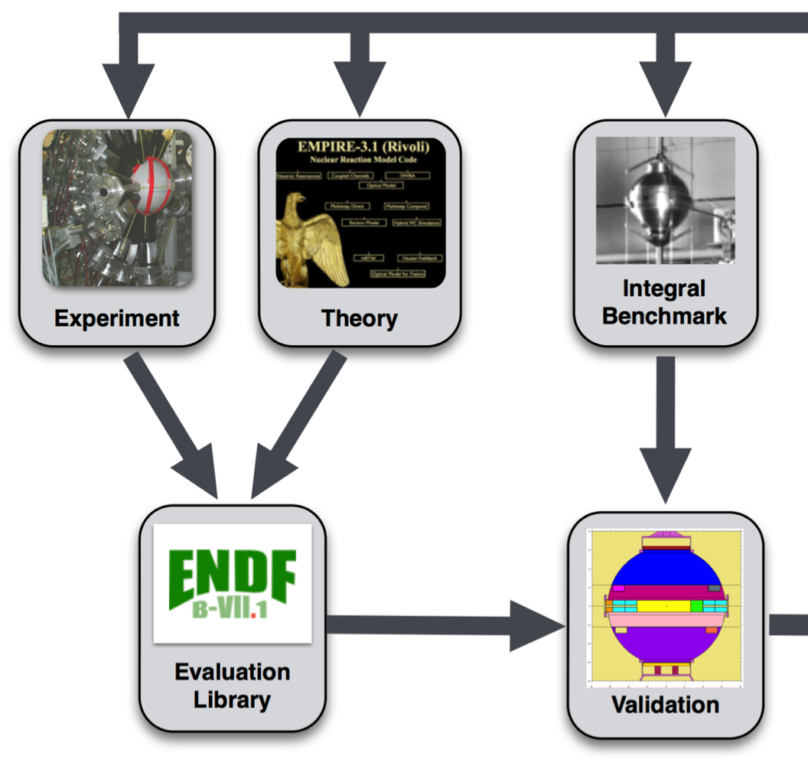
The Nuclear Reaction Evaluation Process
The process is iterated with the benchmark constrained until the evaluation converges
Reaction theory inputs are adjusted until
they reproduce measured data (e.g., cross section as a function of E_{n}, q_{n}) to generate evaluated nuclear data libraries
The cross sections from these models are validated against simulations of integral benchmarks such as a critical assembly and the result is used to guide the models

Slide 18
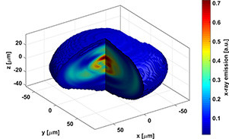
A Cautionary note about the importance of good data:
Ignition Campaign at the National Ignition Facility
The National Ignition Facility (NIF) was designed to produce controlled thermonuclear fusion using a 1.8 MJ laser to drive
Prediction: $R=\sum_{𝓁}{A_{𝓁}P_{𝓁}(cosθ)}$
Predictions based on modeling with incomplete data were that the laser drive would compress the capsule with a non-sphericity ≤ 2%¹
Measurements with neutron scattering, activation and imaging showed a far more asymmetric shape²
Result: A failure to achieve ignition thermonuclear burn (Physics of Plasmas 21, 020501 (2014); https://doi.org/10.1063/1.4865400)
A₆/A₀ ≤ +2%
A₄/A₀ ≤ -2%
Reality: P₂/P₀ ≈31%
Models based on poor data can compromise decision making
1 C. Cerjan et al., UCRL-TRL-229780 (2007)
²Mark Bello; Scilight 2017, 2017, DOI: 10.1063/1.5011179

Slide 19
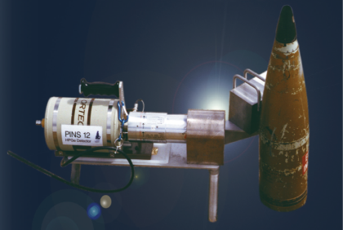
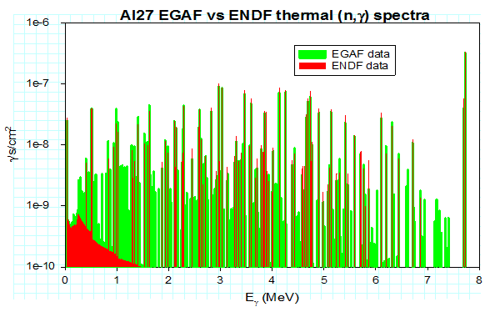
Active neutron interrogation for the interdiction of nuclear material requires good (n,xγ) and (γ,xγ) nuclear data
(n,xγ) and (γ,xγ) g-rays provide a powerful tool for the interdiction of nuclear material, explosives and drugs, nuclear dismantlement, treaty verification.^{1,2}
Their interpretation requires high-fidelity (n, γ), (n,n’ γ) and (γ,xγ) data, but existing data are often incorrect or completely lacking.
PORTABLE ISOTOPIC NEUTRON SPECTROSCOPY
Example: ²⁷Al(n, γ) data contained few γ-rays and included background from Compton scattering.
The USNDP is working to address these issues by measuring, compiling and evaluating γ-ray data for the EGAF (https://www-nds.iaea.org/pgaa/egaf.html) and Baghdad Atlas database (http://nucleardata.berkeley.edu).
¹M.Litz et al., ARL-TR-5871
²J. Medalia, Congressional Research Service 7-5700 www.crs.gov R40154
Poor knowledge of γ-ray production hampers nuclear detection (e.g., CAARS)

Slide 20
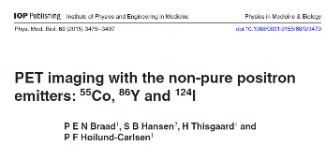
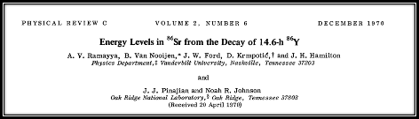
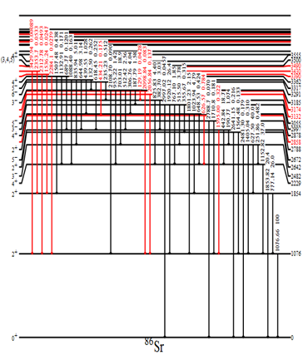
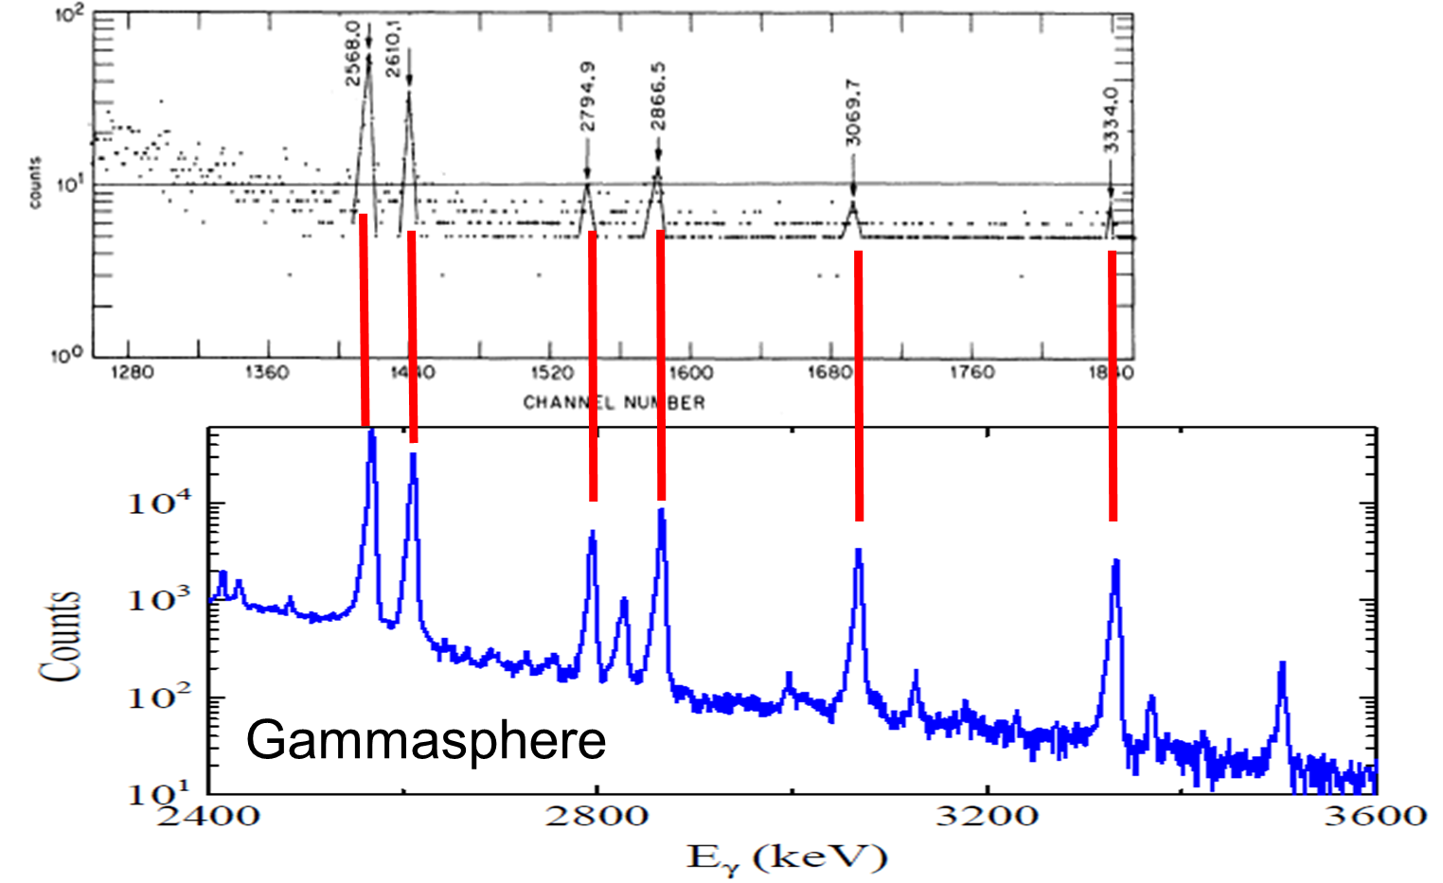
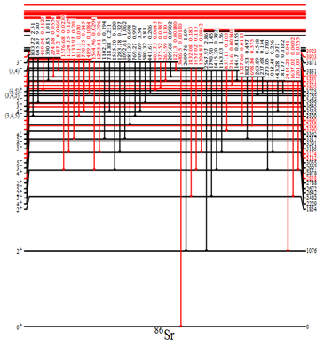
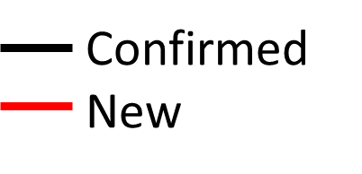
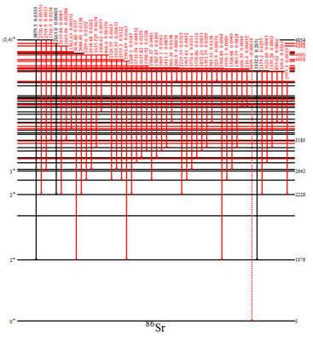
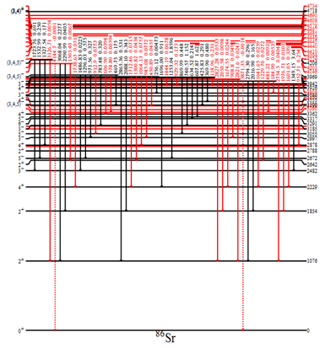
Nuclear Data for Nuclear Medicine: ⁸⁶Y
⁸⁶Y new non-conventional PET isotope
⁸⁶Y decay scheme last studied in 1970
Over 100 new transitions identified
511 keV intensity decreases by 20%
Gamma dose increases
Previous measurement: 10’s of counts in high energy peaks. Present work: 100,000’s of counts

Slide 21
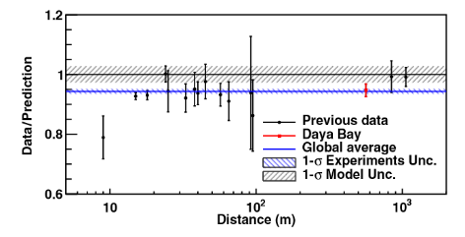
Nuclear Data for Reactor Antineutrinos
Reactor Antineutrino Anomaly
Deficit of total measured antineutrinos relative to predictions
The “Bump”
Excess of measured antineutrinos in 4-7 MeV energy region
F.P. An et al, PRL 116, 061801 (2016).
Involves many types of nuclear data
Beta-spectra of fission fragments
Fission yields
Isomeric ratios
Data is Cross Cutting: applicable not only to Neutrino Physics, but also Non-Proliferation and Nuclear Energy

Slide 22
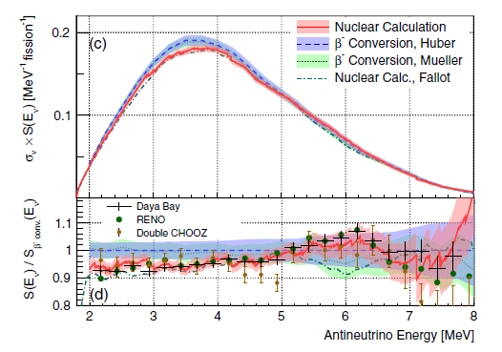
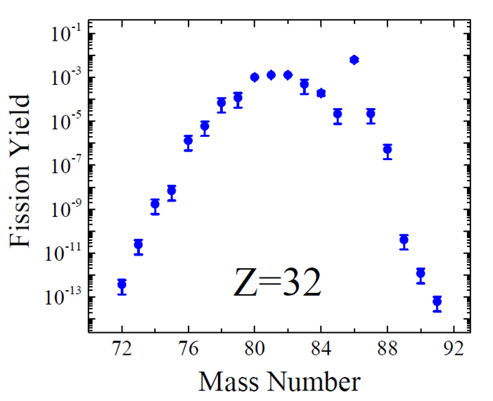
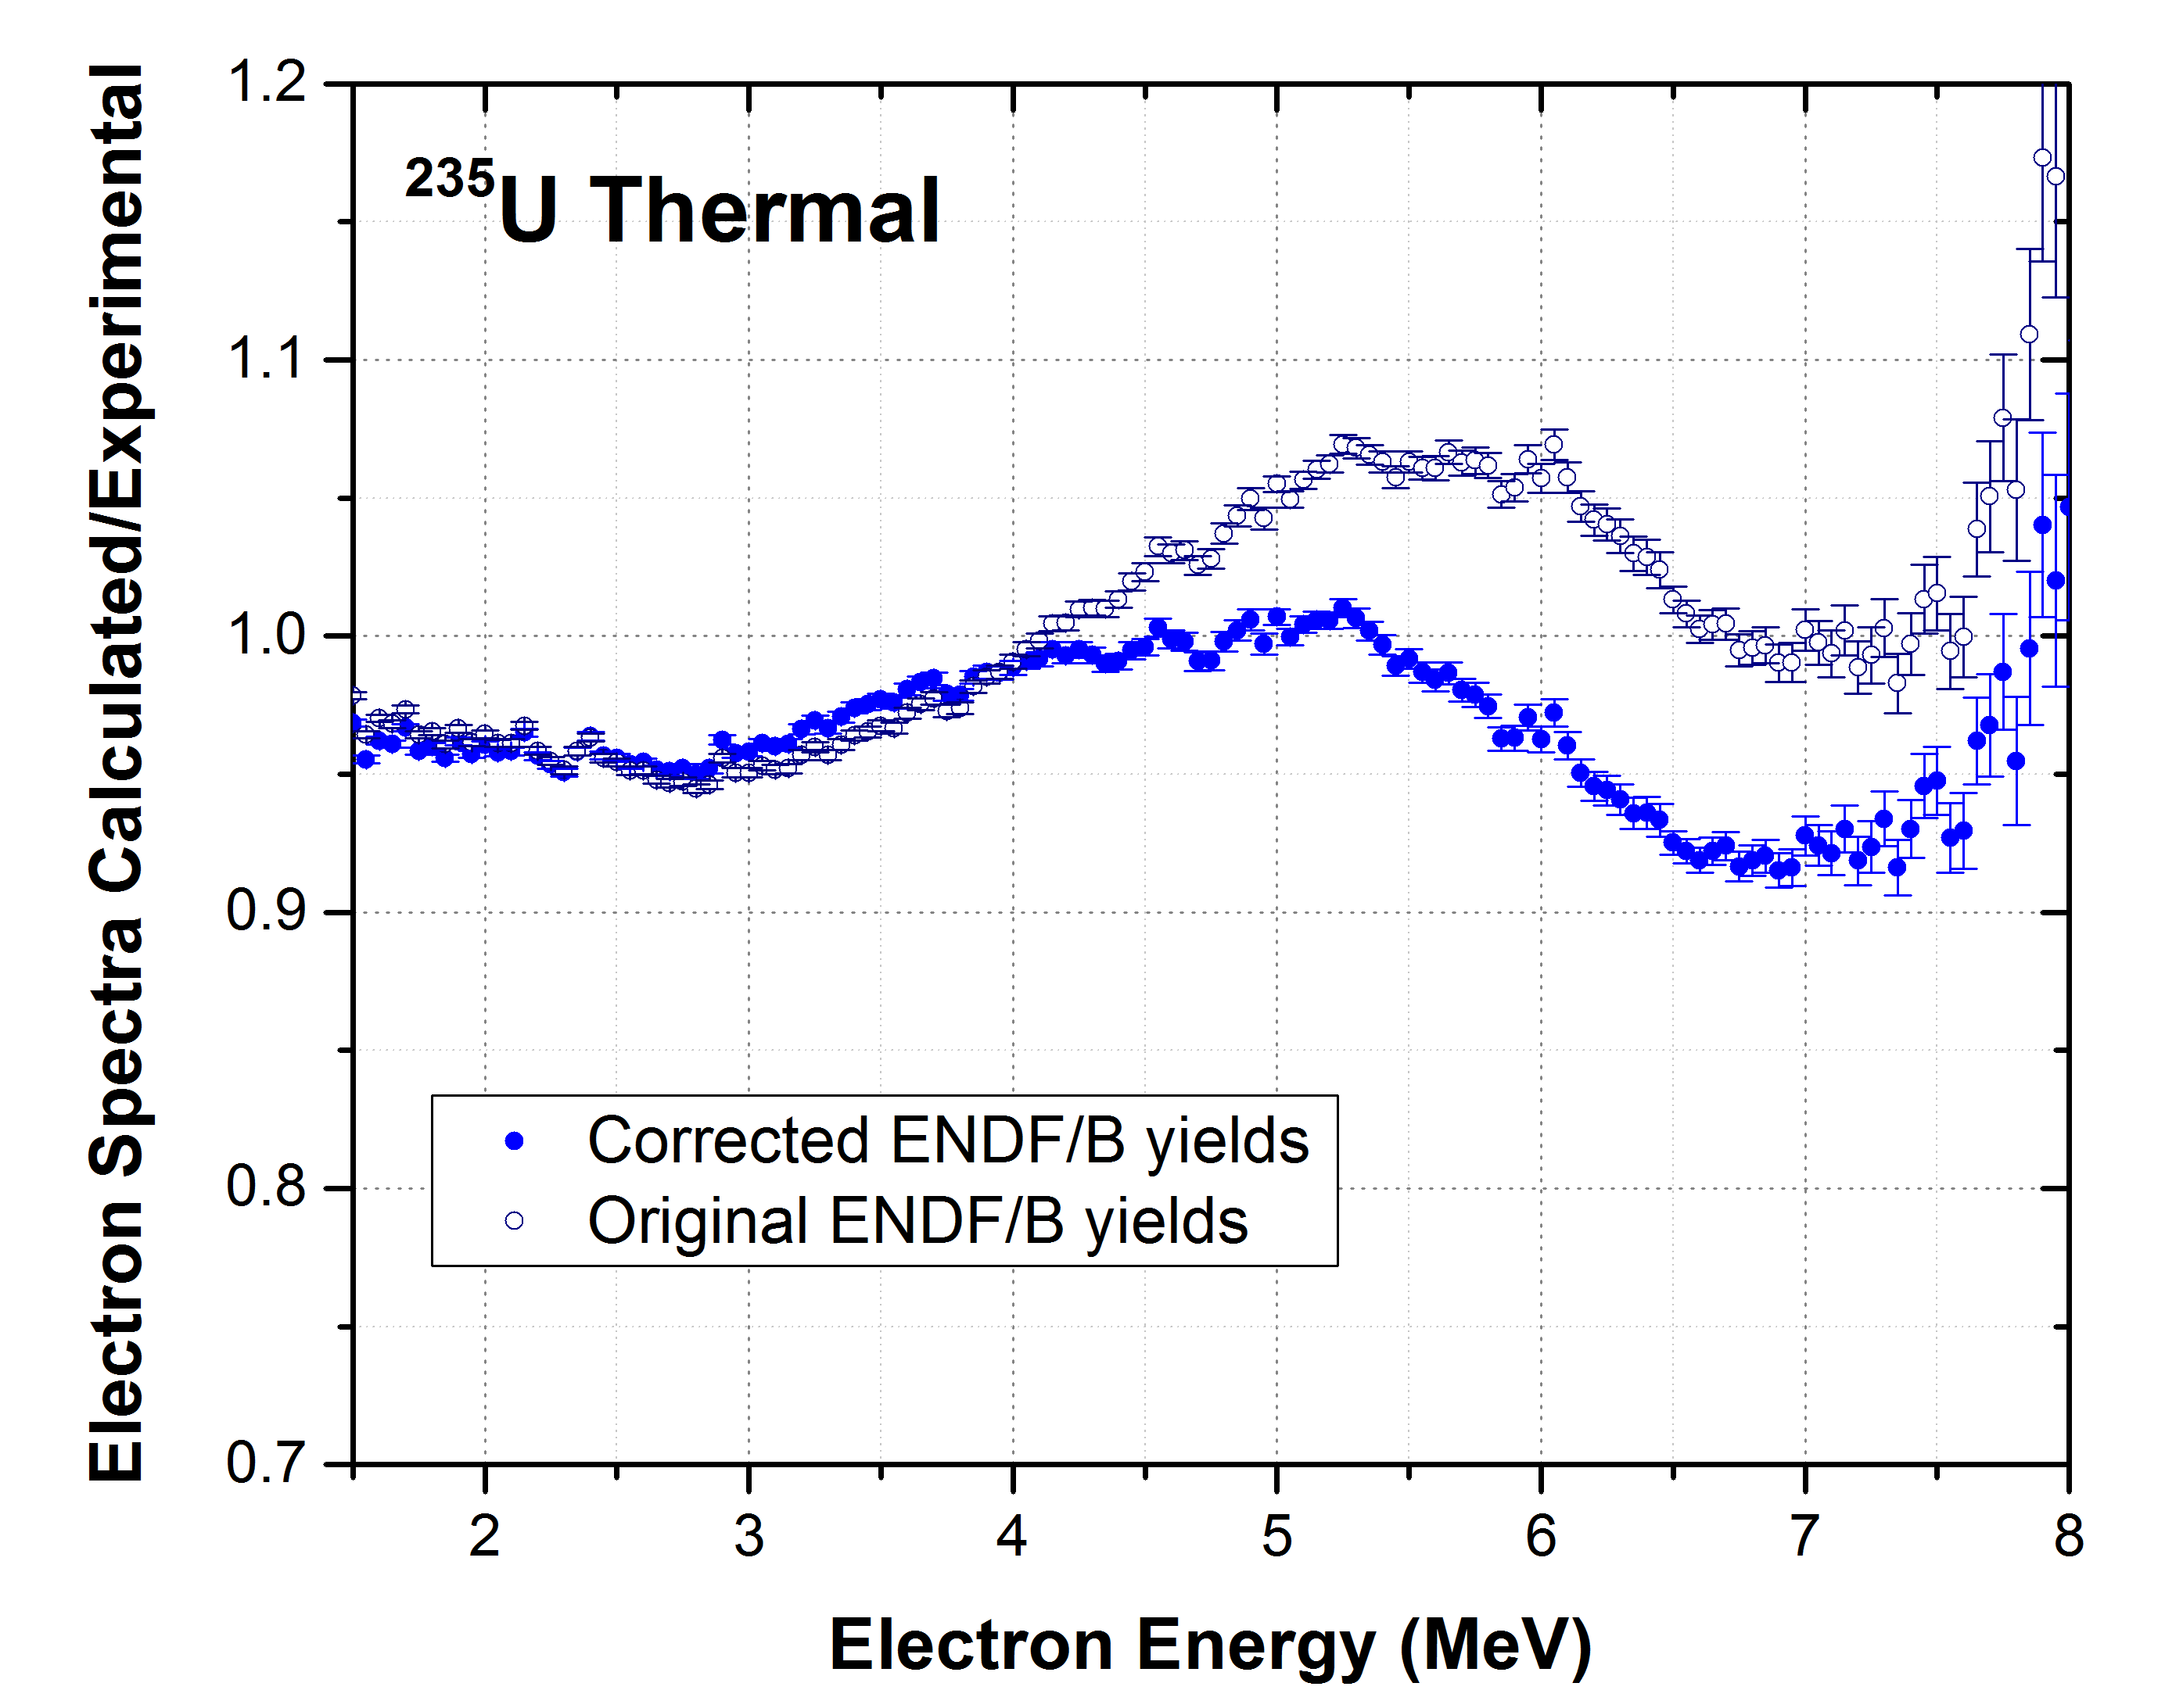
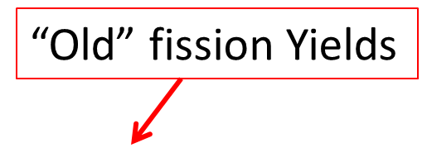
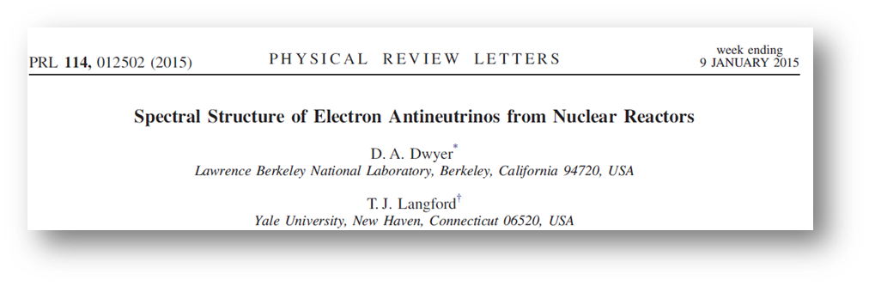
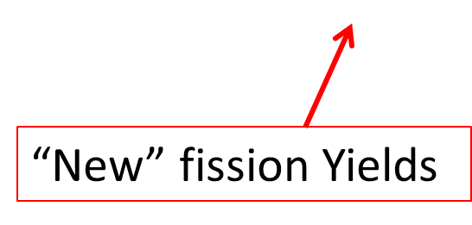
Fission Yield effects on Antineutrino Spectra
However, correction of erroneous yields and improvements in isomeric ratios, lead to dramatically different result, with no evidence for a “bump” in summation calculations
Dwyer and Langford initially calculated that nuclear databases could describe the “bump”
A.A. Sonzogni, et al., Phys. Rev. Lett. 116, 132502 (2016)

Slide 23
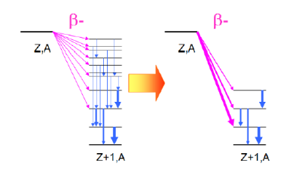
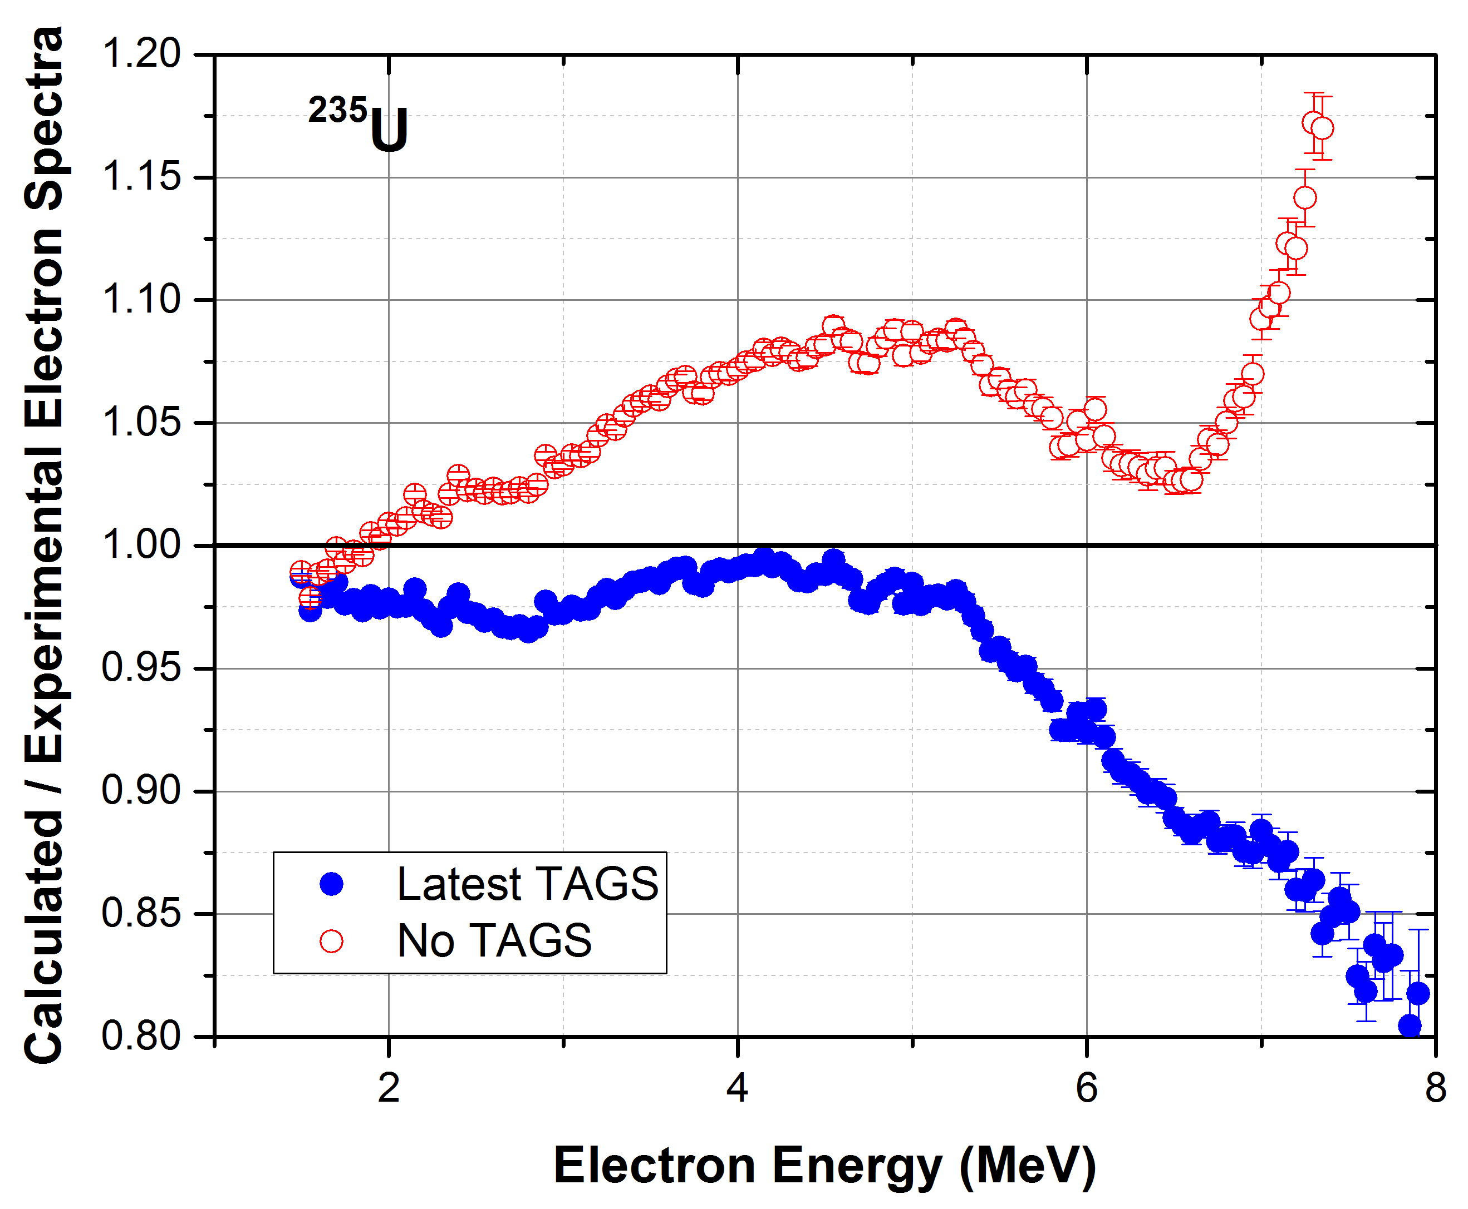
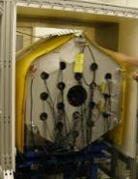
Spectrum Effects on Antineutrino Spectra
Adding just a handful of these recent TAGS measurements has significant effect on predicted spectrum
Observed
Actual
Pandemonium:
overestimation of β …
and antineutrinos
Nearly 10% decrease
Pandemonium can be overcome using Total Absorption Gamma Spectroscopy
MTAS at ORNL
Recently measured more than 50 nuclei relevant to antineutrinos and decay heat

Slide 24
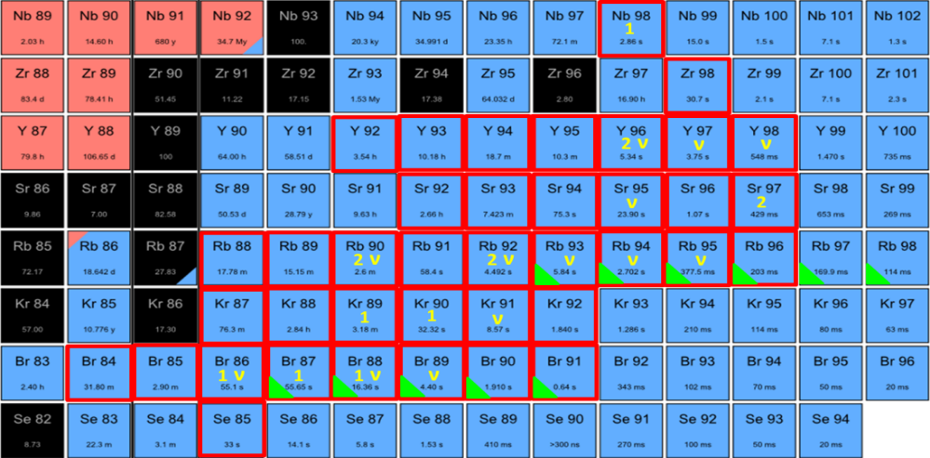
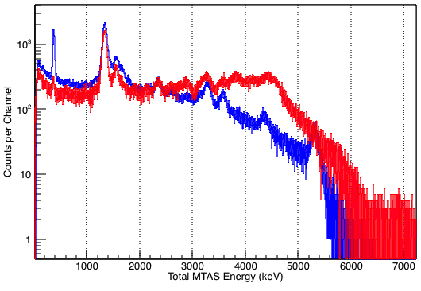
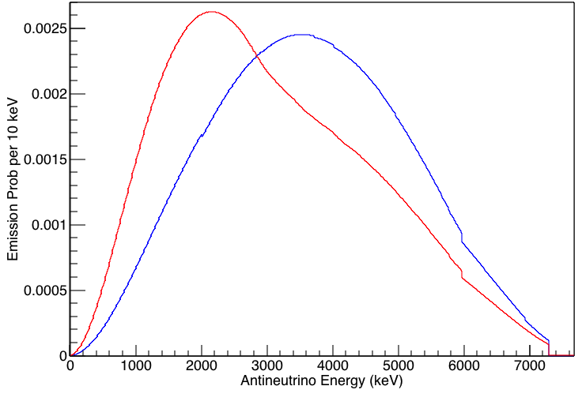
Accurate Beta-Decay Data from Fission Products Needed for Forefront Basic Research: MTAS Results
Over 70 decays measured: 64% of direct production and 34% of cumulative yield in ²³⁵U+n_{th} fission.
Evaluation of 8 activities, ⁸⁶Br, ⁸⁹Kr, ⁸⁹Rb, ⁹⁰Kr, ^{90m,gs}Rb, ⁹²Rb and ¹³⁹Xe, yielded a reduction of the overall reactor anti-neutrino interactions by 1.2% for LEU power reactors and 1.5% for HEU research reactor like HFIR, when MTAS data replace respective entries in ENSDF.
The reported 95(2)% anomaly is reduced, correspondingly.
[Fijałkowska et al.,2016]
MTAS data on the top three activities contributing to the enhancement of anti-neutrino signals at 5-7 MeV,
⁹²Rb, ⁹⁶Y and ¹⁴²Cs, increases this ~ 10% effect to
about 12%. [Rasco, Wolińska et al., 2016]
Conclusion from MTAS measurements:
“reactor anti-neutrino anomaly” is reduced
high energy “anti-neutrino bump” is enhanced
decay heat is enhanced
MTAS β-γ
VANDLE β-n-γ
ν
Priority for $\overline{ν}$
1
Priority for decay heat
¹⁴²Cs decay
¹⁴²Cs decay
$\overline{ν}$
spectra
MTAS experiment
ENSDF simulation
MTAS
ENSDF
MTAS spectra of ¹⁴²Cs decay and anti-neutrinos emitted from ¹⁴²Cs.
Red lines are MTAS data, blue lines are based on present ENSDF data.
The MTAS data points to a shift of the¹⁴²Cs decay to higher excited states
and hence the anti-neutrino spectrum shifts towards lower energies.

Slide 25
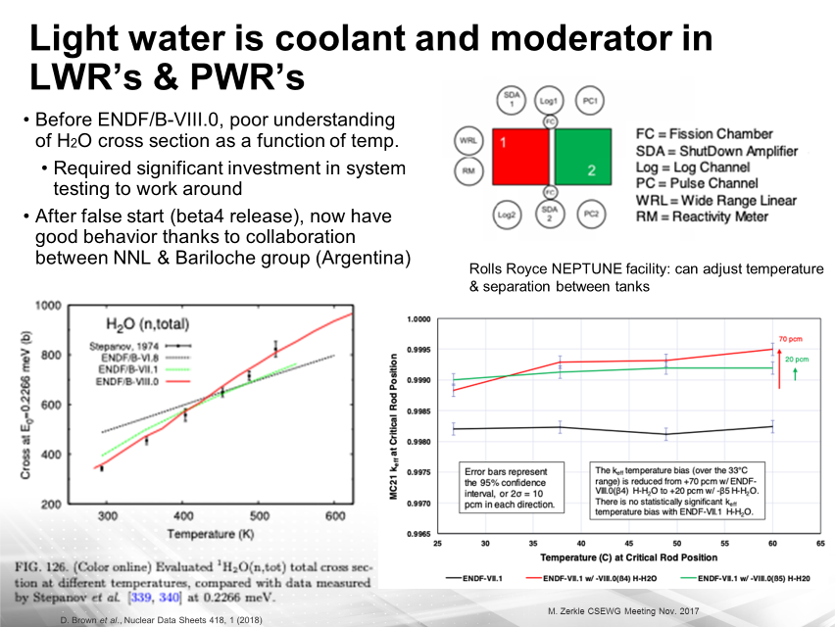
Notes:
ABOUT THIS SLIDE:
Low energy neutrons (de Broglie wavelength ~Angstroms) sensitive to inter-atomic spacings, therefore to thermodynamic properties of materials. Must consider effective cross sections of materials.
H2O is both a coolant and moderator in ALL power reactors in US
Poor performance of H2O at elevated temps was known issue in industry and engineers cleverly (but with extensive and expense testing) created designs to work around flaws in data
(the shortcomings of the data were not shared with broader community in part because of proprietary nature of work)
ENDF/B-VIII.0 collaboration between Centro Atomico Bariloche (Argentina) (made evaluation) and Naval Nuclear Laboratory (US) (did testing) resulted in new tested evaluation
Test in simulation of Rolls Royce NEPTUNE facility. Consists of 2 tanks with spent fuel. Can move back & forth to control reactivity. Can heat between 20-60 deg C.
Don’t care as much about absolute value of reactivity (we control this anyway). We do not want a slope vs. temp. If we see slope, we have got to wonder if reactivity keeps climbing at higher temps. Obviously BAD
Reactivity slope gone in ENDF/B-VIII.0 beta5 == final release

Slide 26
Nuclear Data Submissions to FY2018 IA FOA
Very Significant Interest in Nuclear Data Experimental Program
office | title | Yr.1 | Yr.2 | Yr.3 | Yr.4 | Yr.5 | tot.
NP | State of the Art Gamma-Ray Spectroscopy to Enhance the ENSDF Database for use in Medical Isotope Science. | $178,829 | $182,954 | $186,129 |  |  | $547,912
NE | Thermal Neutron Scattering Data for Fluoride High Temperature Reactors. | $322,269 | $332,722 | $344,689 |  |  | $999,680
NE | ³⁵Cl(n,p)³⁵S Cross Section Measurements in the Intermediate and Fast Energy Regions. | $356,784 | $404,885 | $412,942 |  |  | $1,174,611
NP | An Accurate Measurement of the Ultra Low Energy Isomer ^{229m}Th. | $352,651 | $447,369 | $439,591 |  |  | $1,239,611
NP | Beta Strength Function, Reactor Decay Heat, and Antineutrino Properties from Total Absorption Spectroscopy of Fission Fragments. | $372,534 | $395,630 | $399,307 | $205,218 |  | $1,372,689
NNSA | Energy-Differential Fission Product Yields for ²³⁹Pu and ²⁴⁰Pu. | $472,942 | $483,884 | $424,690 |  |  | $1,381,516
NP-AS | Workflow Improvements for Nuclear Data Validation and Cross-code Comparisons. | $472,093 | $486,819 | $502,620 |  |  | $1,461,532
NNSA | Improved Measurements of Independent Yields of Short-Lived Fission Products. | $605,107 | $447,036 | $447,614 |  |  | $1,499,757
NNSA | Independent Fission Product Yields from 0.5 to 20 MeV. | $500,000 | $500,000 | $500,000 |  |  | $1,500,000
NE | Improving the double-differential ²³⁸U(n,n'gamma) cross section using neutron-gamma coincidences. | $375,811 | $560,278 | $564,945 |  |  | $1,501,034
NNSA | Model-Oriented Nuclear Data Library. | $494,281 | $509,734 | $527,544 |  |  | $1,531,559
NE | Measurement and Evaluation of the ³⁵Cl(n,p) Cross Section Needed by Fast Nuclear Reactors. | $495,176 | $495,482 | $560,000 |  |  | $1,550,658
NP-AS | Improvements in Data Archiving, Acquisition and Analysis Utilizing High Performance Computing. | $517,899 | $537,869 | $552,491 |  |  | $1,608,259
NE | Neutron Scattering distributions and Covariance in ⁵⁶Fe and Steel. | $670,768 | $486,893 | $498,461 |  |  | $1,656,122
NNSA | Fission Studies on ²³⁵U, ²³⁸U and ²³⁹Pu at the DANCE Facility. | $176,923 | $475,663 | $570,944 | $573,206 | $586,875 | $2,383,611
NP-AS | Nuclear Structure Data Evaluation Pipeline. | $639,666 | $644,151 | $660,392 | $681,899 |  | $2,626,108
NP-AS | Automated Testing of ENDF/B Nuclear Data Including Uncertainty using High Performance Computing. | $801,849 | $960,676 | $952,109 |  |  | $2,714,634

Slide 27
Nuclear Data Submissions to FY2018 IA FOA
office | title | Yr.1 | Yr.2 | Yr.3 | Yr.4 | Yr.5 | tot.
NNSA | Energy Dependent Fission Product Yields. | $1,158,741 | $1,054,217 | $1,087,730 |  |  | $3,300,687
NNSA | Measurement of Independent Fission Product Yields. | $1,110,636 | $1,123,619 | $1,134,063 |  |  | $3,368,318
NP-AS | Modernization and Optimization of the Evaluated Nuclear Structure Data File. | $783,653 | $864,011 | $884,853 | $908,660 |  | $3,441,177
NP-AS | A High Performance Computing Approach to Fission Fragment Yields and Beta-Decay Properties. | $776,910 | $793,960 | $811,343 | $829,066 | $848,142 | $4,059,421
NP | Fission Product Yield Measurements using ²⁵²Cf Spontaneous Fission and n-induced Fission on Actinide Targets at CARIBU. | $832,672 | $866,493 | $896,798 | $886,926 | $919,523 | $4,402,412
NNSA | Integral and Differential Measurement of Minor Actinide Fission Yields in High Flux Environments. | $1,505,752 | $1,689,278 | $1,618,285 |  |  | $4,813,315
NNSA | Evaluation of Energy Dependent Fission Product Yields. | $1,000,000 | $1,000,000 | $1,000,000 | $1,000,000 | $1,000,000 | $5,000,000
NNSA | Integral Measurements of Independent and Cumulative Fission Product Yields Supporting Nuclear Forensics and other Applications. | $2,554,331 | $2,635,707 | $2,606,350 |  |  | $7,796,388
 |  | $17,528,276 | $18,379,331 | $18,583,890 | $5,084,975 | $3,354,540 | $62,931,012
Proposals totaling almost $63M Received in Fy2018.

