Slide 1
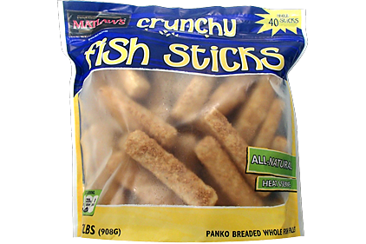

WANDA
Goals and Meeting Structure
Lee Bernstein
Nuclear Science Division
Lawrence Berkeley National Laboratory
Department of Nuclear Engineering
University of California - Berkeley

Slide 2
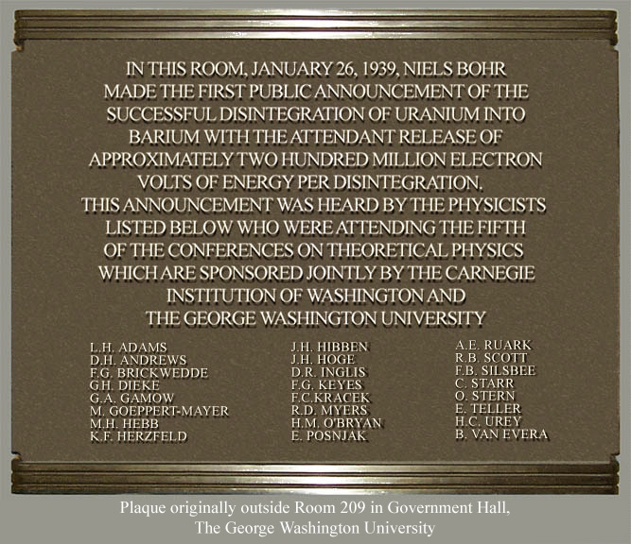
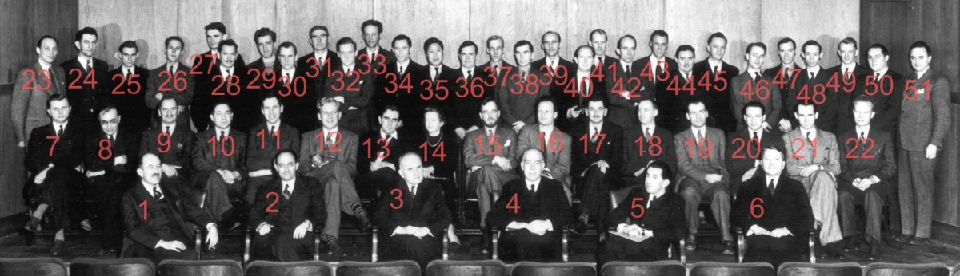
Applied nuclear science is rooted in application
As Tim stated, 80 years ago Bohr ushered in the “Atomic Age” here at GWU, linking application to basic science.
Nuclear scientists have continued to have curiosity drive their work while the applications have grown into their own fields.
At WANDA we’ll bring these spheres together through the lens of nuclear data
…P.S. We’ll celebrate on Friday (with cake!)
1939: Fifth Washington Conference on Theoretical Physics: Low Temperature Physics and Superconductivity
Thanks to Tim Hallman

Slide 3
The main goal of WANDA is to bring you all together
Producers
(Experiment)
Program
Managers
Users
(Applications)
Evaluation/Processing
Our roadmap will help the Program Managers in their important work
Notes:
Emphasis on the last sentence

Slide 4
Day 1 - Plenary talks
Learn about the Program Missions from the people who manage them:
  Nuclear Physics, Nuclear Energy, Isotope Production, Nonproliferation, Stewardship, AFTAC, DTRA, Criticality Safety
Hear about International Efforts
“How the sausage is made” - the Nuclear Data Pipeline
Review New Initiatives from the last two FOAs
  Rapid talks from project PIs
  Three are <1 year old.
  Eleven have just started.

Slide 5
Day 2 & Day 3 Morning – Topical Breakout Sessions
Needs not yet prioritized
Goal:
A set of prioritized needs
Well-defined
Needs
Goal:
A ”Roadmap”
to address the
needs
The session leads have been given total freedom to define their topics, but we need your input!!!
Notes will be taken by our friendly Rapporteurs ☺
The final product is a written document

Slide 6
Let’s meet the important people…
Session 1A: Nuclear Energy (Lindner) –
  Brad Rearden (ORNL)
  Rapporteur – Eric Matthews (UC - Berkeley)
Session 1B: Isotope Production (State) –
  Etienne Vermeulen (LANL)
  Rapporteur – Andrew Voyles (UC – Berkeley)
Session 2A: Materials Damage (State) –
  Catherine Romano (ORNL)
  Rapporteur – Amanda Lewis (UC – Berkeley)
Session 2B: Safeguards (Lindner) –
  Chris Pickett (ORNL)
  Rapporteur – Eric Matthews (UC – Berkeley)
Session 3A: (n,x) Reactions (City View) –
  Robert Casperson (LLNL) and Matt Devlin (LANL)
  Rapporteur – Amanda Lewis (UC – Berkeley)
Session 3B: Atomic/XRF Data (State) –
  Dave Brown (BNL/NNDC) and Marie-Anne Descalle (LLNL)
  Rapporteur – Andrew Voyles (UC – Berkeley)
Let’s have everyone stand one after another so you can associate a name with face!
Administrative Support – Tom Gallant (LBNL)

Slide 7
Day 3 Afternoon Wrap-up
Presentations by the Session Leaders
  This is your chance to catch up on the sessions you missed
Panel Discussion
  Q&A from all attendees
Collection of ideas for future workshops
Wrap-up and Closeout (plus a special session)
Friday, January 25
By-invitation-only classified session being organized by Fredrik Tovesson

Slide 8
Meeting Rooms
City View:
Day 1 All
Day 3 (n,x) reactions & closeout
State:
Day 2 Isotopes & Materials Damage
Day 3 Atomic/XRF
Lindner Family Comm. (6th floor): Day 2 NE & Safeguards

Slide 9
Desired Outcome
NDREW focused on developing a roadmap to address nuclear data needs for non-proliferation
WANDA will add energy, materials damage, isotopes, safeguards, atomic data and (n,x) reactions.
The development of these nuclear data roadmaps requires input from the broadest set of topic matter experts in experiment, modeling and evaluation without institutional or personal bias.
We need your active participation!

Slide 10
Thanks
My hard-working co-organizers:
Catherine Romano and Fredrik Tovesson
Our terrific breakout session organizers!
Program support & speaker recruitment:
Tim Hallmann and Donny Hornback
Our Host from GWU and the NSSC
Allison Macfarlane
Administrative support:
Tom Gallant, Samantha D’Introno, Dorothy Kenlow
My wonderful post-doc and students:
Andrew Voyles, Amanda Lewis and Eric Matthews

