Slide 1
IAEA work on Primary Radiation Damage Cross Sections
Arjan Koning
International Atomic Energy Agency
Head of Nuclear Data Section
Input: Jean-Christophe Sublet
WANDA – Workshop for Applied Nuclear Data Activities,
George Washington University • Washington, DC, January 22-24 2019

Slide 2
CRP on Primary Radiation Damage Cross Sections
(2013-2017)
Bring together Nuclear Data and Materials Experts
  revisit the NRT-DPA standard by the inspection of recoil spectra and by the evaluation of uncertainties;
  elaborate an upgraded primary radiation defect (PRD) cross section to capture the annealing of defects in the recoil cascade on the basis of MD, BCA and other models;
  demonstrate an advantage of PRD-dpa as correlation parameter for microstructural material damage;
  check evaluated gas production cross sections and make recommendations.
Start: Stanislav Simakov
Finalization: Jean-Christophe Sublet

Slide 3
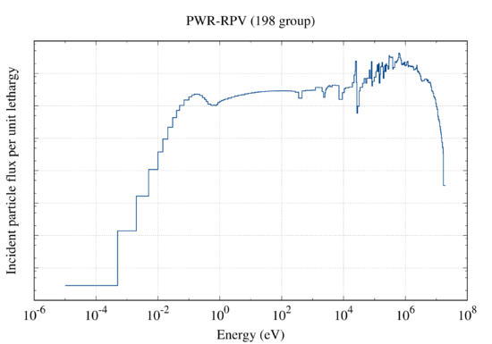
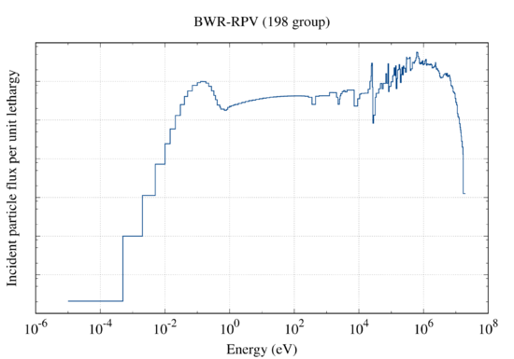
The beginning: background RPV reference
Assuming a 40-year plant operation and a load factor of 0.8, giving an effective lifetime of 32 years, FISPACT-II results
PWR 1.3E-3 x 32 = 0.0416 dpa, total fluence 1.136E+20, > 1 MeV 2.387E+19 n/cm²
BWR 2.3E-4 x 32 = 0.0073 dpa, total fluence 1.798E+19, > 1 MeV 4.469E+18 n/cm²
An end-of-life fluence value of 3.0E+19 n/cm², is quoted to produce about 0.045+/-0.05 dpa in G. R. Odette and G. E Lucas, Embrittlement of Nuclear Reactor Pressure Vessels, JOM, 53 (7) (2001), pp 18-22
FISPACT-II & Kerma/DPA responses: https://fispact.ukaea.uk/

Slide 4
Primary Radiation Damage Cross Sections
https://www-nds.iaea.org/CRPdpa/
MSs’ participation: 14 countries BEL, CPR, FIN, FRA, GFR, JPN, NET, ROK, RUS, SPA, SWE, UK, UKR and USA. 19 national laboratories and universities.
4-8 Nov. 2013, 1st RCM, Vienna, INDC(NDS)-0648
29 June - 2 July 2015, 2nd RCM, Vienna, INDC(NDS)-0691
Technical Meeting held on 13-16 June 2016, Vienna on “Nuclear Reaction Data and Uncertainties for Radiation Damage”, INDC(NDS)-0719, 16 consultants, 4 staffs
15+ technical papers in international Conferences and peer-review journals
CRP extended to hold the 3rd RCM 23 - 25 October 2017
Final report to be published in 2019

Slide 5
CRP’s final report at the submission stage
Nuclear physicist and materials scientists

Slide 6
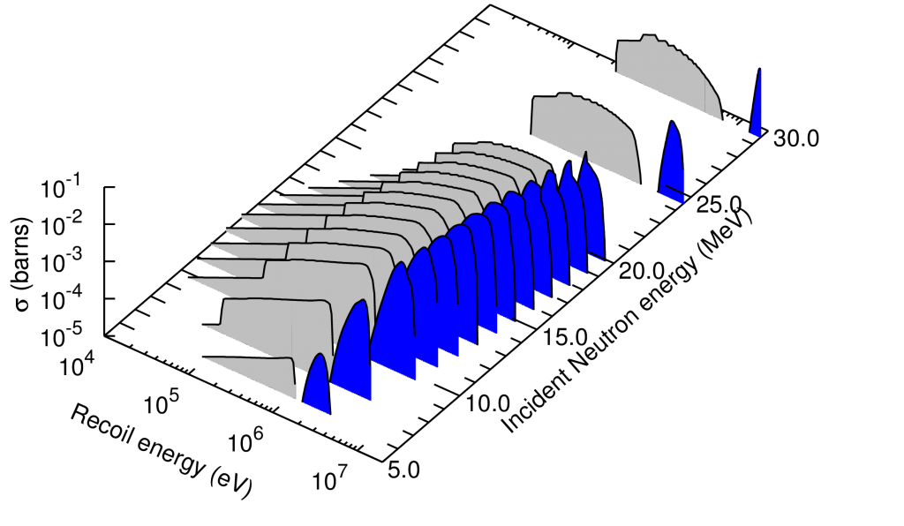
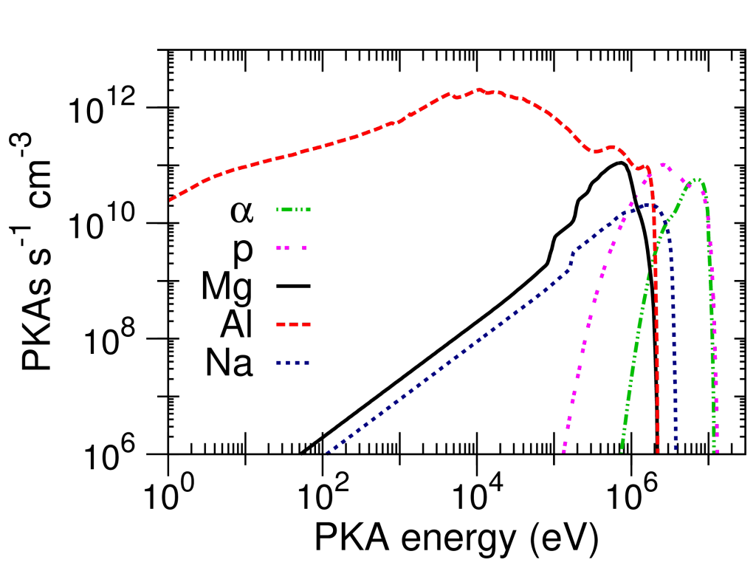
NJOY processing ismooth = 1
Tails are important
Transmuted residual also
Q negative this time, but NJOY ismooth =1 for when the evaluator decided to cut
the secondary energy grid well above the cross section minima !

Slide 7
Underlying complexity shown with SPECTRA-PKA
very complex results with numerous recoils species (isotopes &
Elements, many radioactive)
but already hiding some of the per-channel information that is
available from the output
https://github.com/fispact/SPECTRA-PKA

Slide 8
Uncertainties in damage, DPA etc. (S. Simakov)
Total Monte Carlo

Slide 9
Progress @ nuclear scale
Definitely a step forward in the proper understanding of materials defect metrics induced by radiations
  much better nuclear data with uncertainty
  more complete data forms
  Transmutation, decaying effects
  non-elastic events
  Incident particle energy dependence
A much better coverage of the high energy range
Novel event per event, channel metrics
Uncertainty quantification and propagation UQP
==> to better serve multi-scale, -physics simulation software

Slide 10
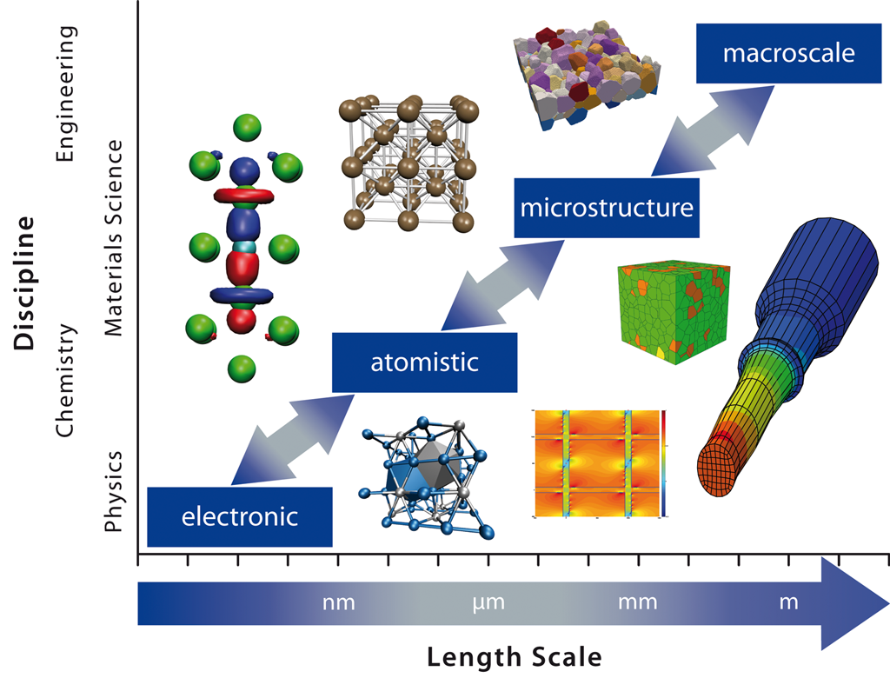
Multi-scale modelling
10-100 atoms
Traditionally different disciplines focus on different length scales. Multiscale modelling of materials across
the length scales requires overcoming the borders between the disciplines for a seamless integration of the
models on different length scales into one coherent multi-scale modelling framework (After D.G. Pettifor, 1991).

Slide 11
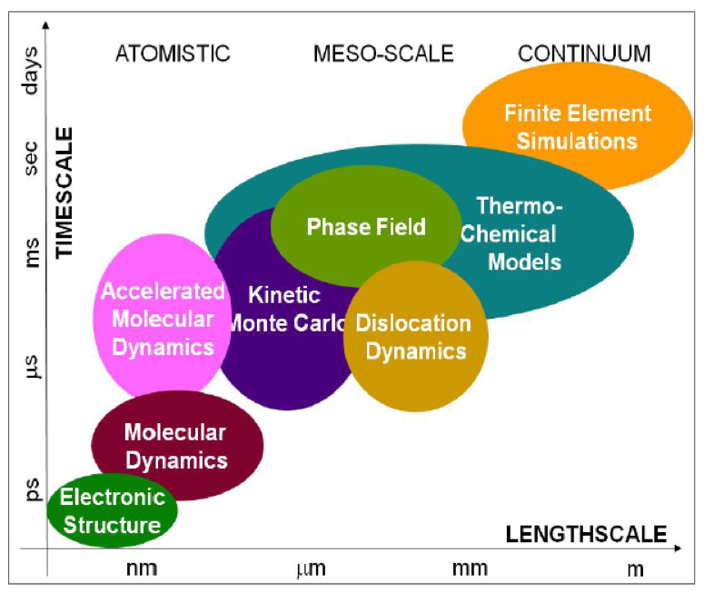
Multi-scales modelling
attoseconds
10⁻¹⁸
Nuclear
Isotopic
as
fm
femtometer, Fermi 10⁻¹⁵

Slide 12
Thank you!
Notes:
Thank you!

