Slide 1
15 T Dipole Prestress and Implementation
Igor Novitski
January 30, 2019
Fermi National Accelerator Laboratory

Slide 2
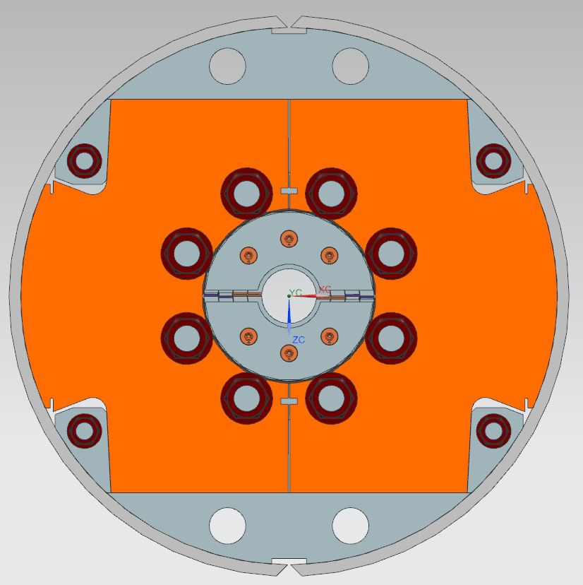
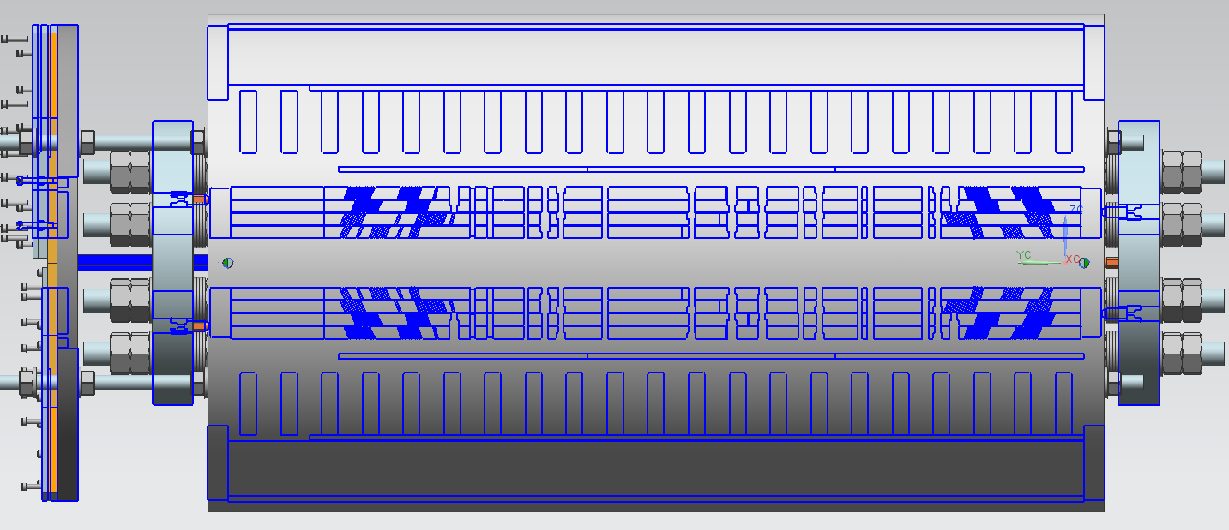
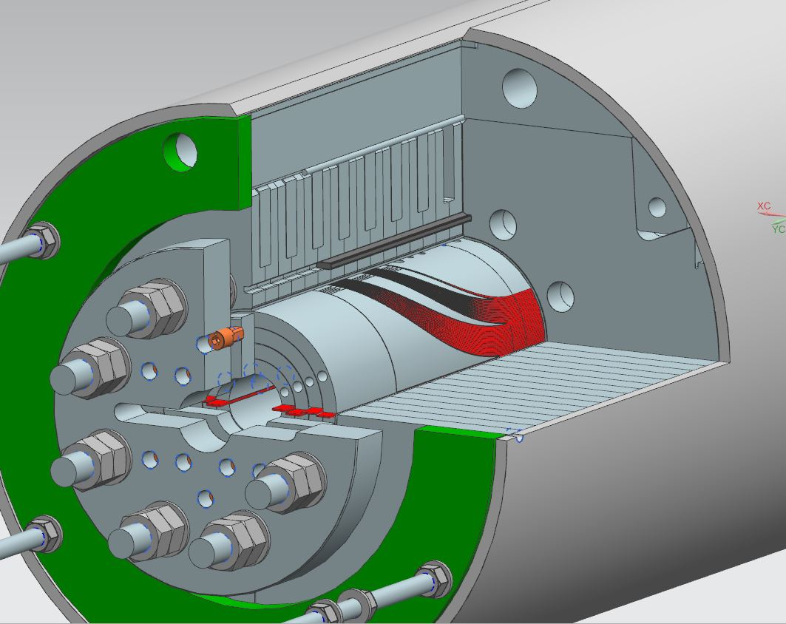
15 T Dipole Magnet design
7
1
4
3
6
5
Weight=2362 kg
612 mm
9
2
10
8
1100 mm
1 – 4-layer Nb₃Sn coil
2 –coil-yoke stainless steel spacer
3 – iron yoke laminations
4 – alignment key
5 – aluminum I-clamp
6 – iron filler
7 – stainless steel welded skin
8 – stainless steel axial rod
9 – stainless steel pusher plate
10 – bullet
15 T Dipole Mechanical Analysis and Mechanical Model Tests
February 8, 2018

Slide 3
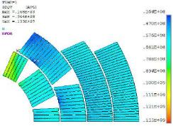
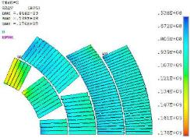
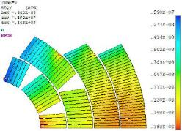
Design and Conservative coil pre-stress
Design coil pre-stress
300K
4K
4K+15T
S_{eqv}=133 MPa
Limit 150 MPa
S_{eqv}=176 Mpa
Limit 200 MPa
S_{eqv}=168 Mpa
Limit 200 MPa
Conservative pre-stress: S_{max} at all steps <150 MPa
Location | Yoking-clamping | Skin welding | Cooling-down | Bmax = 14 T
IL Pole | 60 | 113 | 150 | ~5
IL MP | ~15 | ~40 | ~75 | 143

Slide 4
Coil Interfaces were analyzed and optimized by appropriate radial shims
HFM-CL2-005
218mm from RE
L4 OD by 187 mic smaller
HFM-CL1-003
230mm from RE
L2 OD by 80 mic smaller
L3 ID by 88 mic smaller
L2 OD by
96 mic smaller
HFM-CL1-002
230mm from RE
HFM-CL2-004
201mm from RE
L4 OD by
80 mic smaller
Coil SS 230

Slide 5
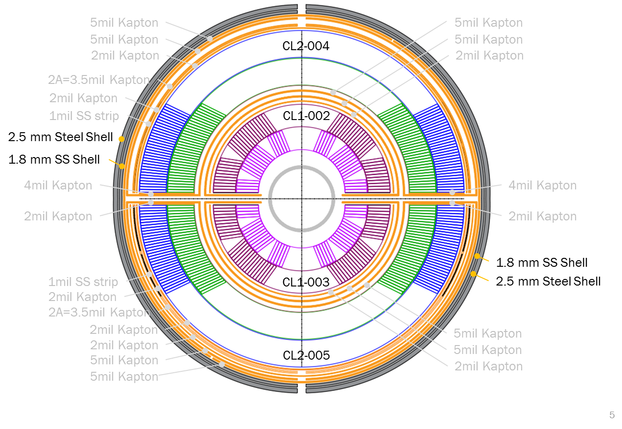
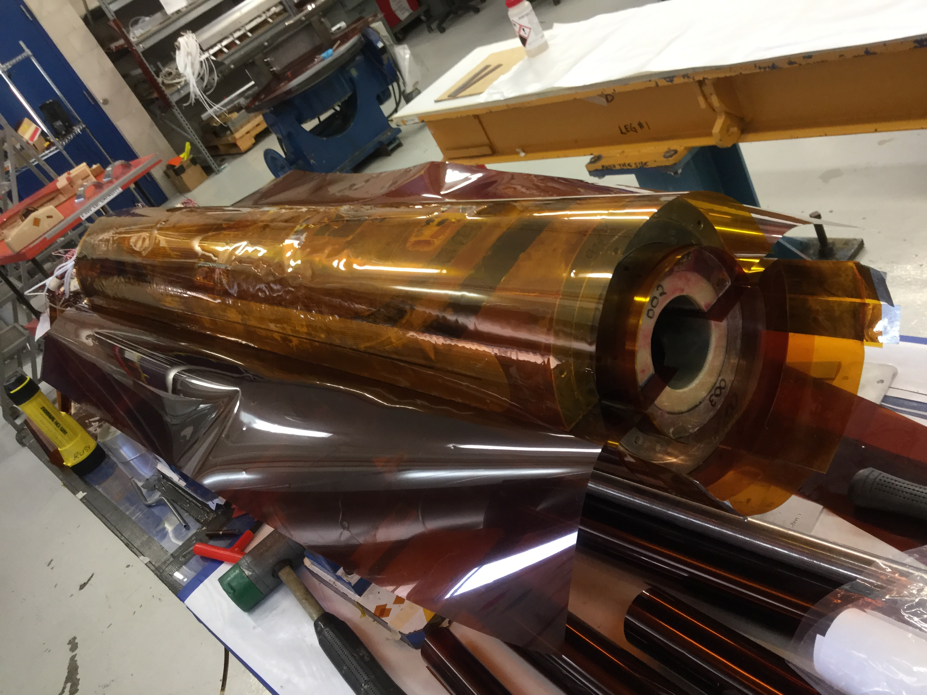
Coil Block was shimmed to the design radial size and wrapped with GI

Slide 6
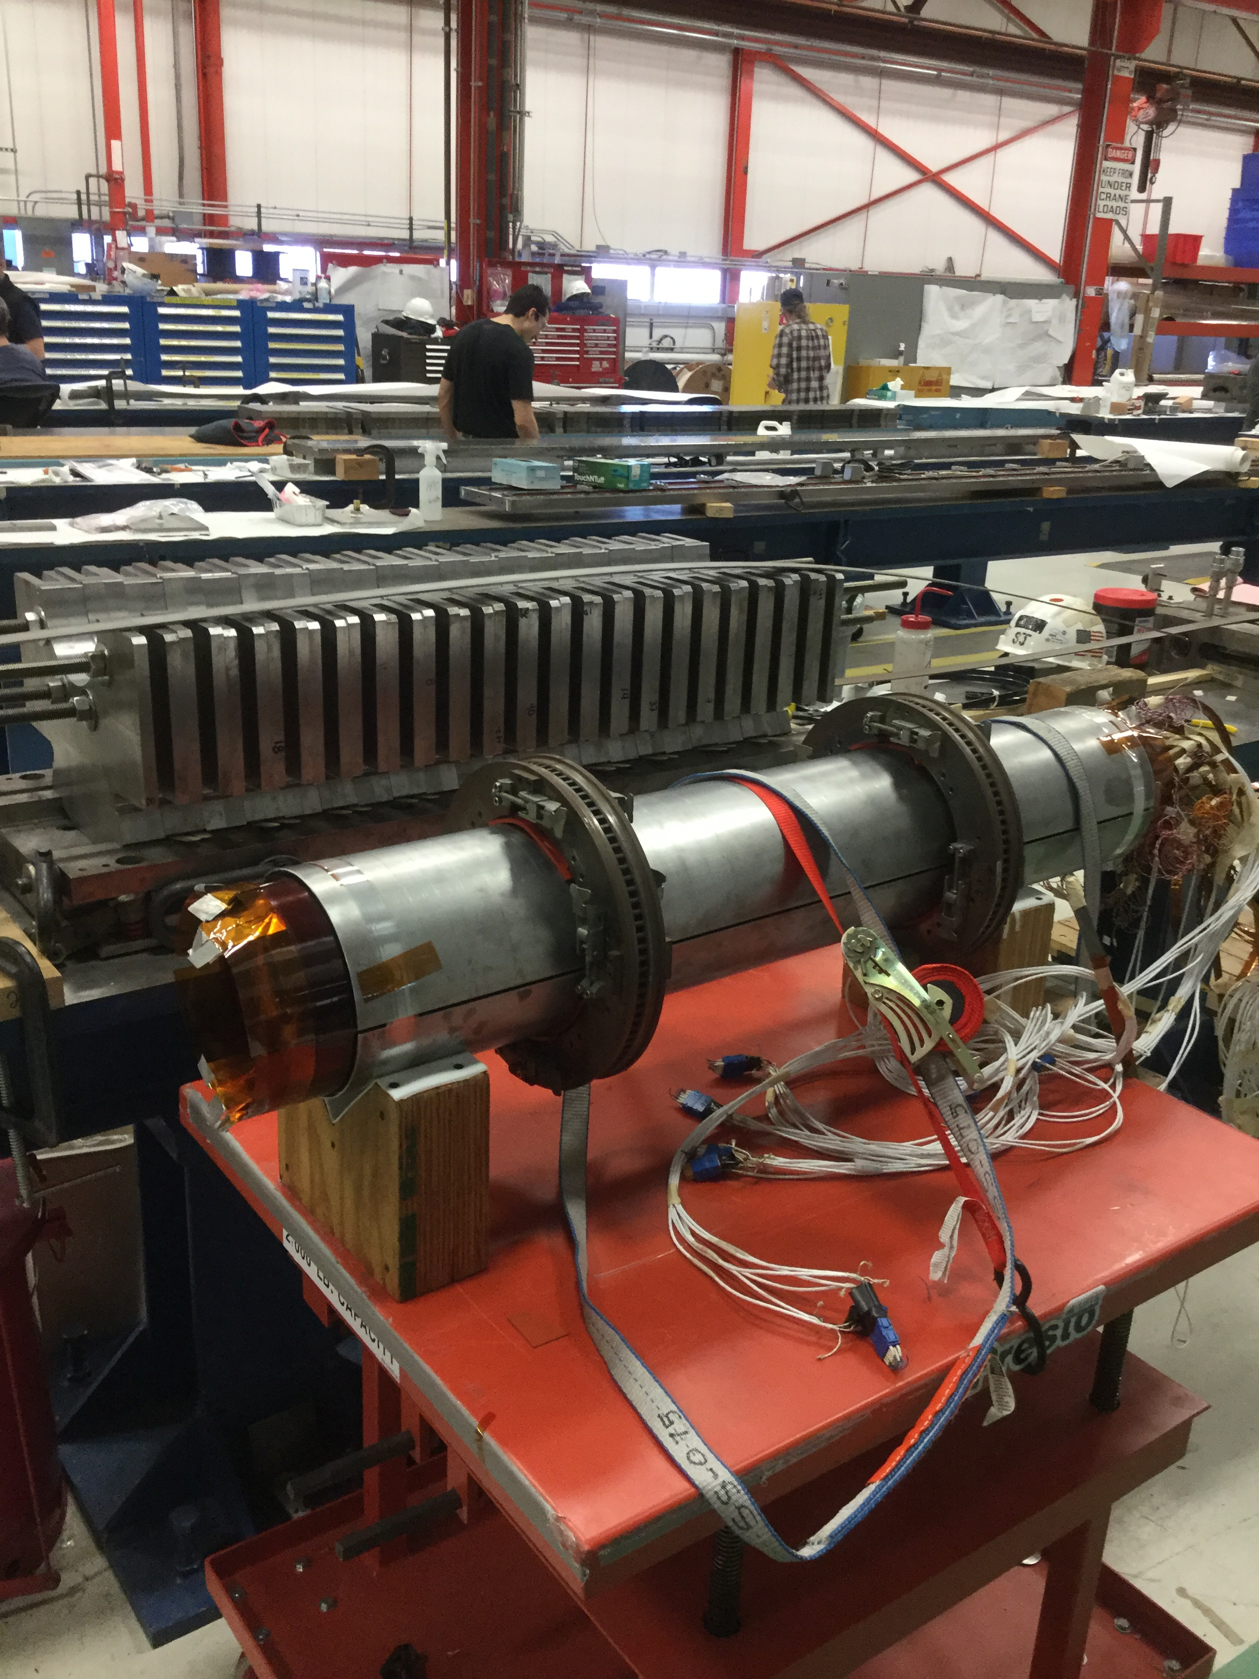
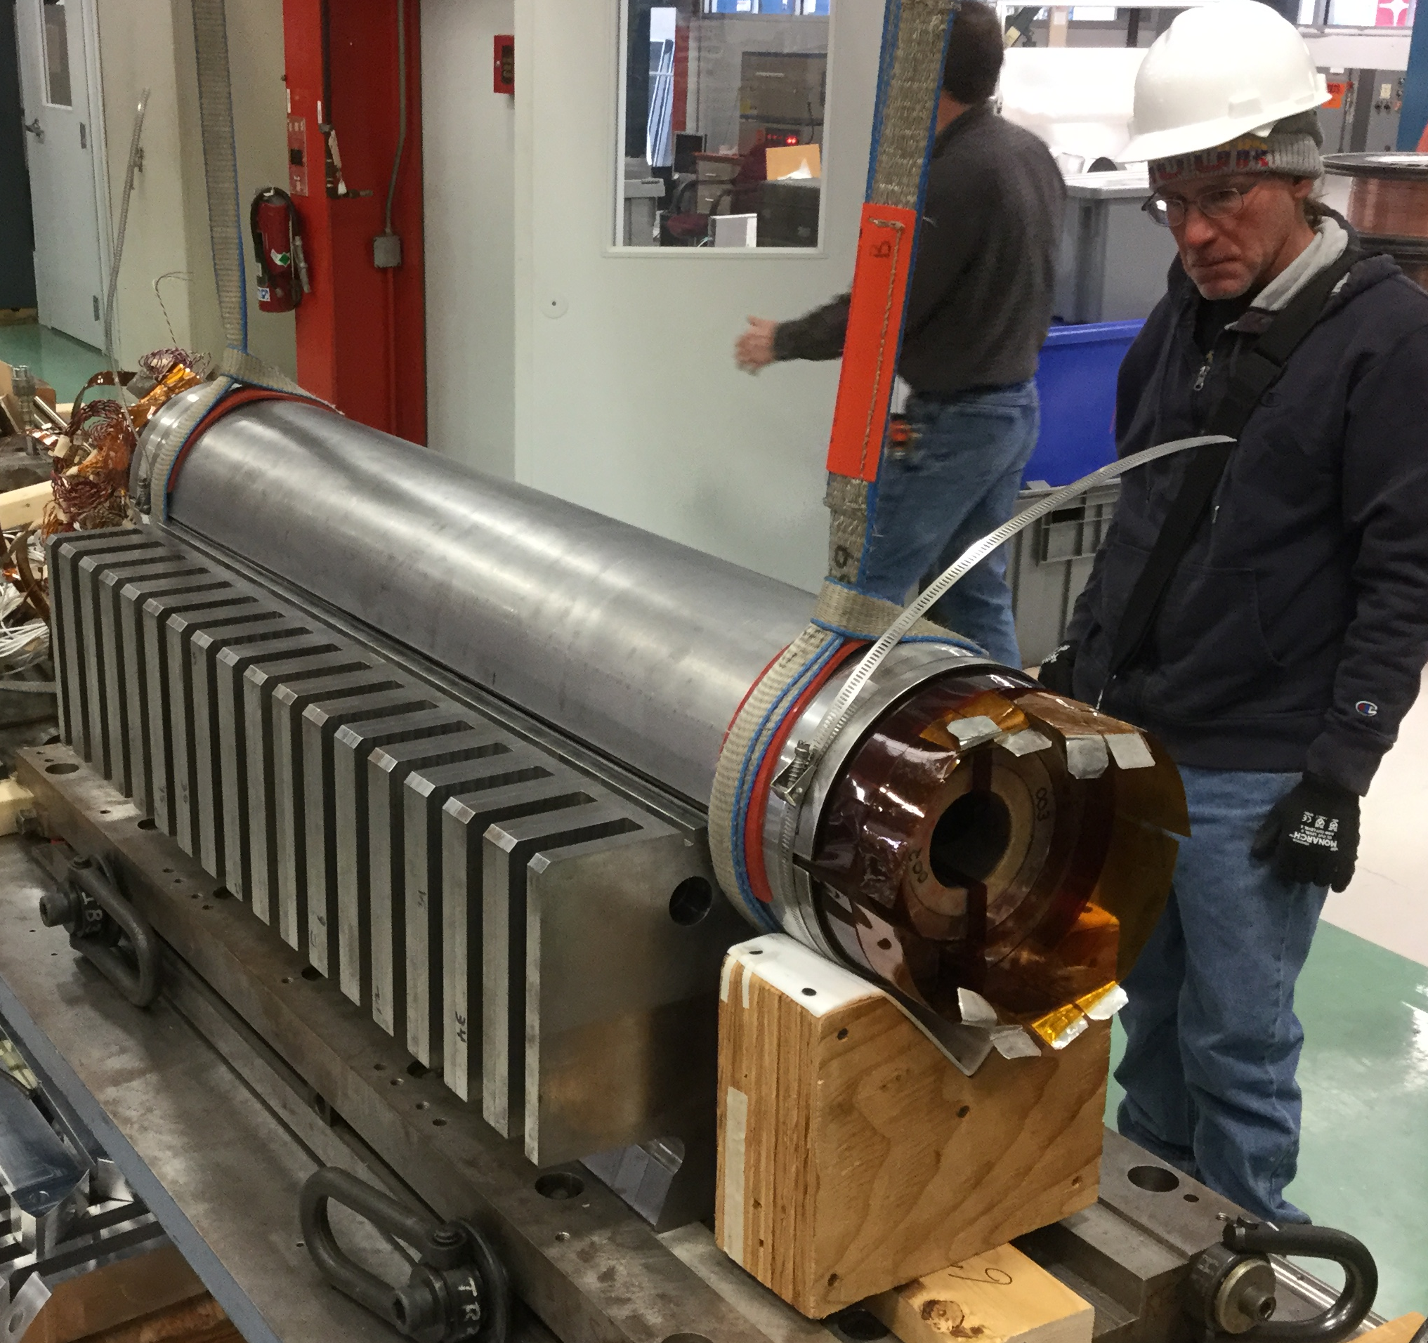
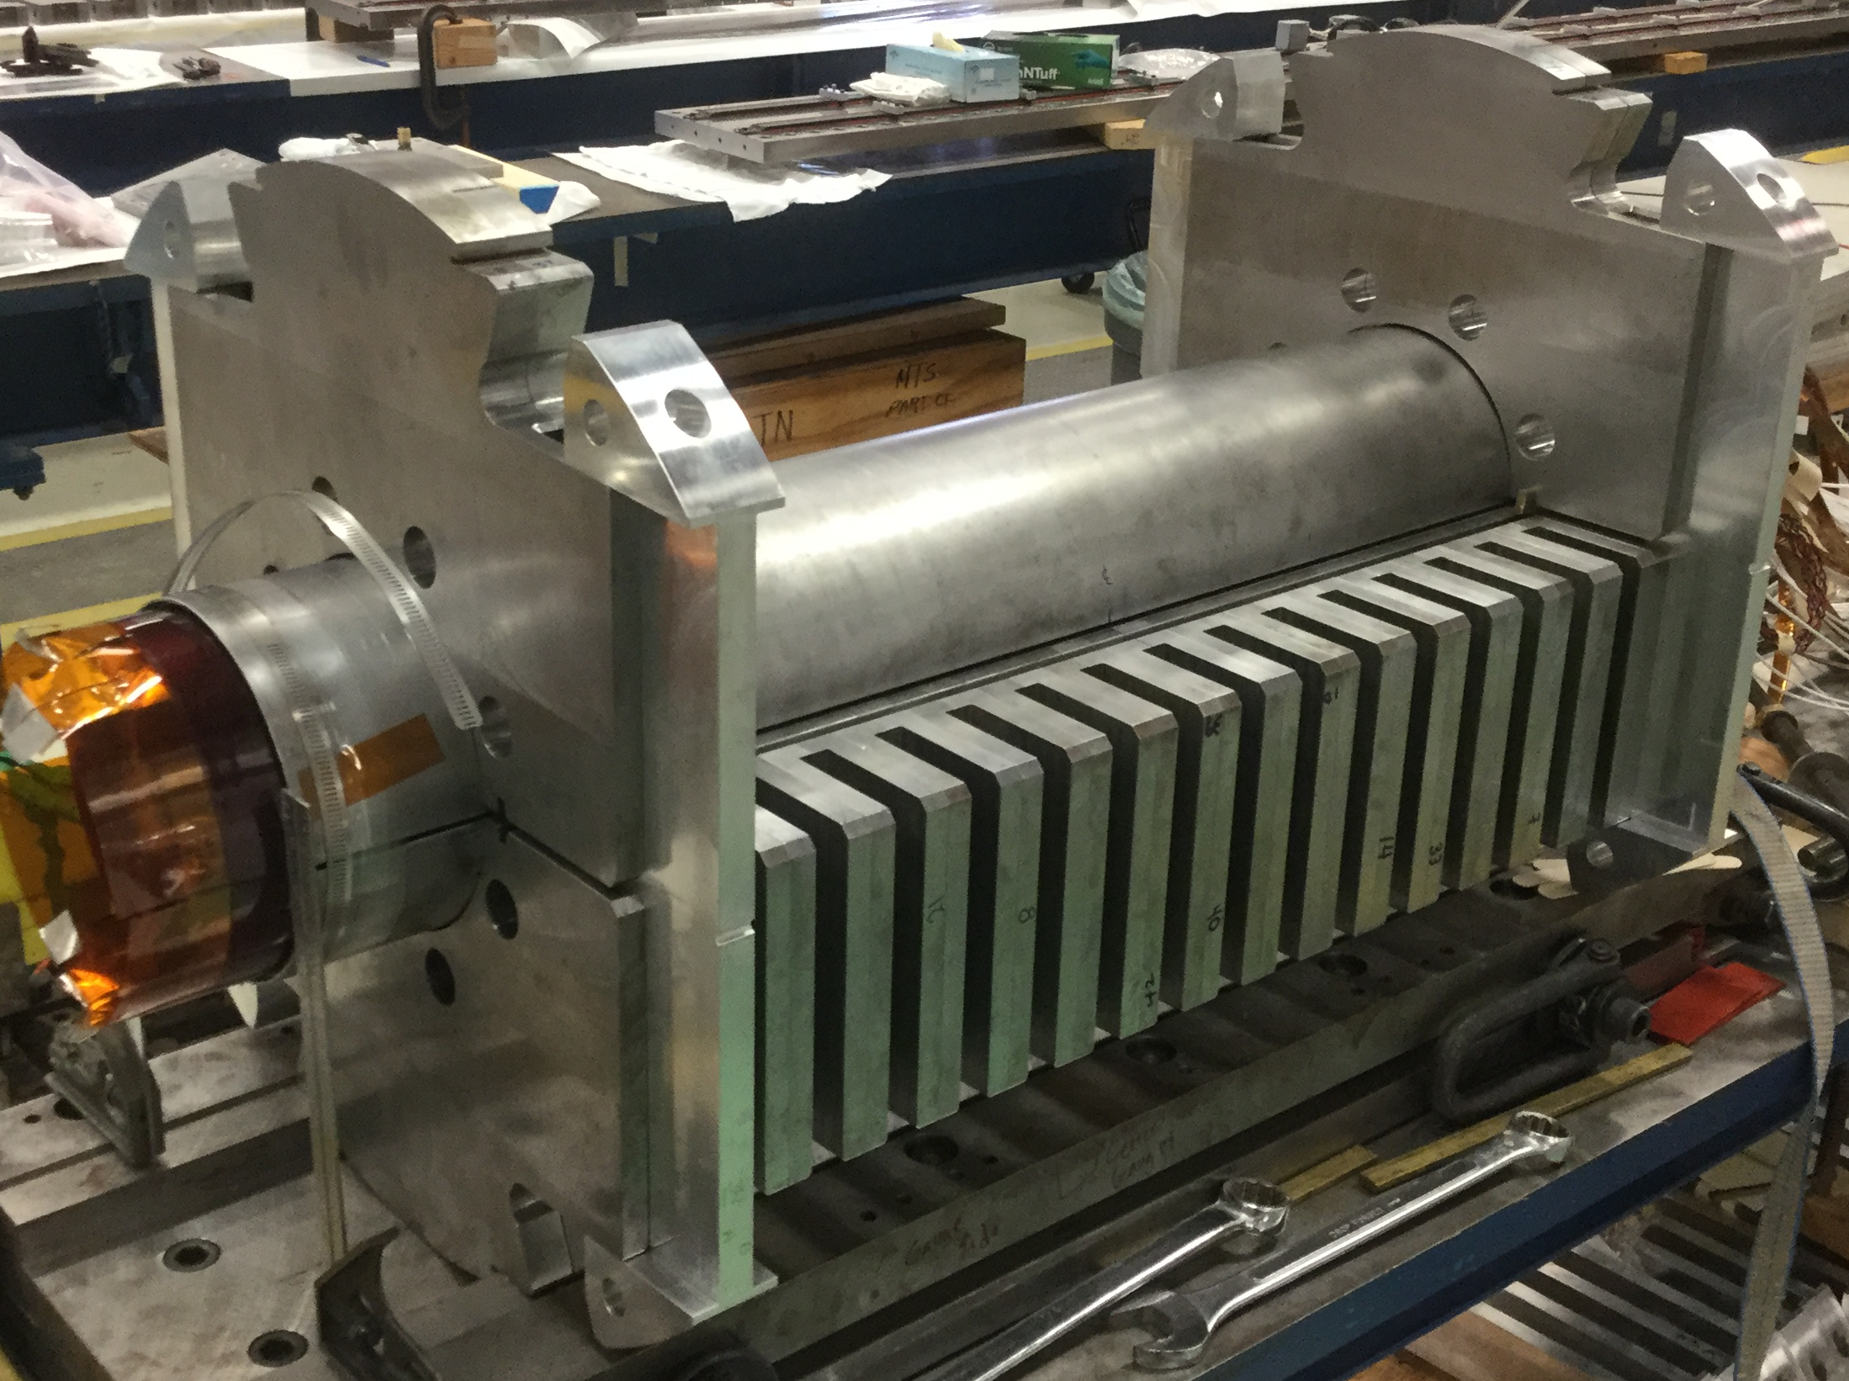
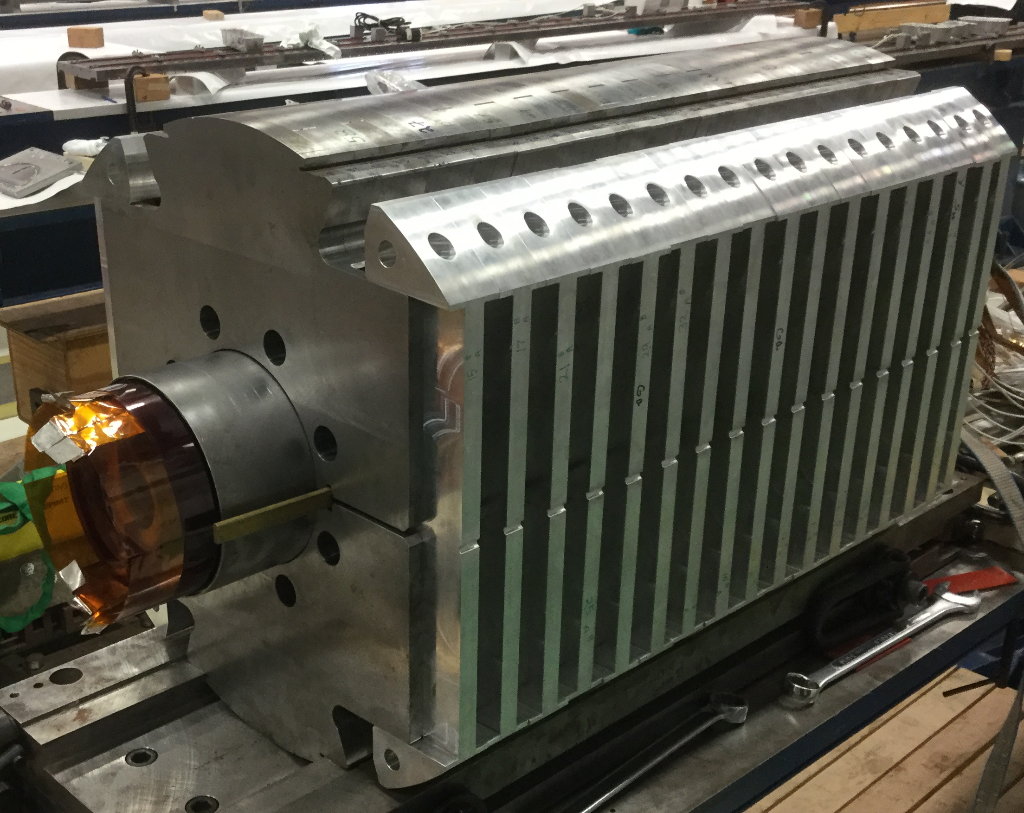
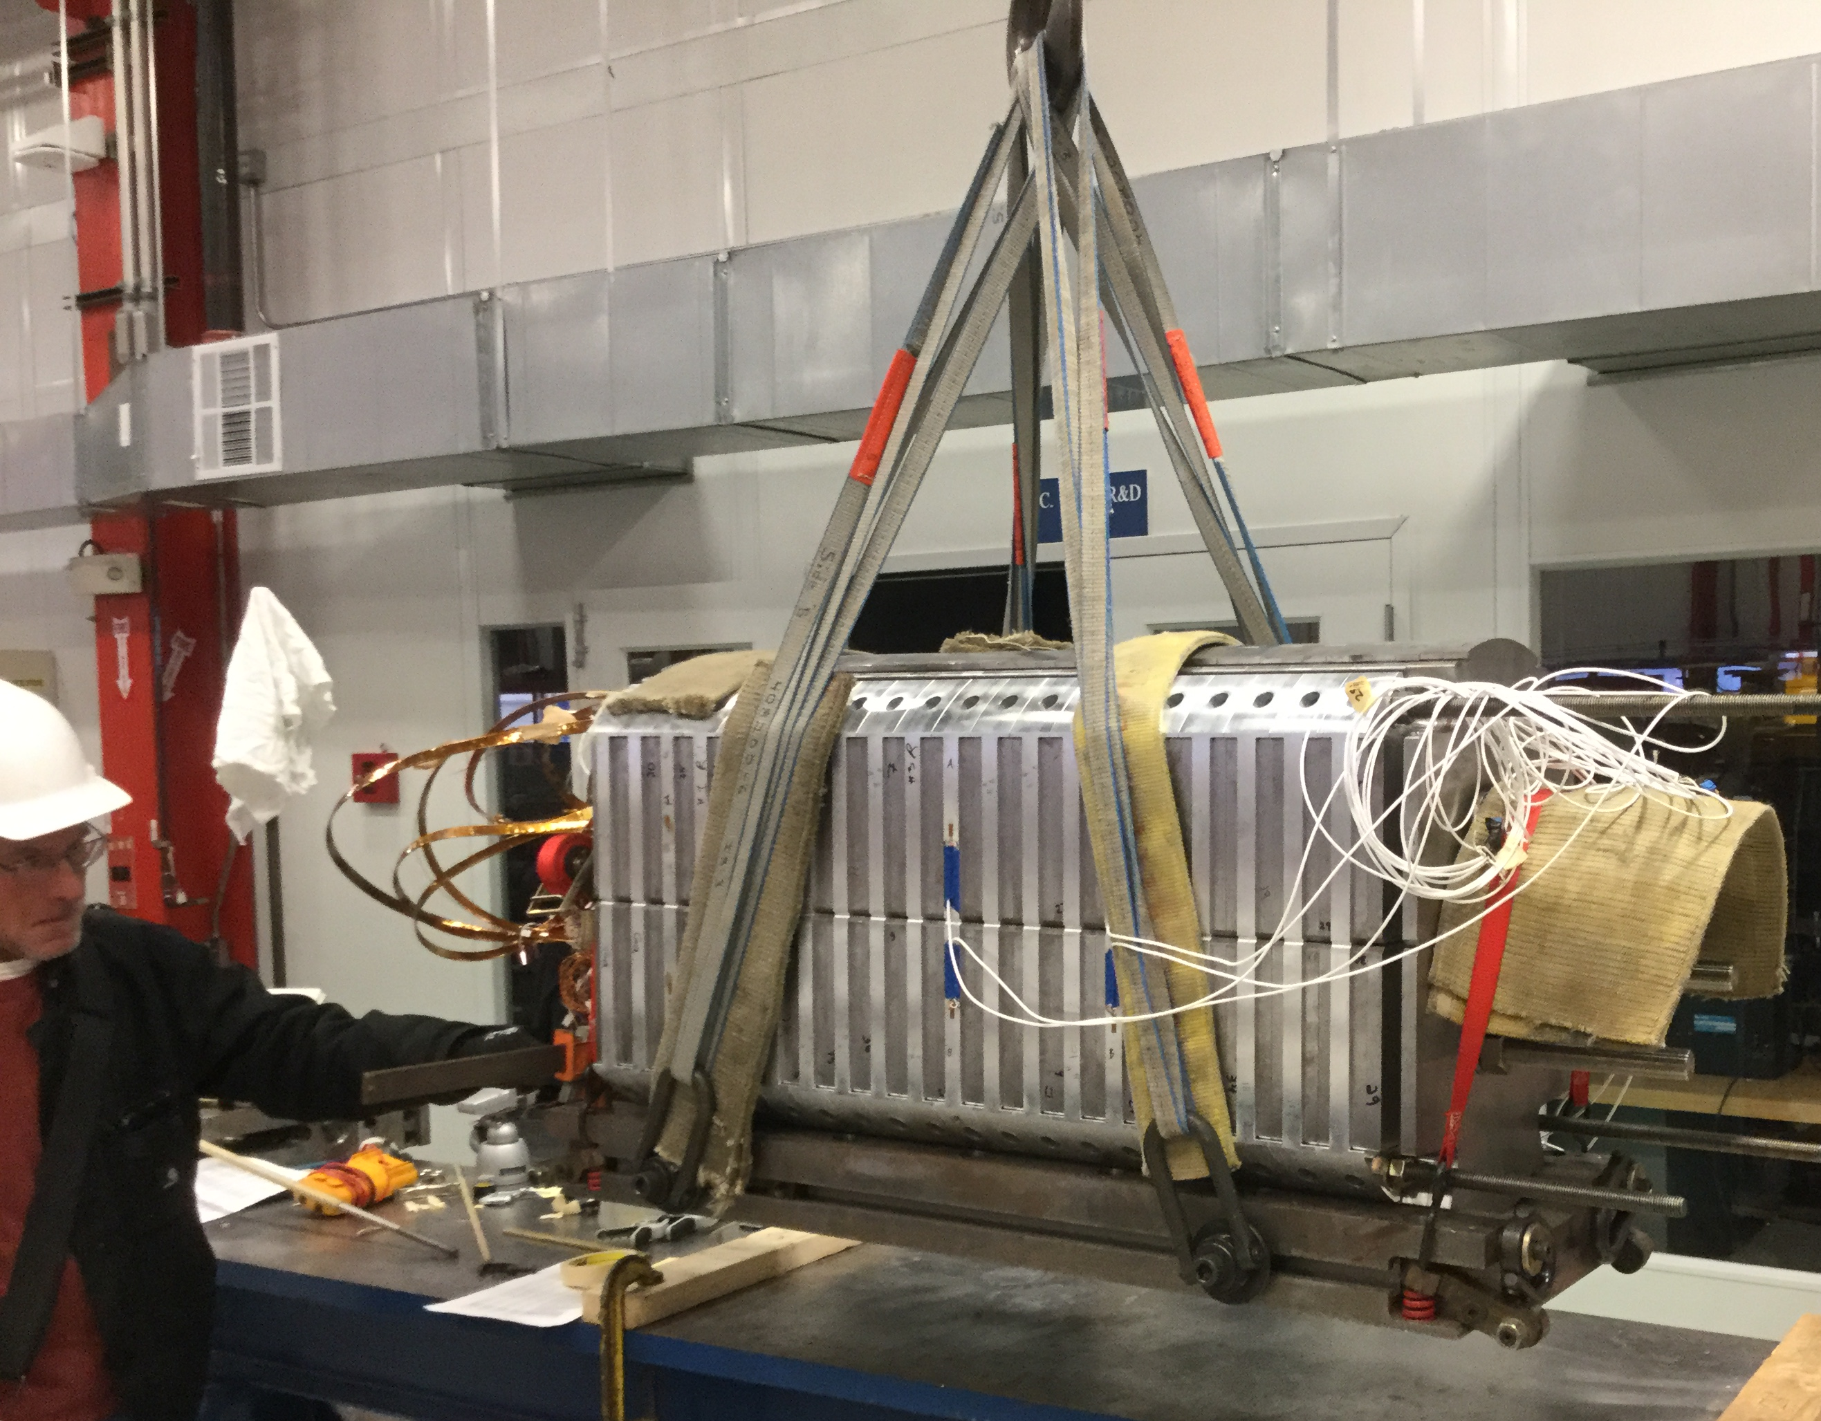
Coil Block Yoking

Slide 7
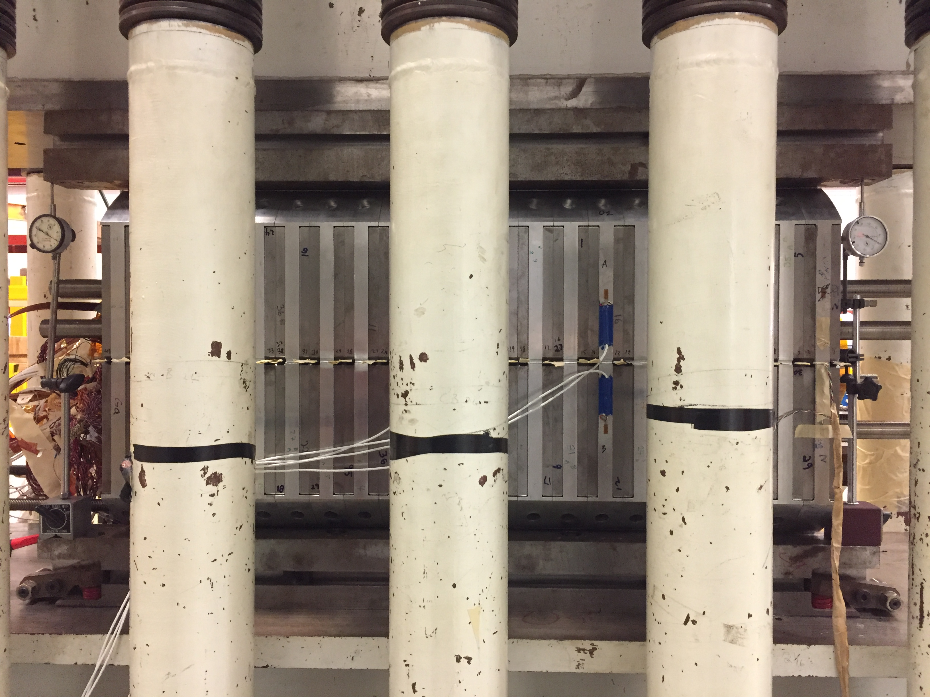
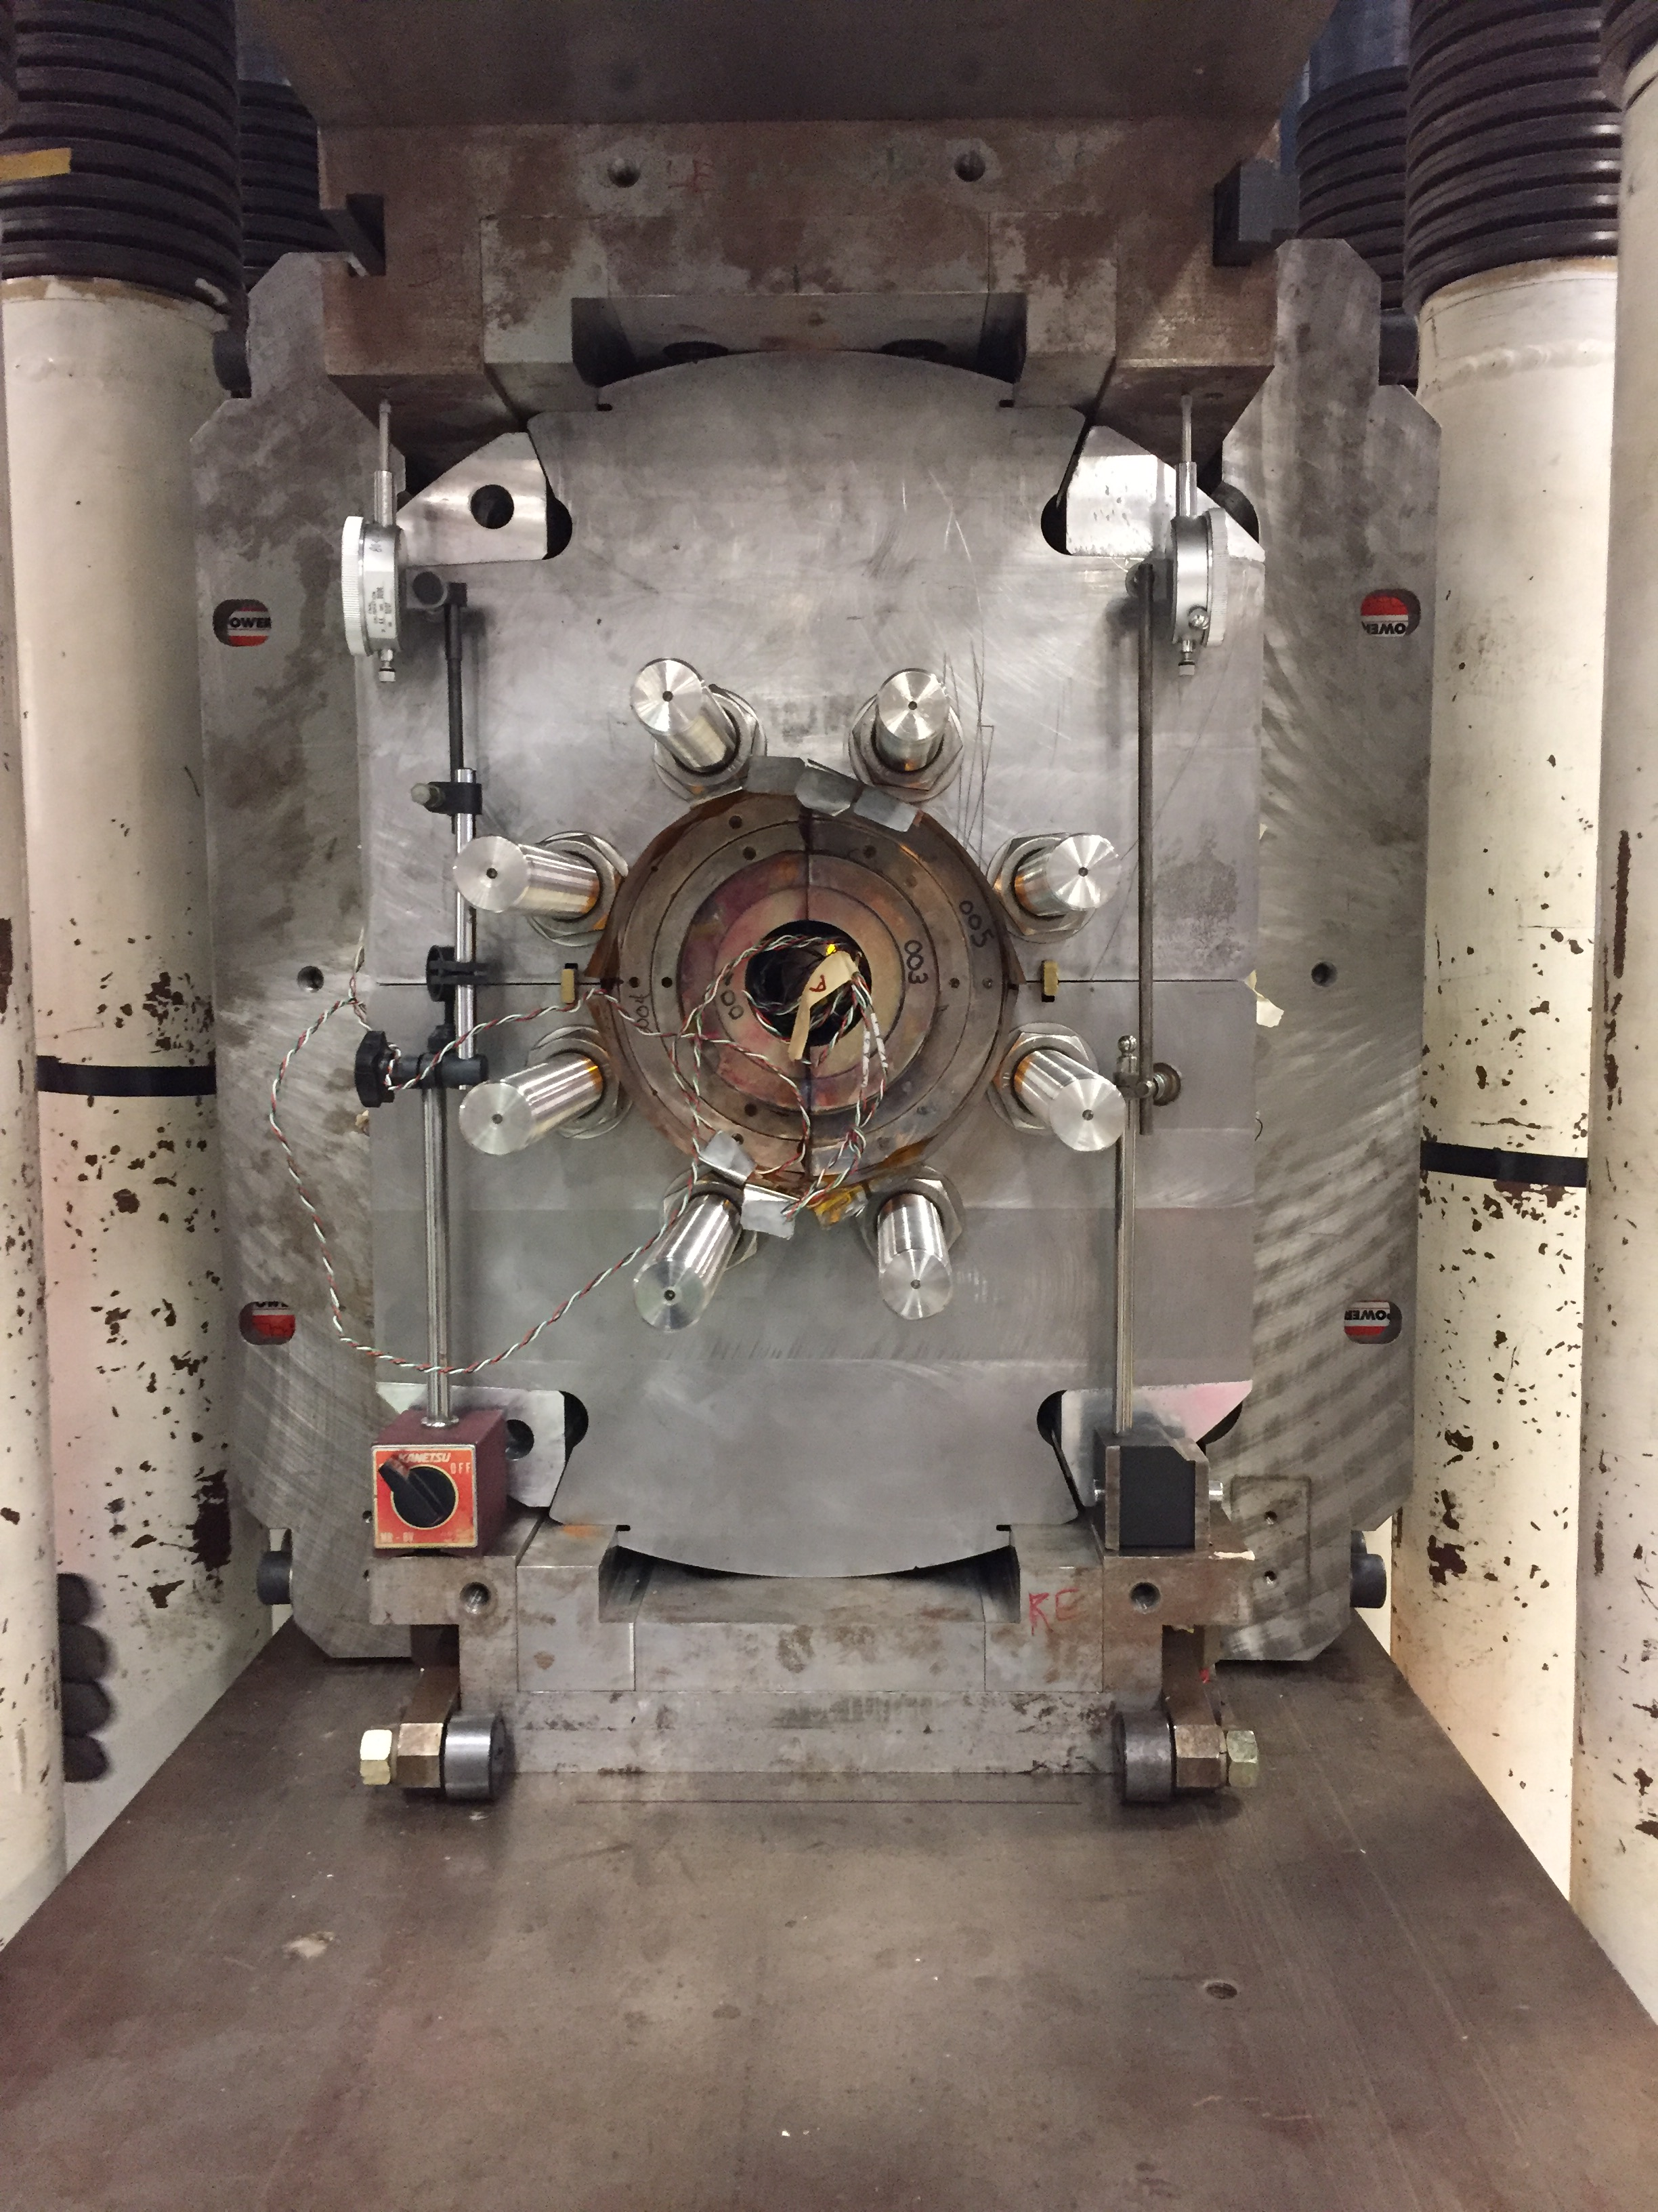
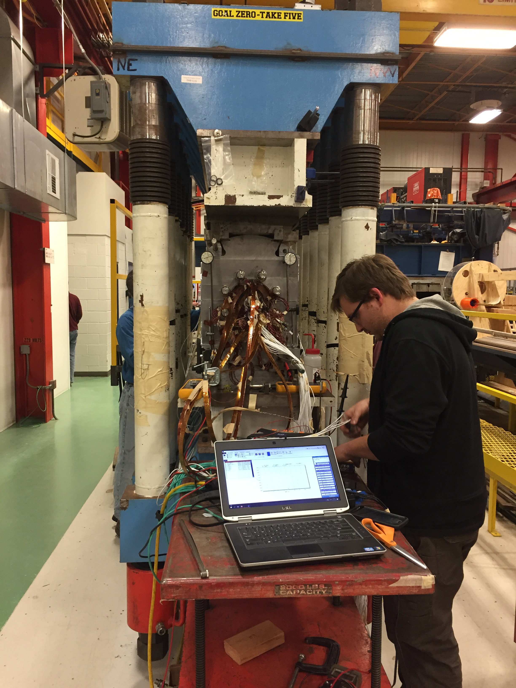
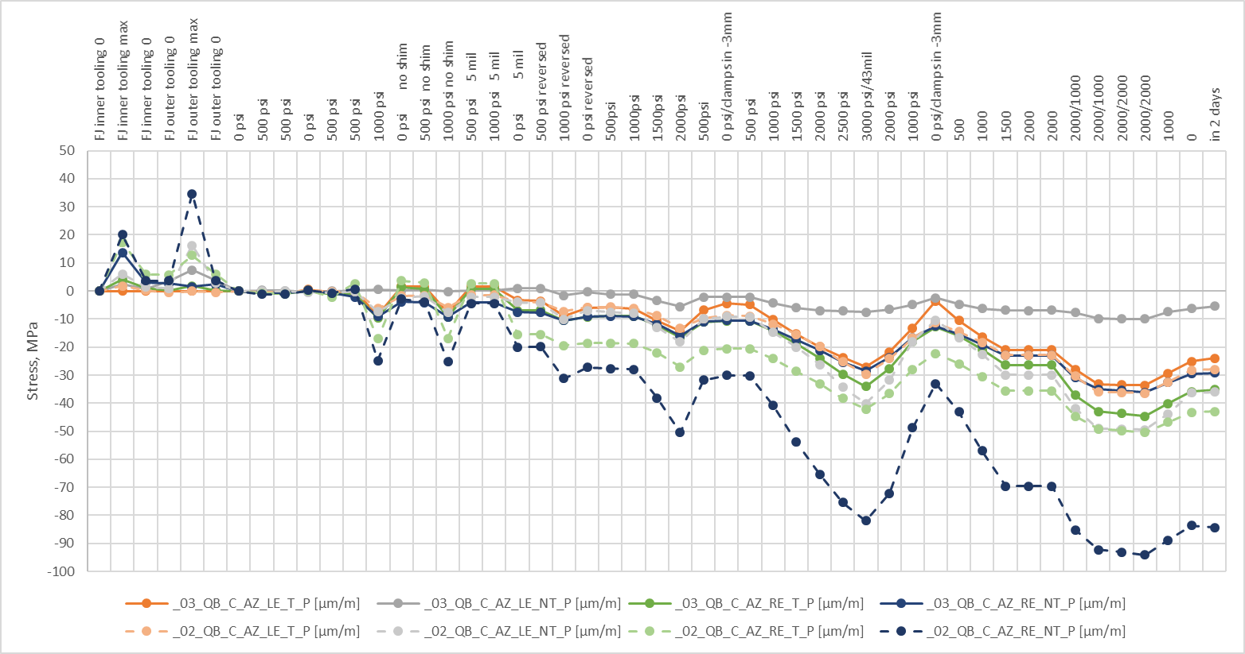
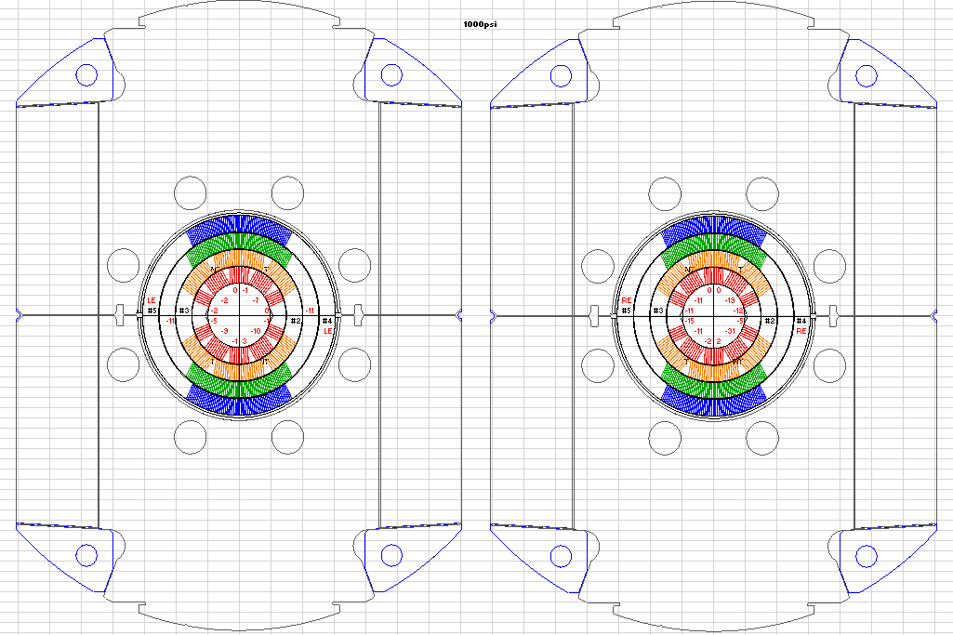
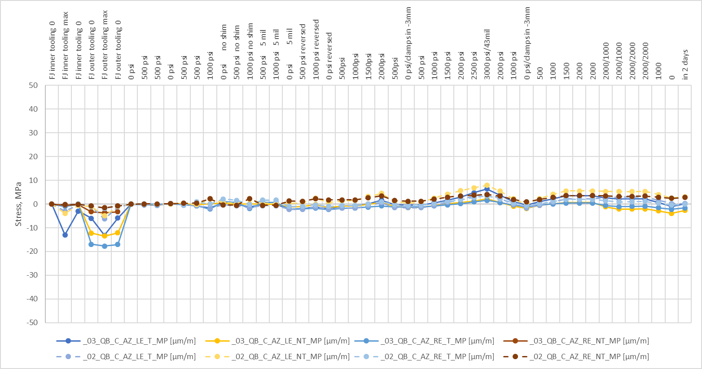
Coil Massaging and 1st Yoke Clamping

Slide 8
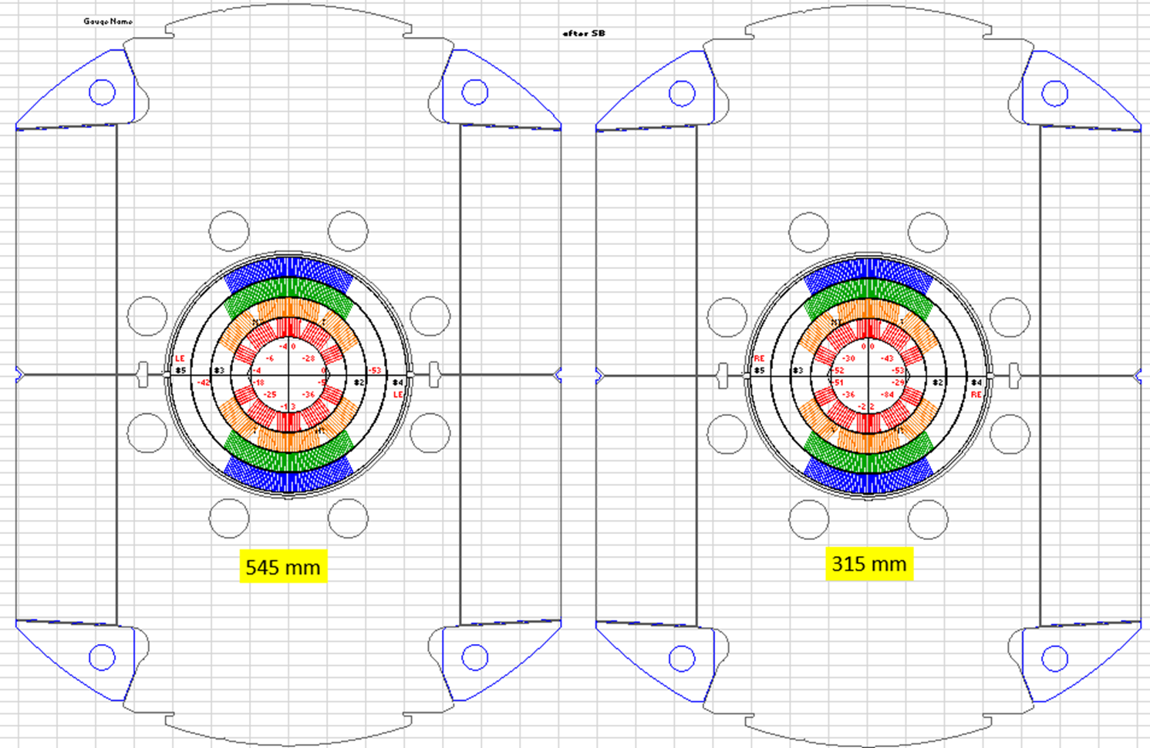
Coil pre-stress after 1st clamping (SGs)
from RE
Coil pole azimuthal stresses before/after clamping
- LE cross-section: 32-84(33 avr.)/25-36 (24 avr.)MPa
- RE cross-section: 36-94(56 avr.)/30-43 (48 avr.)MPa
Pre-stress reduction after spring-back ~30%
Coil pre-stress is smaller than expected 60 MPa due to larger clamp size by ~4 mills.
It has to be compensated by additional radial shim ~5 mills Kapton.

Slide 9
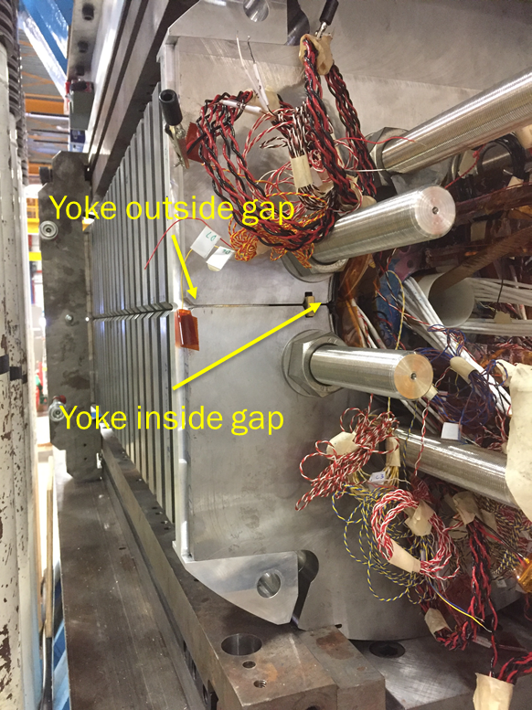
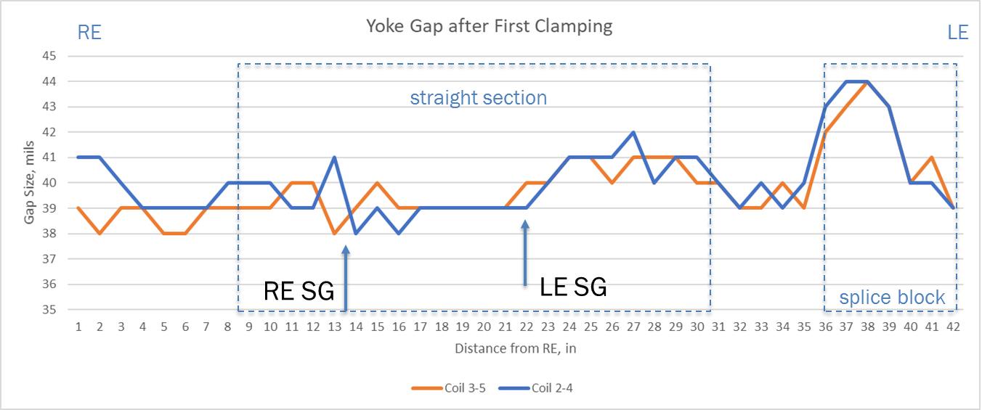
Iron Lamination Side Gap measurement
Data shows that we can use uniform radial shim in the straight section.
The shim is gradually reduced to 0 at coil ends.

Slide 10
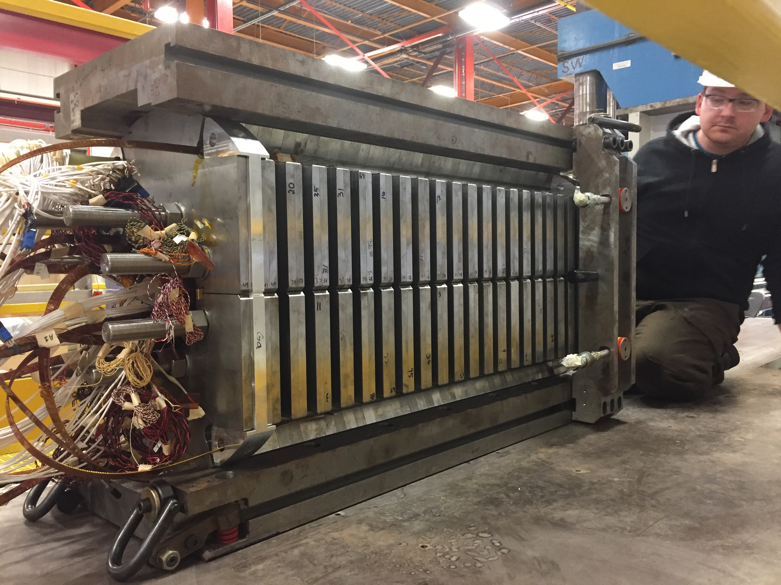
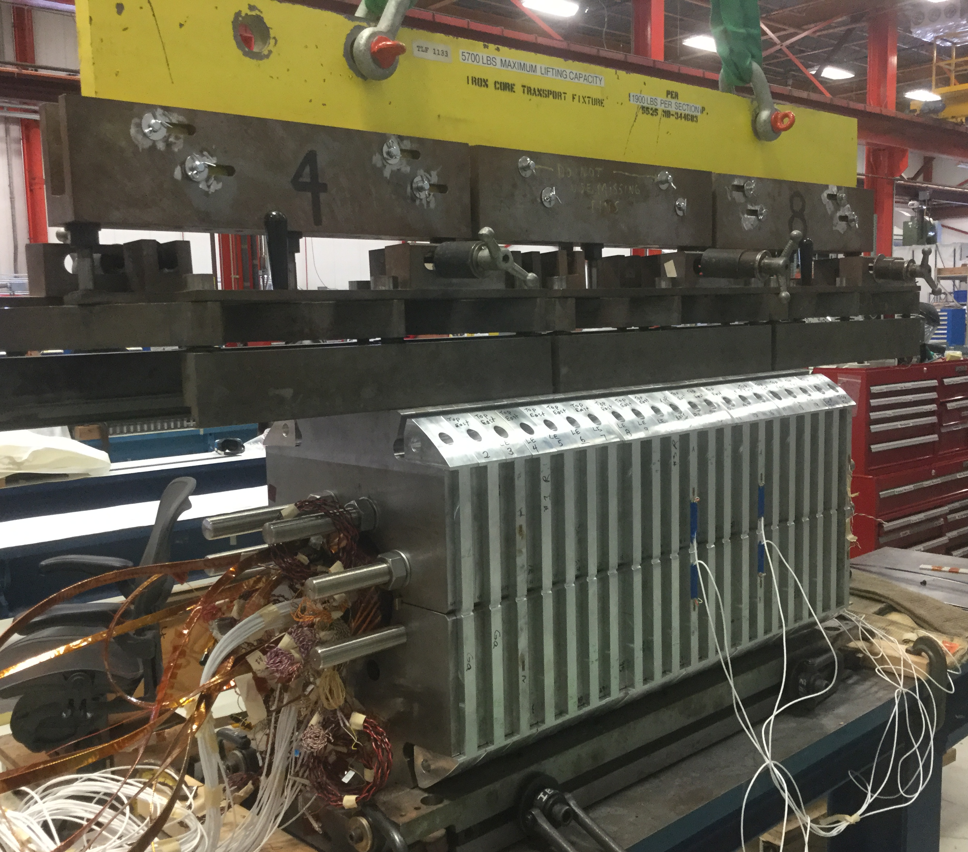
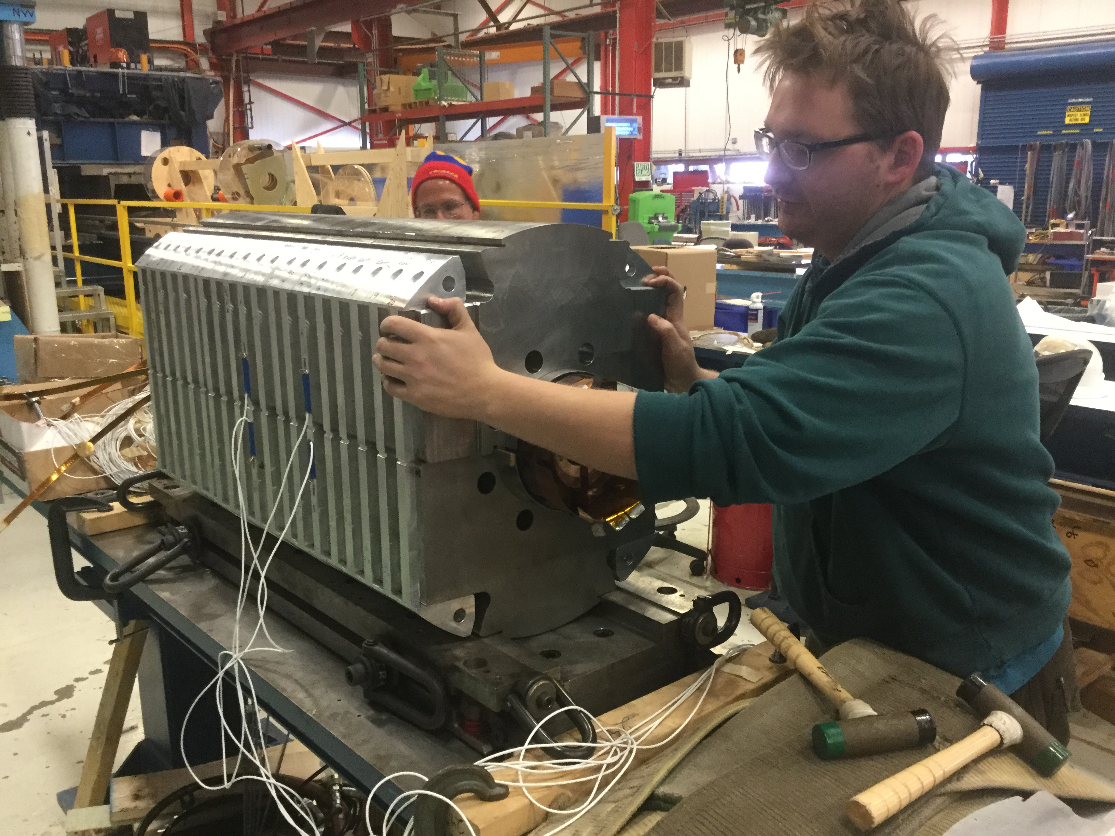
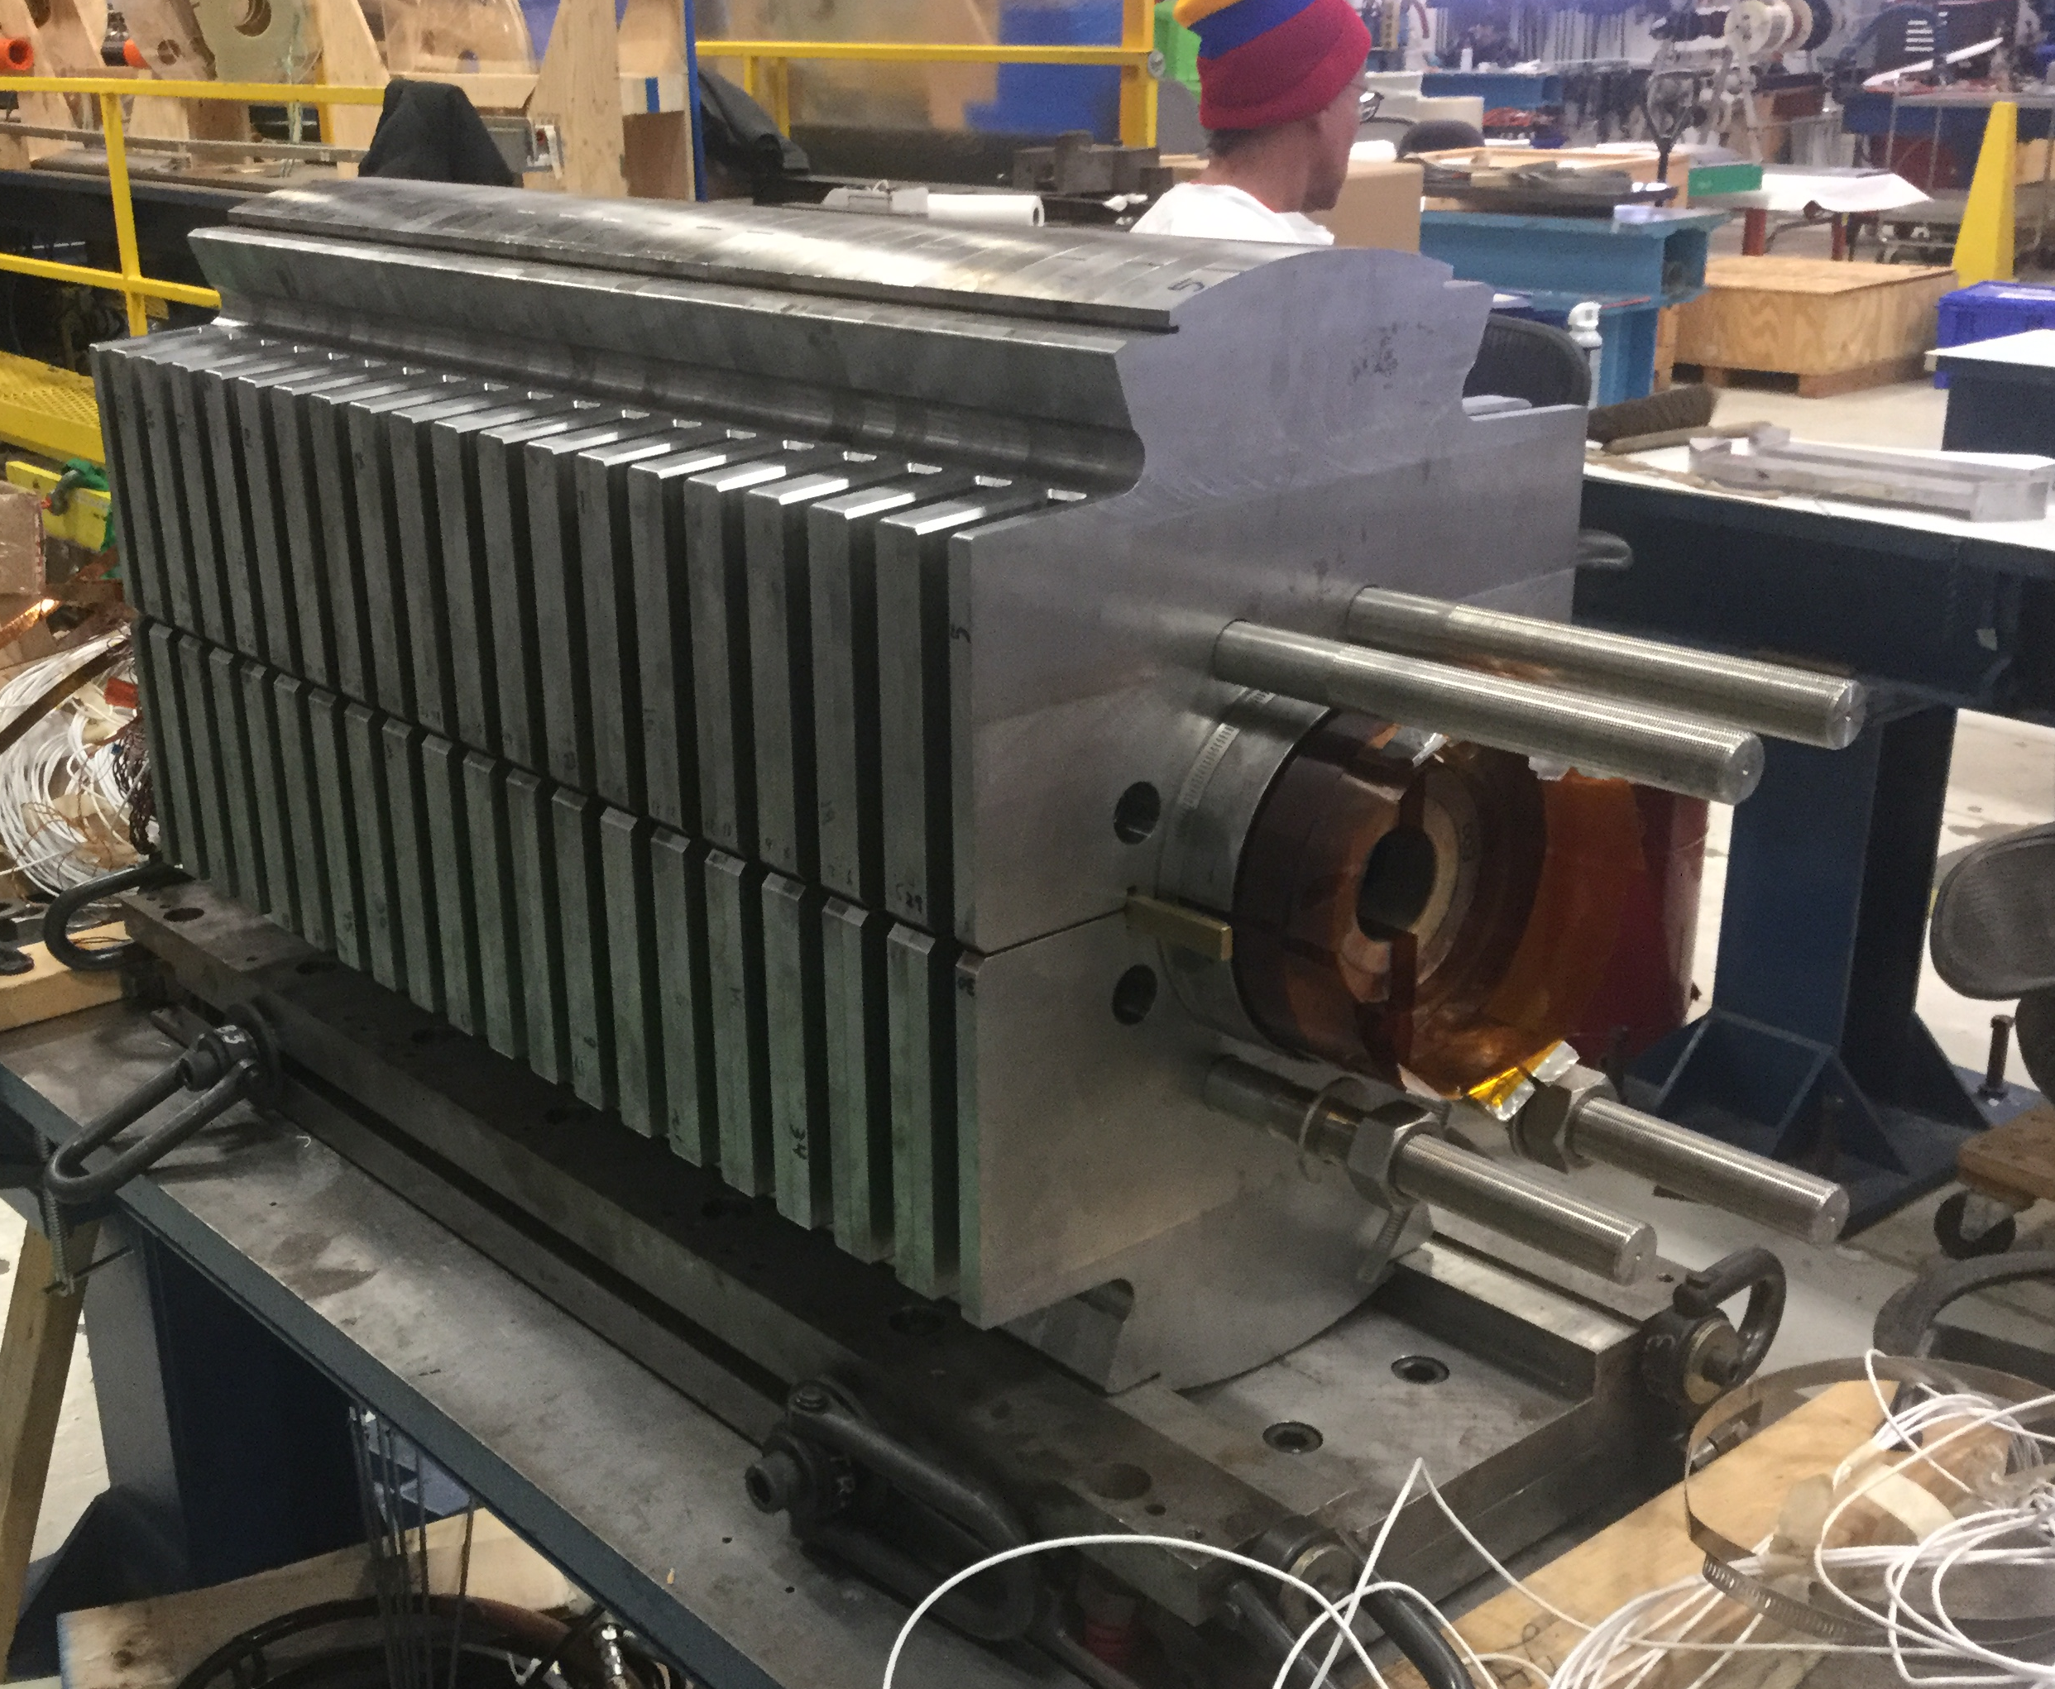
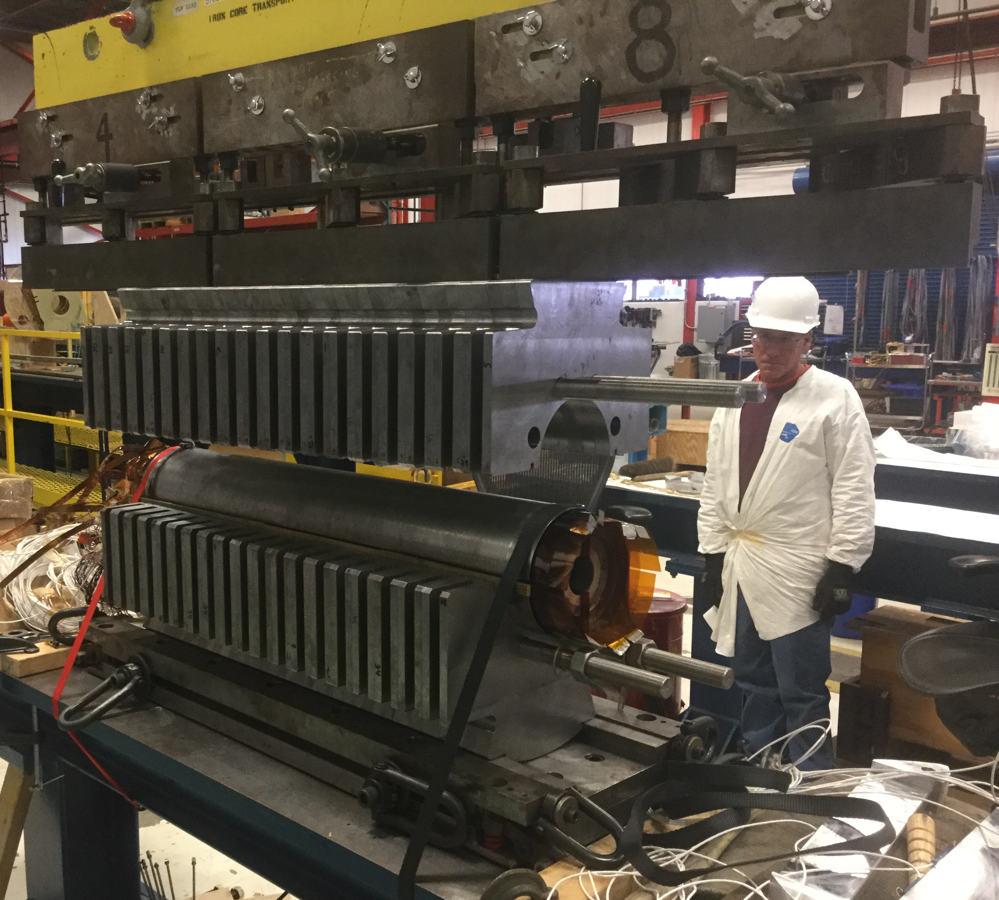
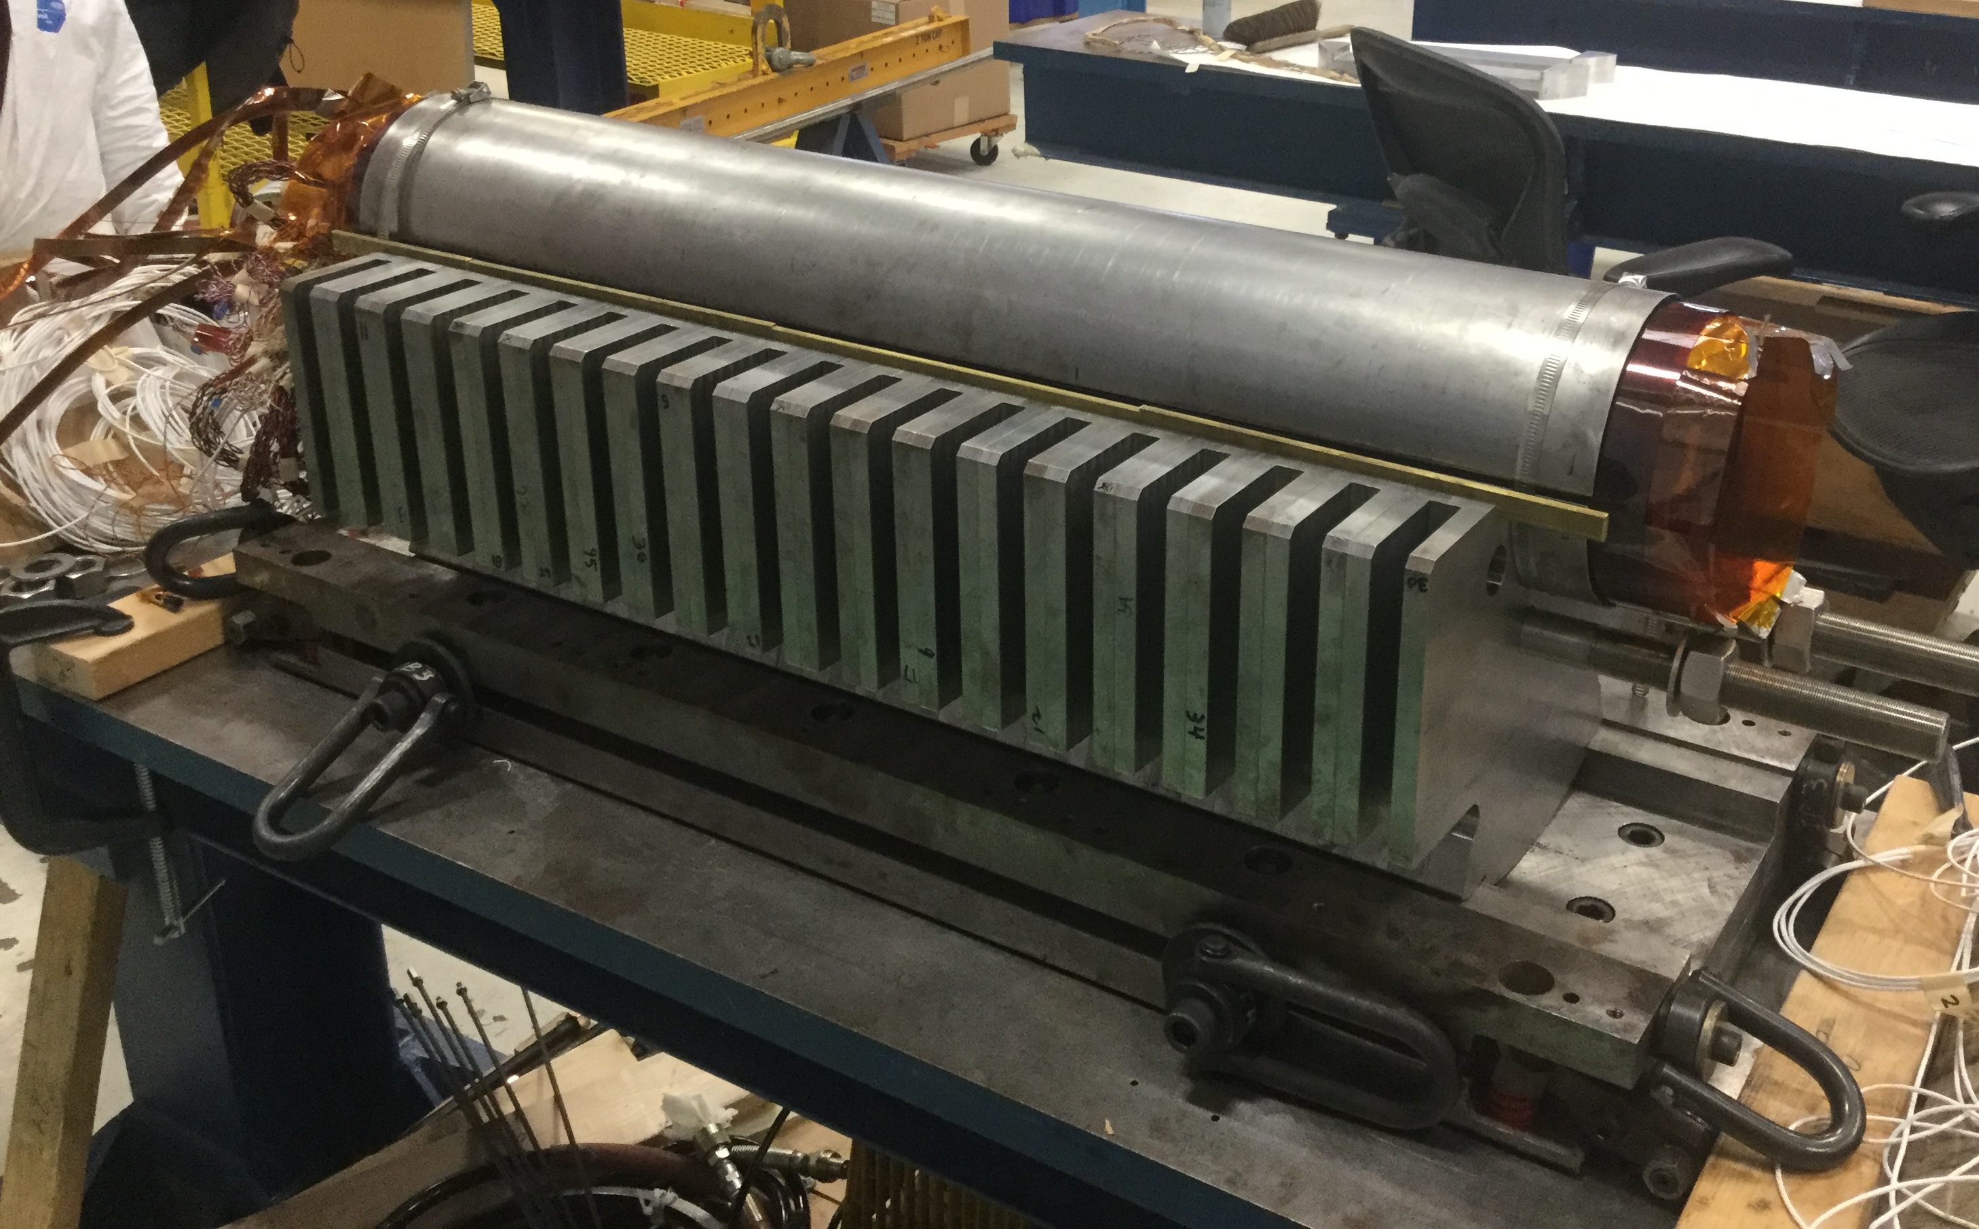
Yoke Removal

Slide 11
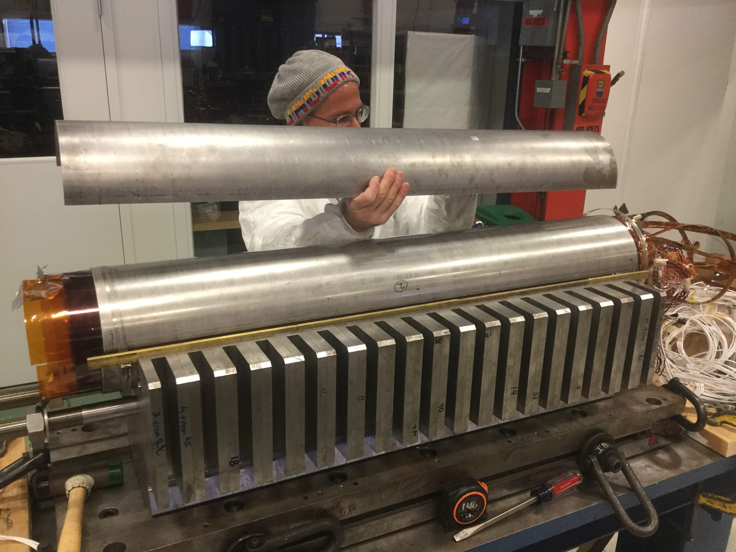
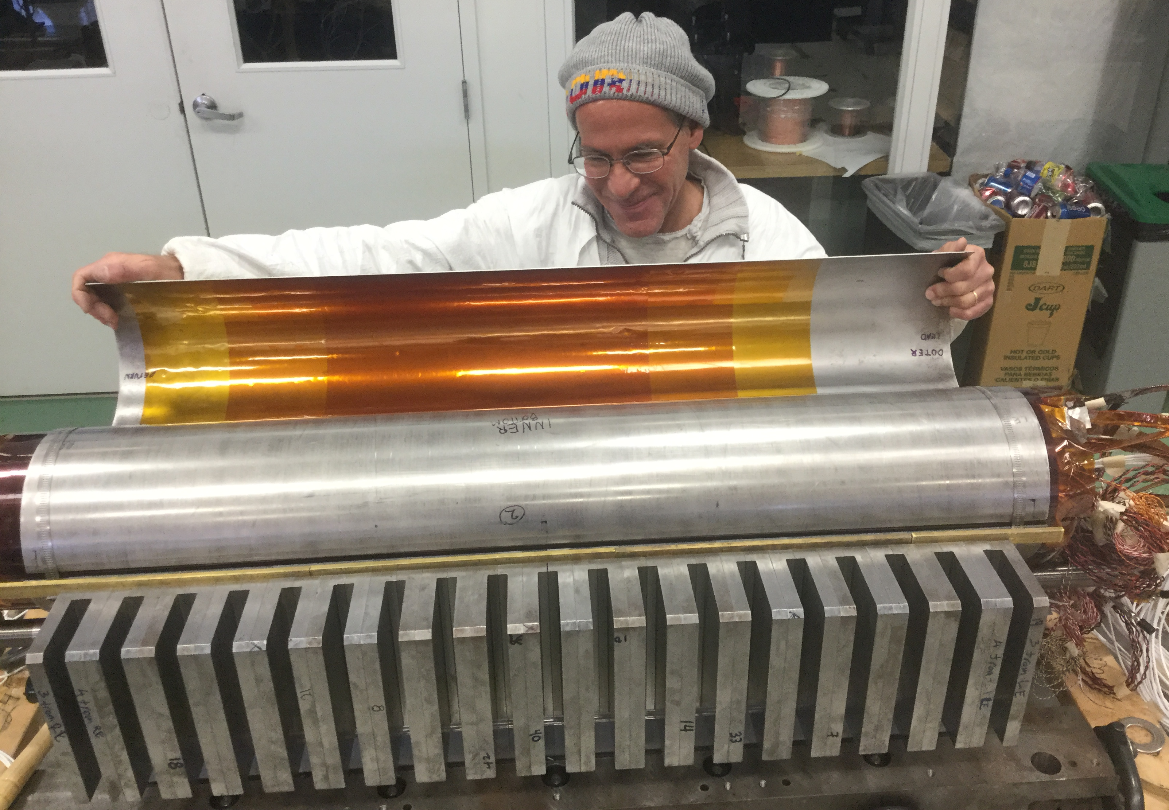
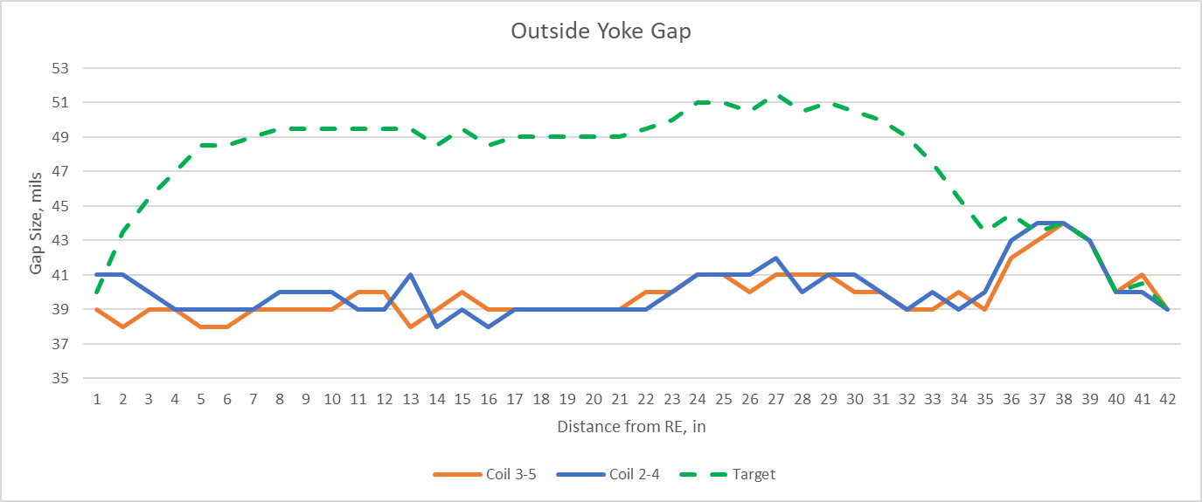
Radial shim installation and expected outside yoke gap

Slide 12
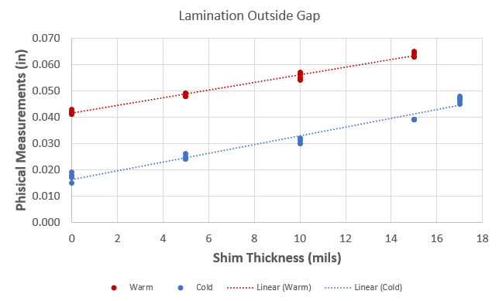
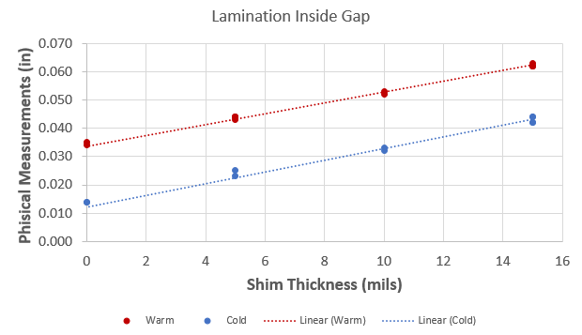
Expected gap sizes based on MM Measurements
These gaps will be measured and compared with expectations.
15 T Dipole Mechanical Analysis and Mechanical Model Tests
February 8, 2018

Slide 13
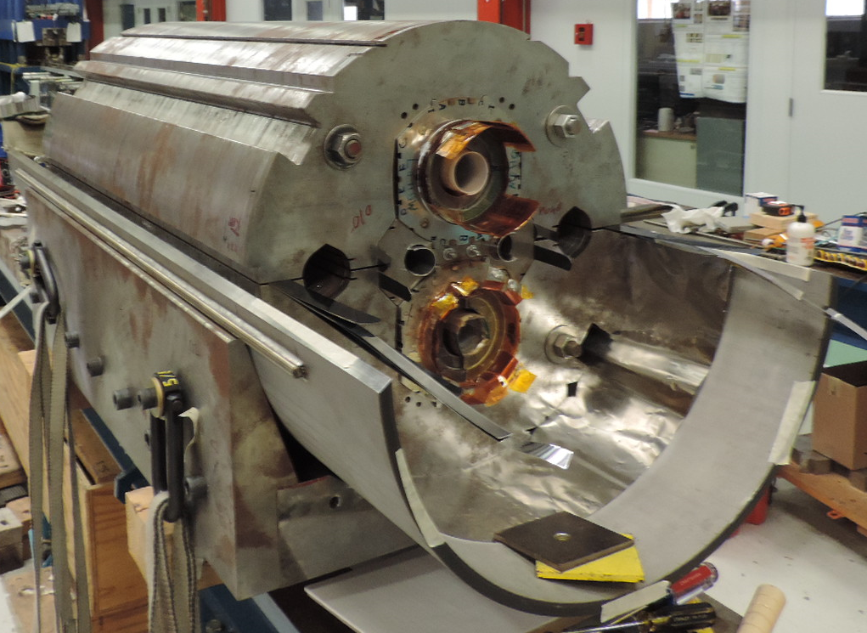
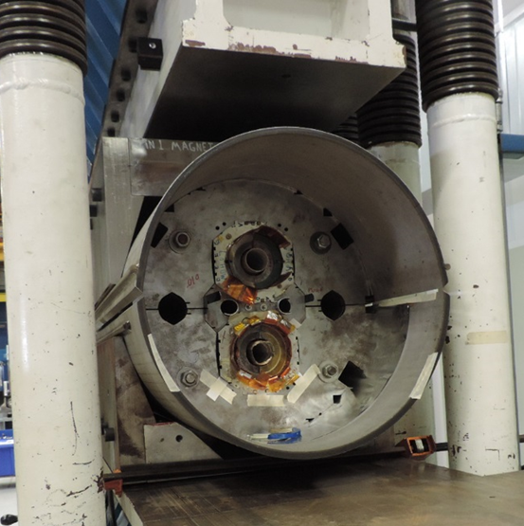
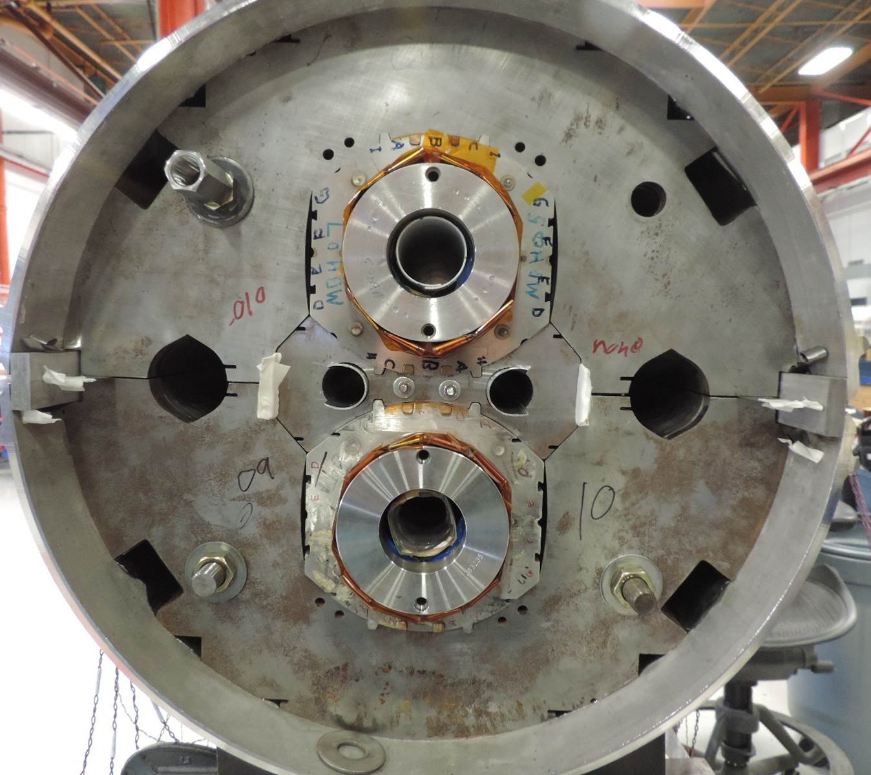
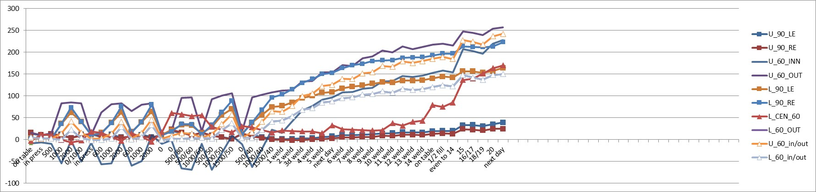
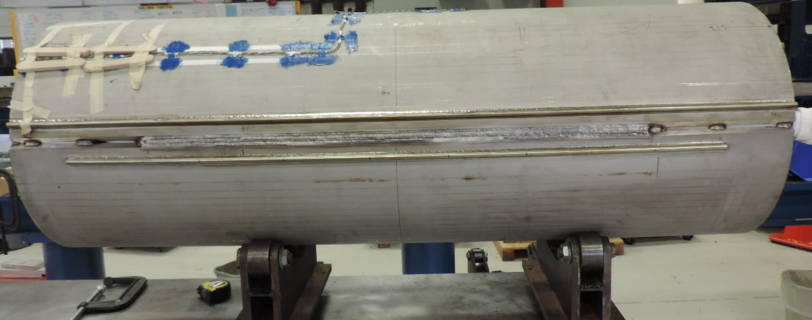
Skin welding
Skip welds under the press
and hand welds on a table
Skin SGs welding history
Stress, MPa

Slide 14
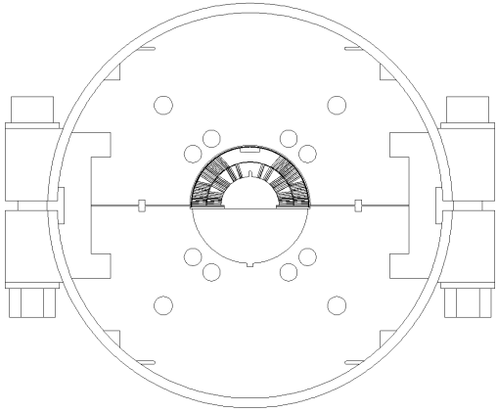
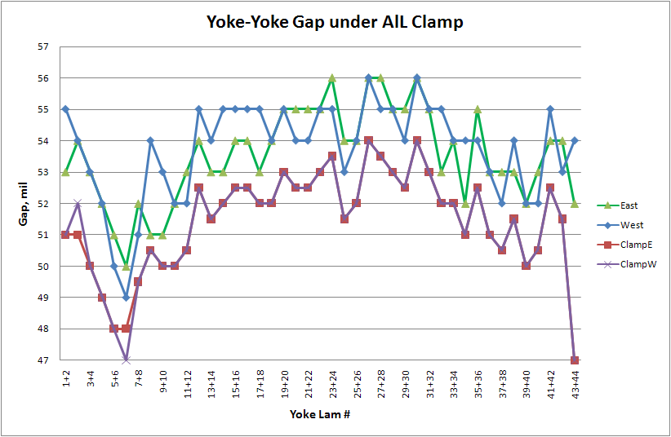
Gap Control Procedure
Mirror Magnet
AL Clamp
after Clamping
after Skin Loading

Slide 15
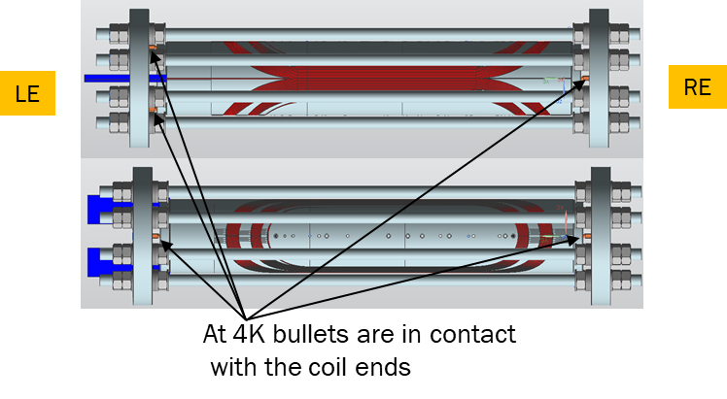
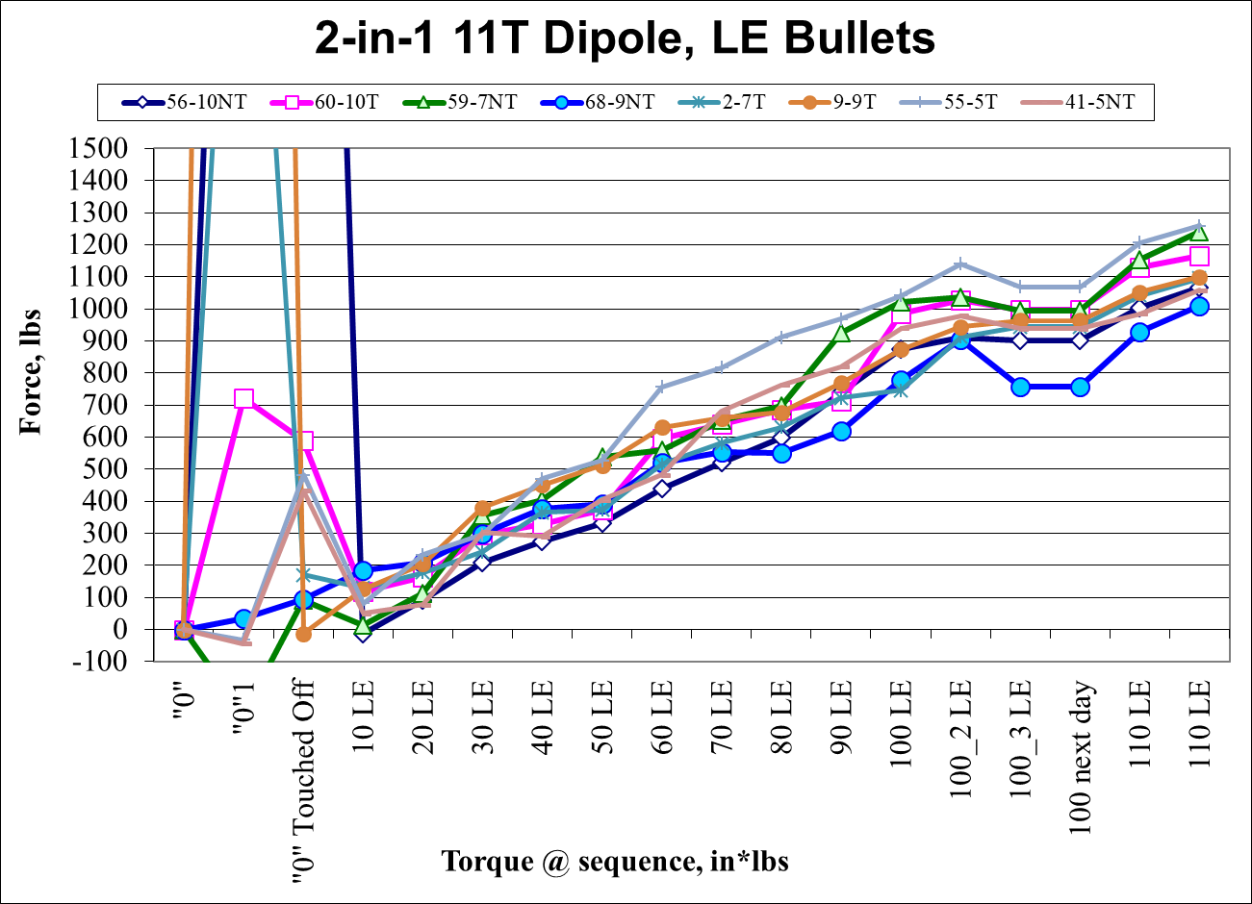
Magnet Ends Load

Slide 16
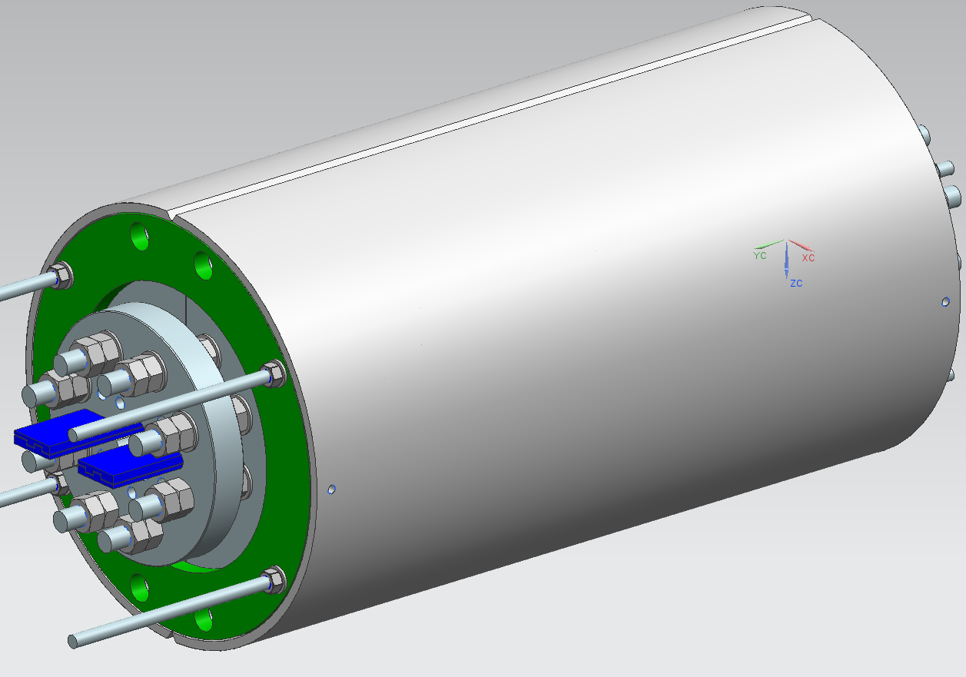
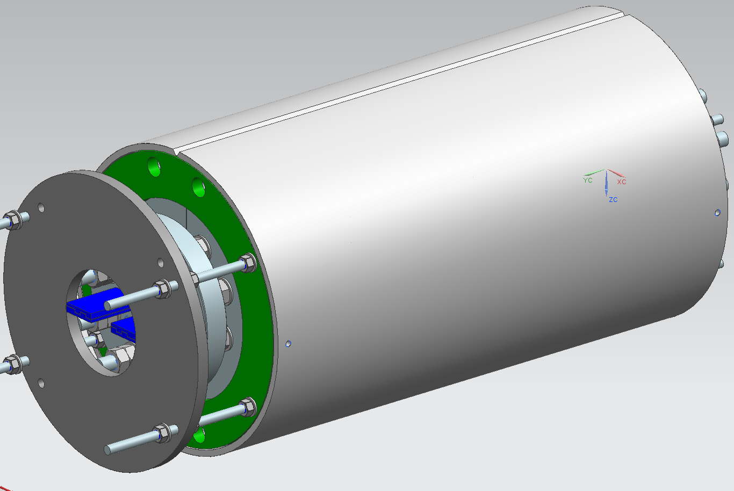
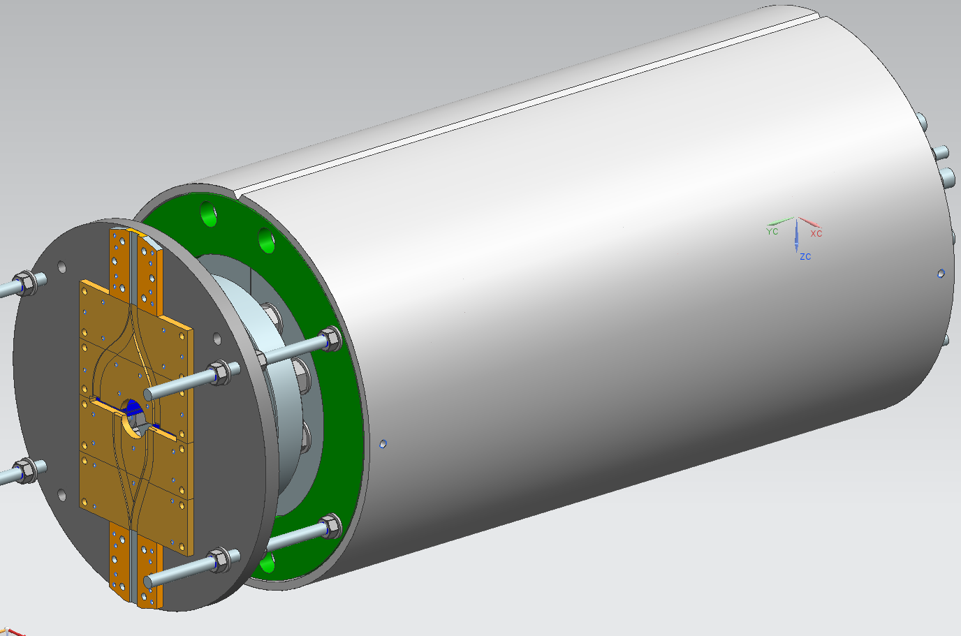
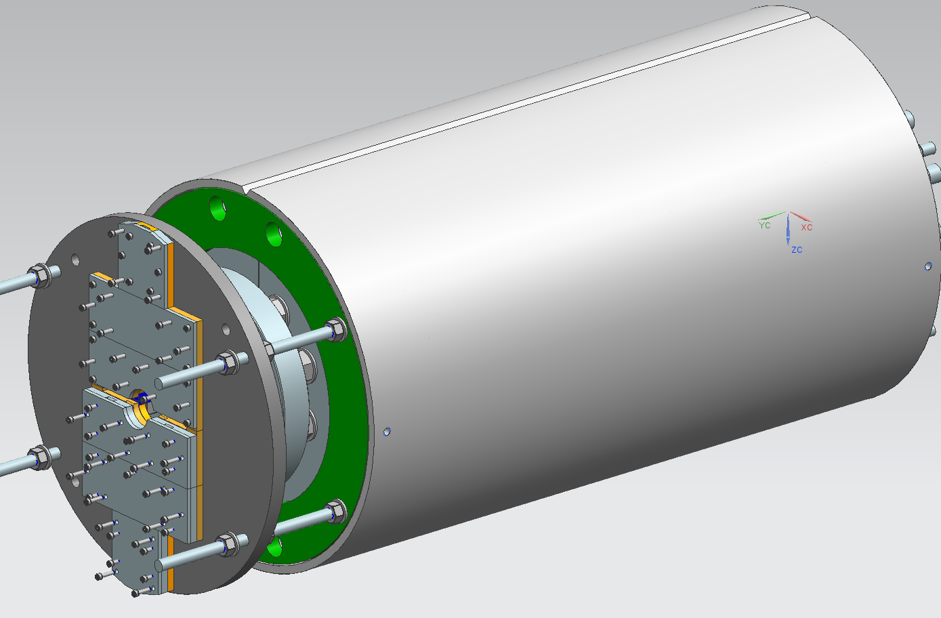
Final assembly
Lead insulating spacers
Stand-off plate
G10 splicing plates
G10 cover plate

Slide 17
Conclusions
To reduce the risk of coil damage during assembly the target prestress was limited by 150 MPa. It limit the target field during the first test by ~14 T.
Target coil pre-stress is defined for each assembly step including yoking, clamping, skin welding and cooling-down.
Assembly of 15 T dipole demonstrator is at the iron clamping stage
  the first clamping has been done and the second one with a larger radial shim is in the progress
  The goal is to reach ~60 MPa in the coil IL
The pre-stress during skin welding will add ~ 50 Mpa and we will achieve our target of ~115 Mpa
The level of maximum coil pre-stress after cooling-down will be controlled by the adjustable gap shims based on the gap measurements after welding

Slide 18
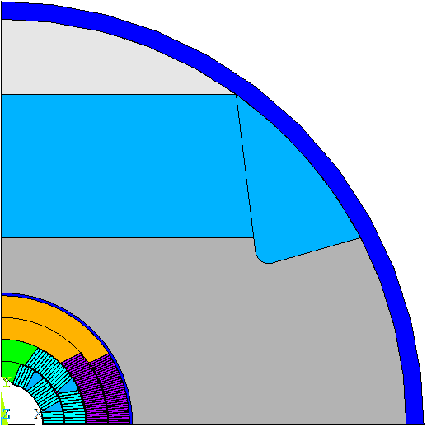
Shim Plan was developed based on FEA
δ Skin and skin thickness
Clamp-Skin Rad
interference
FEA | FNAL | FEAC
MP Shim L1/2 | 0 | 0
MP Shim L3/4 | 0 | 0.06
Shell-Yoke radial | 0 | 0.025
Yoke-Skin Radial | 0.3 | 0.6
Yoke-Yoke Gap t/b | 0.375 0.275 | 0.42 0.36
Yoke-Clamp interference | 0.3 | 0.4
Skin weld | 0.4 | 0.4
Filler-Yoke interference | 0.1 | 0
Filler-Yoke interference
Yoke-Yoke
gap taper
Clamp-Yoke
interference
Coil-Coil Rad
interference
Shell-Yoke Rad
interference
Pole slot
Mid-Plane shims
Yoke-Skin Rad interference

