Slide 1
Status of subscale-CCTs for Technology Development
D. Arbelaez, L. Brouwer, S. Caspi, D. Dietderich, S. Gourlay, R. Hafalia, T. Lipton, M. Martchevskii, S. Myers, J. Swanson, S. Prestemon
US Magnet Development Program
Lawrence Berkeley National Laboratory

Slide 2
Motivation
CCT4,5 exhibited a large number of training quenches
Improvements were made for CCT5, but still have significant number of training quenches
Significant change in layer-to-layer interface still lead to similar training after initial improvement → focus on cable-in-groove stress
Subscale models can lead to faster turnaround for dedicated training experiments, for example:
Epoxy (or other matrix) influence on training
Structural influences
Interface conditions
Subscale models are complementary to overall CCT program and will give feedback to design of large CCT models

Slide 3
Design Goals
Probe behavior in a similar regime to previous CCT training
similar conductor stress state as CCT4,5 (10 T magnet)
Small and easy to test for fast turn around
shorter length and smaller groove depth (quicker machining)
fit in small cryostat with 10 kA power supply (quicker testing)
Use existing conductor already characterized for critical current and stability at low field
RRP 132/169 previously used for Nb₃Sn undulator project

Slide 4
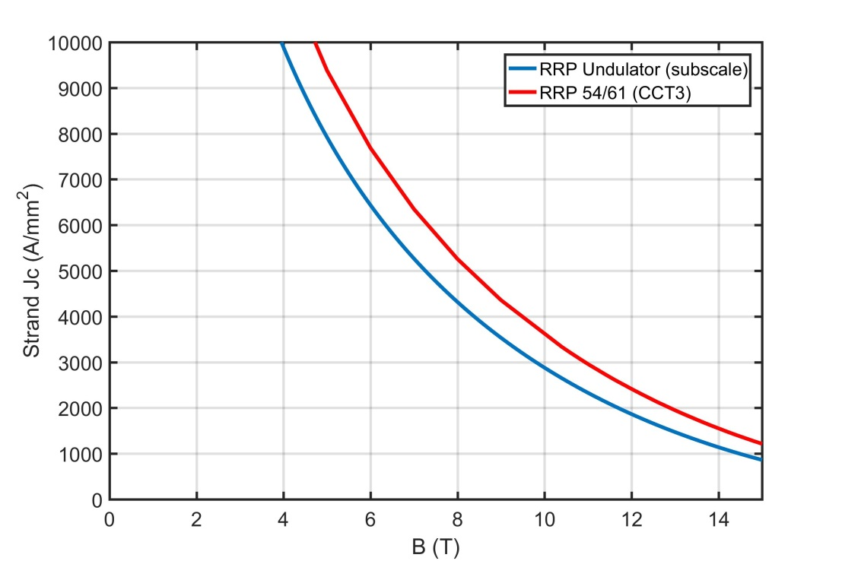
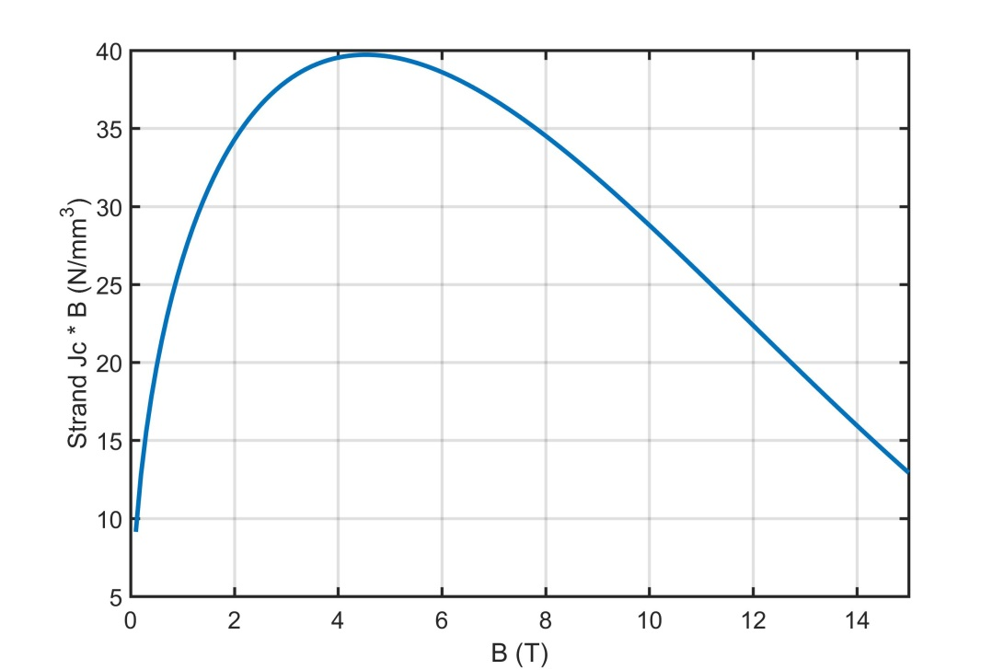
RRP 132/169 Conductor
RRP Nb₃Sn
0.6 mm diameter strand
50% ncf
2880 A/mm^2 at 10 T
Lorentz force density peaks at 4.5 T
Low field Nb₃Sn magnets can have high Lorentz force density

Slide 5
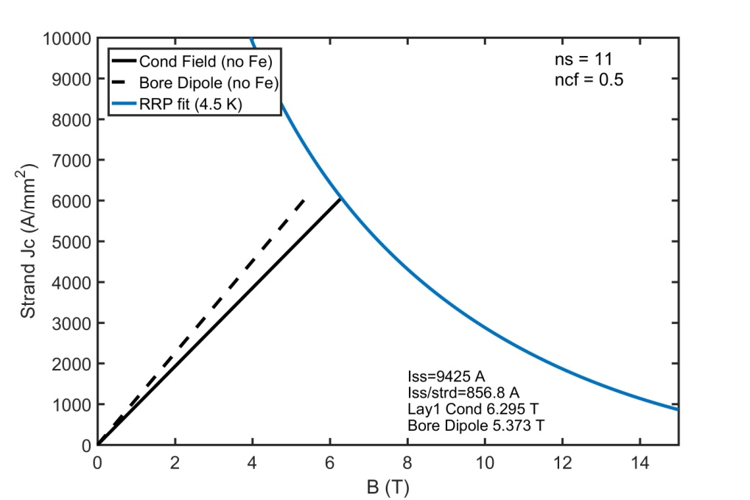
11 strand cable is chosen based on a current limitation of 10 kA
A two layer 11 strand design
matches the Lorentz force density of CCT4
keeps the power supply current under 10 kA
keeps the current per wire < 900 A for stability (previous measurements show that round wire is stable up to 1400A)
4.0 x 1.1 mm cable
Short-sample bore field of 5.37 T, and conductor field of 6.30 T @ 857 A / wire (9.4 kA)

Slide 6
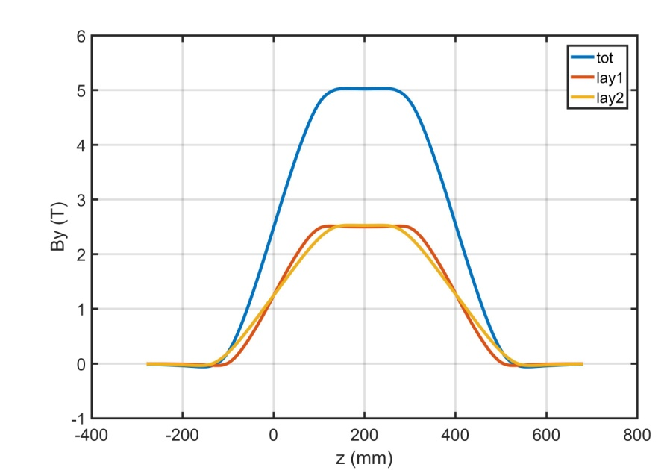
The design fits in the LBNL’s small cryostat and has a short straight section for field quality measurements
50 mm aperture
OR of layer 2 is 39.8 mm
41 m of cable per magnet
85 mm straight-section
45 turns / layer = 500 mm physical length
Cryoplant is not required for the test since it will fit in an existing small cryostat

Slide 7
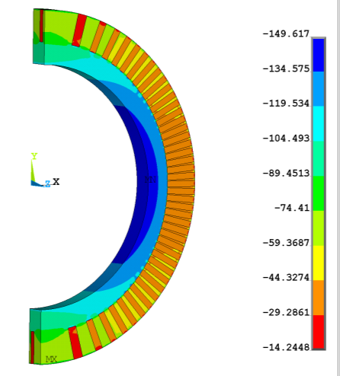
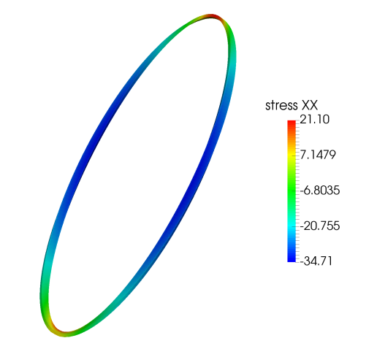
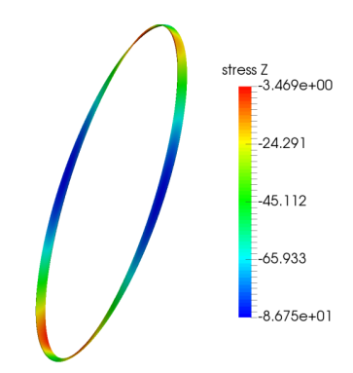
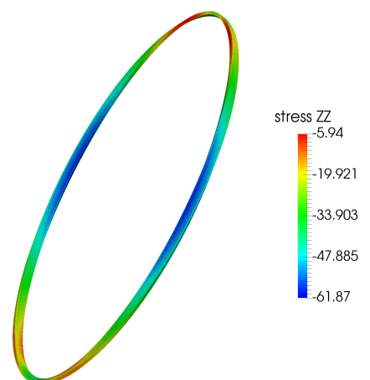
Nominal Subscale Magnet Design Probes a Similar Stress State as 10 T CCT’s (CCT3,4,5)
CCT4 σ_{θ}
CCT Subscale σ_{θ}
Normal Stress along cable
-150 MPa
-143 MPa
CCT4
33 MPa
-54 MPa
-14 MPa
-16 MPa
Subscale
Normal Stress transverse to cable
21 MPa
Subscale
CCT4
-3 MPa
-6 MPa
-35 MPa
-62 MPa
-87 MPa

Slide 8
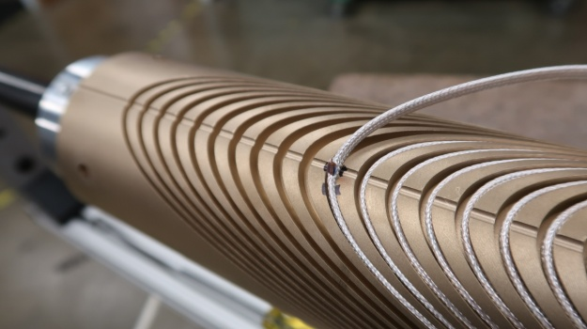
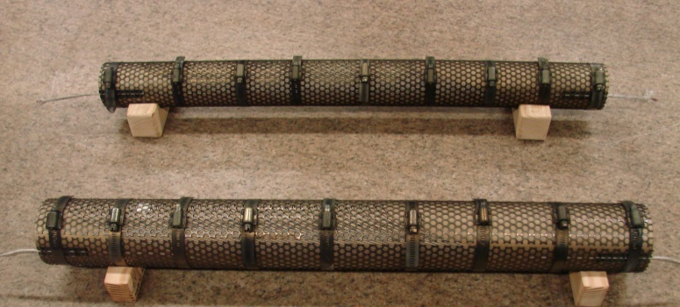
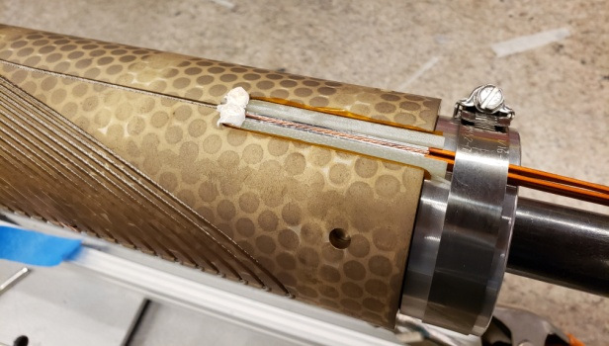
Currently Fabricating First Magnet
Status
Enough cable made and insulated for ~5 full magnets (more tests if outer layer is reused)
First magnet fabrication progress
Mandrels machining complete (machining of grooves takes ~ 2 days per mandrel)
Winding complete (~ 1 day per coil)
Heat treatment complete
Currently working on splices and preparing for potting
8

Slide 9
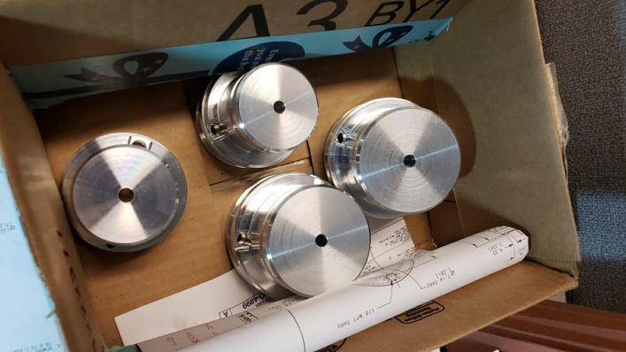
First Test Focuses on Obtaining a Baseline for Training of Subscale CCTs
Need to verify that subscale magnets will train in similar manner to large magnets
Magnet Configuration similar to CCT5
Individual layer impregnation with Mix-61 epoxy
Bend and shim approach with outer Aluminum shell
Fabrication of first magnet will also guide changes to mandrel geometry and fabrication process for next magnets
Changes to the groove geometry have been identified after heat treatment of first coils
Need to focus on efficient fabrication process for subscales since we need quick turn-around to test different concepts
Minimal Tooling for Potting
Will fill two coils with epoxy in one setup
Will cure coils simultaneously in oven
9

Slide 10
Initial Subscale Testing will Focus on Understanding effect of cable and cable/groove interface stress on training
CCT concept leads to reduced normal stress on conductor
Tradeoff between normal stress and shear stress at the cable/groove interface
Shear stress can be reduced by reducing spar thickness but normal stress will increase (accumulation of azimuthal force towards midplane + bending of layers)
First set of tests after Baseline will be of inner layers with thin and thick spars
Thin spar (reduced interface shear stress and increased normal stress due to bending)
Thick spar (increased interface shear stress and reduced normal stress due to bending)

Slide 11
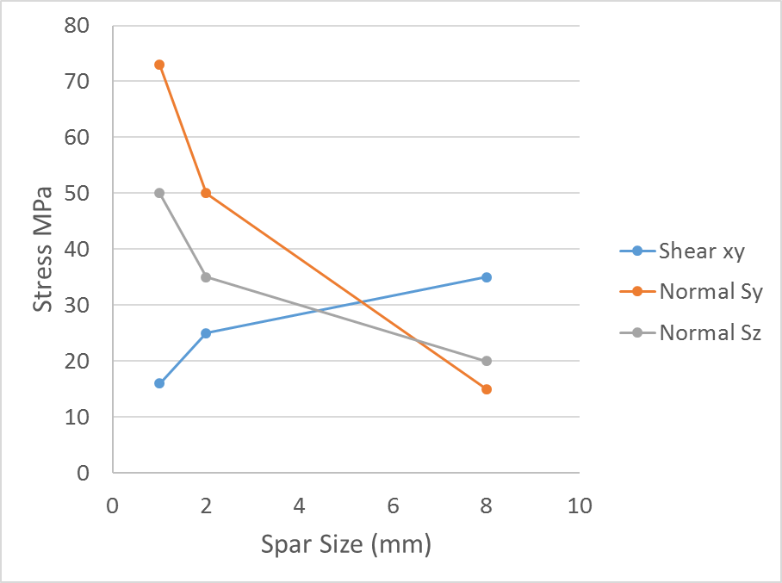
The subscale program can study the tradeoff between conductor normal and shear stress (on training)
Sxy (radial-azimuthal)
Thin spars
Low shear
High normal
Thick spars
High shear
Low normal

Slide 12
Further Subscale Tests Can Focus on Implementation of New Concepts
No-impregnation CCT magnet
Testing of novel impregnation materials and/or fillers
Future testing to improve cable/groove interface
Investigate methods for improving adhesion (surface modification)
Investigate methods of cleaning surfaces and coils
Investigate use of other materials for impregnation

Slide 13
CCT Subscale Status
First subscale magnet is being fabricated (coils have been heat treated)
First magnet will be ready in March
Second test campaign (2-3 magnets) ~ July
This test campaign will give guidance for further directions to pursue
Focus could be on strength and toughness of impregnation material and/or interfacial strength
Testing of cable/groove interface and impregnation material improvements will require separate small scale testing to identify promising technologies and requires further planning

