Slide 1
Status of REBCO magnet development at LBNL
Xiaorong Wang
U.S. Magnet Development Program
Lawrence Berkeley National Laboratory
MDP weekly meeting, 3/6/2019
Notes:
Include the logo of LTSW

Slide 2
Acknowledgement
U.S. Magnet Development Program, a collaboration between ASC/NHMFL, BNL, FNAL and LBNL, supported by DOE Office of Science, Office of High Energy Physics
Danko van der Laan and Jeremy Weiss at Advanced Conductor Technologies LLC supported through DOE HEP SBIR programs
University programs at U. Colorado and OSU
Team at LBNL: D. Arbelaez, T. Bogdanof, L. Brouwer, S. Caspi, L. Garcia Fajardo, W. Ghiorso, H. Higley, A. Lin, T. Lipton, M. Marchevsky, M. Maruszewski, S. Prestemon, T. Shen, J. Taylor, M. Turqueti

Slide 3
Our goal: develop REBCO accelerator magnet technology to enable 20 T dipole magnets
Improve magnet technology and wire performance to generate 5–10 T, stand-alone
5+ T insert
Develop insert magnets
20 T dipole
Test/study hybrids
Use existing 10 T CCT5 to start developing hybrid magnet
CCT6,…, high-field background dipole
Robust high-field REBCO accelerator magnet technology for both stand-alone and insert applications
Notes:
Develop high-field REBCO accelerator magnets for both stand-alone and insert applications.
High-field insert is a subset of high-field magnets. To deliver high-field inserts, we need to demonstrate high-field magnets

Slide 4

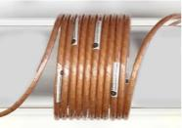
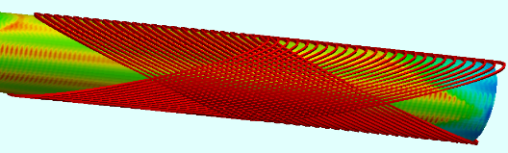
As a first step, we develop CORC® CCT dipole magnets and understand their performances
CORC® wire is a promising HEP cable option
  Isotropic for magnetics and mechanics
  High current (~10 kA) at small bending radius (30 mm)
CCT design is ideal for insert
  Low conductor stress
  Excellent geometric field quality
Field
current
Driving questions:
How to make magnets? mandrel, winding, joint, impregnation...
What’s the magnet performance? Field strength and quality, quench behavior...
What factors limit the performance? How can we improve?
What’s the implication? A paradigm?

Slide 5
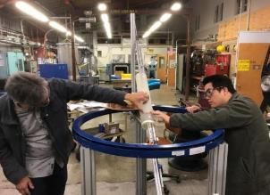
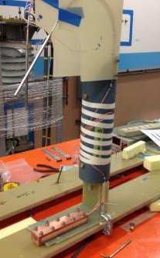
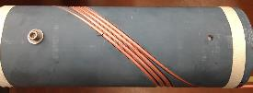
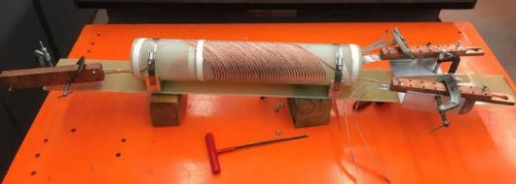
We developed subscale magnets with quick turn-around to effectively establish the grounds
In collaboration with ACT, we are making progress in several key areas
Conductor-friendly winding methods with capability for long magnets
Low-resistance joints (10 nΩ at 4.2 K )
Assembly procedure
Instrumentation and test

Slide 6
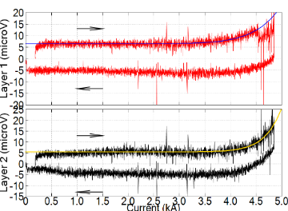
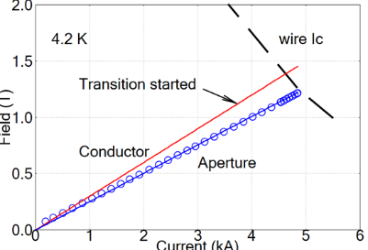
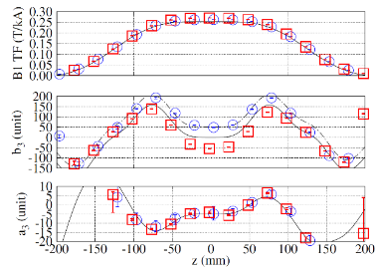
The 2-layer 40-turn C1 was a first step to demonstrate the feasibility of CORC® CCT
Successfully wound ~ 30 m long CORC® wire
Generated 1.2 T dipole field at 4.2 K
Demonstrated high thermal stability at J_{e} of 620 A/mm²
Can proceed to the next magnet (C2) with higher fields

Slide 7
C1 also highlighted several development needs critical for magnets with higher fields
Dipole transfer function is low (0.25 T/kA)
Continue improving the flexibility of CORC® wires
Printed plastic mandrel is weak for magnets with higher fields
Develop mandrels with stronger materials
Conductors move during energization
Develop impregnation technology to support and constrain conductors

Slide 8
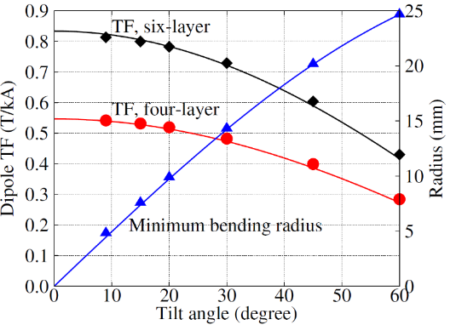

More flexible high-current REBCO wires are critical to demonstrate higher dipole fields
Thinner tapes are the key
  Enable smaller CORC® bending radii and tilt angles → higher dipole fields
  30 µm substrate → 25 µm corresponds to 25% increase in J_{e}
Increase pinning performance at 4.2 K
Bending radius (mm)
Tilt angle
ACT received the first batch of 25 µm tapes from SuperPower to develop next-generation CORC® wire
Notes:
Je increase with no increase in Jc of tape

Slide 9
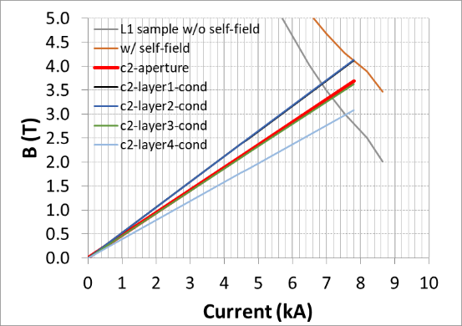
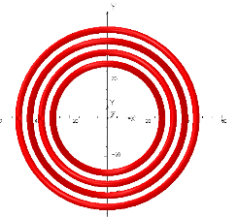
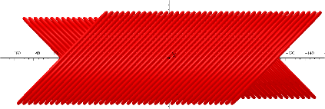
We are working on the next magnet to reach 3 T dipole field – C2, a four-layer CORC® CCT magnet
Magnet ID 70 mm, OD 125 mm
Wire OD: 3.8 mm. Minimum bending radius 30 mm.
4.2 K
Wire sample measured by Jeremy Weiss and Danko van der Laan at ACT

Slide 10
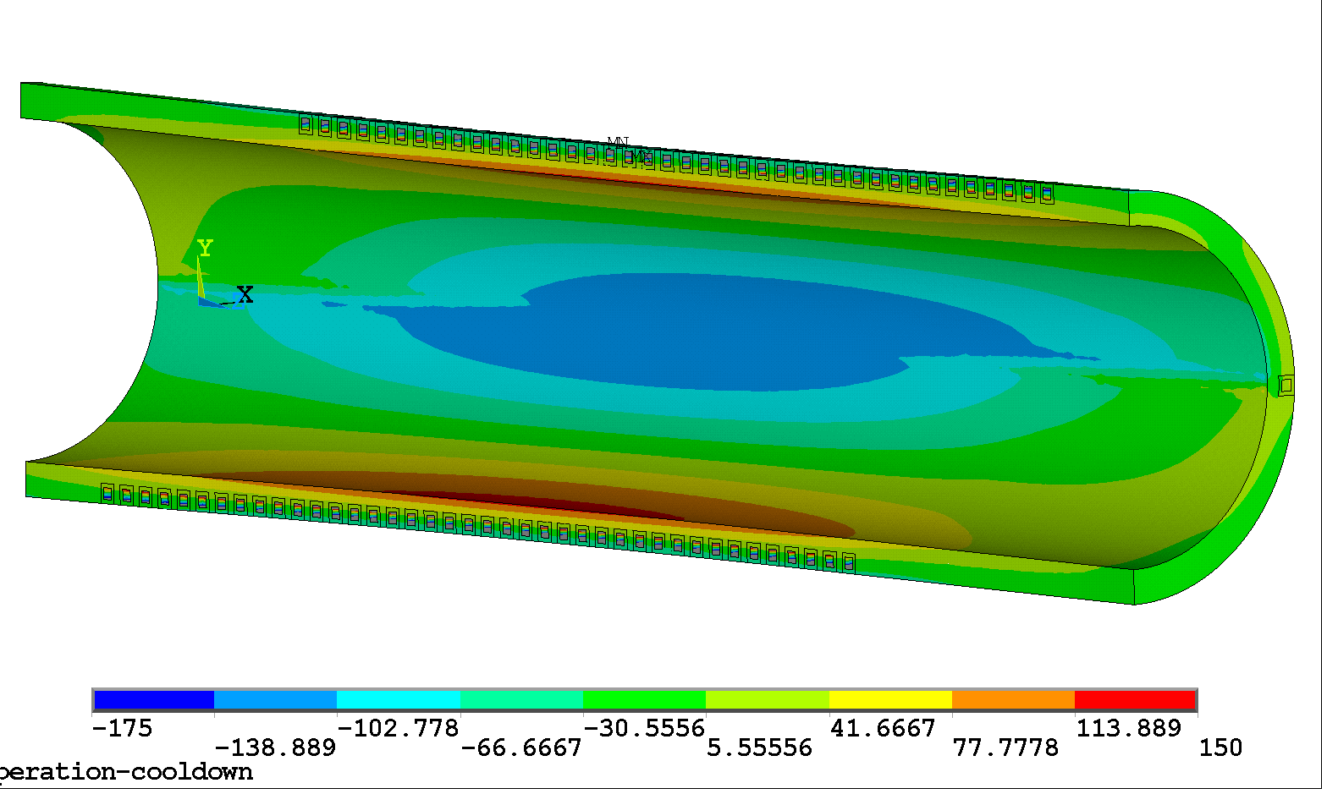
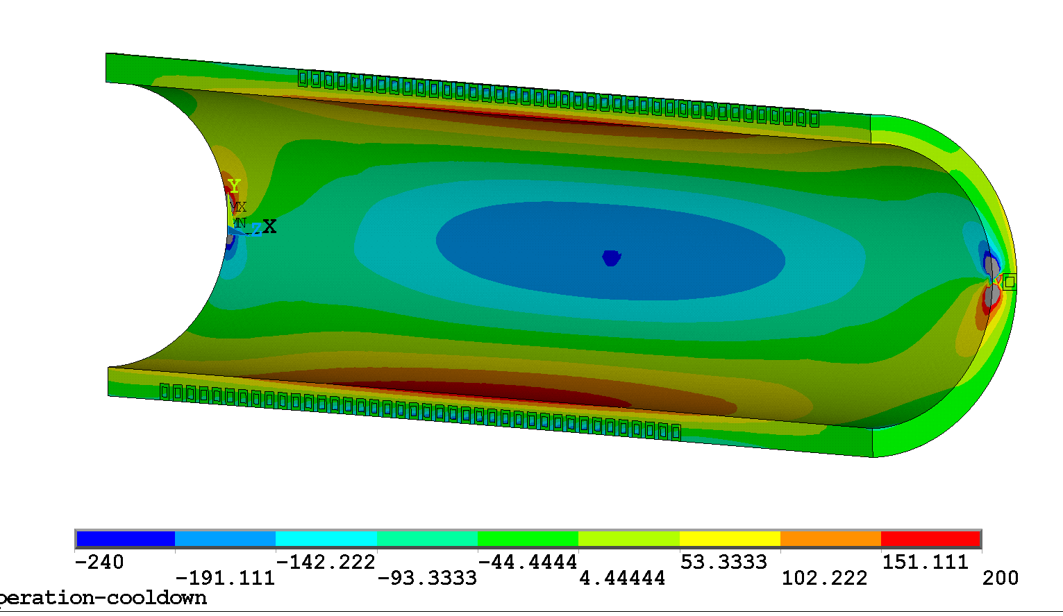
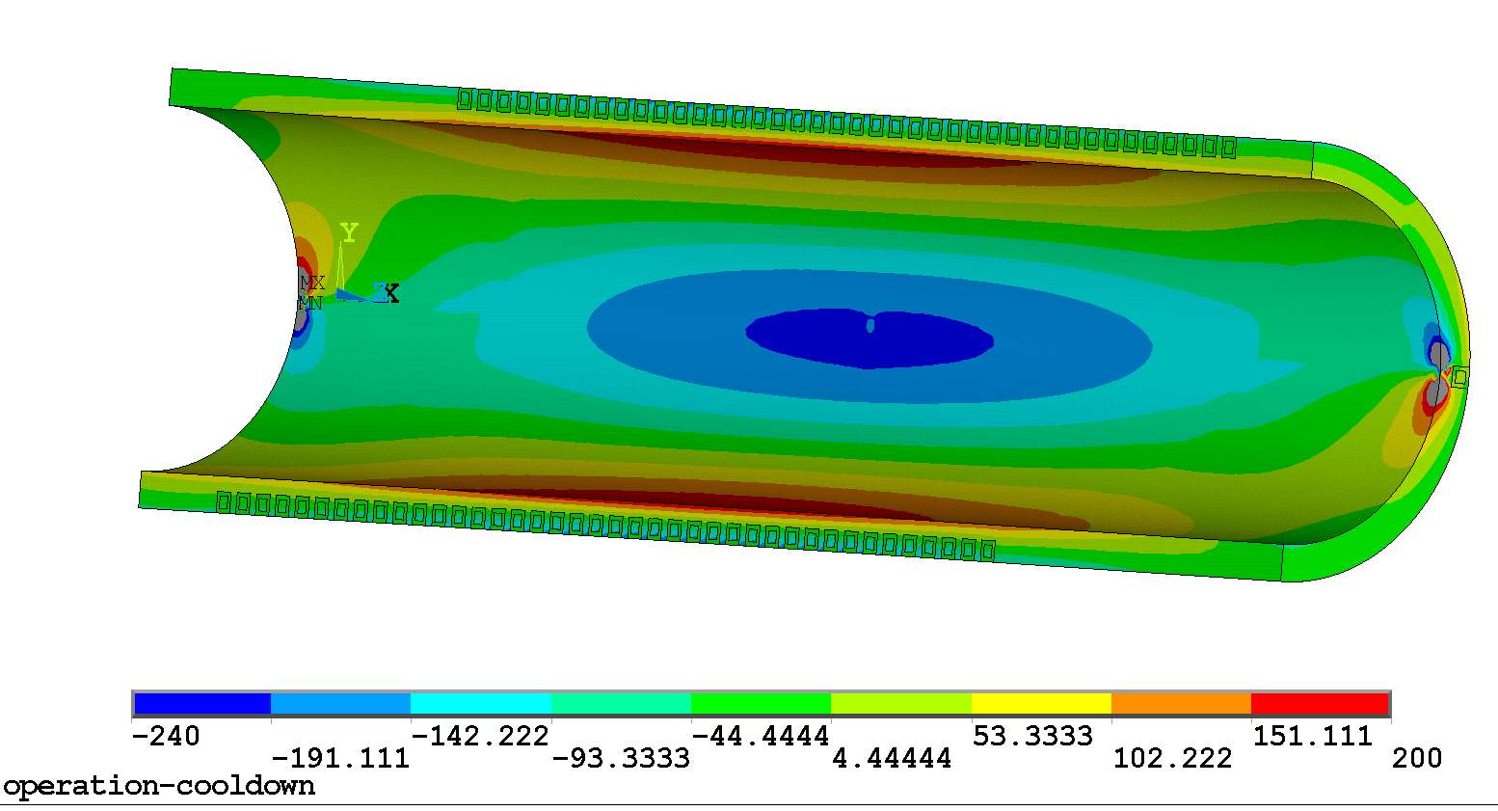
Mechanical analyses confirm that C2 needs a metal mandrel
The real problem for the bluestone mandrel is coming from the Lorentz forces (not much we can do)
Cooldown to 4.5 K minus Lorentz Force (LF induced) -> mandrel SY
Bluestone
Aluminum
Aluminum Bronze
Mandrel Stresses of 150-200 MPa order is large for bluestone
Lucas Brouwer

Slide 11
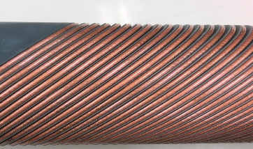
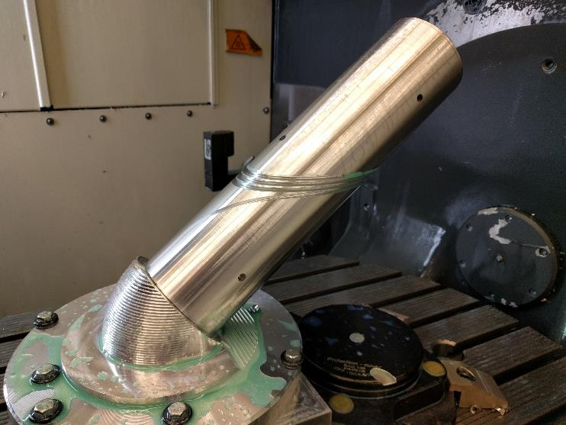
The tilted-groove design can require more involved machining – we are investigating machining possibilities
Tilted groove printed on plastic mandrel
Tilted groove facilitates winding
It’s doable on metal – we machined a 3-turn mandrel with a 5-axis machine
Needs larger or different machines to make longer mandrels
We are talking with outside shops on the possibilities
Tilted groove machined on metal mandrel
Bill Ghiorso and Tom Lipton

Slide 12
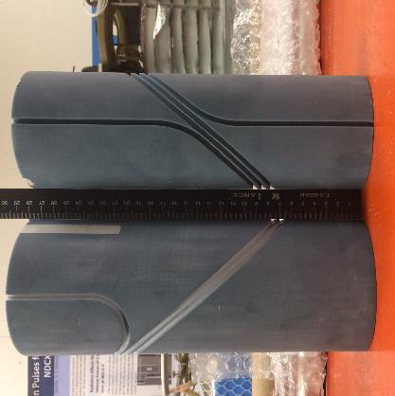
Test winding with the classic radial groove indicated unfavorable friction and challenge to apply tension
Radial groove printed on plastic mandrel
Radial grooves can be easily machined in house
  Proven on all other CCT mandrels (for Nb₃Sn and Bi-2212)
We developed mandrels with radial groove to assess its feasibility
We can manually position the conductors. Automated winding and applying tension can be challenging
Needs further investigation and optimization
Laura Garcia Fajardo

Slide 13
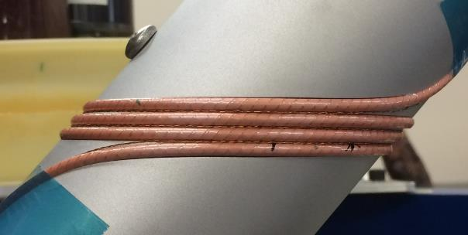
We adopted radial grooves with half depth for C2
Radial groove for quick machining
Reduced groove depth to facilitate winding
A design to continue the magnet development
Test winding on an Aluminum mandrel. Note the wire is partially outside the mandrel
Maxwell Maruszewski, Hugh Higley, Bill Ghiorso, Tim Bogdanof

Slide 14
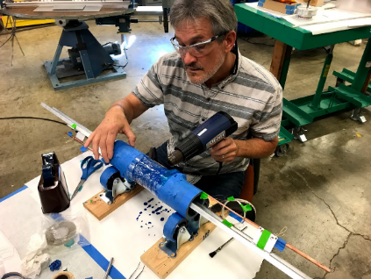
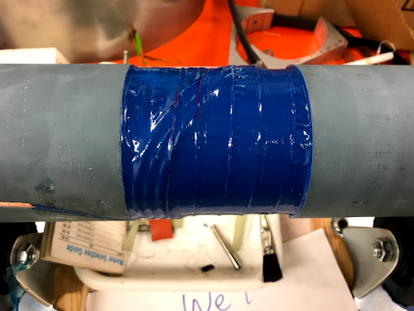
We developed a procedure to apply stycast to constrain the conductor
Strong enough to hold the conductors for C2. Impregnation will be developed for the next magnet
Paint stycast after winding. Wrap with glass fiber cloth to increase strength. Use heat shrink tape to improve the final geometry
Applied to six 3-turn coils (results in following slides). Need to practice on a 40-turn mandrel
Hugh Higley and Tim Bogdanof

Slide 15
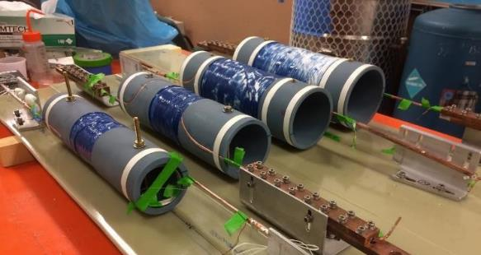
We learned several important things by developing a subscale magnet (c2b, 3-turn)
Used 30-tape prototype wire, 3.81 mm diameter
Developed fabrication techniques (winding, joints, assembly, applying stycast, …)
Modified exit lead design to reduce conductor handling
Gained first feedback on conductor and magnet performance
Hugh Higley, Bill Ghiroso and Tim Bogdanof
Notes:
- Same as C2 with only 3 turns of prototype 30-tape wire

Slide 16
Stycast showed negligible impact on wire performance
Systematic tests on 3-turn coils showed less than 3% I_{c} reduction due to Stycast
Data wrt I_{c} before winding. 10 µV, 77 K, self-field
 | After winding | After stycast | Change
BS-Layer 1 | n/a | -29%
BS-Layer 2 | -30% | -33% | -3%
BS-Layer 3 | -28% | -31% | -3%
BS-Layer 4 | -30% | n/a
AB-Layer 1 | -12% | -14% | -2%
AB-Layer 3 | -23% | -24% | -1%

Slide 17
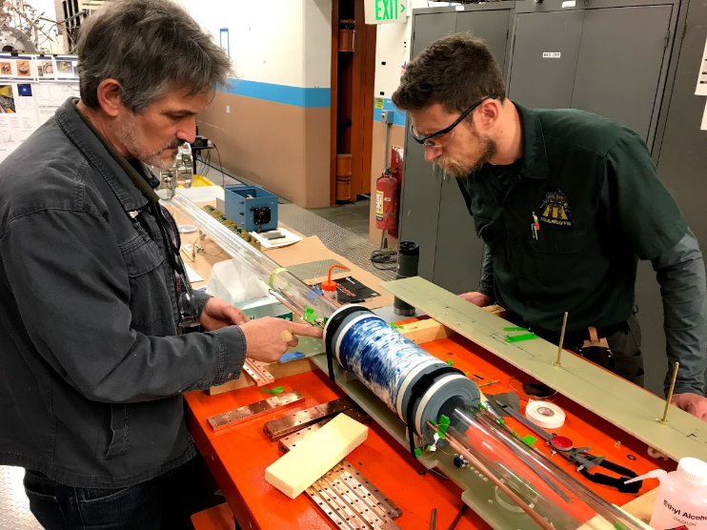
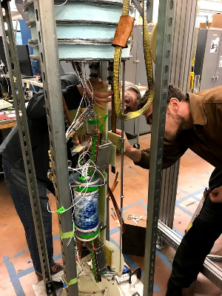
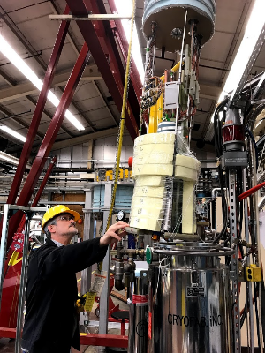
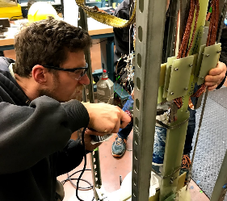
We successfully assembled magnet in December 2018 and tested it in January and February 2019
Assemble the magnet
Apply instrumentation
Insert into the cryostat
Solder leads
Hugh Higley and Tim Bogdanof

Slide 18
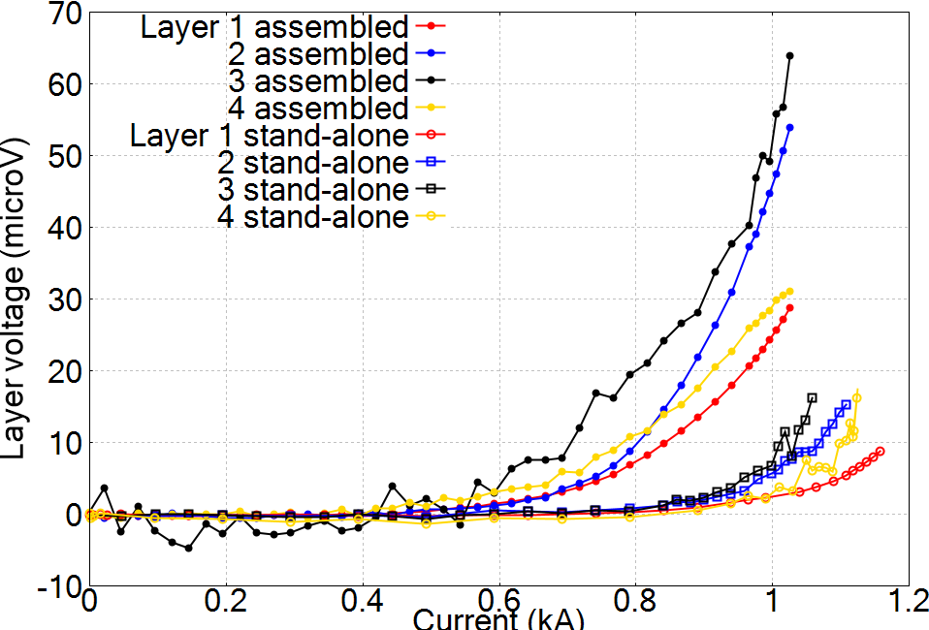
We performed systematical tests at 77 K to probe coil behavior and assess fabrication procedure
Tested assembled
30% I_{c} reduction due to higher fields
77 K
Tested individually
Changed the design in layers 2, 3, 4 to minimize conductor handling
Notes:
- Lose 50% of Ic after winding and assembly

Slide 19
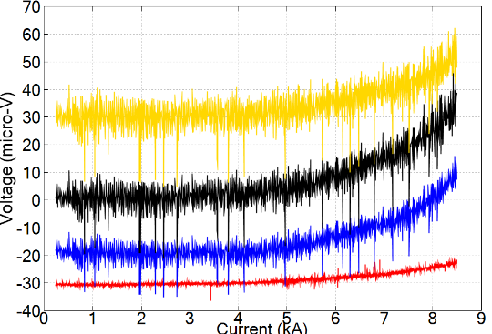
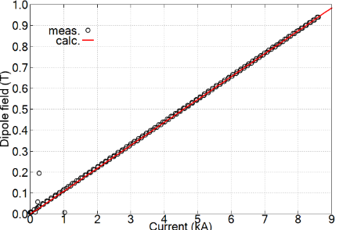
The 3-turn magnet reached 8.5 kA at 4.2 K, a factor of 10 increase from 77 K at 10 µV level
4.2 K
4
750 A/mm² at 8.5 kA
Layer 2/3 had the lowest performance
Low joint resistance: 5 – 21 nΩ
Low n value: 4 – 8
3
2
L1
0.94 T dipole field in the aperture
Validated the calculation
Examine magnet to understand the different behaviors in inductive voltage and joint resistance

Slide 20
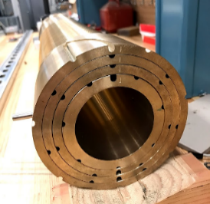
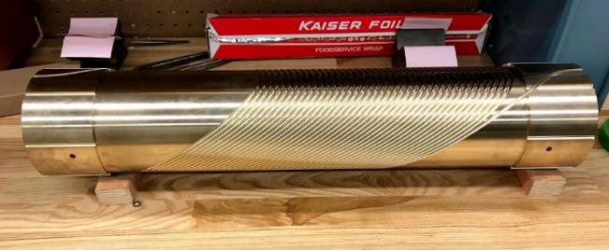
We plan to make the 40-turn C2 magnet in the next few months
Conductors and mandrels in hands
ASC/FSU provided a cryostat for the test (cryogenic test to be done)
Maxwell Maruszewski, Bill Ghiorso and Hugh Higley
Test winding and assembly using dummy conductors
Fabricate and test each layer. Assemble and test in July (Cory Myers, a PhD student from OSU joined us for the test and analysis)

Slide 21
Thanks. Questions?

