Slide 1
FRIB Nb₃Sn ECR ion source magnet:
Schedule, Cost, and Progress monthly report
Tengming Shen for the Supercon team
Lawrence Berkeley National Laboratory
Jan 2025 report
2025/01/06
FRIB: Yoonhyuck Choi, Junwei Guo, Xiaoji Du, Dalu Zhang, Ting Xu, Guillaume Machicoane, Tomofumi Maruta, Jie Wei
LBNL: Tengming Shen, Ye Yang, Philip Mallon, Ray Hafalia, Lianrong Xi, Mariusz Juchno, Paolo Ferracin, Soren Prestemon
The Indico site where the meeting slides can be downloaded: https://conferences.lbl.gov/event/2032/
Access key: FRIB
Past meetings slides are available at https://conferences.lbl.gov/category/109/

Slide 2
Progress since our last meeting, 2024/11/25
Prototype coil fabrication.
Coil winding completed.
In preparation for reaction.
An issue with the endshoes.
Prototype coil cold test: Mirror magnet structure model assembly mechanical analysis, CAD model finalized, parts in production.

Slide 3
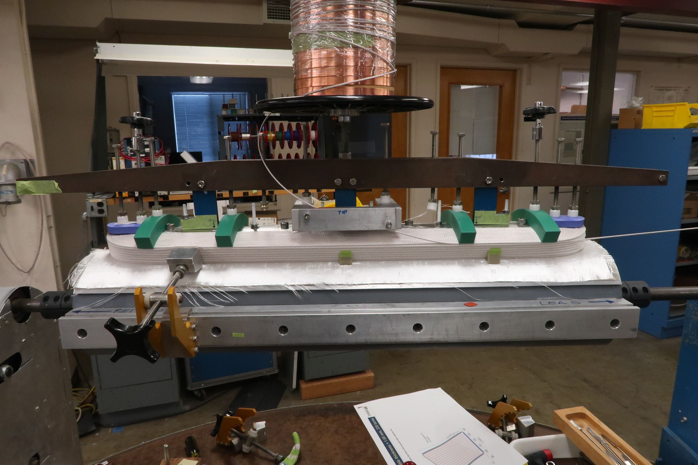
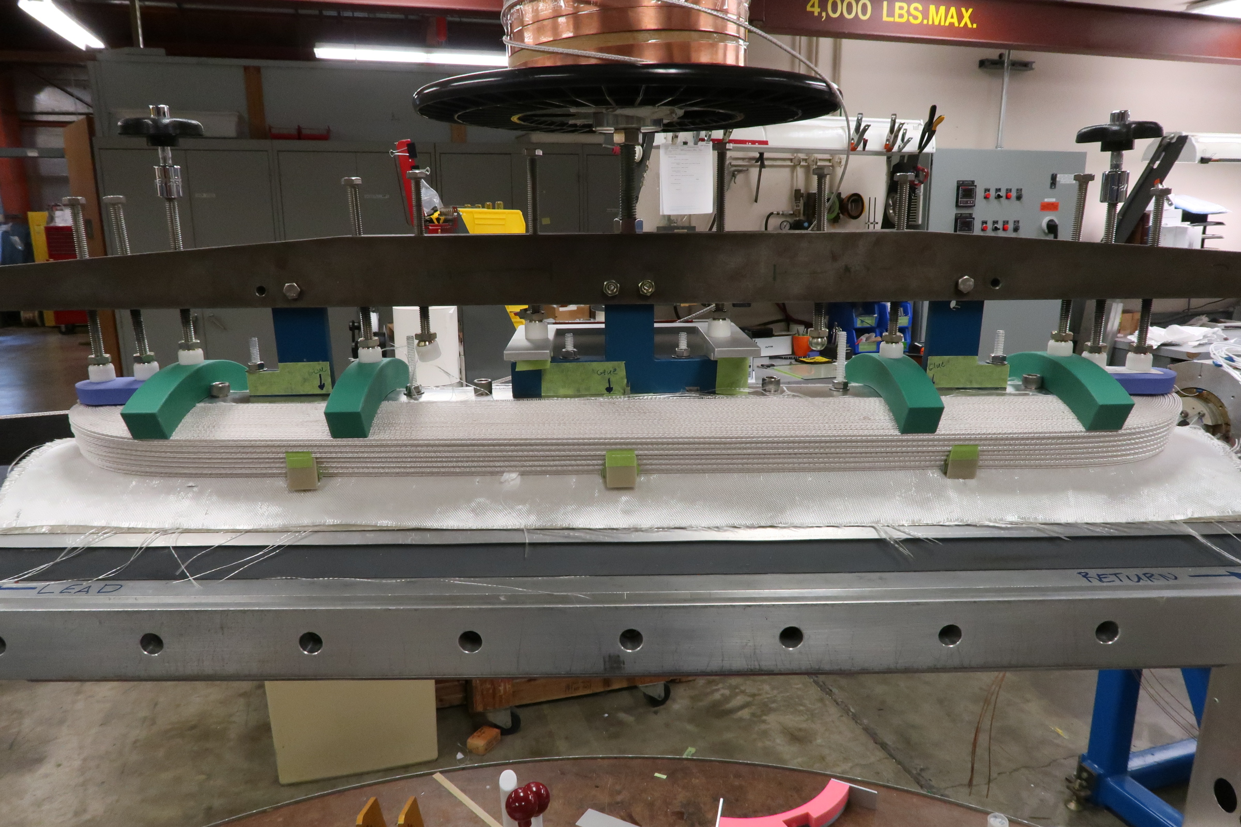
Prototype coil winding completed
Prototype coil winding completed on 11/21/2024.

Slide 4
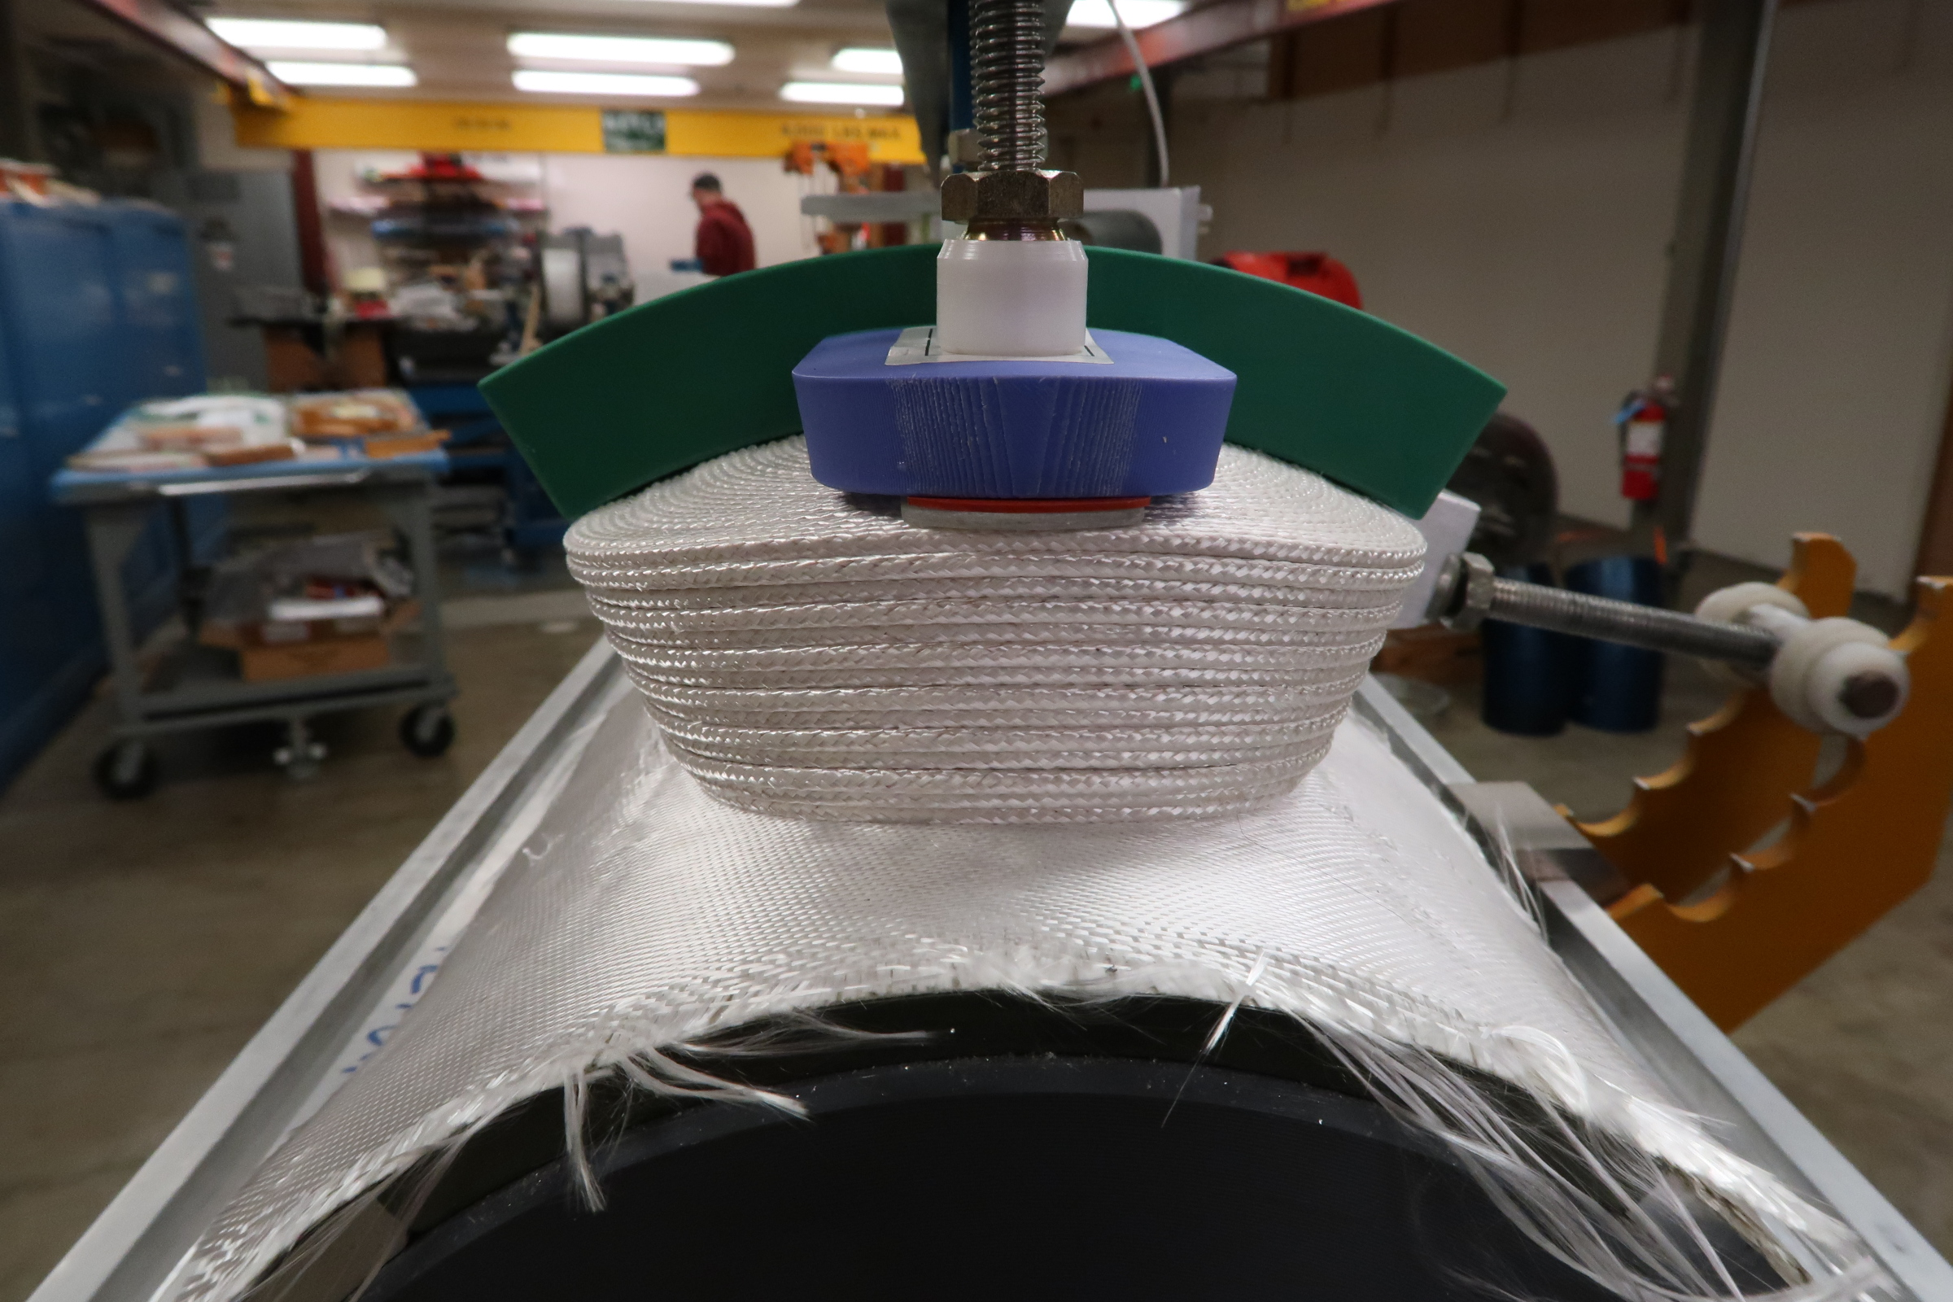
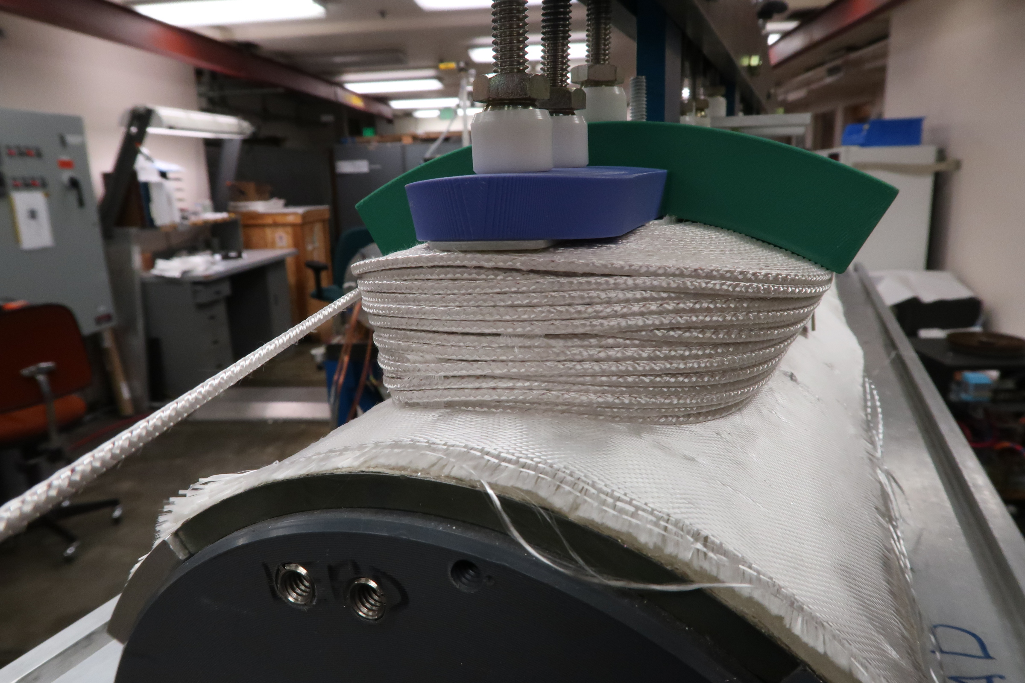
Prototype coil winding completed
Prototype coil winding completed on 11/21/2024.
Return end
Lead end

Slide 5
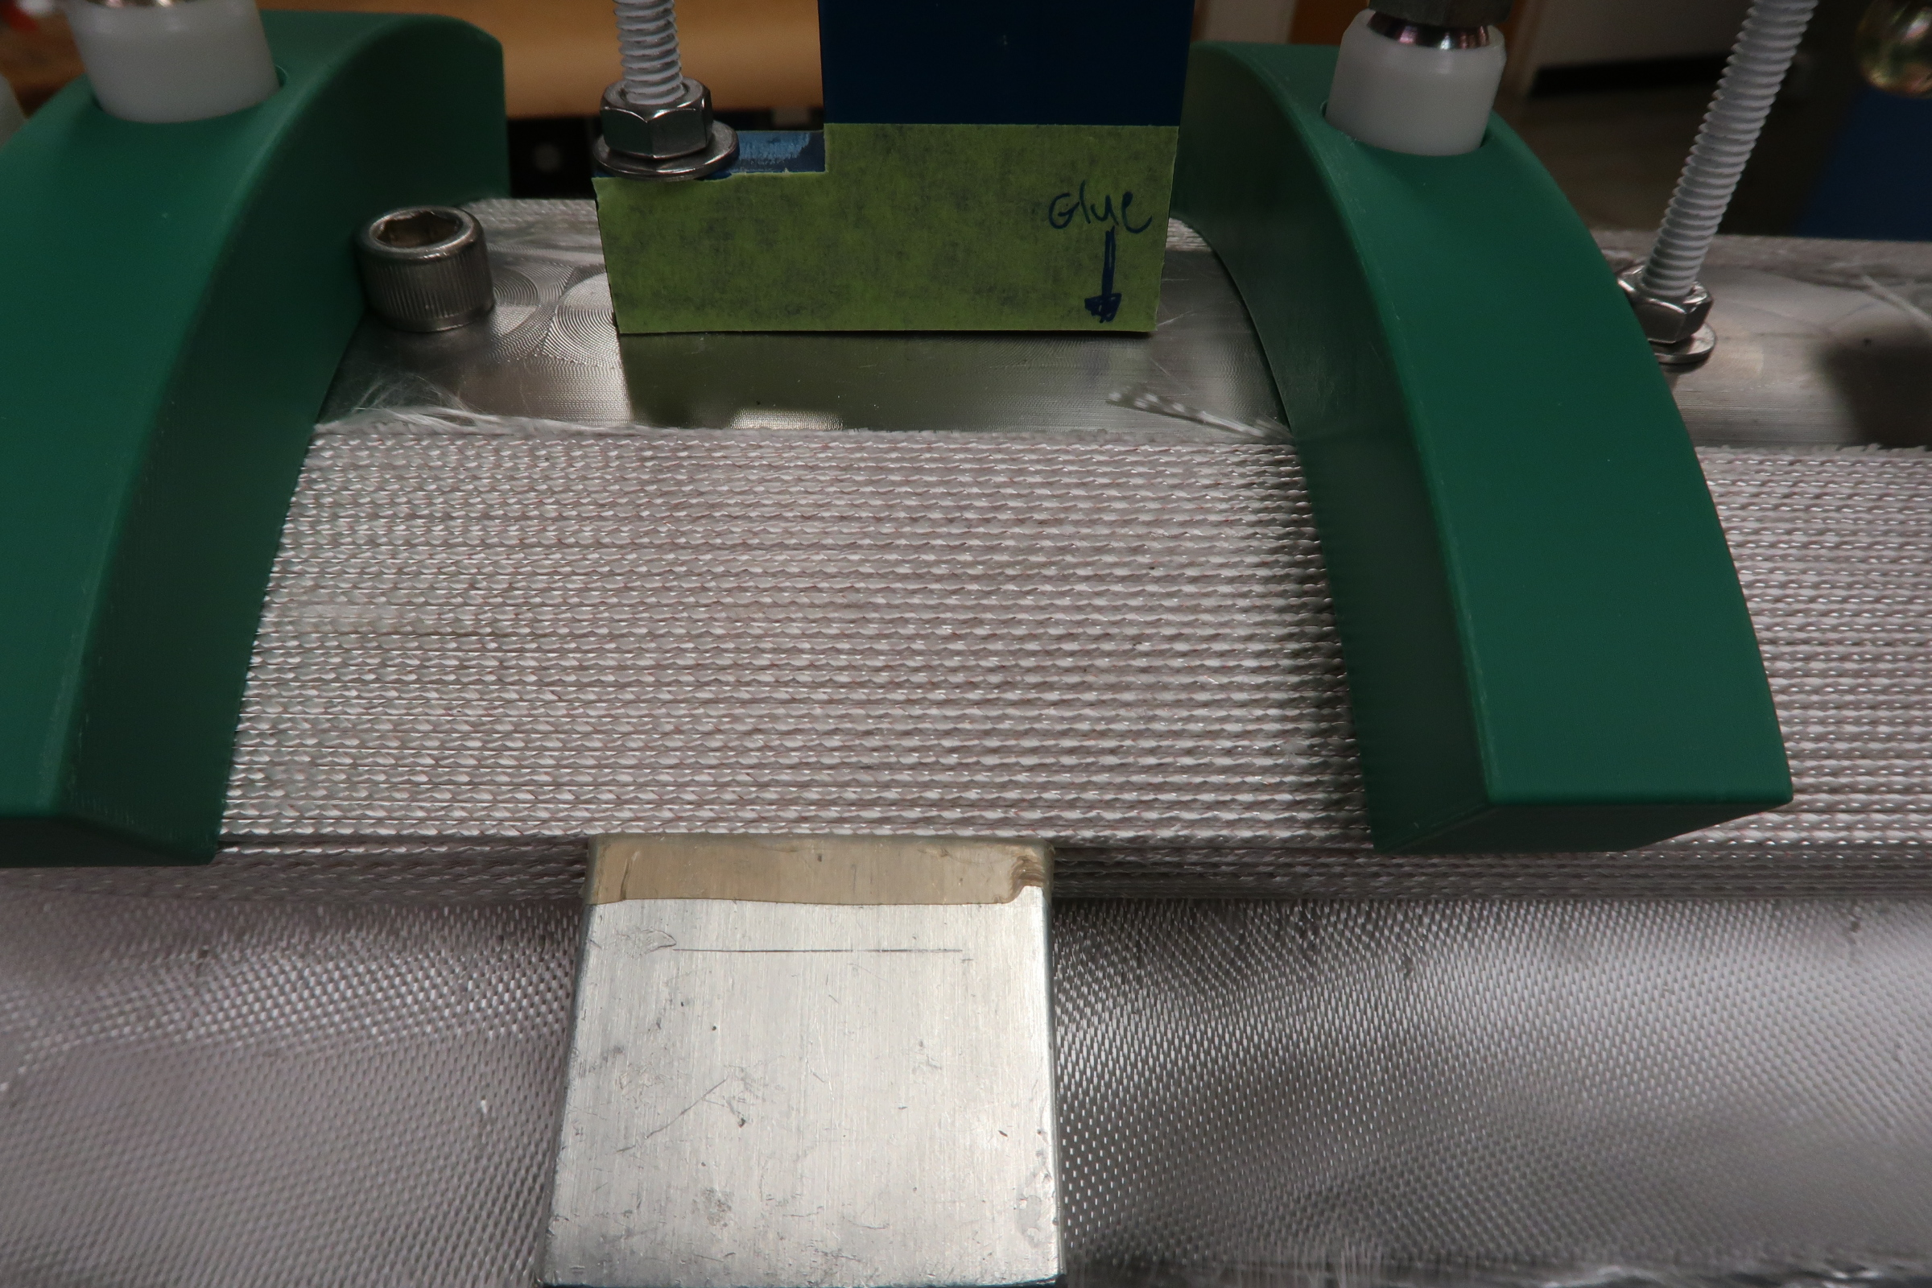
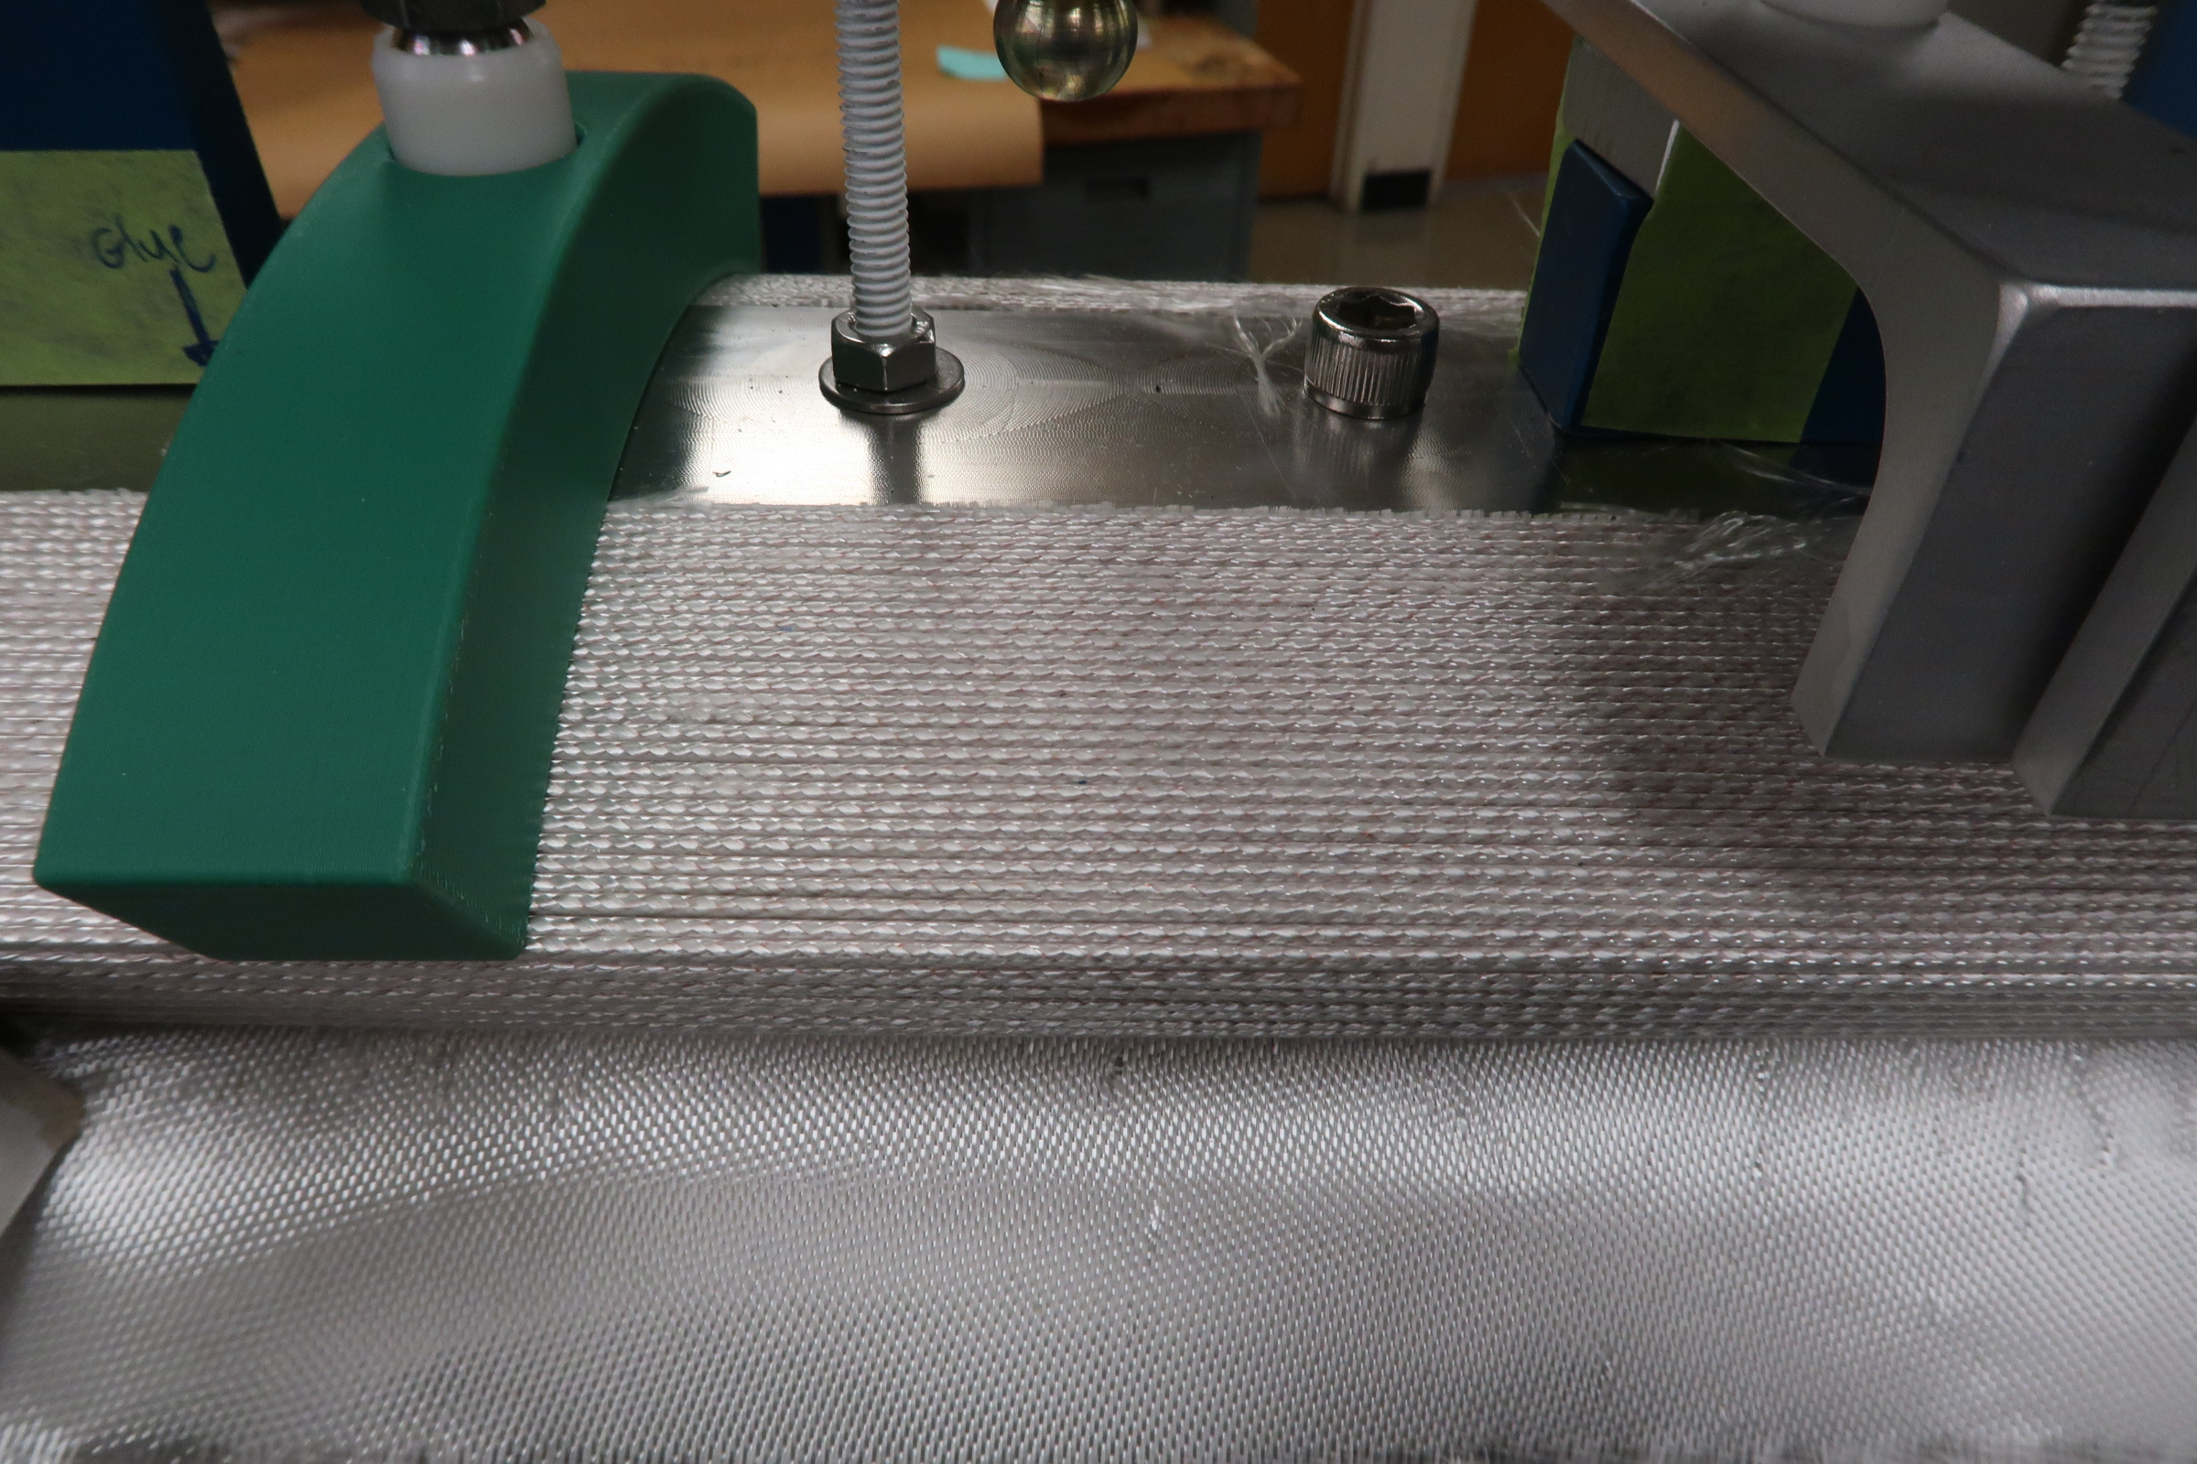
Prototype coil winding completed

Slide 6
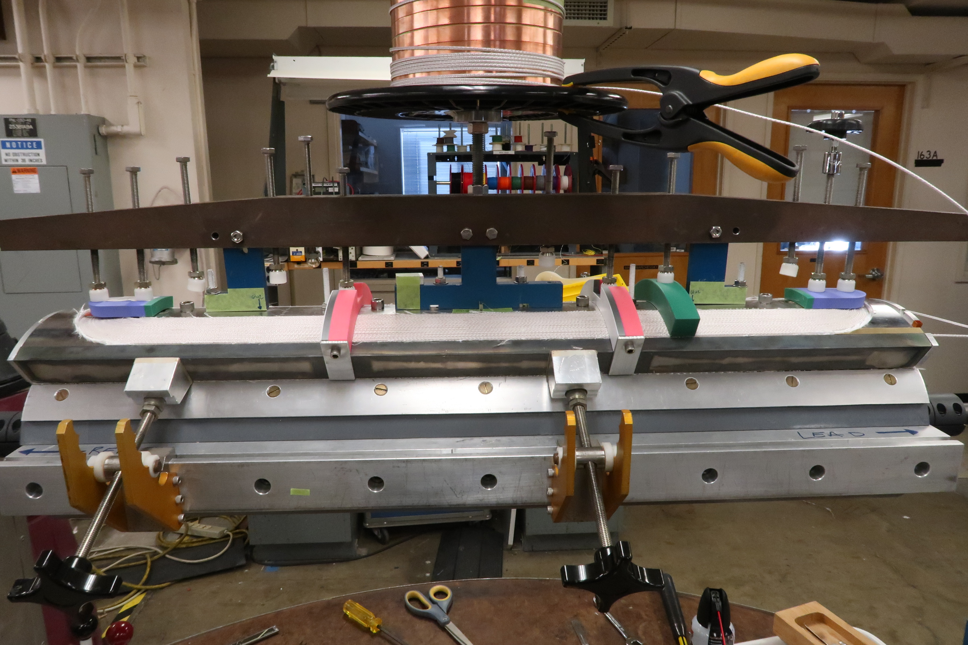
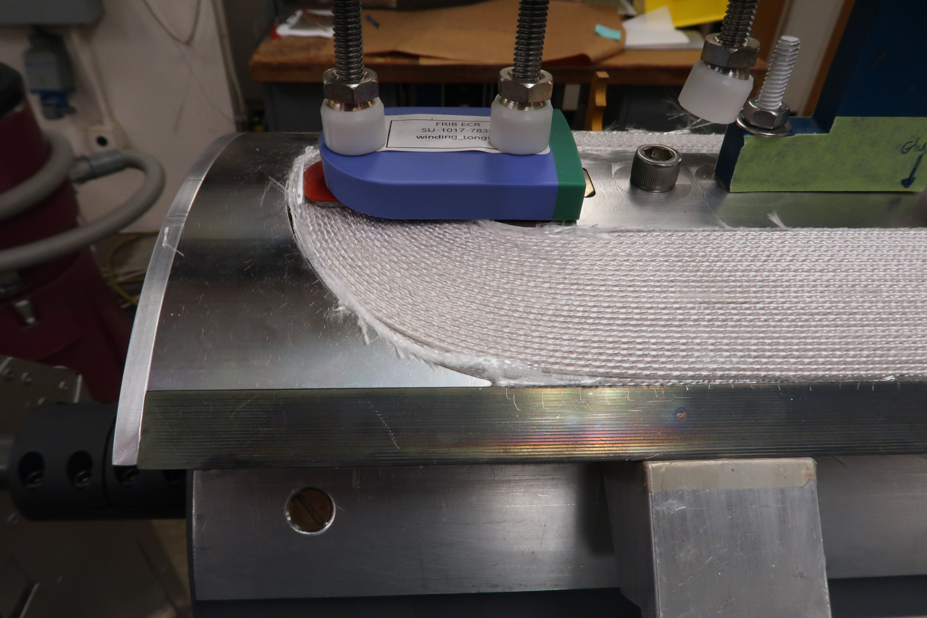
Coil being prepared for reaction
Issue – practical winding meets perfect endshoes.
- Gap between endshoes and coil appears.
- Grinding SS more difficult than grinding Aluminum.
Temporary solution: Add S-2 fiber glass.

Slide 7
Explore potential long-term solutions
Develop 3D models of end shoes from survey data for better fit?

Slide 8
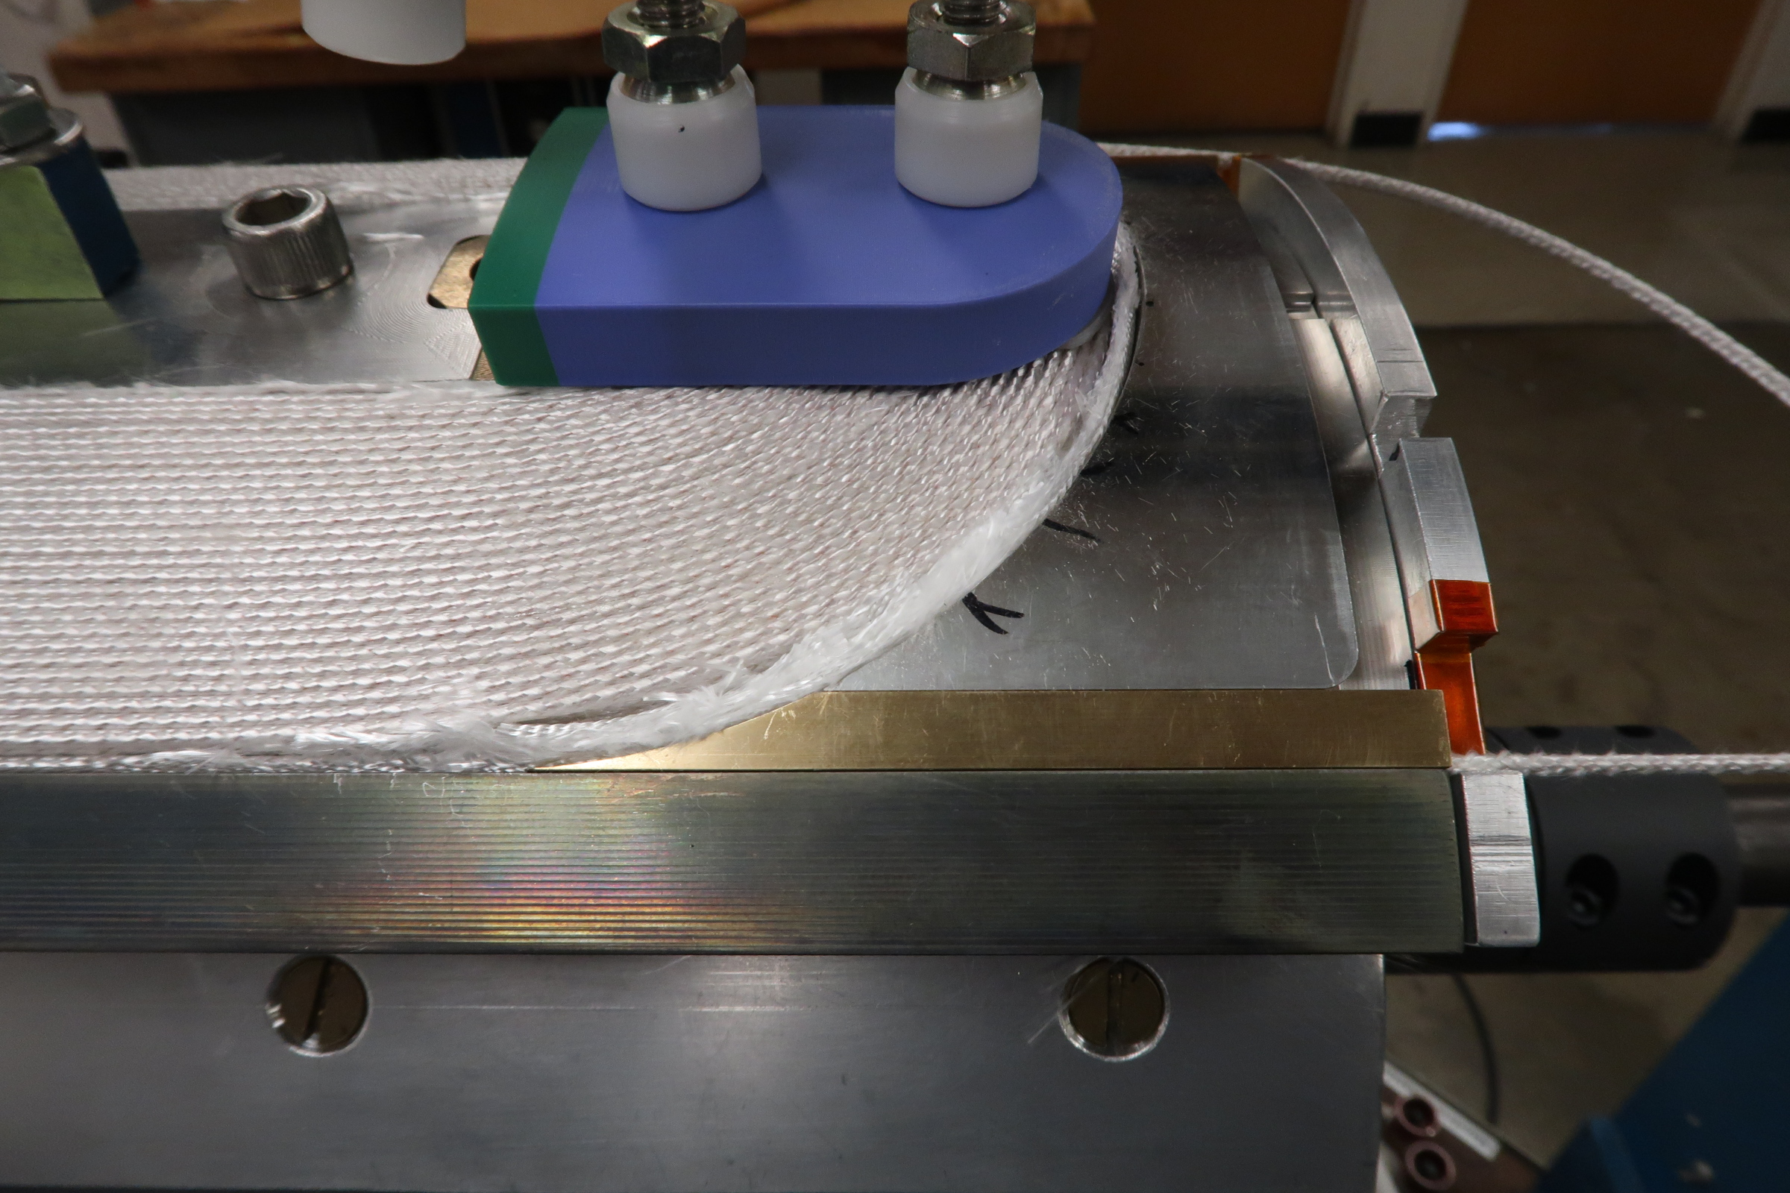
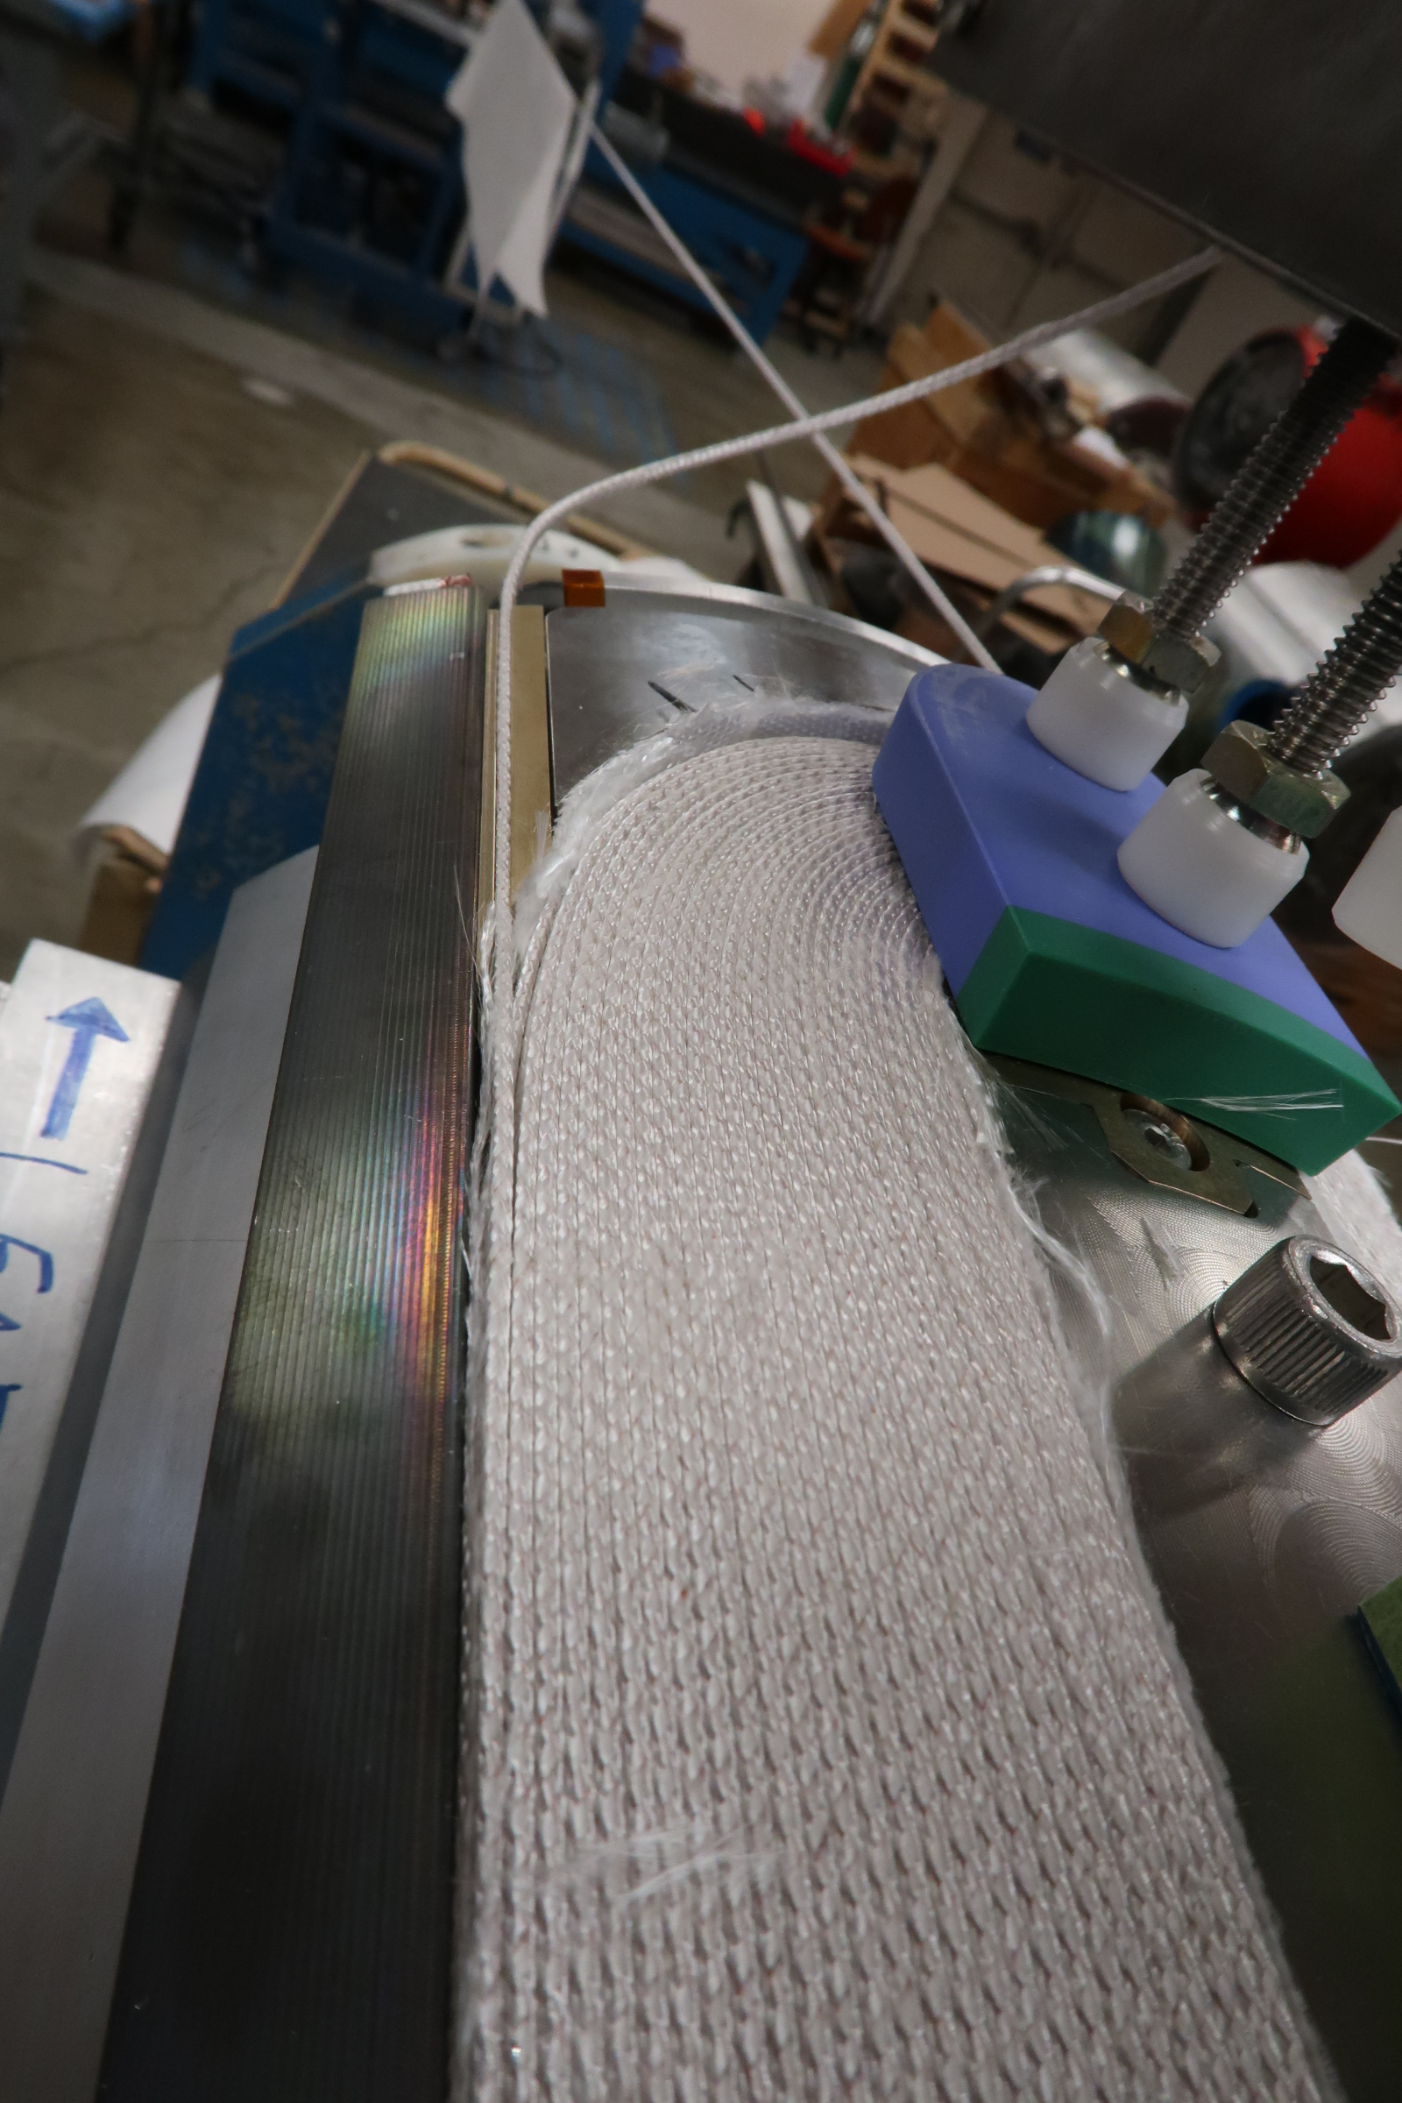
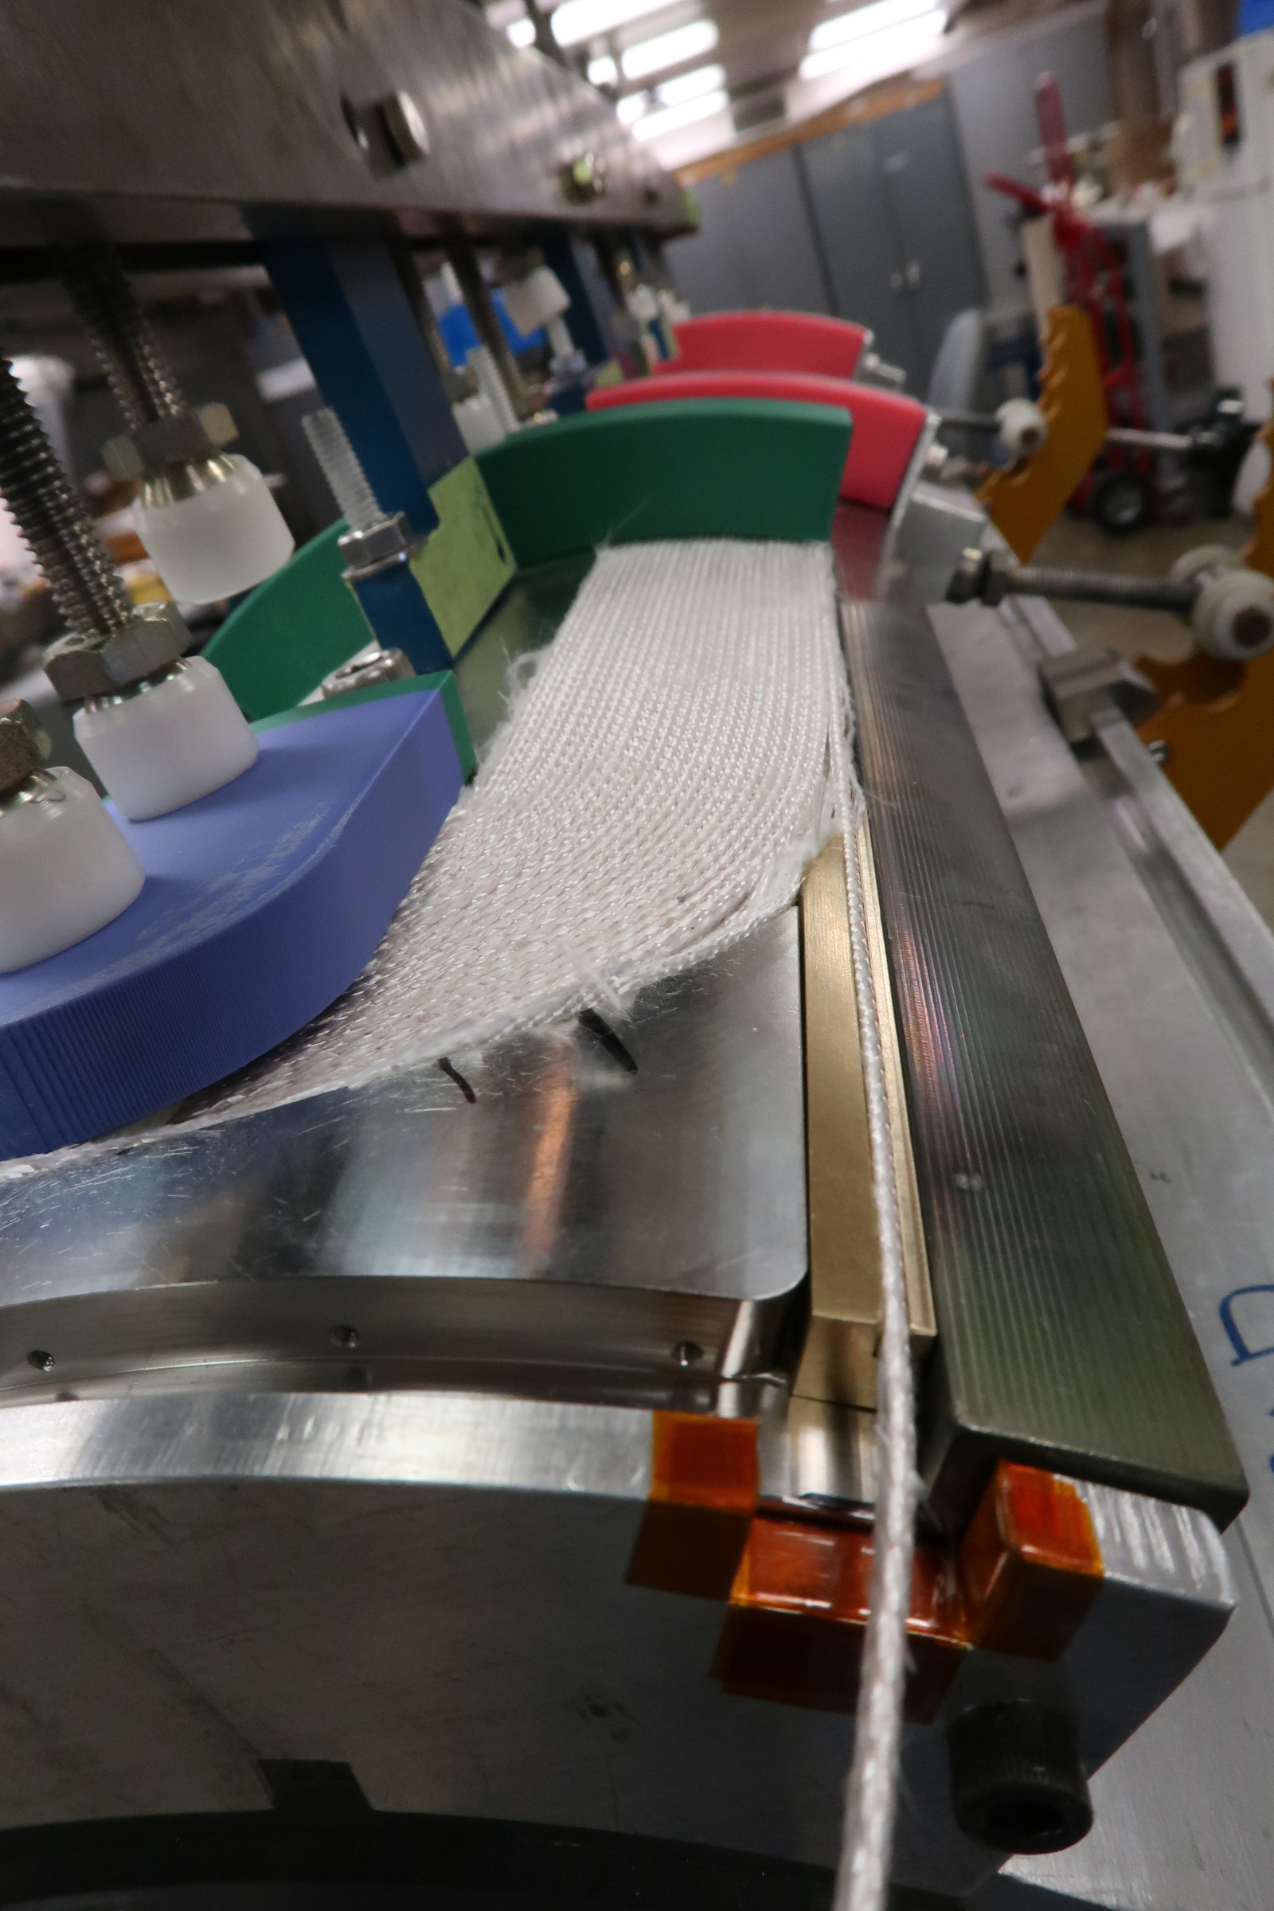
Coil being prepared for reaction – leads region preparation
A critical region due to the brittleness of Nb₃Sn after reaction.

Slide 9
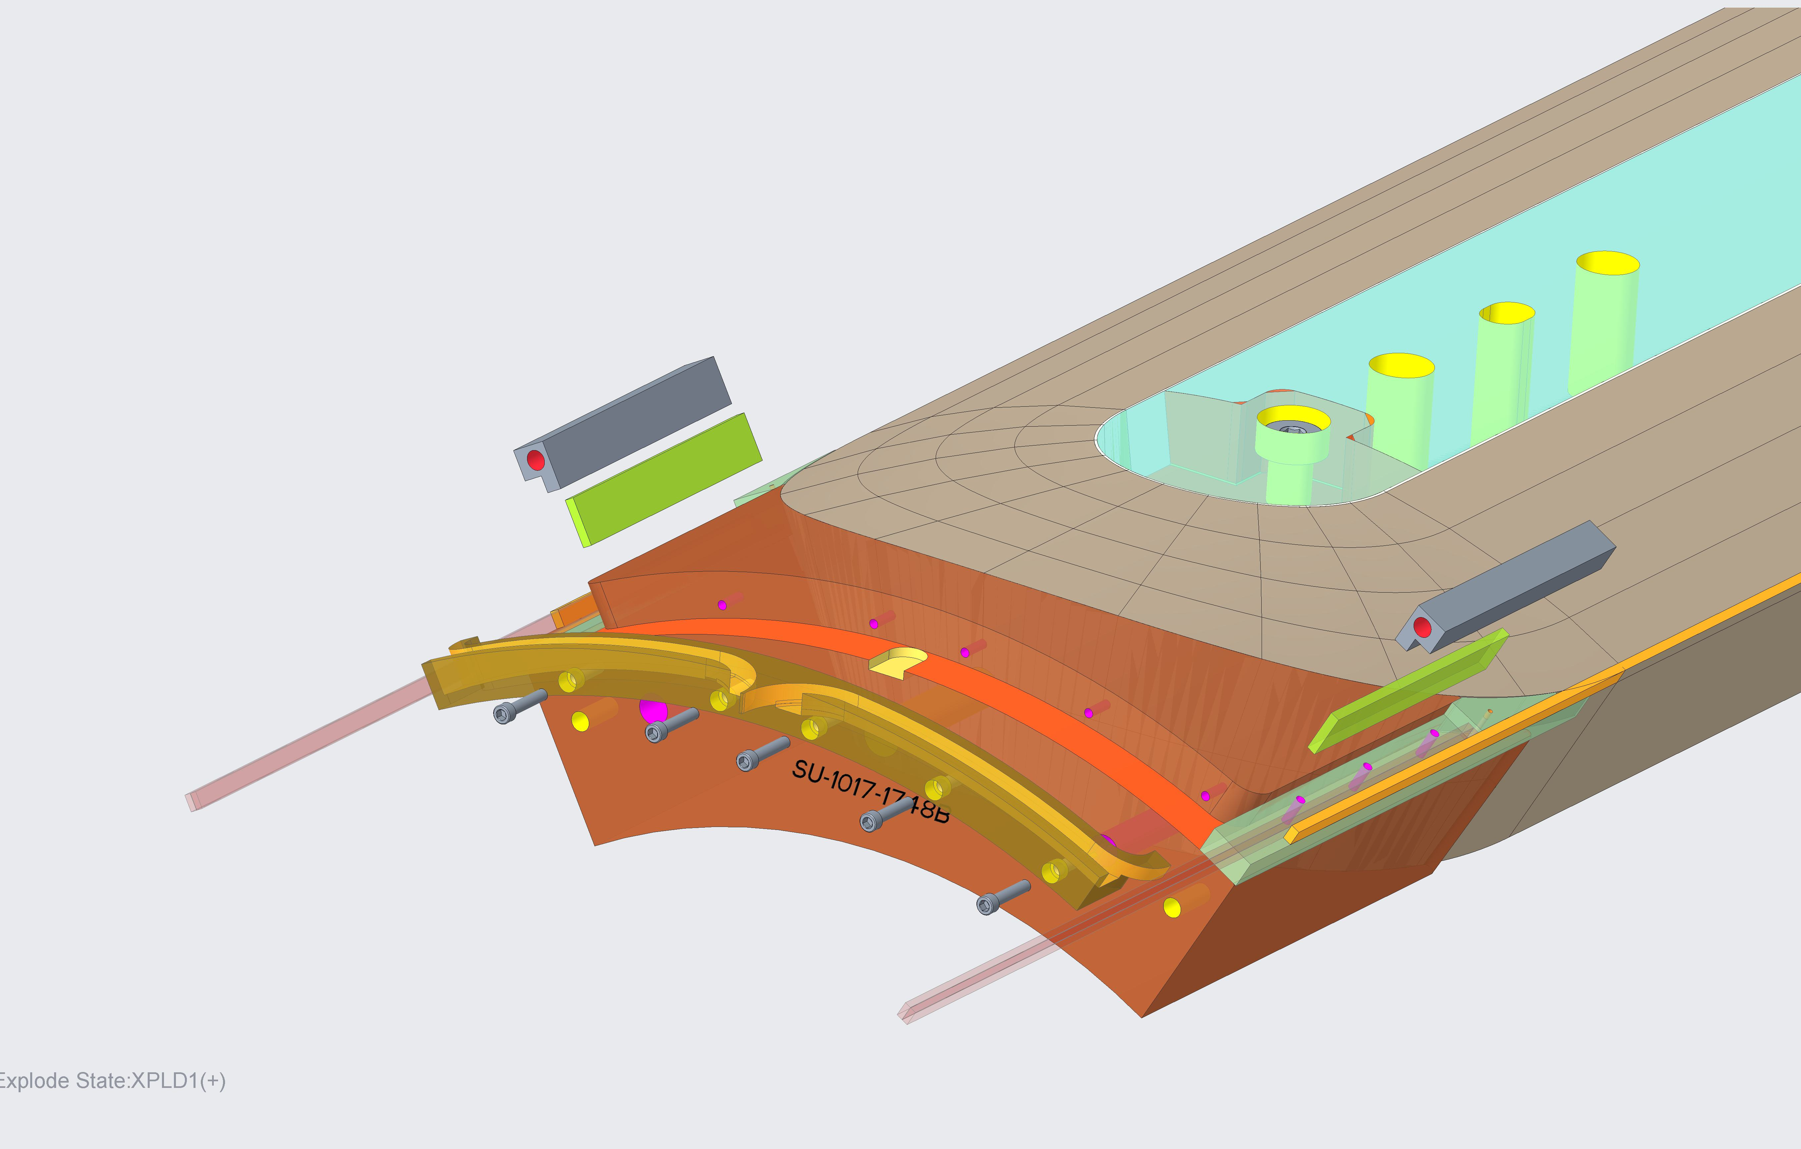
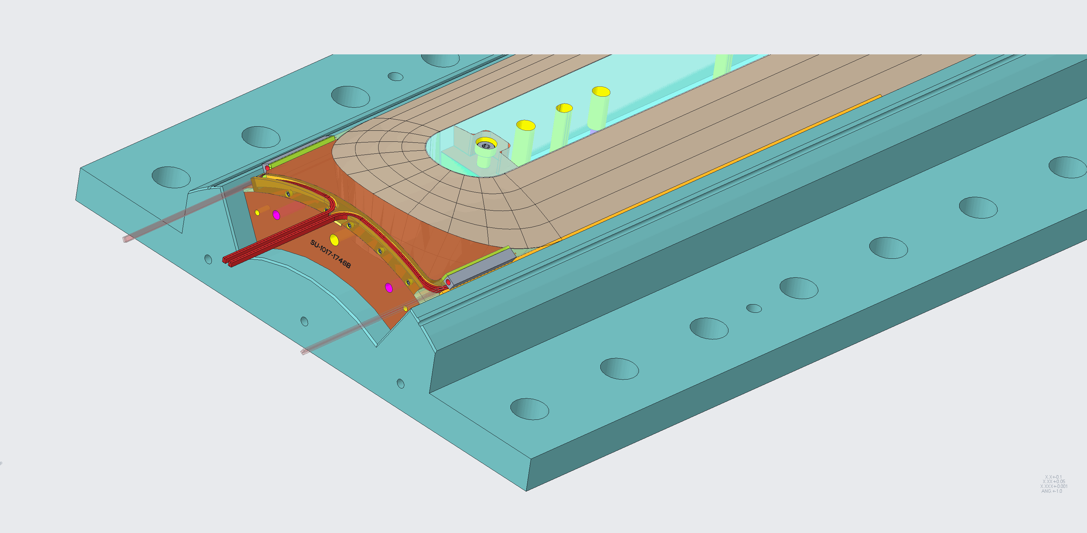
Splicing procedures being practiced and checked.
All parts for splicing have been fabricated.
Practice splicing technique and check soundness of parts, tooling,

Slide 10
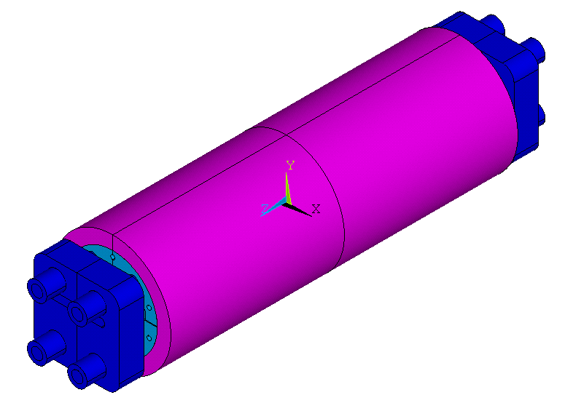
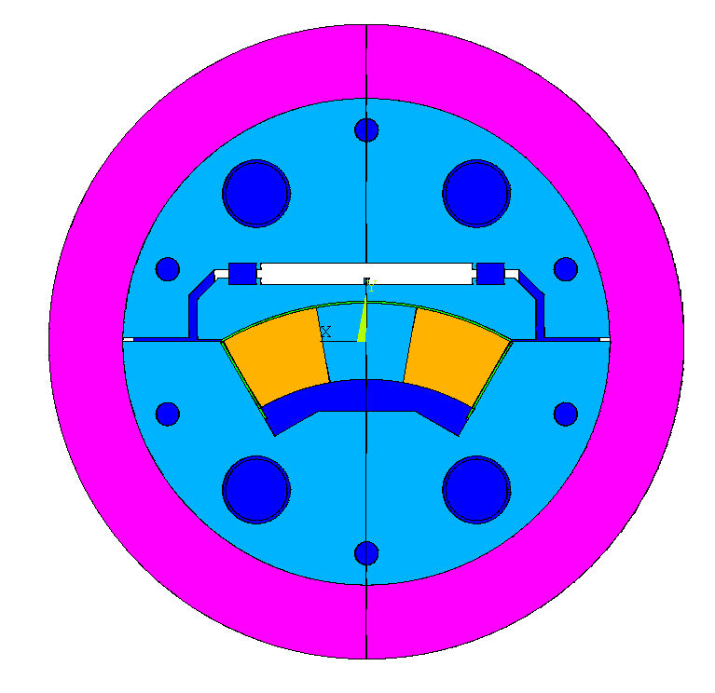
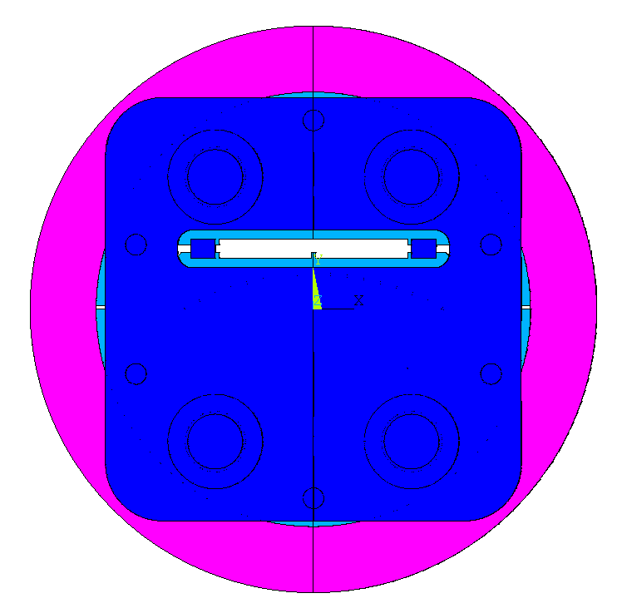
Mirror magnet mechanical model finalized
Ye Yang et al.
63.5mm
35mm

Slide 11
Mirror magnet assembly procedure formulated
Ye Yang et al.
Apply the axial preload
Pull the axial load and push the end plate 0.32mm x 2 in
Open the gap by the bladders
Bladder pressure, 25MPa
Key insertion
Key thickness, 175µm
Release the bladder pressure
Apply the final axial preload
Pull the axial load and push the end plate 0.38mm x 2 in further
Total interference between the nut and the end plate, 0.70mm x 2

Slide 12
Loading assembly in production
Philip Mallon, Ryan Norris, Lianrong Xu et al.
Shell, upper yoke and bottom yoke released for fabrication.
SS end plates, pushers, spacers are released for fabrication.
To be released for fab: 1) load pad, 2) axial rods, 3) key and shim assemblies.

Slide 13
Goals next four weeks
Complete preparation of prototype coil for heat treatment:
Heat treatment of prototype coil.
Complete mirror magnet assembly component fabrication.
- Axial rods.
- Load pad.
- Key and shim assemblies.
Initialize to outline tasks, estimate costs for the next phase, a full ECR magnet cold mass construction project.

