Slide 1
Can we detect signs of training in solenoids? If so, what can we learn from them? Part one: Solenoid fabrication
By: Charlie Sanabria
and Sofía Jiménez Viñolo

Slide 2
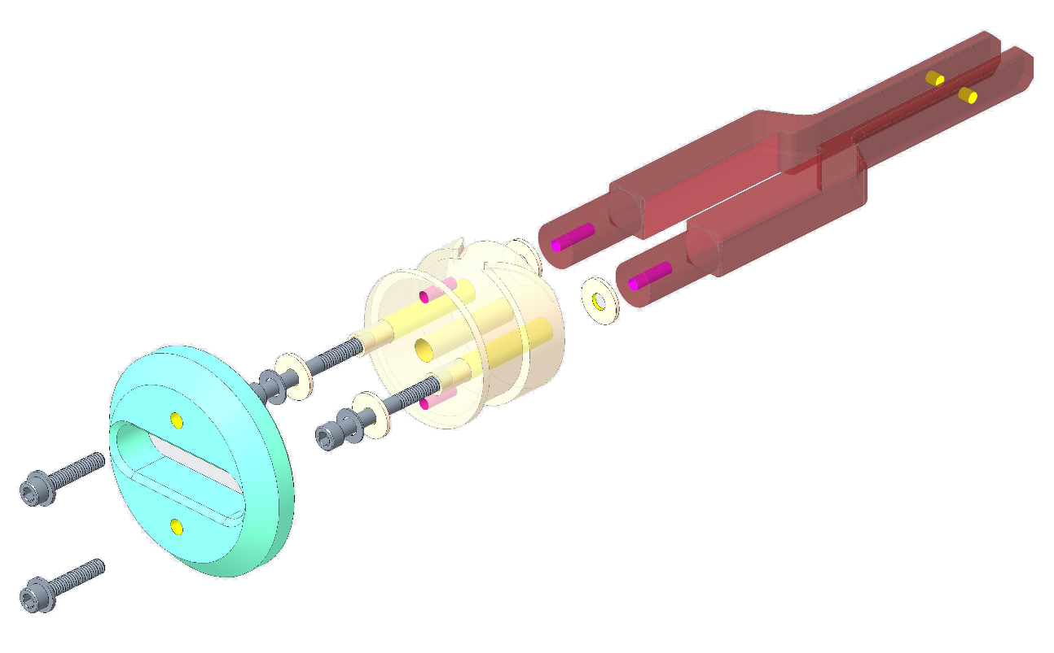
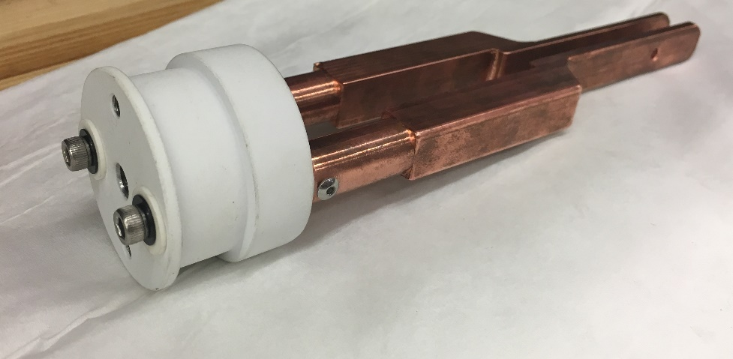
First Prototype
Drawing prepared by
Ray Hafalia
Alumina-coated Stainless steel mandrel
38.1 mm
$$α=\frac{a_{2}}{a_{1}}=1.14$$
OFHC Cu current leads
$$β=\frac{b}{a_{1}}=0.39$$
Alumina washers
45.47 mm
Centering cone (G-10) for testing
a₂ = 21.70 mm
a₁ = 19.05 mm
Wire + insulation Ø = 0.73 mm
2b = 14.65 mm
Expected number of turns = 20 x 4 = 80
Wire length ≈ 10.24 m
Notes:
Boron nitride sheets?

Slide 3
Wire properties and stress calculations
“Medium J_{c}” RRP wire critical current (bold values provided by vendor).
B (T) | I_{c} (A)
8* | 504
9* | 420
10* | 349
11* | 289
12 | 238
13 | 194
14 | 156
a₂ = 21.70 mm
Hoop stress $σ=J∙B∙r$
a₁ = 19.05 mm
B (T) | Stress on OD (MPa) | Stress on ID (MPa)
8 | 177 | 155
9 | 166 | 146
10 | 153 | 134
11 | 140 | 122
12 | 126 | 110
13 | 111 | 97
14 | 96 | 84
2b = 14.65 mm
“Medium J_{c}” RRP wire properties
Diameter | 0.6 mm
Non-Cu% | 56.5%
Average RRR | 200
Wire purchased by ASC
*
Extrapolated using the Pong-Ekin scaling spreadsheet
Notes:
Boron nitride sheets?

Slide 4
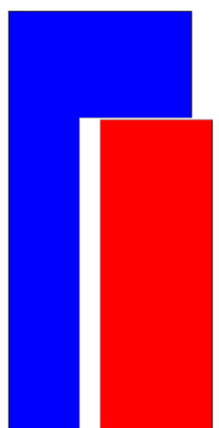
Stress calculations at 9 T
a₂ = 21.70 mm
Hoop stress
a₁ = 19.05 mm
Displacement
ID
OD
2b = 14.65 mm
Sliding surface
146 MPa
172 MPa
72.1 µm
Simulations by L. Brouwer

Slide 5
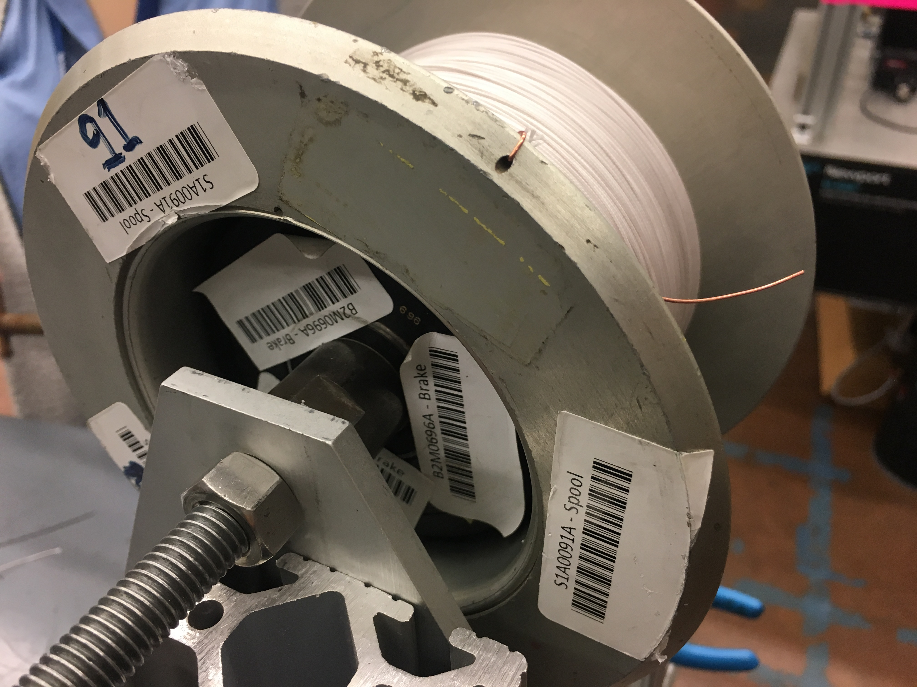
Winding (1 of 4)
Magnetic break inside aluminum payoff spool.
Back tension constant and capable of unwinding.
2.75 lbs. of tension.
Payoff spool
Magnetic break

Slide 6
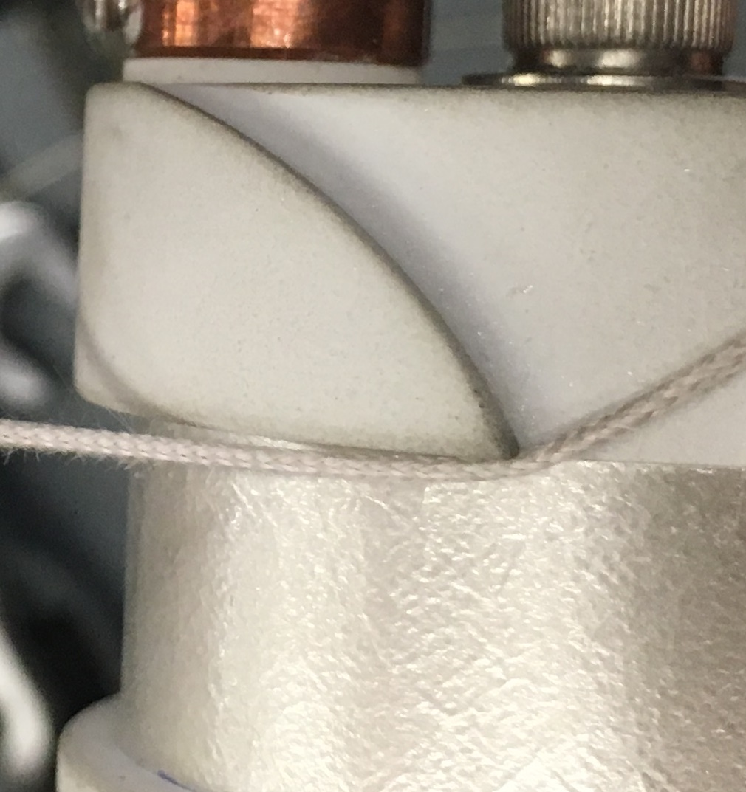
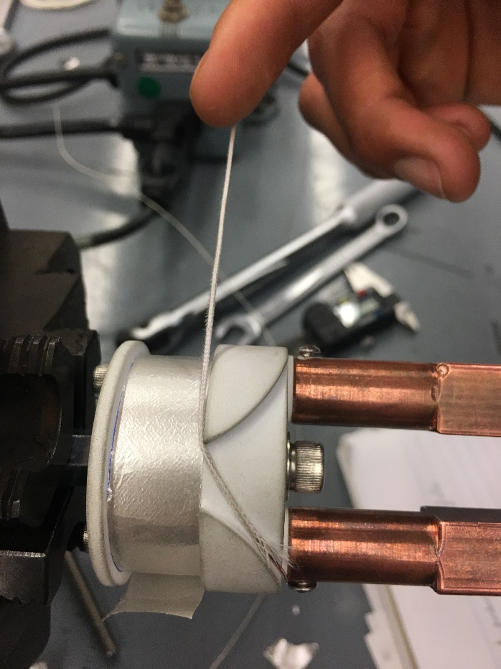
Winding (2 of 4)
March 6th 2019
Sharp turn.
Mica
layer

Slide 7
Winding (3 of 4)
8 mm x 5 mm mica pieces

Slide 8
Winding (4 of 4)
Winding speed: ~3.7 RPM
number of turns: 18, 17, 17, 17
Acoustic sensor will go on top of the mandrel
No voltage taps between layers
One pair of voltage taps will be added after HT.

Slide 9
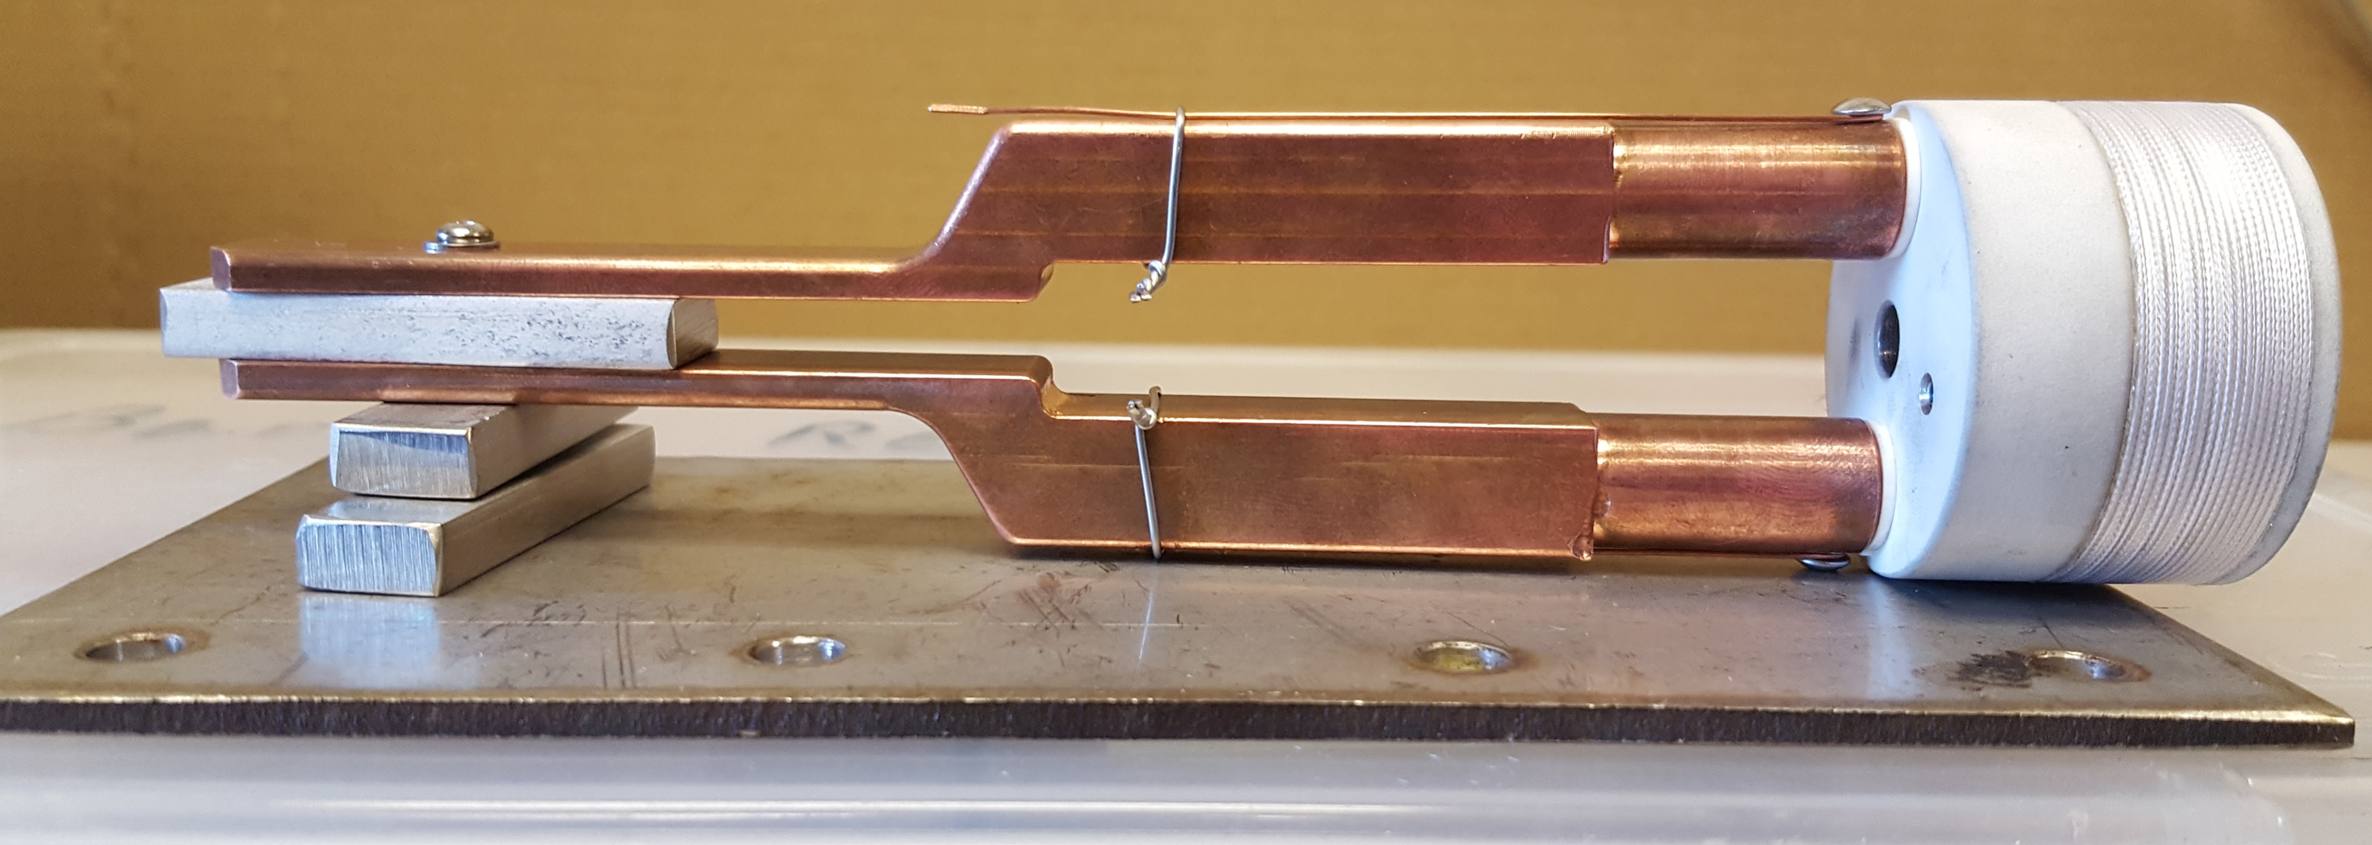
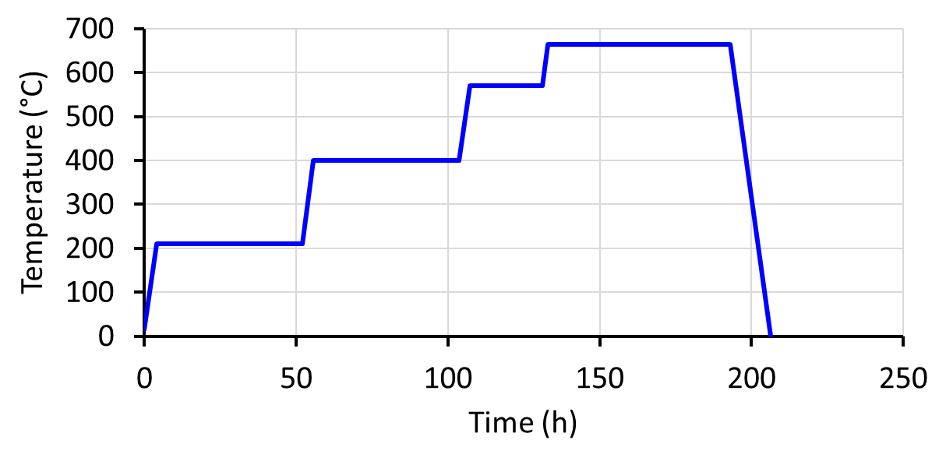
Heat treatment (1 of 2)
Standard “Medium J_{c}” RRP heat treatment.
665°C
570°C
400°C
210°C
Wrapped with a fiberglass sheet.
Inside tube furnace with flowing argon.
Recipe:
210°C/48h + 400°C/48h + 570°C/24h + 660°C/50h
Starting date: Friday 8th, 2019

Slide 10
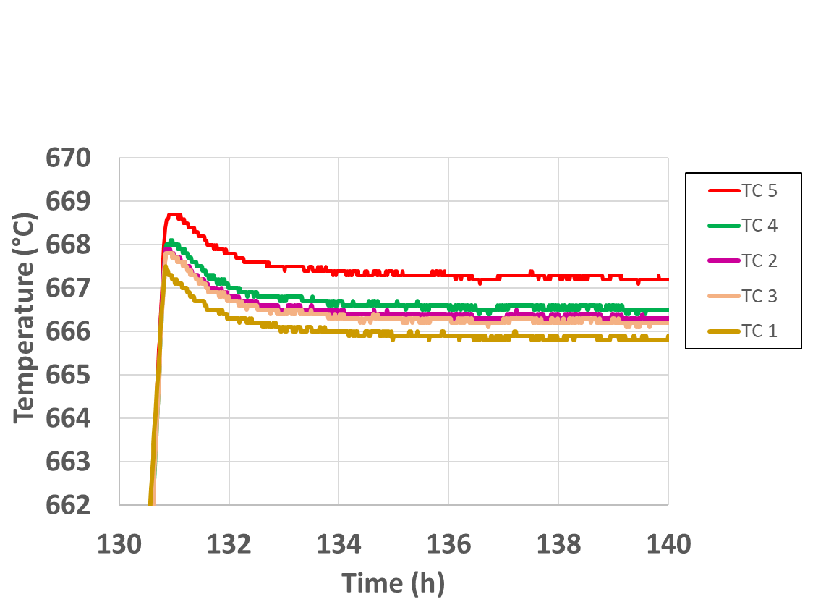
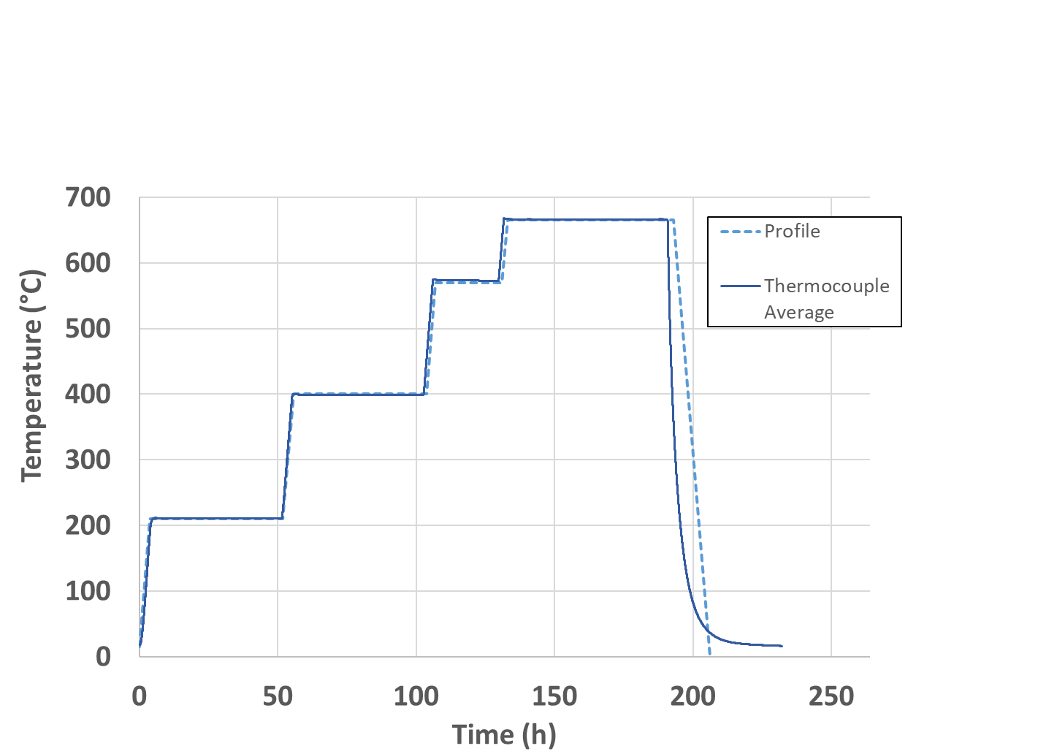
After heat treatment (2 of 2)
Actual measurement [units] | Value
Ramp Rate to 210°C [°C/h] | 44.5
210°C temperature [°C] | 210.8
Time at 210°C [h] | 47.3
Ramp Rate to 400°C [°C/h] | 53.3
400°C temperature [°C] | 399.2
Time at 400°C [h] | 47.7
Ramp Rate to 570°C [°C/h] | 57.2
570°C temperature [°C] | 573.3
Time at 570°C [h] | 24.0
Ramp Rate to 665°C [°C/h] | 55.0
665°C temperature [°C] | 666.4
Time at 665°C [h] | 59.3

Slide 11
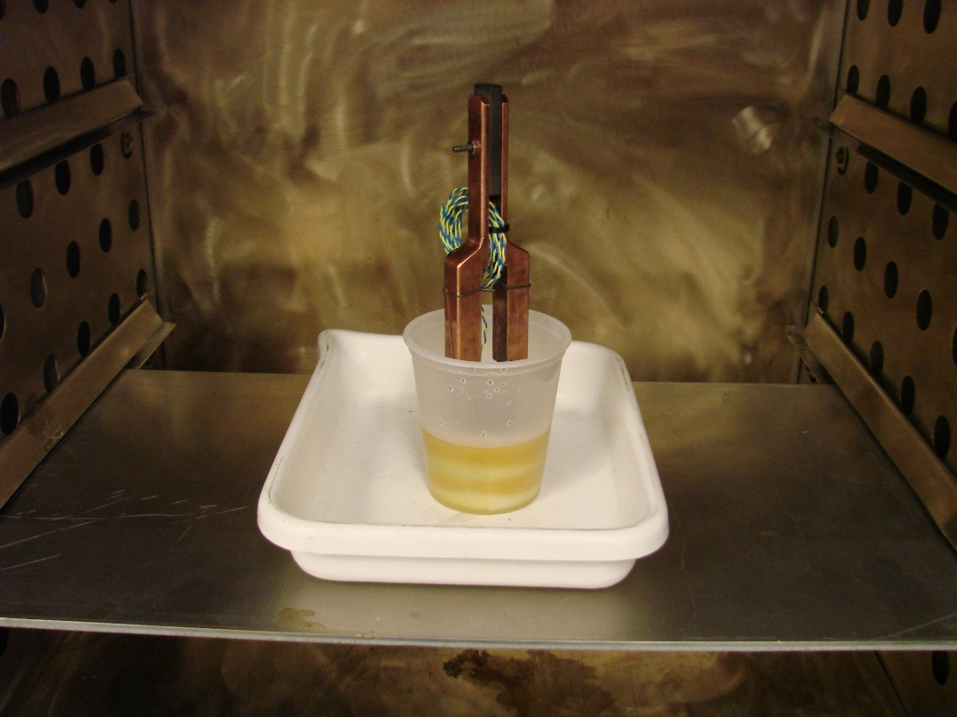
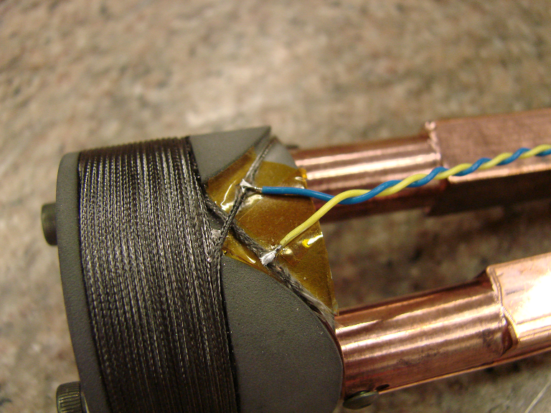
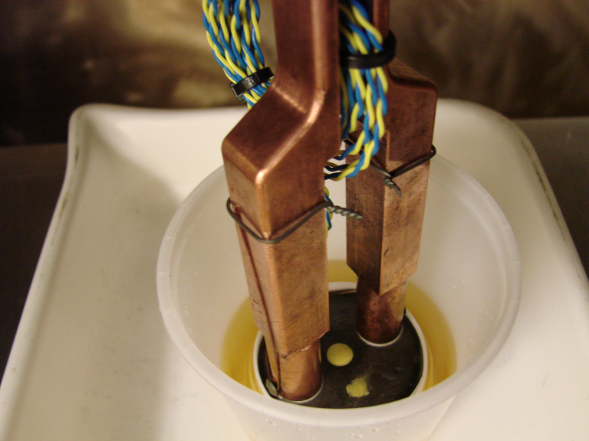
Current status and future plans
Potting and instrumentation in progress.
Testing early April.

Slide 12
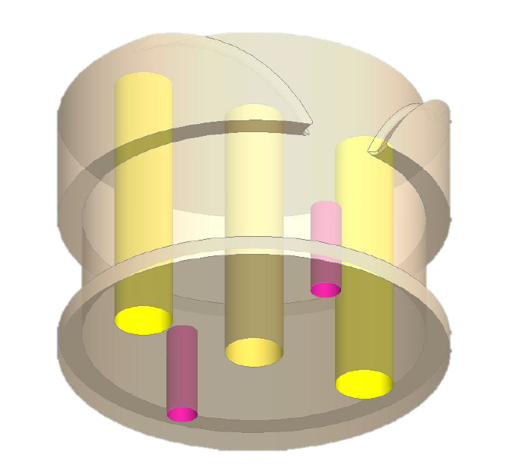
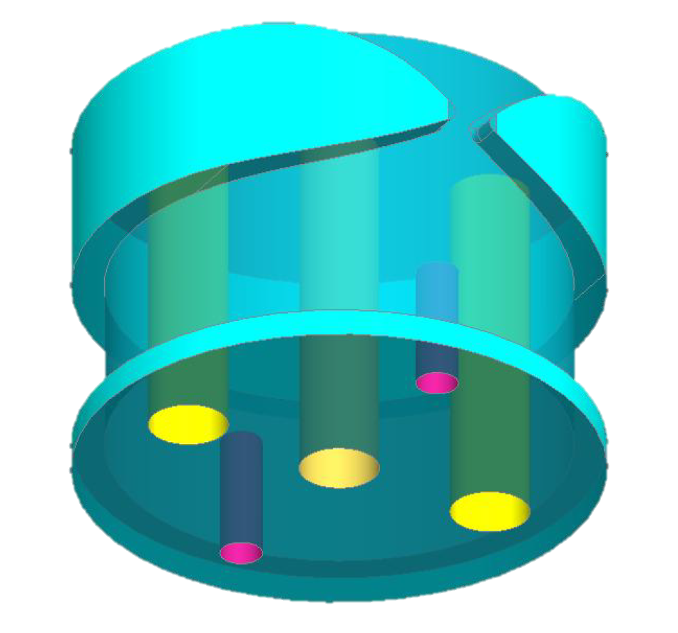
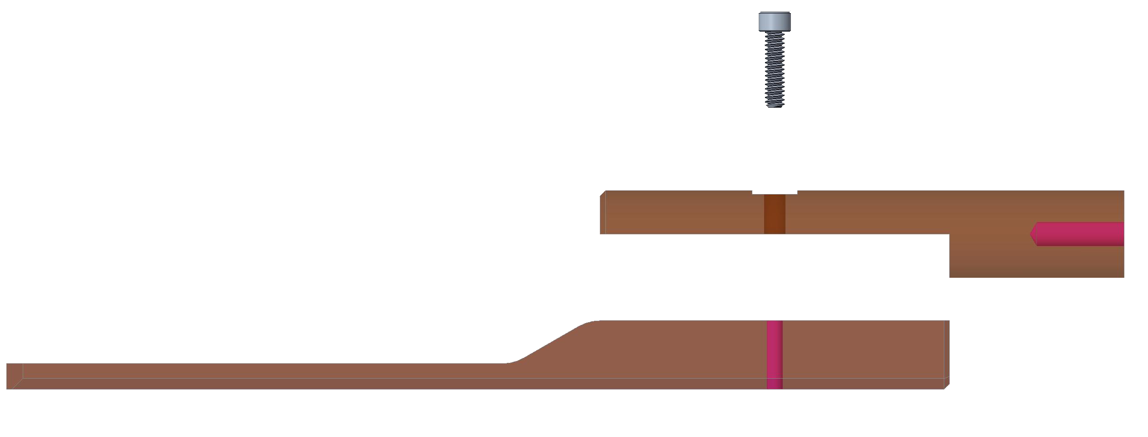
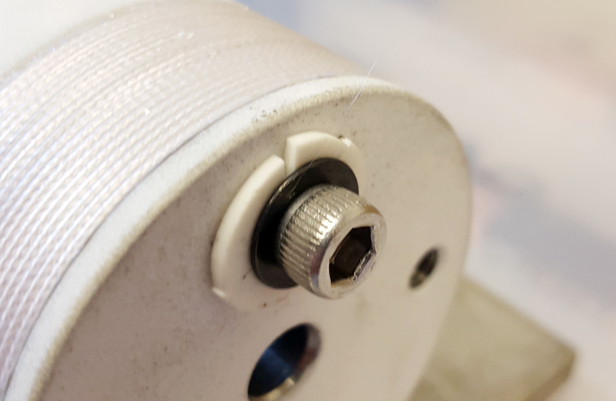
Improvements for next prototype
Interlayer voltage taps… any ideas?
Cost reduction alternatives:
Leads can be broken in two pieces.
Mandrel could be 3D printed.
Target turns were not met. Coating thickness or solenoid dimensions could be adjusted.
New mandrel design
Stronger washers?
Prototype 1
Prototype 2

Slide 13
Names?
STEP coils (Solenoid Training Experimental Project)
SISTER coils (Small Inexpensive Solenoid Training ExpeRiment)
T(r)IPS coils (Training and Interphase Probing Solenoid)
ETCIE coils (Experimental Training Coil Interphase Exploration)
ISETIE coils (Inexpensive Solenoid Experiment for Training and Interphase Exploration)
The little coil that could…

