Slide 1

Unit 5 and 6
Requirements for magnets in accelerators
Ezio Todesco
European Organization for Nuclear Research (CERN)
Technology Department
Magnet Superconductors and Cryostat Group
All the units will use International System (meter, kilo, second, ampere) unless specified

Slide 2
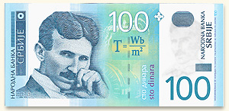
FOREWORD
The science (or the art …) of superconducting magnets is a exciting, fancy and dirty mixture of physics, engineering, and chemistry
  Chemistry and material science: the quest for superconducting materials with better performances
  Quantum physics: the key mechanisms of superconductivity and superfluidity
  Classical electrodynamics: magnet design
  Mechanical engineering: support structures
  Electrical engineering: powering of the magnets and their protection
  Cryogenics: keep them cool …
The cost optimization is a key element
  Keep them cheap …

Slide 3
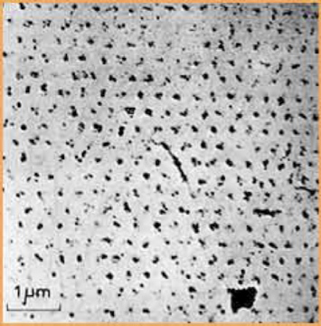
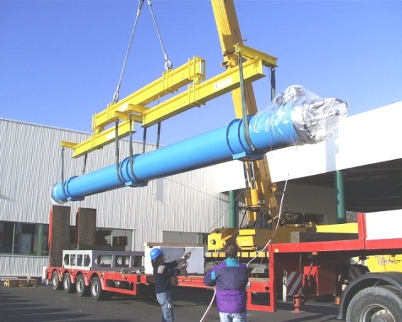
FOREWORD
An example of the variety of the issues to be taken into account
  The field of the LHC dipoles (8.3 T) is related to the critical field of Niobium-Titanium (Nb-Ti), which is determined by the microscopic quantum properties of the material
  The length of the LHC dipoles (15 m) has been determined by the maximal dimensions of (regular) trucks allowed on European roads
This makes the subject complex, challenging and complete for any physicist or engineer who has the chance of working in this field
Quantized fluxoids penetrating a superconductor used in accelerator magnets
A 15m truck unloading a 27 tons LHC dipole

Slide 4
AIM OF THE LECTURES
Superconducting magnets for particle accelerators are a vaste domain
These lectures will be especially focused on magnets for colliders, with a special eye on the CERN high energy infrastructures
  The Large Hadron Collider, 27 km tunnel with 8.3 T magnets based on Nb-Ti (CERN-2004-0039, the blue book)
  The HL-LHC, upgrade in luminosity of the LHC based on Nb3Sn quadrupole – ongoing project with installation foreseen in 2025 (CERN-2017-007)
  We will give some examples for the studies related to FCC (Future Circular Colliders)
    A ∼100 TeV collider based on a ∼16 T Nb₃Sn dipole in a ∼100 km tunnel (CERN-ACC-2018-058)

Slide 5
CONTENTS
Principles of synchrotron
How to keep particles on a circular orbit
  Relation between energy, dipolar field, machine length
The beam size and principles of focusing
  Aperture requirements for arc dipoles and arc quadrupoles
  Gradient requirements for arc quadrupoles
The beam size in the interaction regions
Some examples
Conclusions
Reference: https://indico.cern.ch/category/12408/ Units 1 and 2 (see also the attached notes Chapter1 and Chapter2)

Slide 6
PRINCIPLES OF A SYNCHROTRON
Electro-magnetic field accelerates particles
Magnetic field steers the particles in a ∼circular orbit
  Driving particles in the same accelerating structure several times
  Particle accelerated → energy increased → magnetic field increased (“synchro”) to keep the particles on the same orbit of curvature ρ
Limits to the increase in energy
  The maximum field of the dipoles (proton machines)
    This is why high field magnets are important to get high energies!
    Paradox: B does not accelerate but limits the energy
  The synchrotron radiation due to bending trajectories (electron machines) – ignored in these lectures
Constant

Slide 7
PRINCIPLES OF A SYNCHROTRON
Colliders: two beams with opposite momentum collide
  This doubles the energy !
  One pipe if particles collide their antiparticles (LEP, Tevatron)
  Otherwise, two pipes (ISR, RHIC, HERA, LHC)

Slide 8
PRINCIPLES OF A SYNCHROTRON
The arcs: region where the beam is bent
  Dipoles for bending
  Quadrupoles for focusing
  Correctors
Long straight sections (LSS)
  Interaction regions (IR) where the experiments are housed
    Quadrupoles for strong focusing in interaction point
    Dipoles for beam crossing in two-ring machines
  Regions for other services
    Beam injection (dipole kickers)
    Accelerating structure (RF cavities)
    Beam dump (dipole kickers)
    Beam cleaning (collimators)
LHC: 27.6 km of tunnel, 20.5 km in the arcs, 7.2 km in the insertions
A schematic view of a synchrotron
The lay-out of the LHC

Slide 9
CONTENTS
Principles of synchrotron
How to keep particles on a circular orbit
  Relation between energy, dipolar field, machine length
The beam size and principles of focusing
  Aperture requirements for arc dipoles and arc quadrupoles
  Gradient requirements for arc quadrupoles
Some examples
Conclusions

Slide 10
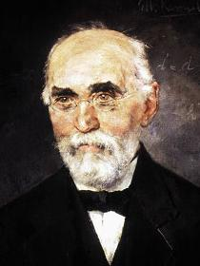
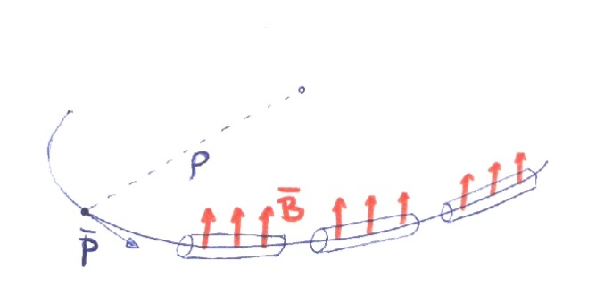
HOW TO KEEP PARTICLES ON A CIRCLE
Kinematics of circular motion
Relativistic dynamics
Lorentz (?) force
Putting all together
  Hyp. 1 - longitudinal acceleration<<transverse acceleration
Hendrik Antoon Lorentz, Dutch
(18 July 1853 – 4 February 1928), painted by Menso Kamerlingh Onnes, brother of Heinke

Slide 11
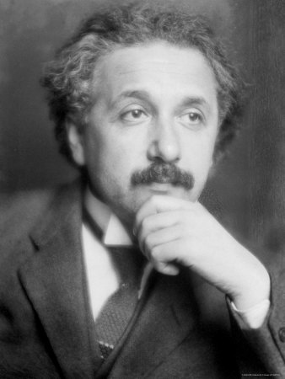
A DIGRESSION ON “RELATIVISTIC MASS”
Note: in several books
  The mass is called the rest mass
  A new relativistic mass is defined
  So that the momentum is still defined as
  This is why you see in several texts that accelerating corresponds to increase the mass (?)
    This is a rather controversial intepretation of the formalism
    Einstein was not in favour of it – I will follow his advice
“It is not good to introduce the concept of the mass of a moving body for which no clear definition
can be given. It is better to introduce no other mass concept than the ’rest mass’ m. Instead of introducing
M it is better to mention the expression for the momentum and energy of a body in motion.”
— Albert Einstein in letter to Lincoln Barnett, 19 June 1948 (quote from L. B. Okun (1989), p. 42^{[1]}
    Other authors against this concept
  "The concept of "relativistic mass" is subject to misunderstanding. That's why we don't use it. First, it applies the name mass - belonging to the magnitude of a 4-vector - to a very different concept, the time component of a 4-vector. Second, it makes increase of energy of an object with velocity or momentum appear to be connected with some change in internal structure of the object. In reality, the increase of energy with velocity originates not in the object but in the geometric properties of spacetime itself."^{[18]}
  E. F. Taylor, J. A. Wheeler (1992), Spacetime Physics, second edition, New York: W.H. Freeman and Company, ISBN 0-7167-2327-1
Albert Einstein, German
(14 March 1879 – 18 April 1955)

Slide 12
RELATION BETWEEN
GAMMA, VELOCITY AND ENERGY
What are the ranges of velocity obtained in particle accelerators?
  From 10⁻⁴ to 10⁻¹¹ from the speed of light !
    Please note e⁻ in LEP (100 GeV) go faster than p⁺ in LHC (7 TeV)
    This happens since 7000/100 < 2000, ie the ratio between p and e mass

Slide 13

HOW TO KEEP PARTICLES ON A CIRCLE
Preservation of 4-momentum
  Rest energy
  Hyp. 2 Ultra-relativistic regime
  Using practical units for particle with charge as electron, one has
  magnetic field in Tesla …
    Remember 1 eV=1.602×10⁻¹⁹ J
    Remember 1 e= 1.602×10⁻¹⁹ C

Slide 14
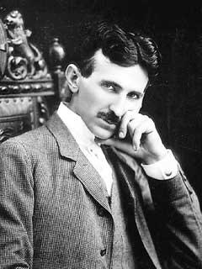
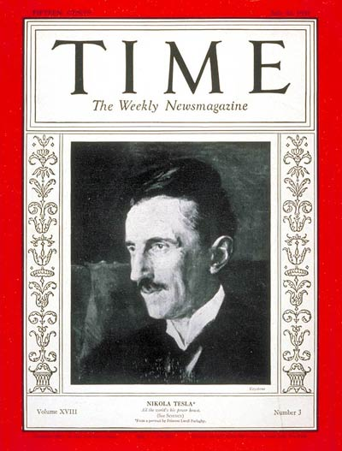
TESLA DIGRESSION
Nikolai Tesla (10 July 1856 - 7 January 1943)
  Born at midnight during an electrical storm in Smiljan
  near Gospić (now Croatia)
  Son of an orthodox priest
  A national hero in Serbia
Career
  Polytechnic in Gratz (Austria) and Prague
  Emigrated in the States in 1884
  Electrical engineer
  Inventor of the alternating current induction motor (1887)
  Author of 250 patents
Miscellaneous
  Strongly against marriage
  Considered sex as a waste of vital energy
Tesla, man of the year

Slide 15
ALL YOU HAVE TO KNOW
ABOUT TAYLOR SERIES
For small ε, one has
Example
  α=1 is trivial
  α=2 is a bit less trivial
  For ε=0.01 (1+0.01)²=1.0201 1+2×0.01+ .. = 1.02+ …
  What is neglected? Order of ε², so my result is precise up to 0.0001
Application to relativity
  We find Newton: energy is mv²/2

Slide 16
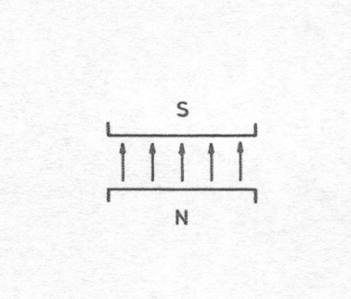
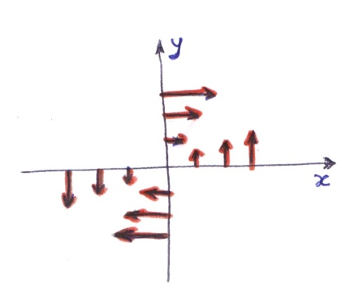
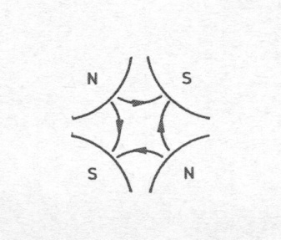
HOW TO KEEP PARTICLES ON A CIRCLE
The magnet that we need should provide a constant (over the space) magnetic field, to be increased with time to follow the particle acceleration
  This is done by dipoles
As the particle can deviate from the orbit, one needs a linear force to bring it back (like a spring)
  We will show in the next section that this is given by quadrupoles

Slide 17
CONTENTS
Principles of synchrotron
How to keep particles on a circular orbit
  Relation between energy, dipolar field, machine length
Requirements for arc dipole and quadrupoles
  Aperture requirements for dipole/quadrupole
  Gradient requirements for quadrupoles
  Some theoretical insight, and some examples
Requirements for interaction region quadrupoles
Conclusions

Slide 18
APERTURE REQUIREMENT IN THE ARC
The aperture (diameter) needed in an arc magnet (dipole or quadrupole) is given by
    A constant accounting φ₀ for the cold bore,
    beam screen, shielding, tolerances …
    A part proportional to the beam size σ (the spread of a Gaussian distribution of the transverse beam) times n (the number of sigma we take, usually more than 15)
  Example: LHC beam size (injection) is σ=1.2 mm (see next slide), we have 56 mm aperture diameter, ∼15 mm for φ₀ and 40 mm for the beam i.e. >15 σ
    Note that initially magnet aperture in LHC was 50 mm and was later enlarged to 56 mm for fears on field quality
Magnet
Cold bore
Beam
(one sigma)
Beam screen

Slide 19
SIZE OF THE BEAM: MAIN DEPENDENCES
Size of the beam is given by
Three relevant dependences:
  ε: emittance [m] invariant along the ring, invariant from ring to ring
    This is a property of the injectors!
  γ_{r} Beam energy: the larger the energy, the smaller the beam
  β is the beta function [m], its square root giving the envelope of the beam along the ring (the sequence of magnets define the beta functions – what is also called beam optics)
  LHC: ε_{n} =3.75 10⁻⁶ m rad
    Beta is 170 m (see next slides)
    High field E=7 TeV, γ=7460, σ=0.29 mm
    Injection E=450 GeV, γ=480, σ=1.2 mm

Slide 20
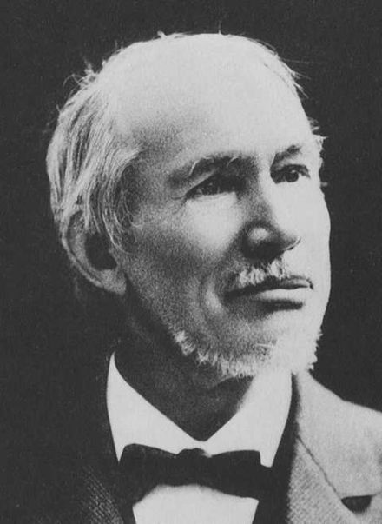
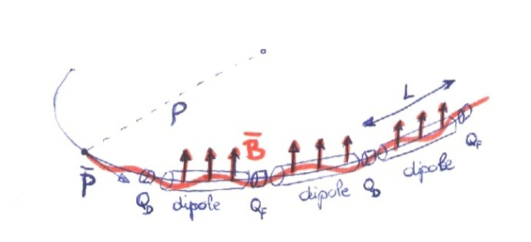
SIZE OF THE BEAM: TRAJECTORY SHAPE
A typical structure is the FODO cell: alternating quadrupoles spaced by length L of similar gradient
This structure can ensure stability for certain combinations of quadrupole strength and quadrupole distance
Ruled by Hill equation
  s is the coordinate along the accelerator
G. W. Hill, American
3 March 1838 – 16 April 1914

Slide 21
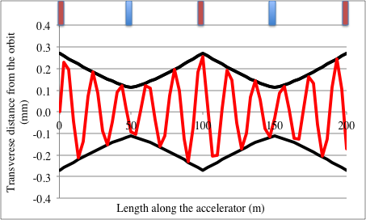
SIZE OF THE BEAM: TRAJECTORY SHAPE
Hill equation solution is a pendulum where both amplitude and phase depend on s
    There are good reason to use
  the square root (see appendix)
  We define the phase advance Ψ_{L} as the angle done along one cell
  In the figure, we count 5 oscillations between red and red quadrupoles, so phase advance is 5*360=1800 degrees

Slide 22
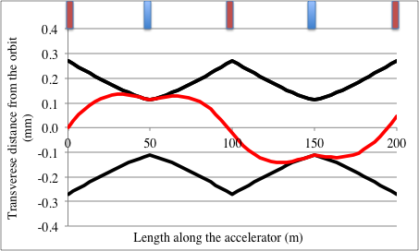
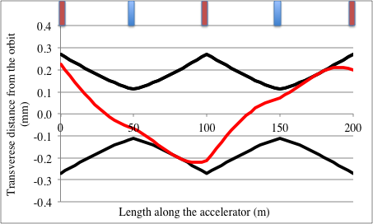
SIZE OF THE BEAM: TRAJECTORY SHAPE
  In reality, the phase advance is much smaller, i.e. in one cell one does not complete one oscillation – here we show a 180 degrees phase advance (two cases shown with different starting points)
  In the LHC, the phase advance is 90 degrees so one complete oscillation is done every four cells (you go through 8 quadrupoles)

Slide 23
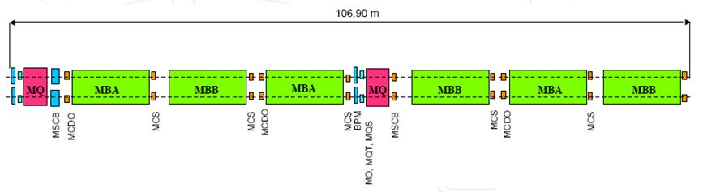
SIZE OF THE BEAM: MAIN DEPENDENCES
The dependence of beta function in FODO cell
  Beta function (the envelope of beam trajectories) is proportional to the distance between the quadrupoles L – the maximum value is achieved in the focusing quadrupole
  ψ_{L} is the phase advance
  For a 90 degrees phase advance cell, one has ψ_{L}=π/2
  LHC: L=53.5, β∼180 m
Cell length 2L

Slide 24
GRADIENT REQUIREMENT FOR ARC QUADRUPOLES
The requirements on the integrated gradient of the cell quadrupoles is
Two relevant dependences:
  Proportional to the energy of the machine (the larger the energy, the larger the integrated gradient
  Inverse proportional to the spacing of the quadrupoles L
For a 90 degrees phase advance cell, one has ψ_{L}=π/2
LHC:
  This is realized via ∼3.15 m long quadrupoles giving ∼200 T/m gradient

Slide 25
OPTIMIZING THE CELL LENGTH
The cell length is the main parameter that can be optimized
  ☺ The larger L, the less quads you need
  ☺ The larger L, the lower integrated gradient
  ☹ The larger L, the larger the beam
  Usually, for longer machines (higher energy) you use longer cells lengths
Case of 60° phase advance: linear dependence on L, different constants
    It looks interesting: same beam size, 30% less focusing required

Slide 26
CONTENTS
Principles of synchrotron
How to keep particles on a circular orbit
  Relation between energy, dipolar field, machine length
The beam size and principles of focusing
  Aperture requirements for arc dipoles and arc quadrupoles
  Gradient requirements for arc quadrupoles
  Aperture requirement in interaction region
Some examples
Conclusions

Slide 27
APERTURE REQUIREMENT IN INTERACTION REGION
In the experiments the beta functions are made as small as possible to get smaller beams and highest probability of collisions
  In the LHC interaction point, beta functions go down to 0.3 m, from the 30/170 m of arcs (three orders of magnitude)
  So beam size is reduced from 1.2 mm (injection, arc) to 0.3 mm (collision, arc) to 13 μm (collisions, interaction point)
Since the experiments are empty of accelerator magnets, beta functions drift according to this unfortunate equation
  So the smaller the beam in the experiment the larger the beam in the first magnets outside the experiment (IR magnets)
  The first IR magnets are a set of quadrupoles to bend the beta functions back to the values of the arc (triplet)

Slide 28
APERTURE REQUIREMENT IN INTERACTION REGION
  For the LHC first magnets are at 23 m from the collision point, b is 0.3 m, and therefore the beta function is 23²/0.3=1500 m
  In reality the requirement on the interaction region magnets is larger since it takes some space to bent the beta functions back to the values in the arc – in LHC the beta function in the IR magnets reaches 8 km at β*=30 cm
High luminosity ? Large apertures (in HL-LHC is 150 mm)
Dependence of aperture of IR magnets
  Proportional to the inverse of the square root of the beta function in the interaction region
  Proportional to the longitudinal size of the experiment l*
  And as usual, inverse proportional to the square root of the energy
  Proportional to the square root of the emittance
  Plus an offset φ₀ due to cold bore, tolerances, shielding …

Slide 29
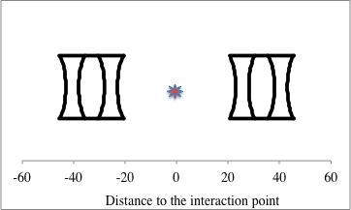
GRADIENT REQUIREMENT IN INTERACTION REGION
The gradient requirement scales as
  Proportional to the beam energy
  Inverse proportional to the longitudinal size of the experiment
  At first order is as an optical system with focusing length equal to the distance of the quadrupoles to the interaction point
  Note that in the gradient requirement there is no dependency on β*

Slide 30
CONTENTS
Principles of synchrotron
How to keep particles on a circular orbit
  Relation between energy, dipolar field, machine length
The beam size and principles of focusing
  Aperture requirements for arc dipoles and arc quadrupoles
  Gradient requirements for arc quadrupoles
Some examples
Conclusions

Slide 31
FIRST EXAMPLE: LHC
The Large Hadron Collider, E=7000 GeV
  Nb-Ti magnets, dipole field B=8.3 T, 14.3 m long, 1232 dipole
    ➔Total (magnetic) length of dipoles 1232×14.3=17.6 km
  Cell semilength L=53.5 m, three dipoles per semicell
    ➔Beta function in the focusing quad β_{f} =180 m
    ➔Filling factor 14.3×3/53.5=80%
    27.6 km of tunnel, 20.5 km in the arcs, 7.2 km in the insertions
  Emittance ε=3.75×10⁻⁶m rad
  Injection energy 450 GeV, γ=480
    ➔Beam size σ=0.0012 m (at injection)
    ➔Coil aperture of 0.056 m (coil-to-coil)

Slide 32
FIRST EXAMPLE: LHC
LHC arc quadrupoles
  56 mm aperture, Nb-Ti, gradient of 200 T/m
    Corresponds to 200×0.028=5.6 T field on the bore
  LHC cell phase advance of 90 degrees
  Integrated gradient of 620 T required, with 3.15-m-long quadrupoles
    Therefore, over a cell whose length is 2L = 107 m we have
    Six 14.3-m-long dipoles → total 86 m (80%)
    Two 3.15-m-long quadrupoles → total 6.3 m (6%)
    Plus interconnections and correctors
  Note that all this equations are relying on several approximations, and are intended to give the main picture, not the details

Slide 33
SECOND EXAMPLE: HE-LHC
A higher energy collider in the LHC tunnel (HE-LHC)
  Assume a 16 T dipole available
  Which energy ? First easy answer, assume same filling factor as LHC, we just scale the energy with the field
    E=7.0/8.33*16 = 13.45 TeV
  If we assume the same injection energy, and the same cell semilength, we obtain the same aperture of 56 mm
  What about the quadrupoles ? We need
  Now B nearly doubles, so integrated gradient becomes 1270 T (it was 660 T for the LHC)
  Since Nb₃Sn cannot do more than 300 T/m in 56 mm aperture (we will see this much later), we will have 4.2 m long quadrupoles
    We lose 2.5% in the filling factor (need 2.5 meters more for two quadrupole in 100 m cell) → the energy shall be not 13.45, but 13.11 TeV

Slide 34
SECOND EXAMPLE: HE-LHC
A higher energy collider in the LHC tunnel (HE-LHC)
  What about if we want to save on the cost of the quadrupoles and make them in Nb-Ti ?
  1270 T of integrated gradient is done with 5.7 m long quadrupoles giving 220 T/m
  Now with respect to the LHC we lose 2.6 m per quadrupole, 5.2 m per cell, i.e. 5% in filling factor → energy will be 12.77 TeV instead of 13.44 TeV
    … unless I can increase the dipole field by 5%, i.e. going from 16 T to 16.8 T – but this looks extremely difficult with Nb₃Sn …

Slide 35
SECOND EXAMPLE: HE-LHC
A higher energy collider in the LHC tunnel (HE-LHC)
  I could also work on the cell length – let us have a cell with L=105, then I just need 620 T of integrated gradient
  So I can use cheaper Nb-Ti with 200 T/m – I could even reuse LHC quadrupoles
  But the peak beta function will double to 320 m
  And I could probably need more aperture – not the double, since it depends with a square root – but to be verified
  … and the optimization goes on…

Slide 36
THIRD EXAMPLE: FCC
A 100 km, 100 TeV collider with 16 T magnets (FCC)
  E=50,000 GeV
  Nb-Ti magnets, dipole field B=16 T
    Curvature radius 10.4 km
    Total length of dipoles L_{d}=65.4 km – looks reasonable for 100 km tunnel
  Cell semilength L=100 m
    Better to increase the LHC value otherwise quadrupole needs will become huge
    Beta function in the focusing quad β_{f} =340 m
  Emittance ε=3.75×10⁻⁶m rad
  Injection energy 1 TeV GeV
    Beta has doubled, but I also double gamma so the aperture is the same as in the LHC

Slide 37
THIRD EXAMPLE: FCC
FCC arc quadrupoles
  We need 2350 T of integrated gradient
  Even with Nb₃Sn quadrupoles, we have 300 T/m and 7.8 m long
  Since we increased the cell length, we have only one quadrupole per 100 m, and therefore quadrupole uses 7.8% of the cell length
Summarizing
  65.4 km of 4573 dipoles (14.3 m long)
  200 m long cell, 1 quadrupole every 6 dipoles: total 762 quadrupoles, occupying 6.0 km
  Interconnection and correctors: 1 m per magnet → 6 km more
  Total length of the arcs: 77 km, the rest for insertions (topic of next unit)

Slide 38
FOURTH EXAMPLE: HL-LHC
LHC has triplet quadrupoles with 70 mm aperture (in Nb-Ti, with ∼8 T peak field
  Integrated gradient of the triplet: 200 T/m over 24 m total (4800 T)
HL-LHC has 150 mm aperture quadrupoles (in Nb₃Sn, with ∼11.5 T peak field)
  Doubling the aperture → four times larger beta function in the triplet, four times smaller beta*
  Integrated gradient: 132 T/m over 32 m total (4100 T) – energy and experiment size stays the same, but the baricentre of triplet shifted away from the experiment

Slide 39
CONCLUSIONS
Equation for a synchrotron
  And for a ultrarelativistic proton/electron one has
More energy?
  Either brute force (longer collider)
  Or technological development (higher magnetic field)
Speed world record is not of LHC, but of LEP
Do not use relativistic mass
  Fast particles do not get fatter
  If you travel by plane you do not weight more
approximation

Slide 40
CONCLUSIONS
Equation for the transverse particle motion
  Like an pendulum, but frequency and amplitude vary along the accelerator
  Alternating sign quadrupoles guarantee stability of oscillations
Aperture requirement is given by
  More energy requires less aperture
  More beta requires more aperture
Essential parameter: spacing between quadrupoles L
    L=53.5 m in the LHC (cell semilength)
  This gives the amplitude of oscillations and the requirements for magnet aperture
  The function beta is proportional to quadrupole spacing
  For a 90 degrees cell
approximation

Slide 41
CONCLUSIONS
The integrated gradient of the quadrupole is inverse proportional to the quadrupole spacing L
The lattice design implies a balance between
  Large spacing L: less quadrupoles in number and in strength, more space for dipoles but larger aperture magnets
  Small spacing L: more quadrupoles in number and in strength, less space for dipoles, but smaller aperture
approximation

Slide 42
REFERENCES
  Beam dynamics - arcs
    P. Schmuser, et al, Ch. 9.
    F. Asner, Ch. 8.
    K. Steffen, “Basic course of accelerator optics”, CERN 85-19, pg 25-63.
    J. Rossbach, P. Schmuser, “Basic course of accelerator optics”, CERN 94-01, pg 17-79.

Slide 43
ACKNOWLEDGEMENTS
    J. P. Kouthcouk, M. Giovannozzi, W. Scandale for discussions on beam dynamics and optics
    www.wikipedia.org for most of the pictures

Slide 44
FLOWCHART FOR MAGNET PARAMETERS

Slide 45
FLOWCHART FOR MAGNET PARAMETERS

Slide 46
FLOWCHART FOR MAGNET PARAMETERS
Input 1. Collision energy E_{c}
  Gives a relation between the dipole magnetic field B and the total length of the dipoles L_{d}
Technology constraint 1. Dipole magnetic field B
    Does not depend on magnet aperture
    B_{t} <2 T for iron magnets
    B_{t} <13 T for Nb-Ti superconducting magnets (10 T in practice)
    B_{t} <25 T for Nb₃Sn superconducting magnets (16 T in practice)
Output 1. Length of the dipole part
        Length in m, B in T, energy in GeV

Slide 47
FLOWCHART FOR MAGNET PARAMETERS

Slide 48
FLOWCHART FOR MAGNET PARAMETERS
Input 2. Injection energy E_{i}
  Determines the relativistic factor, that affect the beam size
Constraint 2. Normalized beam emittance ε
  Determined by the beam properties of the injectors
Semi-cell length L
  This is a free parameter that can be used to optimize
  Determines the beta functions
Output 2. Aperture of the arc magnets (also determined by field errors and beam stability)
  Size of the beam at injection
  Magnet aperture (diameter)

Slide 49
FLOWCHART FOR MAGNET PARAMETERS

Slide 50
FLOWCHART FOR MAGNET PARAMETERS
Technology constraint 1. Quadrupole magnetic field vs aperture
Output 3. Gradient of the quadrupoles
Semi-cell length L
  Also determines the focusing, i.e. the integrated gradient
Output 4. Length of the quadrupoles

Slide 51
FLOWCHART FOR MAGNET PARAMETERS
Output 5. Number of semi-cells and arc length
  Number of semi-cells = number of quadrupoles = n_{q}
  Length of the arc L_{a}

Slide 52
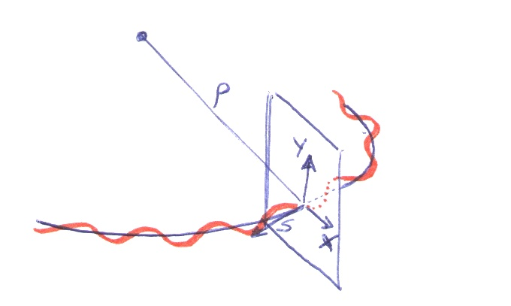

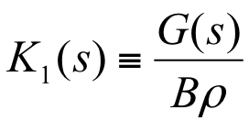
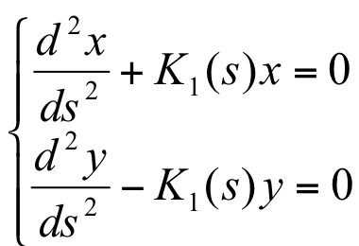
SOME THEORETICAL INSIGHT
The force necessary to stabilize linear motion is provided by the quadrupoles
  Quadrupoles provide a field which is proportional to the transverse deviation from the orbit, acting like a spring
  If we define the gradient as
  the motion equation will read as

Slide 53
SOME THEORETICAL INSIGHT
In this way the motion equation in the transverse space is similar to a harmonic oscillator
  where the force depends on time …
  Solution: a oscillator whose amplitude and frequency are modulated
  We write the amplitude as a s-dependent part (beta function) plus an invariant along the ring
  The invariant is inverse proportional to the energy – so one can define a new invariant, also independent of the energy

Slide 54
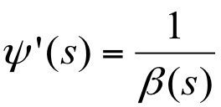
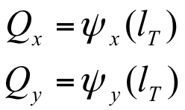
SOME THEORETICAL INSIGHT
It may appear strange to use a square root
The big advantage of using a square root is that there is a relation between the beta function and the phase advance
  Large beta fuction, small phase advance
  Small beta function, large phase advance
The tune is the phase advance over the ring

