Slide 1
Units 4 and 7
Practical superconductors for accelerator magnets
Paolo Ferracin
Lawrence Berkeley National Laboratory (LBNL)
Maxim Marchevsky
Lawrence Berkeley National Laboratory (LBNL)
Ezio Todesco
European Organization for Nuclear Research (CERN)
Soren Prestemon
Lawrence Berkeley National Laboratory (LBNL)

Slide 2
Outline
Introduction and history
Superconducting materials
  NbTi, Nb₃Sn, and their critical surfaces
Multifilament wires
  Motivations and fabrication
Superconducting cables
  Motivations and fabrication
Cable insulation
Filling factor
Conclusions

Slide 3
References
[1] A. Devred, “Practical low-temperature superconductors for electromagnets”, CERN-2004-006, 2006.
[2] “LHC design report v.1: the main LHC ring”, CERN-2004-003-v1, 2004.
[3] A. Godeke, “Performance boundaries in Nb₃Sn superconductors”, PhD thesis, 2005.
[4] M. Wilson, “Superconducting magnets”, Oxford UK: Clarendon Press, 1983.
[5] K.-H. Mess, P. Schmuser, S. Wolff, “Superconducting accelerator magnets”, Singapore: World Scientific, 1996.
[6] D. Dietderich, “Development of High Current Nb₃Sn Rutherford Cables for NED and LARP”, WAMSDO 2008, CERN, Geneva, 2008.
[7] E. Todesco, “Masterclass - Design of superconducting magnets for particle accelerators”, https://indico.cern.ch/category/12408/
[8] Presentations from Luca Bottura and Martin Wilson

Slide 4
References
Parameterization curves
  M.S. Lubell, “Empirical scaling formulas for critical current and critical fields for commercial NbTi,” IEEE Trans. Magn., Vol. MAG-19 No. 3, pp. 754–757, 1983.
  L. Bottura, “A practical fit for the critical surface of NbTi,” IEEE Trans. Appl. Supercond., Vol. 10, No. 1, pp. 1054–1057, 2000.
  L.T. Summers, M.W. Guinan, J.R. Miller and P.A. Hahn, “A model for the prediction of Nb₃Sn critical current as a function of field, temperature, strain and radiation damage,” IEEE Trans. Magn., Vol. 27, No. 2, pp. 2041–2044, 1991.

Slide 5
Outline
Introduction and history
Superconducting materials
  NbTi, Nb₃Sn, and their critical surfaces
Multifilament wires
  Motivations and fabrication
Superconducting cables
  Motivations and fabrication
Cable insulation
Filling factor
Conclusions

Slide 6
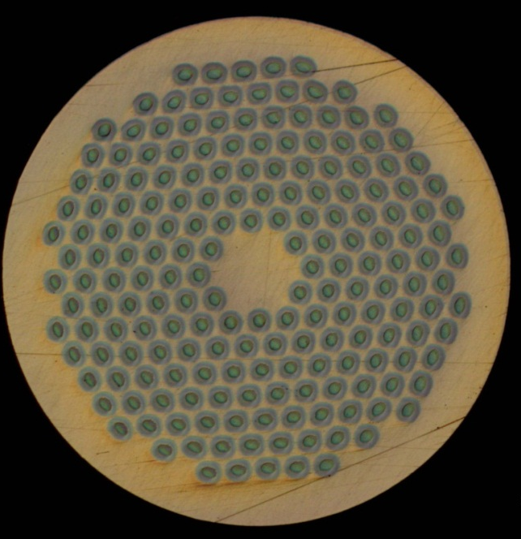
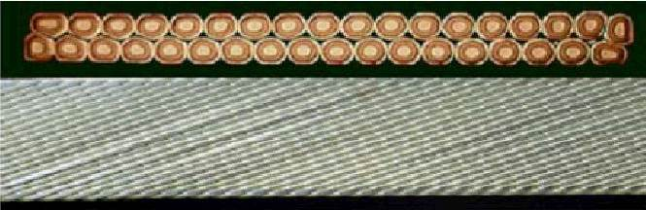
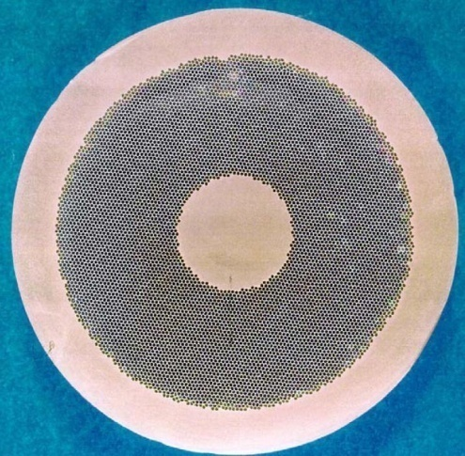
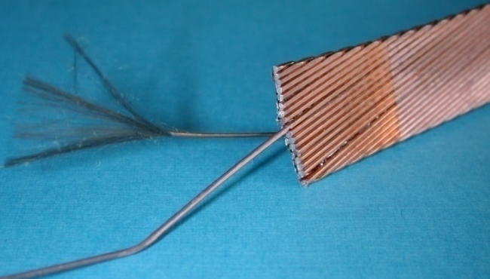
1. Introduction and history
For practical applications, superconducting materials are usually produced in small filaments and surrounded by a stabilizer (typically copper) to form a multifilament wire or strand.
A superconducting cable is usually composed by several wires: multistrand cable.
In this unit we will describe how and why superconducting cables are fabricated in such a geometry.

Slide 7
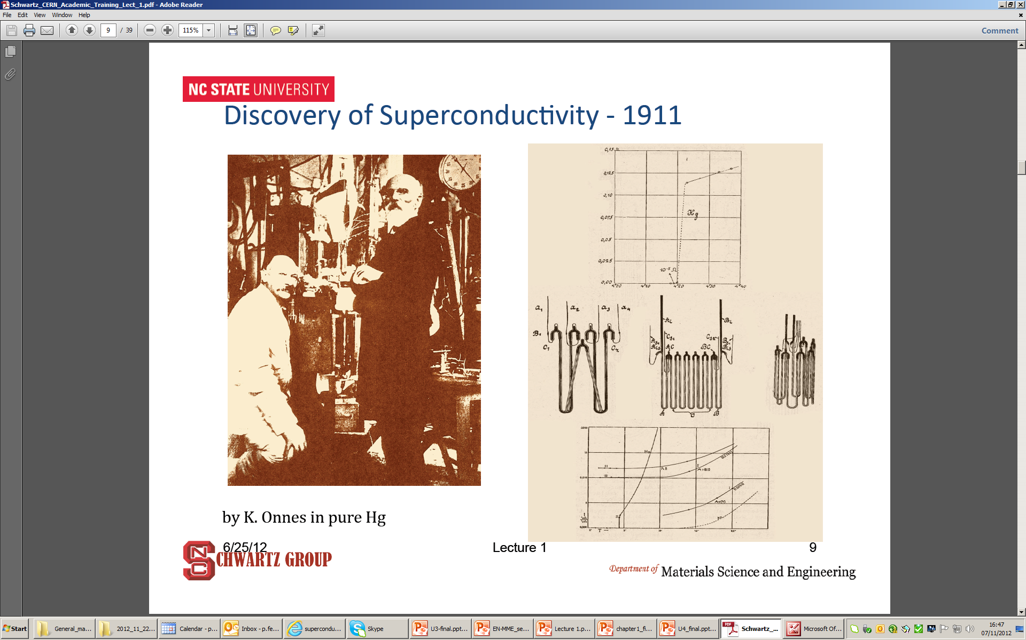
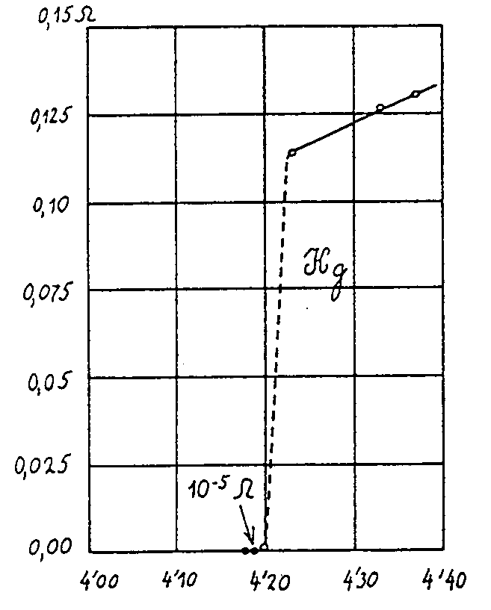
1. Introduction and history
The discovery
Superconductivity was discovered in 1911 by Kammerling-Onnes who observed that the resistance of a mercury wire disappeared (immeasurably small value) at 4.2 K
  Not just “little” resistance - truly ZERO resistance

Slide 8
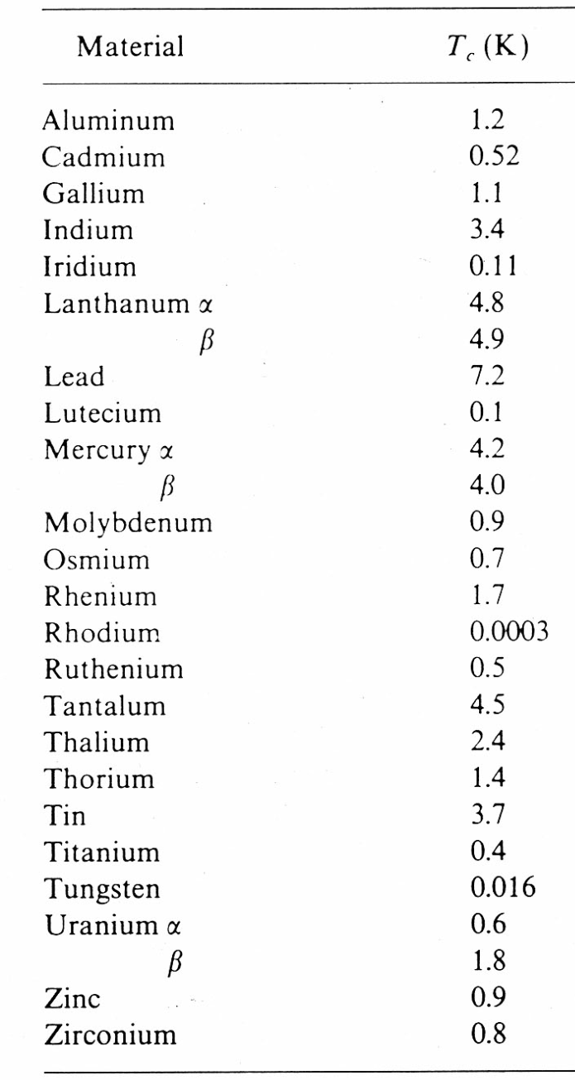
1. Introduction and history
Critical temperature
The temperature at which the transition takes place: critical temperature T_{c}
Below T_{c,} → no resistance
Observed in may materials
  but not in the typical best normal conductors (copper, silver, gold…)
At a temperature > T_{c} , a superconductor is a very poor conductor
2 kinds of superconductors
  Type I and Type II
    Different behaviour with magnetic field

Slide 9

1. Introduction and history
Type I superconductors
Meissner-Ochsenfeld effect (1933)
Perfect diamagnetism
  With T<T_{c} magnetic field is expelled
But, the B must be < critical field B_{c}
  Otherwise superconductivity is lost
by L. Bottura
B
B
Increase of field
Cool-down
Superconducting state
Normal state
Unfortunately, first discovered superconductors (Type I) with very low B_{c} (≤ 0.1 T)
  not practical for electro-magnets

Slide 10
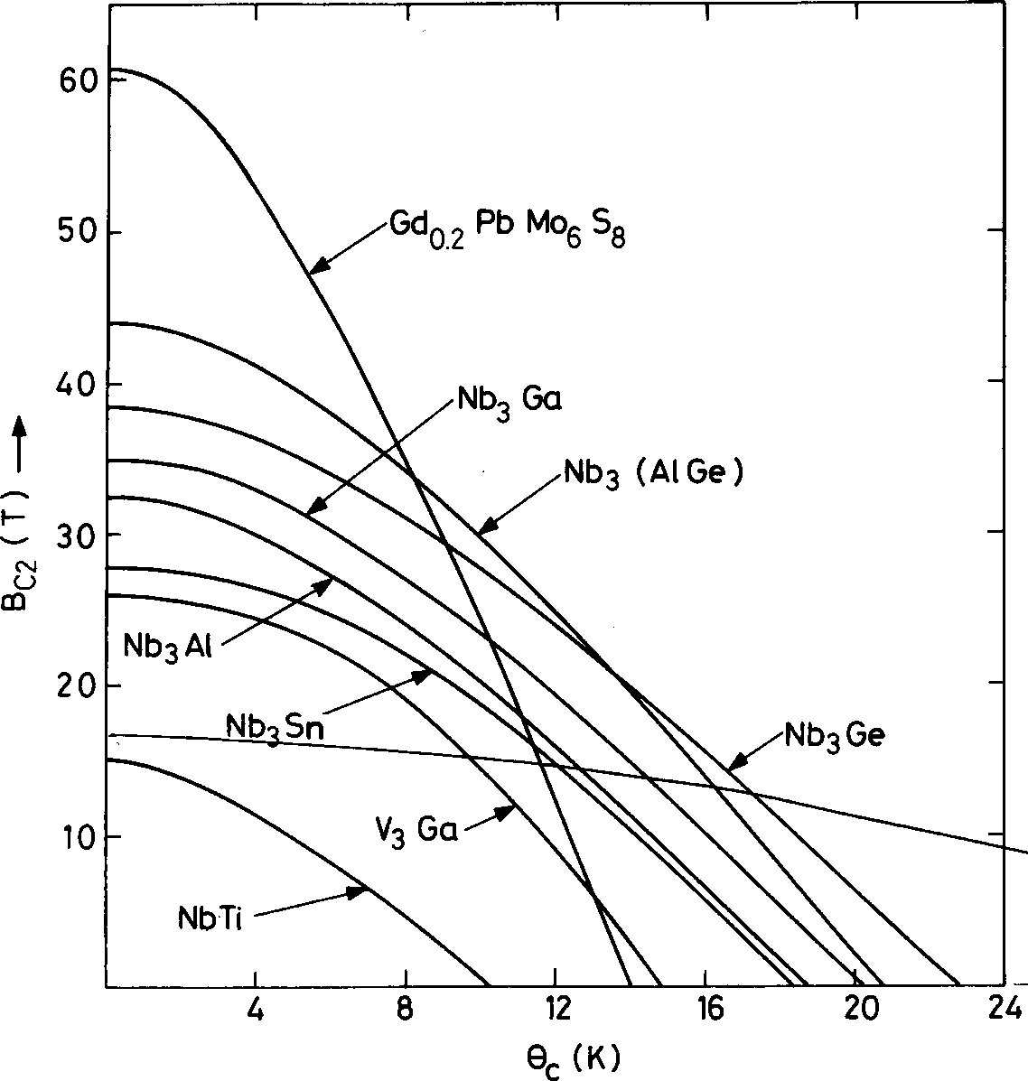
1. Introduction and history
Type II superconductors
So, for 40-50 years, superconductivity was a research activity
Then, in the 50’s, type II superconductors
  Between B_{c1} and B_{c2} : mixed phase
    B penetrates as flux tubes: fluxoids
      with a flux of φ_{o} = h/2e = 2 · 10⁻¹⁵ Wb
Much higher fields and link between T_{c} and B_{c2}
B<B_{c1}
B_{c1}<B<B_{c2}
by L. Bottura
T_{c} (K)

Slide 11
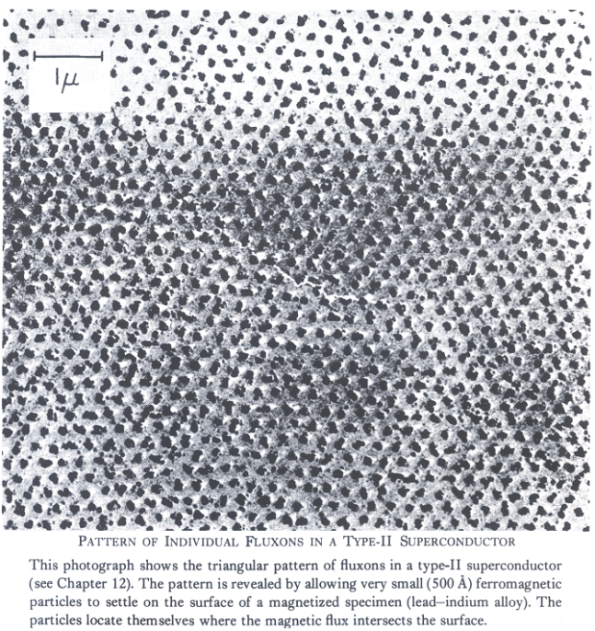
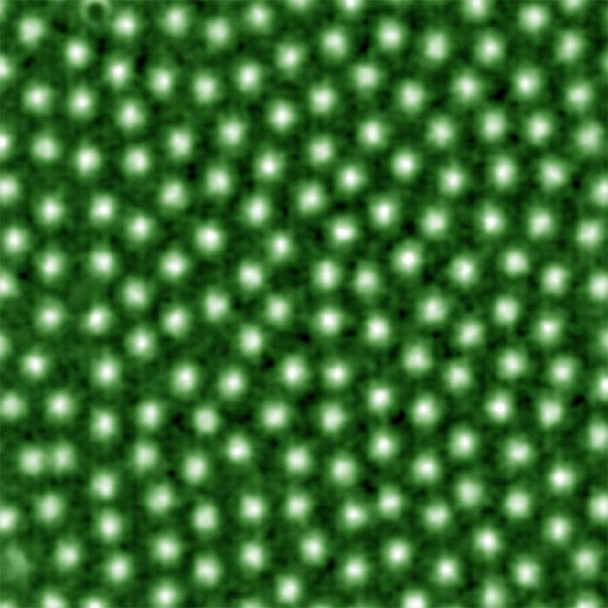
1. Introduction and history
Type II superconductors
Field penetrated in the form of flux tubes (fluxoids), each with a flux of
  φ_{o} = h/2e = 2· 10⁻¹⁵ Wb
Observed both in a photo by Essmann & Träuble (1967) and with magneto-optical imaging technique by Oslo Univerisity
http://www.mn.uio.no/fysikk/english/research/groups/amks/superconductivity/

Slide 12
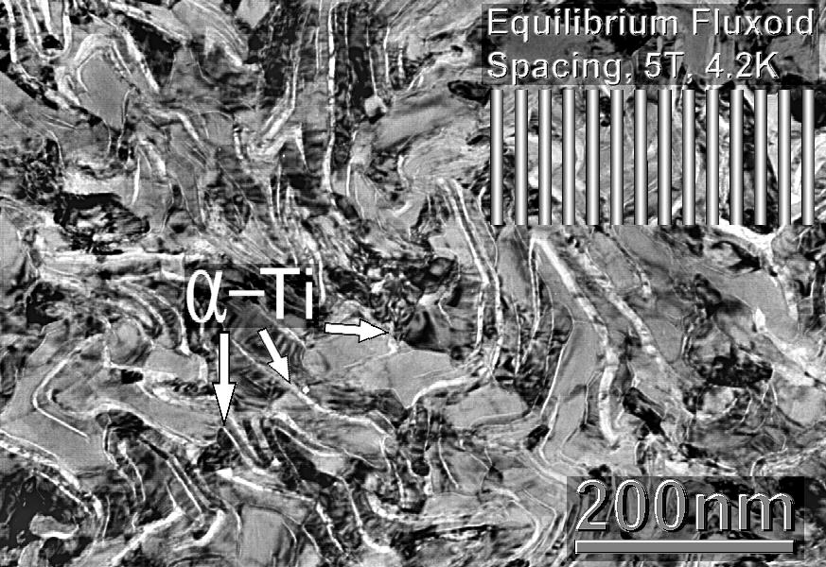
Superconductivity
Hard superconductors
…but, if a current is passed through the type II superconductor under a field >B_{c1}
  Lorentz force on the fluxoids
    F = J x B
The force causes a motion of tubes
  Flux motion (dB/dt)→ voltage (V)→ dissipation (V· I)
The fluxoids are therefore locked in pinning centers
  Defects or impurities in the structure: precipitates or grain boundaries
    Produced during fabrication

Slide 13
Superconductivity
Hard superconductors
The pinning centres exert a pinning force F_{p}
As long as F_{p} ≥ J x B
  No flux motions (flux tubes pinned) → no dissipation
The critical current density of the superconductor J_{c} is the current density at which, for a given B and at a given T the pinning force is exceeded by the Lorentz force
So, there is a mutual link between maximum J, B, and T
by M. Wilson

Slide 14
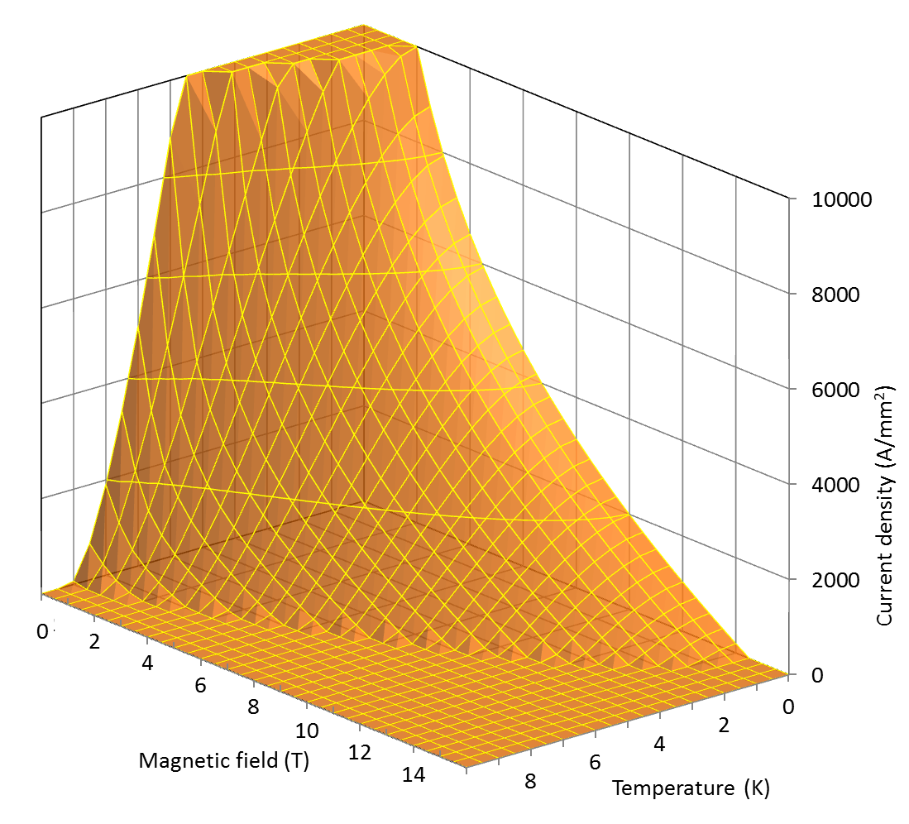
Superconductivity
Critical surface
A type II material is supercond. below the critical surface defined by
  Critical temperature Tc
    Property of the material
  Upper critical field B_{c2}
    Property of the material
  Critical current density J_{c}
    Hard work by the producer

Slide 15
Outline
Introduction and history
Superconducting materials
  Nb-Ti, Nb₃Sn, and their critical surfaces
Multifilament wires
  Motivations and fabrication
Superconducting cables
  Motivations and fabrication
Cable insulation
Filling factor
Conclusions

Slide 16
2. Superconducting materials
Nb-Ti
Niobium and titanium are both soluble and at high temperature they combine in a ductile alloy (called β phase).
  It is easy to process by extrusion and drawing techniques.
When cooled down to about 9 K it becomes a type II superconductor.
Critical temperature T_{c} and upper critical magnetic field B_{C2} depend on Ti content: the optimal is 46.5-47 in weight %.
  T_{c} is ~9.2 K at 0 T.
  B_{C2} is ~14.5 T at 0 K.
The critical current J_{c} depends on the microstructure.
  Cold works and heat treatments determine the formations of other phases; in particular the α phase is used for flux pinning.

Slide 17
2. Superconducting materials
Nb-Ti
LHC pushed this technology to its limit with 8 T magnets
  Why 8 T and not 15 T ?
  One cannot operate at 0 K, at 1.9 K critical field is 13 T
  Critical field decreases with current density, so practical limit is 10 T
  Some margin must be taken to avoid instabilities, so about 8 T is the limit – we will come on this point

Slide 18
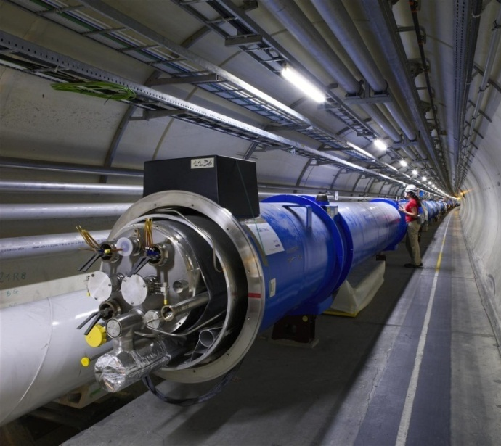
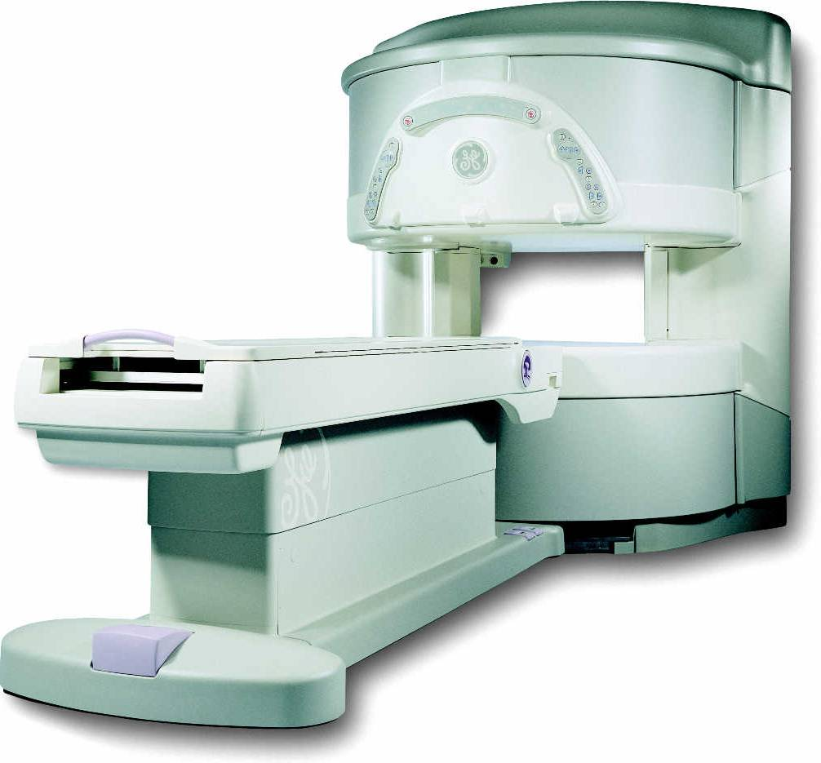
2. Superconducting materials
Nb-Ti
Most widely used superconductor
Implemented on large scale for the first time in the the Tevatron accelerator, built at Fermilab in the early 80s
In High Energy Physics, used also for all the post-Tevatron accelerators
    HERA at DESY
    RHIC at BNL
    SSC (project canceled in 1993)
    LHC at CERN
Other important applications
  MRI /NMR magnets
  Fusion magnets (Tore Supra, France).
The cost is ~ 200 US $ per kg of wire (about 1 euro per m of strand)

Slide 19
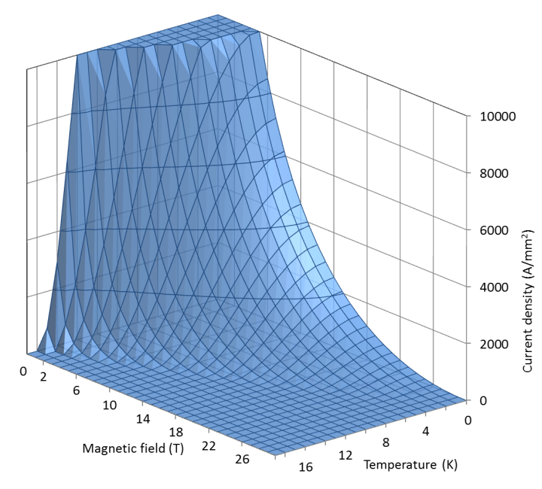
2. Superconducting materials
Nb₃Sn
Niobium and tin can form an intermetallic compound, with the formula Nb₃Sn, from the A15 family (like Nb₃Al).
When cooled down to about 18 K it becomes a type II superconductor.
Critical temperature T_{C0m} and upper critical field B_{C20m} depend on Sn content: the optimal is 20-25 in weight%.
  T_{C0m} is ~18 K at 0 T and zero strain.
  B_{C20m} is ~28 T at 0 K and zero strain.
The critical current J_{c} depends on the microstructure (grain structure).
  High J_{c} obtained with grains from 30 to 300 nm

Slide 20
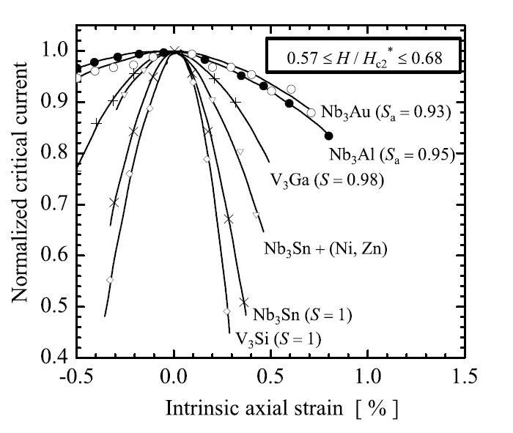
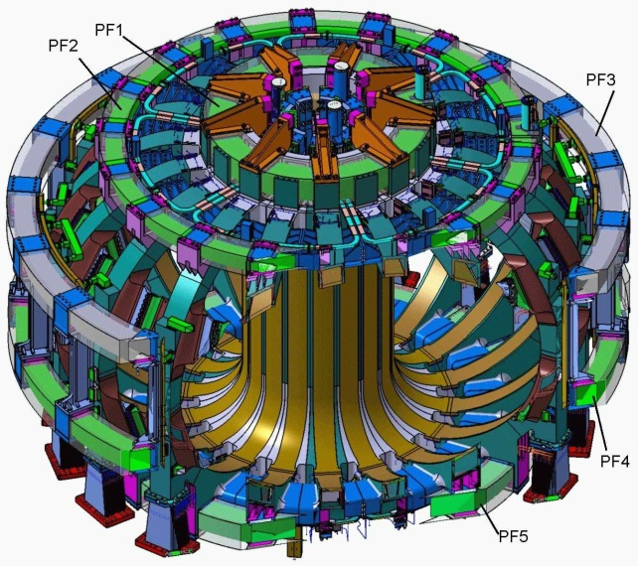
2. Superconducting materials
Nb₃Sn
Nb₃Sn is brittle
  Cannot be extruded as Nb-Ti.
  Its formation must occur only at the end of the cable and/or coil fabrication process.
In addition, it is strain sensitive
  critical parameters ← → applied strain
Used in
  NMR, with field of about 20 T
  Model coils for ITER
  High energy physics (R&D)
The cost is approximately ~1500 US $ per kg of wire.
  ~5 euro per m of strand
by A. Godeke

Slide 21

2. Superconducting materials
Nb-Ti vs. Nb₃Sn
Nb-Ti
Nb₃Sn

Slide 22
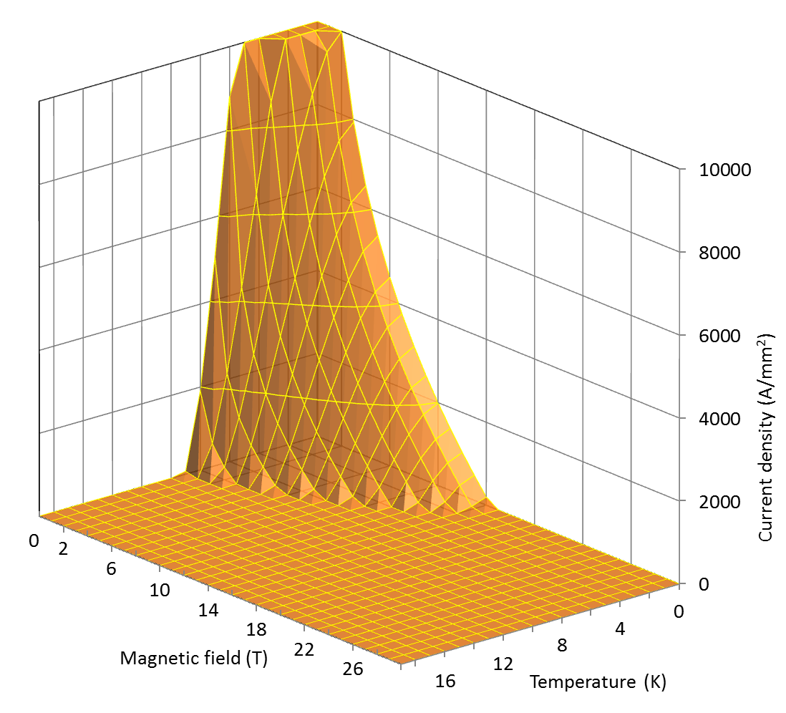
2. Superconducting materials
Nb-Ti vs. Nb₃Sn
Nb-Ti
Nb₃Sn

Slide 23
2. Superconducting materials
Critical surfaces
The critical surface defines the boundaries between superconducting state and normal conducting state in the space defined by temperature, magnetic field, and current densities.
The surface, determined experimentally, can be fitted with parameterization curves.
Nb₃Sn
Nb-Ti

Slide 24
Nb-Ti parameterization curve
(LHC dipole)
Nb-Ti parameterization
  Temperature and field dependence of B_{C2} and T_{C} are provided by Lubell’s formulae:
  where B_{C20} is the upper critical flux density at zero temperature (14.5 T), and T_{C0} is critical temperature at zero field (9.2 K)
  Temperature and field dependence of Jc is given by Bottura’s formula
  where J_{C,Ref} is critical current density at 4.2 K and 5 T (3000 A/mm²) and C_{Nb-Ti} (27 T), α_{Nb-Ti} (0.63), β_{Nb-Ti} (1.0), and γ_{Nb-Ti} (2.3) are fitting parameters.

Slide 25
Nb₃Sn parameterization curve
(typical values for HEP magnets)
Nb₃Sn parameterization
  Temperature, field, and strain dependence of Jc is given by Summers’ formula
  where α_{Nb3Sn} is 900 for ε = -0.003, T_{Com} is 18 K, B_{C20m} is 27.6 T, and C_{Nb3Sn,0} is a fitting parameter equal to 43100000000 AT^{1/2}mm⁻² for a Jc=2900 A/mm² at 4.2 K and 12 T.
  Assume ε = 0.000

Slide 26
2. Superconducting materials from Cu to Nb₃Sn
Typical operational conditions (0.85 mm diameter strand)
Cu
Nb-Ti
Nb₃Sn
J_{e} ~ 5 A/mm²
I ~ 3 A
B = 2 T
J_{e} ~ 600-700 A/mm²
I ~ 300-400 A
B = 8-9 T
J_{e} ~ 600-700 A/mm²
I ~ 300-400 A
B = 12-13 T

Slide 27
2. Superconducting materials from Cu to Nb₃Sn
Typical operational conditions (0.85 mm diameter strand)
Cu
Nb-Ti
Nb₃Sn
J_{e} ~ 5 A/mm²
I ~ 3 A
B = 2 T
J_{e} ~ 600-700 A/mm²
I ~ 300-400 A
B = 8-9 T
J_{e} ~ 600-700 A/mm²
I ~ 300-400 A
B = 12-13 T

Slide 28
Outline
Introduction and history
Superconducting materials
  Nb-Ti, Nb₃Sn, and their critical surfaces
Multifilament wires
  Motivations and fabrication
Superconducting cables
  Motivations and fabrication
Cable insulation
Filling factor
Conclusions

Slide 29
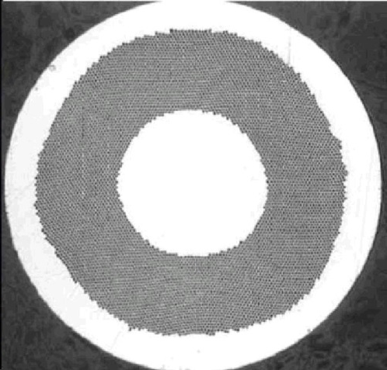
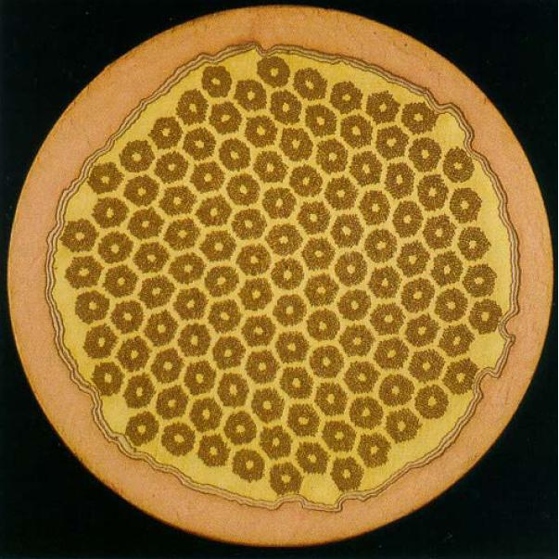
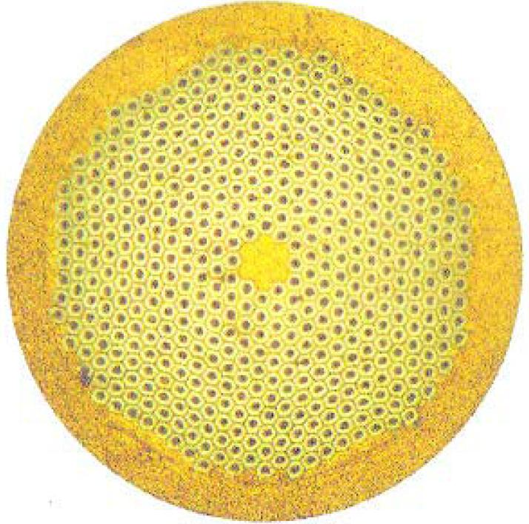
3. Multilfilament wires
Motivations
The superconducting materials used in accelerator magnets are
  subdivided in filaments of small diameters
  twisted together
  embedded in a copper matrix

Slide 30
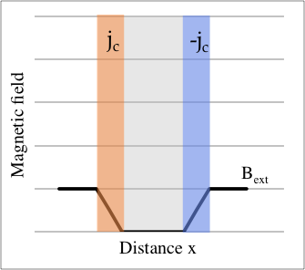

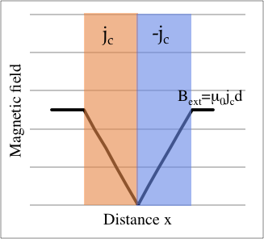
3. Multifilament wires
Motivations
Filament size: magneto-thermal instabilities (flux jumps)
  Let’s use the critical state model (CSM): a superconductor carries either current at j_{c} or no currents at all
  Let us consider a simple geometry of a infinite slab of superconductor, of thickness 2d and we bring the external field to B_{ext}
  A j_{c} over a thickness of Δx start flowing to shield the internal part of the slab
    B_{ext} = µ₀ j_{c} Δx
  Since superconducting, this is a persistent current
  The maximum field that can be shielded is the penetration field
    B_{p} = µ₀ j_{c} d
by E. Todesco

Slide 31
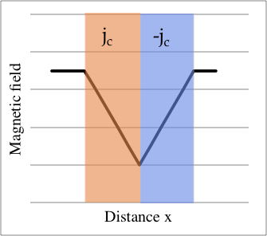
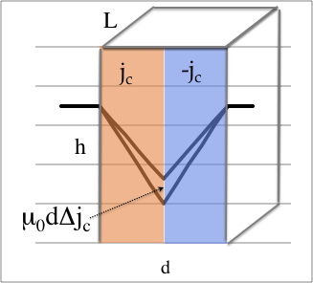
3. Multifilament wires
Motivations
Filament size: magneto-thermal instabilities (flux jumps)
  If the external field increase further, the current cannot shield anymore and the field start increasing inside the slab
    B(x) = B_{ext} - µ₀ j_{c} x
  Now let’s have an increase of temperature ΔT₀ (local heat deposition by the beam, or mechanical movements and friction)
  This induces a reduction of critical current density
  Less critical current means less shielding, and therefore a change of magnetic field in the superconductor
by E. Todesco

Slide 32
3. Multifilament wires
Motivations
Filament size: magneto-thermal instabilities (flux jumps)
  The change of magnetic field flux induces a voltage according to Maxwell
  The voltage and current induce a dissipation VI
  The dissipation induces heat and a change of temperature ΔT₁
  This induces a further reduction of critical current density….. ΔT₂ ….. ΔT₃ …..
  If the sum Σ ΔT_{k} converges we are stable, otherwise there is a mechanism providing a divergence of temperature
by E. Todesco

Slide 33
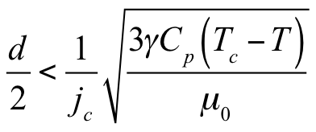
3. Multifilament wires
Motivations
Filament size: magneto-thermal instabilities (flux jumps)
  Stability criteria
    C_{p}: specific heat
    J_{c}: critical current density
    γ: density
    T_{c}-T: difference between operational temperature and critical temperature
  Finer superconductor more stability
  Larger critical current less stability
  Filament diameters are usually less than 50 µm.

Slide 34
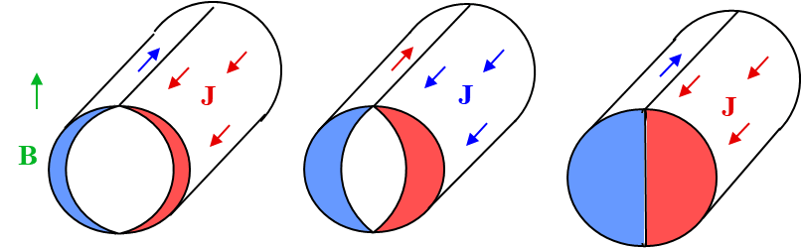
3. Multifilament wires
Motivations
Filament size: superconductor magnetization → field errors
  When a filament is in a varying B_{ext}, its inner part is shielded by currents distribution in the filament periphery
    They do not decay when B_{ex}is held constant → persistent currents
  We can define a magnetization (magnetic moment per unit volume [J/T/m³) for a filament with diameter d_{f} when fully penetrated
  Perturbation of the magnetic field → Field errors
  Finer superconductor, smaller critical current, less field errors
    LHC filament diameter 6-7 µm, HERA filament diameter 14 µm.

Slide 35
3. Multifilament wires
Motivations
Filament size: superconductor magnetization → AC losses within the filaments
  We can define a magnetization (magnetic moment per unit volume [J/T/m³) for a filament with diameter d_{f} when fully penetrated
  This produce an AC loss power (W/m³)
  Again, finer superconductor, smaller critical current, less AC losses within the filament

Slide 36
3. Multifilament wires
Motivations
Filament size: some examples
Nb-Ti:
  for the LHC main magnets filaments of 6-7 µm were used
  For SIS-300 (fast ramped magnet) filament of 3 µm was used
Nb₃Sn:
  Today RRP technology can reach a minimum of 45 µm, PIT a bit less
  LARP initially used a 70 µm (54/61 RRP), and then a 50 µm (108/127 RRP)
  HL-LHC relies on RRP 108/127, and also used PIT with finer filaments (45 µm)

Slide 37
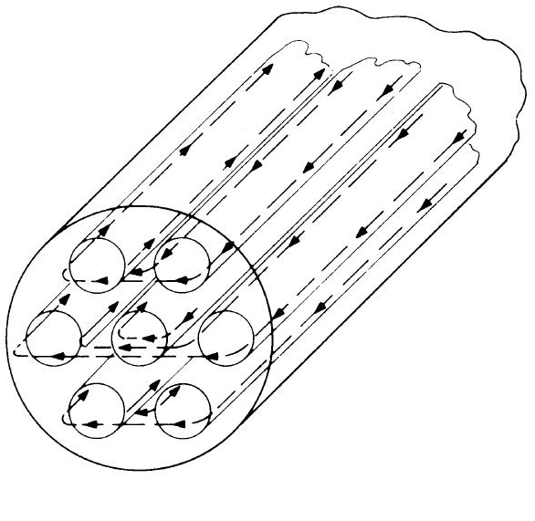
3. Multifilament wires
Motivations
Filament twist: AC losses between the filaments
  When a multi-filamentary wire is subjected to a time varying magnetic field, current loops are generated between filaments.
  If filaments are straight, large loops with large currents → ac losses
  If the strands are magnetically coupled the effective filament size is larger → flux jumps
Filaments are twisted to reduce the AC loss power (P_{e} [W/m³]) with ρ_{t} resistivity across matrix and p_{w} wire twist pitch
Twist pitch p_{w} of the order of 20-30 times of the wire diameter.
by M. Wilson
by L. Bottura

Slide 38
3. Multifilament wires
Motivations
Strand diameter: magneto-thermal instabilities (self-field instability)
  When a transport current is ramped-up, the current flows only in the outermost filaments, with a j_{c} (again the CSM)
  Similarly to the flux jump described before….thermal input → reduction j_{c} → ΔΦ → VI → ….→
  A simplified criterion:
  Where λ is the superconductor fraction, ν volumetric specific heat of the strand, R strand radius
  Usually strand are within 0.5 and 1.1 mm diameter.
See work by B. Bordini

Slide 39
3. Multifilament wires
Motivations
Strand diameter: some examples
Usually between 0.5 mm and 1.1 mm
  0.48-mm-diameter Nb-Ti strand used in LHC matching sections MQM and MQY magnets, in HL-LHC used for nested correctors MCBXF (CIEMAT, Spain)
  LHC Nb-Ti strand for main dipoles:
    0.825-mm-diameter
    1.065-mm-diameter
  Nb₃Sn strands:
    0.7 mm diameter for TQ, 11 T
    0.8 mm diameter for HD2, HQ
    0.85 mm diameter for MQXF
    1.0 mm for Fresca2, MCBPCTD
    1.25-mm-diameter strand proposed for NED Nb₃Sn magnet, very rigid and difficult to wind – used in racetrack coils
    Large diameter strand also suffer from larger instabilities

Slide 40
3. Multifilament wires
Motivations
Cu matrix
  Superconductors have a very high normal state resistivity. It can be shown that a filament of Nb-Ti, if quenched in free space, could reach very high temperatures in few ms.
  If the filament is embedded in a copper matrix, when a quench occurs, the current redistributes in the low-resistivity matrix and the peak temperature can typically be maintained below 300 K.
  The copper matrix facilitates quench protection: it allows the quench to propagate and it provides time to act on the power circuit.
  In the case of a small volume of superconductor heated beyond the critical temperature (for instance because of a flux jump), the current can flow in the copper for a short moment, allowing the filament to cool-down and recover superconductivity.
    The matrix also helps stabilizing the conductor against flux jumps (dynamic stability).
by L. Bottura

Slide 41
3. Multifilament wires
Motivations
Cu matrix: some examples
Copper ratio definition
  Cu/non-Cu of x means that in the strand cross-section one has a quantity 1 of superconductor and a quantity x of Cu
  Example: Cu/non-Cu = 2 means 1/(1+2) = 33% of superconductor and 2/(1+2) = 67% of Cu
Usually between 1 and 2
  Corrector magnets where current density is not critical can have much larger (above 2)
  For main magnets current density is critical, but one needs some Cu to stabilize and protect the magnet
  LHC dipoles: 1.65 (inner layer) and 1.95 (outer layer)
  HL-LHC: 1.1 (11 T) and 1.2 (MQXF)
  LARP TQ: 0.89
  A ratio of 0.4 was used (successfully) in D20, a short model magnet – not viable for long magnets
Cu RRR (the ratio of Cu resistivity at 293 K to the resistivity at 4.2 K)
  The residual resistivity ratio of copper is an important parameter for stability – larger than 100 in cables, larger than 150 in wires

Slide 42
3. Multifilament wires
Motivations
Filament size
  Flux jumps
  Magnetization
    AC losses within filament
    Persistent current (effect on magnetic field)
Filament twisting
  AC losses
  Flux jumps (less filament coupling)
Strand size
  Self field stability
Cu matrix
  Quench protection/stability
  Flux jump and self-field

Slide 43
Outline
Introduction and history
Superconducting materials
  Nb-Ti, Nb₃Sn, and their critical surfaces
Multifilament wires
  Motivations and fabrication
Superconducting cables
  Motivations and fabrication
Cable insulation
Filling factor
Conclusions

Slide 44
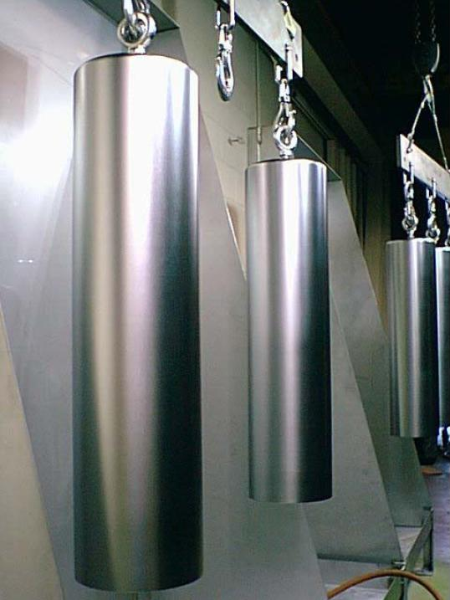
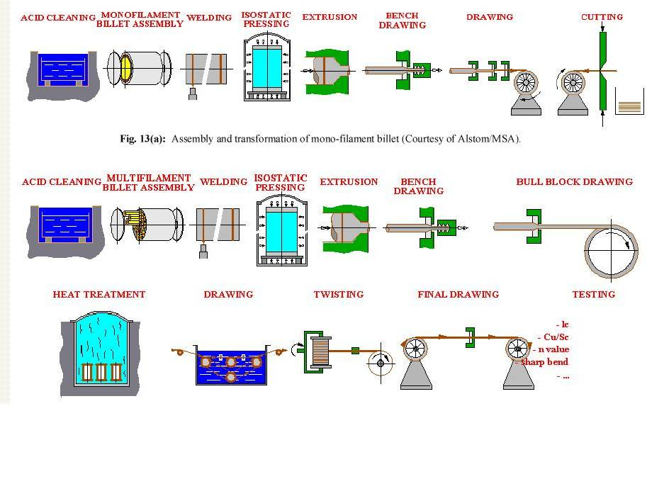
3. Multifilament wires
Fabrication of Nb-Ti multifilament wires
The fabrication of Nb-Ti wire starts from the production of Nb-Ti ingots (with a 200 mm diameter and 750 mm height).
A monofilament billet is assembled, extruded, and drawn down in small pieces (monofilament rods) about 800 mm long and 50 mm in diameter.
A. Devred, [1]

Slide 45
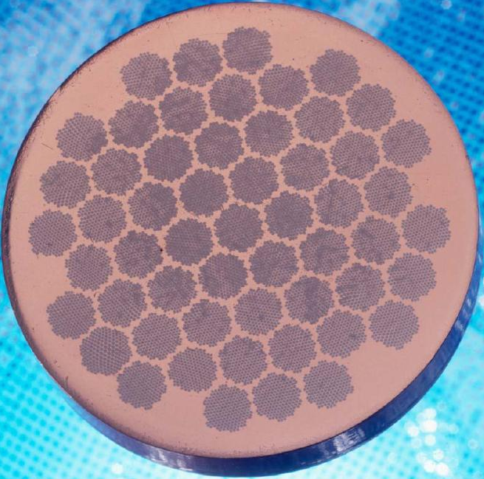
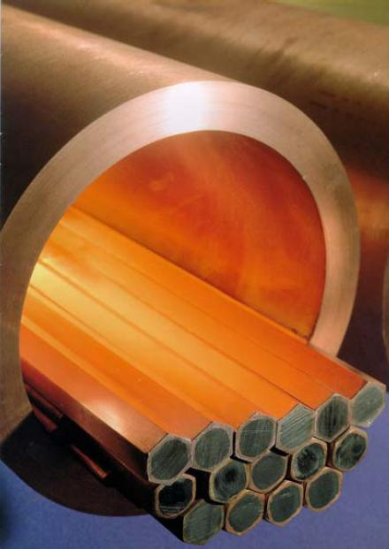
3. Multifilament wires
Fabrication of Nb-Ti multifilament wires
Monofilament rods are stacked to form a multifilament billet, which is then extruded and drawn down.
Heat treatments are applied to produce pinning centers (α-Ti precipitates).
When the number of filaments is very large, multifilament rods can be re-stacked (double stacking process).
A. Devred, [1]

Slide 46
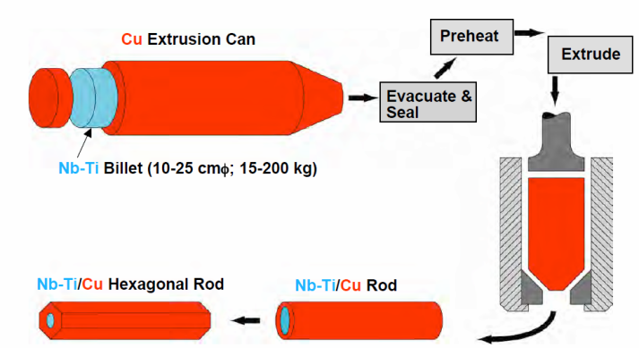
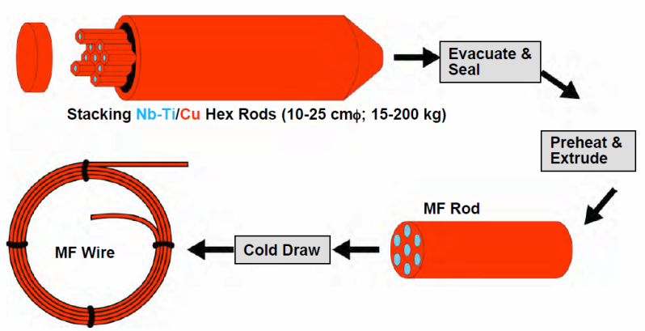
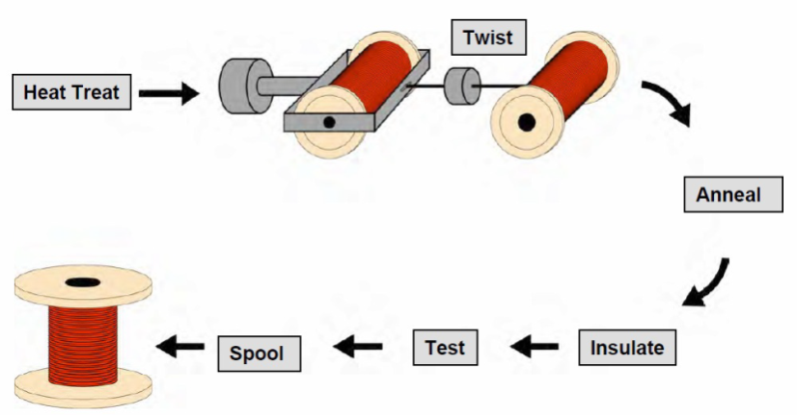
3. Multifilament wires
Fabrication of Nb-Ti multifilament wires

Slide 47
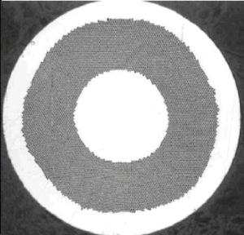
3. Multifilament wires
Fabrication of Nb-Ti multifilament wires
The copper to superconductor ratio is specified for the application to ensure quench protection, without compromising the overall critical current of wire.
The filament diameter is chosen to minimize flux jumps and field errors due to persistent currents, at the same time maintaining the wire processing cost down.
The inter-filament spacing is kept small so that the filaments, harder then copper, support each other during drawing operation. At the same time, the spacing must be large enough to prevent filament couplings.
A copper core and sheath is added to reduce cable degradation.
The main manufacturing issue is the piece length.
  It is preferable to wind coils with single-piece wire (to avoid welding). LHC required piece length longer than 1 km.

Slide 48
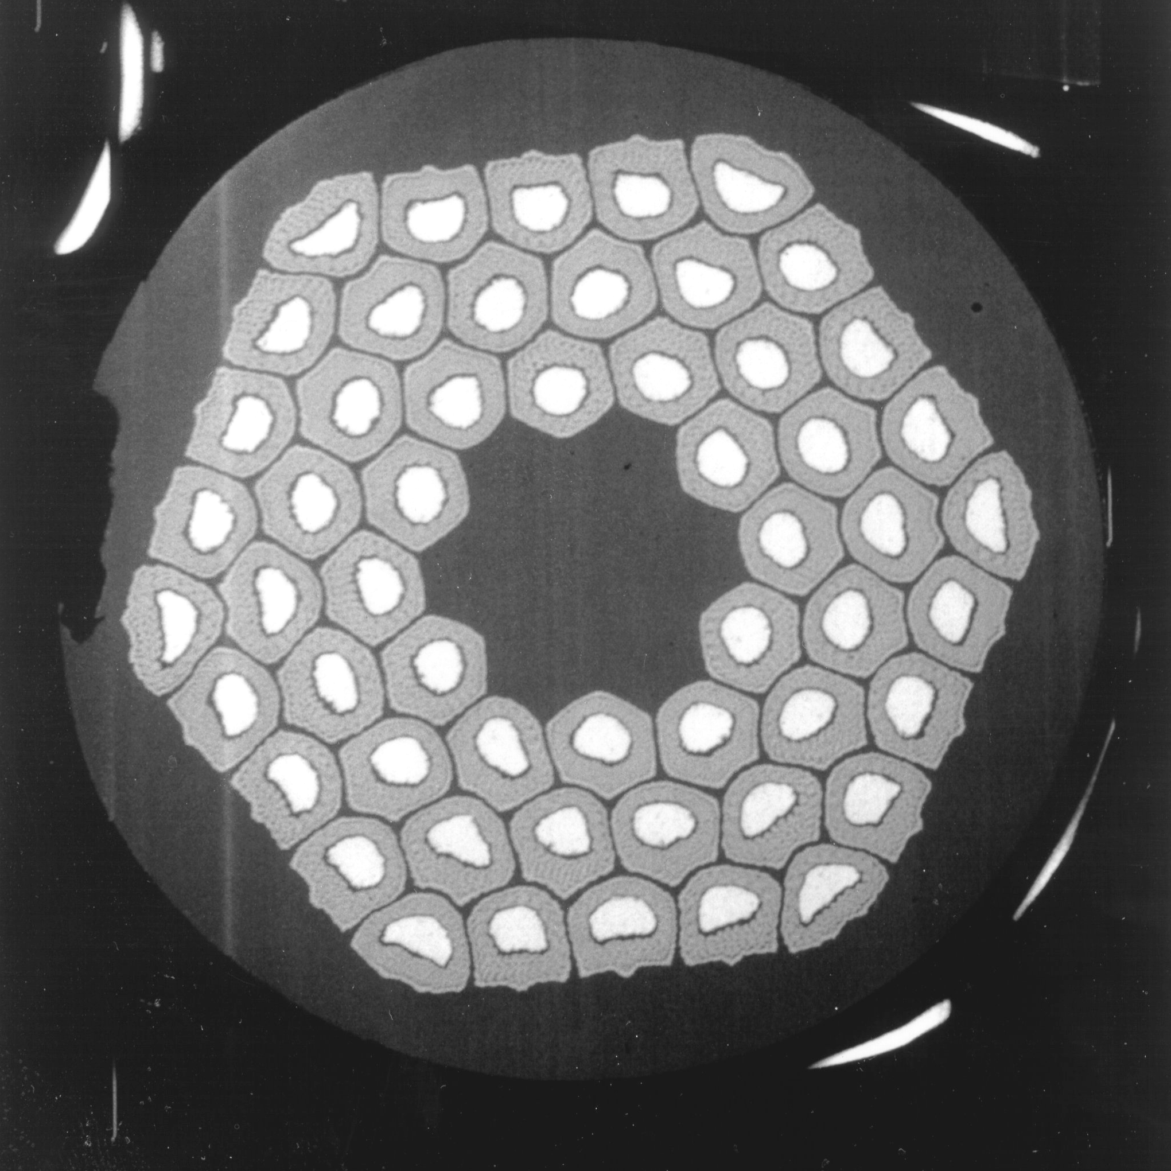
3. Multifilament wires
Fabrication of Nb₃Sn multifilament wires
Since Nb₃Sn is brittle, it cannot be extruded and drawn like NbTi. It must be formed at the end of the fabrication of the cable (or the coil).
The process requires several steps:
  Assembly multifilament billets from Nb₃Sn precursor (CuSn and Nb).
  Fabrication of the wire through extrusion-drawing technique.
  Fabrication of the cable.
  Fabrication of the coil: two different techniques
    “Wind & react” (more common)
      First coil winding and then formation of Nb₃Sn
    “React & wind”
      First formation of Nb₃Sn and then coil winding
During the “reaction”, the CuSn and Nb are heated to about 600-700 C in vacuum or inert gas (argon) atmosphere, and the Sn diffuses in Nb and reacts to form Nb₃Sn.
There are 4 main types of processes to form Nb₃Sn wires.

Slide 49
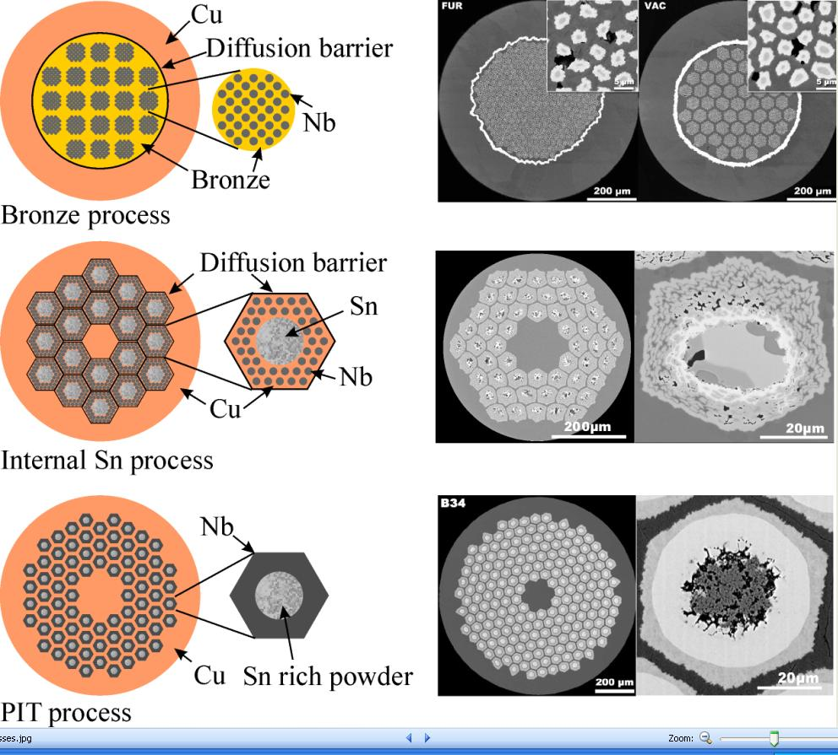
3. Multifilament wires
Fabrication of Nb₃Sn multifilament wires
Bronze process
  Nb rods are inserted in a bronze (CuSn) matrix. Pure copper is put in the periphery and protected with a diffusion barrier (Ta) to avoid contamination.
  Advantage: small filament size
  Disadvantage: limited amount of Sn in bronze and annealing steps during wire fabrication to maintain bronze ductility.
  Non-Cu J_{C} up to 1000 A/mm² at 4.2 K and 12 T.
A. Godeke, [2].

Slide 50
3. Multifilament wires
Fabrication of Nb₃Sn multifilament wires
Internal tin process
  A tin core is surrounded by Nb rods embedded in Cu (Rod Restack Process, RRP) or by layers of Nb and Cu (Modify Jelly Roll, MJR).
  Each sub-element has a diffusion barrier.
  Advantage: no annealing steps and not limited amount of Sn
  Disadvantage: small filament spacing results in large effective filament size (50 µm) and large magnetization effect and instability.
  Non-Cu J_{C} up to 3000 A/mm² at 4.2 K and 12 T.
A. Godeke, [2].

Slide 51
3. Multifilament wires
Fabrication of Nb₃Sn multifilament wires
Powder in tube (PIT) process
  NbSn₂ powder is inserted in a Nb tube, put into a copper tube.
  The un-reacted external part of the Nb tube is the barrier.
  Advantage: small filament size (30 µm) and short heat treatment (proximity of tin to Nb).
  Disadvantage: fabrication cost.
  Non-Cu J_{C} up to 2400 A/mm² at 4.2 K and 12 T.
A. Godeke, [2].

Slide 52
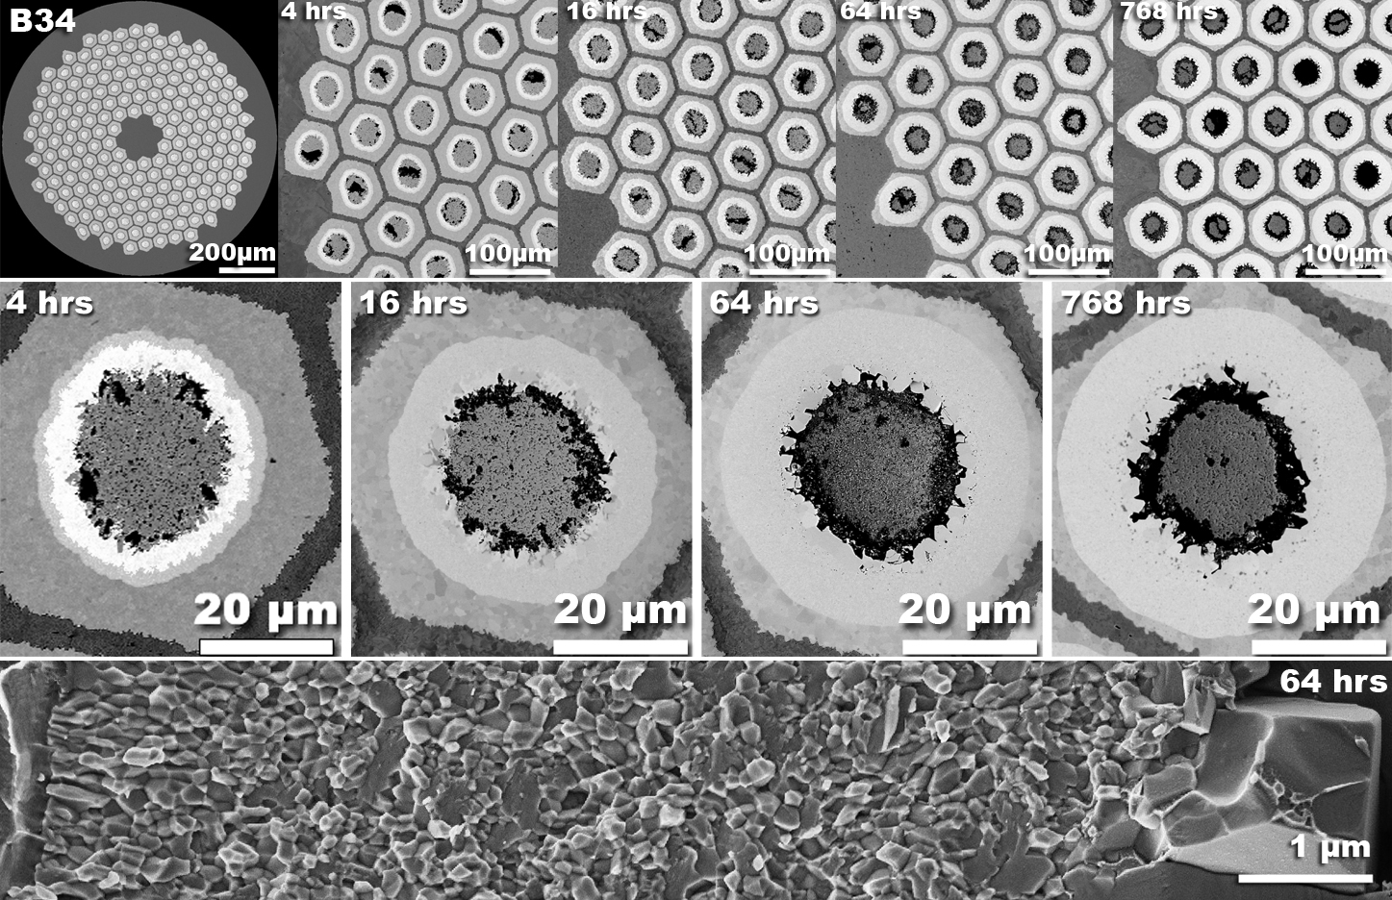
3. Multifilament wires
Fabrication of Nb₃Sn multifilament wires
Reaction of a PIT wire:
A. Godeke, [2].

Slide 53
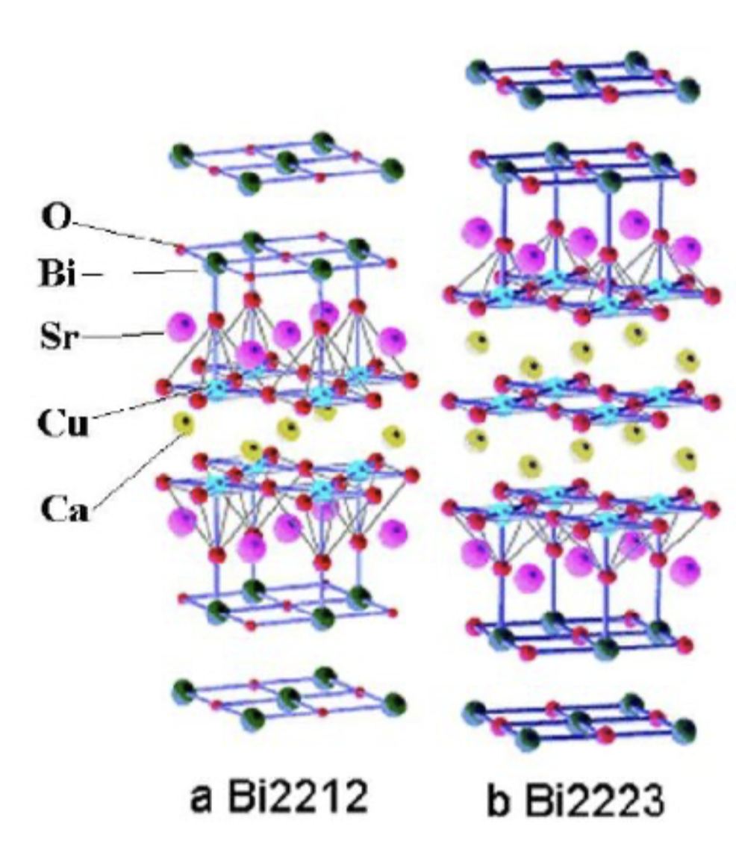
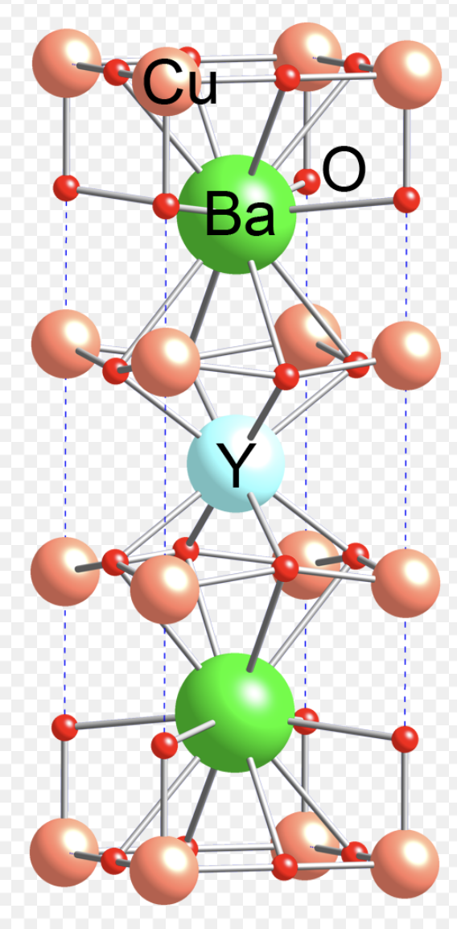
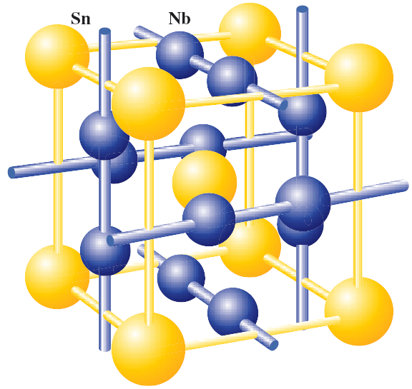
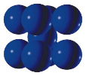
High Temperature Superconductors
Primary “commercial” materials are
  Bi2212
  REBCO
    Also known as “second generation”
    “First generation” refers to Bi2223 tapes
NbTi
Nb3Sn
YBCO

Slide 54
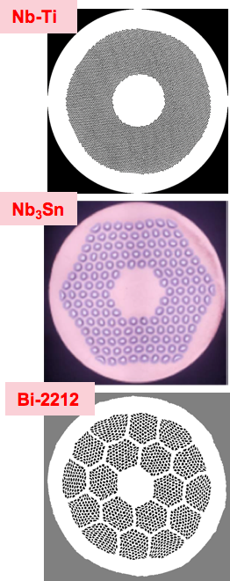
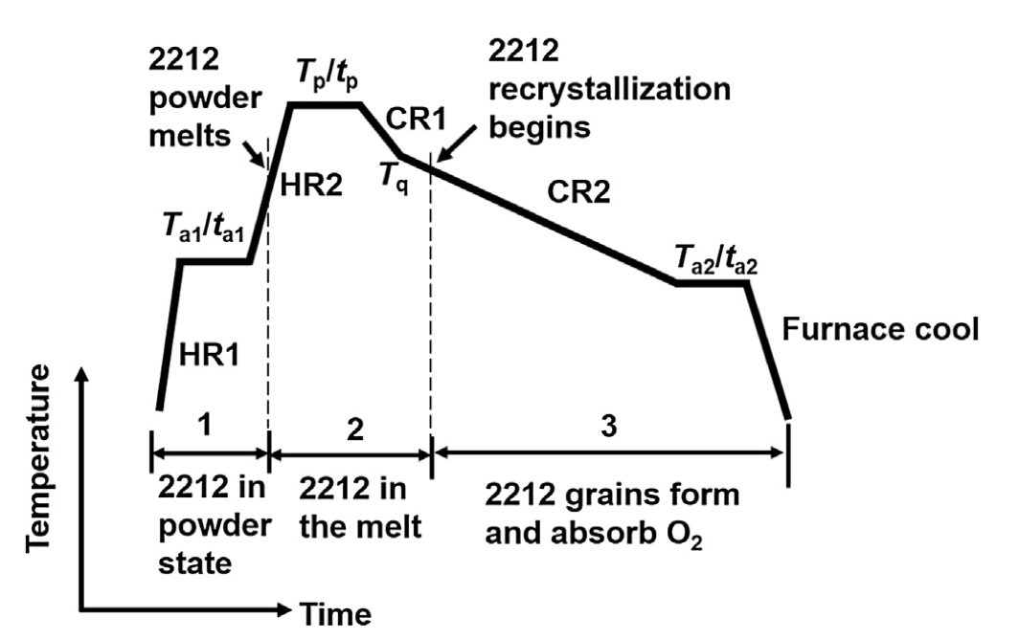
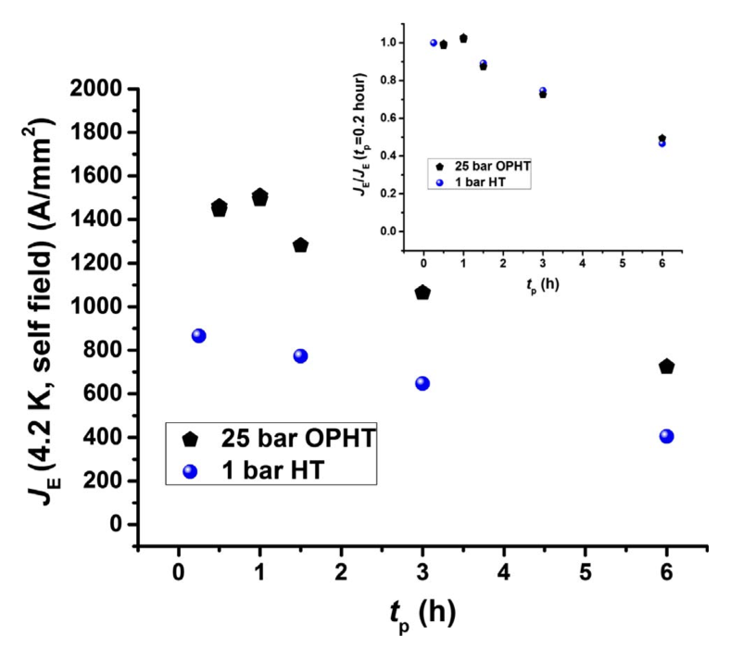
Bi2212 characteristics and fabrication
The only “multifilamentary round wire” HTS
Isotropic properties
High Hc2; barely superconducting at 77K
Relatively “easy” to fabricate
  Good piece lengths
  Good homogeneity
Fabricated using PIT
Shen et al, Cryogenics 89 (2018) 95–101

Slide 55
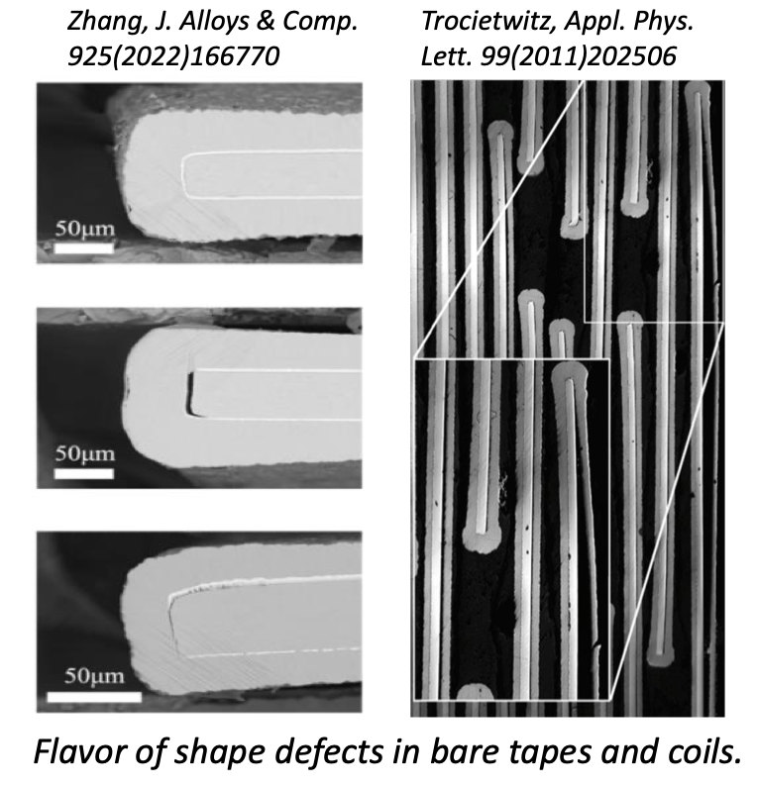
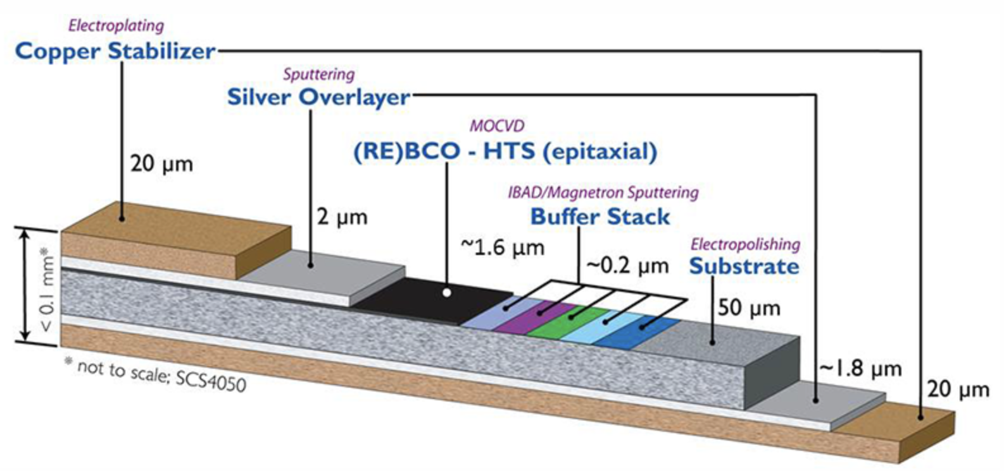
REBCO Characteristics
Tape architecture – essentially a “single crystal” grown on a substrate
Highly anisotropic: Jc(B,T,theta)
Very high critical temperature
Pinning can be enhanced
  tailored to application (e.g. B, T)
Example pinning mechanisms
Point defects
Precipitates (e.g. Y2O3 or Ba-Cu-O, due to deviation of stoichiometry)
Grain boundaries

Slide 56
Comparison of engineering current densities

Slide 57
Outline
Introduction and history
Superconducting materials
  NbTi, Nb₃Sn, and their critical surfaces
Multifilament wires
  Motivations and fabrication
Superconducting cables
  Motivations and fabrication
Cable insulation
Filling factor
Conclusions

Slide 58
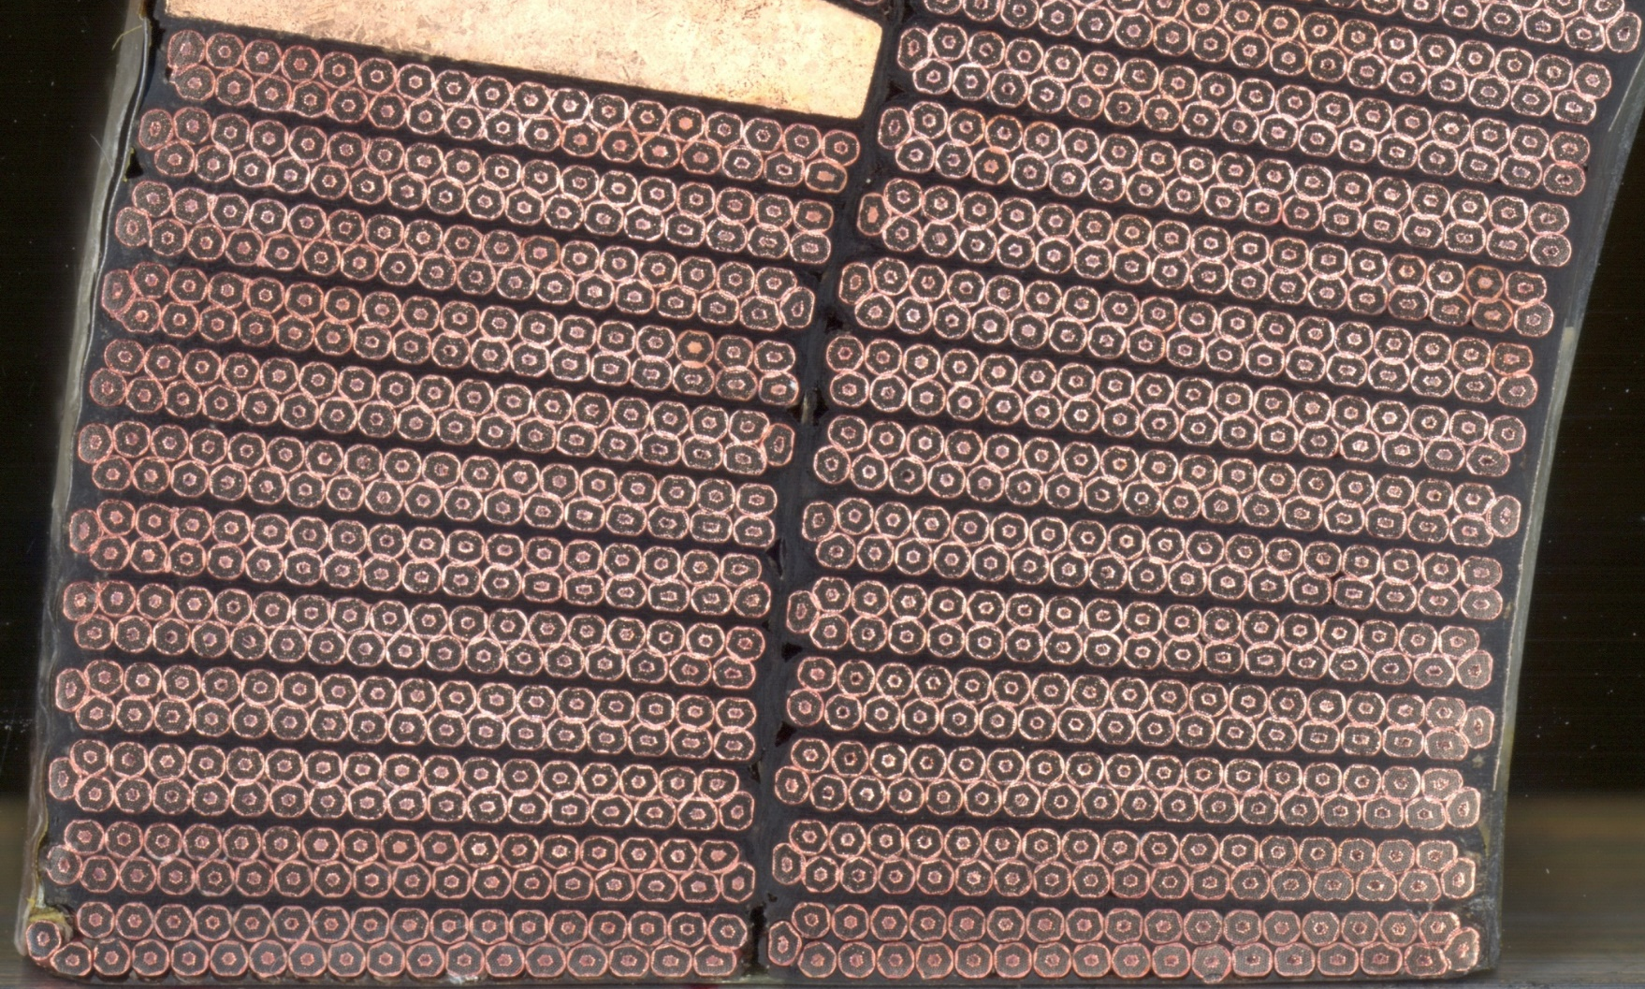
4. Superconducting cables

Slide 59
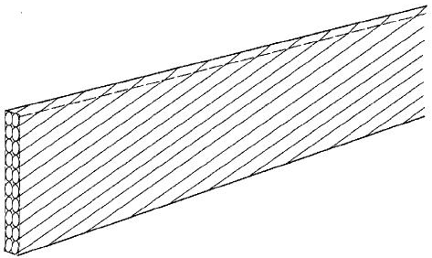

4. Superconducting cables
Motivations
Most of the superconducting coils for particle accelerators are wound from a multi-strand cable.
The advantages of a multi-strand cable are:
  reduction of the strand piece length;
  reduction of number of turns
    easy winding;
    smaller coil inductance
      less voltage required for power supply during ramp-up;
      after a quench, faster current discharge and less coil voltage.
  current redistribution in case of a defect or a quench in one strand.
The most commonly used multi-strand cables are the Rutherford cable and the cable-in-conduit.

Slide 60
4. Superconducting cables
Motivations
The strands are twisted to
  reduce interstrand coupling currents (see interfilament coupling currents): losses
  Considering a cable with N strands
    transverse field crossover resistance power W.m⁻³
    transverse field adjacent resistance power W.m⁻³
    parallel field adjacent resistance power W.m⁻³
R_{a}
R_{c}
B`
2b
2c

Slide 61



4. Superconducting cables
Motivations
The coupling currents can have a significant impact also on the field quality: ss core to further reduce them
The twist provide also more mechanical
stability for winding

Slide 62



4. Superconducting cables
Fabrication of Rutherford cable
Rutherford cables are fabricated by a cabling machine.
  Strands are wound on spools mounted on a rotating drum.
  Strands are twisted around a conical mandrel into an assembly of rolls (Turk’s head). The rolls compact the cable and provide the final shape.

Slide 63
4. Superconducting cables
Fabrication of Rutherford cable
How many strands ?
  As low as 6 (correctors, undulators, subscales…)
  LHC dipoles had 28 and 36 strand cables
  Cabling machine at CERN is limited at 40 strands – this is the number used for MQXF and 11 T
  Cabling machine in FNAL is limited by 42 strands
  Cabling machine in LBNL is limited by 60 strands – HD2 cable used 51 strands

Slide 64


4. Superconducting cables
Fabrication of Rutherford cable
The final shape of a Rutherford cable can be rectangular or trapezoidal.
The cable design parameters are:
  Number of wires N_{wire}
  Wire diameter d_{wire}
  Cable mid-thickness t_{cable}
  Cable width w_{cable}
  Pitch length p_{cable}
  Pitch angle ψ_{cable} (tanψ _{cable} = 2 w_{cable} / p_{cable})
  Cable compaction (or packing factor) k_{cable}
  i.e the ratio of the sum of the cross-sectional area of the strands (in the direction parallel to the cable axis) to the cross-sectional area of the cable.
Typical cable compaction: from 88% (Tevatron) to 92.3% (HERA).

Slide 65
4. Superconducting cables
Fabrication of Rutherford cable
The cable compaction is chosen to provide good mechanical stability and high current capability at the same time leaving enough space for helium cooling or epoxy impregnation.
The trapezoidal shape allow stacking cables in an arc-shaped coil around the beam pipe of a dipole or quadrupole.
When a cable has a trapezoidal (or keystone) shape, the defining parameter is the keystone angle ϕ_{cable} given by
Cables often exhibit degradation: critical current density of a virgin wire before cabling is higher then the one of a wire after cabling.
w_{c}
ϕ
t_{o}
t_{i}
t_{c}

Slide 66
4. Superconducting cables
Fabrication of Rutherford cable
Keystone angle
  Nb-Ti accepts a larger keystone angle – it can be order of 1 degree
  It was 1.25° for inner layer cable, 0.90° for outer layer
  2.16° used for MQY inner layer cable
  For Nb₃Sn 0.7° used in 11 T, 0.4° used in MQXF (larger aperture)

Slide 67
4. Superconducting cables
Fabrication of Rutherford cable
The size is given after cabling, at room temperature, with some azimuthal pressure: be careful about the following details
  The level of azimuthal pressure has to be defined (5 MPa ?)
  Cable could be given at 1.9 or 4.2 K (already with thermal contraction)
  In case of Nb₃Sn, there is a difference between before/after reaction that can be of few percent
Pitch length
  The transposition of the wires makes the cross section composed of elliptic strands, not circular
  Pitch length p_{cable}
  Pitch angle ψ_{cable} (tanψ _{cable} = 2 w_{cable} / p_{cable})
  The area if the ellipse is 1/cosψ_{cable} larger than the area of the strand

Slide 68



4. Superconducting cables
Fabrication of Rutherford cable
In the cable sides, the strands are deformed; the deformation determines
  a reduction of the filament cross-sectional area (Nb-Ti) or
  breakage of reaction barrier with incomplete tin reaction (Nb₃Sn).
In order to avoid degradation
  The strand cross-section after cabling is investigated
  Edge facets are measured
    General rule: no overlapping of consecutive facets
Keystone angle is usually limited to 1 or 2°.
We define as narrow edge compaction or packing factor the ratio of the area of two non-deformed strands to that of a rectangle with dimensions of the narrow edge thickness times the wire diameter, that is πd/2t_{in}.
Usually it ranges from 0.95 to 1.03.

Slide 69
4. Superconducting cables
Fabrication of Rutherford cable
Bad edge deformation
Good edge deformation
D. Dietderich, [6].

Slide 70

4. Superconducting cables
Fabrication of Rutherford cable
Compaction
  We can distinguish between thickness and width compaction
  Nb-Ti is more compacted than Nb₃Sn to avoid the danger of roping
  Nb₃Sn is less compacted than Nb-Ti to avoid the danger of degradation

Slide 71
Outline
Introduction and history
Superconducting materials
  NbTi, Nb₃Sn, and their critical surfaces
Multifilament wires
  Motivations and fabrication
Superconducting cables
  Motivations and fabrication
Cable insulation
Filling factor
Conclusions

Slide 72



5. Cable insulation
The cable insulation must feature
  Good electrical properties to withstand high turn-to-turn voltage after a quench.
  Good mechanical properties to withstand high pressure conditions
  Porosity to allow penetration of helium (or epoxy)
  Radiation hardness
In Nb-Ti magnets the most common insulation is a series of overlapped layers of polyimide (kapton).
In the LHC case:
  two polyimide layers 50.8 µm thick wrapped around the cable with a 50% overlap, with another adhesive polyimide tape 68.6 µm thick wrapped with a spacing of 2 mm.

Slide 73


5. Cable insulation
In Nb₃Sn magnets, where cable are reacted at 600-700 °C, the most common insulation is fiberglass: tape or sleeve or braided.
Typically the insulation thickness varies between 100 and 200 µm.

Slide 74



HTS cables are also under development
Fusion is a major driver for many of these developments
Major issues:
  degradation, contact resistance, AC losses, magnetization

Slide 75
Outline
Introduction and history
Superconducting materials
  NbTi, Nb₃Sn, and their critical surfaces
Multifilament wires
  Motivations and fabrication
Superconducting cables
  Motivations and fabrication
Cable insulation
Filling factor
Conclusions

Slide 76
6. Filling factor
Each strand is characterized by a copper to superconductor (Nb-Ti) or copper to non-copper area.
Each cable includes voids.
The insulation occupies additional area.
The filling factor κ is defined as the ratio of the superconductor or non copper area to the total area of the cable, including insulation, i.e,
κ = (N_{wire} A_{sc})/A_{ins}__{cable}
where N_{wire} is the number of strands per cable, A_{sc} is the area of superconductor per strand, and A_{ins}__{cable} is the area of insulated cable.
κ indicates how much area in a coil is covered by current carrying materials.
Being J_{sc} the current density in the superconductor, we define as the overall current density
J₀ = κ J_{sc}

Slide 77
6. Filling factor
Let’s consider the Nb₃Sn quadrupole magnet TQC.
  Strand diameter d_{wire} : 0.7 mm
  Cu/SC: 0.89
  Number of strand per cable N_{wire} : 27
  Cable width w_{cable} : 10.050 mm
  Cable mid-thickness t_{cable} : 1.260 mm
  Cable inner edge thickness t_{cable_in} : 1.172 mm
  Cable outer edge thickness t_{cable_out} : 1.348 mm
  Cable insulation thickenss t_{ins} : 0.125 mm
Therefore
  N_{wire} A_{sc} = (N_{wire} π d²_{wire} / 4) /(Cu/SC+1) = 5.498 mm²
  A_{ins_cable} = 15.553 mm²
  κ = 0.35

Slide 78
6. Filling factor
Filling ratio: 0.25-0.33

Slide 79

Different j
J_{sc} = J_{supercondutor} = I_{strand} / A_{superconductor}
J_{e} = J_{engineering}= I_{strand} / A_{strand}
J_{o} = J_{overall}= I_{cable} / A_{insulated_cable}

Slide 80
Outline
Introduction and history
Superconducting materials
  NbTi, Nb₃Sn, and their critical surfaces
Multifilament wires
  Motivations and fabrication
Superconducting cables
  Motivations and fabrication
Cable insulation
Filling factor
Conclusions

Slide 81
7. Conclusions
In this unit we briefly explained why superconducting materials used in accelerator magnets are
  subdivided in filaments of small diameters
  twisted together
  embedded in a copper matrix
  and finally combined in a multistrand cable.
We then described how strands are fabricated and we introduced some parameters used to characterize a superconducting cable
  Cable compaction k_{cable}
  Keystone angle ϕ_{cable}
  Filling factor κ

Slide 82
Appendix

Slide 83


Slide 84
MgB₂
MgB₂ is a recent discovery
  Discovered in 2001
  Critical temperature of 39 K, critical field of less than 10 T
  Anomaly in the classification: low temperature or high temperature superconductor?
  Low field but low cost and easy manufacturing
    Interesting for power lines or low field (<10 T) magnets
    Project for superconducting link in MgB₂ in High Luminosity LHC
    www.cern.ch/hilumi and A. Ballarino et al., IEEE Trans Appl Supercond 21 (2011) 980-983
    Technological development of superferric magnet in the HL-LHC framework www.cern.ch/hilumi and M. Sorbi, M. Statera, S. Mariotto et al., IEEE Trans Appl Supercond 29 (2019) 4004505

Slide 85

SUPERCONDUCTIVITY
BSCCO and YBCO
Critical current density in the superconductor versus field for different materials at 4.2 K [P. J. Lee, et al]
https://nationalmaglab.org/images/magnet_development/asc/plots/JeChart041614-1022x741-pal.png

Slide 86
BSCCO AND YBCO
BSSCO and YBCO are the two main HTS (high temperature superconductors
  Discovered in 1988/86
  Large critical temperature ≈100 K
  Very large critical field above 150 T
  Flat critical surface (little dependence on field)
  Large progress in reaching good current density
  Both expensive (more than 10 times Nb-Ti …)
  Drawbacks:
    YBCO round wires are not trivial – most application on tapes
    BSCCO requires a heat treatment at 800 C , and 100 bar of oxygen to increase j
  NMR/MRI solenoids with HTS tapes have been developed
  Projects of dipole inserts for accelerator magnets are onging in many labs (LBNL, BNL, CERN, CEA, …)

Slide 87

4. Superconducting cables
Fabrication of Rutherford cable
For the large solenoids in an accelerator experiment, copper around filament may not be enough to avoid overheating after a quench.
  Large inductance and slow current discharge.
Additional stabilizer (low resistivity material) is added around the strands.
High purity aluminum is transparent to particles and reduced weight with respect to copper.
Cable are fabricated by co-extrusion. This ensure good contact between strands and superstabilizer.

