Slide 1
Unit 8 AC losses in Superconductors
Paolo Ferracin
Lawrence Berkeley National Laboratory (LBNL)
Maxim Marchevsky
Lawrence Berkeley National Laboratory (LBNL)
Ezio Todesco
European Organization for Nuclear Research (CERN)
Soren Prestemon
Lawrence Berkeley National Laboratory (LBNL)

Slide 2
Scope of the Lesson
AC losses – general classification
Hysteresis losses
Coupling and eddy current losse
Self-field losses
Role of transport current in loss terms
Impact of AC losses on cryogenics
Specifying conductors based on the application
Following closely the presentation of Wilson “Superconducting magnets”
Also thanks to:
Mess, Schmueser, Wolff, “Superconducting Accelerator Magnets”
Marijn Oomen Thesis “AC Loss in Superconducting Tapes and Cables”
M.N. Wilson / Cryogenics 48 (2008) 381–395
T. M. Mower and Y. Iwasa, Cryogenics, vol. 26, no. 5, pp. 281–292, May 1986.

Slide 3
Introduction
Superconductors subjected to varying magnetic fields see multiple heat sources that can impact conductor performance and stability
All of the energy loss terms can be understood as emanating from the voltage induced in the conductor:
The hysteretic nature of magnetization in type II superconductors, i.e. flux flow combined with flux pinning, results in a net energy loss when subjected to a field cycle
The combination of individual superconducting filaments and a separating normal-metal matrix results in a coupling Joule loss
Similarly, the normal-metal stabilizer sees traditional eddy currents

Slide 4
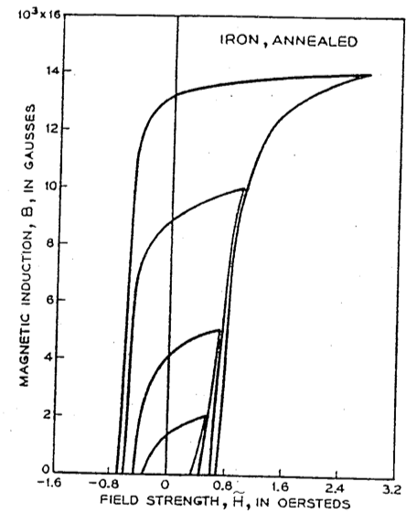
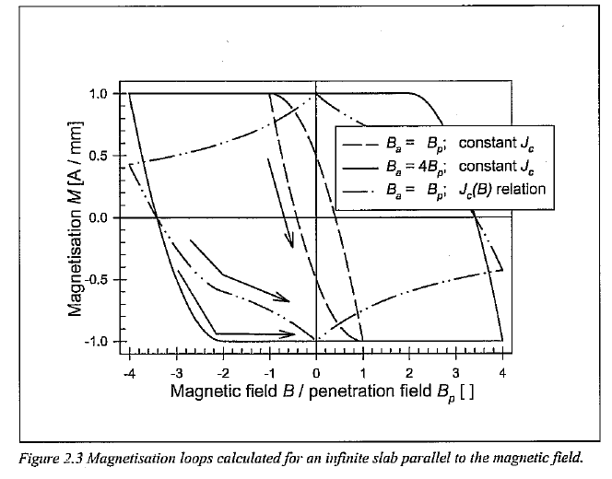
Magnetization losses
The superconductor B-H cycle defines losses associated with magnetization: the area enclosed in a loop is lost as heat

Slide 5
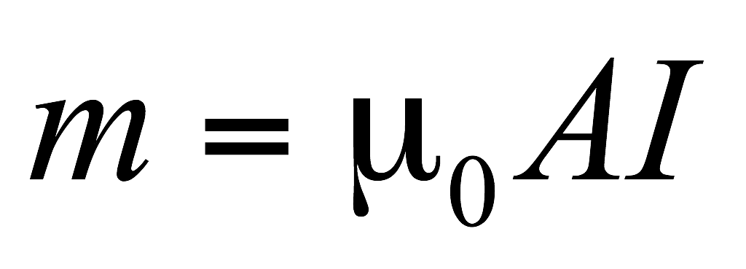
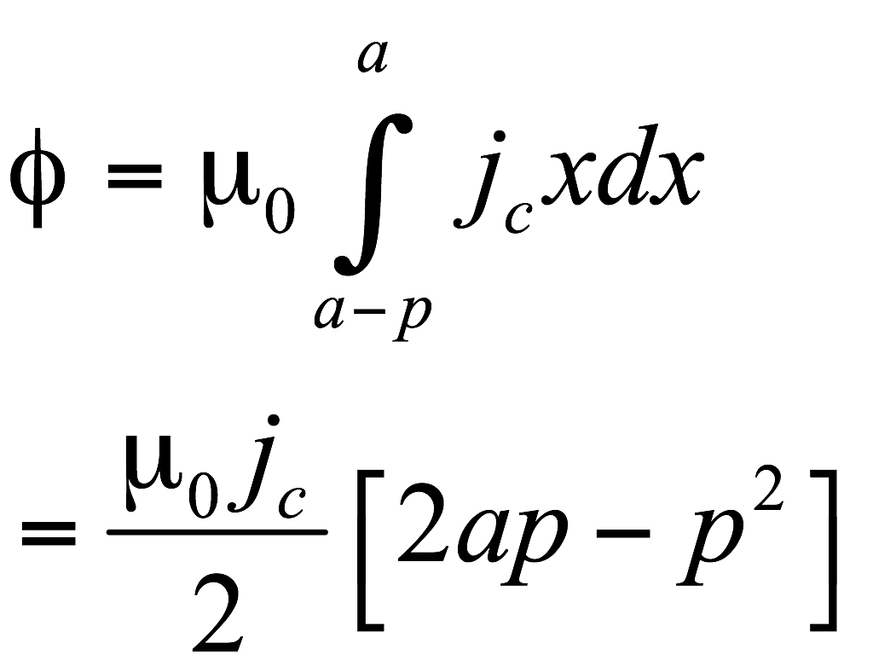
Hysteresis losses – basic model
Hysteresis loss is
y
Problem: how do we quantify this?
Note that magnetic moment generated by a current loop I enclosing an area A is defined as
The magnetization M is the sum of the magnetic moments/volume.
Assume j=j_{c} in the region of flux penetration in the superconductor (Bean Model), then
x
-j_{c}
j_{c}
2a
p
H
Below H_{c1} the superconductor is in the Meissner state and the magnetization from dH/dt corresponds to pure energy storage, i.e. there is no energy lost in heat;
Beyond H_{c1} flux pinning generates hysteretic B(H) behavior; the area enclosed by the B(H) curve through a dB/dt cycle represents thermal loss

Slide 6
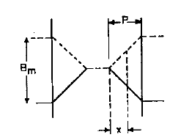
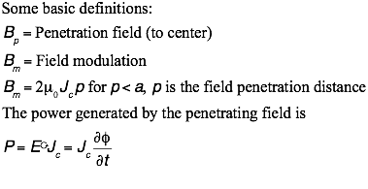
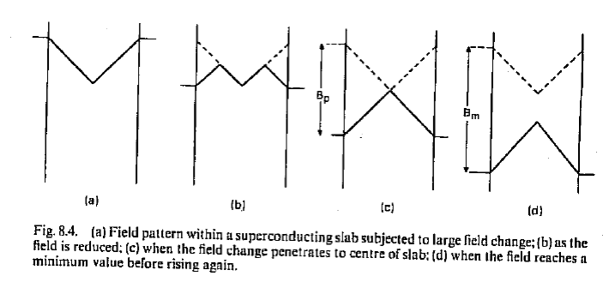
Calculating hysteresis losses
y
x
By

Slide 7
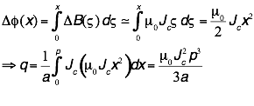
Calculating hysteresis losses
The total heat generated for a half-cycle is then
Note that this calculation assumed p<a; a similar analysis can be applied for the more generally case in which the sample is fully penetrated.
2a

Slide 8
The Critical State
Slide taken from Lance Cooley, USPAS
M
5
4
Field
6
a
7
3
H
a
H_{c1}
b
8
Meissner
2
b
1
9
10
1
2
3
4
10
5
9
8
7
6

Slide 9
Understanding AC losses via magnetization
The screening currents are bound currents that correspond to sample magnetization.
Integration of the hysteresis loop quantifies the energy loss per cycle
=> Will result in the same loss as calculated using

Slide 10
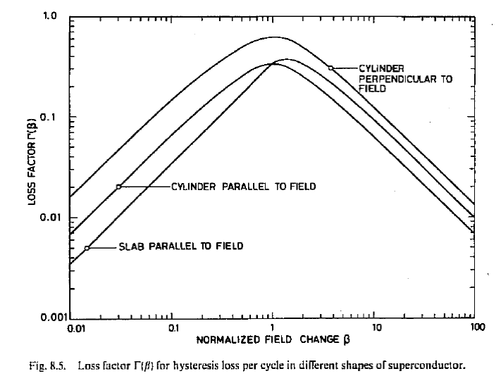
Hysteresis losses - general
The hysteresis model can be developed in terms of:
To reduce losses, we want
β<<1 (little field penetration, so loss/volume is small) or
β>>1 ( full flux penetration, but little overall flux movement)

Slide 11
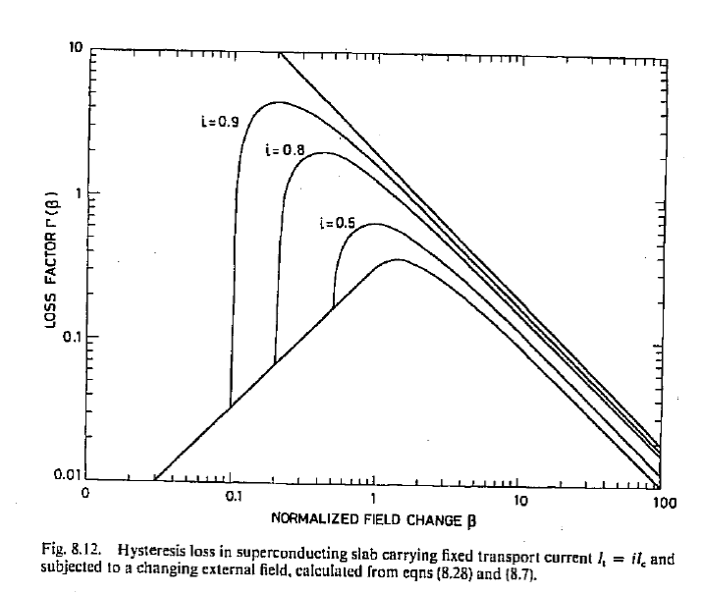
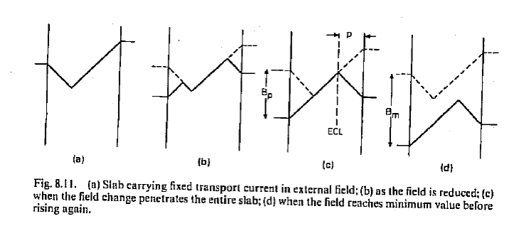
Hysteresis losses
The addition of transport current enhances the losses; this can be viewed as stemming from power supply voltage compensating the system inductance voltage generated by the varying background field.

Slide 12
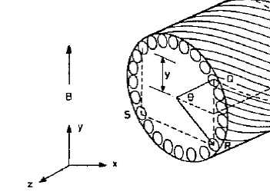
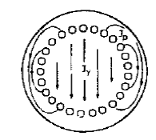
Coupling losses
A multifilamentary wire subjected to a transverse varying field will see an electric field generated between filaments of amplitude:
The metal matrix then sees a current (parallel to the applied field) of amplitude:
Similarly, the filaments couple via the periphery to yield a current:
There are also eddy currents of amplitude:

Slide 13
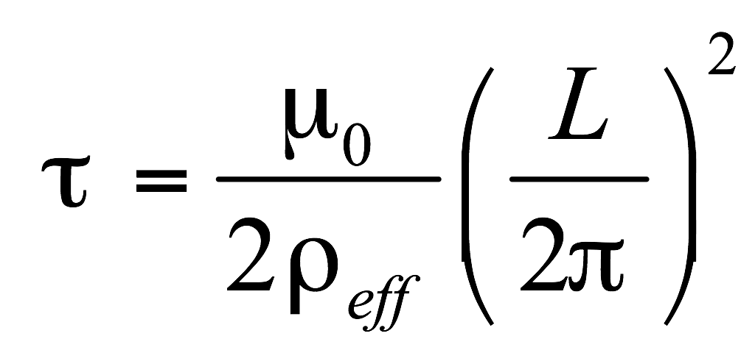
Coupling losses – time constant
The combined Cos(θ) coupling current distribution leads to a natural time constant (coupling time constant):
The time constant τ corresponds to the natural decay time of the eddy currents when the varying field becomes stationary.
The losses associated with these currents (per unit volume) are:
Here B_{m} is the maximum field during the cycle.

Slide 14
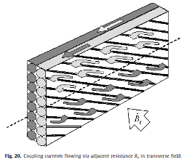
Coupling losses – Rutherford cables
Coupling currents also form between strands in cables
Add core to dramatically reduce transverse coupling, while maintaining decent Ra for current sharing

Slide 15
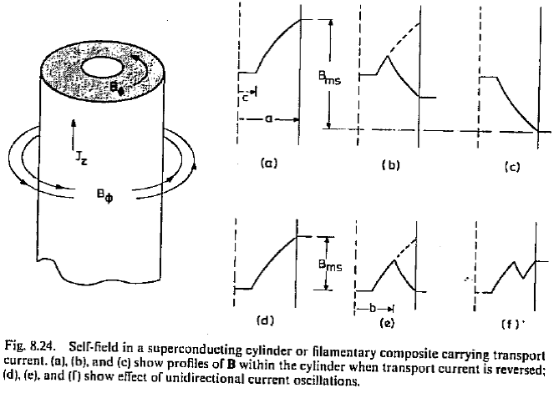
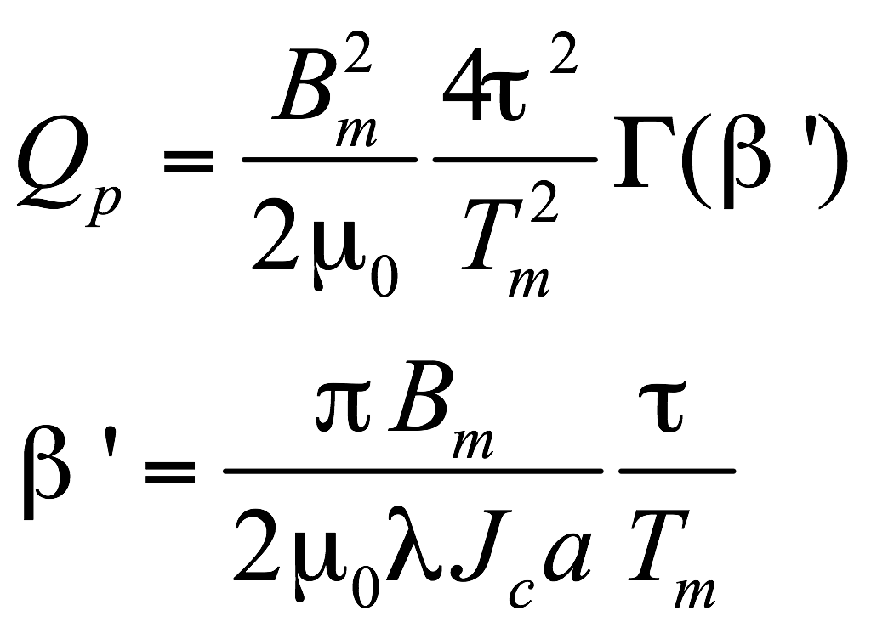
Other loss terms
In the previous analysis, we assumed the cos(θ) longitudinal current flowed on the outer filament shell of the conductor. Depending on dB/dt, ρ, and L, the outer filaments may saturate (i.e. reach Jc), resulting in a larger zone of field penetration. The field penetration results in an additional loss term:
Self-field losses: as the transport current is varied, the self-field lines change, penetrating and exiting the conductor surface. The effect is independent of frequency, yielding a hysteresis-like energy loss:

Slide 16
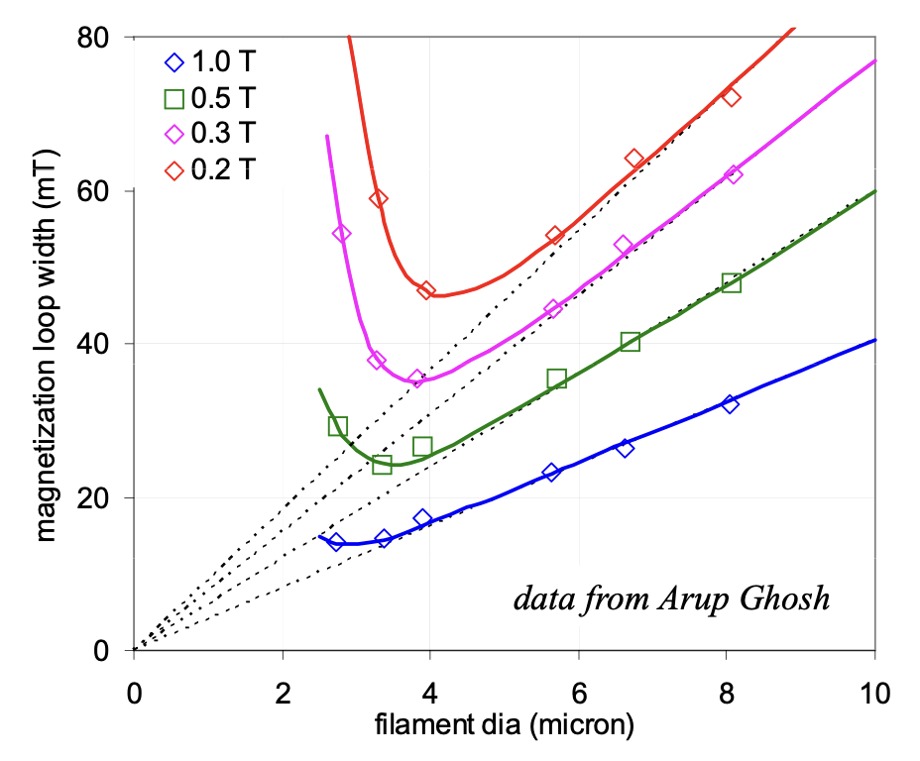
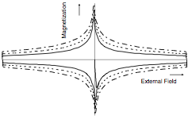
First estimate of AC losses: Hysteresis losses
[J/m³, per cycle]
[J, per cycle]
This has motivated the quest for fine filament wire!
Hysteresis loss reduction:
- minimize Deff

Slide 17
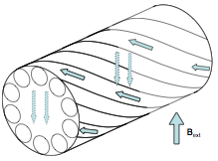
First estimate of AC losses: Coupling losses
[W/m³]
Coupling loss reduction:
- minimize twist pitch

Slide 18
Use of the AC-loss models
It is common (but not necessarily correct) to add the different AC loss terms together to determine the loss budget for an conductor design and operational mode.
AC loss calculations are “imperfect”:
Uncertainties in effective resistivities (e.g. matrix resistivity may vary locally, e.g. based on alloy properties associated with fabrication; contact resistances between metals may vary, etc)
Calculations invariably assume “ideal” behavior, e.g. Bean model, homogeneous external field, etc.
For real applications, these models usually suffice to provide grounds for conductor specifications and/or cryogenic budgeting
For critical applications, AC-loss measurements (non-trivial!) should be undertaken to quantify key parameters

Slide 19
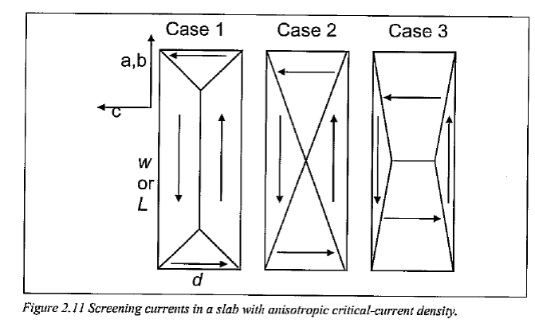
Special cases: HTS tapes
HTS tapes have anisotropic Jc properties that impact AC losses.
The same general AC loss analysis techniques apply, but typical operating conditions impact AC loss conclusions:
the increased specific heat at higher temperatures has significant ramifications - enhances stability
Cryogenic heat extraction increases with temperature, so higher losses may be tolerated

Slide 20
AC losses and cryogenics
The AC loss budget must be accounted for in the cryogenic system
Design must account for thermal gradients – e.g. from strand to cable, through insulation, etc. and provide sufficient temperature margin for operation
Typically the temperature margin needed will also depend on the cycle frequency; the ratios of the characteristic cycle time (τ_{w}) and characteristic diffusion time (τ_{d}) separates two regimes:
τ_{w}<< τ_{d} : Margin determined by single cycle enthalpy
τ_{w}>> τ_{d} : Margin determined by thermal gradients
The AC loss budget is critical for applications requiring controlled current rundown; if the AC losses are too large, the system may quench and the user loses control of the decay rate

Slide 21
Specifying conductors for AC losses
As a designer, you have some control over the ac losses:
Control by conductor specification
Filament size
Contact resistances
Twist pitch
Sufficient temperature margin (e.g. material T_{c}, fraction of critical current, etc)
Control by cryogenics/cooling
Appropriate selection of materials for good thermal conductivity
Localization of cryogens near thermal loads to minimize ΔT
Remember: loss calculations are imperfect! For critical applications, AC loss measurements may be required, and some margin provided in the thermal design to accommodate uncertainties

