Slide 1
Unit 9
Electro-magnetic forces and stresses in superconducting accelerator magnets
Chapter I
Paolo Ferracin
Lawrence Berkeley National Laboratory (LBNL)

Slide 2
Outline
Introduction
Electro-magnetic force
  Definition and directions
Magnetic pressure and forces
Approximations of practical winding cross-sections
  Thin shell, Thick shell, Sector
Stored energy and end forces
Stress and strain
Pre-stress
Conclusions

Slide 3
References
[1] Y. Iwasa, “Case studies in superconducting magnets”, New York, Plenum Press, 1994.
[2] M. Wilson, “Superconducting magnets”, Oxford UK: Clarendon Press, 1983.
[3] A.V. Tollestrup, “Superconducting magnet technology for accelerators”, Ann. Reo. Nucl. Part. Sci. 1984. 34, 247-84.
[4] K. Koepke, et al., “Fermilab doubler magnet design and fabrication techniques”, IEEE Trans. Magn., Vol. MAG-15, No. l, January 1979.
[5] S. Wolff, “Superconducting magnet design”, AIP Conference Proceedings 249, edited by M. Month and M. Dienes, 1992, pp. 1160-1197.
[6] A. Devred, “The mechanics of SSC dipole magnet prototypes”, AIP Conference Proceedings 249, edited by M. Month and M. Dienes, 1992, p. 1309-1372.
[7] T. Ogitsu, et al., “Mechanical performance of 5-cm-aperture, 15-m- long SSC dipole magnet prototypes”, IEEE Trans. Appl. Supercond., Vol. 3, No. l, March 1993, p. 686-691.
[8] J. Muratore, BNL, private communications.
[9] “LHC design report v.1: the main LHC ring”, CERN-2004-003-v-1, 2004.
[10]A.V. Tollestrup, “Care and training in superconducting magnets”, IEEE Trans. Magn.,Vol. MAGN-17, No. l, January 1981, p. 863-872.
[11] N. Andreev, K. Artoos, E. Casarejos, T. Kurtyka, C. Rathjen, D. Perini, N. Siegel, D. Tommasini, I. Vanenkov, MT 15 (1997) LHC PR 179.
[12]E. Todesco, “Masterclass - Design of superconducting magnets for particle accelerators”, https://indico.cern.ch/category/12408/

Slide 4
1. Introduction
Superconducting accelerator magnets are characterized by high fields and high current densities.
As a result, the coil is subjected to strong electro-magnetic forces, which tend to move the conductor and deform the winding.
A good knowledge of the magnitude and direction of the electro-magnetic forces, as well as of the stress of the coil, is mandatory for the mechanical design of a superconducting magnet.
In this unit we will describe the effect of these forces on the coil through simplified approximation of practical winding, and we will introduced the concept of pre-stress, as a way to mitigate their impact on magnet performance.

Slide 5
2. Electro-magnetic force
Definition
In the presence of a magnetic field (induction) B, an electric charged particle q in motion with a velocity v is acted on by a force F_{L} called electro-magnetic (Lorentz) force [N]:
A conductor element carrying current density J (A/mm²) is subjected to a force density f_{L} [N/m³]
The e.m. force acting on a coil is a body force, i.e. a force that acts on all the portions of the coil (like the gravitational force).

Slide 6
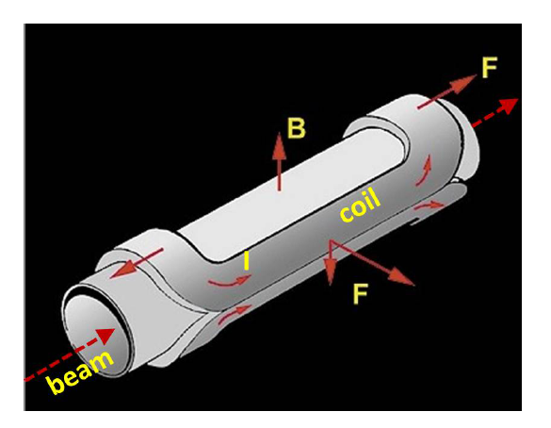
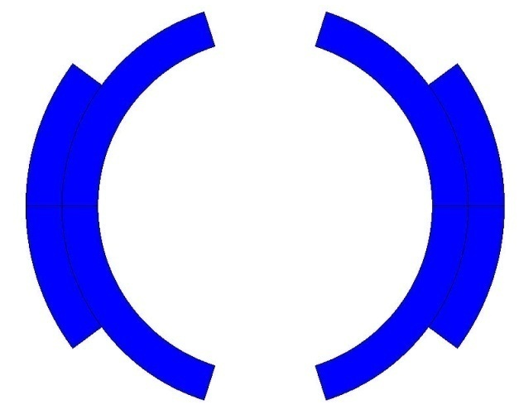
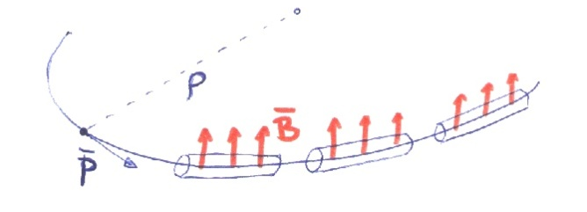
2. Electro-magnetic force
Dipole magnets
Main field components is B_{y}
  Perpendicular to the axis of the magnet z
Electro-magnets: field produced by a current (or current density)
Magnetic field steers (bends) the particles in a ∼circular orbit
×
by E. Todesco
×

Slide 7
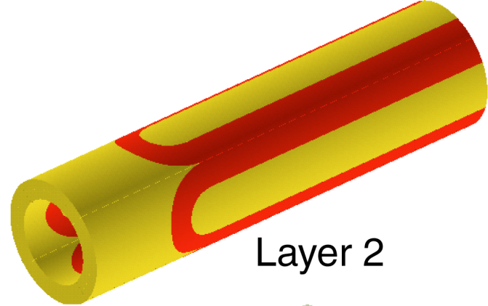
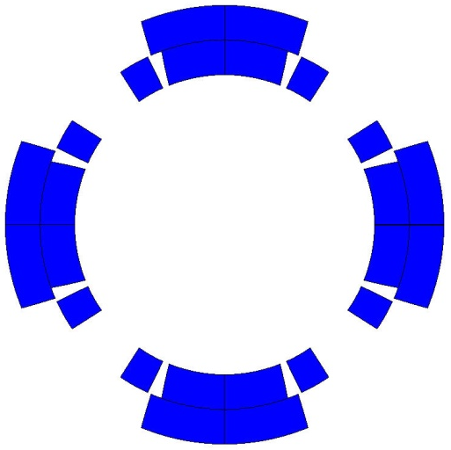
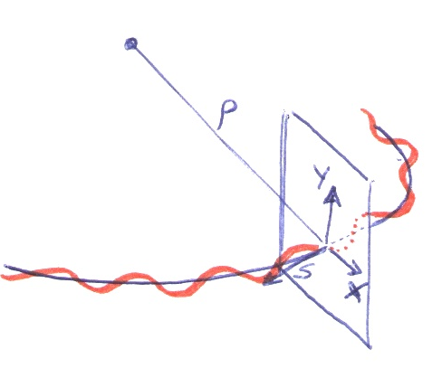
2. Electro-magnetic force
Quadrupole magnet
The force necessary to stabilize linear motion is provided by the quadrupoles
  They provide a field
    equal to zero in the center
    increasing linearly with the radius
They act as a spring: focus the beam
Prevent protons from falling to the bottom of the aperture due to the gravitational force
  it would happen in less than 60 ms
×
×
by E. Todesco

Slide 8
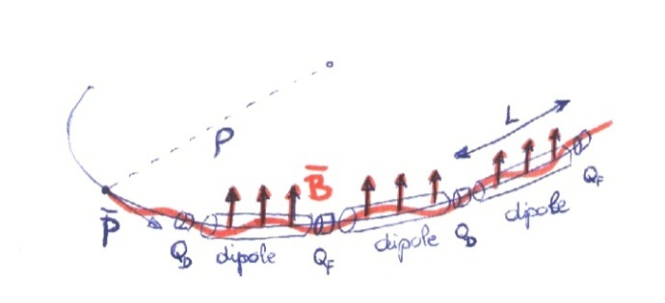
2. Electro-magnetic force
Quadrupole magnets
A typical accelerator structure is the FODO cell
  Alternating quadrupoles spaced by length L of similar gradient
One can prove that this gives positive focusing in both transverse planes
by E. Todesco
×
×
×
×

Slide 9
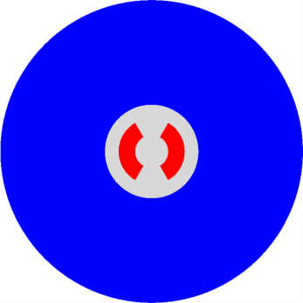
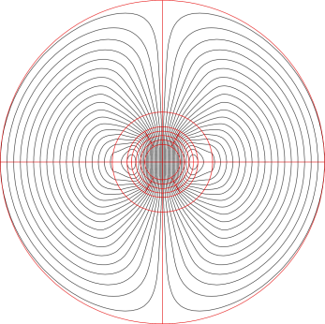
2. Electro-magnetic force
Definition
The superconducting coil (with a J) is in its own field B

Slide 10
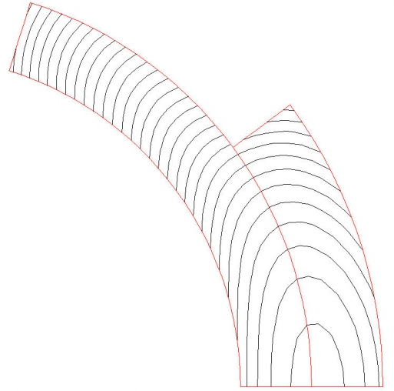
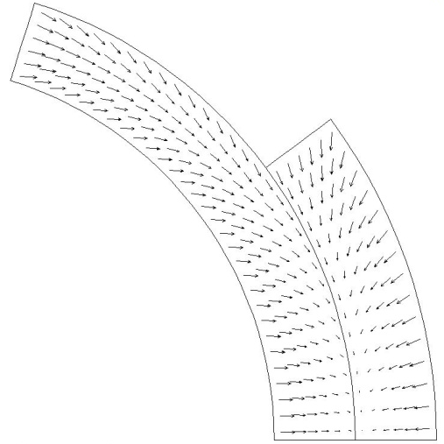
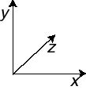
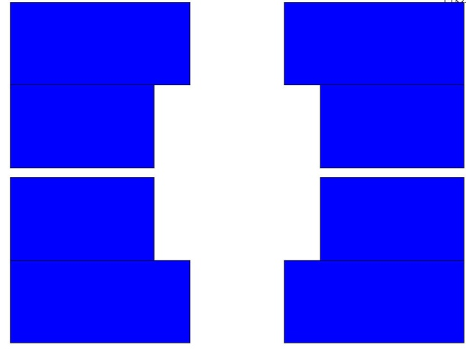
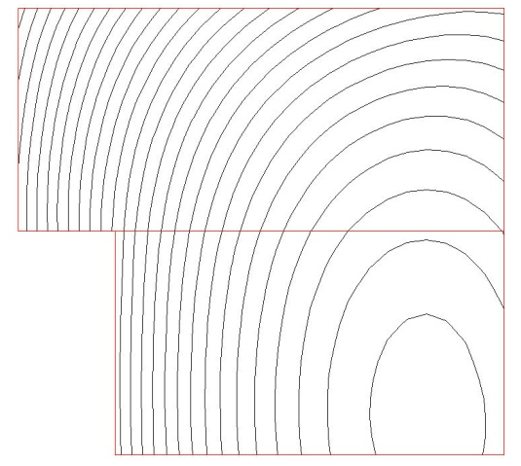
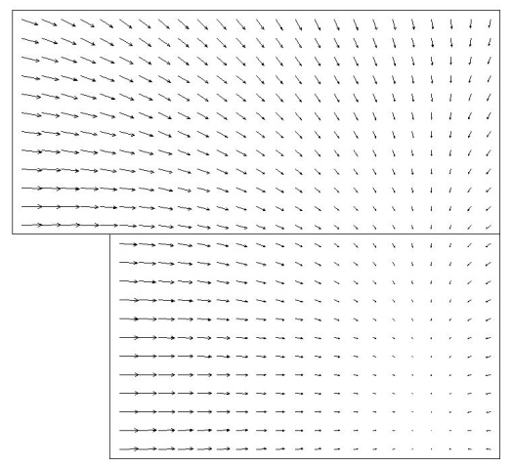
2. Electro-magnetic force
Dipole magnets
The e.m. forces in a dipole magnet tend to push the coil
  Towards the mid-plane in the vertical-azimuthal direction (F_{y}, F_{θ} < 0)
  Outwards in the radial-horizontal direction (F_{x}, F_{r} > 0)
Tevatron dipole
HD2

Slide 11
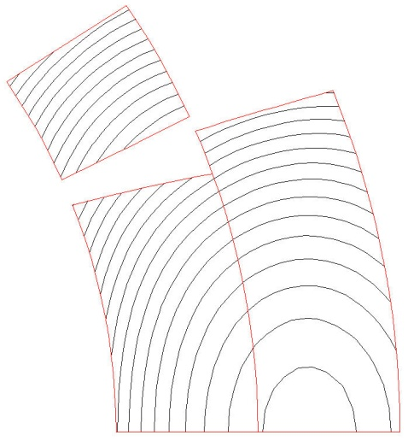
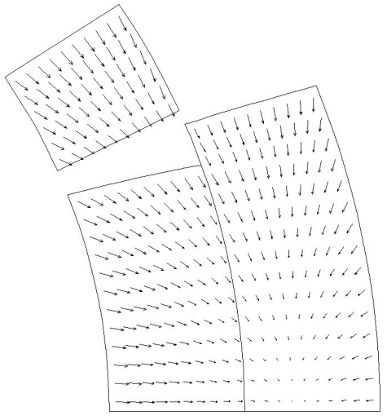
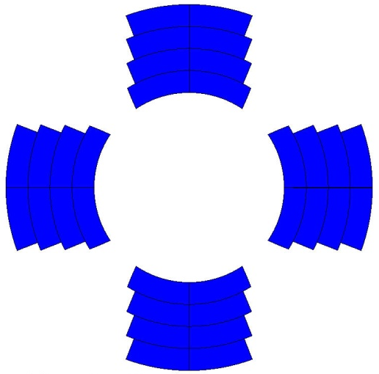
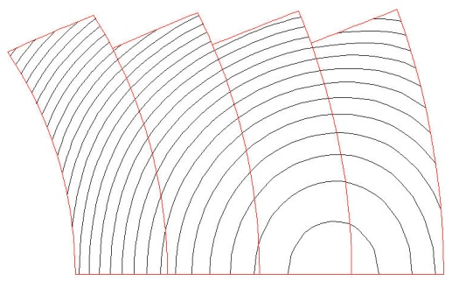
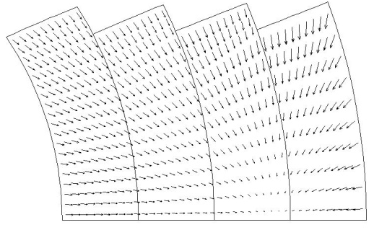
2. Electro-magnetic force
Quadrupole magnets
The e.m. forces in a quadrupole magnet tend to push the coil
  Towards the mid-plane in the vertical-azimuthal direction (F_{y}, F_{θ} < 0)
  Outwards in the radial-horizontal direction (F_{x}, F_{r} > 0)
TQ
HQ

Slide 12
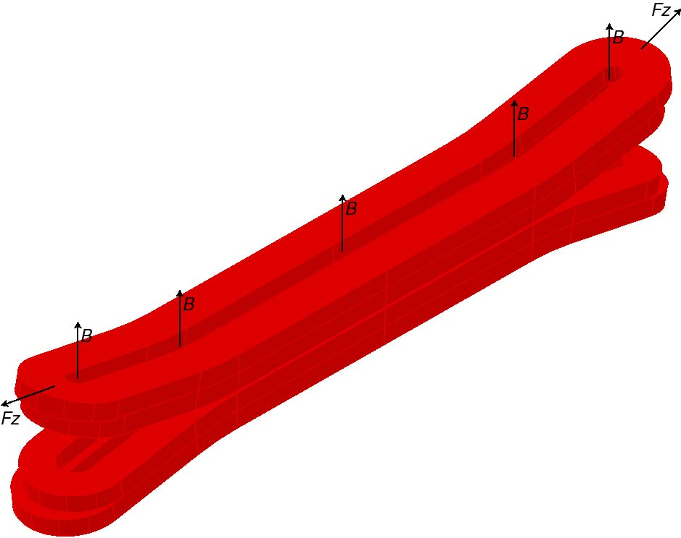
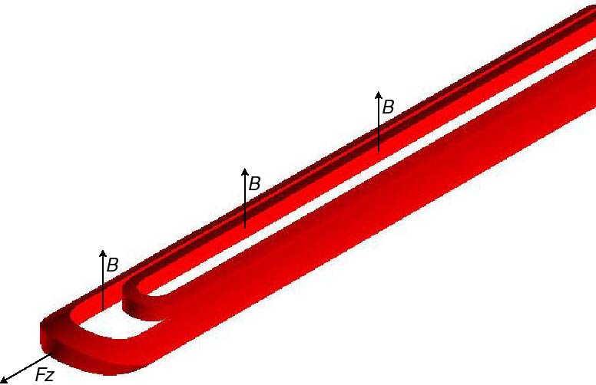
2. Electro-magnetic force
End forces in dipole and quadrupole magnets
In the coil ends the Lorentz forces tend to push the coil
  Outwards in the longitudinal direction (F_{z} > 0)
Similarly as for the solenoid, the axial force produces an axial tension in the coil straight section.

Slide 13
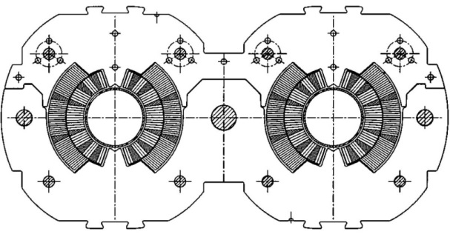
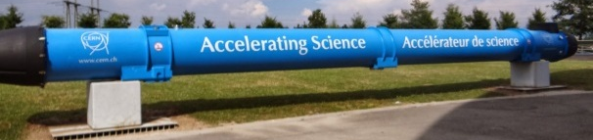

2. Electro-magnetic force
End forces in dipole and quadrupole magnets
Nb-Ti LHC MB (values per aperture)
  F_{x} = 340 t per meter
    ~300 compact cars
    Precision of coil positioning: 20-50 μm
  F_{z} = 27 t
    ~weight of the cold mass
Nb₃Sn dipole (HD2)
  F_{x} = 500 t per meter
  F_{z} = 85 t
  These forces are applied to an objet with a cross-section of 150x100 mm !!!
    and by the way, it is brittle

Slide 14
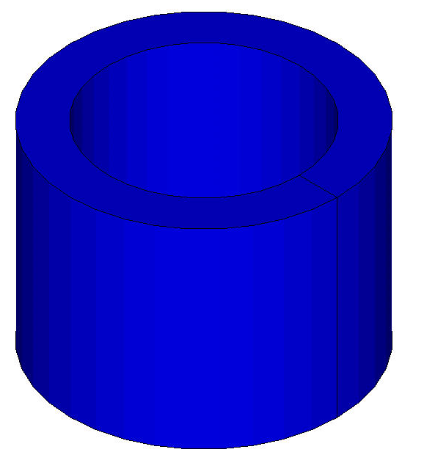
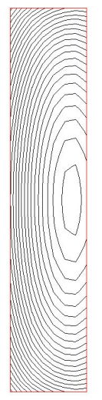
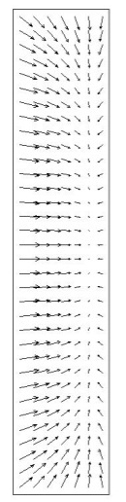
2. Electro-magnetic force
Solenoids
The e.m. forces in a solenoid tend to push the coil
  Outwards in the radial-direction (F_{r} > 0)
  Towards the mid plane in the vertical direction (F_{y} < 0)
Important difference between solenoids and dipole/quadrupole magnets
  In a dipole/quadrupole magnet the horizontal component pushes outwardly the coil
    The force must be transferred to a support structure
  In a solenoid the radial force produces a circumferential hoop stress in the winding
    The conductor, in principle, could support the forces with a reacting tension

Slide 15
Outline
Introduction
Electro-magnetic force
  Definition and directions
Magnetic pressure and forces
Approximations of practical winding cross-sections
  Thin shell, Thick shell, Sector
Stored energy and end forces
Stress and strain
Pre-stress
Conclusions

Slide 16
3. Magnetic pressure and forces
The magnetic field is acting on the coil as a pressurized gas on its container.
Let’s consider the ideal case of a infinitely long “thin-walled” solenoid, with thickness d, radius a, and current density J_{θ} .
The field outside the solenoid is zero. The field inside the solenoid B₀ is uniform, directed along the solenoid axis and given by
The field inside the winding decreases linearly from B₀ at a to zero at a + δ. The average field on the conductor element is B₀/2, and the resulting Lorentz force is radial and given by

Slide 17
3. Magnetic pressure and forces
We can therefore define a magnetic pressure p_{m} acting on the winding surface element:
where
So, with a 10 T magnet, the windings undergo a pressure p_{m} = (10²)/(2· 4 π × 10⁻⁷) = 4 × 10⁷ Pa = 395 atm.
The force pressure increase with the square of the field.
A pressure [N/m²] is equivalent to an energy density [J/m³].

Slide 18

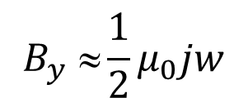
3. Still about solenoids and dipoles
Comparing the two magnets, one can see that solenoids have 50% more conductor the dipoles, but produce twice the field
  Although, in the first the field is parallel to “z”, in the second perpend.
Therefore, a solenoid has a 33% larger efficiency w.r.t. a dipole in producing field for a given quantity of conductor.
$$B_{y} ≈\frac{1}{2}μ_{0}jw$$
$$B_{z}=μ_{0}jw$$
z

Slide 19
Outline
Introduction
Electro-magnetic force
  Definition and directions
Magnetic pressure and forces
Approximations of practical winding cross-sections
  Thin shell, Thick shell, Sector
Stored energy and end forces
Stress and strain
Pre-stress
Conclusions

Slide 20
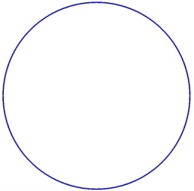
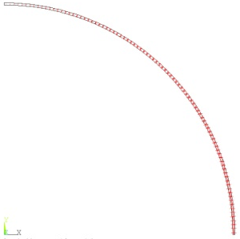
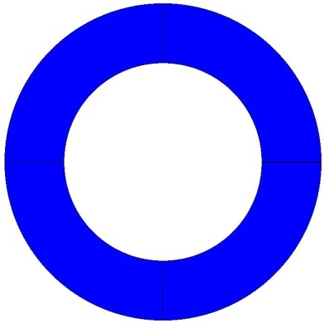
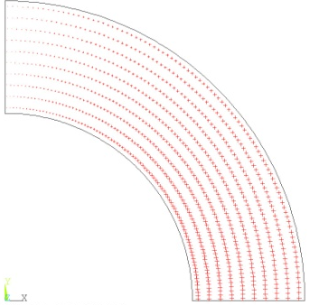
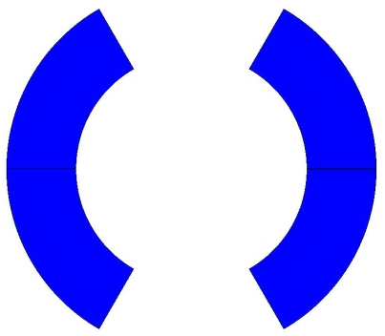
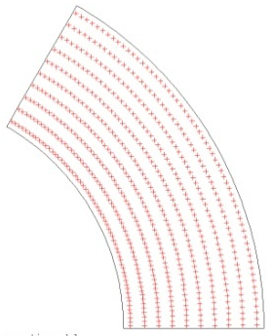
4. Approximations of practical winding cross-sections
In order to estimate the force, let’s consider three different approximations for a n-order magnet
  Thin shell (see Appendix I)
    Current density J = J₀ cosnθ (A per unit circumference) on a infinitely thin shell
      Orders of magnitude and proportionalities
  Thick shell (see Appendix II)
    Current density J = J₀ cosnθ (A per unit area) on a shell with a finite thickness
      First order estimate of forces and stress
  Sector (see Appendix III)
    Current density J = const (A per unit area) on a a sector with a maximum angle θ = 60º/30º for a dipole/quadrupole
      First order estimate of forces and stress

Slide 21
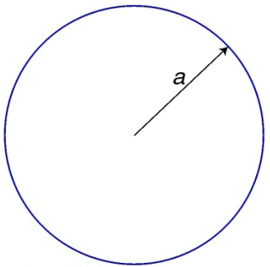
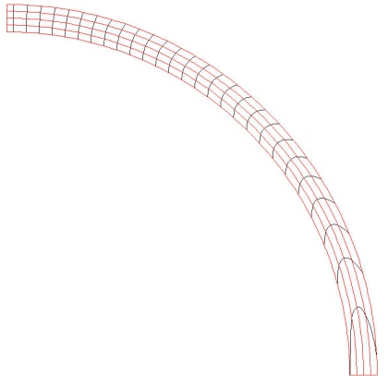
4. Approximations of practical winding cross-sections: thin shell
We assume
  J = J₀ cosnθ where J₀ [A/m] is ⊥ to the cross-section plane
  Radius of the shell/coil = a
  No iron
The field inside the aperture is
The average field in the coil is
The Lorentz force acting on the coil [N/m²] is

Slide 22
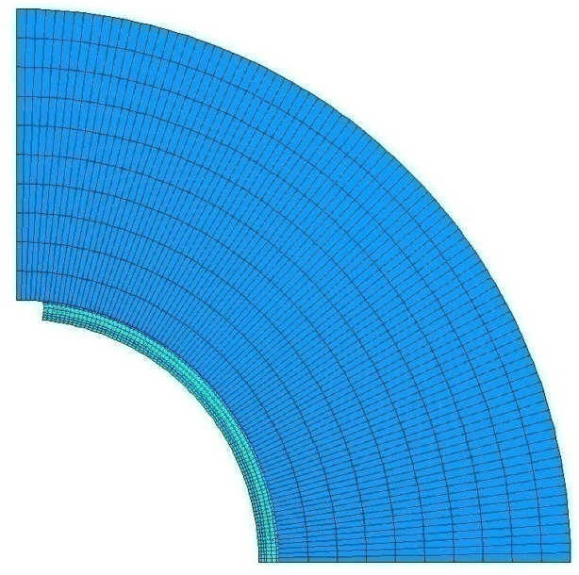
4. Approximations of practical winding cross-sections: thin shell (dipole)
In a dipole, the field inside the coil is
The total force acting on the coil [N/m] is
The Lorentz force on a dipole coil varies
  with the square of the bore field
  linearly with the magnetic pressure
  linearly with the bore radius.
In a rigid structure, the force determines an azimuthal displacement of the coil and creates a separation at the pole.
The structure sees F_{x}.

Slide 23
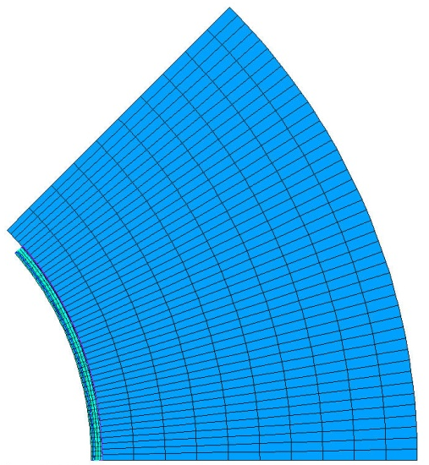
4. Approximations of practical winding cross-sections: thin shell (quadrupole)
In a quadrupole, the gradient [T/m] inside the coil is
The total force acting on the coil [N/m] is
The Lorentz force on a quadrupole coil varies
  with the square of the gradient or coil peak field
  with the cube of the aperture radius (for a fixed gradient).
Keeping the peak field constant, the force is proportional to the aperture.

Slide 24
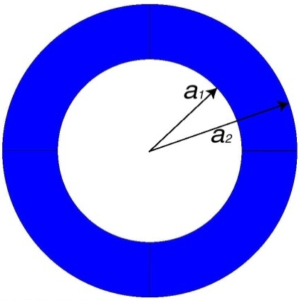
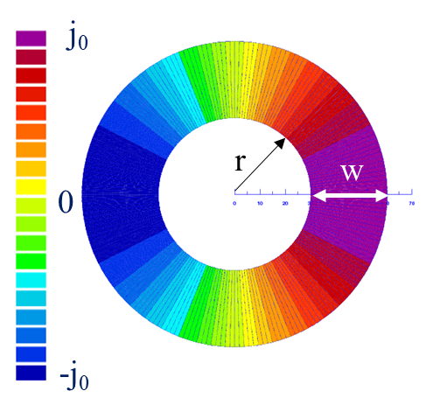
4. Approximations of practical winding cross-sections: thick shell
If we assume
  J = J₀ cosθ where J₀ [A/m²] is ⊥ to the cross-section plane
  Inner (outer) radius of the coils = a1 (a2)
The generated field is a pure dipole
Linear dependence on coil width
Easier to achieve with a Rutherford cable

Slide 25
4. Approximations of practical winding cross-sections: thick shell
We assume
  J = J₀ cosnθ where J₀ [A/m²] is ⊥ to the cross-section plane
  Inner (outer) radius of the coils = a1 (a2)
  No iron
The field inside the aperture is
The field in the coil is
The Lorentz force acting on the coil [N/m³] is

Slide 26
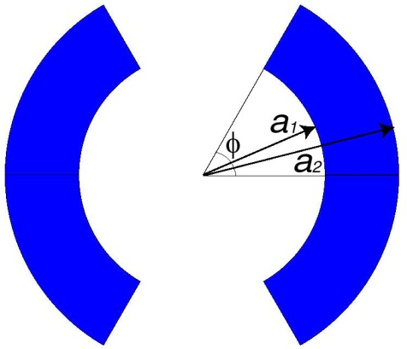
4. Approximations of practical winding cross-sections: sector (dipole)
We assume
  J=J₀ is ⊥ the cross-section plane
  Inner (outer) radius of the coils = a1 (a2)
  Angle φ = 60º (third harmonic term is null)
  No iron
The field inside the aperture
The field in the coil is

Slide 27

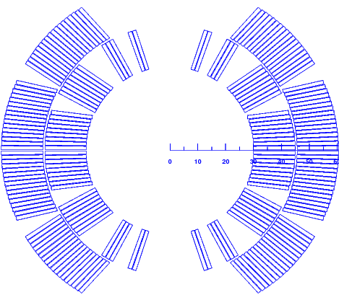
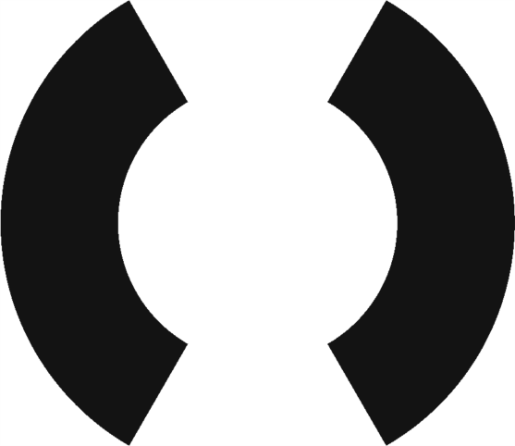
4. Approximations of practical winding cross-sections: comparison

Slide 28
Outline
Introduction
Electro-magnetic force
  Definition and directions
Magnetic pressure and forces
Approximations of practical winding cross-sections
  Thin shell, Thick shell, Sector
Stored energy and end forces
Stress and strain
Pre-stress
Conclusions

Slide 29
5. Stored energy and end forces
The magnetic field possesses an energy density [J/m³]
The total energy [J] is given by
Or, considering only the coil volume, by
Knowing the inductance L, it can also be expresses as
The total energy stored is strongly related to mechanical and protection issues.

Slide 30
5. Stored energy and end forces
The stored energy can be used to evaluate the Lorentz forces. In fact
This means that, considering a “long” magnet, one can compute the end force F_{z} [N] from the stored energy per unit length W [J/m]:
where A_{Z} is the vector potential, given by

Slide 31
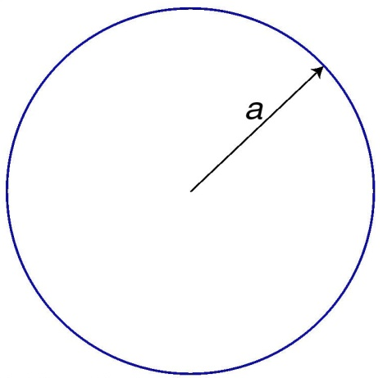
5. Stored energy and end forces
Thin shell
For a dipole, the vector potential within the thin shell is
and, therefore,
  The axial force on a dipole coil varies
    with the square of the bore field
    linearly with the magnetic pressure
    with the square of the bore radius.
For a quadrupole, the vector potential within the thin shell is
and, therefore,
  Being the peak field the same, a quadrupole has half the F_{z} of a dipole.

Slide 32
Appendix I
Thin shell approximation

Slide 33
Appendix I: thin shell approximation
Field and forces: general case
We assume
  J = J₀ cosnθ where J₀ [A/m] is  to the cross-section plane
  Radius of the shell/coil = a
  No iron
The field inside the aperture is
The average field in the coil is
The Lorentz force acting on the coil [N/m²] is

Slide 34
Appendix I: thin shell approximation
Field and forces: dipole
In a dipole, the field inside the coil is
The total force acting on the coil [N/m] is
The Lorentz force on a dipole coil varies
  with the square of the bore field
  linearly with the magnetic pressure
  linearly with the bore radius.
In a rigid structure, the force determines an azimuthal displacement of the coil and creates a separation at the pole.
The structure sees F_{x}.

Slide 35
Appendix I: thin shell approximation
Field and forces: quadrupole
In a quadrupole, the gradient [T/m] inside the coil is
The total force acting on the coil [N/m] is
The Lorentz force on a quadrupole coil varies
  with the square of the gradient or coil peak field
  with the cube of the aperture radius (for a fixed gradient).
Keeping the peak field constant, the force is proportional to the aperture.

Slide 36
Appendix I: thin shell approximation
Stored energy and end forces: dipole and quadrupole
For a dipole, the vector potential within the thin shell is
and, therefore,
  The axial force on a dipole coil varies
    with the square of the bore field
    linearly with the magnetic pressure
    with the square of the bore radius.
For a quadrupole, the vector potential within the thin shell is
and, therefore,
  Being the peak field the same, a quadrupole has half the F_{z} of a dipole.

Slide 37
Appendix I: thin shell approximation
Total force on the mid-plane: dipole and quadrupole
If we assume a “roman arch” condition, where all the f_{θ} accumulates on the mid-plane, we can compute a total force transmitted on the mid-plane F_{θ} [N/m]
For a dipole,
For a quadrupole,
  Being the peak field the same, a quadrupole has half the F_{θ} of a dipole.
  Keeping the peak field constant, the force is proportional to the aperture.

Slide 38
Appendix II
Thick shell approximation

Slide 39
Appendix II: thick shell approximation
Field and forces: general case
We assume
  J = J₀ cosnθ where J₀ [A/m²] is  to the cross-section plane
  Inner (outer) radius of the coils = a1 (a2)
  No iron
The field inside the aperture is
The field in the coil is
The Lorentz force acting on the coil [N/m³] is

Slide 40
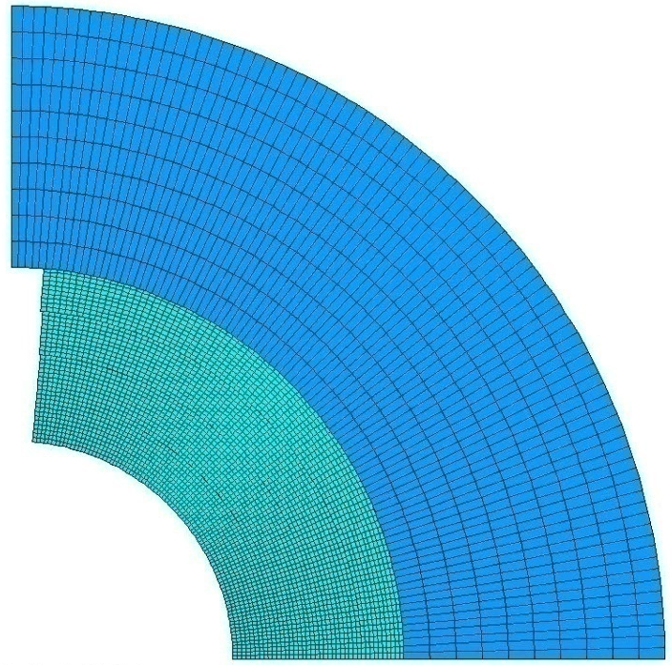
Appendix II: thick shell approximation
Field and forces: dipole
In a dipole, the field inside the coil is
The total force acting on the coil [N/m] is

Slide 41
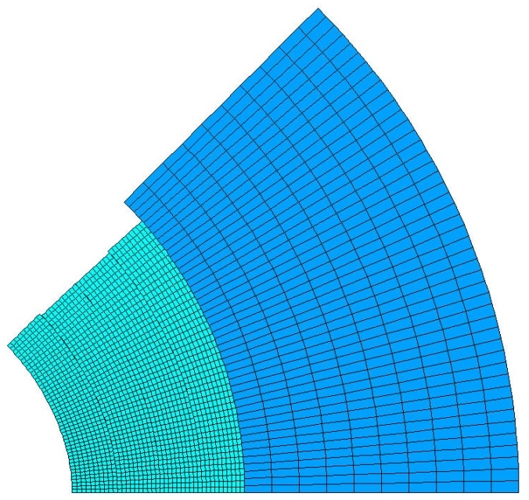
Appendix II: thick shell approximation
Field and forces: quadrupole
In a quadrupole, the field inside the coil is
being
The total force acting on the coil [N/m] is

Slide 42
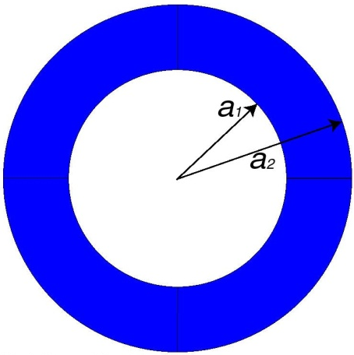
Appendix II: thick shell approximation
Stored energy, end forces: dipole and quadrupole
For a dipole,
and, therefore,
For a quadrupole,
and, therefore,

Slide 43
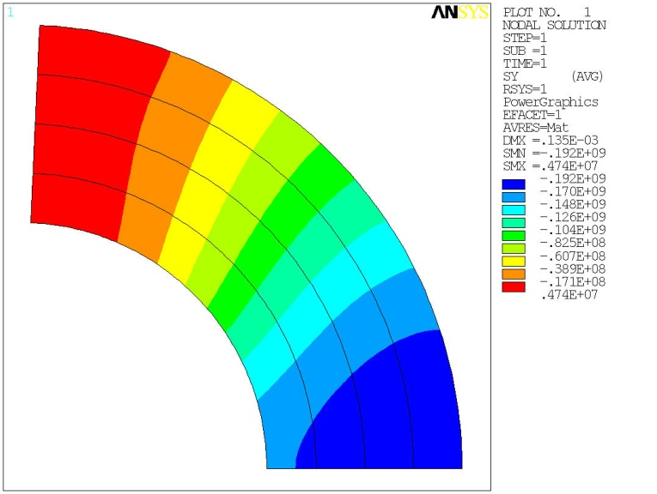
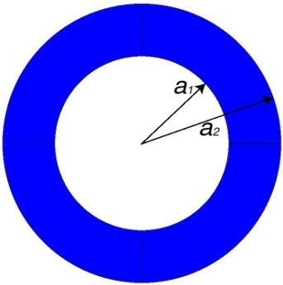
Appendix II: thick shell approximation
Stress on the mid-plane: dipole and quadrupole
For a dipole,
For a quadrupole,
No shear

Slide 44
Appendix III
Sector approximation

Slide 45
Appendix III: sector approximation
Field and forces: dipole
We assume
  J=J₀ is  the cross-section plane
  Inner (outer) radius of the coils = a1 (a2)
  Angle φ = 60º (third harmonic term is null)
  No iron
The field inside the aperture
The field in the coil is

Slide 46
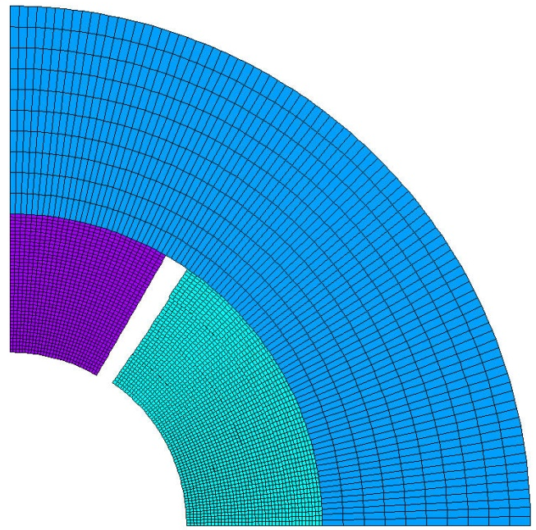
Appendix III: sector approximation
Field and forces: dipole
The Lorentz force acting on the coil [N/m³], considering the basic term, is
The total force acting on the coil [N/m] is

Slide 47

Appendix III: sector approximation
Field and forces: quadrupole
We assume
  J=J₀ is  the cross-section plane
  Inner (outer) radius of the coils = a1 (a2)
  Angle φ = 30º (third harmonic term is null)
  No iron
The field inside the aperture
The field in the coil is

Slide 48

Appendix III: sector approximation
Field and forces: quadrupole
The Lorentz force acting on the coil [N/m³], considering the basic term, is
The total force acting on the coil [N/m] per octant is

Slide 49


Appendix III: sector approximation
Stored energy, end forces: dipole and quadrupole
For a dipole,
and, therefore,
For a quadrupole,
and, therefore,

Slide 50



Appendix III: sector approximation
Stress on the mid-plane: dipole and quadrupole
For a dipole,
For a quadrupole,
No shear

