Slide 1

Unit 10
Multipolar expansion of magnetic field
Ezio Todesco
European Organization for Nuclear Research (CERN)
Technology Department
Magnet Superconductors and Cryostat Group
All the units will use International System (meter, kilo, second, ampere) unless specified

Slide 2
CONTENTS
Definition of field harmonics
Field harmonics of a current line
Validity limits of field harmonics
Some applications of tough mathematics to magnetic field measurements
Hints on beam dynamics requirements on field harmonics

Slide 3
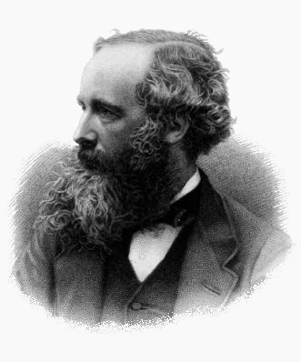
FIELD HARMONICS: MAXWELL EQUATIONS
Maxwell equations for magnetic field
In absence of charge and magnetized material
  (inside a magnet)
If (constant longitudinal field), then
  Remember: x and y perpendicular to the beam (transverse coordinates), z along the beam (s in previous unit)
James Clerk Maxwell,
Scottish
(13 June 1831 – 5 November 1879)

Slide 4
COMPLEX NUMBERS
Complex numbers are defined to be able to find a solution to the square root of negative numbers
  This is an extension of real numbers
  The advantage is that every equation of n^{th} degree has n solutions in the complex domain
The trick is to define i=√(-1)
A complex number has two components z=a+ib
  Can be written also in the exponential form z=ρ exp(iθ)
    ρ=√(a²+b²)
b
z=a+ib
Imaginary part
  z=ρ exp(iθ)
Imaginary part
a
  ρ
Real part
  θ
Real part

Slide 5
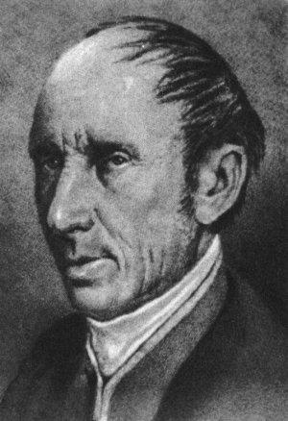
FIELD HARMONICS: ANALYTIC FUNCTIONS
A complex function of complex variables is analytic if it coincides with its power series
on a domain D !
  Note: not every combination of f_{x}+if_{y} is analytic !
  Note: domains are usually a painful part, we talk about it later
A necessary and sufficient condition for (f_{x}, f_{y}) to have f_{x}+if_{y} analytic is that
  called the Cauchy-Riemann conditions
Augustin Louis Cauchy
French
(August 21, 1789 – May 23, 1857)

Slide 6
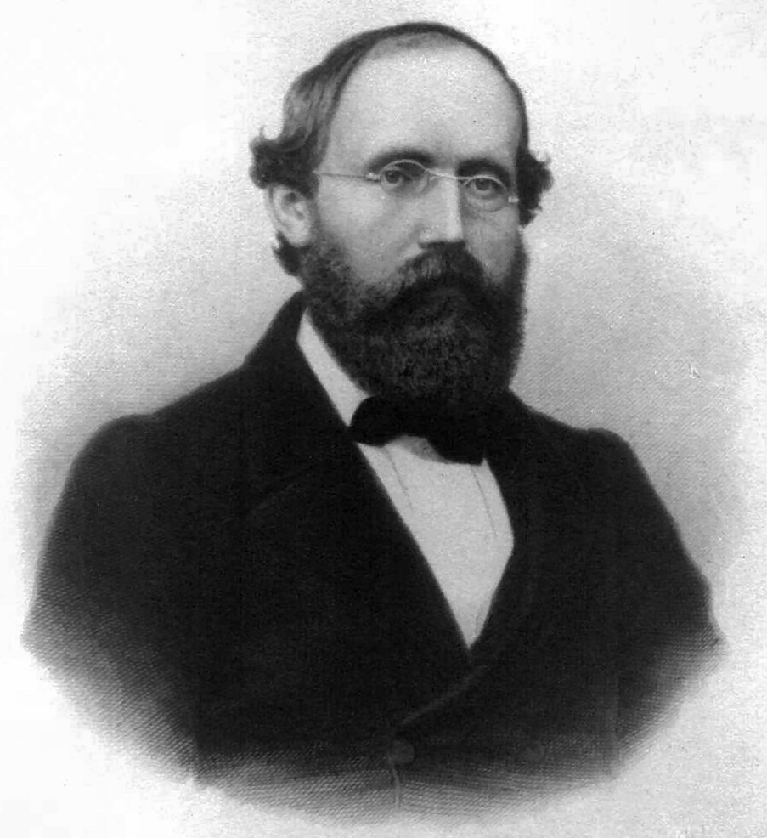
DEFINITION OF FIELD HARMONICS
If
Maxwell gives
and therefore the function B_{y}+iB_{x} is analytic
where C_{n} are complex coefficients
Please note the analytic function is not B_{x}+iB_{y} but B_{y}+iB_{x} … in other books you can find B_{x}-iB_{y} , it is the same
Georg Friedrich Bernhard Riemann,
German
(November 17, 1826 - July 20, 1866)

Slide 7
DEFINITION OF FIELD HARMONICS
To describe the magnetic field we associate to each point of the space a vector
    For instance to store in a computer we need to create a matrix (grid in the space) and for every point of the grid we store two numbers
  Thanks to the multipole expansion, we just need a series of complex coefficient
    A matematician would say “we reduce the description of a function from R² to R² to a (simple) series of complex coefficients”
  Attention !! We lose something (the function outside D) (we will come back to this)
y
(B_{x}(x₀,y₀),B_{y}(x₀,y₀))
y₀
x₀
x

Slide 8
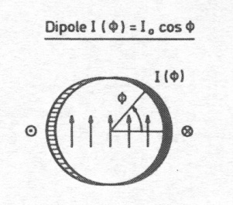
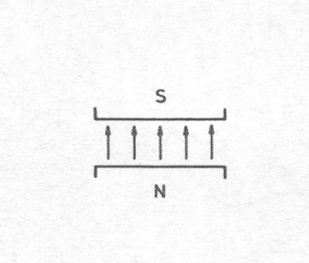
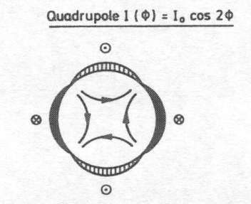
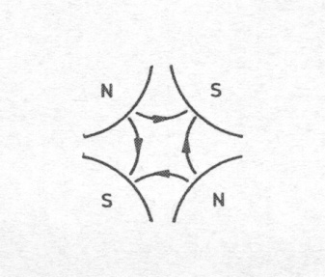
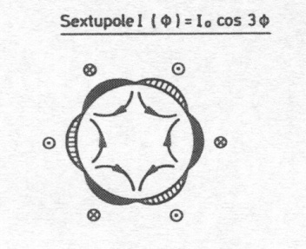
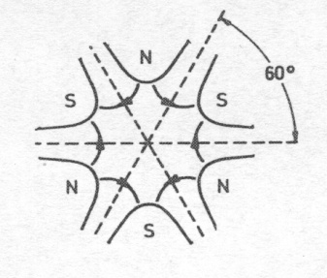
DEFINITION OF FIELD HARMONICS
Each coefficient corresponds to a “pure” multipolar field
Magnets usually aim at generating a single multipole
  Dipole, quadrupole, sextupole, octupole, decapole, dodecapole …
  Combined magnets: provide more components at the same time (for instance dipole and quadrupole) – more common in low energy rings, resistive magnets – one superconducting example: JPARC (KEK, Japan)
A dipole
A quadrupole
[from P. Schmuser et al, pg. 50]
A sextupole

Slide 9
DEFINITION OF FIELD HARMONICS
The field can be described by in infinite number of complex coefficients
  This means a double infinite number of real numbers
We made a huge simplification in the description of the magnetic field
But the story is not ended …
  The series is converging quite rapidly so if you stop at order ten the precision is good enough – only 20 numbers – we will see this in this unit
For the optimization of the layout of a magnet, there are symmetries that set to zero many of these multipoles
  An optimization problem (coil layout in blocks) involves only about 5 numbers !

Slide 10
DEFINITION OF FIELD HARMONICS
The field harmonics are rewritten as
  We factorize the main component (B₁ for dipoles, B₂ for quadrupoles)
  We introduce a reference radius R_{ref} to have dimensionless coefficients
  We factorize 10⁻⁴ since the deviations from ideal field in superconducting magnets for particle accelerators have to be ∼0.01%
The coefficients b_{n}, a_{n} are called normalized multipoles
  b_{n} are the normal, a_{n} are the skew (adimensional)

Slide 11
DEFINITION OF FIELD HARMONICS
Reference radius is usually chosen as 2/3 of the aperture radius
  This is done to have numbers for the multipoles that are not too far from 1
Some wrong ideas about reference radius
  Wrong statement 1: “the expansion is valid up to the reference radius”
    The reference radius has no physical meaning, it is as choosing meters of mm
    We will come back on the validity limit
  Wrong statement 2: “the expansion is done around the reference radius”
    A power series is around a point, not around a circle. The expansion is around the origin

Slide 12
CONTENTS
Definition of field harmonics
Field harmonics of a current line
Validity limits of field harmonics
Some applications of tough mathematics to magnetic field measurements
Hints on beam dynamics requirements on field harmonics

Slide 13
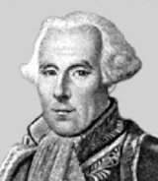
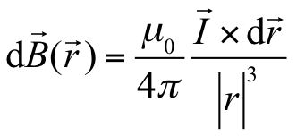
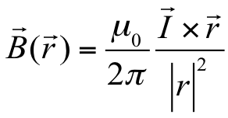
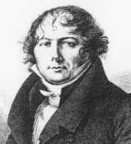
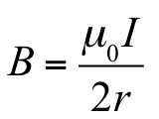
FIELD OF A CURRENT LINE
Field given by a current line (Biot-Savart law)
  Differential form (international system)
  Infinite current line
    A factor two is given by the atan integration
  Field in a centre of a circular loop, radius r
r
Félix Savart,
French
(June 30, 1791-March 16, 1841)
r
Jean-Baptiste Biot,
French
(April 21, 1774 – February 3, 1862)
r

Slide 14
ABOUT THE CONSTANT MU ZERO
Field given by a loop – prototype of a solenoid
  About the constant μ₀
  It is terribly small … μ₀=4π×10⁻⁷ Τm/A
  This means that with 1 A at 1 m you get less than 1 μT
  This is why to make few T you need MA turns
r
Félix Savart,
French
(June 30, 1791-March 16, 1841)
Jean-Baptiste Biot,
French
(April 21, 1774 – February 3, 1862)

Slide 15
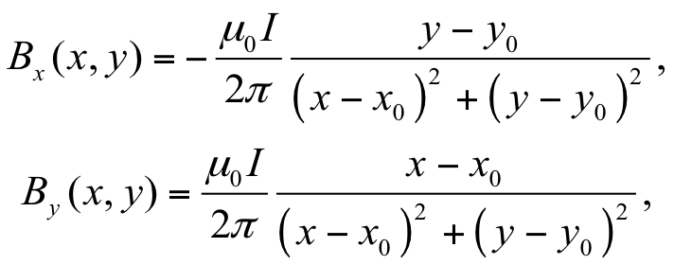
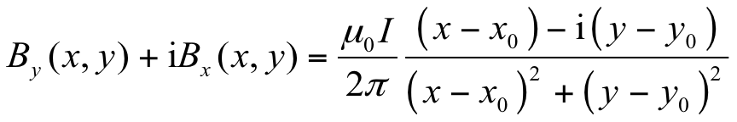
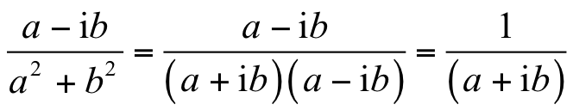
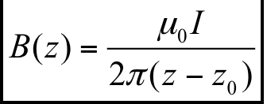
FIELD OF A CURRENT LINE: COMPLEX NOTATION
Field given by a current line (Biot-Savart law)
  Infinite current line
  Complex notation
  Using the relation
  We obtain the compact very useful notation
Félix Savart,
French
(June 30, 1791-March 16, 1841)
Jean-Baptiste Biot,
French
(April 21, 1774 – February 3, 1862)

Slide 16
ANOTHER DISGRESSION ON TAYLOR SERIES
In Unit 1 we saw that, for ε<1 one can write
This is an extremely useful equation
  Example: 1/(1+0.1) =1/1.1=0.90909 but using the approximation(1+0.1)⁻¹=1-0.1+O(0.01) =0.9 and I neglect something that is order of 0.01
Now for a=-1 the whole series can be written
Example

Slide 17
FIELD HARMONICS OF A CURRENT LINE
Field given by a current line (Biot-Savart law)
using
  !!!
we get
Félix Savart,
French
(June 30, 1791-March 16, 1841)
Jean-Baptiste Biot,
French
(April 21, 1774 – February 3, 1862)

Slide 18
FIELD HARMONICS OF A CURRENT LINE
Now we can compute the multipoles of a current line at z₀

Slide 19
FIELD HARMONICS DECAY
OF A CURRENT LINE
Multipoles given by a current line decay with the order
The slope of the decay is the logarithm of (R_{ref}/|z₀|)
  At each order, the multipole decreases by a factor R_{ref} /|z₀|
  The decay of the multipoles tells you the ratio R_{ref} /|z₀|, i.e. where is the coil w.r.t. the reference radius –
  like a radar … one can detect assembly errors in the magnet through slope of the decay of the anomalies of the magnetic field shape (we will come back to this)

Slide 20
FIELD HARMONICS DECAY
OF A CURRENT LINE
Multipoles given by a current line decay with the order
The semilog scale is the natural way to plot multipoles
  This is the point of view of Biot-Savart
But usually specifications are on a linear scale
  In general, multipoles must stay below one or a fraction of units – see later
  This explains why only low order multipoles, in general, are relevant

Slide 21
CONTENTS
Definition of field harmonics
Field harmonics of a current line
Validity limits of field harmonics
Some applications of tough mathematics to magnetic field measurements
Hints on beam dynamics requirements on field harmonics

Slide 22
VALIDITY LIMITS OF FIELD HARMONICS
When we expand a function in a power series we lose something
  Example 1. In t=1/2, the function is
  and using the series one has
  not bad … with 4 terms we compute the function within 7%

Slide 23
VALIDITY LIMITS OF FIELD HARMONICS
When we expand a function in a power series we lose something
  Ex. 2. In t=1, the function is infinite
  and using the series one has
  which diverges … this makes sense

Slide 24
VALIDITY LIMITS OF FIELD HARMONICS
When we expand a function in a power series we lose something
  Ex. 3. In t=-1, the function is well defined
  BUT using the series one has
  even if the function is well defined, the series does not work: we are outside the convergence radius

Slide 25
A GLIMPSE ON DIVERGENT SERIES
If we are very clever, we can resum a divergent series
  Ex. 4. In t=-2, the function is well defined
  BUT using the series one has
  If I am able to recognize this, I can resum 1-2+4-8 + … = 1/3
  This happens if you made an expansion to solve a problem and you are using it outside the series validity limits – there are several type of divergent series and ways to renormalize, remove singularities, etc - this is just one type

Slide 26
VALIDITY LIMITS OF FIELD HARMONICS
If we have a circular aperture, the field harmonics expansion relative to the center is valid within the aperture
For other shapes, the expansion is valid over a circle that touches the closest current line
Don’t use multipoles to compute the field in the coil !!

Slide 27
VALIDITY LIMITS OF FIELD HARMONICS
Field harmonics in the heads
  Harmonic measurements are done with rotating coils of a given length (see unit 21) – they give integral values over that length
    If the rotating coil extremes are in a region where the field does not vary with z, one can use the 2d harmonic expansion for the integral
    If the rotating coil extremes are in a region where the field vary with z, one cannot use the 2d harmonic expansion for the integral
    One has to use a more
    complicated expansion

Slide 28
CONTENTS
Definition of field harmonics
Field harmonics of a current line
Validity limits of field harmonics
Some applications of tough mathematics to magnetic field measurements
Hints on beam dynamics requirements on field harmonics

Slide 29
FIRST APPLICATION: VERIFICATION OF A MEASUREMENT SYSTEM
The decay of multipoles is a powerful tool to verify the consistency of a magnetic measurement
  Let us take a measure of a magnetic field of a magnet via rotating coils
  Let us assume we have N consecutive measurements along the magnet axis
    b_{n}(k), a_{n}(k) k=1, 2, N
  We compute the standard deviation of each multipole and we plot in a semilog scale
    If the measurement is well done and
    reference radius is 2/3 of the aperture
    the slope is 2/3
    This means that the stdev of every successive
    multipole is 2/3 the previous one
    Every two orders you reduce by a factor two
What is expected as multipole decay

Slide 30
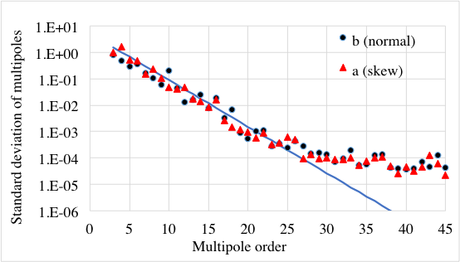
SECOND APPLICATION: VERIFICATION OF A MEASUREMENT SYSTEM
  … and this is a real example from the HL_LHC triplet
    Not only we check that the measurement is ok …
    … but the place where the line starts getting horizontal is the precision of the measurement system – here we have a precision of 10⁻⁴ units, that means 10⁻⁸ of the main field (0.01 ppm)
Precision
Decay of standard deviation of multipoles measured in different sections of MQXFB quadrupole
(L. Fiscarelli, P. Rogacki)

Slide 31
THIRD APPLICATION:
FINDING ASSEMBLY ERRORS
Another example: we have a localized assembly error
  We have four measurements, one of them is affected by the error
    We compute the difference between the anomaly (measurements 2) and the average of 1, 3, and 4
  We put the result in semilog scale
    The slope multiplied by the reference radius will give the distance of the assembly error
    If error is far from the aperture, slope is larger (decay is more rapid, that means it will be visible only on low order multipoles

Slide 32
CONTENTS
Definition of field harmonics
Field harmonics of a current line
Validity limits of field harmonics
Some applications of tough mathematics to magnetic field measurements
Hints on beam dynamics requirements on field harmonics

Slide 33
BEAM DYNAMICS REQUIREMENTS
Main component of the dipoles (field)
  This is ensuring the orbit along the ring
    Typically a absolute knowledge of the magnetic field within 0.1%
    A spread between magnets of the order of 0.1%
    A reproducibility of the order of 0.01%
  We will see that the tolerances needed for building superconducting magnets naturally guarantee these levels
    Cables are positioned within 0.05 mm, apertures of the order of 25 mm, this gives 0.2% error in field, and similar values for spread
    For reproducibility it is critical to cycle the magnets

Slide 34
BEAM DYNAMICS REQUIREMENTS
Main component of the quadrupoles (gradient)
  The tune has to be controlled within 0.001
  Tune is proportional to quadrupole main component
  If the total tune is large (for instance 60 in the LHC) even 0.01% variation of quadrupole force is visible
    Corrector elements and feedback solve the problem – magnets alone cannot reach this level
  In general a absolute knowledge of quadrupole main component within 0.2% is achievable, a spread of 0.1%, and a reproducibility of 0.01%
    Note that accelerators with larger number of cells (larger tune) become more difficult

Slide 35
BEAM DYNAMICS REQUIREMENTS
Sextupolar components
  Sextupole gives chromaticity – to be controlled on a edge of a cliff (positive but smaller than 10, negative values make the beam unstable)
  Dipoles have sextupolar components that needs to be controlled within 0.1 units (normalized multipoles)
    Example: in the LHC 1 units of b₃ in the dipoles give 40 chromaticity units – so one need to know and control b₃ within 0.05 units,
  This is within reach of measurement systems, and with proper precycling reproducibility can be guaranteed

Slide 36
BEAM DYNAMICS REQUIREMENTS
High order mutipoles
  Rule of thumb (just to give a zero order idea): field harmonics have to be of the order of 0.1 to 1 unit
    Higher order are ignored in beam dynamics codes (in LHC up to order 11 only)
    Note that spec is rather flat, but multipoles are decaying !! – Therefore in principle higher orders cannot be a problem

Slide 37
SUMMARY
We outlined the Maxwell equations for the magnetic field
  They give a large constraint on the shape of the magnetic field
We have seen that for a long magnet we can express the transverse field inside the aperture with a series of multipoles
  Compact way of representing the field
  Biot-Savart: multipoles decay with multipole order as a power law
  Attention !! Validity limits and convergence domains

Slide 38
SUMMARY
We have seen how magnetic field is generated by a current line
  We have seen that μ is terribly small, making our work very challenging
r
r

Slide 39
SUMMARY
We have computed the multipoles of a current line
  Using complex numbers it is quite fast …
  …as long as you know that in a certain region (inside the magnet aperture, far from current lines)
r

Slide 40
SUMMARY
We have computed the multipoles of a current line
  Multipoles of a current line decay as a power law
  Therefore:
    Increasing order they become so small that you can neglect them and stop the computation (order 10 to 15)
    Magnet specification are until order 10-15
    Magnet optimization can stop at order 10-15
    The measurement of field anomalies tell you where is the problem (the distance, the angle is more complicated)
r

Slide 41
COMING SOON
Coming soon …
  It is useful to have magnets that provide pure field harmonics
  How to build a pure field harmonic (dipole, quadrupole …) [pure enough for the beam …] with a cable ? Which field/gradient can be obtained ?

Slide 42
REFERENCES
  On field harmonics
    A. Jain, “Basic theory of magnets”, CERN 98-05 (1998) 1-26
    Classes given by A. Jain at USPAS
    P. Schmuser, Ch. 4
  On convergence domains of analytic functions
    Hardy, “Divergent series”, first chapter (don’t go further)
  On the field model
    A.A.V.V. “LHC Design Report”, CERN 2004-003 (2004) pp. 164-168.
    N. Sammut, et al. “Mathematical formulation to predict the harmonics of the superconducting Large Hadron Collider magnets”
    Phys. Rev. ST Accel. Beams 9 (2006) 012402.

Slide 43
ACKOWLEDGEMENTS
    A. Jain for discussions about reference radius, multipoles in heads, vector potential
    S. Russenschuck for discussions about vector potential
    G. Turchetti for teaching me analytic functions and divergent series, and other complicated subjects in a simple way
    www.wikipedia.org for most of the pictures

Slide 44
DEFINITION OF FIELD HARMONICS
Vector potential
  Since one can always define a vector potential A such that
  The vector potential is not unique (gauge invariance): if we add the gradient of any scalar function, it still satisfies
Scalar potential
  In the regions free of charge and magnetic material
  Therefore in this case one can also define a scalar potential (such as for gravity)
One can prove that is an analytic function in a region free of charge and magnetic material

Slide 45
FIELD HARMONICS OF A CURRENT LINE
Field given by a current line (Biot-Savart law) – vector potential formalism …
… and polar coordinates formalism

Slide 46
FIELD HARMONICS: LINEARITY
Linearity of coefficients (very important)
  Non-normalized coefficients are additive
  Normalized coefficients are not additive
  Normalization gives handy (and physical) quantities, but some drawbacks – pay attention !!

