Slide 1

Unit 11
How to make dipoles with current lines
Ezio Todesco
European Organization for Nuclear Research (CERN)
Technology Department
Magnet Superconductors and Cryostat Group
All the units will use International System (meter, kilo, second, ampere) unless specified

Slide 2
CONTENTS
Lay-outs generating a a perfect dipole field
Sector dipoles
Going to large coils and the block coil

Slide 3
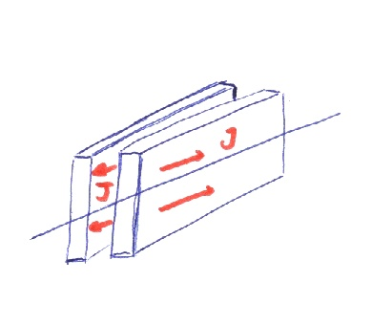
PERFECT DIPOLAR FIELDS
Perfect dipoles - 1
  Wall-dipole: a uniform current density in two walls of infinite height produces a pure dipolar field
  (as a solenoid, proof at the end of the slides)
  15 mm width with 400 A/mm² gives 7.6 T
y
w
d
x
A wall-dipole, artist view
A wall-dipole, cross-section

Slide 4
PERFECT DIPOLAR FIELDS
Perfect dipoles - 2
  Intersecting ellipses: a uniform current density in the area of two intersecting ellipses produces a pure dipolar field
w
Intersecting ellipses

Slide 5
PERFECT DIPOLAR FIELDS
Perfect dipoles - 3
  Cos theta: A current density distribution proportional to the angle
  Academic case, impossible to realize with a real cable, but very popular in the literature
  Looks funny … they all give the same

Slide 6
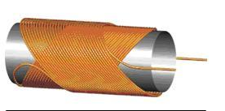
PERFECT DIPOLAR FIELDS
Perfect dipoles - 4
  Canted cos theta
  Also called tilted solenoid, double helix
  First proposed in the 70’s
  Meyer D I and Flasck R 1970 Nuclear Instruments and Methods 80 339-341.
  Industrialized in the USA by AML
  Goodzeit C. L., et al 2003 IEEE Transactions on Applied Superconductivity 13 1365-8
  Proposed for high field magnets as a change of paradigm
  Caspi S, et al 2014 IEEE Transactions on Applied Superconductivity 24 4001804
  High field magnets for accelerators being built in LBNL and PSI
  Application to HL LHC for a low field corrector in Nb-Ti, in kind contribution from China to HL-LHC

Slide 7
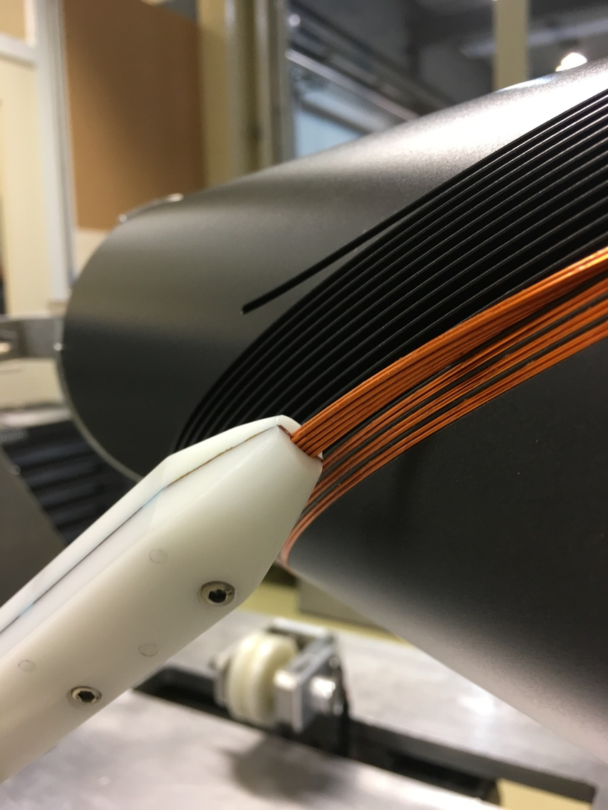
PERFECT DIPOLAR FIELDS
Perfect dipoles - 4
  A solenoidal field is generated by each winding, and cancels out leacing a dipole field
    So some conductor is wasted
  Easily generalized to quadrupoles and higher orders
  A former has grooves where the conductor (cable or wire) is wound
  No tooling, no collaring but no prestress (we will come later to this point)
HL-LHC D2 corrector, G. Kirby et al

Slide 8
CONTENTS
Lay-outs generating a a perfect dipole field
Sector dipoles
Going to large coils: the block coil

Slide 9
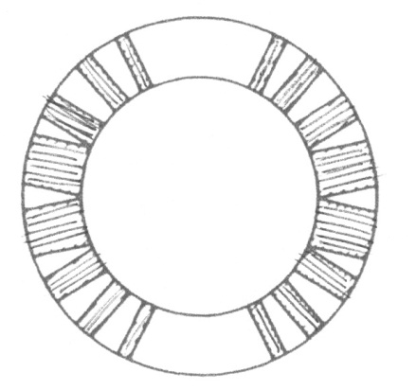
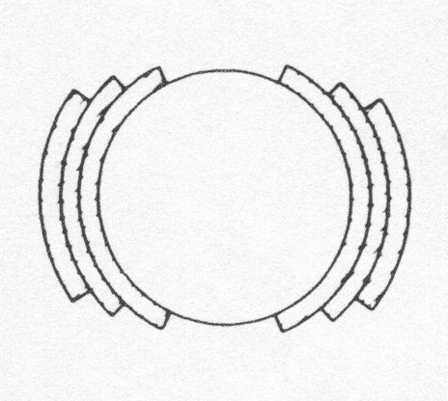
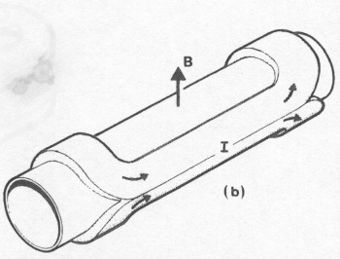
SECTOR COILS FOR DIPOLES
Sector dipoles: “the solution”
  Approximation of the cos-theta layout by sectors with uniform current density
  Self supporting structure, no need of internal support
  Coil ends with saddle geometry
Cable block
wedge
An ideal cosθ
A practical winding with one layer and wedges
[from M. N. Wilson, pg. 33]
A practical winding with three layers and no wedges
[from M. N. Wilson, pg. 33]
Artist view of a cosθ magnet
[from Schmuser]

Slide 10
SECTOR COILS FOR DIPOLES
We recall the equations relative to a current line
we expand in a Taylor series
  the multipolar expansion is defined as
  the main component is
  the non-normalized multipoles are

Slide 11
SECTOR COILS FOR DIPOLES
We compute the central field given by a sector dipole with uniform current density j
  Taking into account of current signs
  This simple computation is full of consequences
  B₁ ∝ current density (obvious)
  B₁ ∝ coil width w (less obvious)
  B₁ is independent of the aperture r (much less obvious)

Slide 12
SECTOR COILS FOR DIPOLES
We compute the central field given by a sector dipole with uniform current density j
Selecting a 60 degrees coil (we will see why)
  And using more reasonable units, we have
  A bit better than previous “perfect” examples
  Example: LHC coil is w=30 mm thick and has j=400 A/mm², this gives 8 T
  With j=400 A/mm², one has 2.8 T for each 10 mm coil width

Slide 13

SECTOR COILS FOR DIPOLES
A dipolar symmetry is characterized by
  Up-down symmetry (with same current sign)
  Left-right antisymmetry (with opposite sign)
Why this configuration?
  Opposite sign in left-right is necessary to avoid that the field created by the left part is canceled by the right one
  In this way all multipoles except B_{2n+1} are canceled
  these multipoles are called “allowed multipoles”
  Remember the power law decay of multipoles with order (Unit 3)
  And that field quality specifications concern only first 10-15 multipoles
    The field quality optimization of a coil lay-out concerns only a few quantities ! Usually b₃ , b₅ , b₇ , and possibly b₉ , b₁₁

Slide 14
SECTOR COILS FOR DIPOLES
Now we compute the multipoles of a sector coil
  for n=2 one has
  and for n>2
Main features of these equations
  Multipoles n are proportional to sin ( n angle of the sector)
    They can be made equal to zero !
  Proportional to the inverse of sector distance to power n
    High order multipoles are not affected by coil parts far from the centre

Slide 15
SECTOR COILS FOR DIPOLES
First allowed multipole B₃ (sextupole)
  for α=π/3 (i.e. a 60° sector coil) one has B₃=0
Second allowed multipole B₅ (decapole)
  for α=π/5 (i.e. a 36° sector coil) or for α=2π/5 (i.e. a 72° sector coil)
  one has B₅=0
  With one sector one cannot set to zero both multipoles … let us try with more sectors !

Slide 16
SECTOR COILS FOR DIPOLES
Coil with two sectors
  Note: we have to work with non-normalized multipoles, which can be added together
Equations to set to zero B₃ and B₅
  There is a one-parameter family of solutions, for instance (48°,60°,72°) or (36°,44°,64°) are solutions

Slide 17
SECTOR COILS FOR DIPOLES
One can compute numerically the solutions of
  There is a one-parameter family
  Integer solutions
    [0°-24°, 36°-60°] – it has the minimal sector width
    [0°-36°, 44°-64°] – it has the minimal wedge width
    [0°-48°, 60°-72°]
    [0°-52°, 72°-88°] – very large sector width (not useful)
  one solution ~[0°-43.2°, 52.2°-67.3°] sets also B₇=0

Slide 18
SECTOR COILS FOR DIPOLES
We have seen that with one wedge one can set to zero three multipoles (B₃, B₅ and B₇)
What about two wedges ?
  One can set to zero five multipoles (B₃, B₅, B₇ , B₉ and B₁₁) ~[0°-33.3°, 37.1°- 53.1°, 63.4°- 71.8°]
One wedge, b₃=b₅=b₇=0
[0°-43.2°,52.2°-67.3°]
Two wedges, b₃=b₅=b₇=b₉=b₁₁=0
[0°-33.3°,37.1°-53.1°,63.4°- 71.8°]

Slide 19
SECTOR COILS FOR DIPOLES
Let us see two coil lay-outs of real magnets
  The Tevatron has two blocks on two layers – with two (thin !!) layers one can set to zero B₃ and B₅
  The RHIC dipole has four blocks
Tevatron main dipole - 1980
RHIC main dipole - 1995

Slide 20
SECTOR COILS FOR DIPOLES
We start with RHIC
  Very similar to our solution for three blocks
  One additional block since cable keystoning is not enough
  Plus small variations, since one does not always aim at having zero multipoles
    There are other contributions (iron, persistent currents …)
Our case with two wedges, setting to zero multipoles up to order 11
RHIC main dipole

Slide 21
SECTOR COILS FOR DIPOLES
Tevatron: case of two layers, no wedges
    There solutions only up to w/r<0.5
    There are two branches that join at w/r∼0.5, in α₁ ∼70° and α₂ ∼25°
    Tevatron dipole fits with these solutions
Tevatron dipole: w/r∼0.20

Slide 22
SECTOR COILS FOR DIPOLES
How much do we pay for field quality ?
  We compute the γ_{c} for each sector coil
  (0°-60°) : one block, canceling b₃, γ_{c} = 6.93×10⁻⁴ (T mm/A)
  (0°-48°,60°-72°) : two blocks, canceling b₃ and b₅, γ_{c} = 6.63×10⁻⁴ (T mm/A)
  (0°-43.2°,53.2°-67.3°) : two blocks, canceling b₃ to b₇, γ_{c} = 6.53×10⁻⁴ (T mm/A)
  Three blocks, canceling b₃ to b₁₁, γ_{c} = 6.48×10⁻⁴ (T mm/A)
  We pay not more than 7% - the price is not so high – and anyway better than = 6.28×10⁻⁴ (T mm/A) , for all “perfect” cases

Slide 23
CONTENTS
Lay-outs generating a a perfect dipole field
Sector dipoles
Going to large coils: the block coil

Slide 24
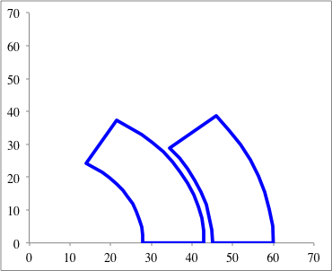
COMPARING DIFFERENT LAYOUTS
The sector coil can be anyway used as a benchmark of any layout
  For any layout one can compute the width of the 60 degrees sector having the same cross-sectional area
  For any layout, compute w_{eq} ; then compute γ_{c}
A/4

Slide 25
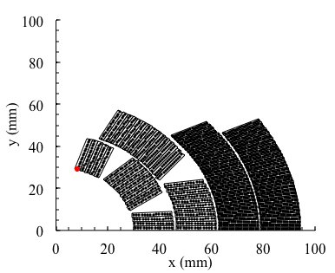
GOING TO LARGE COIL WIDTHS
A four layer sector coil
  Magnet aiming 14-15 T, Nb₃Sn for FCC, developed at FNAL
  I. Novitski et al, IEEE TAS 26 (2016) 4001007
  Magnet reached 14.13 T S. Zlobin et al, IEEE TAS 30 (2020) 4000805
  With grading (we will discuss grading in Unit 9)
  Α= 12300 mm²
  r=30 mm
  w_{eq}= 52.3 mm
  γ_{c}=6.61×10⁻⁴
  computed assuming
  no grading, i.e. same
  current density everywhere
MDPTC1 main dipole (A. Zlobin, et al.)

Slide 26
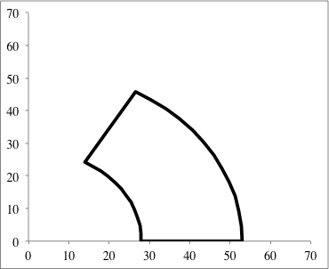
GOING TO LARGE COIL WIDTHS
When we go towards large coil widths, it becomes more fruitful to go to smaller angle
  The loss in cos(angle) is larger than the loss in 1/r

Slide 27
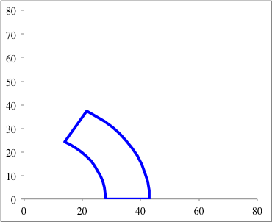
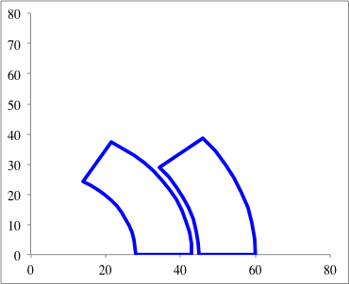
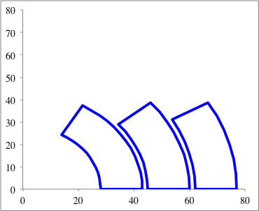
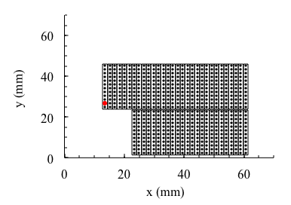
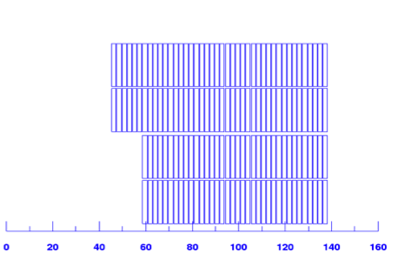
GOING TO LARGER COILD WIDTHS
The evolution of the species ?
HD2 cross-section
FrescaII cross-section

Slide 28
THE BLOCK LAYOUT
A block layout has vertical cables
  Need of internal support, reducing available aperture
  Lack of roman arch gives a different distribution of forces
    Pro and cons, we will come back to this point in the last Unit
  Saddle shape ends – no need of wedges, very simple coil
  HD2 G. Sabbi et al, IEEE TAS 15 (2005) 1128-31 P. Ferracin et al, IEEE TAS 20 (2010) 292-295
  Α= 7775 mm²
  r=17.5 mm
  w_{eq}= 45.9 mm
  γ_{c}=5.93×10⁻⁴

Slide 29
THE BLOCK LAYOUT
FrescaII (100 mm aperture) (CEA-CERN project by G. de Rijk)
  Need of two coils (four layers) A. Milanese et al IEEE TAS 22 (2012) 4002604
  FrescaII is the extension of HD2 design to four layers
  P. Ferracin et al IEEE TAS 23 (2013) 4002005
  World record of high field accelerator-type magnets 14.6 T
  G. Willering et al IEEE TAS 29 (2019) 4004906
  Α= 302000 mm²
  r=50 mm
  w_{eq}= 80.0 mm
  γ_{c}=6.10×10⁻⁴
  Very close to sector coil benchmark (5%)
FrescaII crosss-section

Slide 30
THE BLOCK LAYOUT
How field quality is optimization in a block layout ?
  Three parameters
  One used to increase the coil width
  The other two to cancel b₃ and b₅
  Usually, large coils so wedges are not required
  The upper stage has to come towards the aperture otherwise b3 cannot be corrected

Slide 31
CONCLUSIONS
We have shown how to generate a pure multipolar field
  Sector coil is the paradigm of the accelerator magnets
  Equation for the field
    with γ_{c} around 6.3×10⁻⁴, coil width w expressed in mm and j is the overall current density (including voids and insulation) in A/mm²
    10 mm of coil width, with 400 A/mm², give 2.8 T
  As in the energy of an accelerator, one could say there are two ways
    Technological way: larger j (but there are hard limits, we will come to this)
    Brute force: larger w (but not so brute indeed, large coils imply touching limits imposed from physics, as thermal contraction, etc.) – the problem is the higher cost
    This analogy, as most analogies, is only partially true

Slide 32
CONCLUSIONS
We analysed the constraints for having a perfect field quality in a sector coil
  Field quality comes nearly for free (5% loss in efficiency)
  Equations for zeroing multipoles can be given
  Lay-outs canceling field harmonics can be found
  Several built dipoles and quadrupoles can be understood with simple equations
We benchmarked two alternative layouts versus the sector coil
  w is the coil width, it can be defined also for layouts different from sector coil
  Canted cos theta, with non negligible loss of efficiency
  Block coil, with negligible loss of efficiency for large coil widths

Slide 33
CONCLUSIONS
For quadrupoles, the gradient is still proportional to current density, but to a log of the ratio between coil width and aperture radius
With γ_{c} around 0.63 T/m /(A/mm²)
The field quality constraints are the same, applying the transformation
  Divide the angles by two
  Multiply by two the multipole order (b₃ becomes b₆, b₅ becomes b₁₀, etc.)

Slide 34
REFERENCES
  Field quality constraints
    M. N. Wilson, Ch. 1
    P. Schmuser, Ch. 4
    A. Asner, Ch. 9
    Classes given by A. Devred at USPAS in 2001

Slide 35
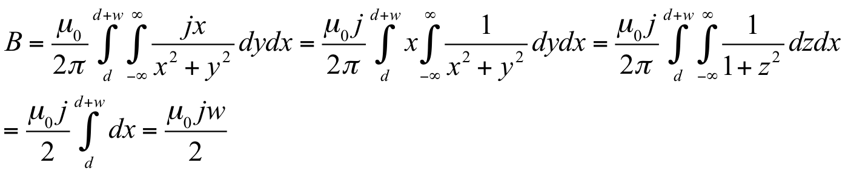
WALL DIPOLE PROOF
The wall dipole
  Wall-dipole: a uniform current density in two walls of infinite height produces a pure dipolar field
  Contribution of one wall:
y
w
d
x

Slide 36
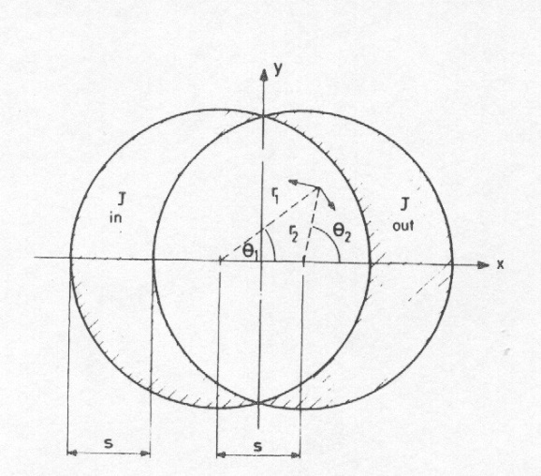
PROOF INERSEPTING ELLIPSE
Perfect dipoles - 2
  Proof that intersecting circles give perfect field
    within a cylinder carrying uniform current j₀, the field is perpendicular to the radial direction and proportional to the distance to the centre r:
    Combining the effect of the two cylinders
    Similar proof for intersecting ellipses
From M. N. Wilson, pg. 28

Slide 37
SECTOR COILS FOR QUADRUPOLES
We recall the equations relative to a current line
we expand in a Taylor series
  the multipolar expansion is defined as
  the main quadrupolar component is
  the non-normalized multipoles are

Slide 38
SECTOR COILS FOR QUADRUPOLES
We compute the central field given by a sector quadrupole with uniform current density j
  Taking into account of current signs
  The gradient is a function of w/r
  For large w, the gradient increases with log w
Field gradient [T/m]
For a 30 degrees coil
  Giving 6.93×10⁻⁷ [T m/A]

Slide 39
SECTOR COILS FOR QUADRUPOLES
For a 30 degrees coil
  Giving γ_{c}=6.93×10⁻⁷ [T m/A]
  Going to more convenient but really horrible units, i.e. j in A/mm² but G in T/m, one gets γ_{c}=0.693 [T/m/(A/mm²)]
  Example: LHC quadrupole
    I= 11850 A Ins. cable x-sec 27 mm² j=440 A/mm²
    w=30 mm r=28 mm ln(1+w/r)=0.73
    0.693 × 440 × 0.73 = 222 T/m

Slide 40
SECTOR COILS FOR QUADRUPOLES
First allowed multipole B₆ (dodecapole)
  for α=π/6 (i.e. a 30° sector coil) one has B₆=0
Second allowed multipole B₁₀
  for α=π/10 (i.e. a 18° sector coil) or for α=π/5 (i.e. a 36° sector coil)
  one has B₅=0
The conditions look similar to the dipole case …

Slide 41
SECTOR COILS FOR QUADRUPOLES
For a sector coil with one layer, the same results of the dipole case hold with the following transformation
  Angles have to be divided by two
  Multipole orders have to be multiplied by two
Examples
  One wedge coil: ~[0°-48°, 60°-72°] sets to zero b₃ and b₅ in dipoles
  One wedge coil: ~[0°-24°, 30°-36°] sets to zero b₆ and b₁₀ in quadrupoles
    The LHC main quadrupole is
  based on this lay-out: one wedge
  between 24° and 30°, plus one on
  the outer layer for keystoning the
  coil
LHC main quadrupole

Slide 42
SECTOR COILS FOR QUADRUPOLES
Examples
  One wedge coil: ~[0°-12°, 18°-30°] sets to zero b₆ and b₁₀ in quadrupoles
    The Tevatron main quadrupole is based on this lay-out: a 30° sector coil with one wedge between 12° and 18° (inner layer) to zero b₆ and b₁₀ – the outer layer can be at 30° without wedges since it does not affect much b₁₀
  One wedge coil: ~[0°-18°, 22°-32°] sets to zero b₆ and b₁₀
    The RHIC main quadrupole is based on this lay-out – its is the solution with the smallest angular width of the wedge
Tevatron main quadrupole
RHIC main quadrupole

Slide 43
BENCHMARKING
OF A CASE OF CANTED COS THETA
The efficiency of the canted cos theta strongly depends on the angle
  We consider here the case of the D2 corrector for HL-LHC
  2.6 T magnet, 2.2 m long
    Rather short, so heads cannot be long, so the angle was selected to 30
  We compute the field with nominal current (392 A) and without iron: B=1.69 T
    Conductor is a 0.825 mm diameter strand, that becomes 1-mm-strand with insulation
    Current density is 392 A/mm2, since the current is spread over insulation and voids
    Total length of strand is 4.4 km
  A=2395 mm²
  w_{eq}= 9.9 mm
  γ_{c}=4.33×10⁻⁴

Slide 44
BENCHMARKING
OF A CASE OF CANTED COS THETA
Two ways of judging the efficiency: first one is the loss in field with the same conductor
  B=1.67 T, j= 392 A/mm², w_{eq}=9.9 mm, γ_{c}=4.33×10⁻⁴
  A sector coil with one wedge would give
  B=2.55 T, j= 392 A/mm², w_{eq}=9.9 mm, γ_{c}=6.33×10⁻⁴
  Having the same coil width (quantity of superconductor) and overall current density you lose 35% of field (1.67 T instead of 2.55 T)
Two ways of judging the efficiency: second one is the increase in conductor to get the same field
  B=2.55 T, j= 392 A/mm², w_{eq}=15.2 mm, γ_{c}=4.33×10⁻⁴
  But w_{eq}=15.2 mm has a coil surface of A=3770 mm², therefore 57% more conductor
  Note: here we do not deal with critical surface, margin etc – this will come in Unit 8 – here it is purely electromagnetic (fixed current density)

