Slide 1
Unit 12
Electro-magnetic forces and stresses in superconducting accelerator magnets
Chapter II
Paolo Ferracin
Lawrence Berkeley National Laboratory (LBNL)

Slide 2
Outline
Introduction
Electro-magnetic force
  Definition and directions
Magnetic pressure and forces
Approximations of practical winding cross-sections
  Thin shell, Thick shell, Sector
Stored energy and end forces
Stress and strain
Pre-stress
Conclusions

Slide 3
References
[1] Y. Iwasa, “Case studies in superconducting magnets”, New York, Plenum Press, 1994.
[2] M. Wilson, “Superconducting magnets”, Oxford UK: Clarendon Press, 1983.
[3] A.V. Tollestrup, “Superconducting magnet technology for accelerators”, Ann. Reo. Nucl. Part. Sci. 1984. 34, 247-84.
[4] K. Koepke, et al., “Fermilab doubler magnet design and fabrication techniques”, IEEE Trans. Magn., Vol. MAG-15, No. l, January 1979.
[5] S. Wolff, “Superconducting magnet design”, AIP Conference Proceedings 249, edited by M. Month and M. Dienes, 1992, pp. 1160-1197.
[6] A. Devred, “The mechanics of SSC dipole magnet prototypes”, AIP Conference Proceedings 249, edited by M. Month and M. Dienes, 1992, p. 1309-1372.
[7] T. Ogitsu, et al., “Mechanical performance of 5-cm-aperture, 15-m- long SSC dipole magnet prototypes”, IEEE Trans. Appl. Supercond., Vol. 3, No. l, March 1993, p. 686-691.
[8] J. Muratore, BNL, private communications.
[9] “LHC design report v.1: the main LHC ring”, CERN-2004-003-v-1, 2004.
[10]A.V. Tollestrup, “Care and training in superconducting magnets”, IEEE Trans. Magn.,Vol. MAGN-17, No. l, January 1981, p. 863-872.
[11] N. Andreev, K. Artoos, E. Casarejos, T. Kurtyka, C. Rathjen, D. Perini, N. Siegel, D. Tommasini, I. Vanenkov, MT 15 (1997) LHC PR 179.
[12]E. Todesco, “Masterclass - Design of superconducting magnets for particle accelerators”, https://indico.cern.ch/category/12408/

Slide 4
Outline
Introduction
Electro-magnetic force
  Definition and directions
Magnetic pressure and forces
Approximations of practical winding cross-sections
  Thin shell, Thick shell, Sector
Stored energy and end forces
Stress and strain
Pre-stress
Conclusions

Slide 5
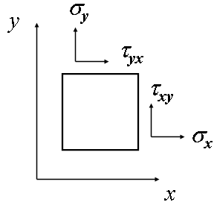
6. Stress and strain
Definitions
A stress σ or τ [Pa] is an internal distribution of force [N] per unit area [m²].
  When the forces are perpendicular to the plane the stress is called normal stress (σ) ; when the forces are parallel to the plane the stress is called shear stress (τ).
  Stresses can be seen as way of a body to resist the action (compression, tension, sliding) of an external force.
A strain ε (δl/l₀) is a forced change dimension δl of a body whose initial dimension is l₀.
  A stretch or a shortening are respectively a tensile or compressive strain; an angular distortion is a shear strain.

Slide 6
6. Stress and strain
Definitions
The elastic modulus (or Young modulus, or modulus of elasticity) E [Pa] is a parameter that defines the stiffness of a given material. It can be expressed as the rate of change in stress with respect to strain (Hook’s law):
ε = σ /E
The Poisson’s ratio ν is the ratio between “axial” to “transversal” strain. When a body is compressed in one direction, it tends to elongate in the other direction. Vice versa, when a body is elongated in one direction, it tends to get thinner in the other direction.
ν = -ε_{axial}/ ε_{trans}

Slide 7
6. Stress and strain
Definitions
By combining the previous definitions, for a biaxial stress state we get
and
Compressive stress is negative, tensile stress is positive.
The Poisson’s ration couples the two directions
  A stress/strain in x also has an effect in y.
For a given stress, the higher the elastic modulus, the smaller the strain and displacement.

Slide 8
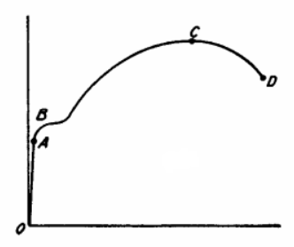
6. Stress and strain
Failure/yield criteria
The proportionality between stress and strain is more complicated than the Hook’s law
  A: limit of proportionality (Hook’s law)
  B: yield point
    Permanent deformation of 0.2 %
  C: ultimate strength
  D: fracture point
Several failure criteria are defined to estimate the failure/yield of structural components, as
  Equivalent (Von Mises) stress σ_{v} < σ_{yield} , where
σ
ε

Slide 9
6. Stress and strain
Mechanical properties
Superconducting coil Nb-Ti: non trivial to characterize, since it is non linear and has hysteresis
Stress-strain relation for Nb-Ti coil of the HL-LHC D1 dipole (M. Sugano, et al.)

Slide 10
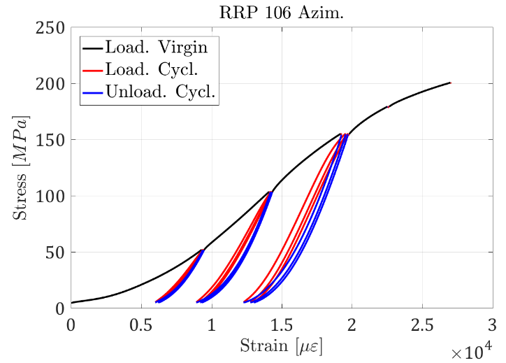
6. Stress and strain
Mechanical properties
Superconducting coil Nb₃Sn
  Also in this case, since it is non linear and has hysteresis
  The coil is harder since it is impregnated (20-40 GPa)
  The coil has a definite size at 0 MPa, contrary to Nb-Ti
Stress-strain for Nb3Sn cable (G. Vallone)

Slide 11
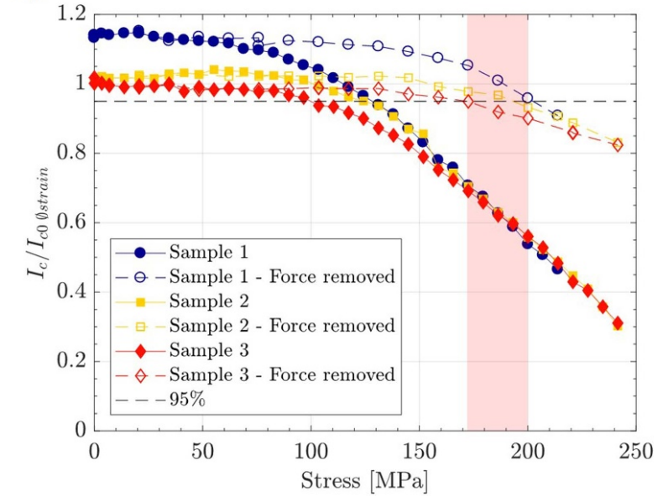
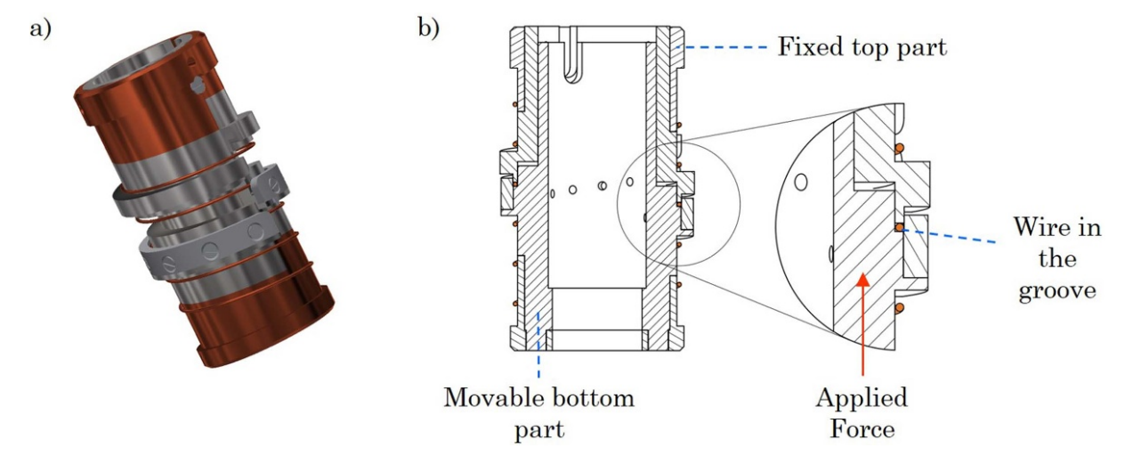
6. Stress and strain
Mechanical properties
Stress sensitivity and stress degradation of Nb₃Sn
  A reversible part (stress sensitivity) and an irreversible one (degradation)

Slide 12
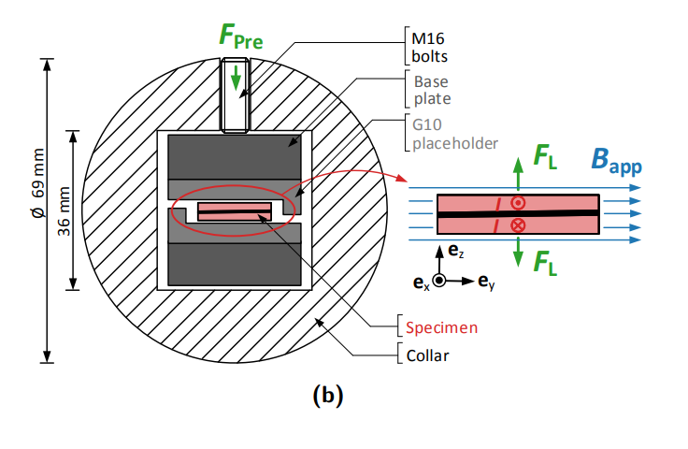
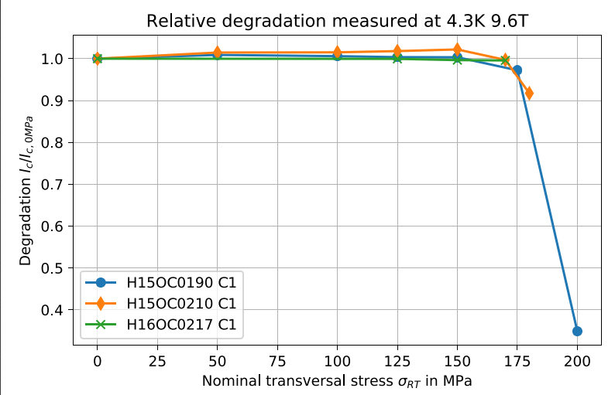
6. Stress and strain
Mechanical properties
Stress sensitivity and stress degradation of Nb₃Sn
  Room temperature loading, then test at 4.2 K
Degradation of critical current for Nb3Sn cable (J. Fleiter)

Slide 13
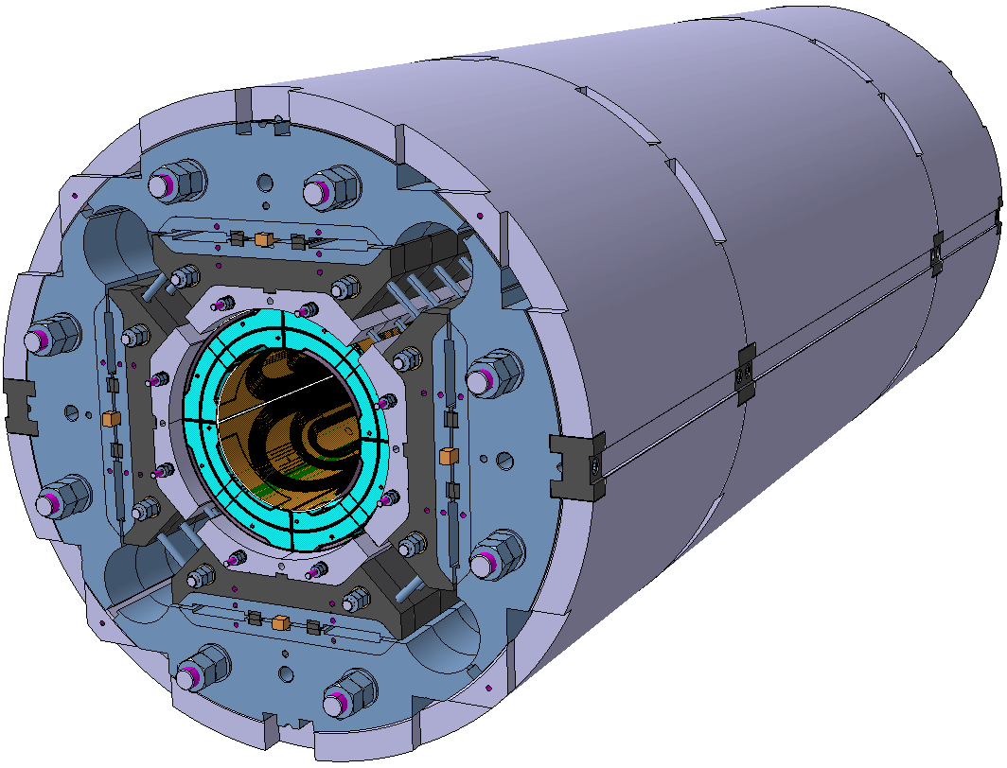
6. Stress and strain
Mechanical properties
Stress sensitivity and stress degradation of Nb₃Sn
  The MQXFS case
    Impact of pre-stress at 1.9 K on maximum current studied with MQXFS7 (PIT and RRP)

Slide 14
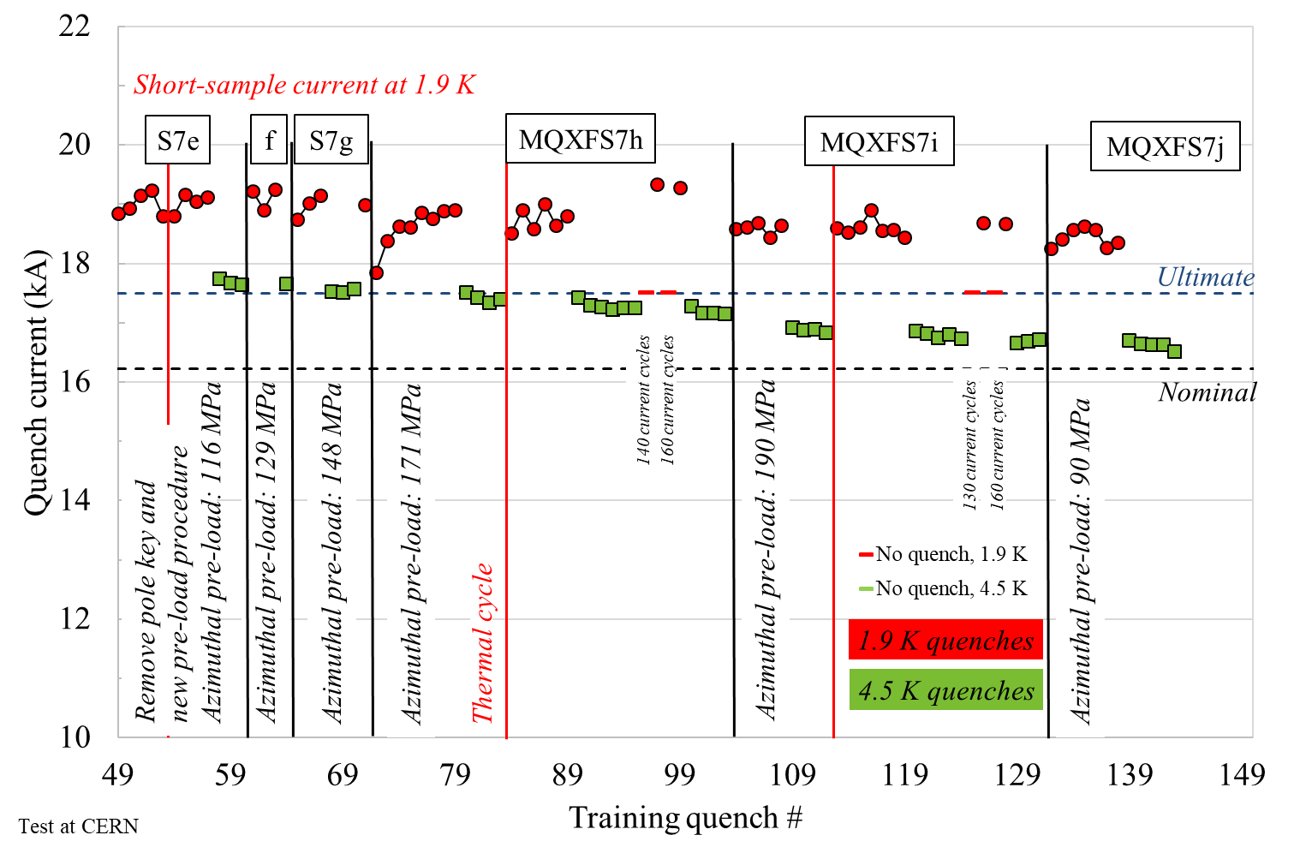
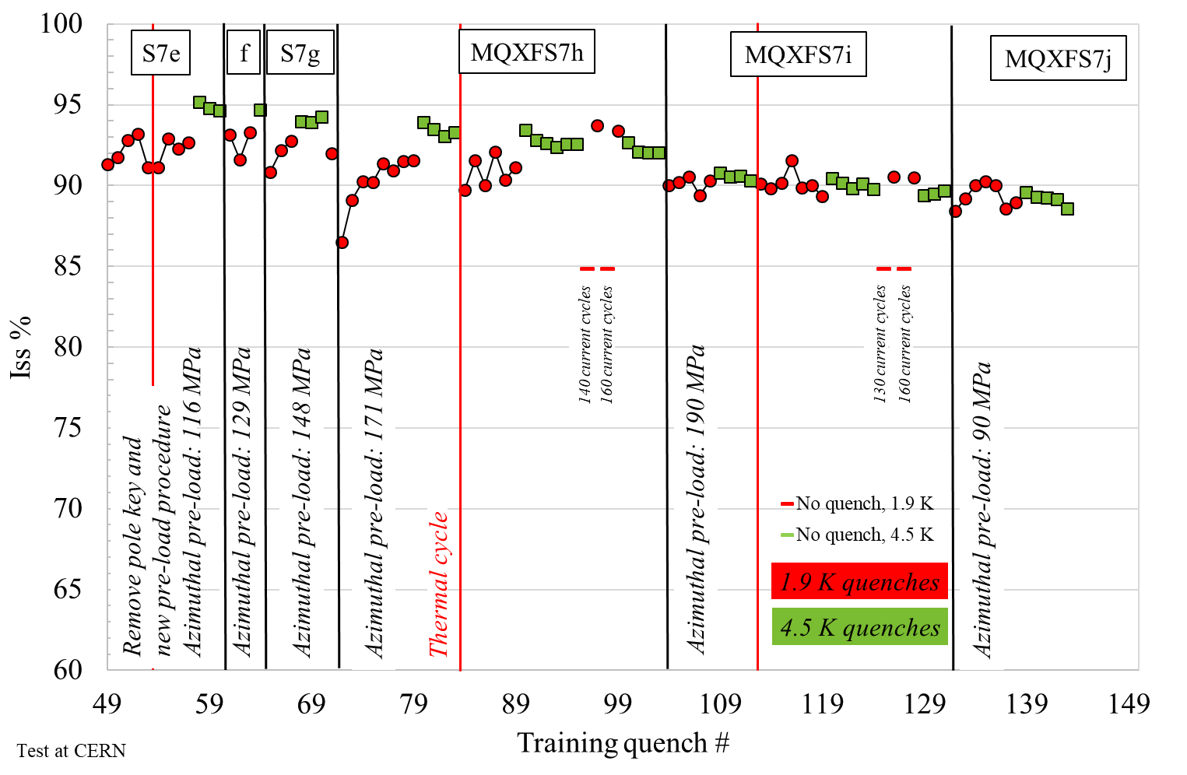
6. Stress and strain
Mechanical properties
Stress sensitivity and stress degradation of Nb₃Sn
  The MQXFS case
    Some degradation appears in the PIT conductor in the 170-190 MPa range
    No degradation observed in RRP up to 190 MPa in the 85% of I_{ss} level
    Magnet above ultimate (and above 85% of I_{ss}) after 150 quenches, 600 power cycles, 14 thermal cycles, many re-loads up to 190 MPa
-116 MPa
-148 MPa
-116 MPa
-148 MPa
-116 MPa
-171 MPa
-190 MPa
-90 MPa
-129 MPa
-171 MPa
-190 MPa
-90 MPa

Slide 15
6. Stress and strain
Mechanical design principles
The e.m forces push the conductor towards mid-planes and supporting structure.
The resulting strain is an indication of
  a change in coil shape
    effect on field quality
  a displacement of the conductor
    potential release of frictional energy and consequent quench of the magnet
The resulting stress must be carefully monitored
  In Nb-Ti magnets, possible damage of kapton insulation at about 150-200 MPa.
  In Nb₃Sn magnets, possible conductor degradation at about 150-200 MPa.
  In general, al the components of the support structure must not exceed the stress limits.
Mechanical design has to address all these issues.

Slide 16
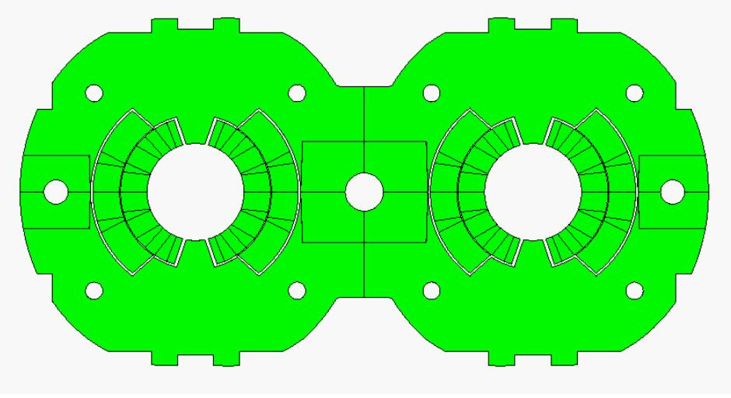
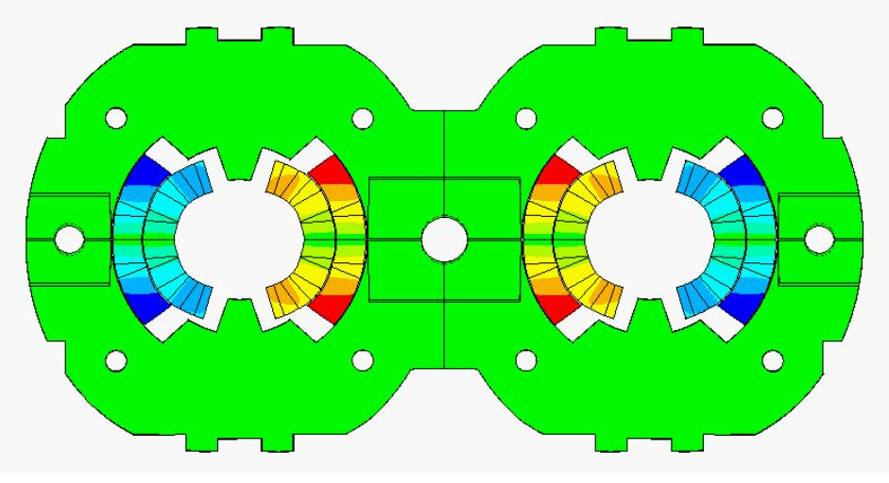
6. Stress and strain
Mechanical design principles
LHC dipole at 0 T LHC dipole at 9 T
Usually, in a dipole or quadrupole magnet, the highest stresses are reached at the mid-plane, where all the azimuthal e.m. forces accumulate (over a small area).
Displacement scaling = 50

Slide 17
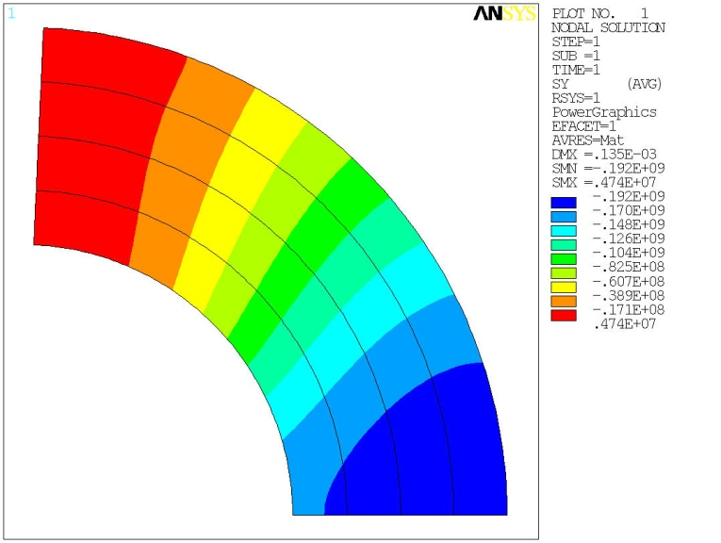
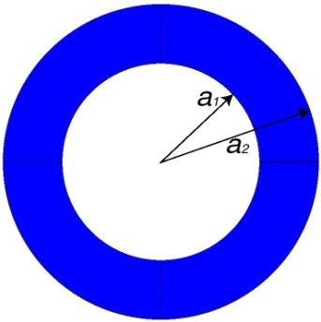
6. Stress and strain
Thick shell
For a dipole,
For a quadrupole,
No shear

Slide 18
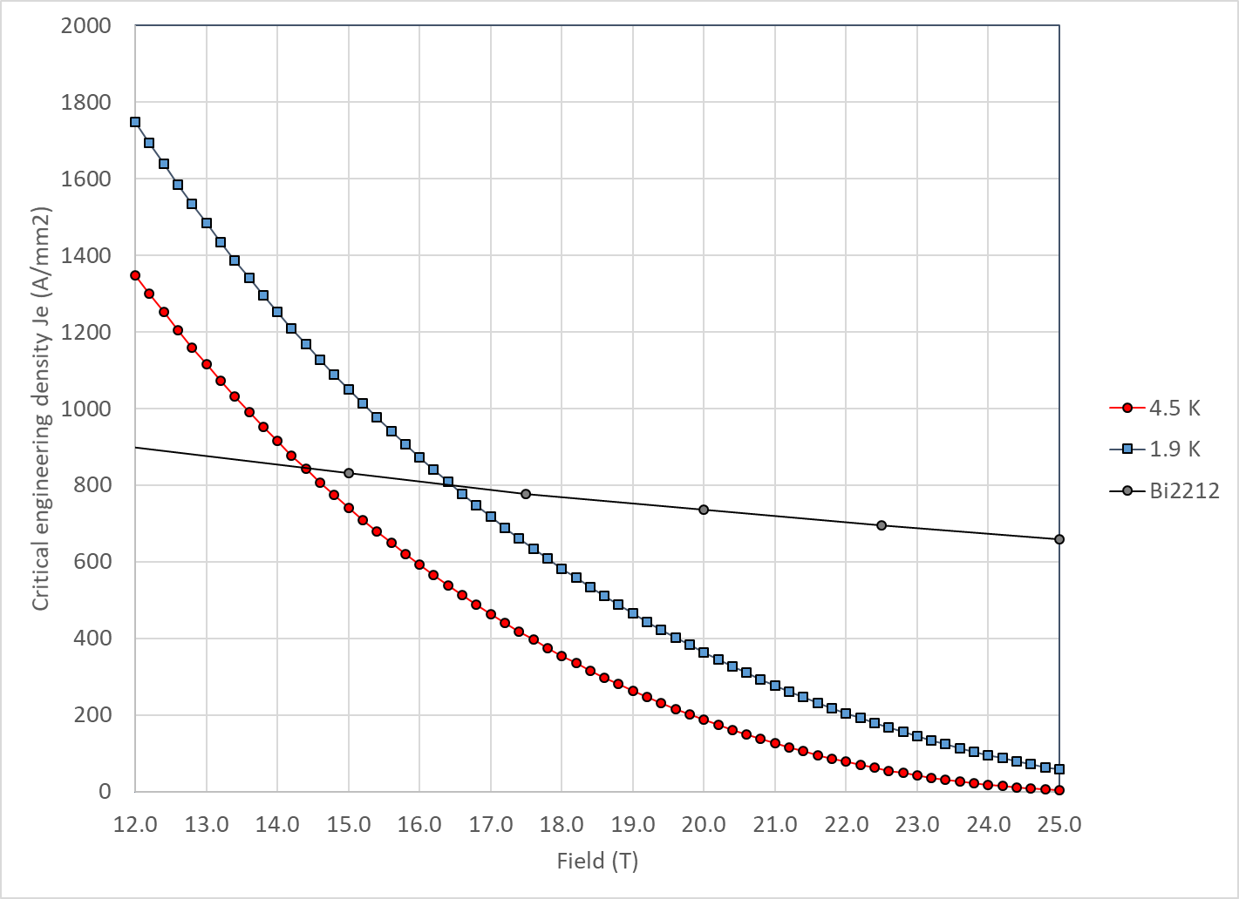
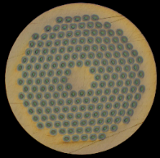
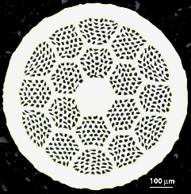
6. Stress and strain
A practical example: 20 T hybrid dipole
Nb₃Sn and Bi2212 cross at 14.5 T at 4.2 K and 16.5 T at 1.9 K

Slide 19
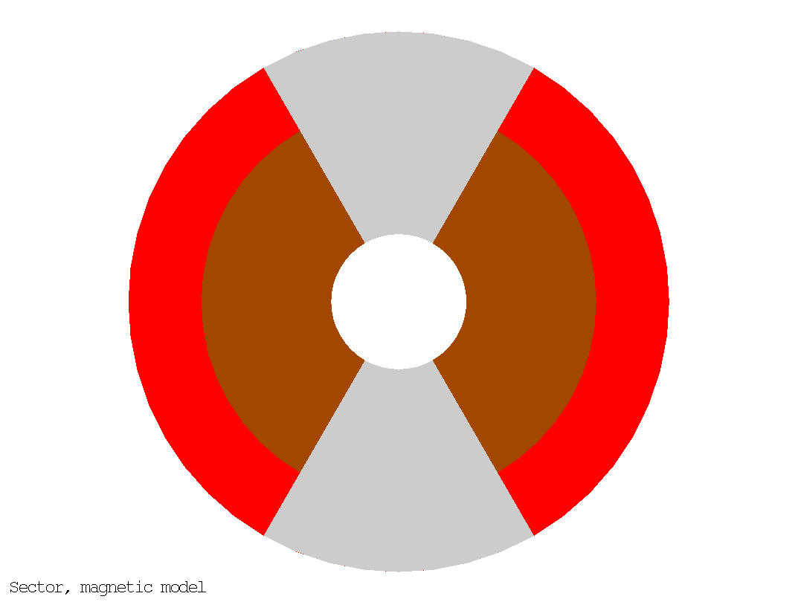
6. Stress and strain
A practical example: 20 T hybrid dipole
50 mm aperture
ID Nb₃Sn = 146 mm
OD Nb₃Sn = 200 mm
76 m total coil thickness
  49 mm thick Bi2212 coil
  27 mm thick Nb₃Sn coil
Area Bi2212: 2540 mm² (1 quadrant)
Area Nb₃Sn: 2470 mm² (1 quadrant)
Stored energy: 2.86 MJ/m (4 quadrants)
20 T = 13 T + 7 T
Nb₃Sn
Bi2212

Slide 20
6. Stress and strain
A practical example: 20 T hybrid dipole
ID: 50 mm
OD: 200 mm
W: 76 mm
ID: 50 mm
OD: 146 mm
W: 49 mm
ID: 146 mm
OD: 200 mm
W: 27 mm
Nb₃Sn
Nb₃Sn
Bi2212
Bi2212
Bi2212

Slide 21
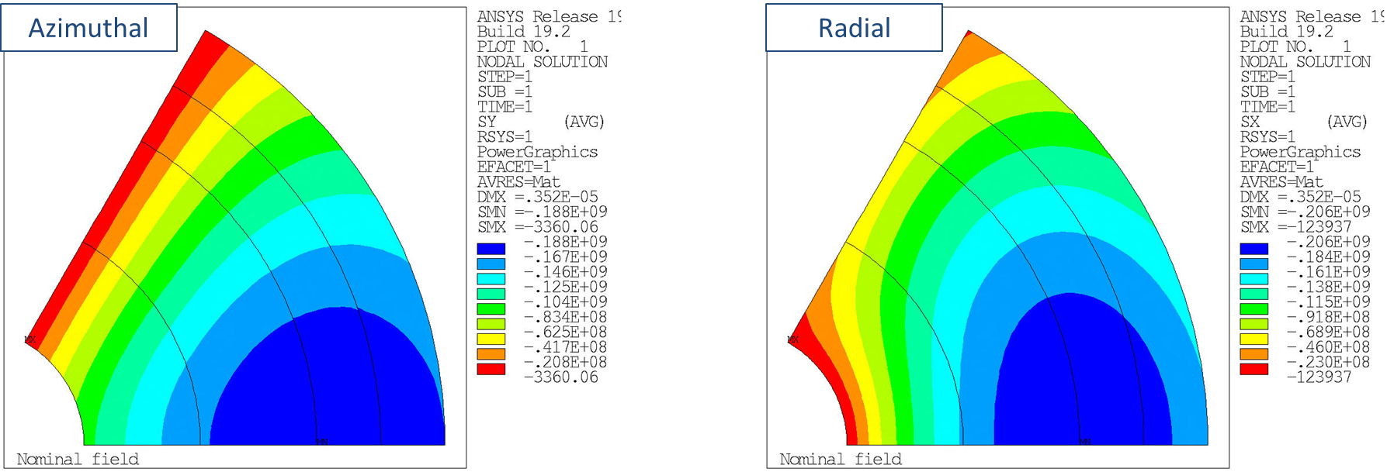
6. Stress and strain
A practical example: 20 T hybrid dipole
Operation J_{e} → coil size → azimuthal and radial stresses

Slide 22
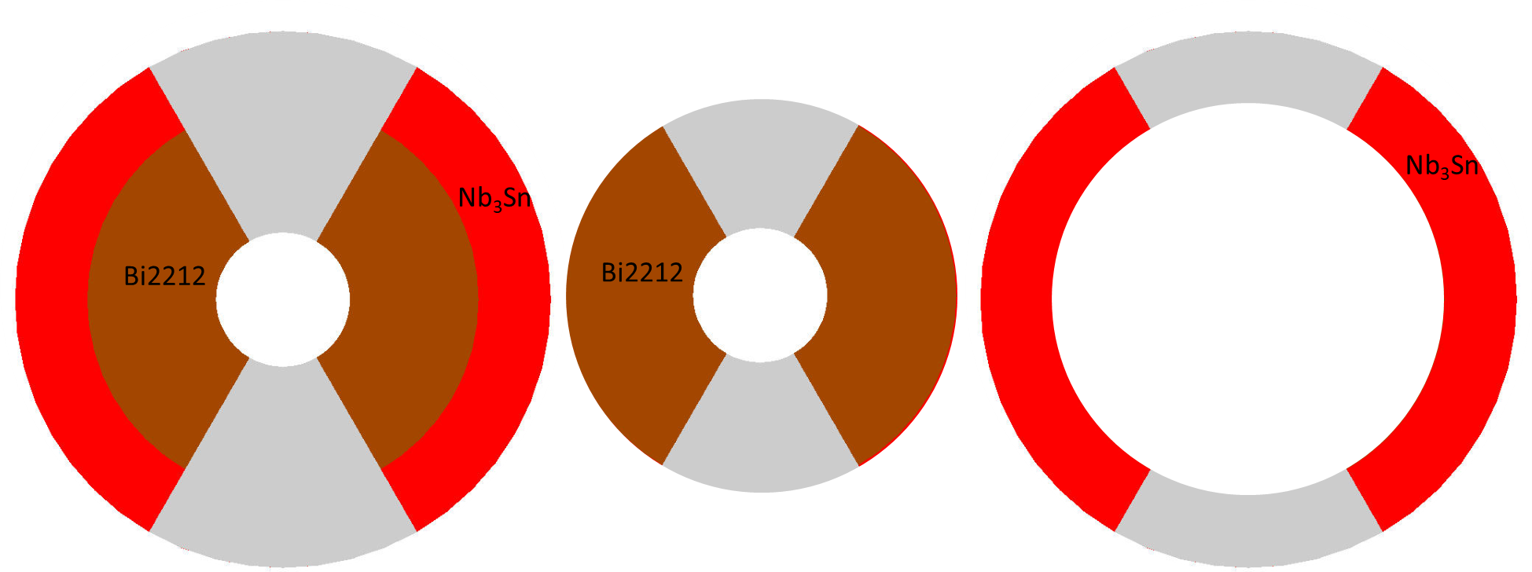
Summary
ID: 50 mm
OD: 200 mm
W: 76 mm
B_{_bore_op} = 20 T
σ_{ϑ}/ σ_{r} =188/206
ID: 50 mm
OD: 146 mm
W: 49 mm
B_{_bore_op} = 14.7 T
σ_{ϑ}/ σ_{r} =128/122
ID: 146 mm
OD: 200 mm
W: 27 mm
B_{_bore_op} = 10.3 T
σ_{ϑ}/ σ_{r} =232/77
We need to build a
  13-14 T HTS magnet (50 mm)
  10-13 T LTS magnet (large bore)
    120 mm seems a good start, but we may need more
In hybrid 20 T, radial stress seems higher than azimuthal
  When tested separately, very high azimuthal stress in LTS

Slide 23
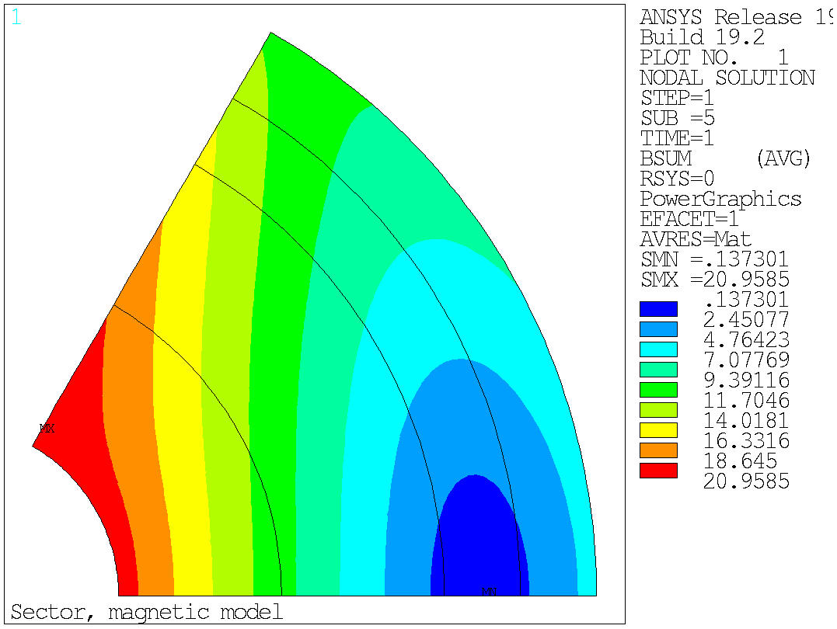
6. Stress and strain
Azimuthal vs radial stress
Now some analytical consideration
Let’s look again at field and stress profiles
Magnetic field
Coil stress
Coil stress

Slide 24
6. Stress and strain
Azimuthal vs radial stress
Azimuthal stress
  Accumulation of stress on the edge of the coil of the azimuthal component
The midplane stress at the edge is
  Proportional to current density
  Proportional to field
  Proportional to aperture radius
by E. Todesco

Slide 25
6. Stress and strain
Azimuthal vs radial stress
Radial stress
  For the radial stress, we have to integrate along the midplane
  This equation can be rewritten, ignoring the iron contribution, in a form where the magnetic pressure is put in evidence
  Let’s assume that the By linearly decreases from B₁ to 0 from r to r+w for a sector coil one has
by E. Todesco

Slide 26
6. Stress and strain
Azimuthal vs radial stress
Azimuthal stress
  Can be cured by lower current density to get higher fields
  Pay attention to the aperture
Radial stress
  Not much you can do when you get to very high field
    (stress management)
by E. Todesco

Slide 27
Outline
Introduction
Electro-magnetic force
  Definition and directions
Magnetic pressure and forces
Approximations of practical winding cross-sections
  Thin shell, Thick shell, Sector
Stored energy and end forces
Stress and strain
Pre-stress
Conclusions

Slide 28
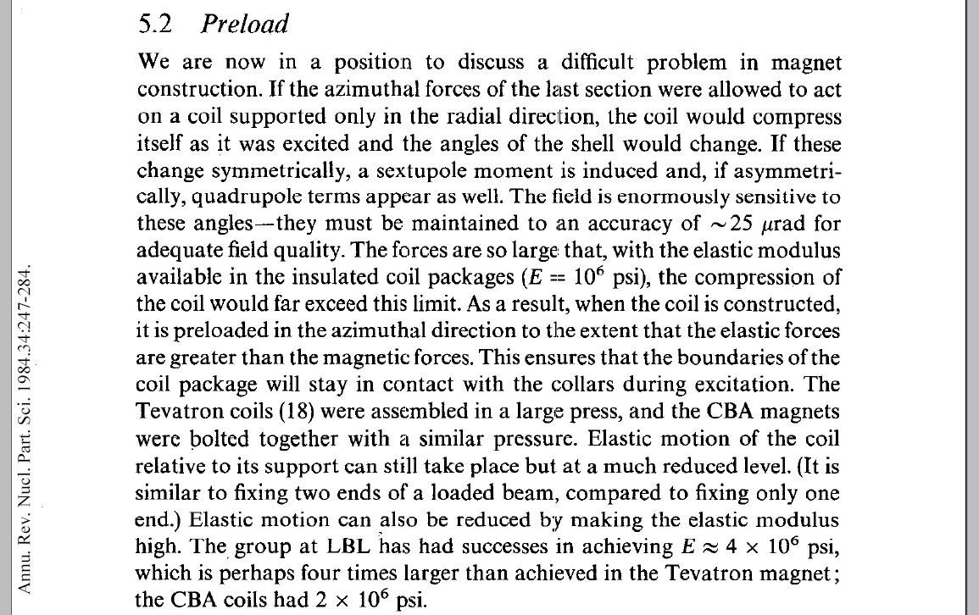
7. Pre-stress
A.V. Tollestrup, [3]

Slide 29
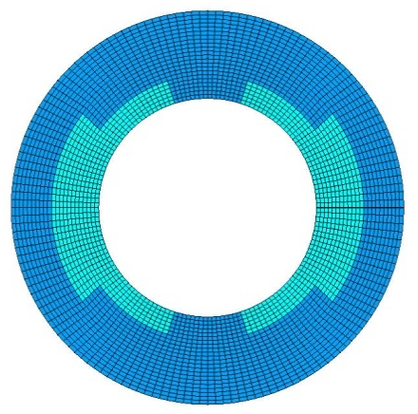
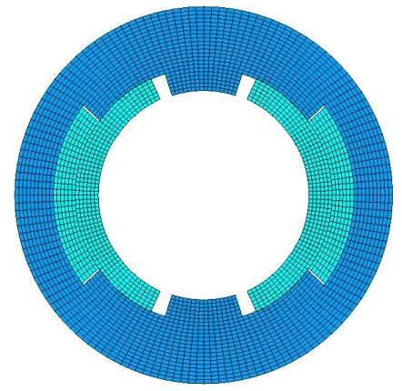
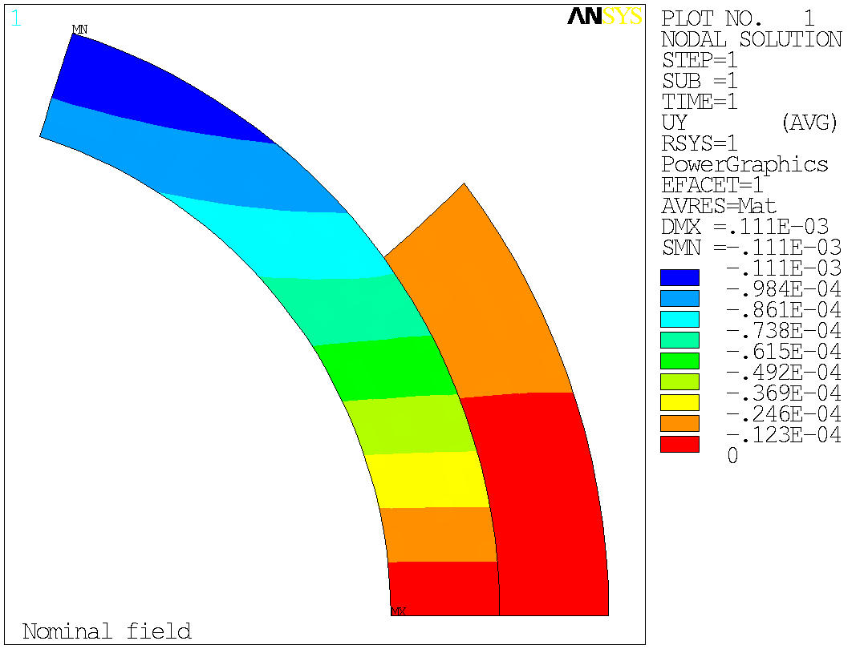
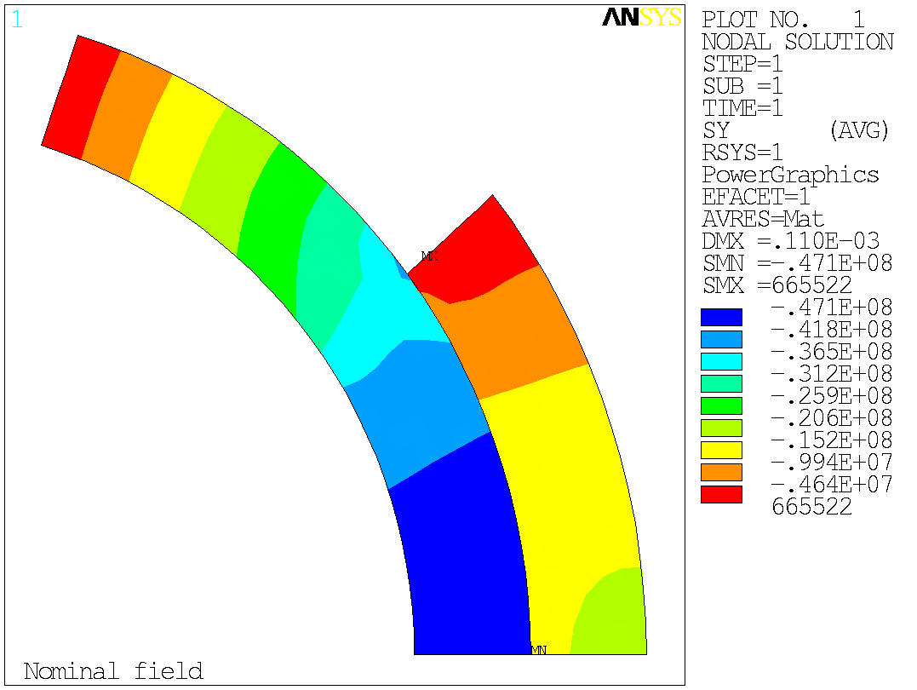
7. Pre-stress
Tevatron main dipole
Let’s consider the case of the Tevatron main dipole (B_{nom}= 4.4 T).
In a infinitely rigid structure without pre-stress the pole would move of about -100 μm, with a stress on the mid-plane of -45 MPa.

Slide 30
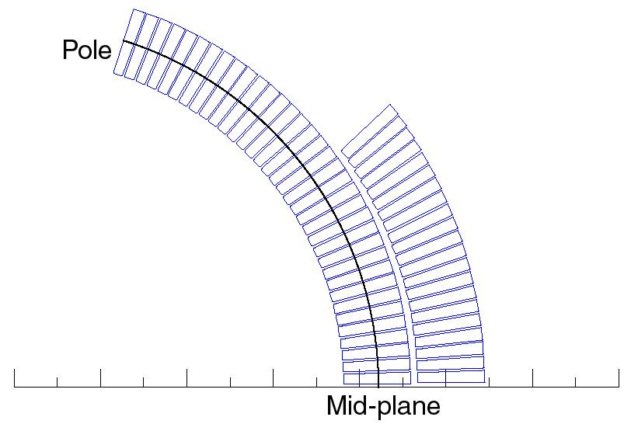
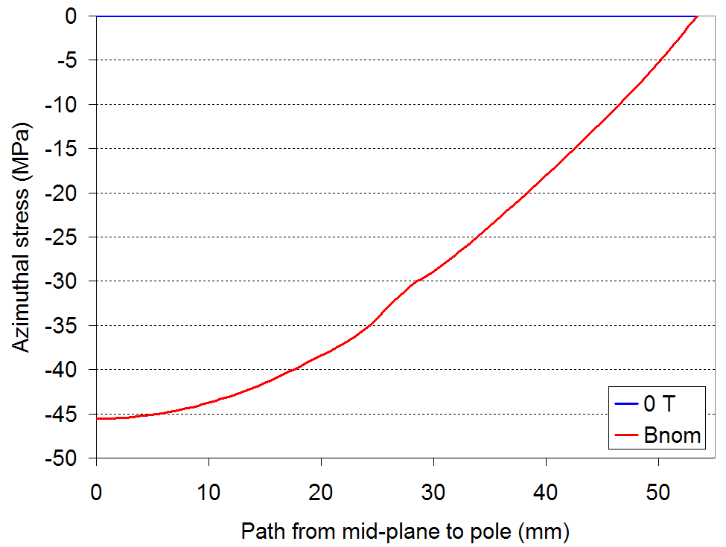
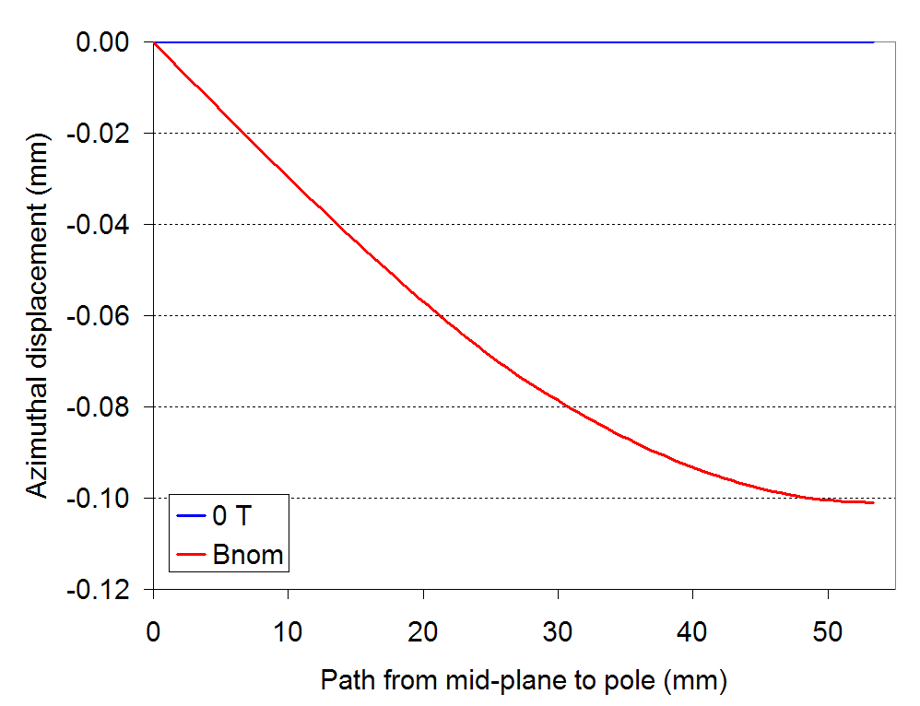
7. Pre-stress
Tevatron main dipole
We can plot the displacement and the stress along a path moving from the mid-plane to the pole.
In the case of no pre-stress, the displacement of the pole during excitation is about -100 μm.

Slide 31
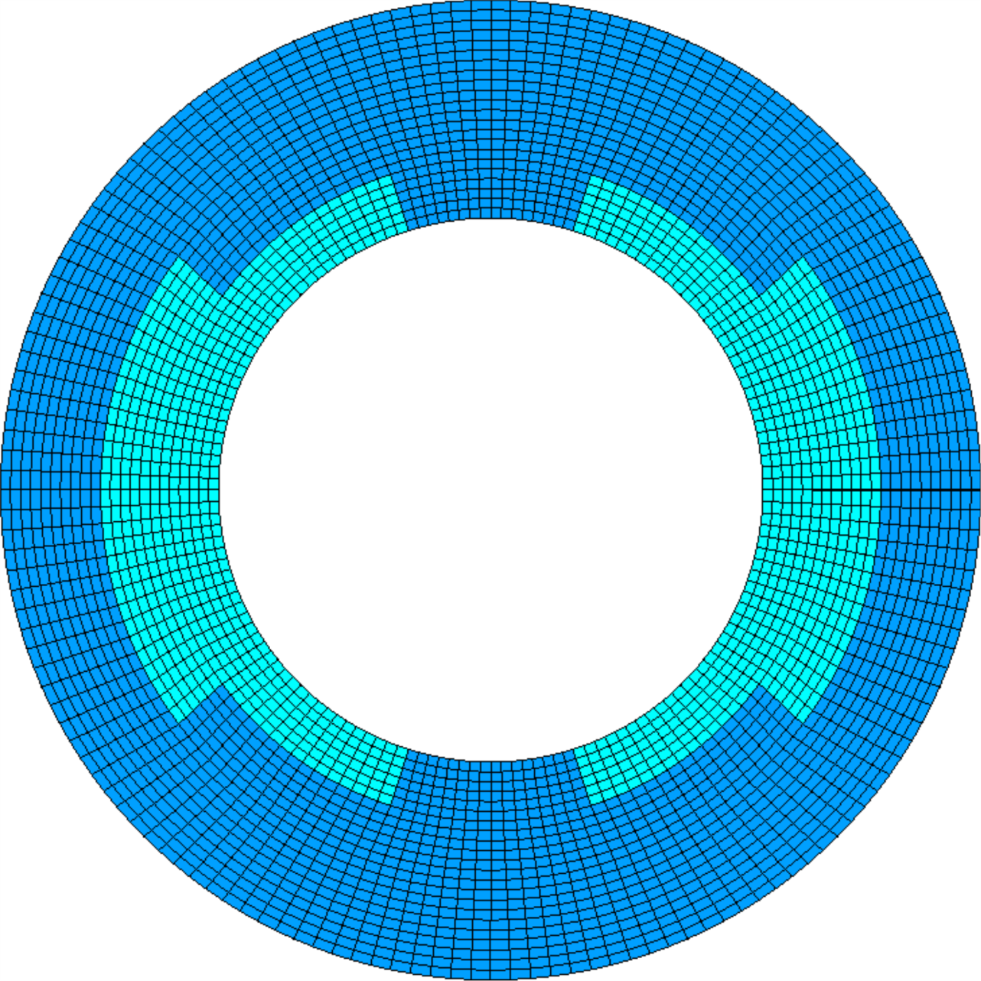
No pre-stress, no e.m. force
Displacement scaling = 50

Slide 32
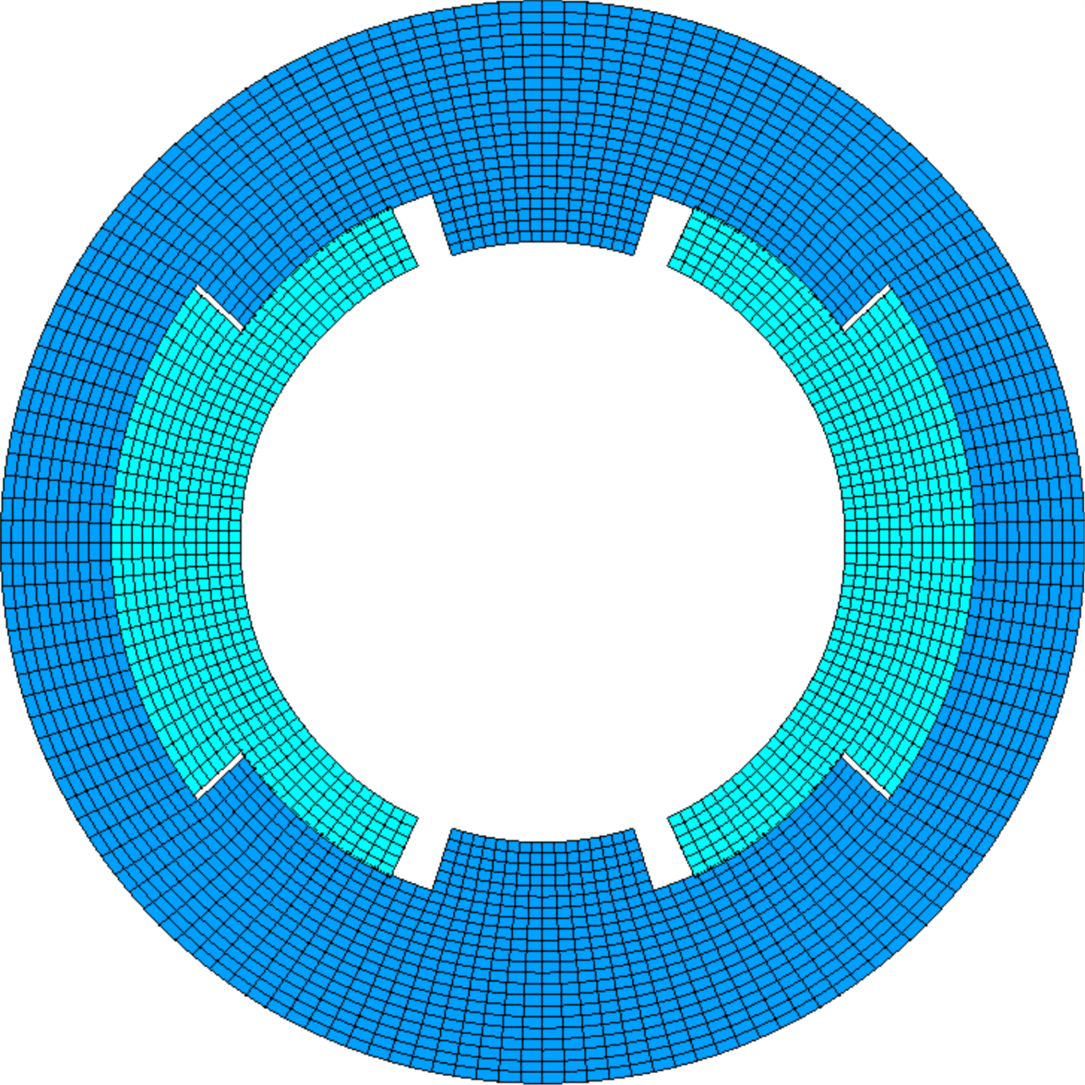
No pre-stress, with e.m. force
About 100 μm for Tevatron main dipole (B_{nom}= 4.4 T)
Displacement scaling = 50

Slide 33
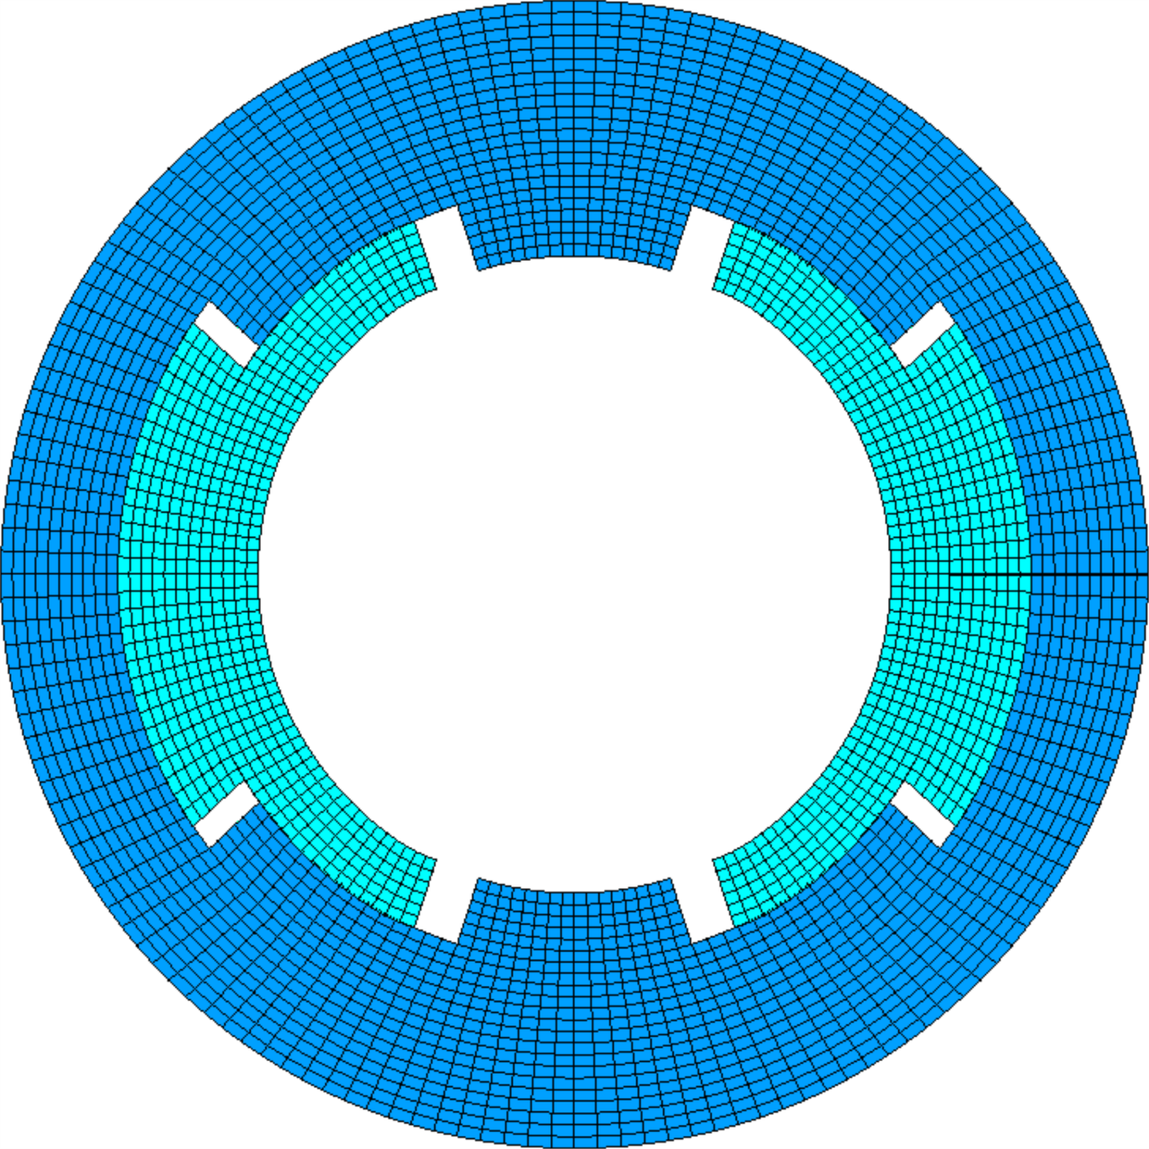
Pre-stress, no e.m. force
Pole shim
Displacement scaling = 50

Slide 34
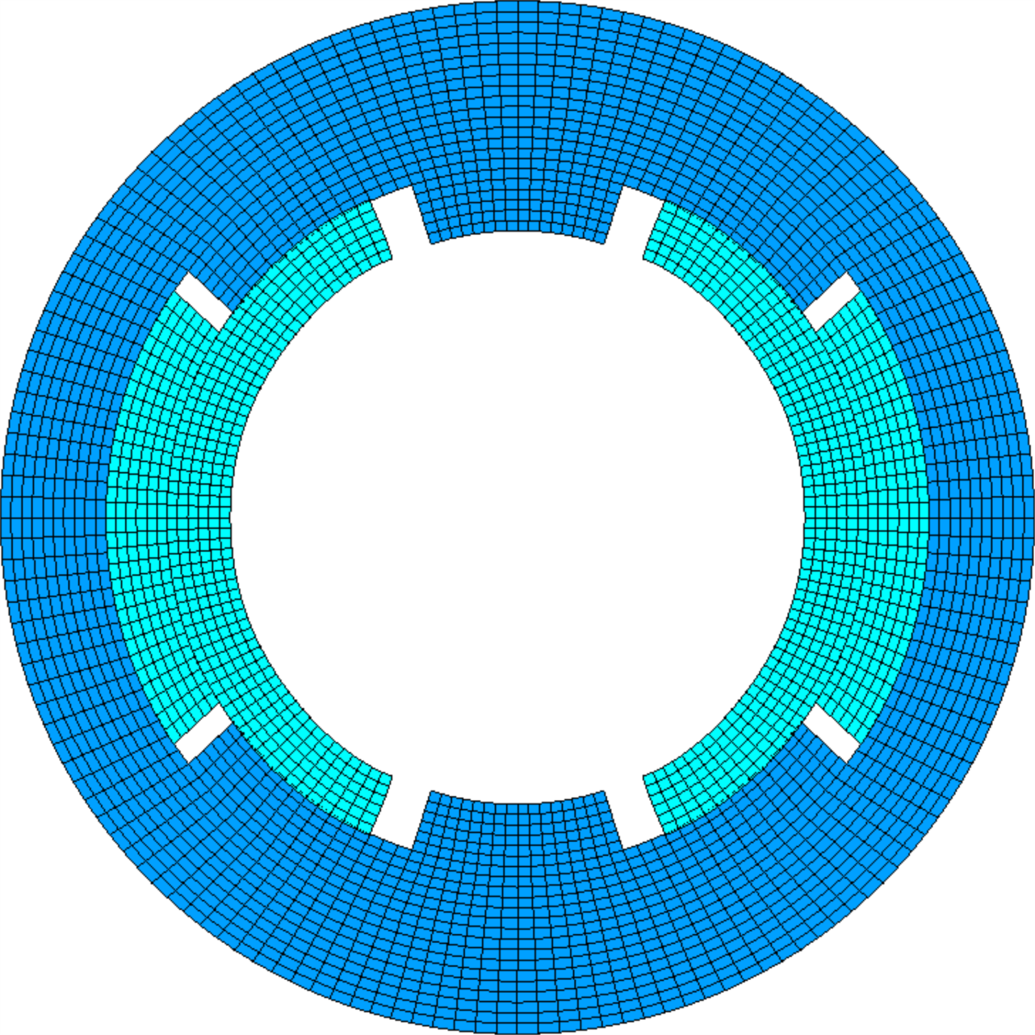
Pre-stress, with e.m. force
Pole shim
Coil pre-stress applied to all the accelerator dipole magnets
Displacement scaling = 50

Slide 35
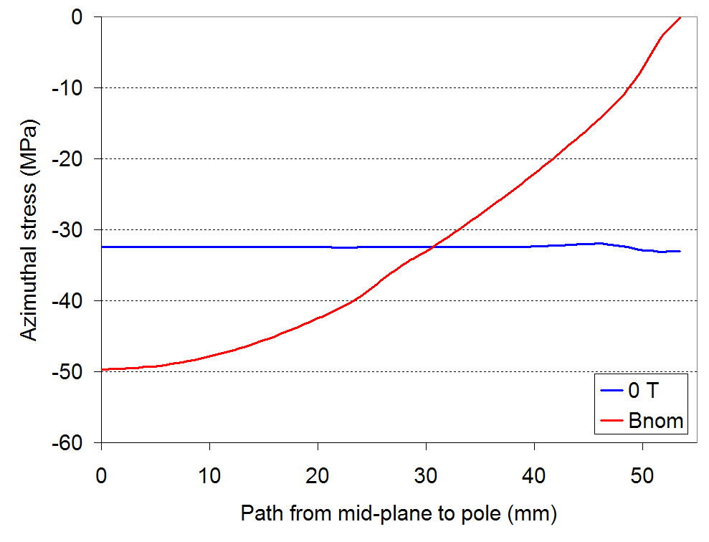
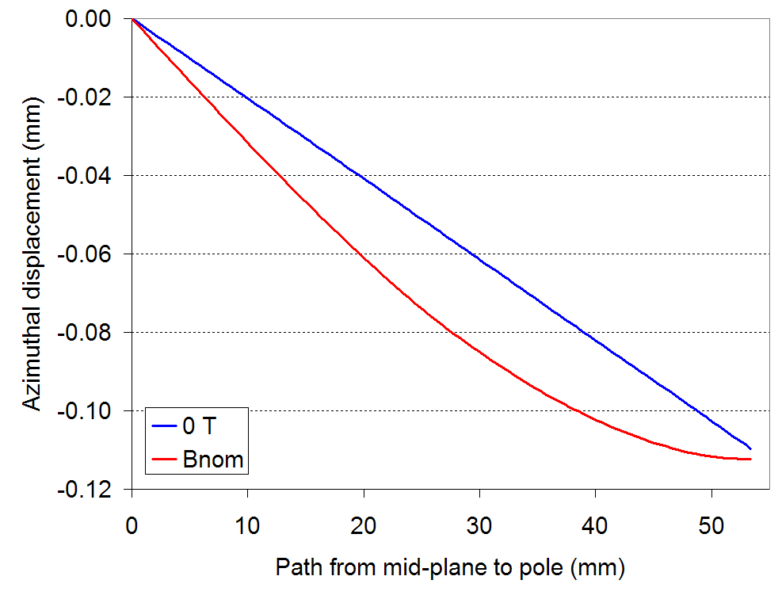
7. Pre-stress
Tevatron main dipole
We now apply to the coil a pre-stress of about -33 MPa, so that no separation occurs at the pole region.
The displacement at the pole during excitation is now negligible, and, within the coil, the conductors move at most of -20 μm.

Slide 36
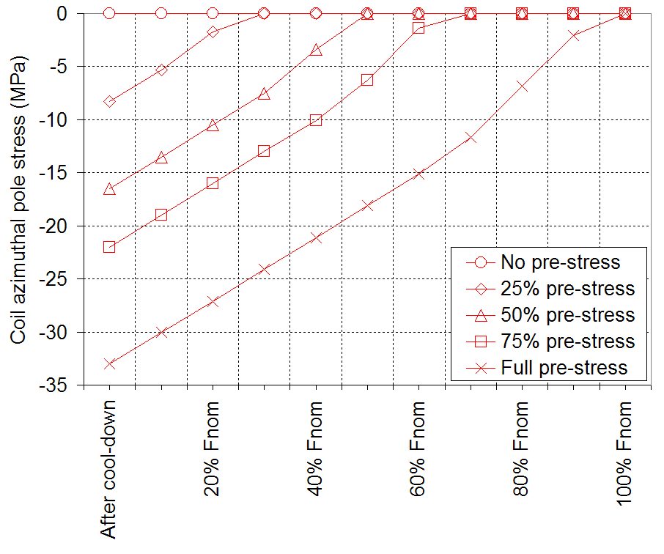
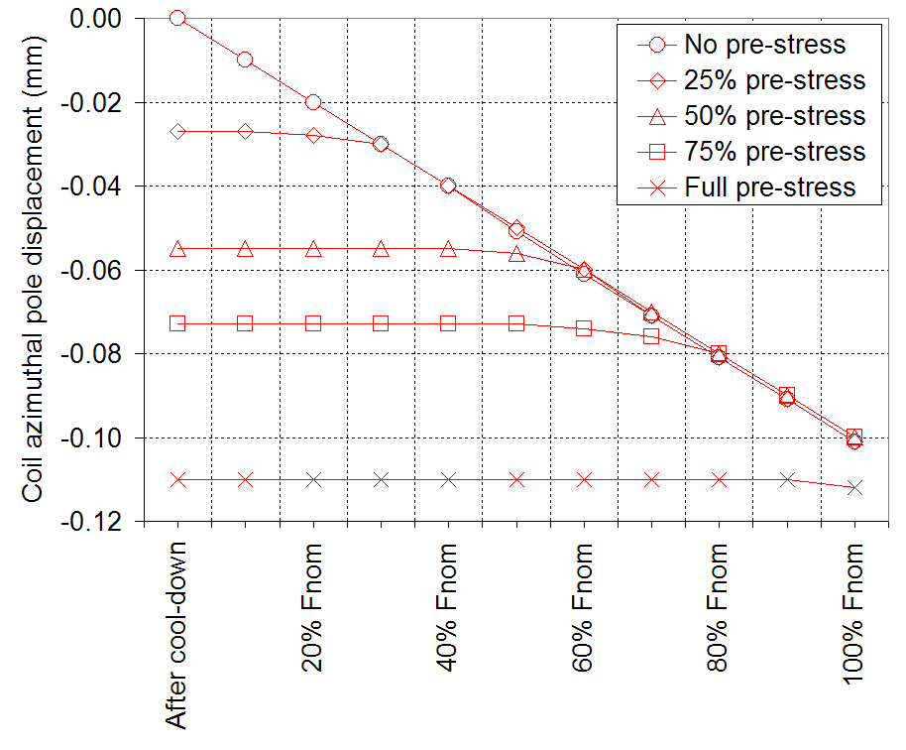
7. Pre-stress
Tevatron main dipole
We focus now on the stress and displacement of the pole turn (high field region) in different pre-stress conditions.
The total displacement of the pole turn is proportional to the pre-stress.
  A full pre-stress condition minimizes the displacements.

Slide 37
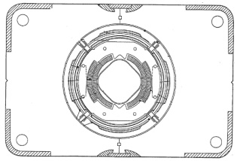
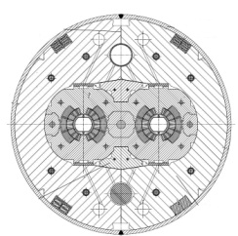
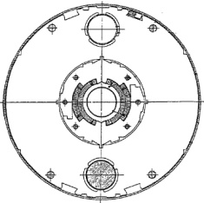
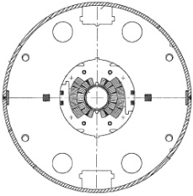
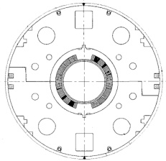
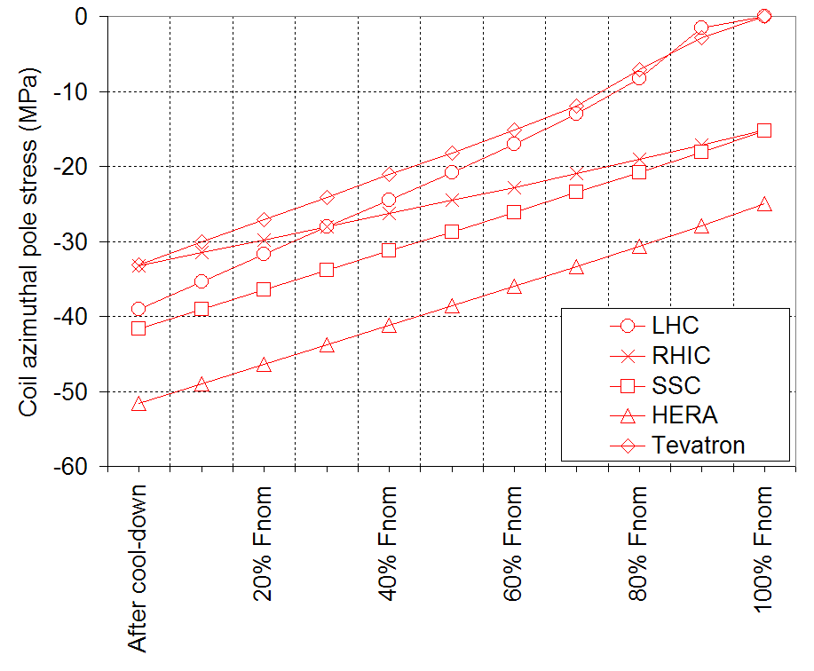
7. Pre-stress
Overview of accelerator dipole magnets
The practice of pre-stressing the coil has been applied to all the accelerator dipole magnets
  Tevatron [4]
  HERA [5]
  SSC [6]-[7]
  RHIC [8]
  LHC [9]
The pre-stress is chosen in such a way that the coil remains in contact with the pole at nominal field, sometime with a “mechanical margin” of more than 20 MPa.

Slide 38
7. Pre-stress
General considerations
As we pointed out, the pre-stress reduces the coil motion during excitation.
This ensure that the coil boundaries will not change as we ramp the field, and, as a results, minor field quality perturbations will occur.
What about the effect of pre-stress on quench performance?
  In principle less motion means less frictional energy dissipation or resin fracture.
  Nevertheless the impact of pre-stress on quench initiation remains controversial

Slide 39
7. Pre-stress
General considerations
The paradigm is still used today, requiring no detachment of the coil at nominal current
  On the other hand there are several examples magnets operating with pole detachment
The paradigm is always used in design and not always followed in reality
  Typically, for the first models and prototypes one speaks of “conservative” loading, meaning that the preload is lower than what required to avoid pole unloading in operational conditions
  The fear is to break something of degrade the conductor

Slide 40
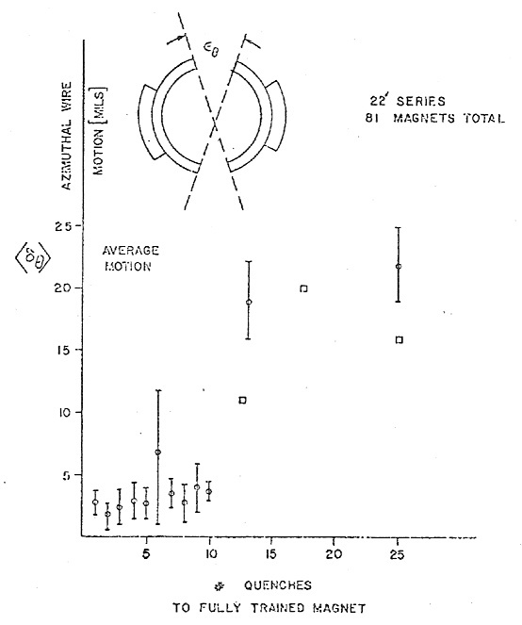
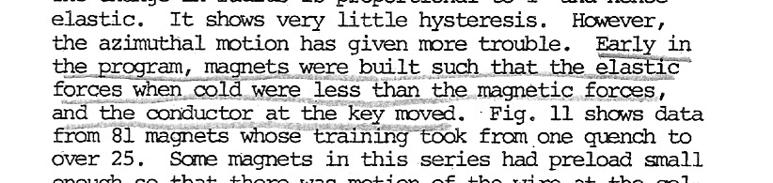
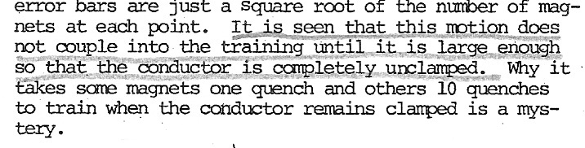
7. Pre-stress
Experience in Tevatron
  Above movements of 0.1 mm, there is a correlation between performance and movement: the larger the movement, the longer the training
  Conclusion: one has to pre-stress to avoid movements that can limit performance
0.1 mm
A.V. Tollestrup, [10]

Slide 41
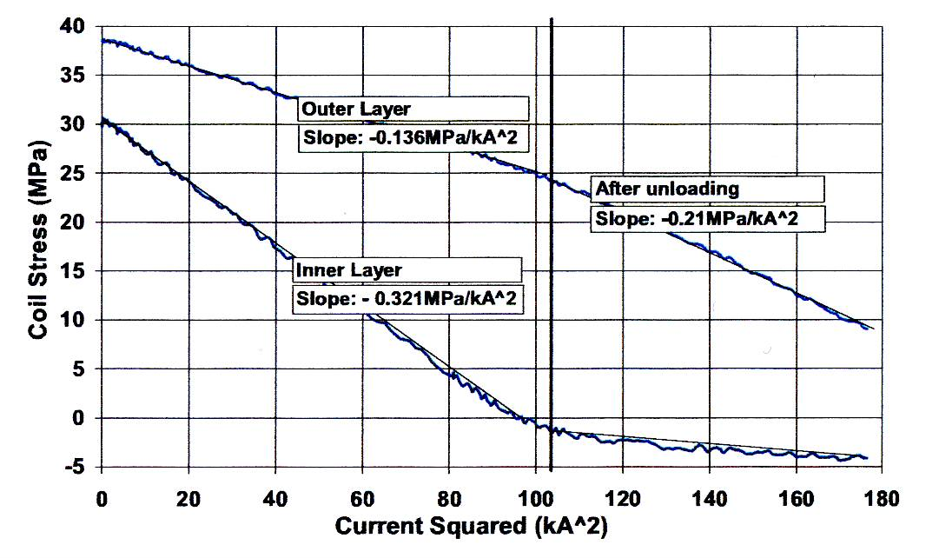
7. Pre-stress
Experience in LHC short dipoles
Study of variation of pre-stress in several models – evidence of unloading at 75% of nominal, but no quench
“It is worth pointing out that, in spite of the complete unloading of the inner layer at low currents, both low pre-stress magnets showed correct performance and quenched only at much higher fields”
N. Andreev, [11]

Slide 42
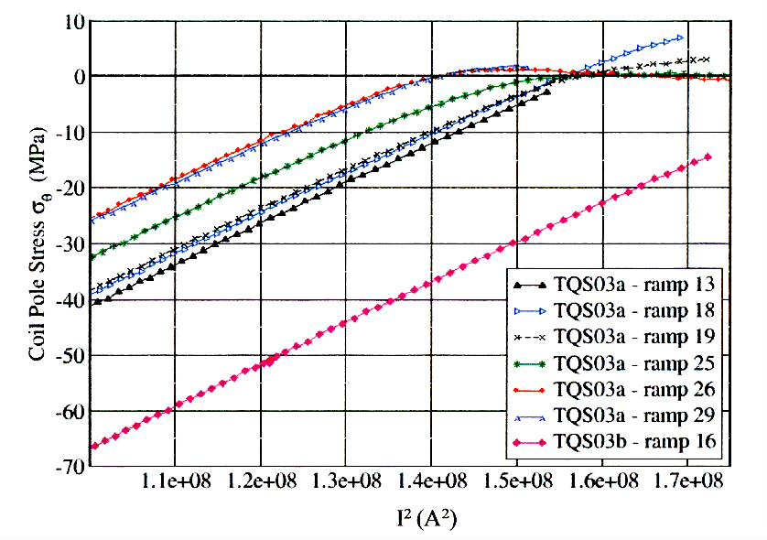
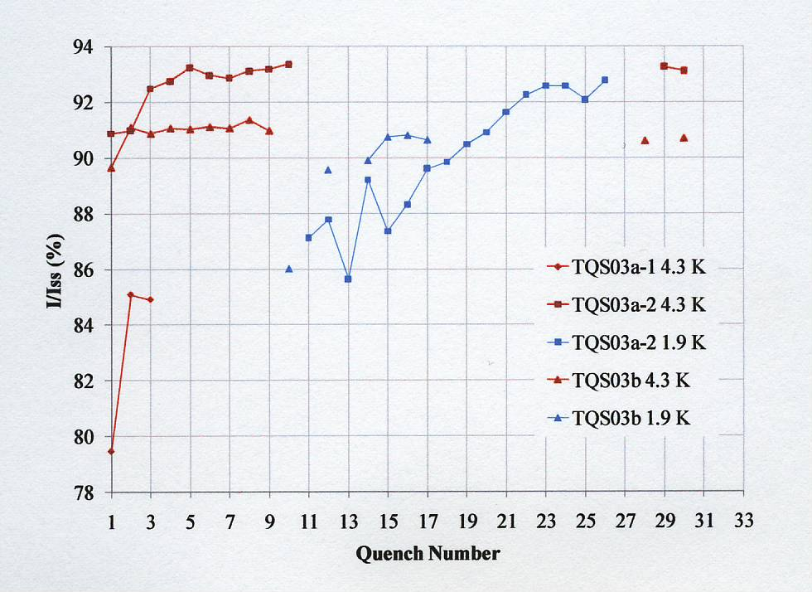
7. Pre-stress
Experience in LARP TQ quadrupole
With low pre-stress, unloading but still good quench performance
With high pre-stress, stable plateau but small degradation
TQS03a low prestress
TQS03a low prestress
TQS03b high prestress
TQS03b high prestress

Slide 43
7. Pre-stress
Experience in MQXFS quadrupole
“The experiment proves that (i) a preload to 60% of short sample allows operating the magnet at 85% of short sample without significant training and (ii) a preload at 80% of short sample allows to expand the operational field of the magnet from 90% to 95% of short sample current, and to reduce the training.”

Slide 44
8. Conclusions
We presented the force profiles in superconducting magnets
  A solenoid case can be well represented as a pressure vessel
  In dipole and quadrupole magnets, the forces are directed towards the mid-plane and outwardly.
    They tend to separate the coil from the pole and compress the mid-plane region
    Axially they tend to stretch the windings
We provided a series of analytical formulas to determine in first approximation forces and stresses.
The importance of the coil pre-stress has been pointed out, as a technique to minimize the conductor motion during excitation.

Slide 45
Appendix I
Thin shell approximation

Slide 46
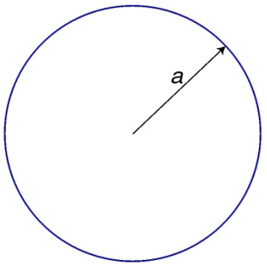

Appendix I: thin shell approximation
Field and forces: general case
We assume
  J = J₀ cosnθ where J₀ [A/m] is  to the cross-section plane
  Radius of the shell/coil = a
  No iron
The field inside the aperture is
The average field in the coil is
The Lorentz force acting on the coil [N/m²] is

Slide 47

Appendix I: thin shell approximation
Field and forces: dipole
In a dipole, the field inside the coil is
The total force acting on the coil [N/m] is
The Lorentz force on a dipole coil varies
  with the square of the bore field
  linearly with the magnetic pressure
  linearly with the bore radius.
In a rigid structure, the force determines an azimuthal displacement of the coil and creates a separation at the pole.
The structure sees F_{x}.

Slide 48

Appendix I: thin shell approximation
Field and forces: quadrupole
In a quadrupole, the gradient [T/m] inside the coil is
The total force acting on the coil [N/m] is
The Lorentz force on a quadrupole coil varies
  with the square of the gradient or coil peak field
  with the cube of the aperture radius (for a fixed gradient).
Keeping the peak field constant, the force is proportional to the aperture.

Slide 49

Appendix I: thin shell approximation
Stored energy and end forces: dipole and quadrupole
For a dipole, the vector potential within the thin shell is
and, therefore,
  The axial force on a dipole coil varies
    with the square of the bore field
    linearly with the magnetic pressure
    with the square of the bore radius.
For a quadrupole, the vector potential within the thin shell is
and, therefore,
  Being the peak field the same, a quadrupole has half the F_{z} of a dipole.

Slide 50
Appendix I: thin shell approximation
Total force on the mid-plane: dipole and quadrupole
If we assume a “roman arch” condition, where all the f_{θ} accumulates on the mid-plane, we can compute a total force transmitted on the mid-plane F_{θ} [N/m]
For a dipole,
For a quadrupole,
  Being the peak field the same, a quadrupole has half the F_{θ} of a dipole.
  Keeping the peak field constant, the force is proportional to the aperture.

Slide 51
Appendix II
Thick shell approximation

Slide 52

Appendix II: thick shell approximation
Field and forces: general case
We assume
  J = J₀ cosnθ where J₀ [A/m²] is  to the cross-section plane
  Inner (outer) radius of the coils = a1 (a2)
  No iron
The field inside the aperture is
The field in the coil is
The Lorentz force acting on the coil [N/m³] is

Slide 53

Appendix II: thick shell approximation
Field and forces: dipole
In a dipole, the field inside the coil is
The total force acting on the coil [N/m] is

Slide 54

Appendix II: thick shell approximation
Field and forces: quadrupole
In a quadrupole, the field inside the coil is
being
The total force acting on the coil [N/m] is

Slide 55

Appendix II: thick shell approximation
Stored energy, end forces: dipole and quadrupole
For a dipole,
and, therefore,
For a quadrupole,
and, therefore,

Slide 56
Appendix II: thick shell approximation
Stress on the mid-plane: dipole and quadrupole
For a dipole,
For a quadrupole,
No shear

Slide 57
Appendix III
Sector approximation

Slide 58

Appendix III: sector approximation
Field and forces: dipole
We assume
  J=J₀ is  the cross-section plane
  Inner (outer) radius of the coils = a1 (a2)
  Angle φ = 60º (third harmonic term is null)
  No iron
The field inside the aperture
The field in the coil is

Slide 59

Appendix III: sector approximation
Field and forces: dipole
The Lorentz force acting on the coil [N/m³], considering the basic term, is
The total force acting on the coil [N/m] is

Slide 60

Appendix III: sector approximation
Field and forces: quadrupole
We assume
  J=J₀ is  the cross-section plane
  Inner (outer) radius of the coils = a1 (a2)
  Angle φ = 30º (third harmonic term is null)
  No iron
The field inside the aperture
The field in the coil is

Slide 61

Appendix III: sector approximation
Field and forces: quadrupole
The Lorentz force acting on the coil [N/m³], considering the basic term, is
The total force acting on the coil [N/m] per octant is

Slide 62


Appendix III: sector approximation
Stored energy, end forces: dipole and quadrupole
For a dipole,
and, therefore,
For a quadrupole,
and, therefore,

Slide 63



Appendix III: sector approximation
Stress on the mid-plane: dipole and quadrupole
For a dipole,
For a quadrupole,
No shear

