Slide 1
Unit 13
Construction methods and support structures
Chapter I
Paolo Ferracin
Lawrence Berkeley National Laboratory (LBNL)

Slide 2
Outline
Introduction
Coil winding and curing
Reaction of Nb₃Sn coils
Vacuum impregnation of Nb₃Sn coils
“React & Wind” approach
Instrumentation and measurements
Nb-Ti – Nb-Ti and Nb₃Sn – Nb-Ti splices
Final assembly
Practical examples
Conclusions

Slide 3
References
[1] L. Rossi, “Superconducting Magnets”, CERN Academic Training, 15-18 May 2000.
[2] MJB Plus, Inc. “Superconducting Accelerator Magnets”, an interactive tutorial.
[3] K.-H. Mess, P. Schmuser, S. Wolff, “Superconducting accelerator magnets”, Singapore: World Scientific, 1996.
[4] “LHC design report v.1: the main LHC ring”, CERN-2004-003-v-1, 2004.
[5] R. Gupta, et al., “React and wind common coil dipole”, talk at Applied Superconductivity Conference 2006, Seattle, WA, Aug. 27 - Sept. 1, 2006.
[6] Slides from J. C. Perez on coil fabrication process in MDT section at CERN.

Slide 4
1. Introduction
In this unit we show how the coils are fabricated.
  How do we go from the insulated cable to a full coil ready to be used in a magnet?
  Which are the fabrication steps for a Nb-Ti coil and Nb₃Sn coil?
    Which are the differences?

Slide 5
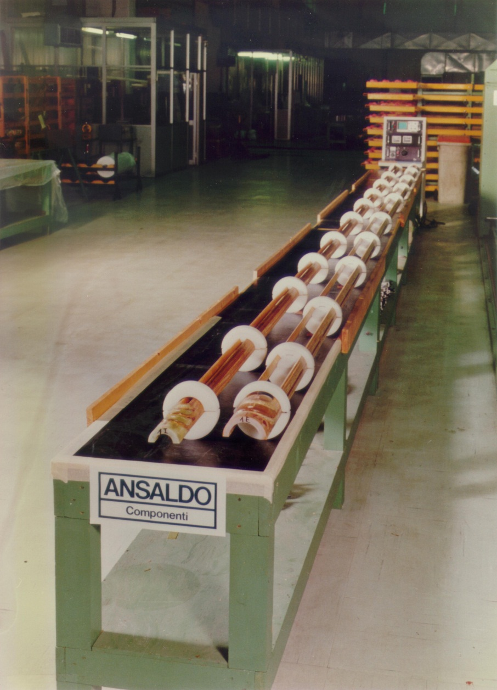
2. Coil winding and curing
The coil is the most critical component of a superconducting magnet.
Cross-sectional accuracy of few hundredths of millimeters (few mils) over up to 15 m length must be reached for field quality requirements.
The coils are manufactured in a clean areas with adequate air circulation and air filtration. The cable must be free of any metallic chips that could damage the conductor or the insulation (shorts).
Coil is fabricated with laminated tooling: very accurate laminations can be fabricated at low cost and assembled in long length.
L. Rossi, [1]

Slide 6
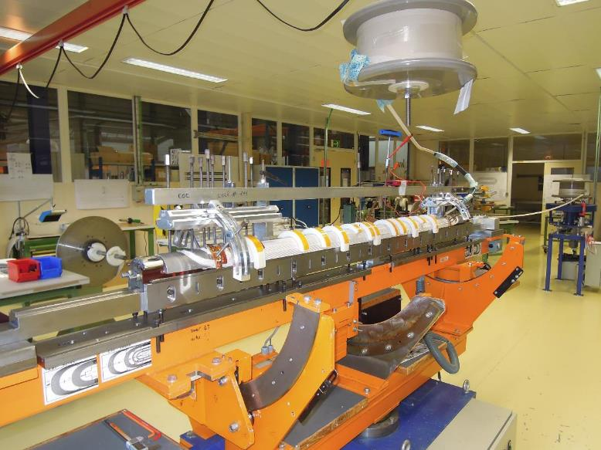
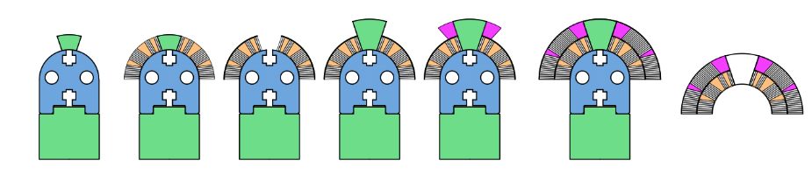
2. Coil winding and curing
Winding tooling
A continuous length of insulated cable sufficient for one coil is wound on a spool.
Then, from the spool, the cable is wound around a pole mounted on a steel mandrel. The mandrel is made of laminations mounted on a beam.
Winding starts from the pole turn of the inner layer after preparing the coil ramp for the outer layer.
The cable is maintained in tension (200 N)

Slide 7
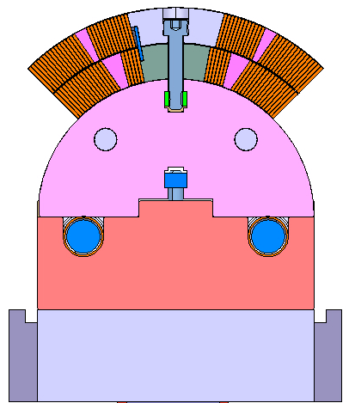
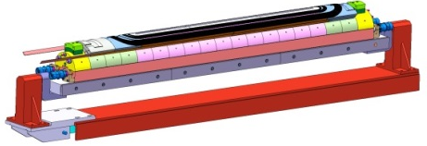
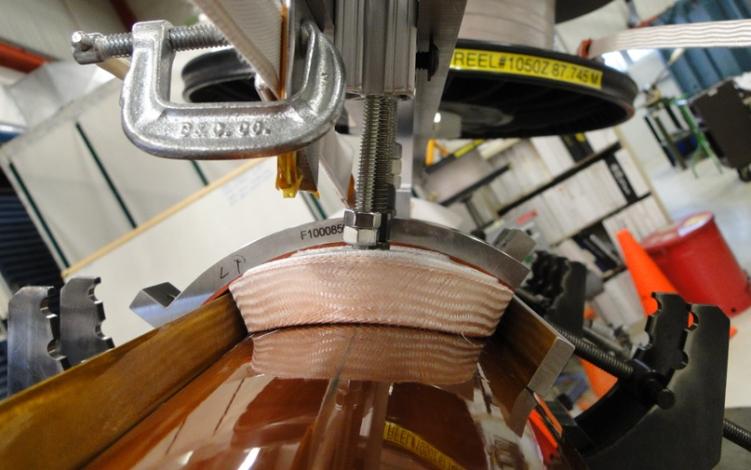
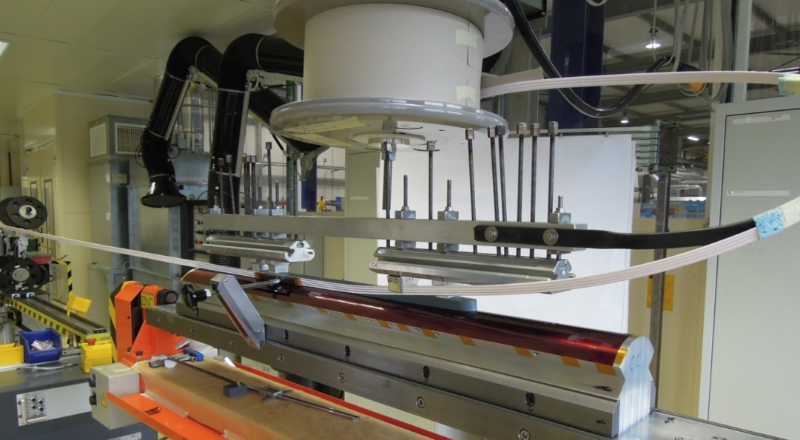
Coil fabrication
Winding and curing
The cable is wound around a pole mounted on a steel mandrel.
  The mandrel is made of laminations
Winding starts from the pole turn of the inner layer after preparing the coil ramp for the outer layer.
Cable maintained in tension (200 N)

Slide 8
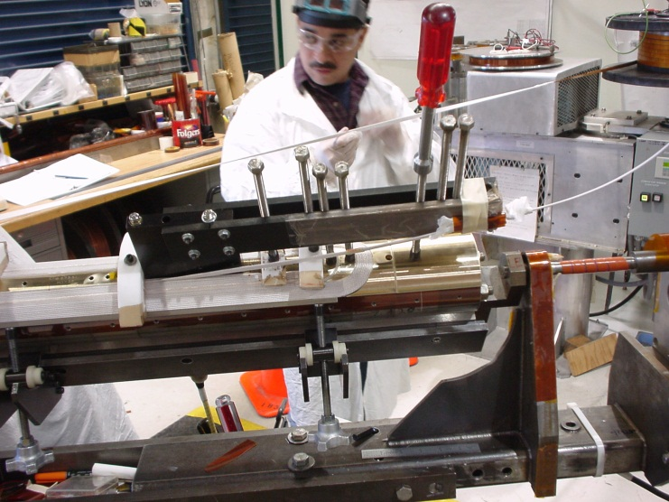
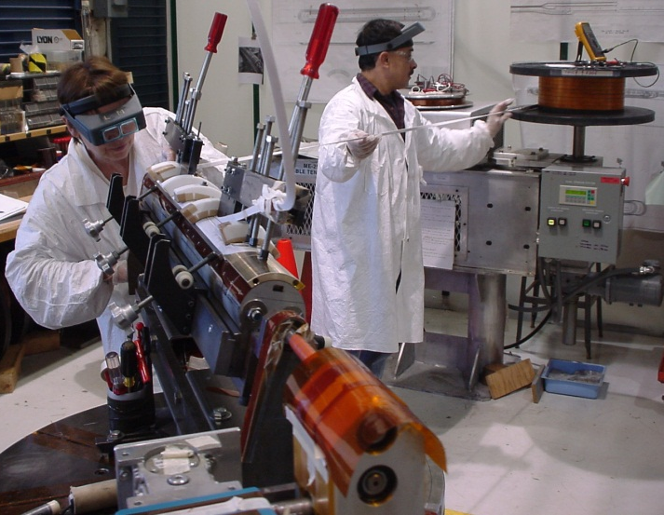
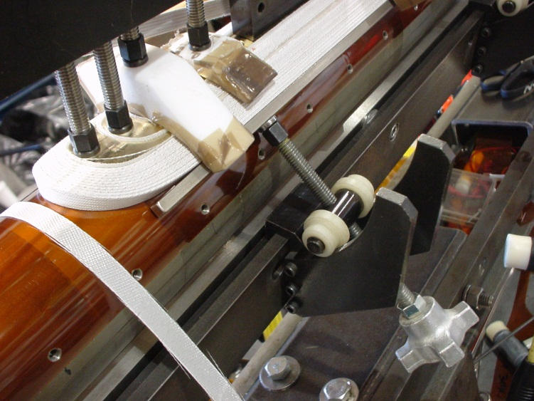
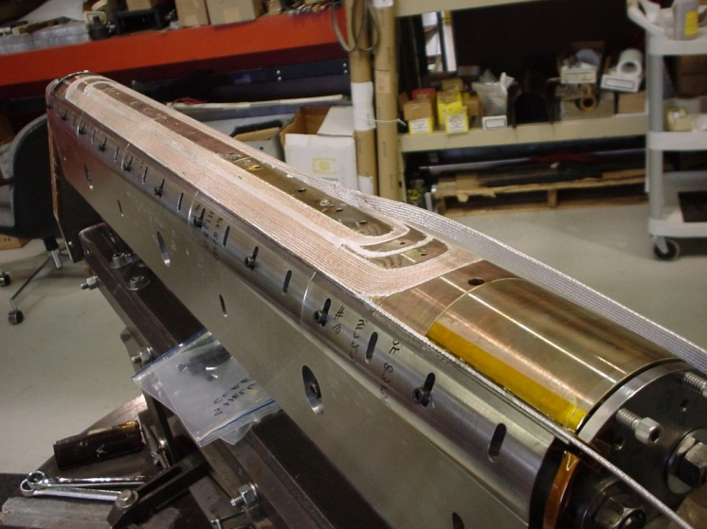
2. Coil winding and curing
Winding machines
For short models, a rotating mandrel is used.

Slide 9
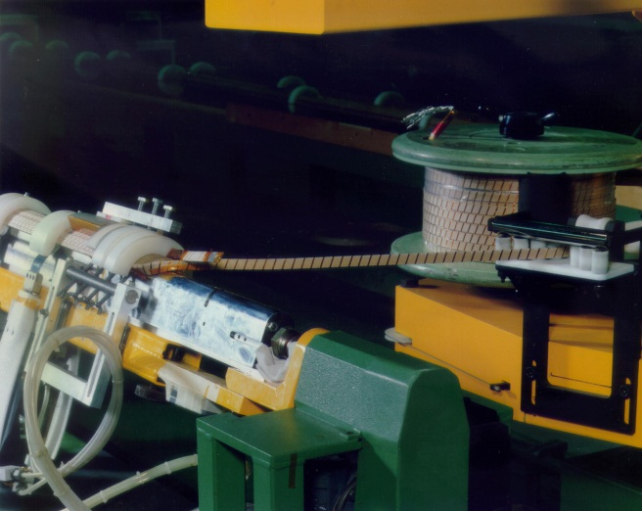
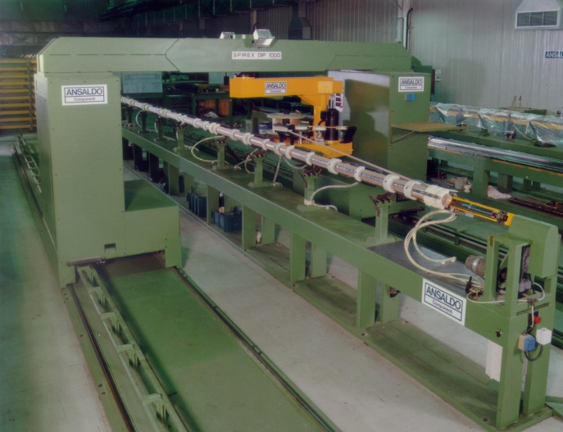
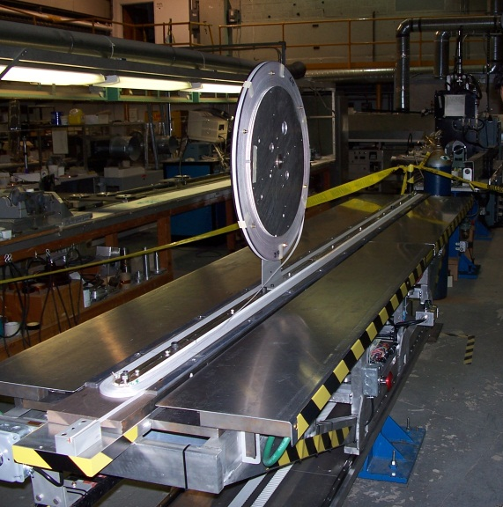
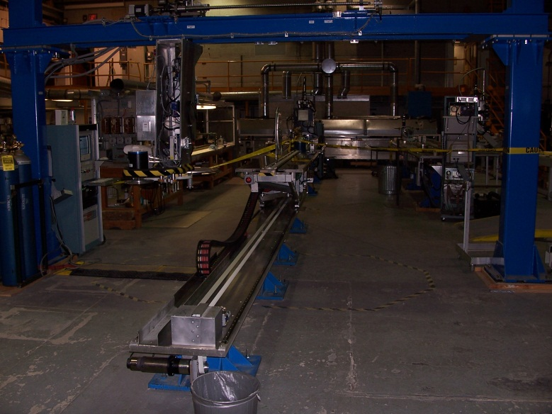
2. Coil winding and curing
Winding machines
For large production of long coils, coil winding is done with automated winding machines.
The cable spool, mounted on a motor driven wagon, moves around the mandrel.
As an alternative, the mandrel moves back and forth with respect a spool fixed to a frame.
The conductor must always be clamped in the straight parts before winding the ends.
L. Rossi, [1]

Slide 10
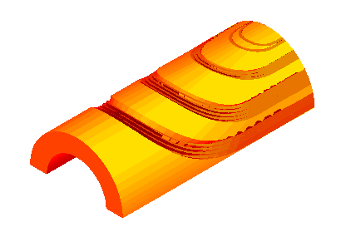
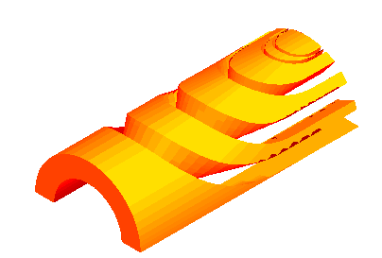
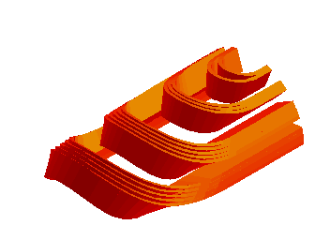
2. Coil winding and curing
Ends
In the end region, it is more difficult to constrain the turn which is bent over the narrow edge while moving around the mandrel.
To improve the mechanical stability of the ends (and to reduce the peak field), spacers are precisely designed, using the constant perimeter approach.
  The two narrow edges of the turn in the ends follow curves of equal lengths.
In Nb-Ti magnets, end spacers are produced by 5-axis machining of epoxy impregnated fiberglass. Remaining voids are then filled by injection of loaded resins.
Turns
End spacers
Coil ends
200
L. Rossi, [1]

Slide 11
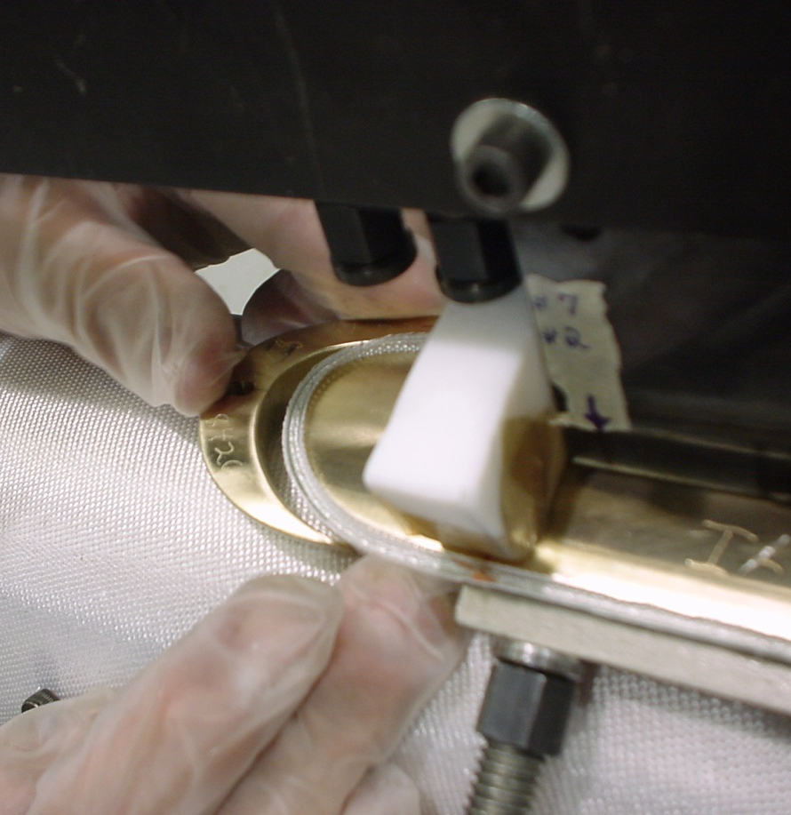
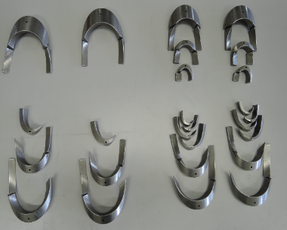
2. Coil winding and curing
Ends
In Nb₃Sn magnets, end spacers are produced by 5-axis machining of aluminum bronze or stainless steel.

Slide 12
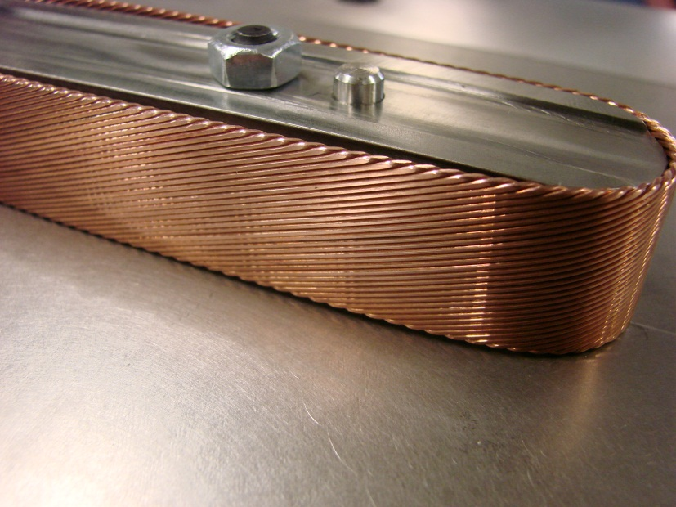
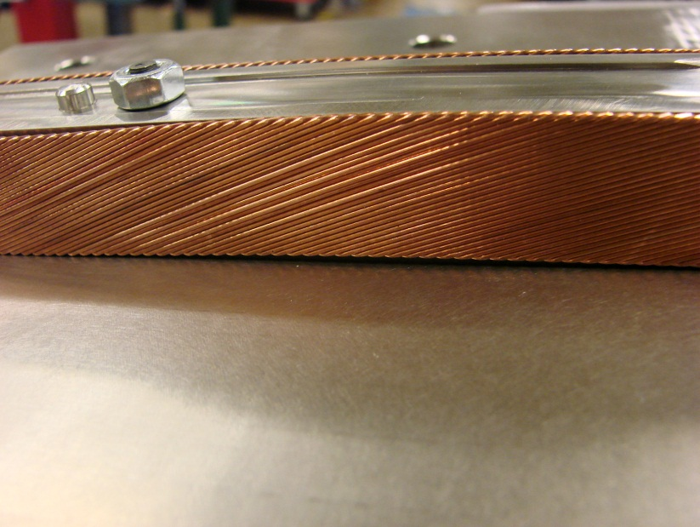
2. Coil winding and curing
Ends
There is a minimum bending radius, which depends on the cable dimensions.
  Is there a general rule? No, but usually the bending radius is 10-15 times the cable thickness.
  The cable must be constantly monitored during winding.
If the bending radius is too small
  De-cabling during winding;
  Strands “pop-out”.
There is no difference in minimum bending radius between Nb-Ti and Nb₃Sn, if the cable is reacted after winding (“wind-and-react technique”).
If the cable is reacted before winding (“react-and-wind” technique), a much larger bending radius is required.

Slide 13
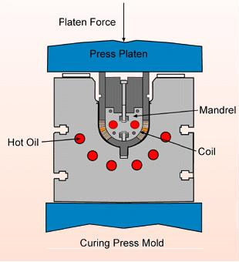
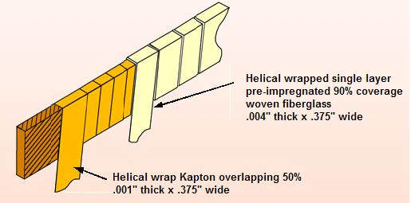
2. Coil winding and curing
NbTi coil curing
The aim of the curing operation is to:
  Glue the turns together in order to facilitating coil handling during magnet assembly and define the mechanical dimensions of the coils.
    For the LHC, coil dimensions must respect a tolerance of ± 0.05 mm, with the average value having ± 0.03 mm.
While still lying on the mandrels, coils are placed in the curing mold equipped with a heating system, and compressed in curing press.
Nb-Ti coils are cured up to 190±3 °C under a maximum pressure of 80-90 MPa (LHC main dipoles). The high temperature activates the resin present on the 3rd insulation layer.
MJB Plus, Inc., [2]

Slide 14
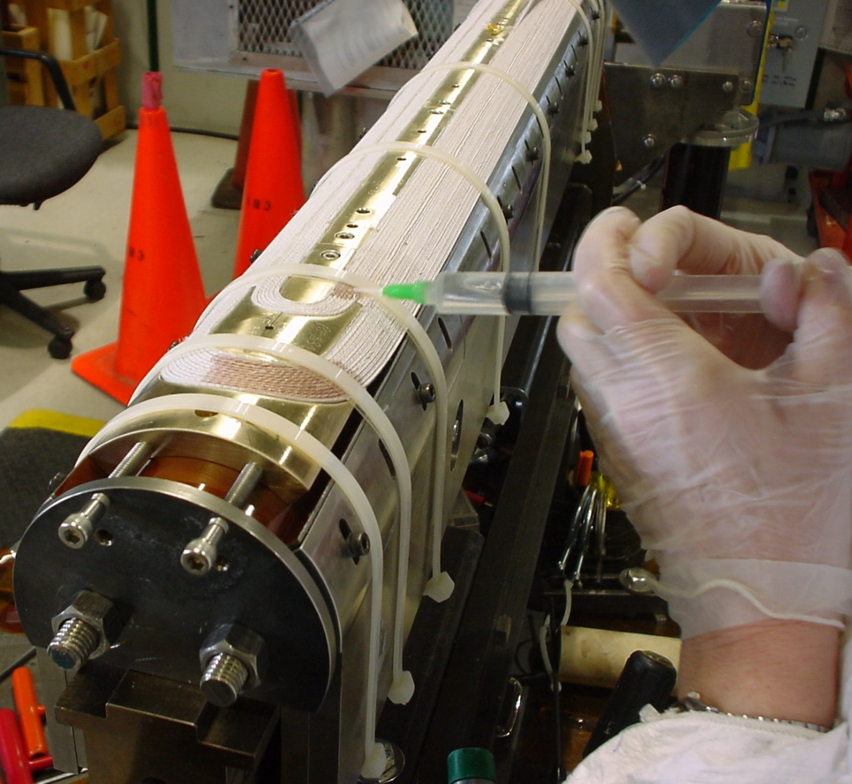
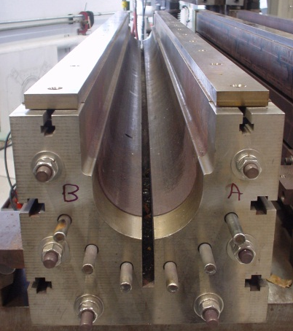
2. Coil winding and curing
Nb₃Sn coil curing
Similarly to Nb-Ti coils, in Nb₃Sn coils curing is done to set the coil size for reaction, as well as allow the coils to be easily handled, facilitating insertion into the reaction fixture without damage.
After winding, cable insulation is injected with ceramic binder. Then coils are cured at 150° C for 30 minutes, subjected to an azimuthal pressure of approximately 5 to 35 MPa.

Slide 15
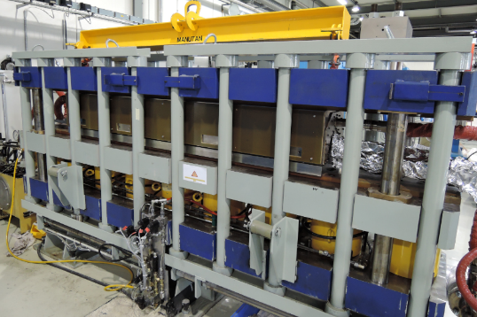
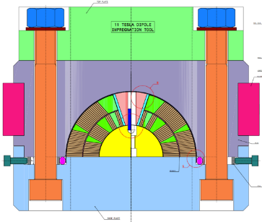
2. Coil winding and curing
Nb₃Sn coil curing

Slide 16
Outline
Introduction
Coil winding and curing
Reaction of Nb₃Sn coils
Vacuum impregnation of Nb₃Sn coils
“React & Wind” approach
Instrumentation and measurements
Nb-Ti – Nb-Ti and Nb₃Sn – Nb-Ti splices
Final assembly
Practical examples
Conclusions

Slide 17
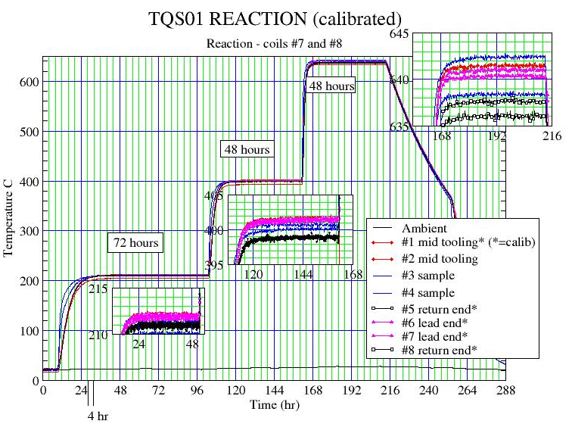
3. Reaction of Nb₃Sn coils
During the “reaction” process, the CuSn and Nb are heated to about 650-700 C in vacuum or inert gas (argon) atmosphere, and the Sn diffuses in Nb and reacts to form Nb₃Sn.
A cable of Nb₃Sn is brittle, thus it cannot be bent to a small radius.
In the “Wind & React” approach, the coil is wound un-reacted: then the entire coil undergoes the reaction process.
The reaction is characterized by three temperature steps.
The required temperature homogeneity is of about ± 3 °C.

Slide 18
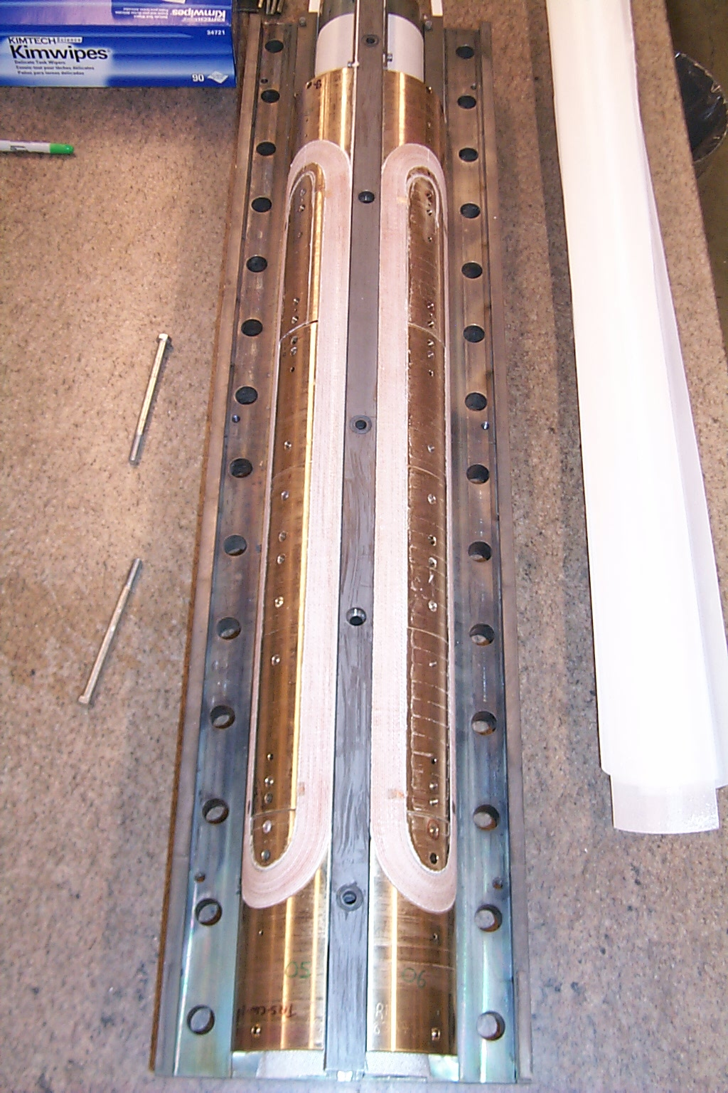
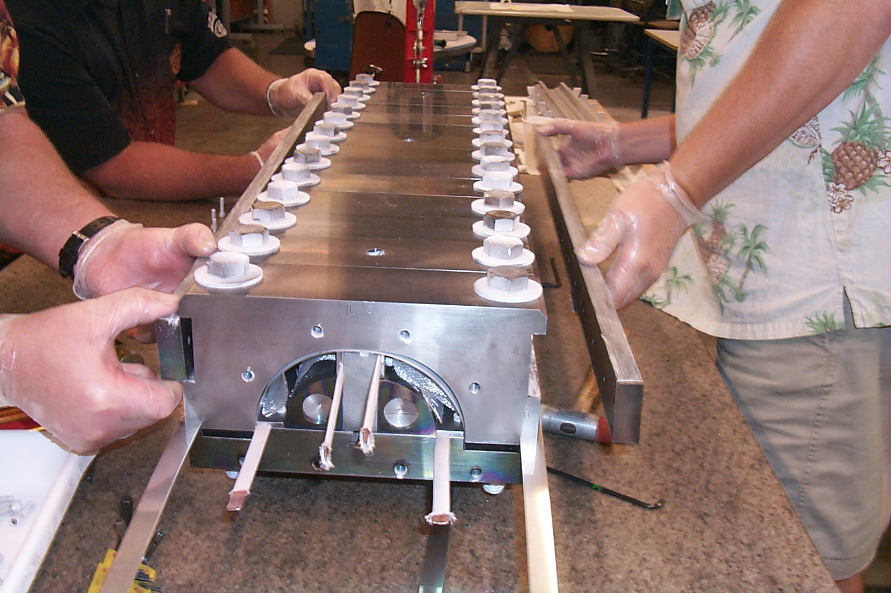
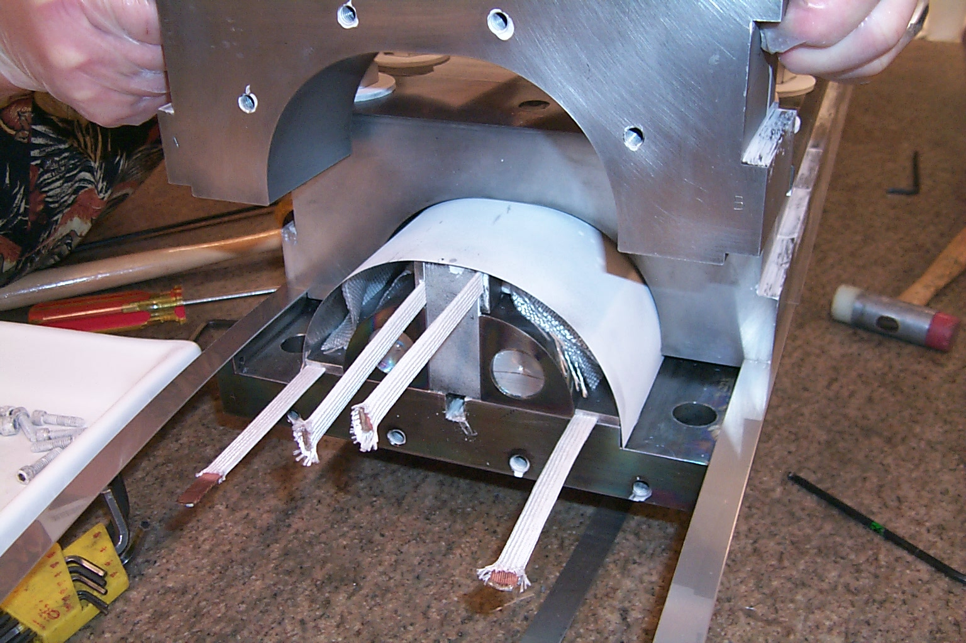
3. Reaction of Nb₃Sn coils
Coils are clamped in a reaction fixture made of stainless steel mold blocks.
  The pressure on the coil is minimal to reduce risk of degradation.
Layers of fiberglass, MICA, stainless steel are placed between coil and mold blocks.

Slide 19
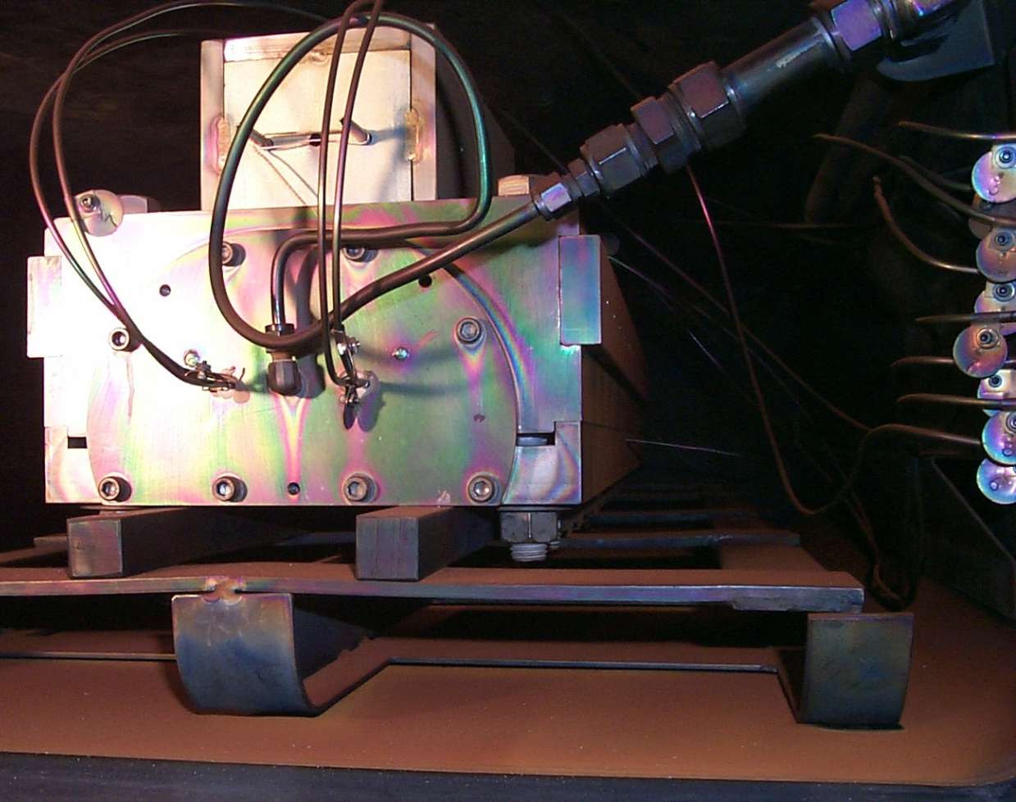
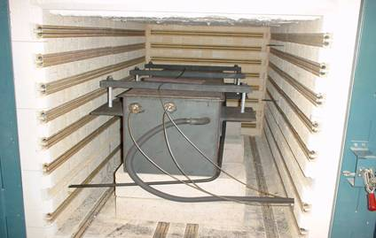
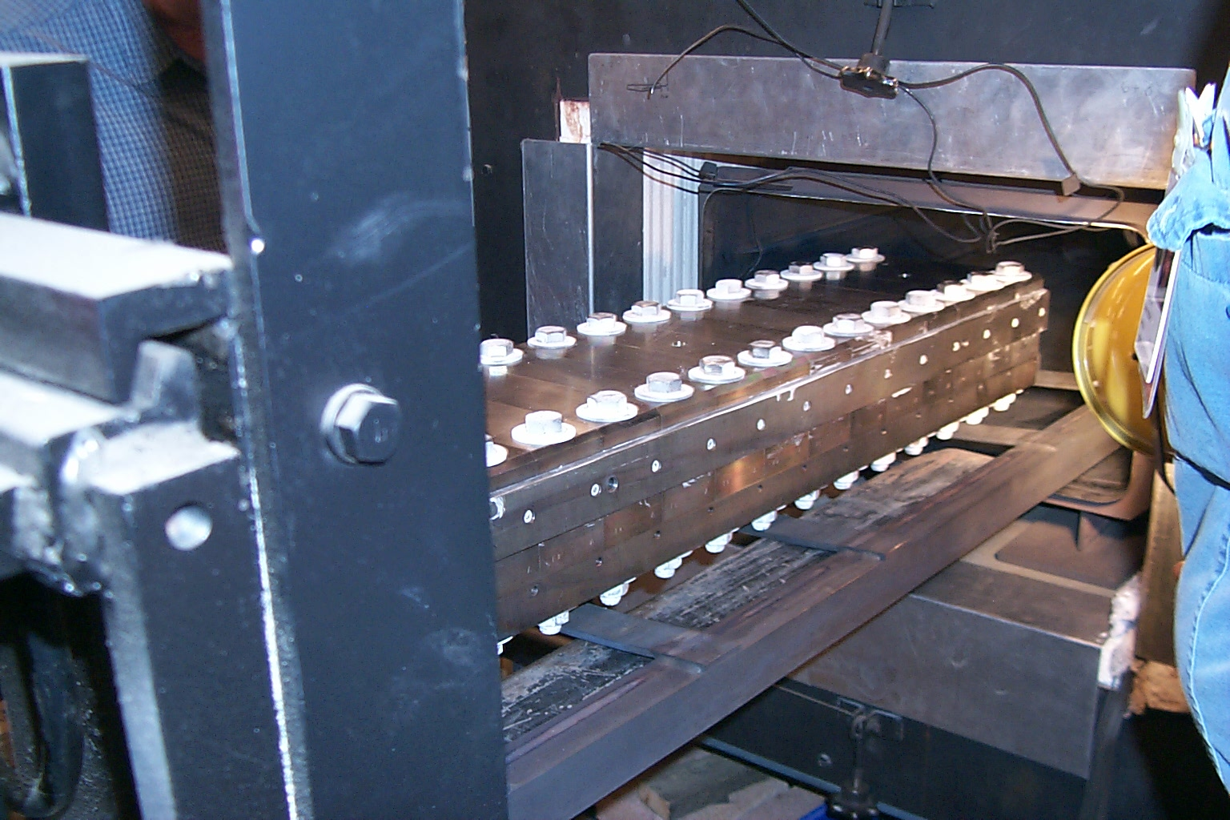
3. Reaction of Nb₃Sn coils
Reaction fixture is placed in the oven and argon gas flow connected.
The argon flows in the reaction fixture in contact with the conductor and fills the oven (welded).

Slide 20
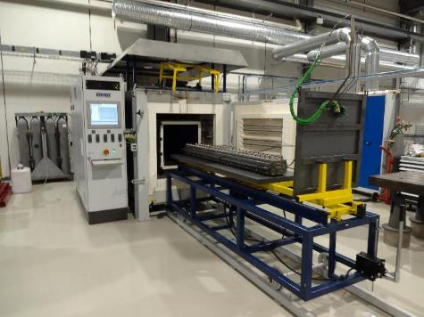
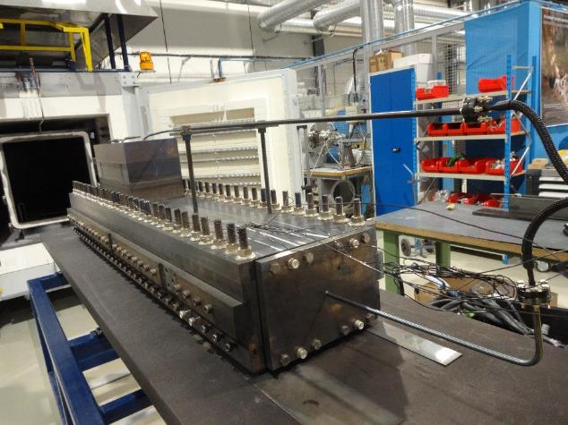
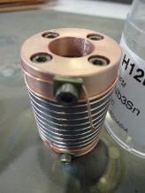
3. Reaction of Nb₃Sn coils

Slide 21
Outline
Introduction
Coil winding and curing
Reaction of Nb₃Sn coils
Vacuum impregnation of Nb₃Sn coils
“React & Wind” approach
Instrumentation and measurements
Nb-Ti – Nb-Ti and Nb₃Sn – Nb-Ti splices
Final assembly
Practical examples
Conclusions

Slide 22
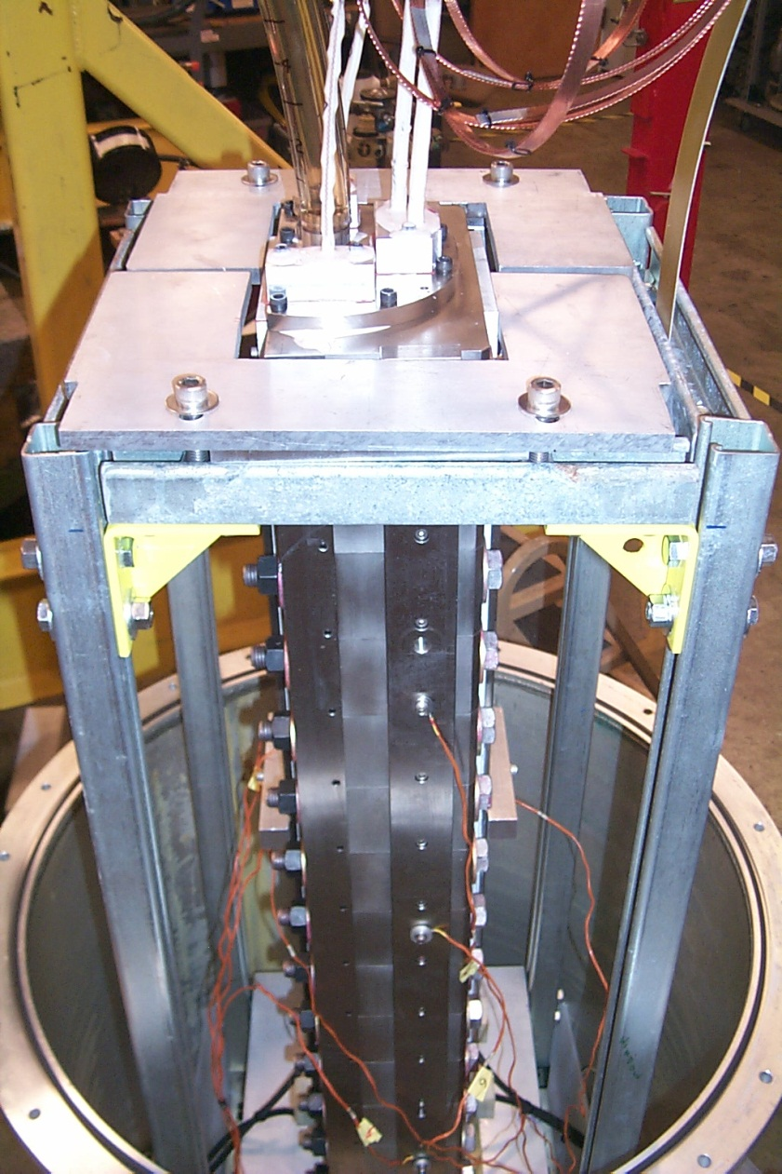
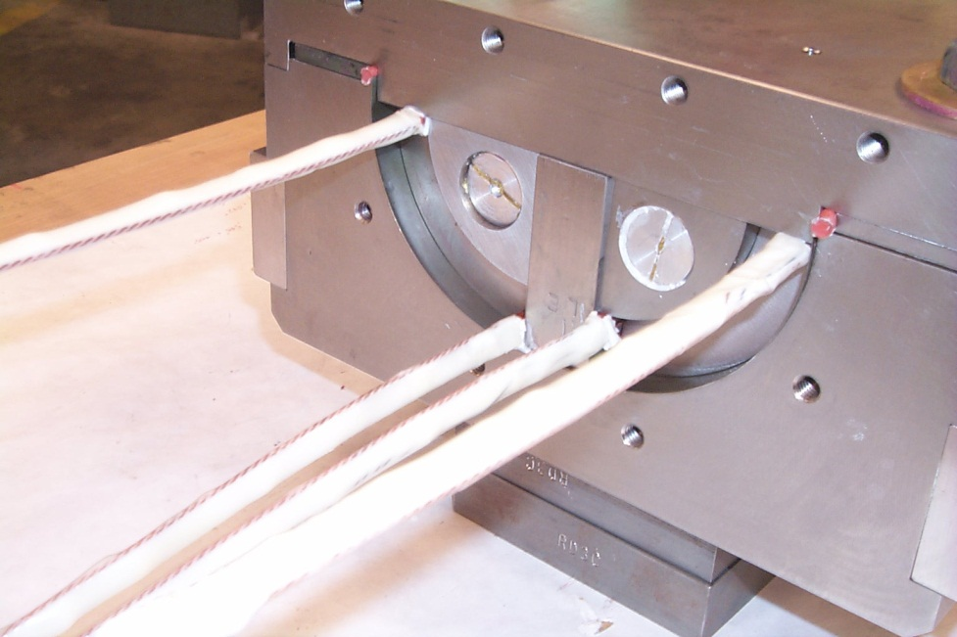
4. Vacuum impregnation of Nb₃Sn coils
After reaction, Nb₃Sn coil are vacuum impregnated (potted) with epoxy.
  Resin creates a solid block, thus distributing the stress.
Coil is placed in a fixture (potting fixture) in tight contact with the winding in order to minimize voids.
The fixture is inserted in a vacuum tank and evacuated.

Slide 23
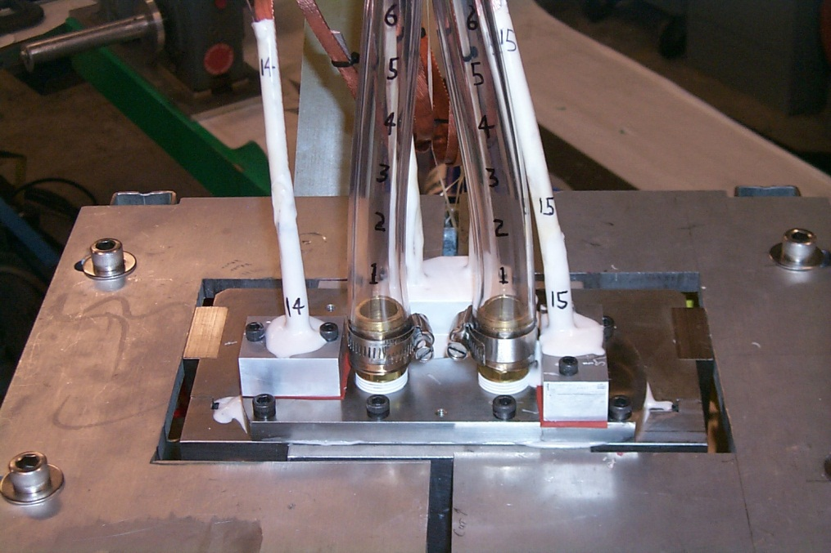
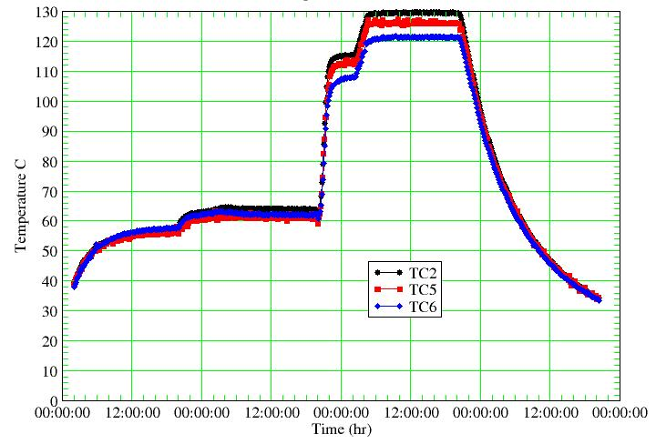
4. Vacuum impregnation of Nb₃Sn coils
Reservoirs are connected to the fixture.
Epoxy has high viscosity at room temperature. At about 60 °C, when it has low viscosity, atmospheric pressure is applied to drive the epoxy inside the mould.
  Fixture must be leak tight
Then, the further increase of temperature cures the epoxy which becomes solid.

Slide 24
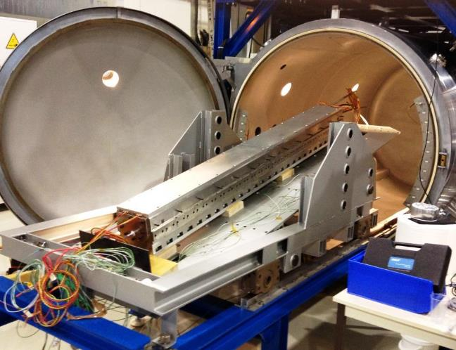
4. Vacuum impregnation of Nb₃Sn coils

Slide 25
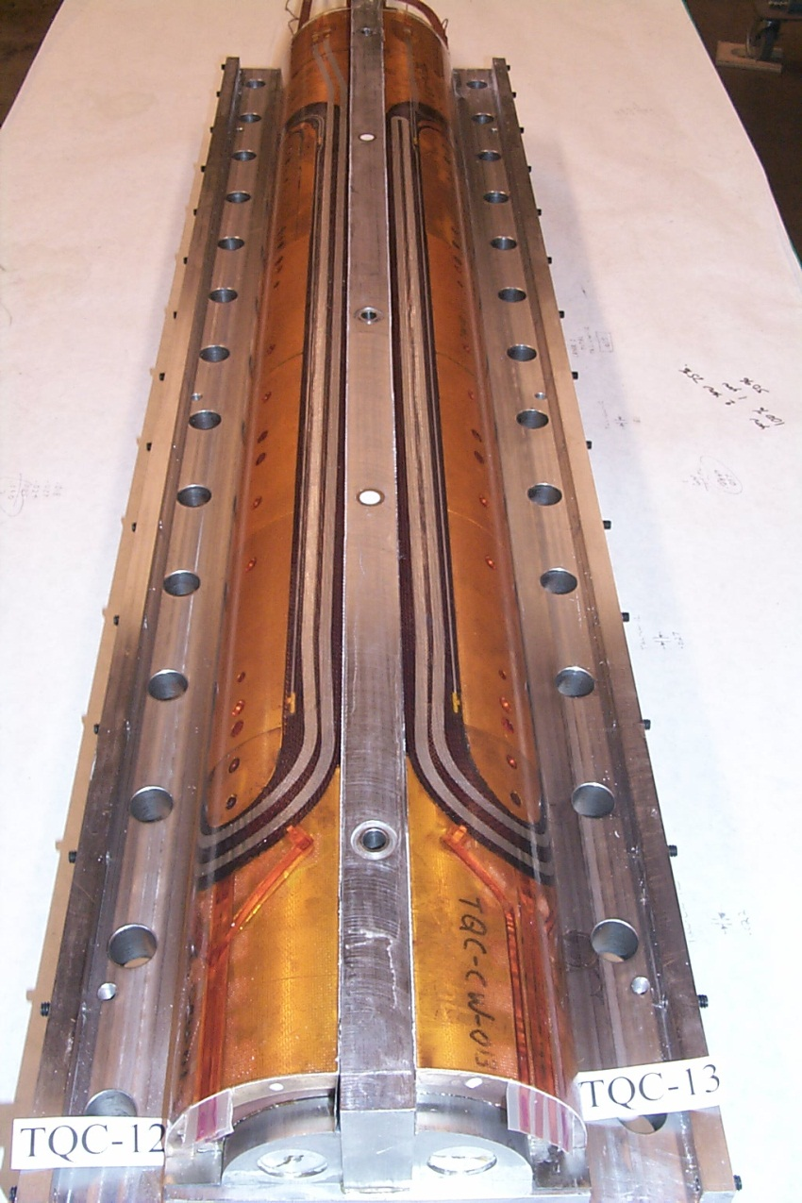
4. Vacuum impregnation of Nb₃Sn coils
Once the fixture is brought to room temperature again, the coil can be inspected.
While for Nb₃Sn coils the impregnation is mandatory due to the brittleness of the superconductor, in most cases NbTi coils are not potted.
Porous coils, with overlapping polyimide layers, allow the helium to get in contact with the conductor providing higher stabilization.
Furthermore, because of its high thermal contraction with respect to the strands resin may fracture.
An energy release is associated to epoxy fracture.

Slide 26
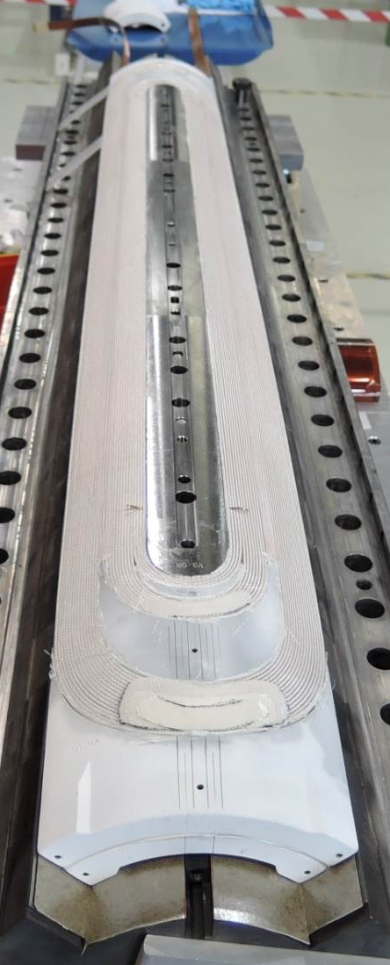
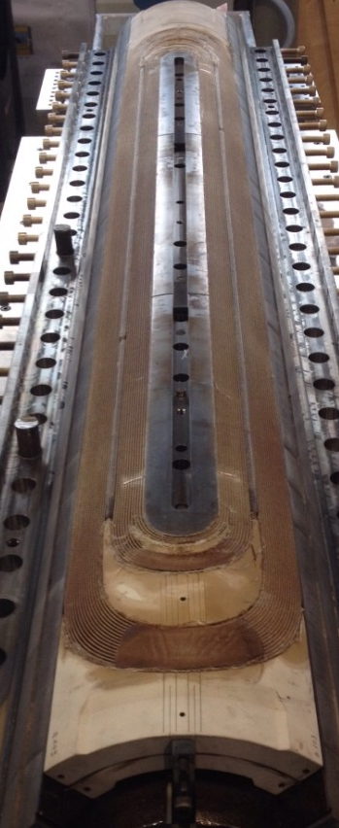
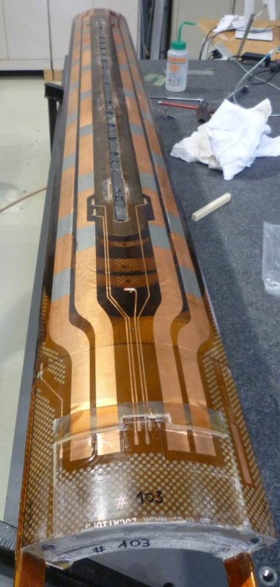
Overview of Nb₃Sn coil fabrication stages
After winding/curing
After reaction
After impregnation

Slide 27
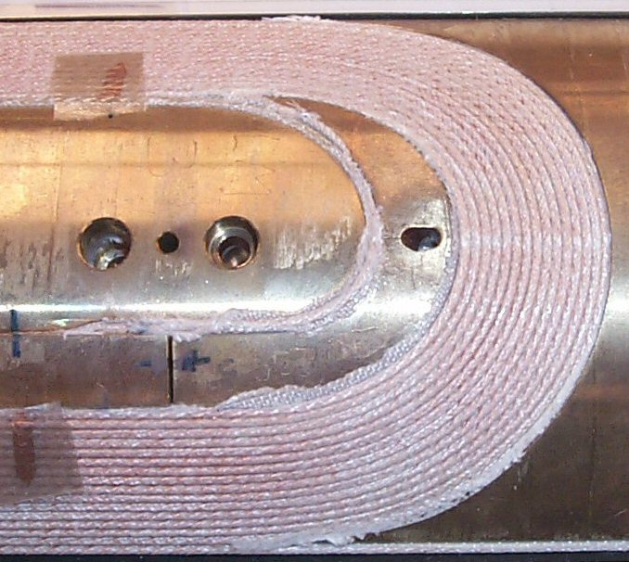
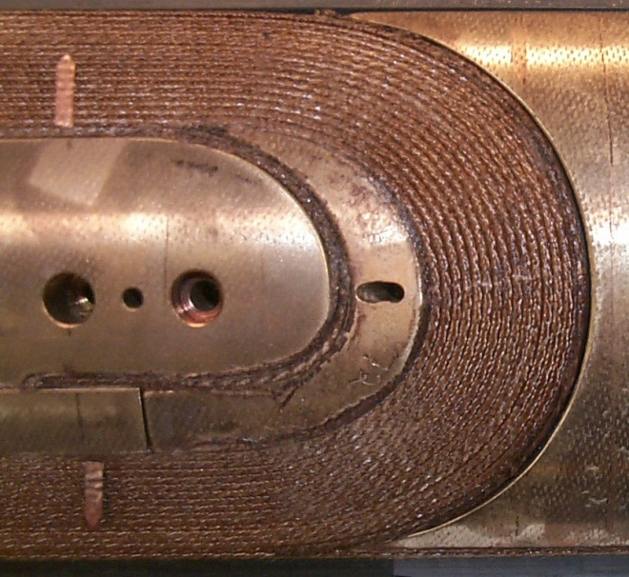
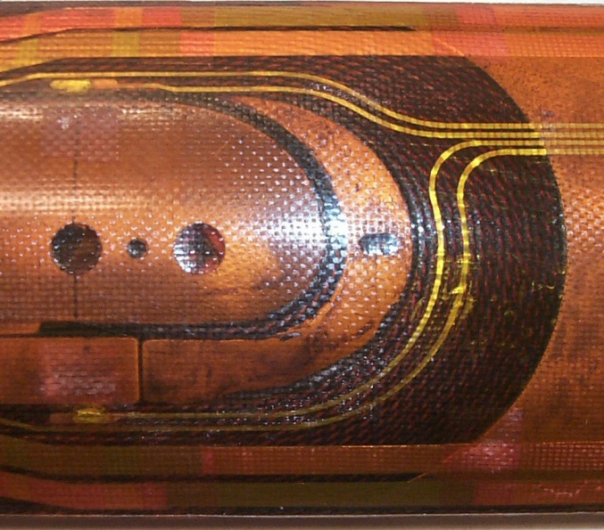
Overview of Nb₃Sn coil fabrication stages
After winding/curing
After reaction
After impregnation
Cured with matrix Reacted Epoxy impregnated

Slide 28
Outline
Introduction
Coil winding and curing
Reaction of Nb₃Sn coils
Vacuum impregnation of Nb₃Sn coils
“React & Wind” approach
Instrumentation and measurements
Nb-Ti – Nb-Ti and Nb₃Sn – Nb-Ti splices
Final assembly
Practical examples
Conclusions

Slide 29
5. “React & Wind” approach
An alternative construction process for Nb₃Sn coils is the “React & Wind”.
  First react the conductor and second wind the coil
On the one hand, since the conductor is brittle, small bending radius and complex end geometries (like in cosθ magnets) are not allowed.
On the other hand, the process may look attractive for long magnets
  “In the “Wind & React” approach, the integrated build-up of differential thermal expansion of various materials during the high temperature heat treatment may result in large accumulated strain in the ends of the magnets. Magnets with complex end geometries are more prone to degradation/damage due to this large local strain. Since the integral build-up is proportional to length, this issue becomes more critical in “Wind & React” as magnets get longer” [5].

Slide 30



5. “React & Wind” approach
Conductor is reacted on a spool with large radius.
Coil geometry must be simple conductor friendly
  Common coil design is a particular suitable design due to the large bending radius in the ends
Strain is minimized during winding.
R. Gupta, [5]

Slide 31
Outline
Introduction
Coil winding and curing
Reaction of Nb₃Sn coils
Vacuum impregnation of Nb₃Sn coils
“React & Wind” approach
Instrumentation and measurements
Nb-Ti – Nb-Ti and Nb₃Sn – Nb-Ti splices
Final assembly
Practical examples
Coils for solenoids
Conclusions

Slide 32


6. Instrumentation and measurements
Quench heaters
  When a quench occurs, quench heaters raise the temperature of the entire coil, bringing it to the normal state. By dissipating the stored energy in the whole coil volume, peak temperature after a quench is minimized

Slide 33
6. Instrumentation and measurements
Spot heaters
  By initiating a quench in a particular turn/location, they allow investigating quench velocities, peak temperature, and voltages as a function of current and field.

Slide 34


6. Instrumentation and measurements
Voltage taps
  By providing a measurement of the voltage across a conductor segment, they allow monitoring in which turn/location a quench occurred, and how it propagated along the turn and from turn to turn.

Slide 35


6. Instrumentation and measurements
Strain gauges
  By measuring strain, they provide information about the stress status of coil and components (see Unit 19).
Temp. Compensator
Z
theta

Slide 36



6. Instrumentation and measurements
Elastic modulus and arc length are measured in different locations along the longitudinal direction. A measuring tool moves along the coil applying the pre-loading pressure.

Slide 37
Outline
Introduction
Coil winding and curing
Reaction of Nb₃Sn coils
Vacuum impregnation of Nb₃Sn coils
“React & Wind” approach
Instrumentation and measurements
Nb-Ti – Nb-Ti and Nb₃Sn – Nb-Ti splices
Final assembly
Practical examples
Conclusions

Slide 38



7. Nb-Ti – Nb-Ti splices
If a coil is composed by layers with the same conductor, the outer layer can be wound on the cured inner layer and then cured as well.
Alternatively, especially in the presence of different cables, the two (or more) layers can be wound and cured separately and then connected through internal or external splices (solder joints).
Solder is usually 40% lead and 60% tin, or silver-tin (5% silver) with a resistivity of less than 2-3 x 10⁻⁹ Ωm.
The temperature rise in the joints is of the order of few mK.
MJB Plus, Inc., [2]

Slide 39




7. Nb₃Sn – Nb -Ti splices
Nb-Ti leads are compressed against Nb₃Sn cables for a length of about 1-1.5 time the pitch length and soldered.

Slide 40
Outline
Introduction
Coil winding and curing
Reaction of Nb₃Sn coils
Vacuum impregnation of Nb₃Sn coils
“React & Wind” approach
Instrumentation and measurements
Nb-Ti – Nb-Ti and Nb₃Sn – Nb-Ti splices
Final assembly
Practical examples
Conclusions

Slide 41


8. Final assembly
Additional layers of insulations, usually composed by polyimide films, are added around the coils. Besides the electrical function of guaranteeing coil-to-coil and coil-to-ground insulation, they also provide slip surfaces during assembly of the surrounding support structure (collars).
Quench protection heaters are also added to warm the entire coil after a quench. The quench heaters consist stainless steel strips in a sandwich of polyimide insulating foils.
The conductor must be protected from the clamping structure.
  In the HERA dipoles, 6 layers of kapton 125 mm thick.
  In the RHIC dipole, glass-phenolic form
  In the SSC, kapton
  In the LHC dipoles, coil protection sheets made of stainless steel are used.
LHC design report, [4]
MJB Plus, Inc., [2]

Slide 42
Outline
Introduction
Coil winding and curing
Reaction of Nb₃Sn coils
Vacuum impregnation of Nb₃Sn coils
“React & Wind” approach
Instrumentation and measurements
Nb-Ti – Nb-Ti and Nb₃Sn – Nb-Ti splices
Final assembly
Practical examples
Conclusions

Slide 43


9. Practical examples
LHC dipole coil (Nb-Ti) fabrication steps
Winding
Curing
  Coil at 190 °C under a pressure of 35 MPa
Surfacing of the heads
  Voids in the ends are filled with resin
Measurements of coil azimuthal size
Superposition of the outer layer onto the inner
Splicing
Shimming of the end region
Assembly of four poles around the bore tube
Instrumentation (quench heaters) and insulation)

Slide 44

9. Practical examples
TQ quadrupole coil (Nb₃Sn) fabrication steps
Winding of inner layer
Curing of inner layer
  Coil at 150 °C under a pressure of 30 MPa
Winding of outer layer
Curing of inner and outer layer
  Coil at 150 °C under a pressure of 30 MPa
First instrumentation phase
  voltage taps
Reaction
Splicing
Second instrumentation phase
  Voltage taps, strain gauges, quench heaters
Impregnation

Slide 45
Outline
Introduction
Coil winding and curing
Reaction of Nb₃Sn coils
Vacuum impregnation of Nb₃Sn coils
“React & Wind” approach
Instrumentation and measurements
NbTi-NbTi and Nb₃Sn -NbTi splices
Final assembly
Practical examples
Conclusions

Slide 46
10. Conclusions
We described the steps in the fabrication of a superconducting coil
  Winding
  Curing
  Reaction
  Impregnation
Instrumentation is implemented to monitor the mechanical, electrical and thermal behavior of the coils.

