Slide 1
Unit 16
Construction methods and support structures
Chapter II
Paolo Ferracin
Lawrence Berkeley National Laboratory (LBNL)

Slide 2
Outline
Introduction
Support structure main features
  Collars, Yoke, Shell,
  End plates and axial support
  Cold bore tube and beam screen
Cool-down effect
Electro-magnetic force effect
Practical examples of accelerator magnets
  Tevatron, Hera, RHIC, SSC, LHC main dipole
  LHC IR quadrupoles
Practical examples of “not-yet” accelerator magnets
  TQS, TQS, MQXF, 11T
Stress management structures
Conclusions

Slide 3
References
[1] L. Rossi, “Superconducting Magnets”, CERN Academic Training, 15-18 May 2000.
[2] MJB Plus, Inc. “Superconducting Accelerator Magnets”, an interactive tutorial.
[3] S. Wolff, “Superconducting magnet design”, AIP Conference Proceedings 249, edited by M. Month and M. Dienes, 1992, p. 1160-1197.
[4] L. Rossi, “The LHC from construction to commisioning”, FNAL seminar, 19 April 2007.
[5] P. Schmuser, “Superconducting magnets for particle accelerators”, AIP Conference Proceedings 249, edited by M. Month and M. Dienes, 1992, p. 1100-1158.
[6] A. Devred, “The mechanics of SSC dipole magnet prototypes”, AIP Conference Proceedings 249, edited by M. Month and M. Dienes, 1992, p. 1309-1372.
[7] T. Ogitsu, et al., “Mechanical performance of 5-cm-aperture, 15-m-long SSC dipole magnet prototypes”, IEEE Trans. Appl. Supercond., Vol. 3, No. l, March 1993, p. 686-691.
[8] K. Artoos, et al., “Status of the short dipole model program for the LHC”, IEEE Trans. Appl. Supercond., Vol. 10, No. l, March 2000.
[9] K. Koepke, et al., “Fermilab doubler magnet design and fabrication techniques”, IEEE Trans. Magn., Vol. MAG-15, No. l, January 1979.
[10] J. Muratore, BNL, private communications.
[11] “LHC design report v.1: the main LHC ring”, CERN-2004-003-v-1, 2004.
[12] C.L. Goodzeit, “Superconducting Accelerator Magnets”, USPAS, January 2001.
[13]E. Todesco, “Masterclass - Design of superconducting magnets for particle accelerators”, https://indico.cern.ch/category/12408/

Slide 4
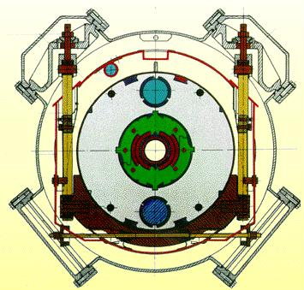
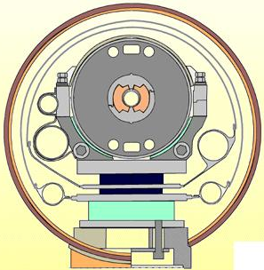
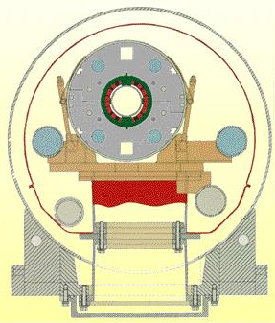
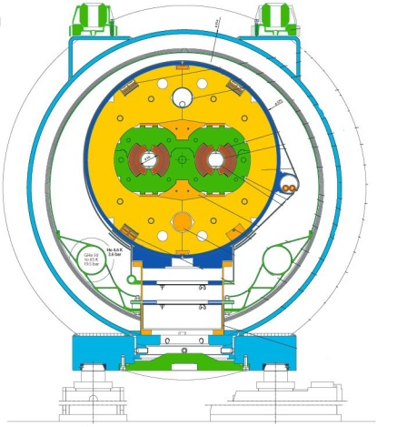
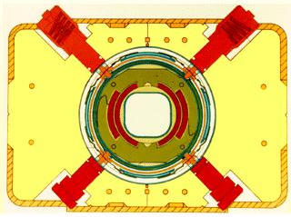
1. Introduction
After winding and curing (reaction and potting), the coil is placed inside a support structure capable of
  providing the required pre-stress to the coil after cool-down in order to reduce conductor motion;
  withstanding the electro-magnetic forces;
  providing Helium containment.
In this Unit we will address the main features of the magnet support structure (cold mass), its fabrication process, with some examples of accelerator and R&D magnets.
Tevatron
HERA
SSC
RHIC
LHC
Not in scale

Slide 5
Outline
Introduction
Support structure main features
  Collars, Yoke, Shell,
  End plates and axial support
  Cold bore tube and beam screen
Cool-down effect
Electro-magnetic force effect
Practical examples of accelerator magnets
Conclusions

Slide 6
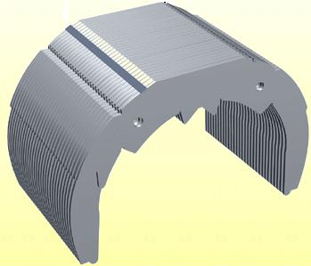
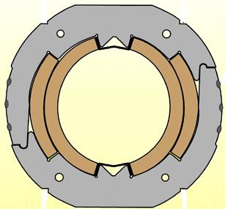
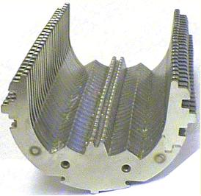
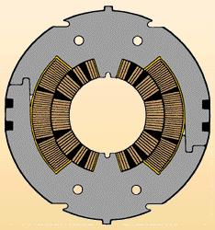
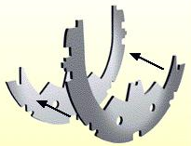
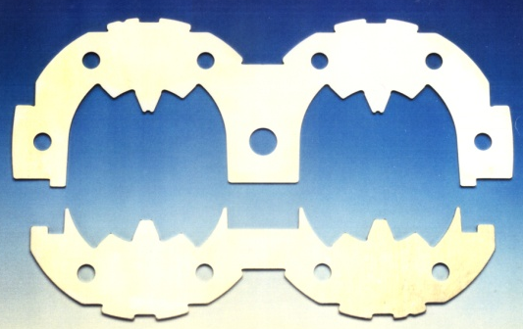
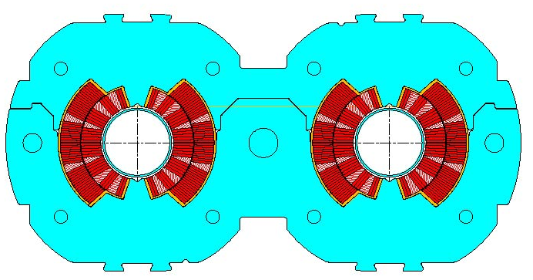
2. Support structure main features
Collars
Collars were implemented for the first time in the Tevatron dipoles.
Since then, they have been used in all but one (RHIC) the accelerator magnets and in most of the R&D magnets.
They are composed by stainless-steel or aluminum laminations few mm thick.
By clamping the coils, the collars provide
  coil pre-stressing;
  rigid support against e.m. forces (it can be self-supporting or not);
  precise cavity (tolerance ± 20 μm).
Tevatron
SSC
LHC
MJB Plus, Inc., [2]
L. Rossi, [1]

Slide 7
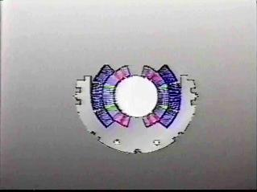
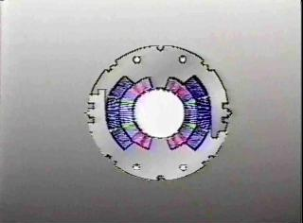
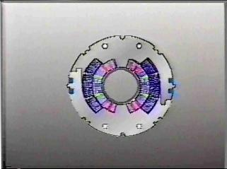
2. Support structure main features
Collars
Collaring procedure
  Collars are pre-assembled in packs (several cm long) and placed around the coil.
    The collar laminations are divided in “short” and “long”.
  Since the uncompressed coil is oversized with respect to the collar cavity dimension, at the beginning of the collaring procedure the collars are not locked (open).
  The coil/collar pack is then introduced into a collaring press.
  The pressure of the press is increased until a nominal value.
  Collars are locked with keys, rods or welded, and the press released.
  Once the collaring press is released, the collar experience a “spring back” due to the clearance of the locking feature and deformation.
MJB Plus, Inc., [2]

Slide 8
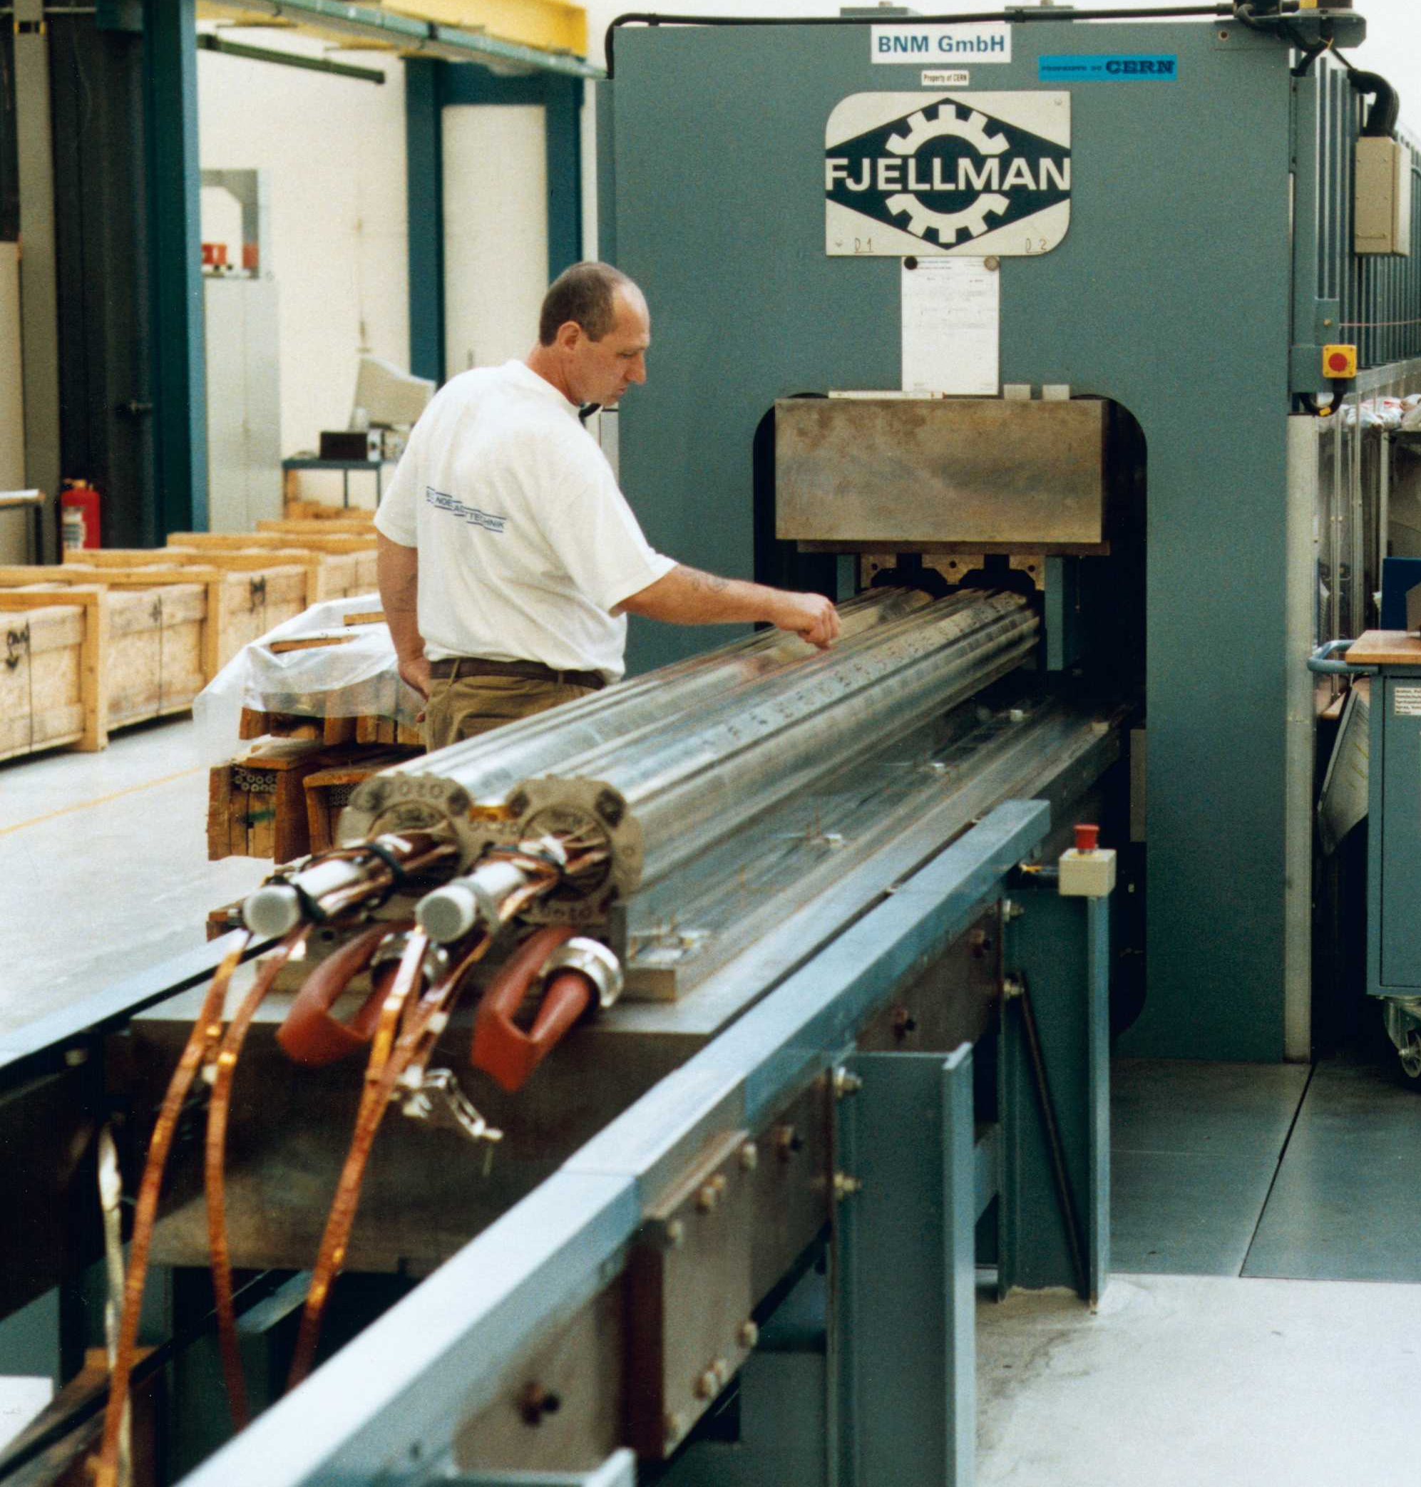
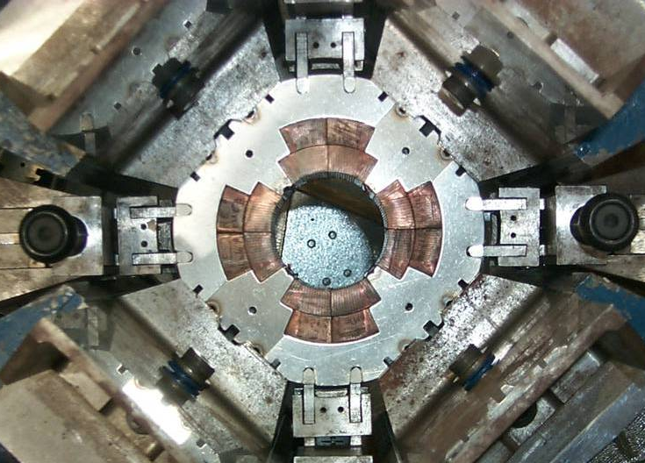
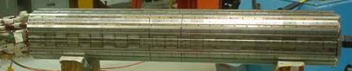
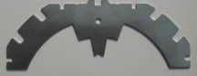
2. Support structure main features
Collars
Collaring of a dipole magnet
Collaring of a quadrupole magnet
L. Rossi, [4]

Slide 9
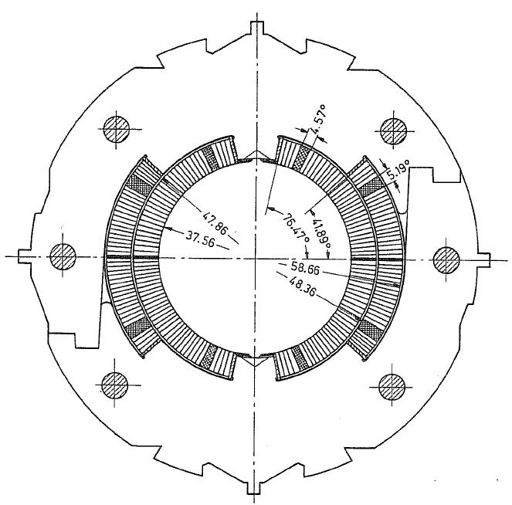
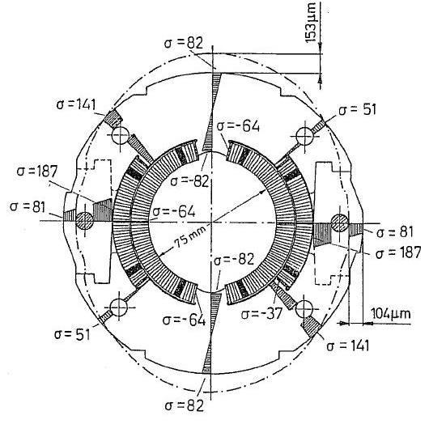
2. Support structure main features
Collars
The purpose of the collar is to pre-compress the coil inside a “rigid” cavity.
  The collar cavity fixes the dimension of the coil.
  Coil geometry is given by the collars.
Coil stress-strain is given by
  ε_{coil}=(l_{coil_0}-l_{cavity})/l_{coil_0}
  σ_{coil}=E_{coil}ε
A good knowledge of the coil properties (l_{coil_0} and E) is mandatory to predict final coil status.
In addition, collar deformation must be taken into account.
S. Wolff, [3]

Slide 10
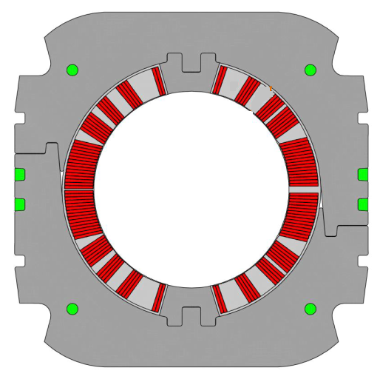
2. Support structure main features
Collars
Dimensioning the collar thickness
  Collar thickness determines the cost (material) and the distance between coil and iron (decrease of current density)
Even though the problem is intrinsically two-dimensional, one can try to slice it in two main aspects
  Thickness needed to give the required prestress (white arrow)
  Thickness needed to avoid a large deformation in
  the horizontal plane due to radial forces (black arrow)
  Difficult to find this in the literature
How large should be the collar to give the prestress?
  First: having a rigid structure, not deforming the collars
    Thumb rule: since SS has ten times larger modulus than the coil, having collar width as the coil width guarantees very small deformationecond: having the collars far from yield
    This prevents to go to very very thin collars, otherwise you reach the yield point – or you need an additional support (support of the iron)

Slide 11
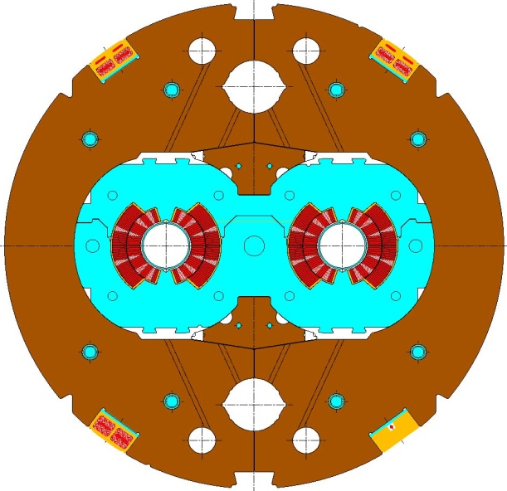
2. Support structure main features
Iron yoke
As the collars, iron yoke are made in laminations (several mm thick), with a packing factor > 95%.
Magnetic function
  The yoke contains and enhances the magnetic field.
Structural function
  Except for the cases where the collars are self supporting (i.e. like in Tevatron and HERA dipoles), the yoke is in tight contact with the collar. Therefore, it contributes to increase the rigidity of the coil support structure and limit radial displacement.
Holes/slots are included in the yoke design for
  Correction of saturation effect
  Cooling channel
  Assembly features
  Electrical bus
L. Rossi, [4]

Slide 12
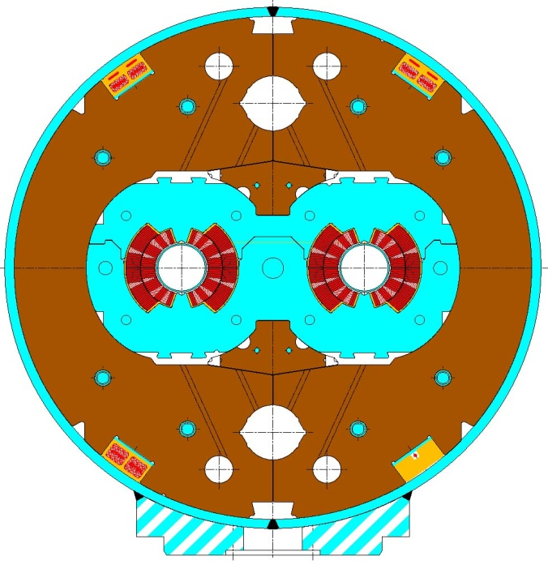
2. Support structure main features
Shell
The cold mass is contained within a shell (or shrinking cylinder).
The shell constitutes a containment structure for the liquid Helium.
It is composed by two half shells of stainless steel welded around the yoke with high tension (about 150 MPa for the LHC dipole).
  With the iron yoke, it contributes to create a rigid boundary to the collared coil.
If necessary, during the welding process, the welding press can impose the desired curvature on the cold mass.
  In the LHC dipole the nominal sagitta is of 9.14 mm.
L. Rossi, [4]

Slide 13
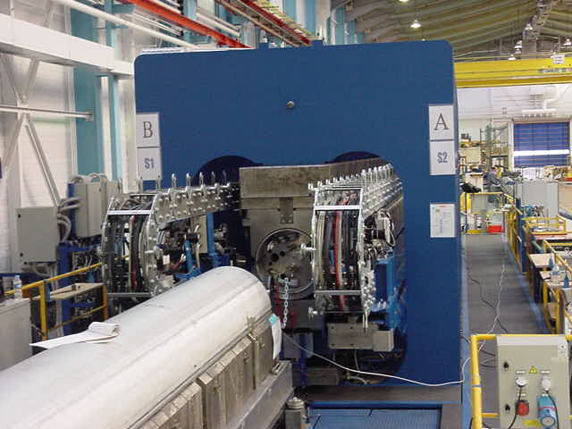
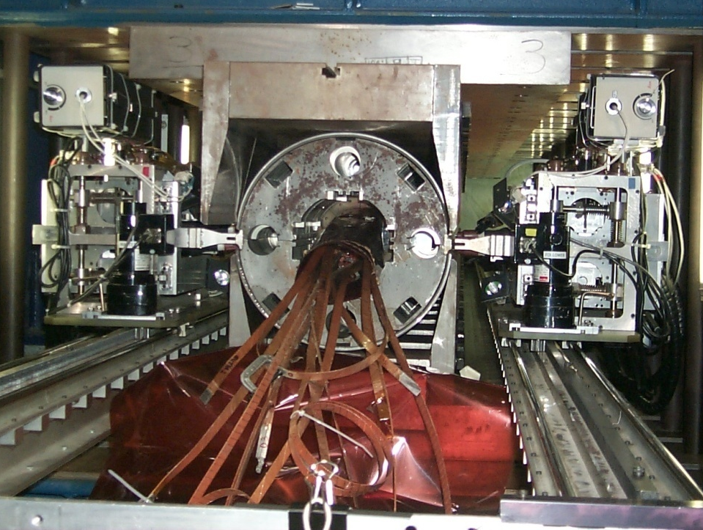
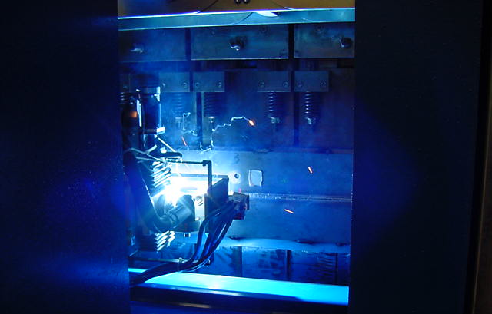
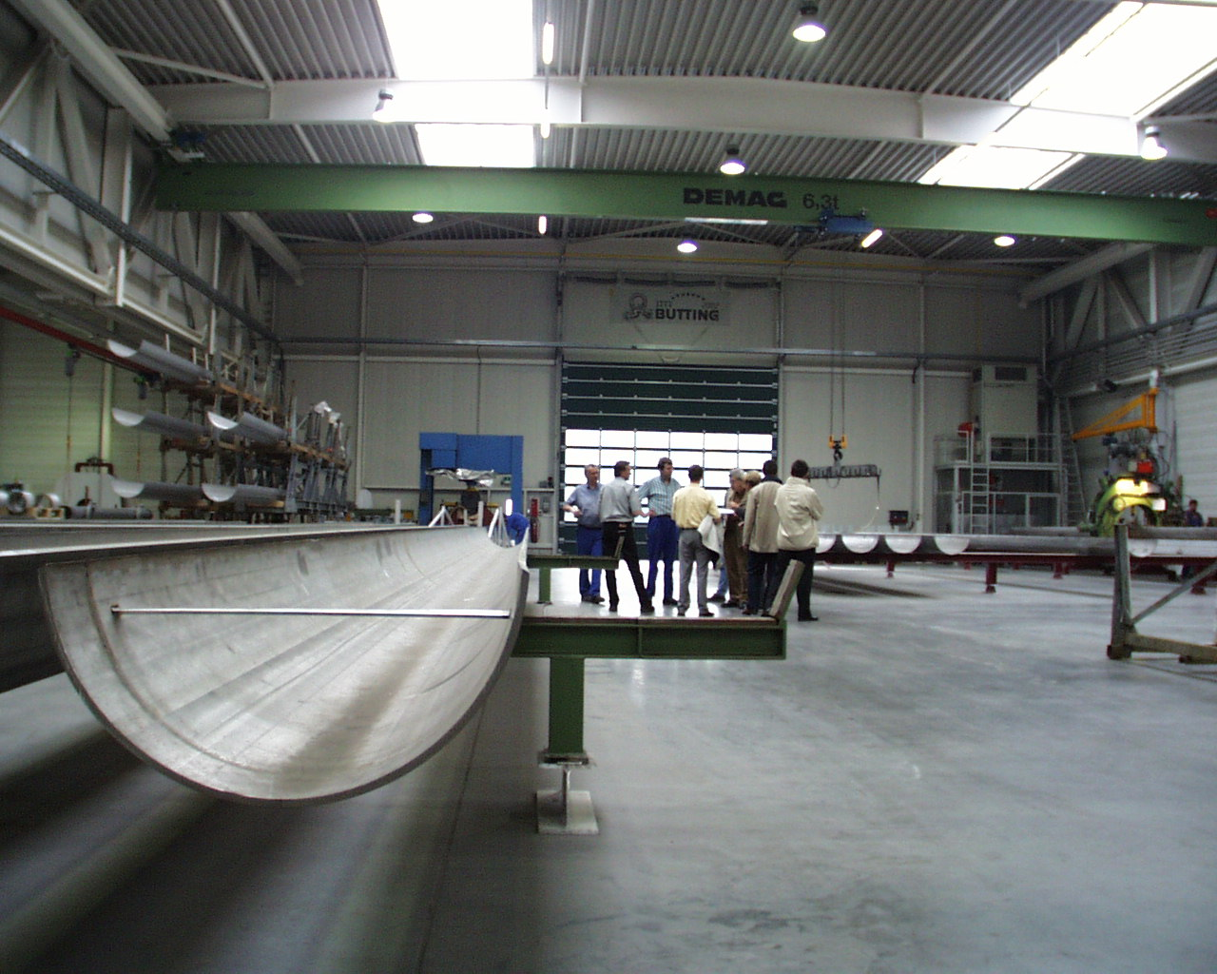
2. Support structure main features
Shell
L. Rossi, [4]

Slide 14
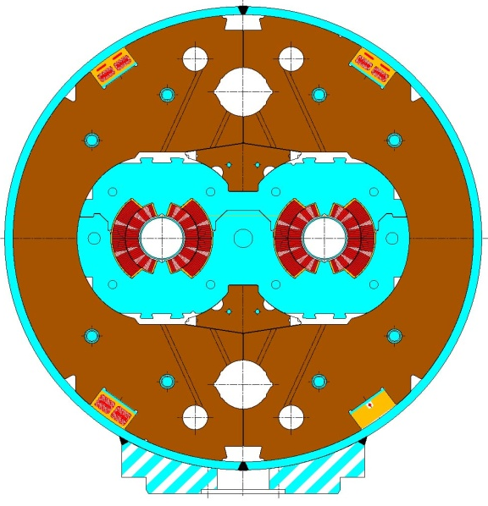
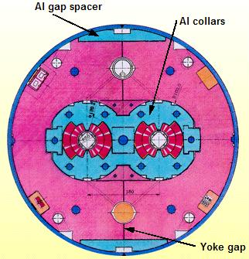
2. Support structure main features
Shell
The shell tension provided by the welding may contribute to the overall support of the collared coil.
An often (SSC, LHC) implemented approach is the line-to-line fit.
  When the yoke is put around the collared coil, a gap (vertical or horizontal) remains between the two halves; this gap is due to the collar deformation induced by coil pre-stress.
  After welding, the shell tension closes the gap, and good contact is provided between yoke and collar.
  After cool-down, despite the higher thermal contraction of the collared coil with respect to iron, the gap remain closed (high rigidity), and the collared coil in good contact with the yoke.
Aluminum spacer may be used to control the yoke gap.
MJB Plus, Inc., [2]

Slide 15
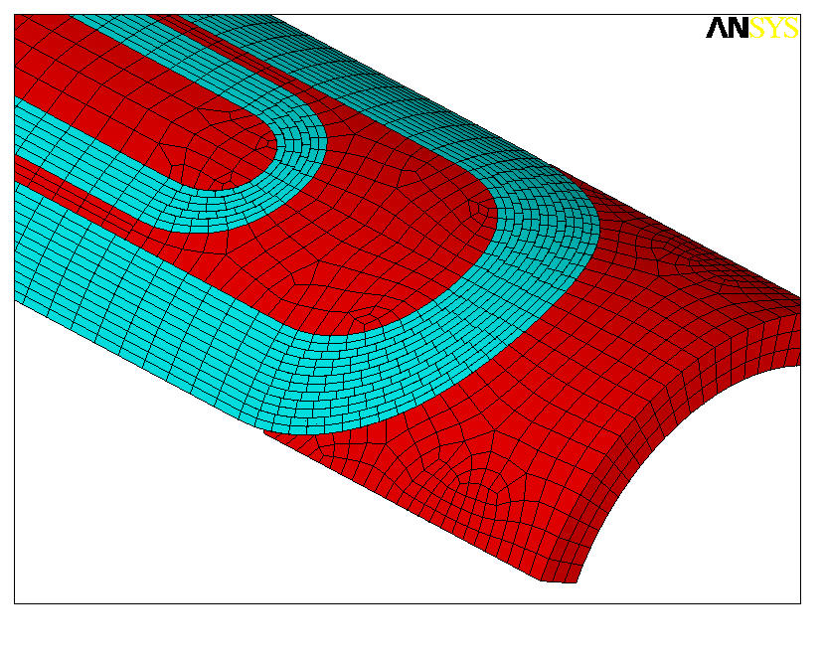
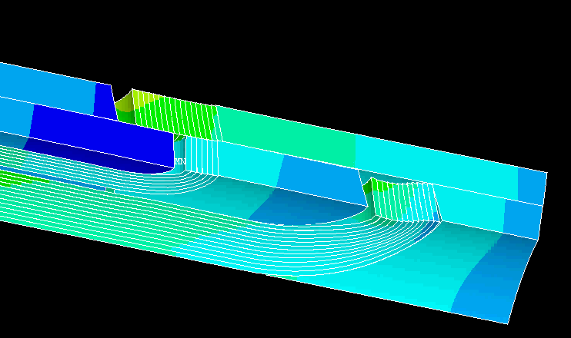
2. Support structure main features
End plates and axial support
Goal: minimize coil motion in end region due to axial forces
  Both overall coil motion
    By for example preventing the end-shoe from moving
  And pole turn displacement with respect the winding pole and spacers
    By, for example, pre-loading the coil (as for the 2D case)
3 elements react against the axial force
  The coil itself, with its own axial rigidity
  The structure, holding the coil via friction
  The axial support system
Two possible approaches for the axial support

Slide 16
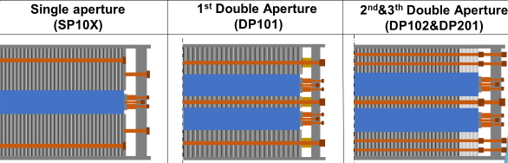
2. Support structure main features
End plates and axial support
Rigid axial system
  End plate bolted/connected to the magnet structure (yoke, shell)
    Rigidity provide by the all structure
  Force delivered to the coil via bullets at room temperature
  After cool-down, usually, but not always, some loss of pre-load
    The coil tends to contracts more than the structure
  The system is more focused on providing a rigid boundary, less on pre-loading the turns against winding pole and end spacers
CERN 11T

Slide 17
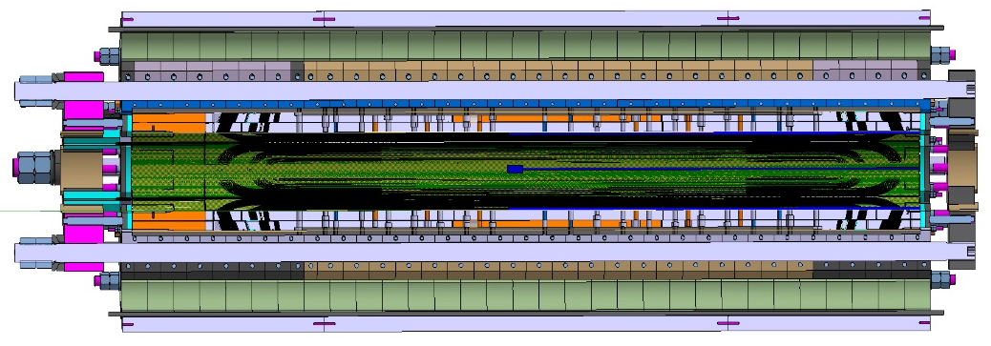
2. Support structure main features
End plates and axial support
Pre-loading axial system
  Full length axial rods (not connected to the structure) are pretensioned to push end plate against coils at room temperature
  Increase of stress during cool-down: all the forces from rods transferred to the coil (no interception from the structure)
  High forces delivered → turn pre-loaded, but less rigidity
    For the rigidity the system relies on the friction coil-to-structure

Slide 18
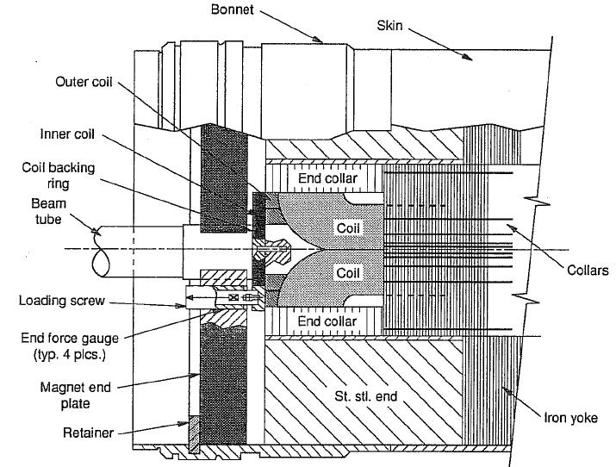
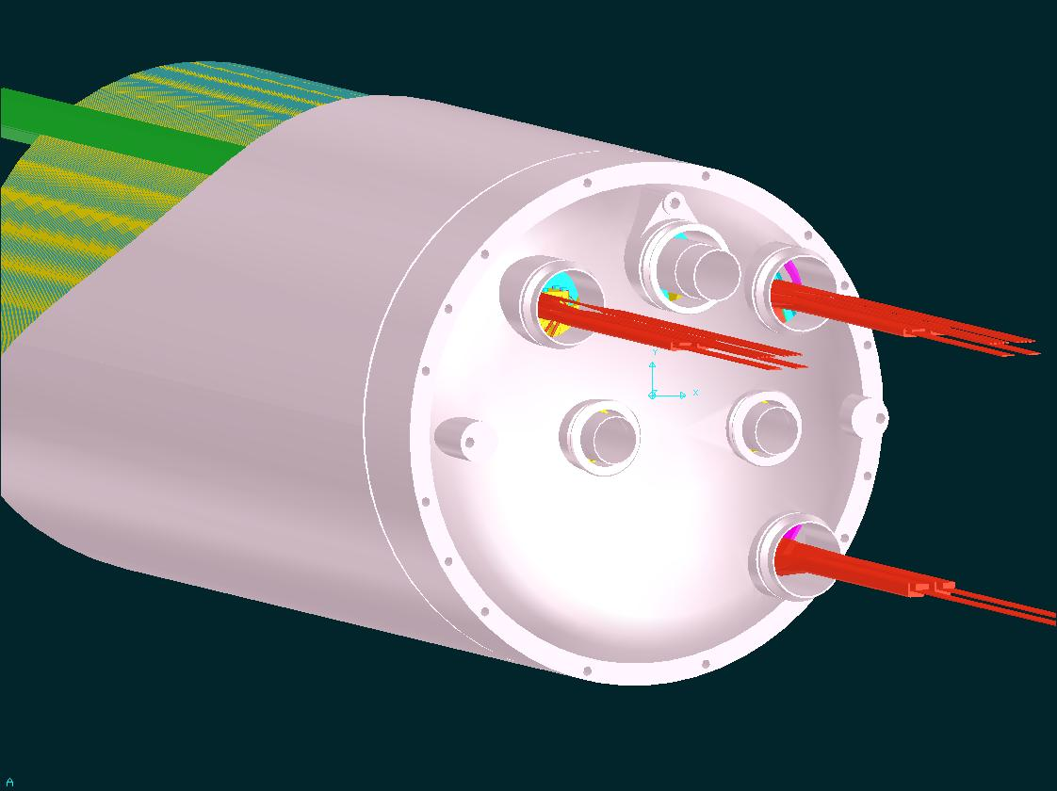
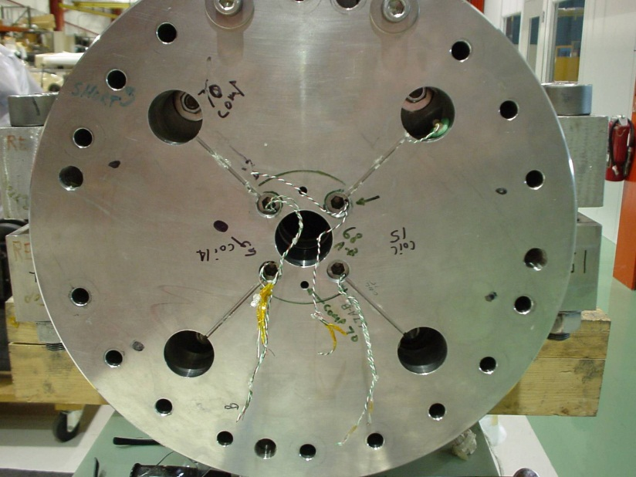
2. Support structure main features
End plates and axial support
End plates, applied after shell welding, provide also
  Liquid Helium containment.
A. Devred, [5]
L. Rossi, [4]

Slide 19
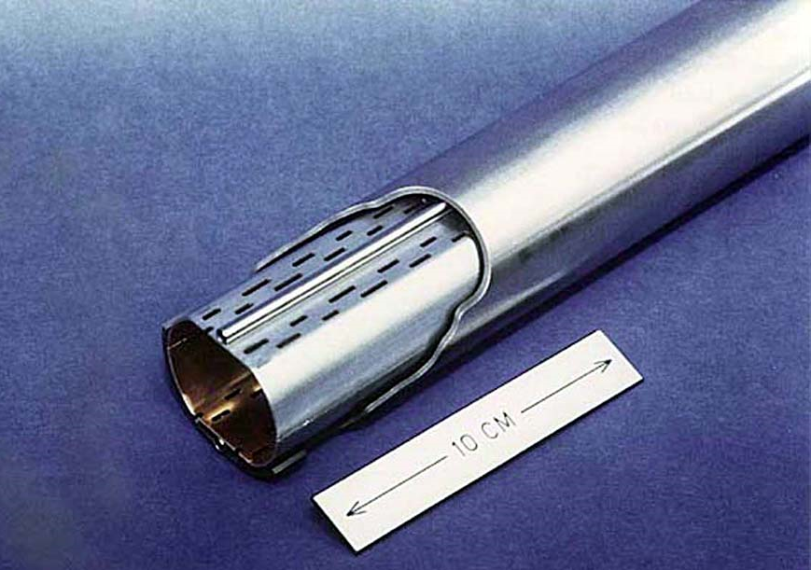
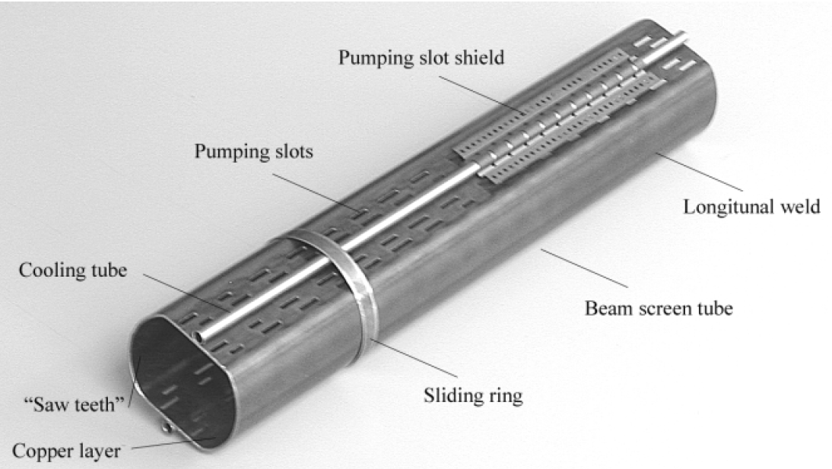
2. Support structure main features
Cold bore tube and beam screen
Insulated cold bore tubes are placed in the aperture of the coils and form part of the inner wall of the helium vessel.
  The tube wall separates the helium volume from the beam vacuum.
The beam screen reduces the heat loads from the beam (synchrotron radiation, electron clouds, energy lost by scattering protons, etc)
  Cooled by two stainless steel tubes

Slide 20
Outline
Introduction
Support structure main features
  Collars, Yoke, Shell,
  End plates and axial support
  Cold bore tube and beam screen
Cool-down effect
Electro-magnetic force effect
Practical examples of accelerator magnets
Conclusions

Slide 21
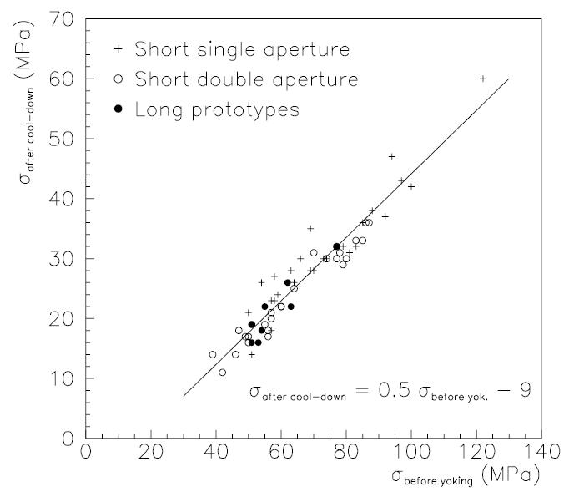
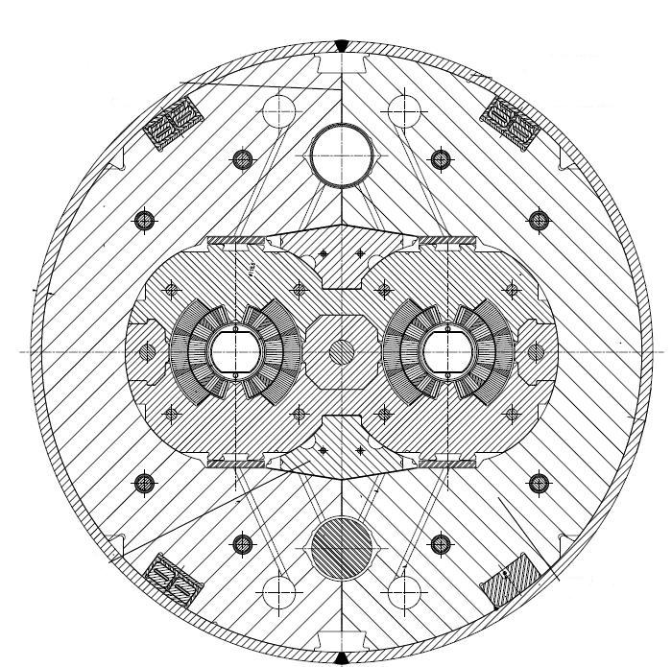
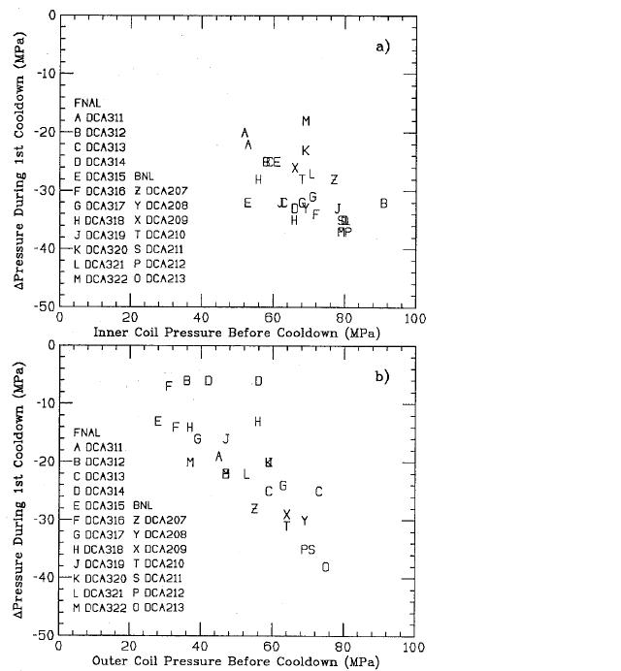
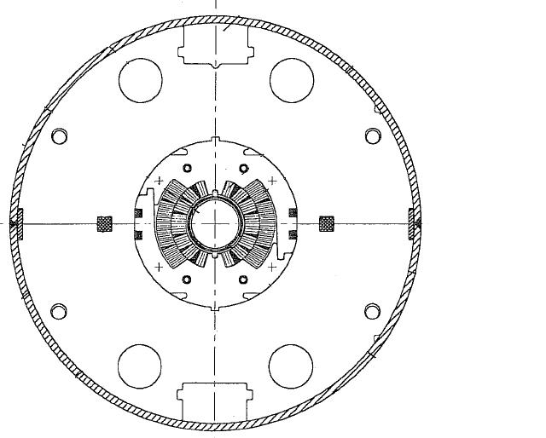
3. Cool-down effect
During cool-down, the shell, the yoke, the collar and the coil shrink differently.
The integrated thermal contraction from 293 K to 1.9 K vary from 1.9· 10⁻³ for iron to 4.2 · 10⁻³ for aluminum.
Significant variations of coil stress may occur during cool-down.
T. Ogitsu, [7]
T. Ogitsu, [7]

Slide 22
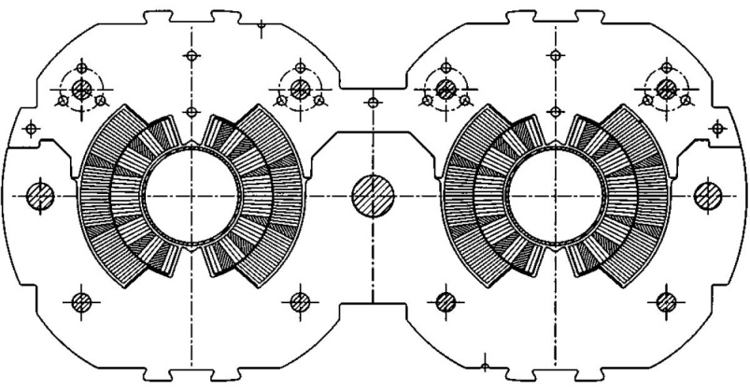
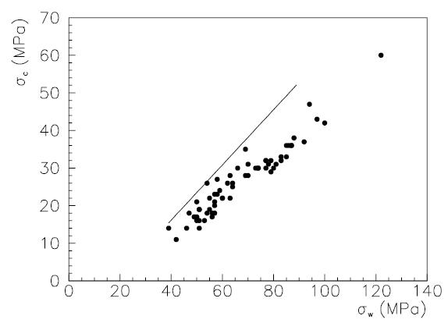
3. Cool-down effect
The cool-down effect (pre-stress loss) can be easily express as follows.
If we assume an infinitely rigid collar (similar to line-to-line fit situation), the variation of coil strain during cool-down (ε_{wc} - ε_{cc}) is given by
where α_{c} and α_{s} are respectively the thermal contraction of the coil and the collar.
Therefore, on can write
The loss of pre-stress is proportional to the difference of thermal contraction between coil and collars.
LHC prototype dipole data
Coil stress after cool-down
Coil stress before cool-down

Slide 23
Outline
Introduction
Support structure main features
  Collars, Yoke, Shell,
  End plates and axial support
  Cold bore tube and beam screen
Cool-down effect
Electro-magnetic force effect
Practical examples of accelerator magnets
Conclusions

Slide 24
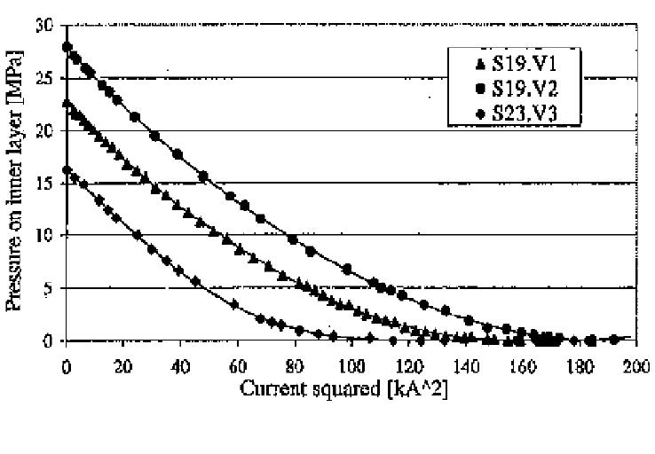
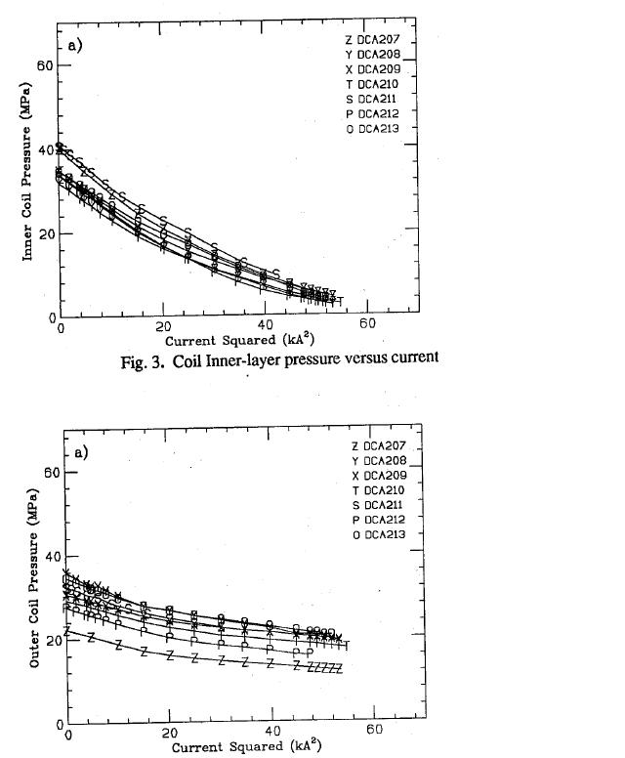
4. Electro-magnetic force effect
During excitation, the pole region of the coil unloads because of the e.m. forces.
Depending on the pre-stress after cool-down, at nominal field the coil may unload completely or maintain a certain compression.
K. Artoos, [8]
T. Ogitsu, [7]
T. Ogitsu, [7]

Slide 25
Overview of coil stress
Collaring
  Azimuthal pre-stress is provided to the coil.
Yoking and shell welding
  Additional support is added to the collared coil.
Cool-down
  Coil stress changes depending on the material of the surrounding components.
Excitation
  The pole unloads, the mid-plane loads, and radially the conductors are pushed against the structure.
All these contributions must be take into account in the mechanical design of the structure, with the goal of
  Minimize coil motion (pre-stress)
  Minimize cost and dimension of the structure
  Maintain the maximum stress of the component below the plasticity limits
  …and for (especially) Nb₃Sn coils, limit coil stress (150-200 MPa).

Slide 26
Outline
Introduction
Support structure main features
  Collars, Yoke, Shell,
  End plates and axial support
  Cold bore tube and beam screen
Cool-down effect
Electro-magnetic force effect
Practical examples of accelerator magnets
Conclusions

Slide 27
Practical examples of accelerator magnets
Classification
Traditionally, the support structure is characterized by three main components: the collars, the iron yoke and the external shrinking cylinder (or shell). Depending on the role and the importance of each of these three components, the support structures can be classified in three main groups:
  1. Collar-based structures
  2. Yoke-based structures
  3. Shell-based structures
An additional family
  4. Stress-managed structures
where additional structural components are added to the coil design to reduce the peak stress in the winding due to e.m. forces.

Slide 28
5. Practical examples of accelerator magnets
Collar-based structures
Example of collar-based structures (not in scale): from left, the CERN LHC main dipole magnet, the CERN 11T dipole magnet, the LARP TQ quadrupole magnet.
The three main components are the collars (in grey, around the coil, the iron yoke (in blue around the collars) and the shrinking cylinder (in grey around the yoke).

Slide 29
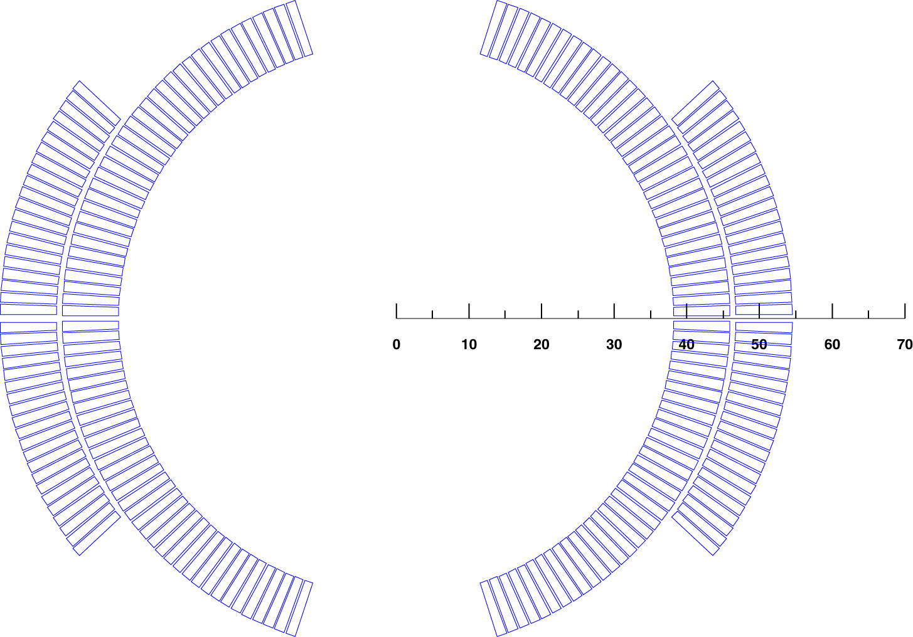
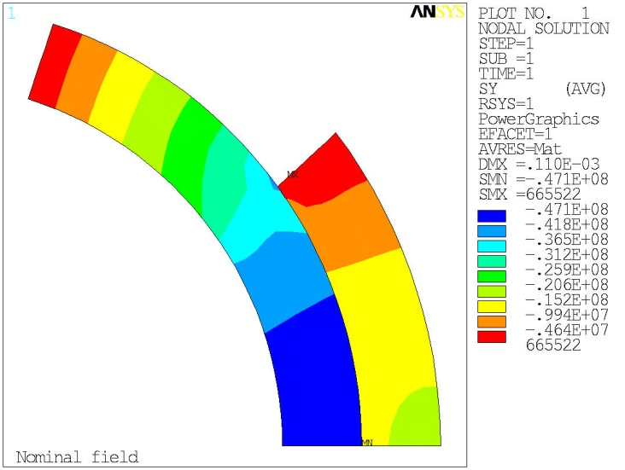
5. Practical examples of collar-based structures
Tevatron main dipole
B_{nom} = 4.4 T
Force at B_{nom}
  F_{x_layer1} = + 477 kN
  F_{x_layer2} = + 7 kN
  F_{y_layer1} = - 144 kN
  F_{y_layer2} = - 130 kN
Stored energy (4 quadrants) at B_{nom}
  E = 78 kJ/m
Axial force (4 quadrants) at B_{nom}
  F_{z_}= 78 kN
Average mid-plane stress at B_{nom} (assumptions: infinitely rigid structure and no pre-stress)
  σ_{θ_layer1} = - 45 MPa
  σ_{θ_layer2} = - 15 MPa

Slide 30
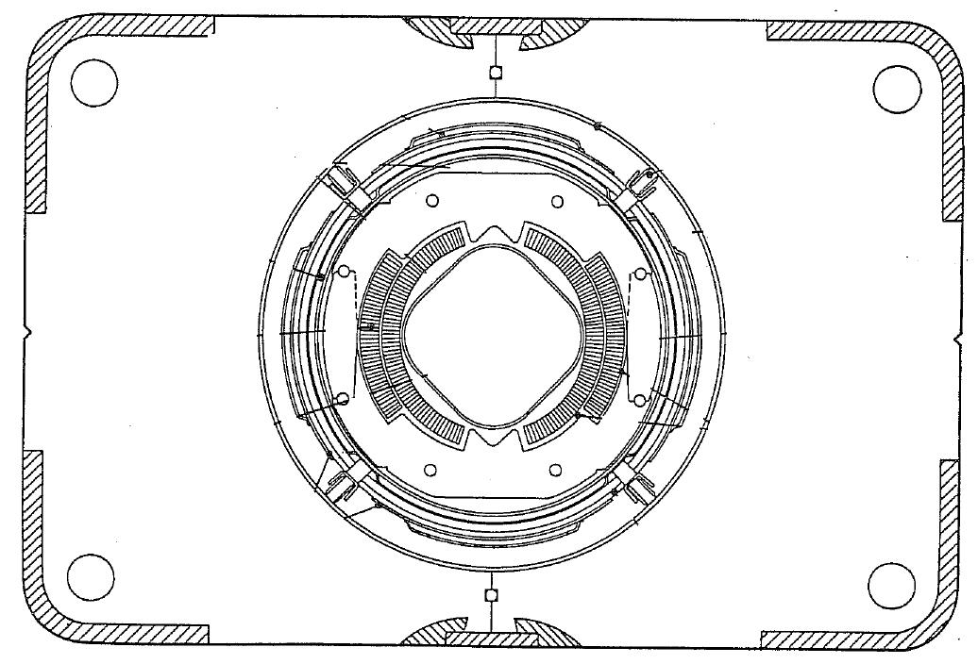


5. Practical examples of collar-based structures
Tevatron main dipole
The stainless steel collars are welded in three locations per side at the end of the collaring procedure.
  The stress provided by the collaring press is retained (minimum spring-back)
Warm iron design
  The cold mass is composed by the collared coil; the iron is maintained at room temperature.
The compact cryostat contains a liquid helium shield and a liquid nitrogen shield.
The cold mass and cryostat are supported by four cartridges, which also contribute to the alignment of the magnet.
MJB Plus, Inc., [2]

Slide 31


5. Practical examples of collar-based structures
Tevatron main dipole
Coil stress evolution
  According to [9], “Upon cool-down, at least 4700 PSI (32 MPa) of azimuthal pre-load remains in the inner coil”.
  By computing the coil response in a infinitely rigid structure, it appears that the coil pole remains always in contact with the collar during excitation.

Slide 32


5. Practical examples of collar-based structures
HERA main dipole
B_{nom} = 4.68 T
Force at B_{nom}
  F_{x_layer1} = + 533 kN
  F_{x_layer2} = + 45 kN
  F_{y_layer1} = - 138 kN
  F_{y_layer2} = - 137 kN
Stored energy (4 quadrants) at B_{nom}
  E = 87 kJ/m
Axial force (4 quadrants) at B_{nom}
  F_{z_}= 87 kN
Average mid-plane stress at B_{nom} (assumptions: infinitely rigid structure and no pre-stress)
  σ_{θ_layer1} = - 38 MPa
  σ_{θ_layer2} = - 14 MPa

Slide 33



5. Practical examples of collar-based structures
HERA main dipole
Collars are made of aluminum and are self supporting
  No contact between collars and yoke.
Collared coil is locked by keys.
The iron yoke is cooled to liquid He temperature
  Cold iron design.
Alignment is achieved through keys between the collars and the yoke.
The He containment is provided by two half shells welded together.
The welding process provides also the sagitta (17 mm over 9 m length).
MJB Plus, Inc., [2]

Slide 34

5. Practical examples of collar-based structures
HERA main dipole
Since the collars are not supported by the yoke, they deforms under the action of coil pre-stress and e.m. forces.
  After cool-down, the collars are vertically ovalized.
  When e.m. forces are applied, the collars deform horizontally on the mid-plane.
Nominal dimensions
After cool-down
At maximum field
S. Wolff, [3]

Slide 35


5. Practical examples of collar-based structures
HERA main dipole
Coil stress evolution
  According to [3], after cool-down the coil is pre-compressed to about 50 (40) MPa in the inner (outer) layer.
  No pre-stress loss occurs during cool-down (aluminum collars).
  By computing the coil response in a infinitely rigid structure, it appears that the coil pole remains always in contact with the collar during excitation, with a margin of more than 20 MPa in compression.

Slide 36


5. Practical examples of collar-based structures
SSC main dipole
B_{nom} = 6.6 T
Force at B_{nom}
  F_{x_layer1} = + 634 kN
  F_{x_layer2} = + 259 kN
  F_{y_layer1} = - 104 kN
  F_{y_layer2} = - 304 kN
Stored energy (4 quadrants) at B_{nom}
  E = 149 kJ/m
Axial force (4 quadrants) at B_{nom}
  F_{z_}= 149 kN
Average mid-plane stress at B_{nom} (assumptions: infinitely rigid structure and no pre-stress)
  σ_{θ_layer1} = - 35 MPa
  σ_{θ_layer2} = - 32 MPa

Slide 37


5. Practical examples of collar-based structures
SSC main dipole
Stainless steel collars are assembled into packs from spot welded pairs.
The collared-coil assembly is contained by the iron yoke and the welded a stainless steel outer shell.
Interference is provided between collars and yoke (line-to-line fit).
Two different designs
  In the BNL design, the yoke is split horizontally
    Tight contact results from a collar-yoke interference along the vertical diameter.
  In the FNAL design, the yoke is split vertically
    Tight contact results from a collar-yoke interference along the horizontal diameter.
MJB Plus, Inc., [2]

Slide 38


5. Practical examples of collar-based structures
SSC main dipole
Coil stress evolution
  According to [6]-[7], after cool-down the coil is pre-compressed to about 40 (35) MPa in the inner (outer) layer.
  Pre-stress is lost during assembly and cool-down.
  By computing the coil response in a infinitely rigid structure, it appears that the coil pole remains always in contact with the collar during excitation, with a margin of more than 15 MPa in compression.

Slide 39


5. Practical examples of collar-based structures
LHC main dipole
B_{nom} = 8.33 T
Force at B_{nom}
  F_{x_layer1} = + 1117 kN
  F_{x_layer2} = + 532 kN
  F_{y_layer1} = - 160 kN
  F_{y_layer2} = - 675 kN
Stored energy (1 aperture) at B_{nom}
  E = 265 kJ/m
Axial force (1 aperture) at B_{nom}
  F_{z_}= 265 kN
Average mid-plane stress at B_{nom} (assumptions: infinitely rigid structure and no pre-stress)
  σ_{θ_layer1} = - 46 MPa
  σ_{θ_layer2} = - 57 MPa

Slide 40

5. Practical examples of collar-based structures
LHC main dipole
Two-in-one configuration
  Both beam pipes are contained within one cold mass
Stainless steel collars are locked by three full-length rods.
Magnetic insert
  It transfers vertical force from the yoke to the collared coils
  It improves field quality
Iron yoke vertically split
  At the end of the welding operation the yoke gap is closed
Stainless steel shell halves are welded around the yoke to provide He containment, a 9 mm sagitta, and to increase rigidity.
MJB Plus, Inc., [2]

Slide 41


5. Practical examples of collar-based structures
LHC main dipole
Coil stress evolution
  According to [11], after cool-down the coil is pre-compressed to about 40 MPa.
  Pre-stress is lost during assembly and cool-down.
  By computing the coil response in a infinitely rigid structure, it appears that the coil pole remains (almost) always in contact with the collar during excitation.

Slide 42






5. Practical examples of collar-based structures
11T
Goal: replace a LHC dipole with 2 shorter 11T dipoles to provide room for collimator
Support structure based on ss collars
14.3 m
Nb-Ti 8.3 T
5.5 m
Nb₃Sn 11 T
5.5 m Nb₃Sn
1 m Collimator
5.5 m Nb₃Sn

Slide 43



5. Practical examples of collar-based structures
11T
Most of coil pre-stress achieved by collaring

Slide 44


5. Practical examples of collar-based structures
11T

Slide 45
5. Practical examples of collar-based structures
11T
  Pole shim
  Collar/yoke shim (default: 0.4 mm)
  Pole adjustment shim (default: 0.2 mm)
  Gap closing @ room temperature
  remaining closed to 12 T.
  Stainless-steel shell
4.
3.
1.
2.
(3) is an optional knob.
(2) and (4) must be controlled in order to close the yoke gap at RT.
5.

Slide 46

5. Practical examples of collar-based structures
11T
  Pole shim
  Collar/yoke shim (default: 0.4 mm)
  Pole adjustment shim (default: 0.2 mm)
  Gap closing @ room temperature
  remaining closed to 12 T.
  Stainless-steel shell
1
2
(3) is an optional knob.
(2) and (4) must be controlled in order to close the yoke gap at RT.
3
4
5

Slide 47


5. Practical examples of collar-based structures
LHC IR quadrupole
Support structure based on collars and welded stainless steel shell are also used for quadrupole magnets.
During the collaring operation, 4 keys/rods are inserted at the four mid-planes.
CERN-Oxford Inst. (MQY)
Fermilab
(MQXB)
L. Rossi, [1]

Slide 48
Practical examples of accelerator magnets
Classification
Traditionally, the support structure is characterized by three main components: the collars, the iron yoke and the external shrinking cylinder (or shell). Depending on the role and the importance of each of these three components, the support structures can be classified in three main groups:
  1. Collar-based structures
  2. Yoke-based structures
  3. Shell-based structures
An additional family
  4. Stress-managed structures
where additional structural components are added to the coil design to reduce the peak stress in the winding due to e.m. forces.

Slide 49
5. Practical examples of accelerator magnets
Yoke-based structures
Example of yoke-based structures (not in scale): from left, the BNL RHIC main dipole magnet, the KEK HL-LHC D1 dipole magnet, and the BNL RHIC arc quadrupole magnet.
The three main components are the insulator or collar (in green or grey, around the coil), the iron yoke (in blue around the insulator/collar) and the shrinking cylinder (in grey around the yoke).

Slide 50


5. Practical examples of yoke-based structures
RHIC main dipole
B_{nom} = 3.46 T
Force at B_{nom}
  F_{x_layer1} = + 311 kN
  F_{y_layer1} = - 110 kN
Stored energy (4 quadrants) at B_{nom}
  E = 48 kJ/m
Axial force (4 quadrants) at B_{nom}
  F_{z_}= 48 kN
Average mid-plane stress at B_{nom} (assumptions: infinitely rigid structure and no pre-stress)
  σ_{θ_layer1} = - 26 MPa

Slide 51



5. Practical examples of yoke-based structures
RHIC main dipole
The coil is surrounded by glass-filled phenolic insulators that provide the alignment, insulation to ground and separation of the coils from the iron to reduce saturation effects.
The iron yoke clamps the coil-insulator structure like a collar.
Stainless steel shell halves are welded around the yoke to provide He containment, a 48.5 mm sagitta, and to increase rigidity.
MJB Plus, Inc., [2]

Slide 52


5. Practical examples of yoke-based structures
RHIC main dipole
Coil stress evolution
  According to [10], after cool-down the coil is pre-compressed to about 35 MPa.
  Pre-stress is lost during assembly and cool-down.
  By computing the coil response in a infinitely rigid structure, it appears that the coil pole remains always in contact with the collar during excitation, with a margin of about 15 MPa in compression.

Slide 53

5. Practical examples of yoke-based structures
LHC IR quadrupole
KEK
(MQXA)
L. Rossi, [1]

Slide 54










Overview of accelerator dipole magnets
Tevatron
HERA
SSC
RHIC
LHC

Slide 55
Practical examples of accelerator magnets
Classification
Traditionally, the support structure is characterized by three main components: the collars, the iron yoke and the external shrinking cylinder (or shell). Depending on the role and the importance of each of these three components, the support structures can be classified in three main groups:
  1. Collar-based structures
  2. Yoke-based structures
  3. Shell-based structures
An additional family
  4. Stress-managed structures
where additional structural components are added to the coil design to reduce the peak stress in the winding due to e.m. forces.

Slide 56

5. Practical examples of accelerator magnets
Shell-based structures
Example of collar-based structures, in scale, from top left clock-wise: LABNL SM, CEA SD, LBNL HD1, LBNL HD2, CERN RMC, CERN FRESCA2, HL-LHC MQXF, LARP HQ, LARP LQS, LARP TQS, LARP SQ, LARP LRS.

Slide 57

5. Practical examples of shell-based structures
TQS
All the structures presented so far are characterized by significant coil pre-stress losses
  The coil reaches the maximum compression (about 100 MPa) during the collaring operation.
  After cool-down the residual pre-stress is of about 30-40 MPa.
What if the “required” coil pre-stress after cool-down is > 100 MPa?

Slide 58



5. Practical examples of shell-based structures
TQS
The coil is surrounded by four pads and four yokes
  Pad and yoke gaps remain open during all the magnet operations.
An aluminum shell contains the cold mass.
Initial pre-compressions is provided by bladders and locked by keys.
After cool-down the coil pre-stress increases due to the high thermal contraction of the aluminum shell.

Slide 59

5. Practical examples of shell-based structures
TQS
In the TQS case, the collaring press operation is substituted by the bladder operation.
A spring back occurs when bladder pressure is reduced
  Clearance for key insertion
The coil pre-stress significantly increases during cool-down.

Slide 60

5. Practical examples of shell-based structures
MQXF
Target: 132.6 T/m in 150 mm coil aperture
To be installed in 2023
Q1/Q3
  2 magnets with 4.2 m of magnetic length within 1 cold mass
Q2
  1 magnet of 7.15 m within 1 cold mass, including MCBX (1.2 m)
Different lengths, same design
by E. Todesco

Slide 61

5. Practical examples of shell-based structures
MQXF

Slide 62


5. Practical examples of “mixed” support structures
MDPCT1
The MDPCT1 dipole recently built in FNAL makes use another concept based on prestress increase due to Al but with a closed gap
  Iron yoke vertical split, I-shaped Al clamps give prestress increase during cool down
  The gap is closed after cool-down, so the structure is not open as in Al shell and B&k – this is easing alignment but requiring a very careful control of the gap closing
  Assembly needs a press, 50-70 MPa at room temperature, 100-130 MPa after cool-down

Slide 63
Practical examples of accelerator magnets
Classification
Traditionally, the support structure is characterized by three main components: the collars, the iron yoke and the external shrinking cylinder (or shell). Depending on the role and the importance of each of these three components, the support structures can be classified in three main groups:
  1. Collar-based structures
  2. Yoke-based structures
  3. Shell-based structures
An additional family
  4. Stress-managed structures
where additional structural components are added to the coil design to reduce the peak stress in the winding due to e.m. forces.

Slide 64

5. Stress management structures
The equation for stress shows that to go above 15-20 T fields for a sector coil accelerator dipole of 25 mm aperture radius one has to start addressing azimuthal and radial stresses on the coil
  The community has proposed exploring an alternative way: stress management
Stress management: having a mechanical structure that intercepts the stress accumulation
  As in a building, the weight of the furniture of each floor
  does not accumulate on the family living at ground floor,
  but is taken by the walls

Slide 65
5. Stress management structures
The case of radial stress seems particularly challenging, since it is proportional just to the magnetic pressure so even a less effective magnet (lower current density) has the same stress
  In this case stress management has to be with an horizontal frame taking the horizontal forces
The main problem (still open today) of stress management structures is the following
  How to give preload to each part ?
The second feature is that the structure gives a dilution of the current density, i.e. a less effective design
  But this is a price we are ready to pay

Slide 66


5. Stress management structures
TAMU (Texas A&M)
“Stress management” system
  Each coil block is isolated in its own compartment and supported separately.
  E.m. force exerted on multiple coil blocks does not accumulate, but it is transmitted to the magnet frame by the Inconel ribs to Inconel plates.
  A laminar spring is used to preload each block.

Slide 67

5. Stress management structures
CCT (LBNL)
Canted Cosine-Theta Magnet
  Two superimposed coils, oppositely skewed, achieve a pure cosine-theta field and eliminate axial field.
  Ribs (wedges) simulate a Cosine-Theta current density and intercept the Lorentz forces

Slide 68





5. Stress management structures
SMCT (FNAL)
Stress management cos-theta
  Through wedges (ribs) and cylinders (spars)

Slide 69
Outline
Introduction
Support structure main features
  Collars, Yoke, Shell,
  End plates and axial support
  Cold bore tube and beam screen
Cool-down effect
Electro-magnetic force effect
Practical examples of accelerator magnets
Conclusions

Slide 70
8. Conclusions
We presented the main features of the magnet support structure
  Most of the accelerator magnets are based on collars and a shrinking cylinder
    This kind of structure guarantees good control of conductor position and coil alignment.
Coil stress evolution for different accelerator magnets has been presented
  Significant pre-stress losses occur from collaring to excitations, but no separation takes place between coil and collars in the pole region.
Alternative designs have been presented
    Bladder and key structure
      Increase of stress during cool-down
    Stress management structure
      Minimization of e.m. force accumulation

