Slide 1

Unit 15 – Magnetic design II
Short sample field, margin and sensitivity analysis
Ezio Todesco
European Organization for Nuclear Research (CERN)
Technology Department
Magnet Superconductors and Cryostat Group
All the units will use International System (meter, kilo, second, ampere) unless specified

Slide 2
QUESTIONS
Given a material and an aperture, and a quantity of cable, what is the strongest dipole / quadrupole we can build ?
  Can we have explicit equations ?
  Can we make an analytical sensitivity analysis on coil width, filling factor, critical current
  Or do we have to run codes in each case ?
  We treat the case of a sector coil for dipoles and quadrupoles
  Please note that we ignore the role of iron and of grading, that will be described in the next unit

Slide 3
CONTENTS
Margins
Recall on filling ratio and linear approximation for critical surface
Short sample field in dipoles
Sensitivity analysis
Appendix
  A better approximation for Nb₃Sn
  Quadrupoles: short sample gradient versus material and lay-out

Slide 4
SHORT SAMPLE CONCEPT
Short sample condition: where the combination of current density and peak field in the coil lay on the critical surface
  This is the maximum theoretical performance of the magnet
j_{sc}
Superconductive state
Normal state
j_{sc,ss}
Loadline for bore field
Loadline for peak field
B_{1,ss}
B_{1p,ss}
B₁

Slide 5
LOADLINE MARGIN
One cannot work on the critical surface
  Loadline fraction: ratio between operational current and short sample current (0.70 in the figure)
  Loadline margin: 1- loadline fraction (30% in the figure)
Example of a Nb-Ti magnet at 1.9 K with 10 T shor sample and 0.70 loadline fraction

Slide 6
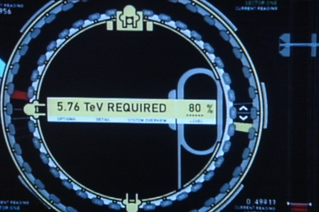
LOADLINE MARGIN
The loadline margin concept
  It is an empirical concept, widely used
  Notwithstanding the criticism, and the lack of physical meaning, it hat not yet been replaced by any other criteria
Empirical rules
  Main superconducting magnets have a 10-30% loadline margin
  Correctors have about 50% margin
Loadline margin of the main dipoles in four accelerators
20% margin for the Terminator III accelerator

Slide 7
LOADLINE MARGIN
The loadline margin concept
  Note that the loadline margin for a magnet class is defined with respect to the conductor specification
  For a single magnet the loadline margin can be given with respect to the actual values of the critical current measured for that conductor
  The value is defined with a precision that is of the order of 1%
  How a gain in critical current translates in gain in loadline margin ? This will be discussed in Unit 8
More empirical rules (take them with a pinch of salt)
  A magnet able to reach >90% of the short sample is considered a full success
  Below 50-60% of short sample the training phenomena are absent
    Training: a quench at current lower than short sample, followed by quenches at higher currents
  Above 75% of short sample, training can be very relevant and can become an issue

Slide 8

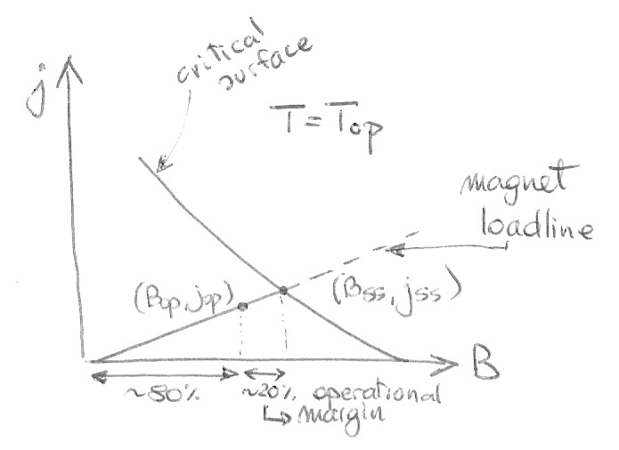
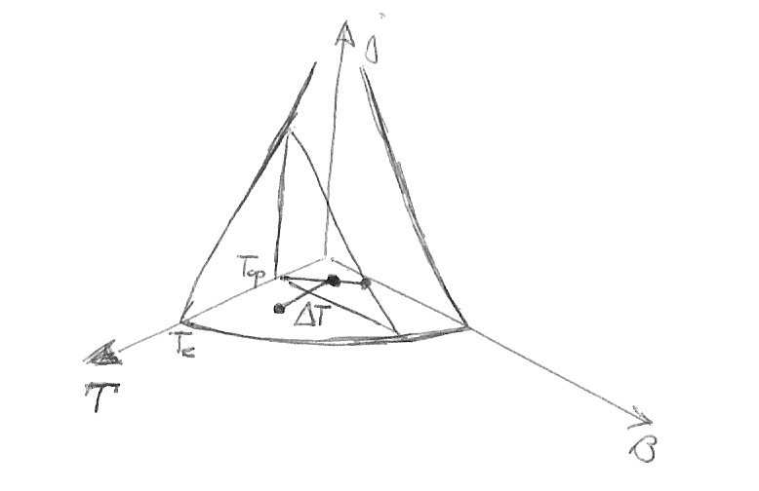
TEMPERATURE MARGIN
A more physical quantity is the temperature margin
  How much we can heat locally to reach the critical surface (at the operational current density and field)?
Loadline with 20% operational margin
Operational margin and temperature margin

Slide 9
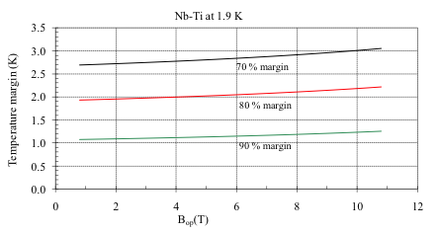
TEMPERATURE MARGIN
Temperature margins are of the order of few kelvin
  For instance in Nb-Ti for each 10% margin you have ≈1 K
  With 20% margin, about 2 K temperature margin
30% margin
20% margin
10% margin
Temperature margin versus operational field for different loadline margins in Nb-Ti

Slide 10
TEMPERATURE MARGIN
Some parametric analysis
  Nb-Ti at 4.2 K loses at least 1/3 of temperature margin w.r.t. 1.9 K
    But the specific heat is larger …
    But helium is not superfluid …
  Nb₃Sn has a temperature margin 2.5 times larger than Nb-Ti
    This is due to the shape of the critical surface
    At 80%, Nb₃Sn has about 5 K of temperature margin
Temperature margin of Nb-Ti at 1.9 K and at 4.2 K
versus operational field, for 20% margin on the loadline
Temperature margin of Nb-Ti and Nb₃Sn
versus operational field, for 20% margin

Slide 11
TEMPERATURE MARGIN
Two regimes of heat flow
  Continuous regime: the magnet is under a source of heat deposition stable in time: power density (mW/cm³)
    In this case the temperature margin is the physical quantity limiting performance
    Source can be beam losses, ramp rate power losses …
    … and the relevant features are the heat extraction channels
  Impulse regime: the magnet has heat depositions on short times: energy density (mJ/cm³)
    In this case the energy margin is the physical quantity limiting performance (no time to remove heat – adiabatic case)
    Source can be heat deposition due to friction, resin cracks, current redistribution
    And the relevant features are the local properties of materials (critical current, specific heats, …)

Slide 12
ENTHALPY (OR ENERGY) MARGIN
The temperature margin can be translated in energy density required to reach the critical surface (in adiabatic approx)
  For instance, to increase temperature of 2 K at 1.9 K (from 1.9 K to 3.9 K) takes 6000 J/m³ in Nb-Ti and 12000 J/m³ in Nb₃Sn
  Energy density is usually given in cm³, so the energy density is of the order of 10 mJ/cm³
  The estimation is complicated by the following aspect
    If we are at 1.9 K and if the coil is not impregnated (as in Nb-Ti), the HeII (superfluid) has a large enthalpy at its transition, that dominates over the enthalpy of the superconductor

Slide 13
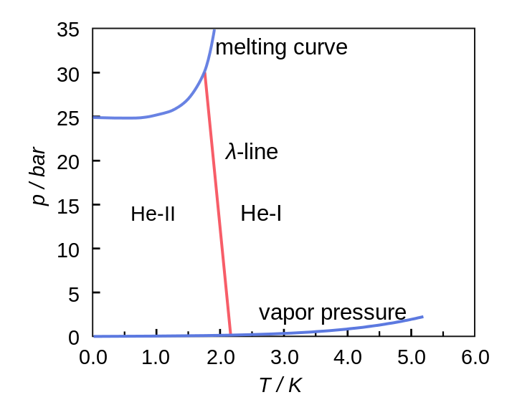
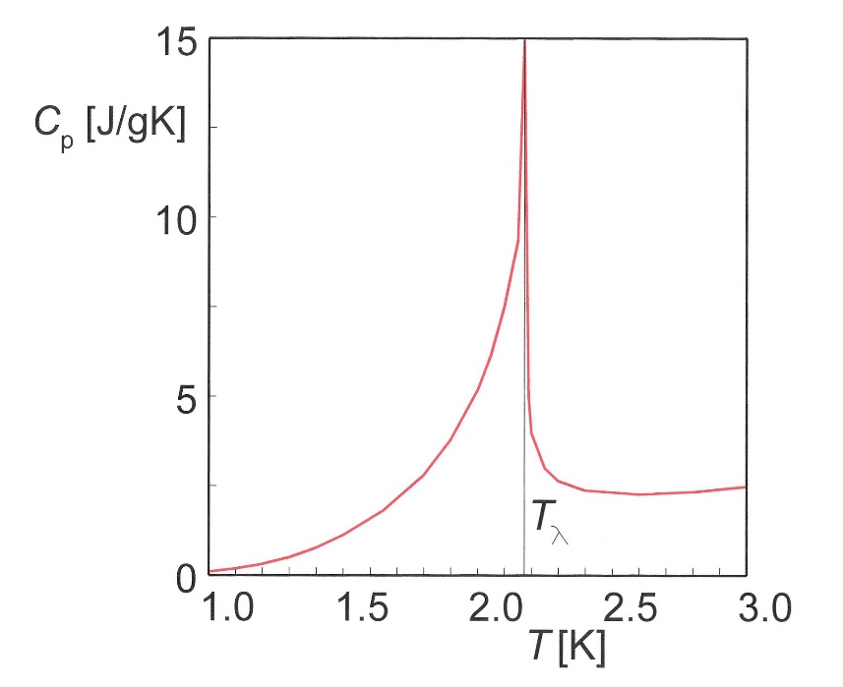
SUPERFLUID HELIUM
Helium is the only element that never freezes at 1 bar
  Liquid helium has two phases, the second one (below 2.17 K) being superfluid
Phase diagram of helium
Specific heat of HeII

Slide 14
ENTHALPY (OR ENERGY) MARGIN
Four examples of 20% loadline margin
  Nb₃Sn at 1.9 K: 5 K margin gives 60 mJ/cm³
  Nb₃Sn at 4.2 K: 3 K margin gives 50 mJ/cm³
  Nb-Ti at 1.9 K: 2 K margin gives 6 mJ/cm³
    plus the 30 mJ/cm³ of HeII latent heat
  Nb-Ti at 4.2 K: 1.3 K margin gives 8 mJ/cm³
The other relevant ingredient is the spectrum of the energy of perturbations
  That can be totally different for impregnated/non impregnated coils, at 1.9 K or at 4.2 K
  Resin cracks, coil movement with friction, current redistribution, local damages …
Today, we face a situation where the loop has not been closed
  Loadline margin is still used in magnet design
  This loadline margin is not justified in terms of enthalpy margin and perturbation spectrum

Slide 15
CONTENTS
Margins
Recall on filling ratio and linear approximation for critical surface
Short sample field in dipoles
Sensitivity analysis
Appendix
  A better approximation for Nb₃Sn
  Quadrupoles: short sample gradient versus material and lay-out

Slide 16
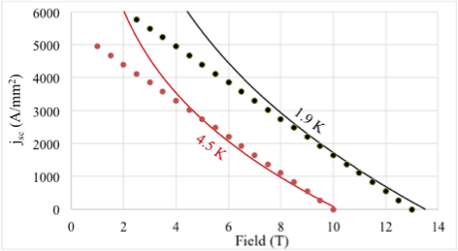
Nb-Ti CRITICAL SURFACE APPROXIMATION
We recall the equations for the critical surface
  Nb-Ti: linear approximation is commonly used
  with s~550 [A/(T mm²)] and b~10 T at 4.2 K and b~13 T at 1.9 K
    This is a typical mature Nb-Ti high current density strand (LHC)
    Tevatron had half of it!
Critical current density in the superconductor in Nb-Ti at 1.9 K and 4.2 K, and linear interpolation

Slide 17
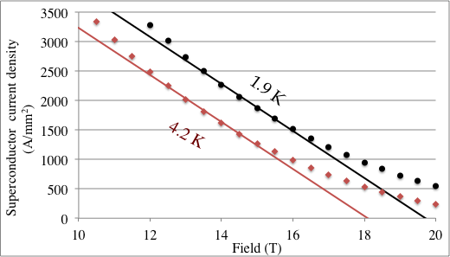
Nb-Ti CRITICAL SURFACE APPROXIMATION
We recall the equations for the critical surface
  The linear fit for Nb₃Sn is less good, but still usable with some caution
  For RRP used in HL-LHC in the range 13-16 T we have
  s~400 [A/(T mm²)] and b~18.1 T at 4.2 K and b~19.7 T at 1.9 K
Critical current density in the superconductor in Nb₃Sn at 1.9 K and 4.2 K, and linear interpolation

Slide 18
RECALL ON FILLING RATIO
The current density in the coil is lower
  Strand made of superconductor and normal conducting (∼copper)
    ν_{Cu-sc} is the ratio between the copper and the superconductor, usually ranging from 1 to 2 in most cases
  If the strands are assembled in rectangular cables, there are voids:
    κ_{w-c} is the fraction of cable occupied by strands (usually ~85%)
  The cables are insulated:
    κ_{c-i} is the fraction of insulated cable occupied by the bare cable (~85%)
The current density flowing in the insulated cable is reduced by a factor κ (filling ratio)
  The filling ratio ranges from ¼ to 1/3
  The critical surface for j (overall current density) is

Slide 19
RECALL ON FILLING RATIO
Examples of filling ratio in main dipoles (similar for quads)
  Copper to superconductor ranging from 1.1 to 2.2
    Extreme case of D20: 0.43 (low copper, short model with energy extraction (see Unit 11 on protection)
  Void fraction from 11% to 18%
  Insulation from 11% to 18%

Slide 20
CONTENTS
Margins
Recall on filling ratio and linear approximation for critical surface
Short sample field in dipoles
Sensitivity analysis

Slide 21
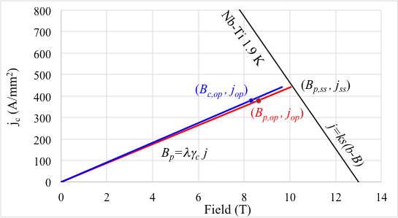
SHORT SAMPLE FIELD IN Nb-Ti DIPOLES
We consider a sector coil of width w
  Equation for the bore field is
  with for a coil with one wedge setting to zero b₃ to b₇
  We define λ as the ratio between peak field and central field
  Now, we can compute the highest peak field reachable in the dipole
  γ_{c}=6.6×10⁻⁴ (T mm/A)
j_{ss}

Slide 22
SHORT SAMPLE FIELD IN Nb-Ti DIPOLES
We can now compute the maximum current density that can be tolerated by the superconductor (short sample limit)
  the short sample current is
  and the bore short sample
  field is
j_{ss}

Slide 23

SHORT SAMPLE FIELD IN Nb-Ti DIPOLES
When we go for larger and larger coils we increase w
  In the limit of very large coils, one can reach the maximum field b (apart from the λ factor, i.e. the ratio between peak field in the coil and bore field) for very small current density
  In this case the magnet coil becomes very large
  Two regimes: small coils and large coils
  Last missing piece: an estimate for λ

Slide 24
RATIO PEAK FIELD BORE FIELD
How much is the ratio between peak field and bore field)?
  To compute the peak field one has to compute the field everywhere in the coil, and take the maximum
  One can prove that if the current density is constant the maximum is always on the border of the coil – useful to reduce the computation time
Tevatron main dipole –
location of the peak field
RHIC main dipole –
location of the peak field
LHC main dipole –
location of the peak field

Slide 25
RATIO PEAK FIELD BORE FIELD
Numerical evaluation of λ for different sector coils
  The ratio is larger for smaller coil widths
    Improving field quality, peak field is closer to bore field
  Hyperbolic fit with a~0.04
    (r aperture radius, w coil width of sector coil)

Slide 26
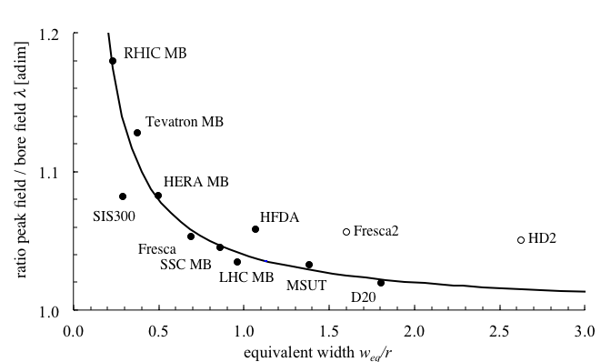
RATIO PEAK FIELD BORE FIELD
We verify the fit derived from sector coils on real magnets
    Agreement with the hyperbolic fit is very good
    Block design (Fresca2, HD2) have higher ratio
    Very good optimization of SIS300

Slide 27
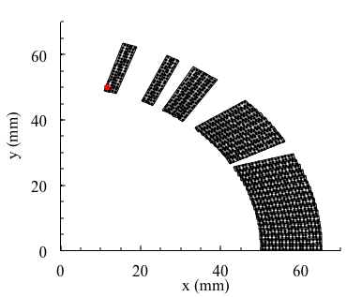
RATIO PEAK FIELD BORE FIELD
The case of SIS300 dipole (M. Sorbi, G. Volpini, P. Fabbricatore, S. Farinon, et al, many papers on IEEE TAS vol 18 and 19 (2008, 2009)
  Very small ratio between equivalent coil width (14 mm, one layer of the LHC dipole cable) and aperture (50 mm radius)
    Wedges at large amplitude reduce the peak field – last two blocks have only to cables each
SIS300 main dipole – location of the peak field

Slide 28
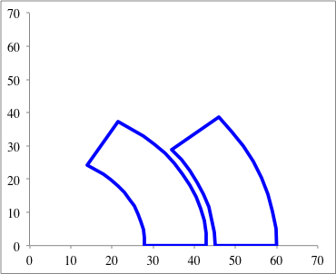
SHORT SAMPLE FIELD IN Nb-Ti DIPOLES
Finally, to have a more precise approximation, we use the equivalent coil width, defined in Unit 3
  So for instance in the LHC dipole instead of w=15.4*2=31 mm we use 28 mm, that accounts for wedges
A/4

Slide 29
SHORT SAMPLE FIELD IN NB-Ti DIPOLES
Final equation for short sample field in a sector coil dipole
  Superconductor parameters s, b
  Cable parameters κ
  Aperture radius r and coil width w_{eq}
  a=0.04 γ_{c}=6.6×10⁻⁴ [Tmm/A]
  for Nb-Ti s~550 [A/(T mm²)] and b~10 T at 4.2 K or 13 T at 1.9 K
  for Nb₃Sn high current density of HL-LHC s~400 [A/(T mm²)] and b~18.1 T at 4.2 K or 19.7 T at 1.9 K
Having these equations we can implement in a worksheet and make a parametric analysis – the iron is still missing, coming in next Unit

Slide 30
CONTENTS
Recall on filling ratio and linear approximation for critical surface
Short sample field in dipoles
Sensitivity analysis

Slide 31
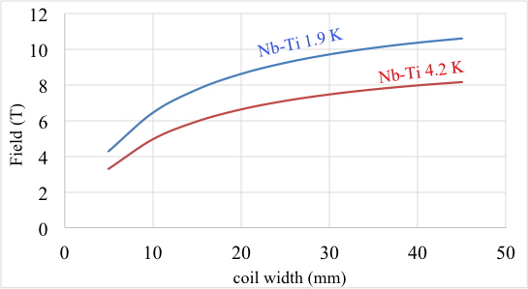
SENSITIVITY TO PARAMETERS
Short sample field for a 50 mm aperture, filling factor of 0.3
  Tends asymptotically to b, as b w/(1+w), for w→∞
  Beyond 30 mm (the LHC choice) very little gain
  30% gain from 4.2 K to 1.9 K
LHC dipole

Slide 32
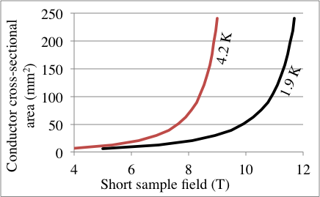
SENSITIVITY TO PARAMETERS
Note that conductor quantity is more than linear in the coil width
  Here you see the plot of the quantity of conductor versus field – dramatic increase for the last teslas (50 mm aperture, 0.3 filling)
  That’s why LHC dipoles have a coil width of 30 mm
LHC dipole

Slide 33
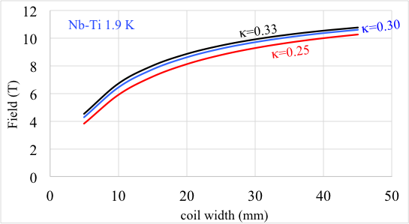
SENSITIVITY TO PARAMETERS
Dependence on the filling factor (case 50 mm aperture)
  Not a huge gain, but from increasing the fraction of superconductor from ¼ to 1/3, one gains 1 T

Slide 34
SENSITIVITY TO PARAMETERS
The parametric analysis can be done also analytically
  The relevant quantity to distinguish large from small coil regime is the factor X – an adimensional quantity >>1 for large coils
  Using X, we can write
  The factor X depends on the coil, on the conductor and on the slope of the critical surface

Slide 35
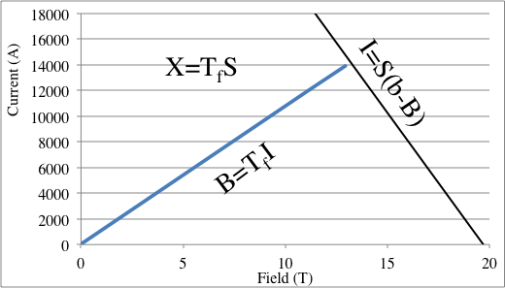
SENSITIVITY TO PARAMETERS
The factor X of a magnet has a simple interpretation
  If we go in the plot I versus B it is simply the transfer function
  T_{f} (T/A) times the slope S of the critical surface (A/T)

Slide 36
SENSITIVITY TO PARAMETERS
The factor X of a magnet depends on the coil lay out and on the superconductor properties
Example: Tevatron main dipole
  (A. Tollestrup, et many al, 80’s)
  w_{eq}= 14 mm
  X=6.6×10⁻⁴×0.23×550×14= 1.2

Slide 37
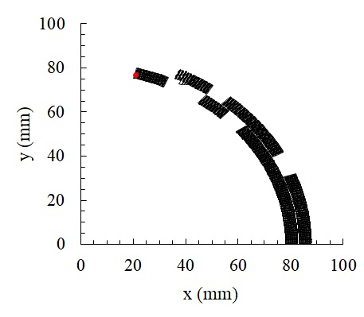
SENSITIVITY TO PARAMETERS
The factor X of a magnet depends on the coil lay out and on the superconductor properties
Example: MCBXF corrector dipole
  (F. Toral, J. C. Perez, P. Fessia, J. Garcia,
  et al. papers in IEEE TAS 2015-2020)
  w_{eq}= 8.8 mm
  X=6.6×10⁻⁴×0.23×550×8.8= 0.74

Slide 38
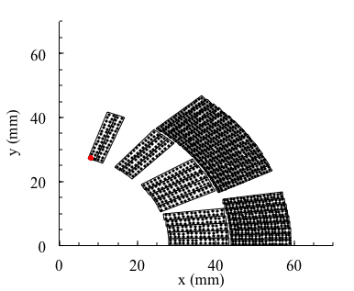
SENSITIVITY TO PARAMETERS
The factor X of a magnet depends on the coil lay out and on the superconductor properties
Example: LHC main dipole
  (development in the 90’s, papers in
  IEEE TAS by R. Perin, L. Rossi,
  D. Perini, S. Russenschuck et many al)
  w_{eq}= 27 mm
  X=6.61×10⁻⁴×0.29×550×27= 2.24

Slide 39
SENSITIVITY TO PARAMETERS
The equation allows to derive analytically the sensitivity to parameters
  We first consider sensitivity to the parameters that are in X
  The effect of a X relative increase on short sample field is weighted by 1/(1+λX)

Slide 40
SENSITIVITY TO PARAMETERS
The equation allows to derive analytically the sensitivity to parameters
  Example: if we increase the coil width by 10%
  For a magnet as the LHC dipole, having X=2.2, you do not gain 10% in short sample field but about 3.1%
  For a smaller coil magnet as Tevatron dipole, having X=1.2, you do not gain 10% in short sample field but about 4.5%
  For an even smaller coil magnet as MCBXF dipole, having X=0.7, you do not gain 10% in short sample field but about 5.8%
Increasing the coil width or improving the filling factor is more effective for small coils

Slide 41
SENSITIVITY TO PARAMETERS
The equation allows to derive analytically the sensitivity to parameters
  Same effect if we increase the filling ratio by 10%, either with less Cu or thinner insulation
  For a magnet as the LHC dipole, having X=2.2, you do not gain 10% in short sample field but about 3.1%
  For a smaller coil magnet as Tevatron dipole, having X=1.2, you do not gain 10% in short sample field but about 4.5%
  For an even smaller coil magnet as MCBXF dipole, having X=0.7, you do not gain 10% in short sample field but about 5.8%

Slide 42
SENSITIVITY TO PARAMETERS
The equation allows to derive analytically the sensitivity to parameters
  We now consider sensitivity to λ (ratio peak field bore field)
  The effect of a decrease of the ratio bore field / central field is weighted by X/(1+λX); minus sign since lower lambda increases short sample

Slide 43
SENSITIVITY TO PARAMETERS
The equation allows to derive analytically the sensitivity to parameters
  What happens if we reduce the peak to bore field from 1.05 to 1.02 ?
  For a magnet as the LHC dipole, having X=2.2, you do not gain 3% in short sample field but about 2.1%
  For a smaller coil magnet as Tevatron dipole, having X=1.2, you do not gain 3% in short sample field but about 1.6%
  For an even smaller coil magnet as MCBXF dipole, having X=0.7, you do not gain 3% in short sample field but about 1.2%
Improving the ratio peak to bore field is more effective for large coils

Slide 44
SUMMARY
We wrote equations for computing the short sample field or gradient
  This gives the dependence on the aperture, coil thickness, filling ration, material
  For a linear approximation of the critical surface
  Where the factor X is an adimensional parameter, the slope of the transfer function times the slope of the critical surface
  This equation shows that the last teslas toward b are extremely expensive
  That’s why Nb-Ti has b=13 T, but practically one makes B_{ss}=10 T (as in the LHC, full exploiting the Nb-Ti at 1.9 K

Slide 45
SUMMARY
We wrote equations for computing the short sample field or gradient
  The factor X gives the sensitivity of short sample field to parameters (filling ratio, copper content, critical current, coil width,
  One can define two regimes: small coil with X≈1 (RHIC, Tevatron dipoles) and large coils with X≈2 to 10 (LHC dipole to FrescaII “the monster”)

Slide 46
SUMMARY
We wrote equations for computing the short sample field or gradient
  For quadrupoles, it is not possible to reach a gradient corresponding to b/r
  For very large coils the ratio peak field/(gradient×aperture radius) becomes larger and larger, making the magnet less effective
  So it does not make sense to go for extremely large quadrupoles
Coming soon (Unit 9)
  Can we make better ?
  What about iron ?

Slide 47
REFERENCES
Field quality constraints
  M. N. Wilson, Ch. 1
  P. Schmuser, Ch. 4
  A. Asner, Ch. 9
  Classes given by A. Devred at USPAS
Electromagnetic design
  S. Caspi, P. Ferracin, “Limits of Nb3Sn accelerator magnets“, Particle Accelerator Conference (2005) 107-11.
  L. Rossi, E. Todesco, “Electromagnetic design of superconducting quadrupoles”, Phys. Rev. ST Accel. Beams 9 (2006) 102401.
  Classes given by R. Gupta at USPAS 2006, Unit 3,4,5,6
  S. Russenschuck, “Field computation for accelerator magnets”, J. Wiley & Sons (2010).
  The sensitivity analysis (X Factor) is unpublished

Slide 48
ACKNOWLEDGEMENTS
    B. Auchmann, L. Bottura, A. Den Ouden, A. Devred, P. Fabbricatore, P. Ferracin, V. Kashikin, S. Izquierdo Bermudez, A. McInturff, T. Nakamoto,, S. Russenschuck, M. Sorbi, T. Taylor, F. Toral, S. Zlobin, for kindly providing magnet designs … and perhaps others I forgot
    L. Rossi for asking me to get involved in magnet design at the end of the LHC production

Slide 49
APPENDIX
A better fit for Nb3Sn
Equations for quadrupoles

Slide 50
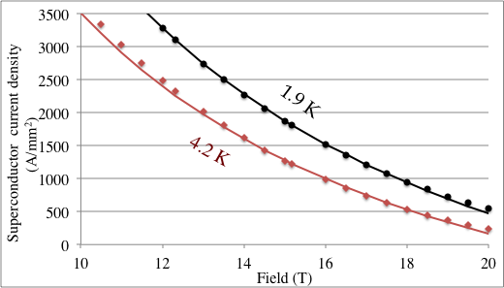
A BETTER APPROXIMATION FOR Nb3Sn
In the sensitivity analysis, we did not show a global plot for Nb₃Sn of short sample field versus coil width
  To do this you need a better fit - an hyperbolic fit is a very good approximation, and can be treated analytically
  For HL LHC RRP, s=3750 A/mm² and b=22.5 T at 1.9 K
  s=3200 A/mm² and b=21 T at 4.2 K

Slide 51
A BETTER APPROXIMATION FOR Nb3Sn
Using this fit one can derive the short sample field for a Nb₃Sn magnet over a large range
    The critical surface is not linear, but it can be solved with a similar approach
    And using the factor X
    The saturation for large widths is slower (due to the shape of the surface), but still exists for large coils

Slide 52
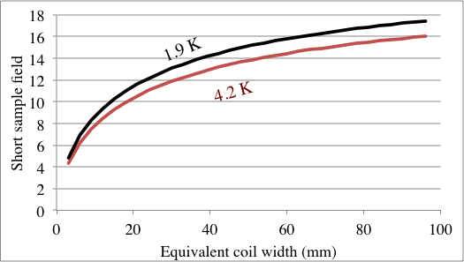
A BETTER APPROXIMATION FOR Nb3Sn
Case of Nb₃Sn – 50% more than Nb-Ti
  Gain of about 1.5 T going from 4.2 K to 1.9 K
  Saturation starts later than in Nb-Ti
  Note that values for short sample are a first order estimate, since iron contribution is excluded (next Unit)
FrescaII
11 T
D20, HD2

Slide 53
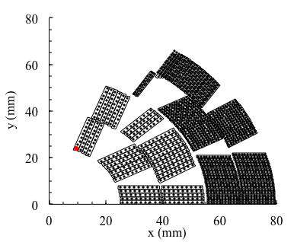
SENSITIVITY TO PARAMETERS
The factor X of a magnet depends on the coil lay out and on the superconductor properties
Example: D20 dipole
  (development in the 90’s, papers in
  IEEE TAS by S. Caspi, Dall’Orco et al)
  w_{eq}= 45 mm
  Filling factor 0.35/0.48
  X=6.61×10⁻⁴×0.41×400×45= 4.9

Slide 54
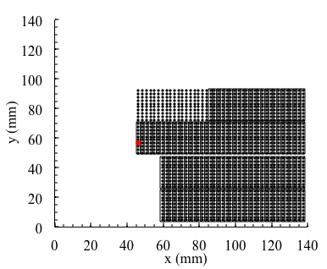
SENSITIVITY TO PARAMETERS
The factor X of a magnet depends on the coil lay out and on the superconductor properties
Example: Fresca2 dipole
  (development in the 10’s, papers in
  IEEE TAS by G. de Rijk, A. Milanese,
  P. Ferracin, J. C. Perez, et al)
  w_{eq}= 80 mm
  Filling factor 0.33
  X=6.61×10⁻⁴×0.33×400×80= 7.0

Slide 55
APPENDIX
A better approximation for Nb₃Sn
Quadrupoles: short sample gradient versus material and lay-out

Slide 56
QUADRUPOLE SHORT SAMPLE GRADIENT
The same approach can be used for a quadrupole
  The loadline is given by
  With γ_{c}=0.63 using practical units
  The peak field is given by
  Where the factor λ has to be found
  With a linear surface one has

Slide 57
QUADRUPOLE SHORT SAMPLE GRADIENT
The ratio λ is defined as ratio between peak field and gradient times aperture (central field is zero …)
  Numerically, one finds that for large coils λ→∞
  Peak field is “going outside” for large widths
RHIC main quadrupole
LHC main quadrupole

Slide 58
QUADRUPOLE SHORT SAMPLE GRADIENT
The ratio λ is defined as ratio between peak field and gradient times aperture (central field is zero …)
  The ratio depends on w/r
  A good fit is
  a₋₁~0.04 and a₁~0.11 for the [0°-24°,30°-36°] coil
  A reasonable approximation is λ~λ₀=1.15 for ¼<w/r<1

Slide 59
QUADRUPOLE SHORT SAMPLE GRADIENT
  Comparison for the ratio λ between the fit for the [0°-24°,30°-36°] coil and actual values
  One can do a bit better than 1.15, and reach 1.10
  λ=1.10 means that peak field in the coil is 10% larger than gradient times aperture radius

Slide 60
QUADRUPOLE SHORT SAMPLE GRADIENT
We now can write the short sample gradient for a sector coil as a function of
  Material parameters s, b (linear case, see slides)
  Cable parameters κ
  Aperture r and coil width w
  Constants: γ_{c} = 0.63 (T/m)/(A/mm²) a₋₁=0.04 a₁=0.11
  Relevant feature: for very large coil widths w→∞ the short sample gradient tends to zero !

Slide 61
QUADRUPOLE SHORT SAMPLE GRADIENT
Evaluation of short sample gradient in several sector lay-outs for a given aperture (r=30 mm)
  No point in making coils larger than 30 mm !
  Max gradient is 300 T/m and not 13/0.03=433 T/m !! We lose 30% !!
-30%

Slide 62
QUADRUPOLE SHORT SAMPLE GRADIENT
Dependence of of short sample gradient on the aperture
  Large aperture quadrupoles go closer to G*=b/r
  Very small aperture quadrupoles do not exploit the sc !!
  Large aperture need smaller ratio w/r
    For r=30-100 mm, no need of having w>r

Slide 63
QUADRUPOLE SHORT SAMPLE GRADIENT
Sensitivity analysis can be done following the case of the dipole
Case of Nb₃Sn, hyperbolic fit
  Using the factor X

