Slide 1

Unit 16 – Magnetic design III
Iron effect, grading and coil ends
Ezio Todesco
European Organization for Nuclear Research (CERN)
Technology Department
Magnet Superconductors and Cryostat Group
All the units will use International System (meter, kilo, second, ampere) unless specified

Slide 2
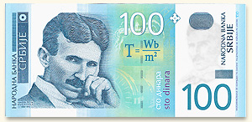
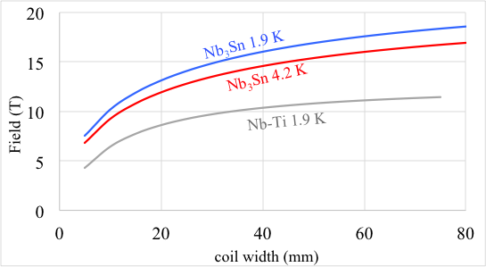
QUESTIONS
Efficiency: the last Teslas are expensive … are there techniques to save conductor ?
What is the effect of iron ? Does it help in having higher short sample fields ?
What happens in coil heads ?

Slide 3
CONTENTS
The role of iron
Grading techniques
A few words on coil ends

Slide 4
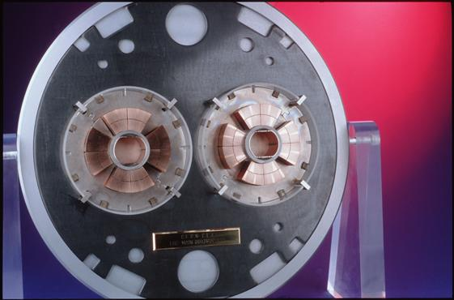
IRON YOKE - GENERICS
An iron yoke usually surrounds the collared coil – it has several functions
  Keeps the return magnetic flux
  avoiding fringe fields
  The iron can contributing (Unit 11)
  to the mechanical structure
    RHIC magnets: no collars, iron holds the Lorentz forces
    LHC dipole: very thick collars, iron gives small contribution
  Considerably enhance the field for a given current density
    The increase is relevant (10-30%), getting higher for thin coils
    This allows using lower current density, reducing stress and easing protection
  Increase the short sample field
    The increase is small (a few percent) for “large” coils, but can be considerable for small widths
    This action is effective when we are far from reaching the asymptotic limit of b (thin coils)

Slide 5
IRON YOKE – WHAT THICKNESS
A rough estimate of the iron thickness necessary to avoid fields outside the magnet
  The iron cannot withstand more than 2 T
  Shielding condition for dipoles:
    i.e., the iron thickness times 2 T is equal to the central field times the magnet aperture – One assumes that all the field lines in the aperture go through the iron (and not for instance through the collars)
    Example: in the LHC main dipole the iron thickness is 150 mm
  Shielding condition for quadrupoles:
r
t_{iron}

Slide 6
IRON YOKE – IMAGE METHOD
The iron yoke contribution can be estimated analytically for simple geometries
  Circular, non-saturated iron: image currents method
  Iron effect is equivalent to add to each current line a second one
    at a distance
    with current
  Limit of the approximation: iron
  is not saturated (less than 2 T)
Iron
Coil
Coil

Slide 7
IRON YOKE – IMAGE METHOD
Remarks on the equations
  When iron is not saturated, one has μ>>1 and then
  Since the image is far from the aperture,
  its impact on high order multipoles is small
  The impact of the iron is negligible for
    Large coil widths
    Large collar widths
    High order multipoles
  The iron can be relevant for
    Small coil widths, small collar widths, low order multipoles, main component
  At most, iron can double the main component for a given current density (i.e. can give a Δγ_{c}=100%)
    This happens for infinitesimally small coil and collar widths

Slide 8
IRON YOKE – IMAGE METHOD
Estimate of the gain in main field Δγ_{c} for a sector coil
  the current density has to satisfy the integral condition
  and one obtains after some algebra
For higher order multipoles
  The relative contribution becomes very small

Slide 9
IRON YOKE – IMAGE METHOD
Estimate of the gain in main field for fixed current in a sector coil
  Estimate of several built dipoles
  Smallest: LHC ∼ 16% (18% actual value with ROXIE)
  Largest: RHIC ∼ 55% (56% actual value with ROXIE)

Slide 10
IRON YOKE - DIPOLES
Impact of the iron yoke on dipole short sample field, Nb-Ti
The change of γ_{c} is the change of B for a fixed current, previously computed
  Two regimes:
    for X<<1 the increase in γ corresponds to the same increase in the short sample field (“thin coils”)
    for X>>1 no increase in the short sample field (“thick coils”)
    Please note that the “thin” and “thick” regimes depend on filling ratio κ and on the slope s of the critical surface
  For the Nb₃Sn one has to use the corresponding equations

Slide 11
IRON YOKE - DIPOLES
Impact of the iron yoke on short sample field
  Large effect (25%) on RHIC dipoles (thin coil and collars)
  Between 4% and 10% for most of the others
  (both Nb-Ti and Nb₃Sn)
D20 and yoke
RHIC main dipole and yoke

Slide 12
IRON YOKE - QUADRUPOLES
Similar approach can be used in quadrupoles
  Large effect on RHIC quadrupoles (thin coil and collars)
  Between 2% and 5% for most of the others
  The effect is smaller than in dipoles since the
  contribution to B₂ is smaller than to B₁
RHIC MQ and yoke
LHC MQXA and yoke

Slide 13
IRON YOKE - SATURATION
Iron saturation: B-H curve
    for B<2 T, one has μ>>1 (μ∼10³-10⁴), and the iron can give a relevant contribution to the field according to what discussed before
    for B>2 T, μ→1, and the iron becomes “transparent” (no effect on field)

Slide 14
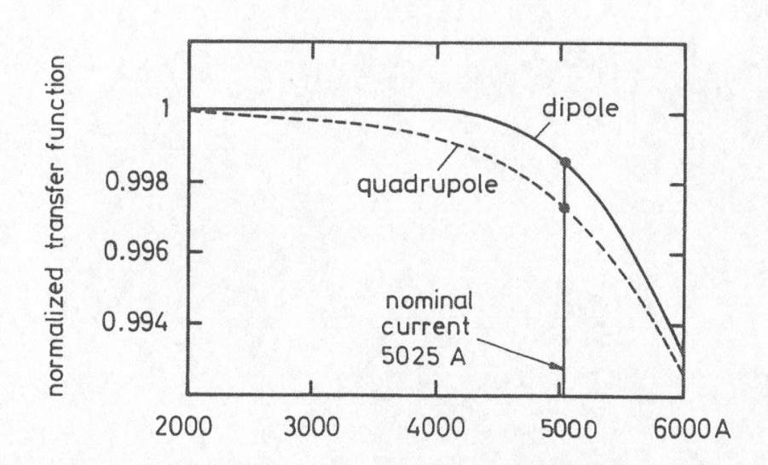
IRON YOKE - SATURATION
Impact on calculation
    When iron saturates → image current method cannot be applied, finite element method is needed (Poisson, Opera, Ansys, ROXIE, …)
    Accuracy of model is good (error less than 10% if B-H well known)
Impact on main component and multipoles
    The main field is not ∝ current → transfer function B/i drops of several
    (tens) of units – in worse cases 1-10%
    Since the field in the iron has an
    azimuthal dependence, some parts
    of the iron can be saturated and
    others not → variation of b₃
  It was considered critical
    Led to warm iron design in Tevatron
    Today, even few % of saturation
    are manageable in operation
    (saturation is compensated via current fine tuning)
40 units
Impact of yoke saturation in HERA dipole and quadrupoles,
From Schmuser, pg 58, fig. 4.12

Slide 15
IRON YOKE - OPTIMIZATION
Corrective actions: shaping the iron
  In a dipole, the field is larger at the pole – over there, iron will saturate
    The dependence on the azimuth of the field in the coil provokes different saturations, and a strong impact on multipole
  One can optimize the shape of the iron to reduce these effects
    Optimization of the position of holes (holes anyway needed for cryogenics) to minimize multipole change
    RHIC is the most challenging case, since the iron gives a large contribution (50% to γ, i.e. to central field for a given current)

Slide 16
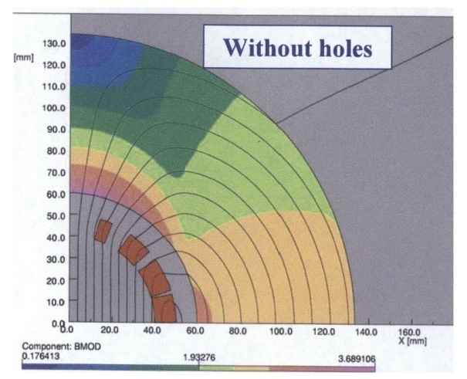
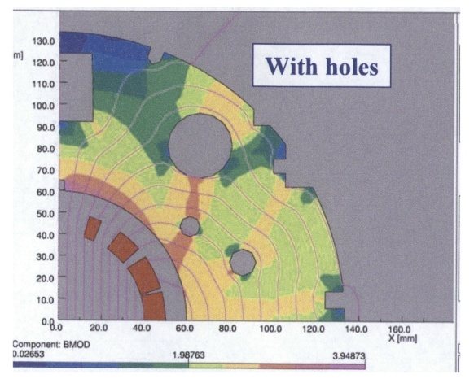
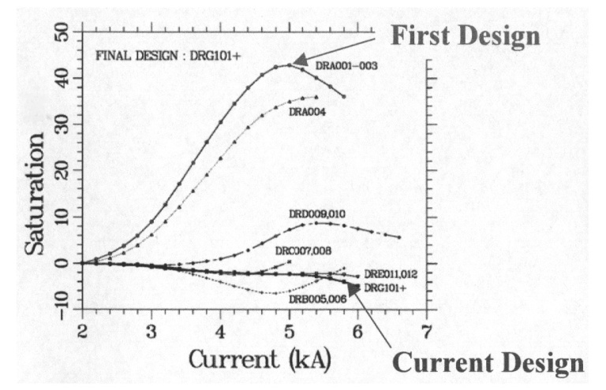
IRON YOKE - OPTIMAZATION
Corrective actions: shaping the iron – the RHIC dipole
    The field in the yoke is larger on the pole
    Drilling holes in the right places, one can reduce saturation of b₃ from 40 units to less than 5 units (one order of magnitude), and to correct also b₅
  A similar approach has been used for the LHC dipole
    Less contribution from the iron (20% only), but left-right asymmetries due to two-in-one design [S. Russenschuck, C. Vollinger, works in IEEE TAS in 2000-2005)
  Another possibility is to shape the contour of the iron (elliptical and not circular)
Field map in the iron for the RHIC dipole, with and without holes
From R. Gupta, USPAS Houston 2006, Lecture V, slide 12
Correction of b3 variation due to saturation
for the RHIC dipoles, R. Gupta, ibidem

Slide 17
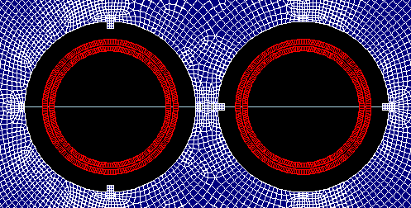
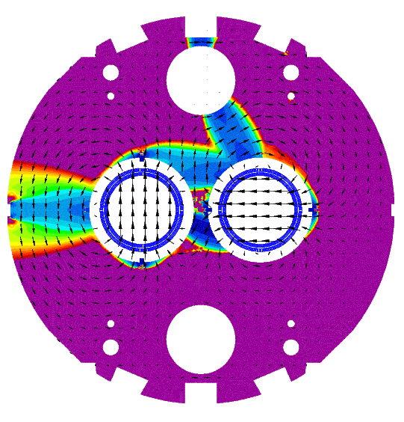
IRON YOKE EFFECT
The estimate of the impact of iron saturation, coupled with iron shape and coil design is totally non trivial, even for low fields
  Ideal tool is ROXIE, using a coupled method to solve the equations
  Example: the impact of magnetic/non magnetic keys in a low field magnet (D2 correctors in HL LHC, a CCT based design with 2.6 T field): 10 units of b₃ !
The iron keys, of place in the wrong place, can give 10 units of b3
D2 corrector magnet (A. Musso, G. Kirby)
Iron saturation in D2 corrector magnet
(P. Hagen, A. Musso, G. Kirby)

Slide 18
CONTENTS
The role of iron
Grading techniques
A few words on coil ends

Slide 19
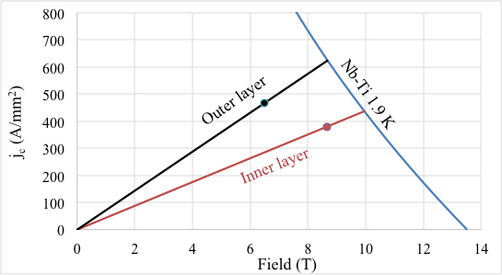
GRADING TECHNIQUES
The map of the field inside a coil is strongly non-uniform
  Two grading possibilities: first one
    In the outer layer the peak field can be lower than in the inner layer, therefore larger current density can be used, and thinner coil
    Example: in the LHC main dipole, 23% larger current density
    Usually larger loadline margin is used for the outer layer
LHC dipole loadlines for peak field in inner and outer layer

Slide 20
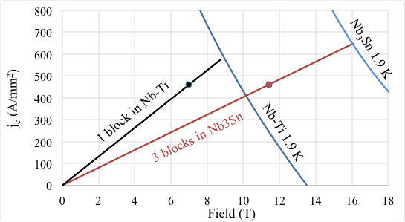
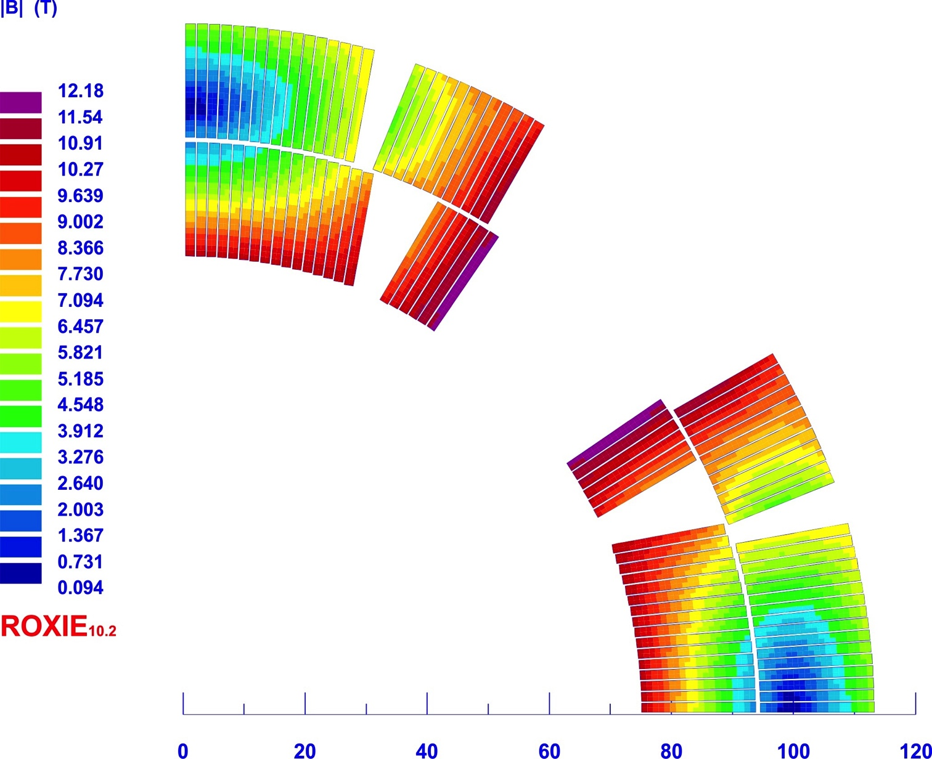
GRADING TECHNIQUES
The map of the field inside a coil is strongly non-uniform
  Two grading possibilities: second one
    The same current density is kept, but lower performance material is used for the lower field blocks, saving money
    For instance, in this magnet Nb₃Sn with peak field 12 T one block has a peak field of 7 T, where Nb-Ti could be used, with a 30% saving at the price of higher complexity (splice between Nb-Ti and Nb₃Sn)
An hypothetical material grading applied to MQXF magnet

Slide 21
GRADING TECHNIQUES - DIPOLES
Examples of graded coils
  LHC main dipole (~9 T)
    grading of 1.23 (i.e. +23% current density in outer layer)
    3% more in short sample field, 17% save of conductor
  MSUT - Nb₃Sn model of Univ. of Twente (~11 T)
    strong grading 1.65
    5% more in short sample field, 25% save of conductor
LHC main dipole
MSUT dipole

Slide 22
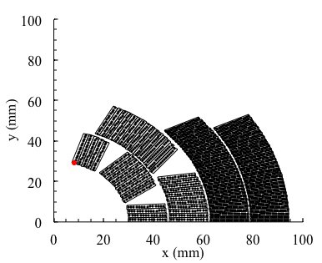
GRADING TECHNIQUES - DIPOLES
Examples of graded coils
  MDPTC1 main dipole (~14 T)
    Grading of 1.34 (i.e. +34% current density in outer layer)
    Coil width: 15 mm for each layer
    Last two layers (30 mm) are equivalent to 30*1.34=40 mm
    Aperture radius is 30 mm
    No grading: coil surface
      2π((30+70)²-30²)/3=19000 mm²
    With grading
      2π((30+60)²-30²)/2=15000 mm²
  Conductor quantity with grading : -20%
MDPTC1 main dipole (A. Zlobin, et al.)

Slide 23
GRADING TECHNIQUES - DIPOLES
Results for a two layer with same width sector case, Nb-Ti
  The gain in short sample field is ~5%
  But given a short sample field, one saves a lot !
    At 8 T one can use 30 mm instead of 40 mm (-25%)
    At 9 T one can use 50 mm instead of 80 mm (-37%)

Slide 24
GRADING TECHNIQUES - QUADRUPOLES
Similar strategy for quadrupoles – gain of 5-10% in G_{ss}
  LHC MQXB – quadrupole for IR regions
    grading of 1.24 (i.e. +24% current density in outer layer)
    6% more in short sample field, 41% save of conductor
  LHC MQY – quadrupole close to IR regions
    Special grading (grading inside outer layer, upper pole with lower density) of 1.43 – this is the most amazingly optimized quadrupole
    9% more in short sample field, could not be reached without grading
LHC MQXB (J. Kerby, et al, IEEE TAS 1995-2000)
LHC MQY (G. Kirby, R. Ostojic, et al IEEE TAS 1999-2005)

Slide 25
CONTENTS
The role of iron
Grading techniques
A few words on coil ends

Slide 26
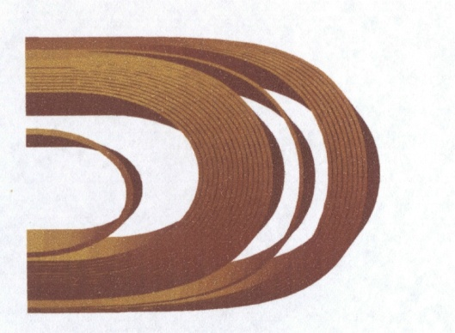
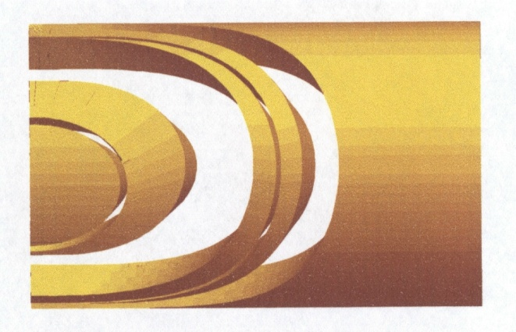
COIL ENDS
Main features of the coil end design
  ++Mechanical: find the shape that minimizes the strain in the cable due to the bending (constant perimeter)
    In a cosθ magnet this strain can be large if the aperture is small
    In a racetrack design the cable is bent in the ‘right’ direction and therefore the strain is much less
    It is important to have codes to design the end spacers that best fit the ends, giving the best mechanical support – iteration with results of production is usually needed
End of a cosθ coil
[S. Russenschuck, World Scientific, Fig. 32.13]
End spacers supporting the ends of a cosθ coil
[S. Russenschuck,World Scientific, Fig. 32.13]

Slide 27
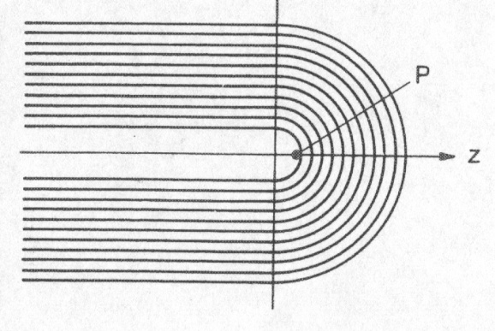
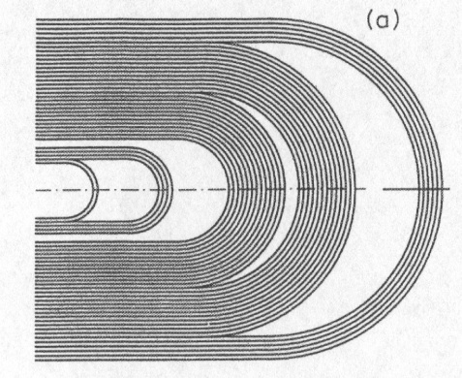
COIL ENDS
Main features of the coil end design
  + Magnetic: find the shape that allows to avoid a higher field in the ends
    Due to the coil return, the main field in the ends is enhanced (typically several %)
    On the other hand, end are the most difficult parts to manufacture → are the most unstable from a mechanical point of view
    It is wise to reduce the main field in the ends by adding spacers - this makes the design a bit more complicated
Simple coil end with increased field in P
[Schmuser,pg. 58]
Coil end with spacers to decrease
the main field in the end
[Schmuser,pg. 58]

Slide 28
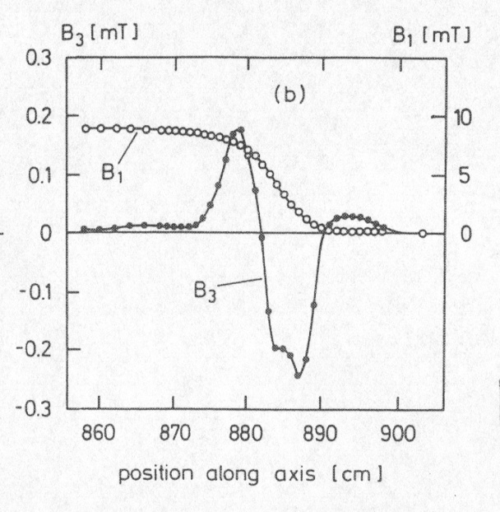
COIL ENDS
Main features of the coil end design
  +/- Magnetic: take care of field quality (especially if magnet is short)
    In general a coil end will give a non-negligible contribution to multipoles
    Two possibilities
      Leave it as it is and compensate the coil end with the straight part so that the multipoles integral over the magnet is optimal (cheap, simple)
      Optimize the end spacer positions to set to zero the integral multipoles in each the head (more elegant, complicated)
    In the plot pseudo-multipoles are shown,
    extracted as Fourier coefficients
      The scaling with the reference radius is not valid
      They are not unique – if you start from
      radial or tangential expression, B_{x} or B_{y} you get
      different things
      They give an idea of the behavior of the field
      harmonics, and way to get a compensation
    The real 3d expansion can be written
    (see A. Jain, USPAS 2006 in Phoenix: “Harmonic description of 2D fields”, slide 4)
Main field and pseudo-multipoles in coil end
optimized to have null integrated b₃
[Schmuser,pg. 58]

Slide 29
CONCLUSIONS
The iron has several impacts
  Useful for shielding, but the main role is to increase field for a given current
  Therefore very beneficial for stresses (Unit 10) and protection (Unit 12)
  Reduction can be considerable for small coil width
  The impact on the performance (short sample) is small but not negligible
  Minor drawbacks: saturation, inducing field harmonics at high field – can be cured by power converter (main component) and by shaping or drilling holes in the right place (multipoles)
  ROXIE is the ideal tool for these computations

Slide 30
CONCLUSIONS
Grading the current density in the layers can give a larger performance for the same amount of conductor
  Two types:
    Higher current density in lower field
    Cheaper material in lower field (material grading)
  3-5% more in dipoles, 5-10% more in quadrupoles
  Non negligible reduction of cost for large factor X (see Unit 8) magnets
Coil ends: to be done with complex codes (ROXIE)
  Nothing much can be said with analytical tools
  The design must aim at reducing the peak field
  The design must aim at good windability

Slide 31
REFERENCES
  Iron
    M. N. Wilson,
    P. Schmuser, Ch. 4
    Classes given by R. Gupta at USPAS 2006, Unit 5
    R. Gupta, Ph. D. Thesis, available on his web site
    C. Vollinger, CERN 99-01 (1999) 93-109
  Grading
    S. Caspi, P. Ferracin, S. Gourlay, “Graded high field Nb3Sn dipole magnets“, 19th Magnet Technology Conference, IEEE Trans. Appl. Supercond., (2006) in press.
    L. Rossi, E. Todesco, Electromagnetic design of superconducting quadrupoles
    Phys. Rev. ST Accel. Beams 9 (2006) 102401.
  Coil ends
    S. Russenschuck, CERN 99-01 (1999) 192-199
    G. Sabbi, CERN 99-01 (1999) 110-120

Slide 32
ACKNOWLEDGEMENTS
    L. Rossi for discussions on magnet design
    F. Borgnolutti
    S. Izquierdo Bermudez
    P. Ferracin, S. Caspi for discussing magnet design and grading
    A. Jain for discussing the validity of field expansion in the ends

