Slide 1
Unit 20
Degradation and training
Chapter I
Paolo Ferracin
Lawrence Berkeley National Laboratory (LBNL)

Slide 2
Outline
Introduction
Quench of a superconductor
Classification of quenches
Conductor limited quenches
  Measurements of critical surfaces
  Short sample current
  Degradation
Energy deposited quenches
  Distributed disturbances
    Minimum quench energy density
  Point disturbances
    Minimum quench energy
    Minimum propagation velocity
Practical example: SSC and HERA wires
Cryogenic stabilization
Practical example: LHC wire
Conclusions

Slide 3
References
[1] A. Devred, “Quench origins”, AIP Conference Proceedings 249, edited by M. Month and M. Dienes, 1992, p. 1309-1372.
[2] M. Wilson, “Superconducting magnets”, Oxford UK: Clarendon Press, 1983.
[3] A. Godeke, “Performance boundaries in Nb₃Sn superconductors”, PhD thesis, 2005.
[4] A. Devred, “Practical low-temperature superconductors for electromagnets”, CERN-2004-006, 2006.
[5] Y. Iwasa, “Mechanical disturbances in superconducting magnets – A review”, IEEE Trans. Magn., Vol. 28, No. 1, January 1992, p. 113-120.
[6] L. Rossi, “Superconducting Magnets”, CERN Academic Training, 15-18 May 2000.
[7] K.-H. Mess, P. Schmuser, S. Wolff, “Superconducting accelerator magnets”, Singapore: World Scientific, 1996.
[8] D. Leroy, “Review of the R&D and supply of the LHC superconducting cables”, IEEE Trans. Appl. Supercond. , Vol. 16, No. 2, June 2006, p. 1152- 1159.
[9] A.K. Ghosh, et al., “Minimum quench energies of rutherford cables and single wires”, IEEE Trans. Appl. Supercond. , Vol. 7, No. 2, June 1997, p. 954- 957.
[10] B.J. Maddok, et al., “Superconductive composites: heat transfer and steady state stabilization”, Cryogenics 9, 1969, p. 261-273.

Slide 4
1. Introduction
In this unit we will address the following questions
  What is a quench?
  How can we classify a quench according to the different causes?
  What is the maximum current that a wire can carry and how can we measure it?
  Which are the volumes and the energies involved in the quench phenomenon?
  What is the role of the stabilizer and of the liquid helium?

Slide 5

“Quench”

Slide 6
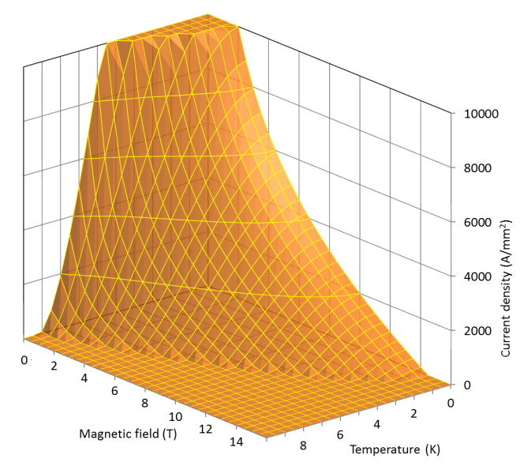
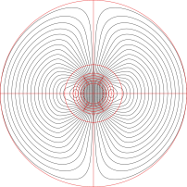
2. Quench of a superconductor
The superconducting state is defined by the critical surface
  B (T), J (A/mm²), T (K)
A superconducting magnet operates in conditions corresponding to a point located beneath the critical surface, and defined by T=T_{op}, J=J_{op}, and B=B_{op}.
Let’s assume (A. Devred, [1]) that, starting from the operational conditions, we increase the current in the magnet, and, as a result, the magnetic field.
At a certain point, the critical surface is crossed, and a small volume V of superconductor becomes normal.
Therefore, the volume V starts dissipating heat because of Joule effect, and its temperature increases.
J
B

Slide 7
2. Quench of a superconductor
Due to thermal diffusion, also the surrounding volume dV undergoes an increase in temperature.
If the heat dissipated by V is enough, dV reaches the critical temperature, becomes normal conducting, and dissipates heat.
In certain conditions, the normal zone propagates through the coil: this phenomenon is called quench.
Depending on its causes, a quench can be classified and defined in different ways.
J
B

Slide 8
Quench
Heat balance
…If power high enough and cooling low enough….
  In both cases, once the critical surface is passed, the quench phenomenon can be described by heat balance equation
Heat capacity
Heat source
Joule heat
Conduction
cooling
J
generation
Heat transfer
B

Slide 9
Outline
Introduction
Quench of a superconductor
Classification of quenches
Conductor limited quenches
  Measurements of critical surfaces
  Short sample current
  Degradation
Energy deposited quenches
  Distributed disturbances
    Minimum quench energy density
  Point disturbances
    Minimum quench energy
    Mininum propagation velocity
Practical example: SSC and HERA wires
Cryogenic stabilization
Practical example: LHC wire
Conclusions

Slide 10
3. Classification of quenches
A first classification (A. Devred, [1])
  The maximum field seen by the conductor in the coil is usually called peak field (B_{peak}).
  At a given temperature T₀, the maximum current that the conductor can reach will be I_{max}=I_{c} (B_{peak}, T₀), where I_{c} is the critical current at B_{peak} and T₀.
  When the magnet quenches, we can have either I_{quench} = I_{max} or I_{quench} < I_{max} .
  In the first case we have a conductor-limited quench (or exhausted margin quench).
    If the maximum current is consistent with measurements performed on wire short samples, we have a short-sample quench (success!!)
    If the current is lower, we have degradation.
  In the second case, a quench occurs because of a release of energy that increases the temperature of the conductor beyond the critical temperature. These are called energy-deposited quenches or, also, premature quenches.

Slide 11
Quench
Definitions
First scenario
  Critical surfaces is passed by increasing the current
    The superconductor still carries the critical current at T_{cs}
    The rest flows in the stabilizer → power dissipation
  If power high enough and cooling low enough
    Temperature of the superconductor increases → critical current decreases
      More current in the stabilizer, less in the superconductor → more dissipation
    Irreversible transition → quench → propagation
Conductor-limited quench
J
by L. Bottura
B

Slide 12
Quench
Definitions
Other scenario
  Disturbance → release of energy → increase the temperature of the conductor
    The superconductor still carries the critical current at T_{cs}
    The rest flows in the stabilizer → power dissipation
  If power high enough and cooling low enough
    Temperature of the superconductor increases → critical current decreases
      More current in the stabilizer, less in the superconductor → more dissipation
    Irreversible transition → quench → propagation
Energy-deposited or premature quenches
J
B

Slide 13
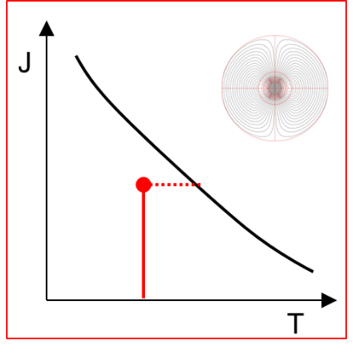

Quench
Definitions
In other words
  Conductor-limited quench
    critical surface is crossed because of an increase of I (and B)
  Energy-deposited or premature quenches
    critical surface is crossed because of an increase of T
J
B

Slide 14
3. Classification of quenches
A second, more detailed classification (M. Wilson, [2])
  We can define a spectrum of disturbances, which classifies the energy disturbances along two dimensions: time and space.
  Continuous disturbances are due to a steady power dissipation in the coil
    Point: ramp splice with high resistance joint
    Distributed: a.c. losses in the conductor, thermal leak of the cryogenic system.
  They are usually well understood disturbances.
 |  | Space
 |  | Point | Distributed
Time | Transient | J | J/m³
 | Continuous | W | W/m³

Slide 15
3. Classification of quenches
  Transient quenches are due to a sudden release of energy, either over a small volume (J) or over a large volume (J/m³)
    Flux jumps: dissipative redistribution of magnetic field within the superconductor. It can be eliminated with small filaments.
    Mechanical disturbances: wire frictional motion, epoxy cracking. They are less predictable and difficult to avoid, since the are related to mechanical design, material properties, fabrication processes, etc.
 |  | Space
 |  | Point | Distributed
Time | Transient | J | J/m³
 | Continuous | W | W/m³

Slide 16
Outline
Introduction
Quench of a superconductor
Classification of quenches
Conductor limited quenches
  Measurements of critical surfaces
  Short sample current
  Degradation
Energy deposited quenches
  Distributed disturbances
    Minimum quench energy density
  Point disturbances
    Minimum quench energy
    Mininum propagation velocity
Practical example: SSH and HERA wires
Cryogenic stabilization
Practical example: LHC wire
Conclusions

Slide 17
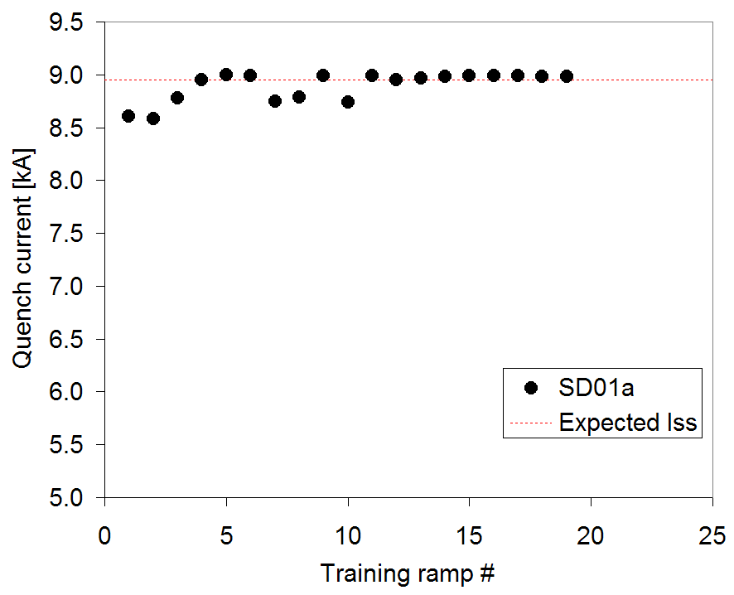
4. Conductor limited quenches
Conductor limited quenches are usually very stable.
A series of conductor limited quench in a “quench current vs. quench number” graph appears as a stable plateau. For these reasons they are also called plateau quenches.
After having reached the maximum current of the magnet, we have to compare it with the critical current measured on a short sample of the conductor.
If the two coincide, we say that the magnet reached short sample current I_{ss}.

Slide 18
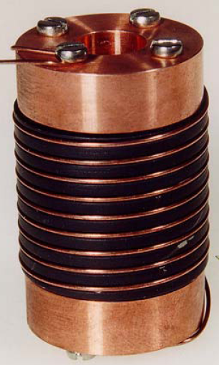
4. Conductor limited quenches
Measurements of the conductor critical current
The critical current of a conductor is measured by winding a sample of the wire around a sample holder.
To avoid premature quenching induced by Lorentz forces during ramping, the wire must be well supported
  Stycast glue may be used to constrain the wire around the holder
In case of Nb₃Sn wires, a sample holder made of titanium is used.
Once the wire is cooled-down and placed in a given magnetic field, the current is increased until the transition occurs.
A. Devred, [4]

Slide 19
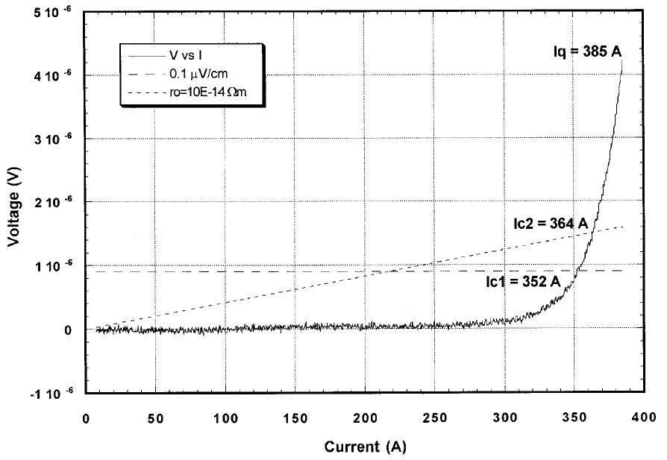
4. Conductor limited quenches
Measurements of the conductor critical current
The transition from superconducting to normal state is observed through an increase of voltage.
The increase is initially slow and reversible. By further increasing the current, the voltage rise becomes more steep, until it takes off and becomes irreversible: we refer in this case to short sample quench current I_{qss}.
In different conditions (wire as a part of a cable in a magnet, in different cooling conditions) the quench may occur at a different current.
A. Devred, [4]

Slide 20
4. Conductor limited quenches
Measurements of the conductor critical current
The conventions to determine the quench current are the following [4].
  Let’s assume that we have a wire of length L and cross-sectional area S.
  Being λ the copper to supercond. or copper to non-copper ratio, we define as apparent resisitivity of the superconductor and apparent electrical field
  where V is the measured voltage across the wire.
  The critical current I_{c} is defined as the current where ρ_{sc} = 10⁻¹⁴ Ωm or E = 0.1 μV/cm.
A. Devred, [4]
“It has been verified, in particular for
accelerator magnets, that the critical currents defined above can be used to make fairly accurate
estimations of the maximum quench current of a superconducting magnet” [4].

Slide 21
4. Conductor limited quenches
Degradation
The critical current is measured in few different conditions of temperature and field. By fitting the data with known parameterizations (see previous unit), the entire critical surface can be reconstructed.
If the magnet reaches the maximum current computed through the intersection of the measured critical surface and the load line, i.e. I_{max} = I_{ss}, one can declare victory (at least from the quench performance point of view).
If the magnet maximum current I_{max} is lower that I_{ss} , the quench performance is expressed in term of fraction of short sample (I_{max}/ I_{ss}).
A conductor-limited quench or a plateau at a level lower than the expected short sample is an indication of conductor degradation

Slide 22
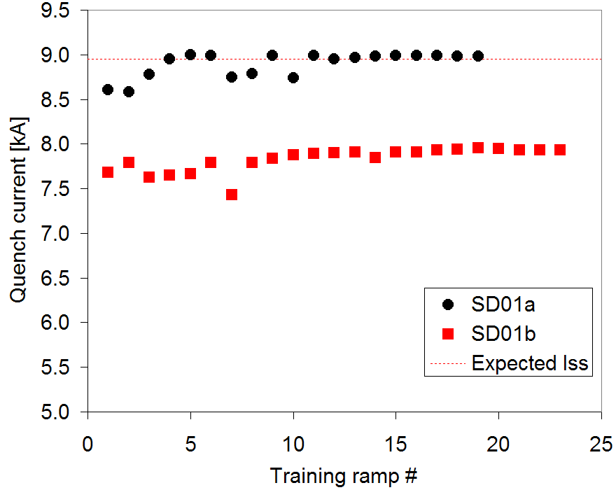
4. Conductor limited quenches
Degradation
Degradation in a superconductor can be due to
  Conductor damage or error in cable manufacturing
  Stress
….but, sometimes, magnet performance can be interpreted as degraded in case of
  Errors in the evaluation of maximum current
    Computation of peak field
    Measurements of temperature
    Difference between coil and witness sample reaction temperature and time.
      During the reaction of Nb₃Sn coils, the temperature in the oven is not uniform.
In general, there is about 5% uncertainty in the short sample current estimate.

Slide 23
Outline
Introduction
Quench of a superconductor
Classification of quenches
Conductor limited quenches
  Measurements of critical surfaces
  Short sample current
  Degradation
Energy deposited quenches
  Distributed disturbances
    Minimum quench energy density
  Point disturbances
    Minimum quench energy
    Mininum propagation velocity
Practical example: SSC and HERA wires
Cryogenic stabilization
Practical example: LHC wire
Conclusions

Slide 24
5. Energy deposited quenches
Distributed disturbances
Let’s consider a distributed disturbance, that is a release of energy uniformly distributed. This situation corresponds to an adiabatic condition.
  The temperature increase is uniform and no heat is conducted along the coil.
In this conditions, the temperature rise depends only on the specific heat Cp (J/kg-K)

Slide 25
5. Energy deposited quenches
Distributed disturbances
In this conditions, the temperature rise depends only on the specific heat Cp (J/kg-K)
Energy at low temperature are small since Cp are about 10⁻³ of the room temperature values
  For copper, Cp from 28e-3 J/kg-K at 1.8 K to 380 J/kg-K at 300 K

Slide 26
5. Energy deposited quenches
Distributed disturbances
Because of the change in Cp with temperature, for the computation of the energy density required to quench a coil, it is convenient to use the volumetric specific enthalpy H (J/m³)
where γ (kg/m³) is the density of the material.
Assuming a volume fraction of 1/3 of superconductor , 1/3 of copper, and 1/3 of epoxy, we can estimate a Nb-Ti and Nb₃Sn coil volumetric specific enthalpy.
Then, it is possible to compute the energy density to quench, but we need the temperature margins.

Slide 27
Temperature margins at 80%of I_{ss}
NbTi
  At 1.8 K
    1.8 K of margin
  At 4.2 K
    1.0 K of margin
Nb₃Sn
  At 1.8 K
    4.2 K of margin
  At 4.2 K
    3.0 K of margin

Slide 28
Temperature and energy margin
At 80% of I_{ss}
  Nb₃Sn has ~5 K of temperature margin at 1.9 K → ~15 mJ/cm³ (strand volume)
    …but impregnated (~adiabatic) coils
  Nb-Ti has ~2 K of temperature margin at 1.9 K → ~3 mJ/cm³ (strand volume)
    …but superfluid LHe surrounding the strands
1.9 K
4.2 K
1.9 K
4.2 K

Slide 29
Outline
Introduction
Quench of a superconductor
Classification of quenches
Conductor limited quenches
  Measurements of critical surfaces
  Short sample current
  Degradation
Energy deposited quenches
  Distributed disturbances
    Minimum quench energy density
  Point disturbances
    Minimum quench energy
    Minimum propagation velocity
Practical example: SSC and HERA wires
Cryogenic stabilization
Practical example: LHC wire
Conclusions

Slide 30
5. Energy deposited quenches
Point disturbances

Slide 31
5. Energy deposited quenches
Point disturbances
Let’s imagine that, in a coil operating in the superconducting state, a certain amount of energy E is released. This energy will bring a volume V of the superconductor to a temperature T ≥ T_{c}.
One can imagine that if E or V are not large enough, the temperature of the superconductor will decrease to below the critical temperature, because of cooling and or thermal conductivity.
If, on the other hand, E or V are large enough, the normal zone will increase and a quench propagate.
We therefore define
  as minimum quench energy MQE, the minimum energy necessary to initiate a quench
  as minimum propagation zone MPZ, the minimum volume of superconductor that must be brought beyond the critical temperature in order to initiate a quench.
The two parameters are connected: MQE is the energy necessary to created MPZ, i.e [5]
where C is the specific heat [J kg⁻³ K⁻¹] and γ is the density [kg m⁻³].

Slide 32
5. Energy deposited quenches
Point disturbances
We start considering a wire made purely of superconductor.
Let’s assume that a certain amount of energy E increased the temperature of the superconductor beyond θ_{c} over a length l. The segment l of superconductor is dissipating power given by J_{c}²ρAl [W].
Part (or all) of the heat is conducted out of the segment because of the thermal gradient, which can be approximated as (θ_{c}-θ_{o})/l. Therefore, being k the conductivity [W m⁻¹ K⁻¹], when the power dissipated equals the power conducted away
which results in
l
L. Rossi, [6]
A
T
θ_{c}
T_{cs}
θ₀
T₀
Conductor length

Slide 33
5. Energy deposited quenches
Point disturbances
The length l defines the MPZ (and MQE).
  A normal zone longer that l will keep growing (quench). A normal zone shorter than l will collapse.
An example [2]
  A typical Nb-Ti 6 T magnet has the following properties
    J_{c} = 2 × 10⁹ A m⁻²
    ρ = 6.5 × 10⁻⁷ Ω m
    k = 0.1 W m⁻¹ K⁻¹
    θ_{c} = 6.5 K
    θ_{o} = 4.2 K
  In this case, l = 0.5 μm and, assuming a 0.3 mm diameter, the required energy to bring to θ_{c} is 10⁻⁹ J.
A wire made purely of superconductor, without any stabilizer (like copper) around, would quench with nJ of energy.
  In order to increase l, since we do not want to reduce J_{c}, we have to increase k/ρ: we need a composite conductor!

Slide 34
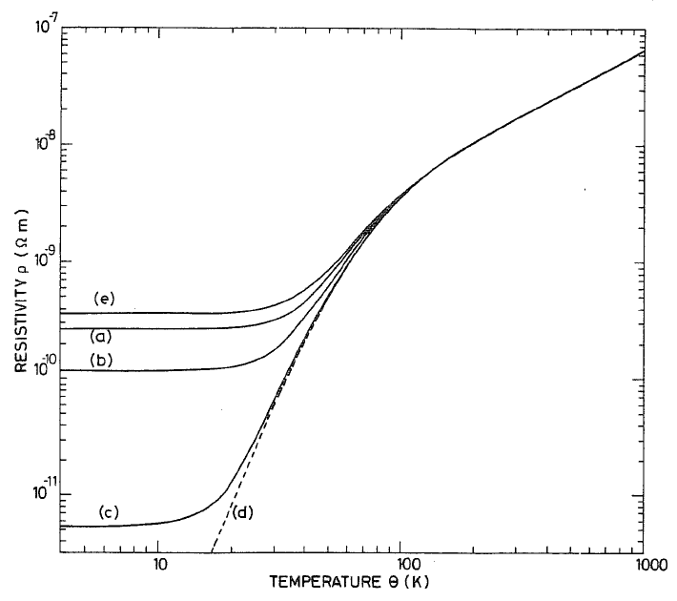
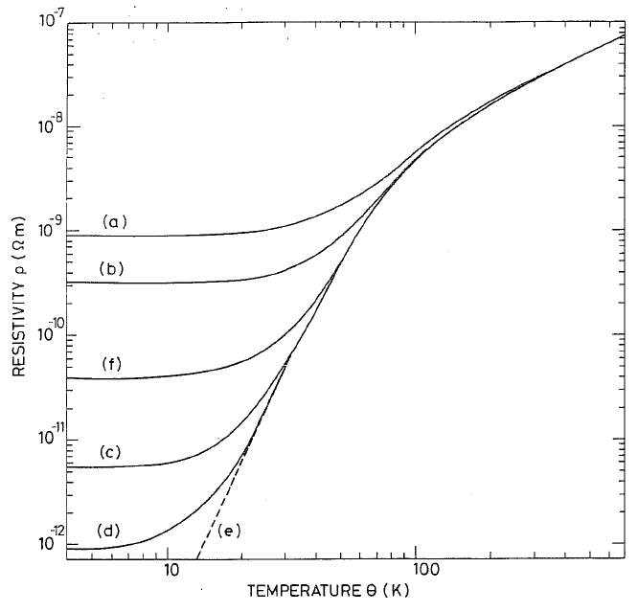
5. Energy deposited quenches
Point disturbances
We now consider the situation where the superconductor is surrounded by material with low resistivity and high conductivity.
Copper can have at 4.2 K
  resistivity ρ = 3 × 10⁻¹⁰ Ω m (instead of 6.5 × 10⁻⁷ Ω m for NbTi)
  k = 350 W m⁻¹ K⁻¹ (instead of 0.1 W m⁻¹ K⁻¹ for NbTi).
We can therefore increase k/ρ by almost a factor 10⁷.
A significant improvement was achieved in the early years of superconducting magnet development after the introduction of composite conductor
  Both for flux jump and stability viewpoint
Copper
Aluminum
M. Wilson, [2]

Slide 35
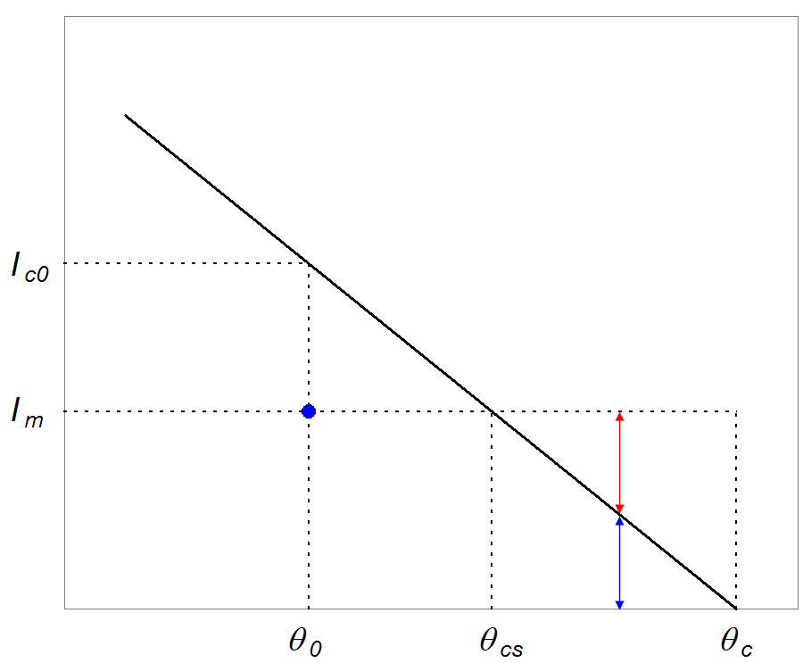
5. Energy deposited quenches
Point disturbances
In a composite superconductor, when a transition from normal to superconducting state occurs, the heat dissipated per unit volume of the entire wire (stabilizer and supercond.) G [W m⁻³], can be subdivided in three parts
  All the current flows in the superconductor
  The current is shared by the superconductor and the stabilizer
  All the current flows in the stabilizer.
by L. Bottura

Slide 36
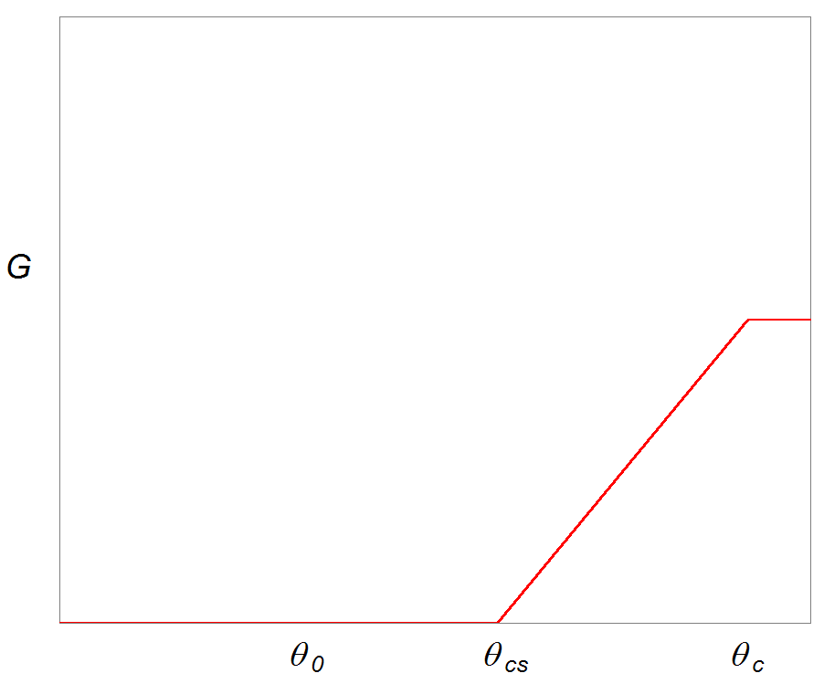
5. Energy deposited quenches
Point disturbances
The heat dissipated per unit volume of the entire wire (stabilizer and supercond.) G [W m⁻³] has a linear increase from θ_{cs} and θ_{c} .

Slide 37
5. Energy deposited quenches
Point disturbances
Once we provided an expression for G(θ), we modify the one-dimensional equation considered for the pure superconductor case, with a three-dimensional equation which includes the transverse conductivity.
Assuming the coil as an isotropic continuum with two-direction conduction, the steady state equation of heat conduction becomes
where
  k_{r} is the conductivity along the wire
  k_{z} is the conductivity transverse to the wire
  λ_{w} is the fraction in volume of the composite conductor (both superconductor and stabilizer) over the coil.

Slide 38
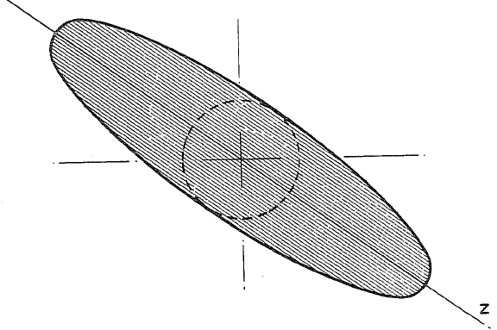
5. Energy deposited quenches
Point disturbances
The solution provides as MPZ an ellipsoid elongated in the z direction (along the cable), with a semi-axis R_{g} in z
and a circular cross-section in the transverse plane with radius r_{g}
The MQE necessary to MPZ is significantly increased, from the nJ level to the 10-100 μJ level.
M. Wilson, [2]

Slide 39
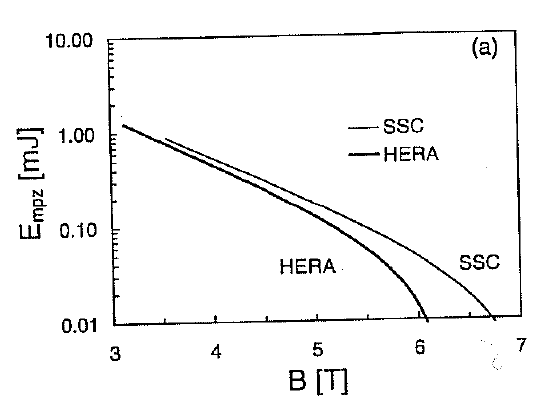
6. Practical example I
SSC and HERA wires [7]
SSC
  The design field (> 6.5 T) is close to the short sample field
  MQE = 10 μJ
  MPZ is less then strand diameter
    “Adiabatic” condition (no heat exchanged with liquid helium) is a good estimate
HERA
  The design field (5 T) is less close to the short sample field
  MQE = 150 μJ
  MPZ is several mm
    Helium cooling will increase the energy threshold.
K.-H. Mess, et al., [7]
K.-H. Mess, et al., [7]

Slide 40
Outline
Introduction
Quench of a superconductor
Classification of quenches
Conductor limited quenches
  Measurements of critical surfaces
  Short sample current
  Degradation
Energy deposited quenches
  Distributed disturbances
    Minimum quench energy density
  Point disturbances
    Minimum quench energy
    Mininum propagation velocity
Practical example: SSC and HERA wires
Cryogenic stabilization
Practical example: LHC wire
Conclusions

Slide 41
7. Cryogenic stabilization

Slide 42
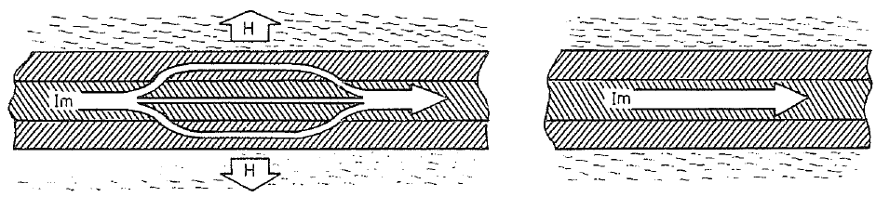
7. Cryogenic stabilization
When a distributed disturbance (large volume) produces a transition in the superconductor in the normal zone, or when the MPZ is significantly larger then the strand diameter, we abandon the adiabatic conditions described in Sec. 5.
In this case, we have to take into account the cryogenic liquid (liquid Helium) in contact with the wire.
M. Wilson, [2]

Slide 43
7. Cryogenic stabilization
The heat generation per unit of cooled area is given by
where we assumed that θ₀ = θ_{cs} (i.e. J_{m}=J_{C}), and A is the cross-sectional area of the conductor and P is the cooled perimeter.
M. Wilson, [2]

Slide 44
7. Cryogenic stabilization
The cooling per unit of cooled area is given by
where h [W m⁻¹ K⁻¹] is the heat transfer coefficient (we assume it constant) and θ₀ the temperature of the bath.
M. Wilson, [2]

Slide 45
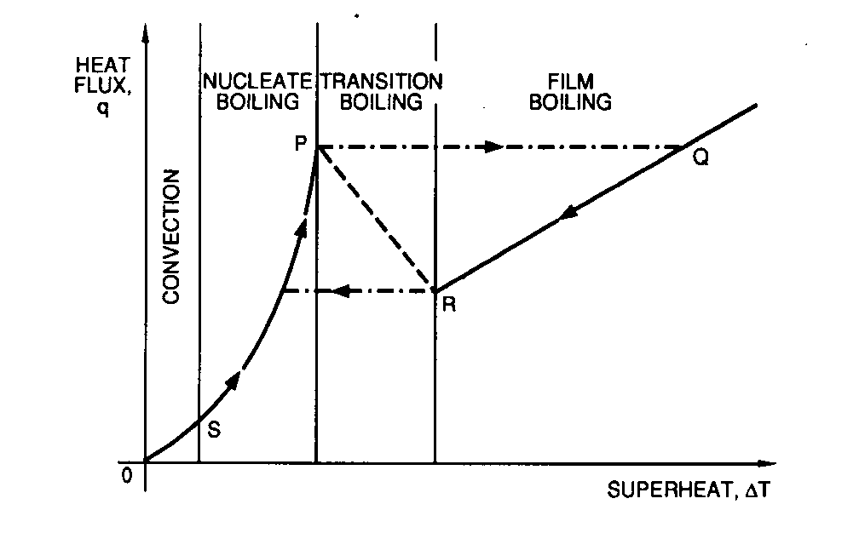
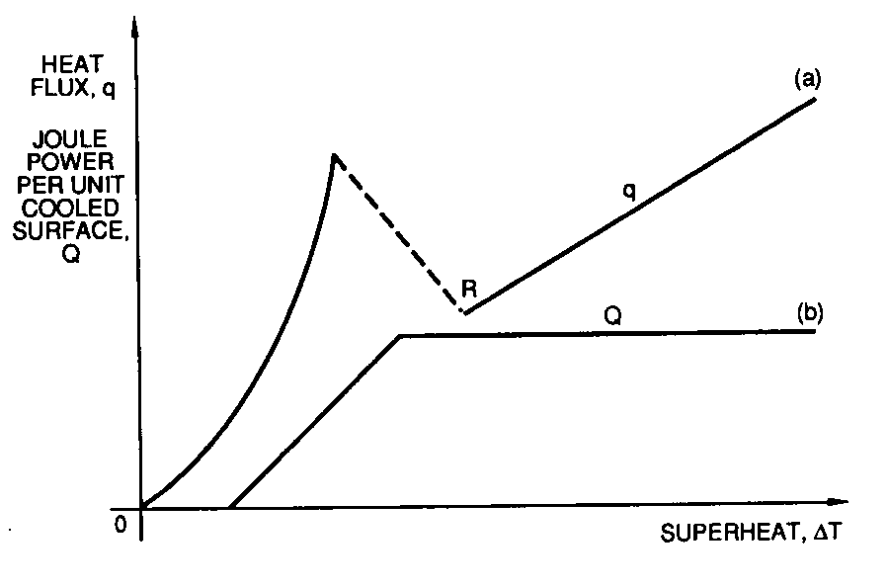
7. Cryogenic stabilization
Stekly criteria
The criterion for cryogenic stability (Stekly and Zar) is therefore
In reality h is characterized by three zones
  Nucleate boiling
  Transition boiling
  Film boiling
In general, we have cryogenic stability when the curve of the dissipated power G(θ) stays below the curve of the power removed by helium.
Stekly criteria require an ohmic heat per unit area of cooled surface < 1.5-2.0 kW/m²
L. Rossi, [6]

Slide 46
7. Cryogenic stabilization
Equal-area theorem (Maddock criteria)
The Stekly criteria neglects heat conduction.
But, if the hot zone has finite dimensions and is surrounded by a cold zone, the heat conduction at the boundaries can improve the stability
  Conductor can be stable also if G >H
Maddock, et al., [10] proposed to equal area theorem
  The surplus of heat generation must be balanced by a surplus of cooling.
Maddock criteria requires an ohmic heat per unit area of cooled surface < 3 kW/m²
M. Wilson, [2]

Slide 47
Outline
Introduction
Quench of a superconductor
Classification of quenches
Conductor limited quenches
  Measurements of critical surfaces
  Short sample current
  Degradation
Energy deposited quenches
  Distributed disturbances
    Minimum quench energy density
  Point disturbances
    Minimum quench energy
    Mininum propagation velocity
Practical example: SSC and HERA wires
Cryogenic stabilization
Practical example: LHC wire
Conclusions

Slide 48
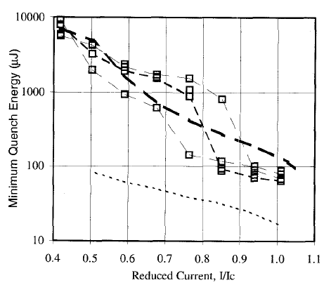
8. Practical example II
LHC wire [8]
Wire
  Measurements showed that the most important parameter is the amount of helium in contact with the strand.
  The MQE at 0.8 I_{c} is
    10 μJ in adiabatic conditions
    1000 μJ in open bath
Cable
  A “kink“ is observed
    Zone where the strands behave collectively
    Zone where the strands behave individually
  Above the kink
    MQE is around 100 μJ
  Below the kink
    MQE is > 1000 μJ
A.K. Ghosh, et al., [9]

Slide 49
Outline
Introduction
Quench of a superconductor
Classification of quenches
Conductor limited quenches
  Measurements of critical surfaces
  Short sample current
  Degradation
Energy deposited quenches
  Distributed disturbances
    Minimum quench energy density
  Point disturbances
    Minimum quench energy
    Mininum propagation velocity
Practical example: SSC and HERA wires
Cryogenic stabilization
Practical example: LHC wire
Conclusions

Slide 50
9. Conclusions
We defined and classified quenches in superconducting magnets
  Conductor limited quenches
  Energy deposited quenches
We introduced the concept of MPV and MQE
  Depending on the assumptions, the energy required to quench a magnet is
    10⁻⁹ J in the case of a “pure superconductor”
    10-100 μJ in the case of a composite wire
    More than 1000 μJ in open bath
In the case of distributed disturbance, the minimum quench energy density can be of about 10³ J m⁻³ (Nb-Ti magnets).
Considering the effect of liquid He, a conductor can be stable up to an ohmic heat per unit area of cooled surface of about 3 kW/m².

Slide 51
Appendix I

Slide 52
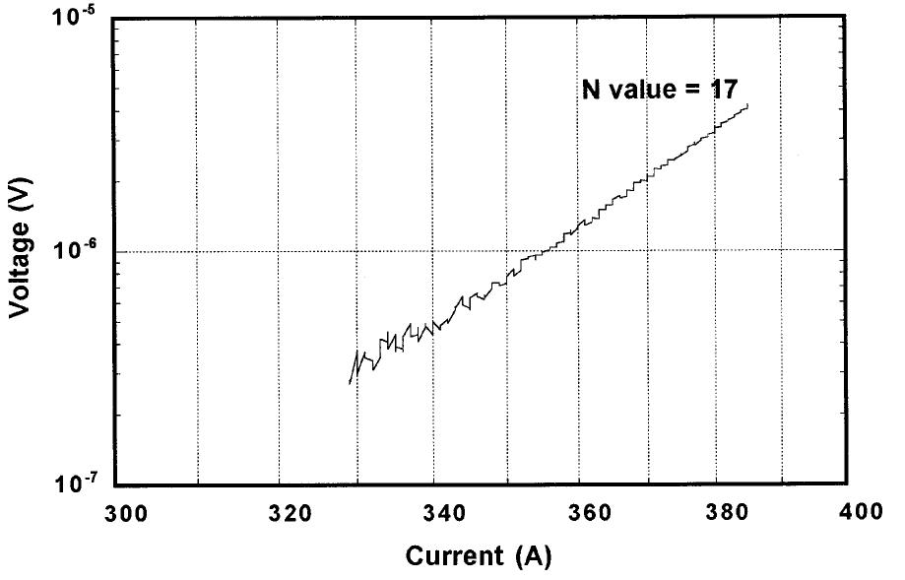
4. Conductor limited quenches
Measurements of the conductor critical current
Both the increase in ρ_{sc} and V can be fitted by a scaling law like
N is called the resisitivity transition index, or N-value, and it is an indication of the sharpness of the transition from superconducting to normal state (see Unit 6).
Usually, the better is the conductor, the higher (≥ 30) is the N-value.
A. Devred, [4]

Slide 53
References
[1] L. Rossi, “Superconducting Magnets”, CERN Academic Training, 15-18 May 2000.
[2] MJB Plus, Inc. “Superconducting Accelerator Magnets”, an interactive tutorial.
[3] S. Wolff, “Superconducting magnet design”, AIP Conference Proceedings 249, edited by M. Month and M. Dienes, 1992, p. 1160-1197.
[4] L. Rossi, “The LHC from construction to commisioning”, FNAL seminar, 19 April 2007.
[5] P. Schmuser, “Superconducting magnets for particle accelerators”, AIP Conference Proceedings 249, edited by M. Month and M. Dienes, 1992, p. 1100-1158.
[6] A. Devred, “The mechanics of SSC dipole magnet prototypes”, AIP Conference Proceedings 249, edited by M. Month and M. Dienes, 1992, p. 1309-1372.
[7] T. Ogitsu, et al., “Mechanical performance of 5-cm-aperture, 15-m-long SSC dipole magnet prototypes”, IEEE Trans. Appl. Supercond., Vol. 3, No. l, March 1993, p. 686-691.
[8] K. Artoos, et al., “Status of the short dipole model program for the LHC”, IEEE Trans. Appl. Supercond., Vol. 10, No. l, March 2000.
[9] K. Koepke, et al., “Fermilab doubler magnet design and fabrication techniques”, IEEE Trans. Magn., Vol. MAG-15, No. l, January 1979.
[10] J. Muratore, BNL, private communications.
[11] “LHC design report v.1: the main LHC ring”, CERN-2004-003-v-1, 2004.
[12] C.L. Goodzeit, “Superconducting Accelerator Magnets”, USPAS, January 2001.
[13]E. Todesco, “Masterclass - Design of superconducting magnets for particle accelerators”, https://indico.cern.ch/category/12408/

