Slide 1
Unit 18
Degradation and training
Chapter II
Paolo Ferracin
Lawrence Berkeley National Laboratory (LBNL)

Slide 2
Outline
Introduction
Degradation or energy deposited quenches?
  Ramp-rate dependence studies
  Temperature dependence studies
  Voltage signal studies
Training
  Definition
  Causes
Frictional motion
Epoxy failure
Overview of training performance
Conclusions

Slide 3
References
[1] H. Brechna and P. Turowsky, “Training and degradation phenomena in superconducting magnets”, proceedings of the 6th International Conference on Magnet Technology, 1978. p. 597.
[2] A. Tollestrup, “Care and training in superconducting magnets”, IEEE Trans. Magn., Vol. MAG-17, No. 1, January 1981, p. 863-872.
[3] O. Tsukamoto and Y. Iwasa, “Sources of acoustic emission in superconducting magnets”, J. Appl. Phys. 54, 997 (1983).
[4] Y. Iwasa, “Mechanical disturbances in superconducting magnets – A review”, IEEE Trans. Magn., Vol. 28, No. 1, January 1992, p. 113-120.
[5] H. Maeda, “The mechanism of frictional motion and its effects at 4.2 K in superconducting magnet winding models”, Cryogenics 22, 287 (1982).
[6] M. Wilson, “Superconducting magnets”, Oxford UK: Clarendon Press, 1983.
[7] A. Devred, “Quench origins”, AIP Conference Proceedings 249, edited by M. Month and M. Dienes, 1992, p. 1309-1372.
[8] H.T. Edwards, “The Tevatron energy doubler: a superconducting accelerator”, Ann. Rev. Nucl. Part. Sci. 1985, 35: 605 60.
[9] S. Wolff, “Superconducting magnet design”, AIP Conference Proceedings 249, edited by M. Month and M. Dienes, 1992, p. 1160-1197.
[10] W. Nah, et al., “Quench characteristics of 5-cm-aperture, 15-m-long SSC dipole magnet prototypes”, IEEE Trans. Supercond., Vol. 3, Issue 1, Part 4, March 1993, p. 658 – 661.
[11] A. Green, et al., “The magnet system of the Relativistic Heavy Ion Collider (RHIC)”, IEEE Trans. Magn., Vol. 32, No. 4, July 1996, p. 2041-2046.
[12] L. Rossi, “The LHC from construction to commissioning”, FNAL seminar, 19 April 2007.

Slide 4
1. Introduction
In this unit we will address the following question
  How do we establish if a magnet
    reached its limit?
    is degraded?
    is limited by conductor motion or flux jumps?
  What is “training”?
  Which are the causes?

Slide 5
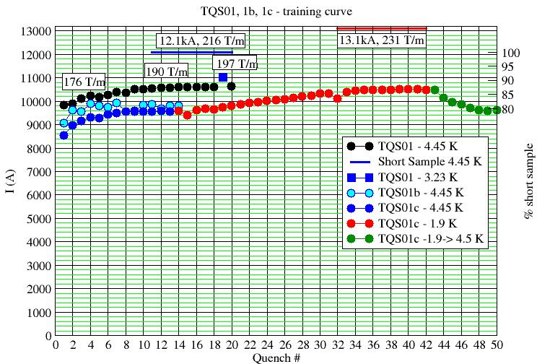
2. Degradation or energy deposited quenches?
A magnet quenches at a current lower than I_{ss} : is it a conductor- limited/degradation quench or a energy deposited quench?
In general the answer is never easy, but four types of analysis may give us some information.

Slide 6
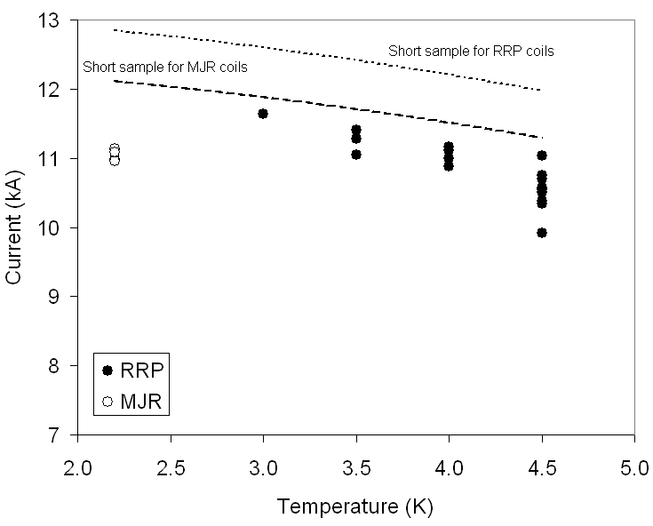
2. Degradation or energy deposited quenches?
1) Temperature dependence studies
  Since conductor limited quenches occur when the magnet current passes the critical current at a given temperature, they are very sensitive to temperature
    One of the way to check if a magnet reached the conductor limit is to vary the temperature, and verify if the maximum current is “moving” along the critical surface.

Slide 7
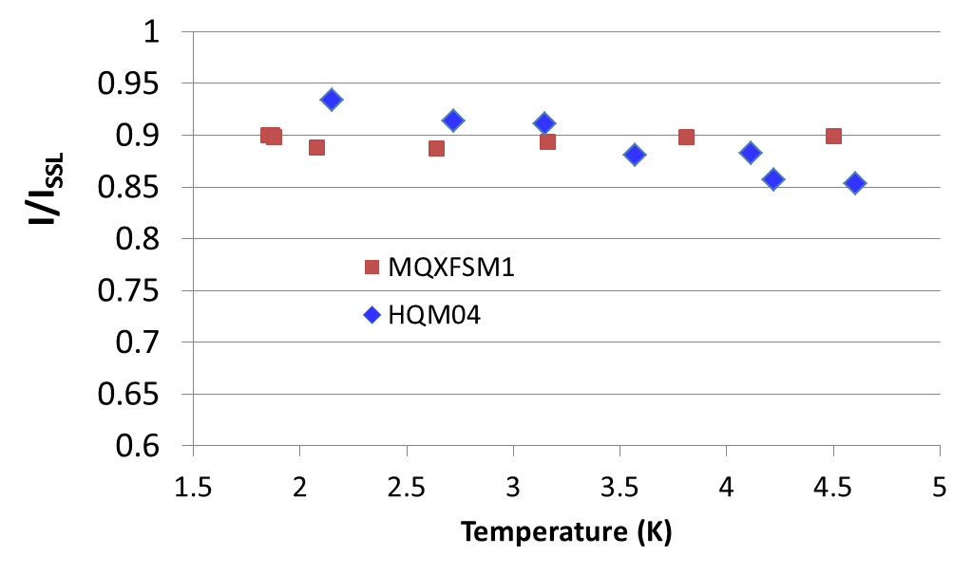
2. Degradation or energy deposited quenches?
1) Temperature dependence studies
  One of the way to check if a magnet reached the conductor limit is to vary the temperature, and verify if the maximum current is “moving” along the critical surface.

Slide 8
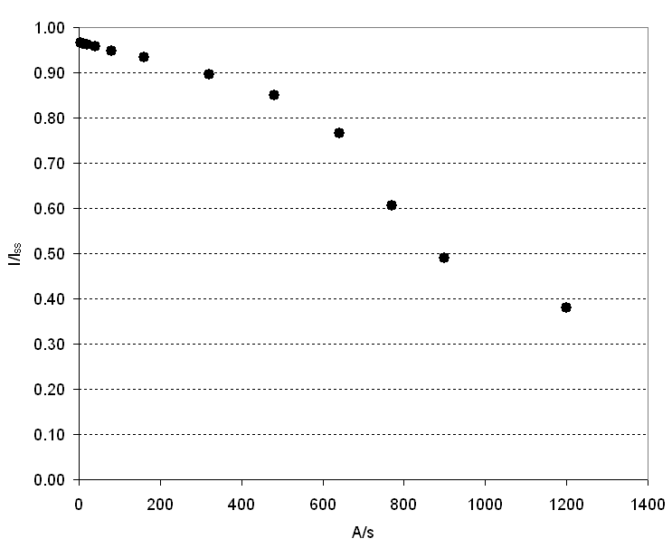
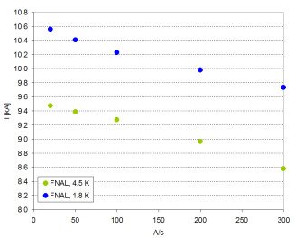
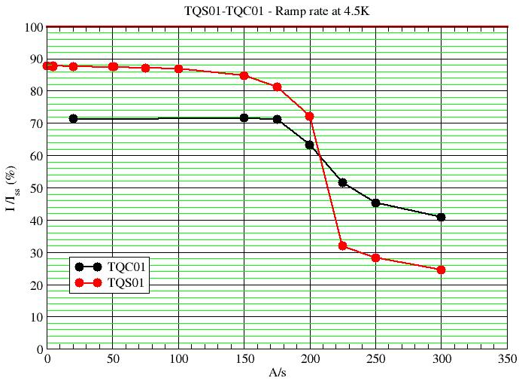
2. Degradation or energy deposited quenches?
2) Ramp-rate dependence studies
  Ramp-rate quenches are induced by AC losses. At high ramp rate, AC losses can dominate over the other quench causes.
  A reduction of the ramp rate, and consequently of the AC losses, should produce, in the absence of other possible causes of premature quenches, a “smooth” increase of quench current to the conductor limit.
  A sharp change in the quench current vs. ramp-rate curve can represent an indication of a magnet not limited by the conductor.

Slide 9
2. Degradation or energy deposited quenches?
3) Voltage signal studies
  Quench have different voltage precursors.
    A motion or a flux jump generates a change in magnetic flux inside the winding.
    A variation of magnetic flux results in a voltage signal detected across the coil.
  Depending on the shape of the voltage signal, it is possible to identify
    Conductor limited quenches: slow, gradual resistive growth
    Flux jump induced quenches: low-frequency flux changes
    Motion induced quenches: acceleration-deceleration-ringing
Conductor limited
Flux-Jump
Motion

Slide 10
Outline
Introduction
Degradation or energy deposited quenches?
  Ramp-rate dependence studies
  Temperature dependence studies
  Voltage signal studies
Training
  Definition
  Causes
Frictional motion
Epoxy failure
Overview of training performance
Conclusions

Slide 11
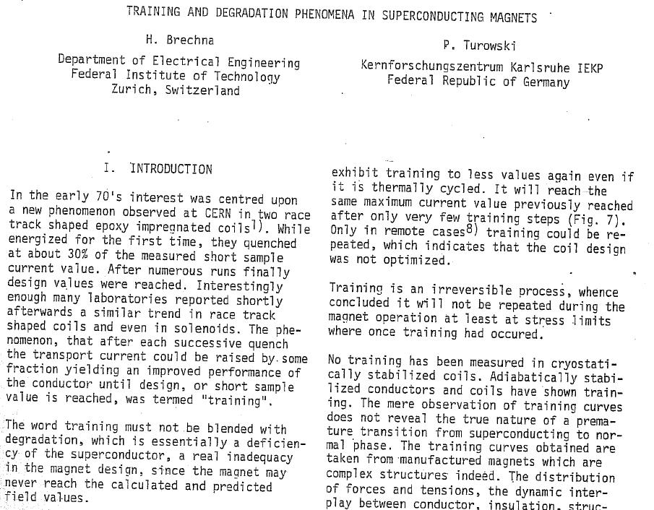
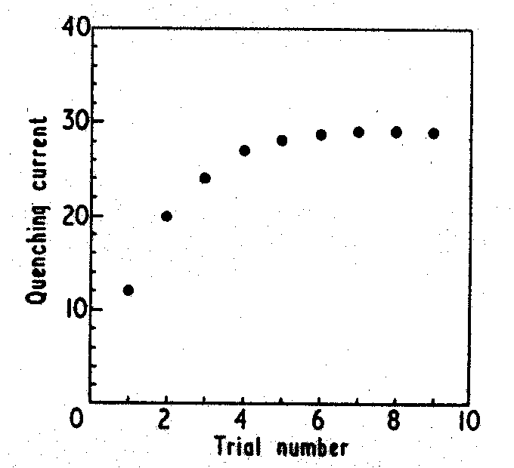
3. Training
NbZr solenoid
Chester, 1967
P.F. Chester, Rep. Prog. Phys., XXX, II, 561, 1967.
Proceedings of the 6th International Conference on Magnet Technology, 1978. p. 597.

Slide 12
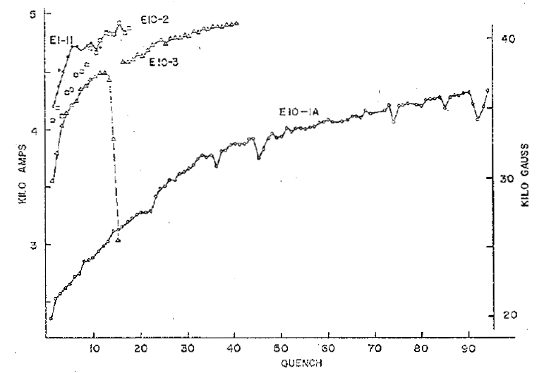
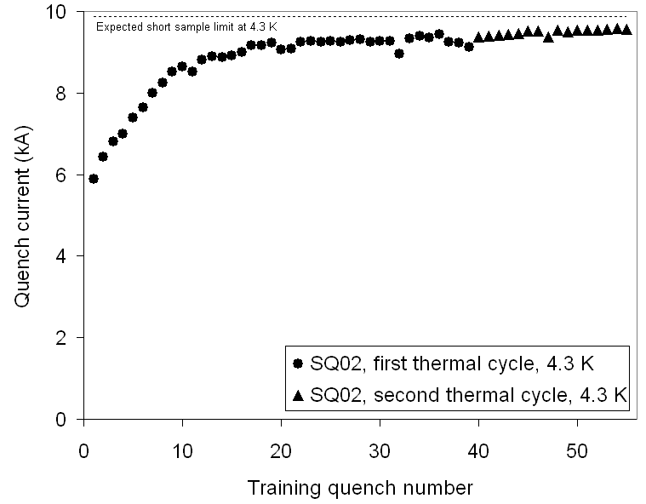
3. Training
Definition
Training is characterized by two phenomena
  The occurrence of premature quenches
    Which are the causes?
  The progressive increase of quench current
    Something not reversible happens, or, in other words, the magnet is somehow “improving” or “getting better” quench after quench.
    Some irreversible change in the coil’s mechanical status is occurring.
In R&D magnets, training may not be an issues.
For accelerator magnets it can be expensive, both in term of time and cost.
A. Tollestrup, [2]

Slide 13
3. Training
Causes
Mechanical induced quenches are considered the main causes of training in a superconducting magnets.
  Frictional motion of a superconductor
    During excitation electromagnetic forces determine conductor motion; any motion of a conductor in a frictional environment produces heat.
    After each quench, the coil is partially locked by friction in a new and more secure state which allows the conductors to withstand higher levels of electro-magnetic forces.
  Epoxy failure
    Under the stress status induced by the mechanical structure and the e.m. forces, the coil stores strain energy. When a crack is initiated and propagates (for example in the resin), part of the original strain energy is dissipated as heat.
    Premature quenches produced by epoxy cracking take place when the stresses in the winding exceed the epoxy’s fracture stress. Once the epoxy is locally fractured, further cracking appears only when the e.m. stress is increased.

Slide 14
Outline
Introduction
Degradation or energy deposited quenches?
  Ramp-rate dependence studies
  Temperature dependence studies
  Voltage signal studies
Training
  Definition
  Causes
Frictional motion
Epoxy failure
Overview of training performance
Conclusions

Slide 15
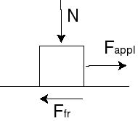
4. Frictional motion
The Coulomb friction (or static friction) model is defined as follows.
  Let’s consider two bodies in contact, being N the normal force exerted between the two surfaces.
  We then apply to one of the two body a force F_{appl} parallel to the contact surface.
  The friction force is given by F_{fr} ≤ μN where μ is the friction factor.
  This means that the friction force depends on F_{app}
    If F_{app} ≤ μN, no sliding occurs, i.e. the friction force is (just) what is needed to prevent motion
    If F_{app} > μN, sliding occurs, and the friction force is constant and equal to μN.

Slide 16
4. Frictional motion
We can use a contact pressure P instead of force N, and frictional stress or shear stress σ_{fr} instead of F_{fr.}
The Coulomb model can be reformulated as follows
  Two surfaces can carry shear stresses σ_{fr} up to a magnitude of μP across their interface before they start sliding relative to each other.
Whenever two surfaces slide with respect to each other in a frictional environment, frictional energy is dissipated. The frictional energy dissipated per unit area E (J/m²) can be estimated as
where δ (m) is the relative sliding of the two surfaces, and σ_{fr} (N/m²) is the frictional stress between the two surfaces (in the direction parallel to the two surfaces).

Slide 17
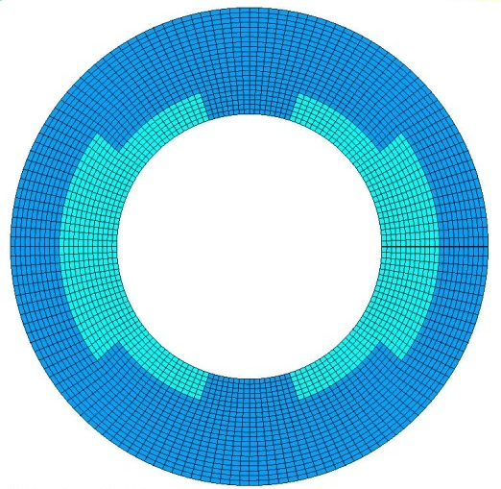
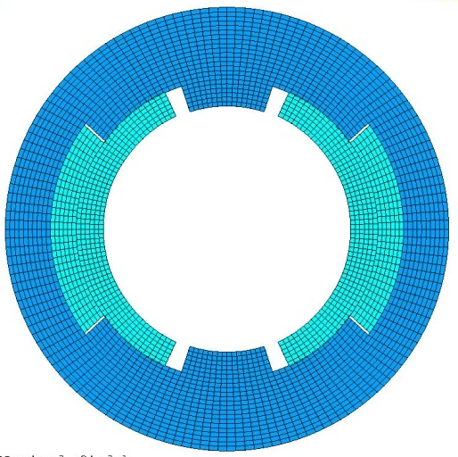
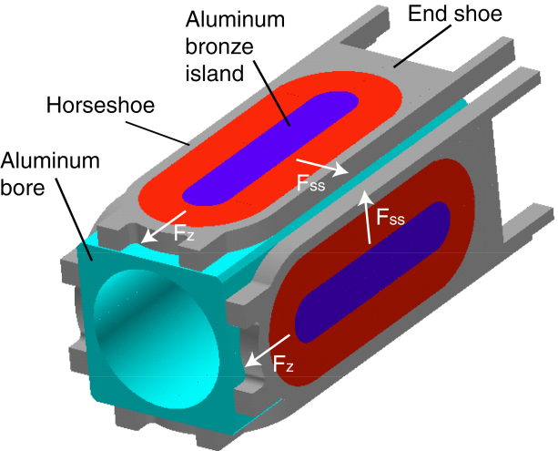
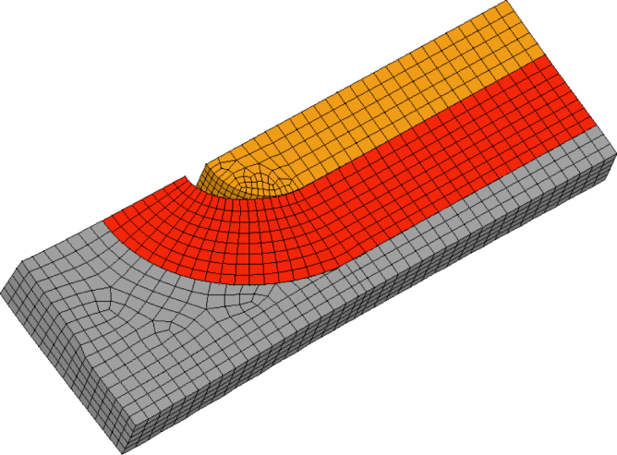
4. Frictional motion
Where does this frictional motion occurs?
Some examples
  Azimuthal sliding between coil and collar because of azimuthal e.m. forces
  Radial sliding between coil and collar because of azimuthal e.m. forces
  Axial sliding between coil and pole because of axial e.m. forces

Slide 18
4. Frictional motion
Some order of magnitude
  Let’s consider a contact pressure between coil and support structure (or between adjacent cables) P of about 30 MPa (LHC or SSC).
  With a friction factor μ = 0.3, the maximum frictional stress will be
  σ_{fr} = μP = 9 MPa
  A relative sliding δ of about 1 μm will dissipate
  E = σ_{fr} δ ~ 10 μ J/mm²
  10 μ J was the computed MQE for the SSC dipole: a very small motion under friction can initiate a quench
Fine, but how can we explain the progressive increase of quench current?
Notes:
q qde`
&&&&&&&&&(((&&&((‘’’’’’’’’’

Slide 19
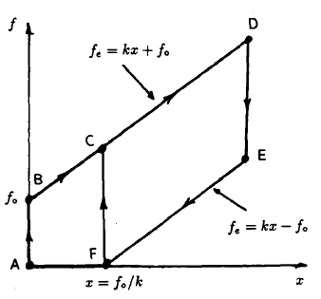
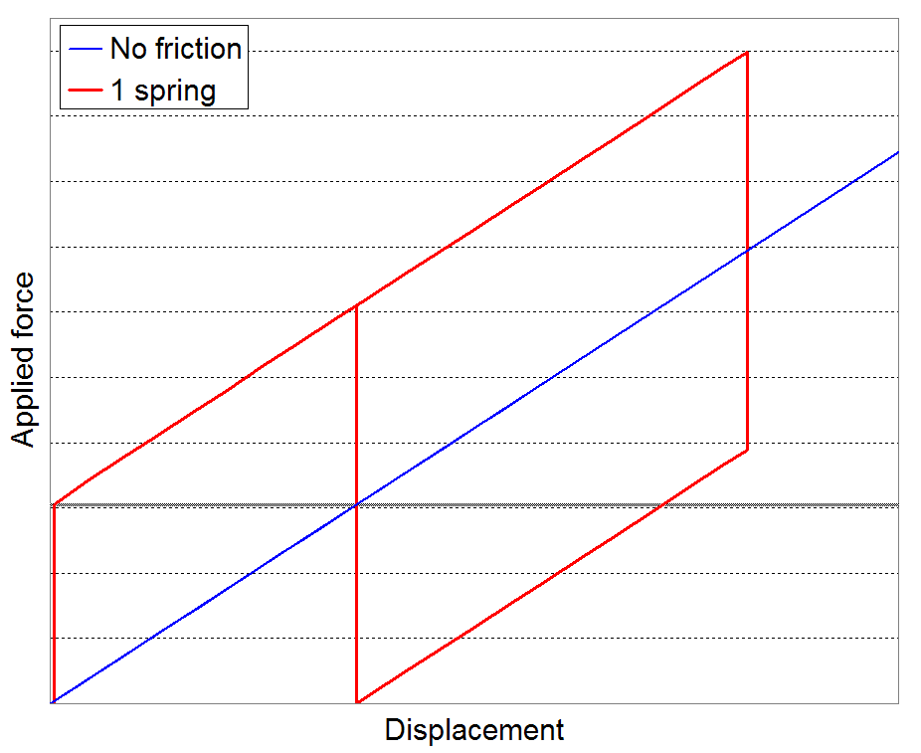
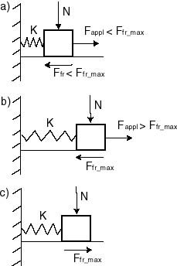
4. Frictional motion
A simple analytical model has been proposed by O. Tsukamoto and Y. Iwasa [3].
  A simple force cycle applied to a spring system shows
    Irreversible displacement at the end of the first cycle
    Reduction of total displacement in the second cycle
Y. Iwasa, [4]

Slide 20
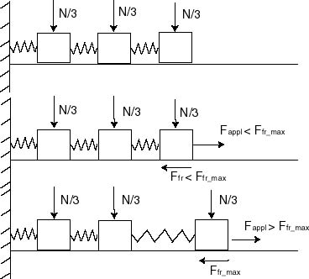
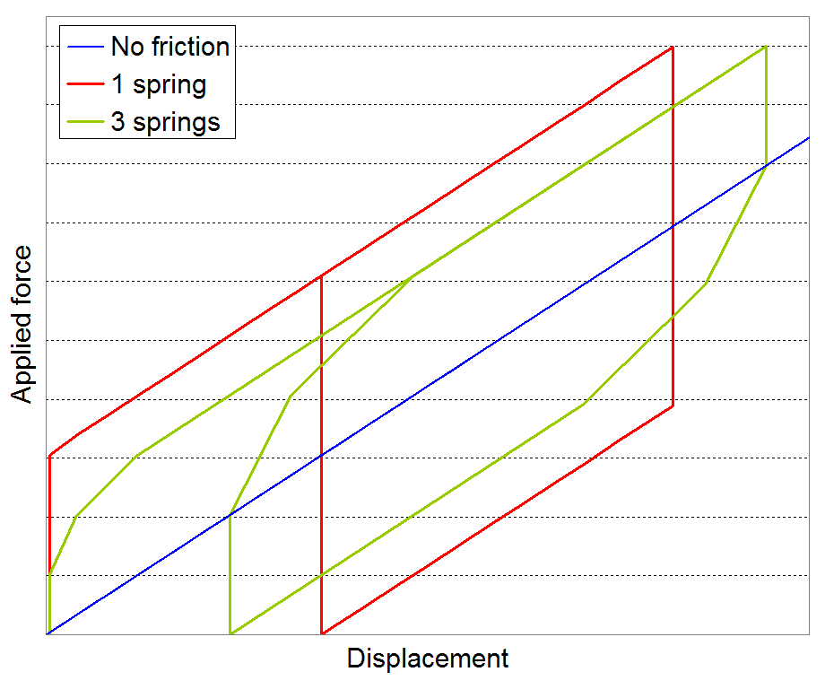
4. Frictional motion
If we consider three springs, the transition from stick to sliding is more gradual, both during the increase of force and the decrease of force.
With increasing or decreasing applied force, the bodies start sliding one after the other.

Slide 21
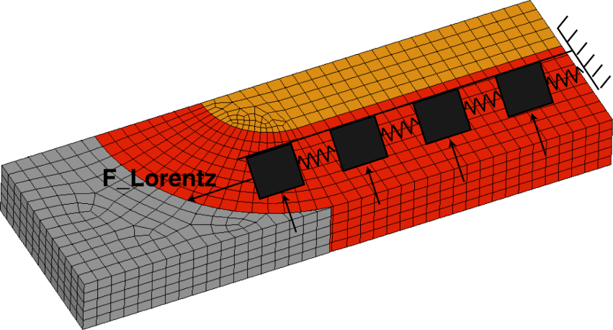
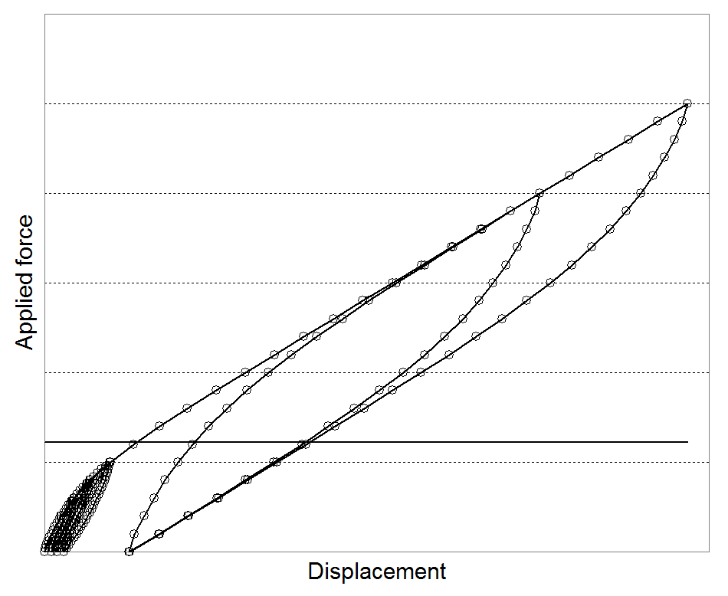
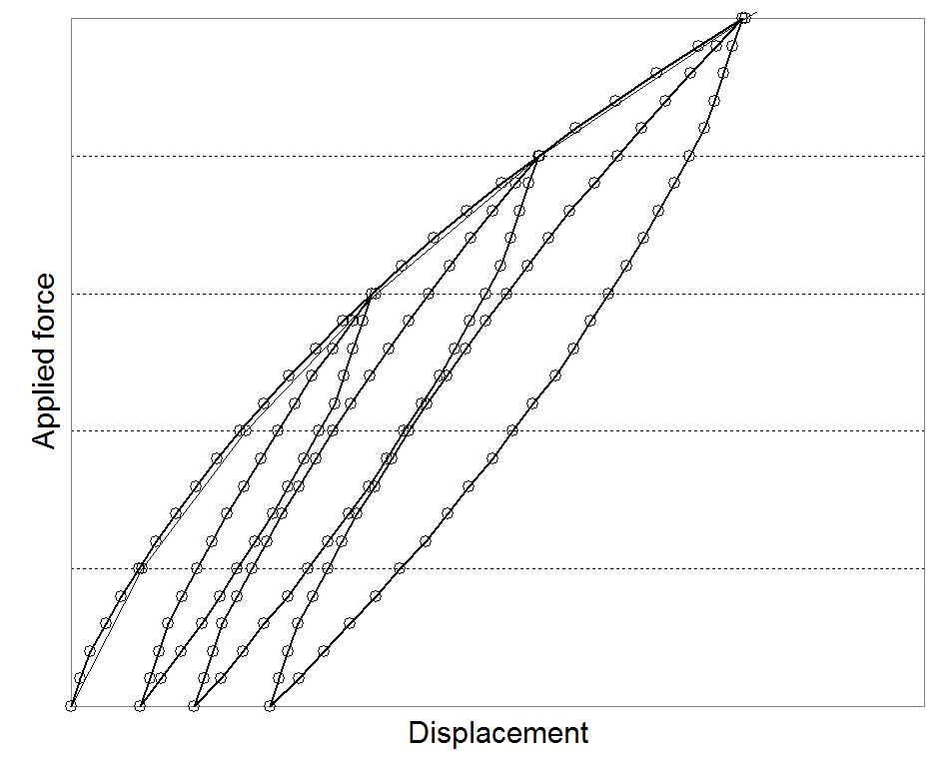
4. Frictional motion
A real coil under the effect of Lorentz forces, can be analyzed as a series of springs.
  If we cycle the forces, a frictional system in not completely reversible.

Slide 22
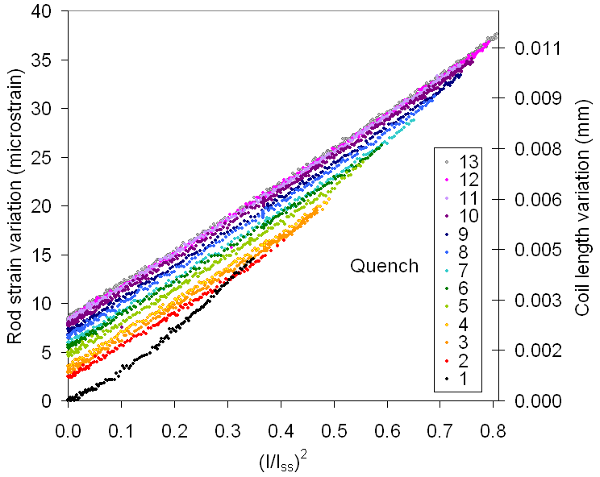
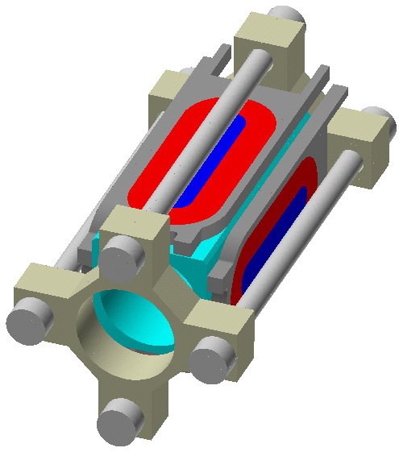
4. Frictional motion
Strain measurements
  Increase of coil length as Lorentz forces are cycled
    The axial Lorentz forces tend to pull the coil ends outwardly
    After an excitation cycle, the coil does not return to its original length

Slide 23
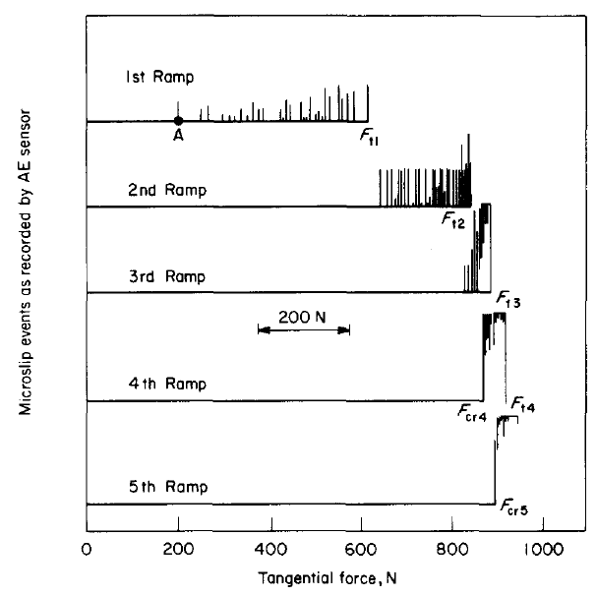
4. Frictional motion
Acoustic emissions measurements
  AE are emitted during frictional sliding between two surfaces (cracks)
  Kaiser effect
    “During a sequence of cyclic loading, mechanical disturbances such as conductor motion and epoxy fracture appear only when the loading responsible for disturbances exceeds the maximum level achieved in the previous loading sequence.” [3]
H. Maeda, et al., [4]

Slide 24
4. Frictional motion
How to prevent it?
  Minimizing conductor motion
    Hold the coil as tight as possible
  Quality of the components
    Smooth surfaces to minimize frictional energy
  Epoxy impregnation
    It glues the conductor
    It “protects” the brittle superconductor (Nb₃Sn)
    It increases the coil modulus
      For the same force/stress applied, the displacement/strain is reduced
Unfortunately epoxy impregnation presents a drawback
  Epoxy failures

Slide 25
Outline
Introduction
Degradation or energy deposited quenches?
  Ramp-rate dependence studies
  Temperature dependence studies
  Voltage signal studies
Training
  Definition
  Causes
Frictional motion
Epoxy failure
Overview of training performance
Conclusions

Slide 26
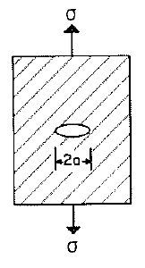
5. Epoxy failures
Epoxy resin becomes brittle at low temperature
  Micro-cracking or micro-fractures may occur
The phenomenon is enhanced by the fact that the epoxy has an higher thermal contraction than the composite superconductor (to which it is glued)
  After cool-down the resin is in tension
A brittle material in tension may experience crack propagation.
  When a crack propagated, the strain energy previously stored in the volume surrounding the crack is converted in heat.
We can compute the order of magnitude of the energies released by epoxy cracking.
M. Wilson, [6]

Slide 27
5. Epoxy failures
A material under stress/strain stores a strain energy density [J/m³] given by (uniaxial case)
where E is the elastic modulus [N/m²].
After cool-down, considering the much higher modulus of the composite conductor, the strain in the epoxy can be express as
where α is the integrated thermal contraction (from 293 K to 4.2 K).

Slide 28
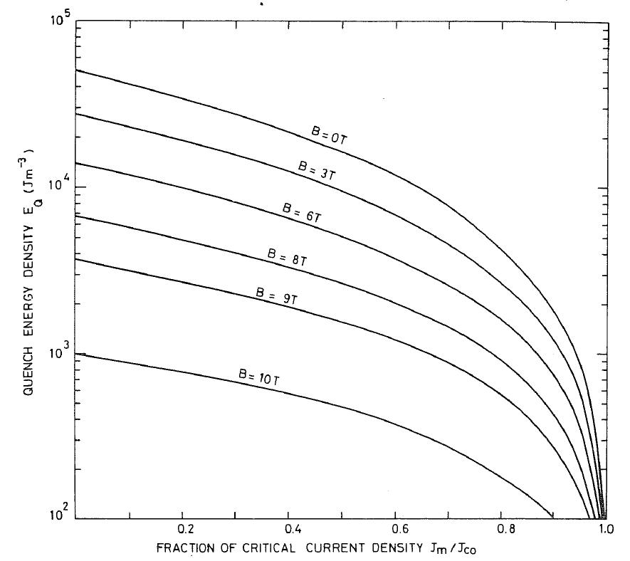
5. Epoxy failures
Assuming for the epoxy an elastic modulus of 5000 MPa, one gets a stored energy density of 1.6 × 10⁵ J/m³, which is very high compared to the minimum quench energy density.
To prevent or minimize this potential quench initiation phenomenon
  fibrous reinforcement (fiberglass) are added to the epoxy to reduce cracks and thermal contraction;
  volume with only resin are minimized;
  In general, epoxy is used where it is needed (Nb₃Sn magnets).
M. Wilson, [2]

Slide 29
Outline
Introduction
Degradation or energy deposited quenches?
  Ramp-rate dependence studies
  Temperature dependence studies
  Voltage signal studies
Training
  Definition
  Causes
Frictional motion
Epoxy failure
Overview of training performance
Conclusions

Slide 30
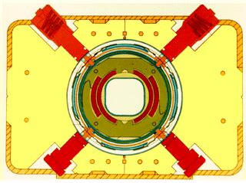
6. Overview of quench performances
Tevatron dipole magnets
All magnet were measured under two different excitation cycles (different ramp rates).
The average J_{c} measured on the cable is 1800 A/mm² at 5 T and 4.2 K. The average short sample current is 4600 A (nominal 4333 A).
First quench
H.T. Edwards, [8]

Slide 31
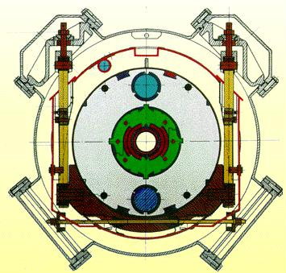
6. Overview of quench performances
HERA dipole magnets
Training is negligible: maximum quench current reached after few quenches.
S. Wolff, [9]

Slide 32
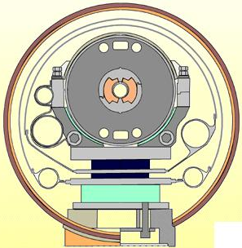
6. Overview of quench performances
SSC dipole magnets
Test results from 18, 50 mm aperture, SSC dipole prototypes [10]
  No or very little training to 6600 A (operating current).
  All the magnets tested reached a plateau current very close to the short sample current.
W. Nah, et al. [10]

Slide 33
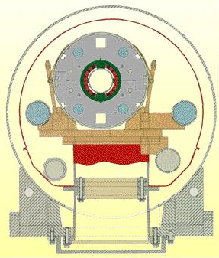
6. Overview of quench performances
RHIC dipole magnets
Test results of the first 41 RHIC dipole magnets [11]
  All the magnets exhibited minimum quench well above the RHIC operating current of 5000 A.
A. Green, et al. [11]

Slide 34
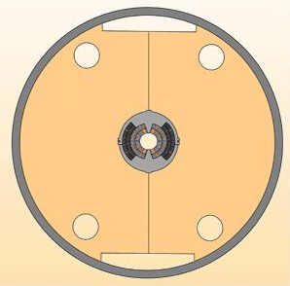
6. Overview of quench performances
D20
Conditioning
  Magnet is cool-down at 1.8 K and then warm up to 4.4 K to improve training performance
De-training
  A progressive degradation occurred due to a damage to a splice.

Slide 35
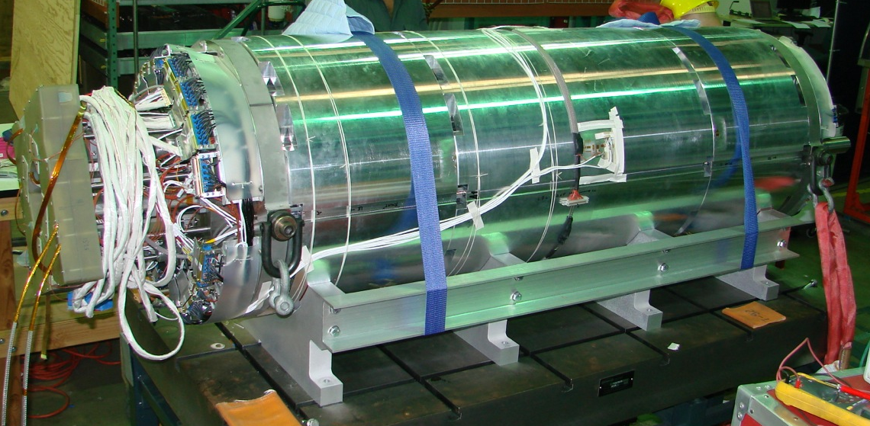
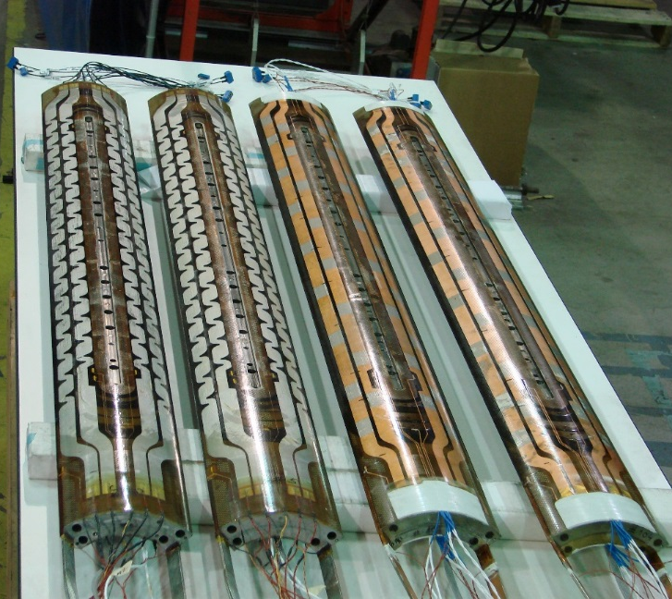
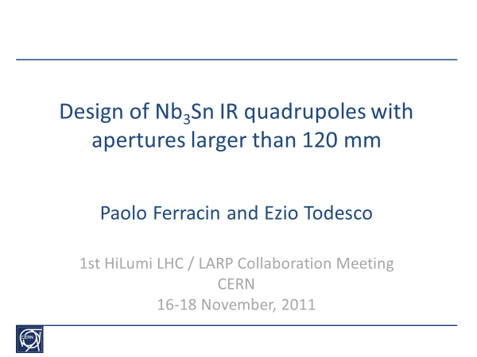
MQXFS01 test
First test of HiLumi Nb₃Sn IR quadrupole
Conceptual design started in 2011
Test at FNAL in 2016

Slide 36
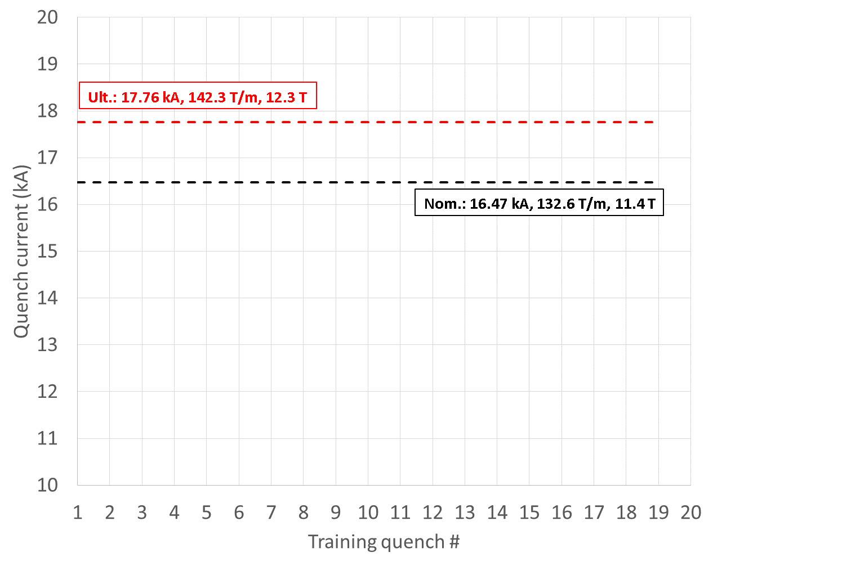
MQXFS01 test
First test of HiLumi Nb₃Sn IR quadrupole

Slide 37
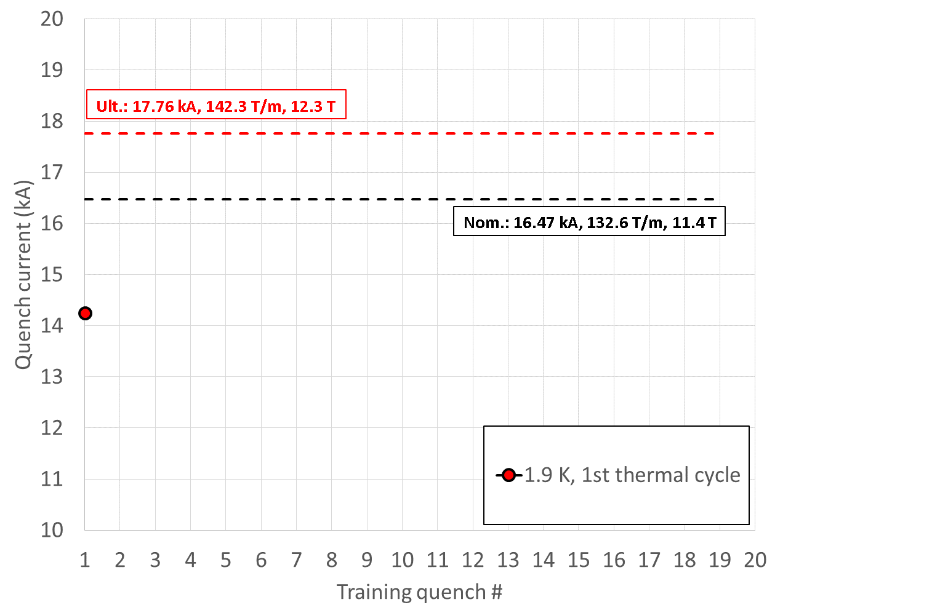
MQXFS01 test
First test of HiLumi Nb₃Sn IR quadrupole

Slide 38
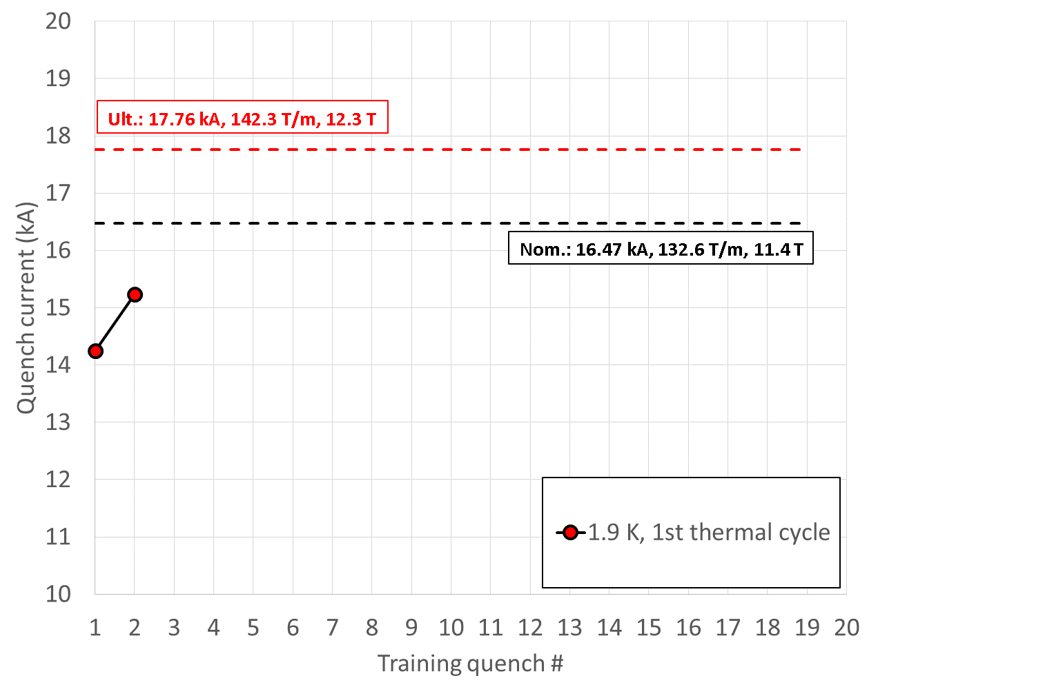
MQXFS01 test
First test of HiLumi Nb₃Sn IR quadrupole

Slide 39
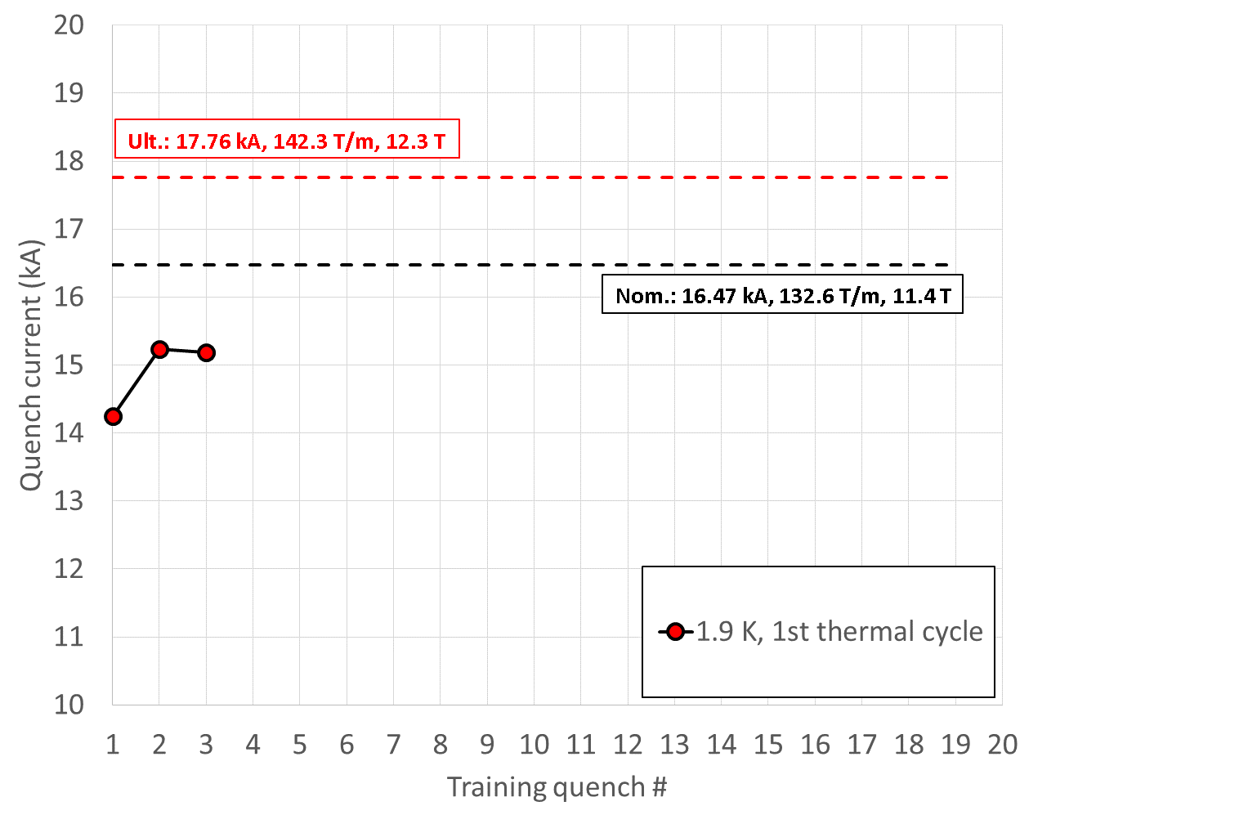
MQXFS01 test
First test of HiLumi Nb₃Sn IR quadrupole

Slide 40
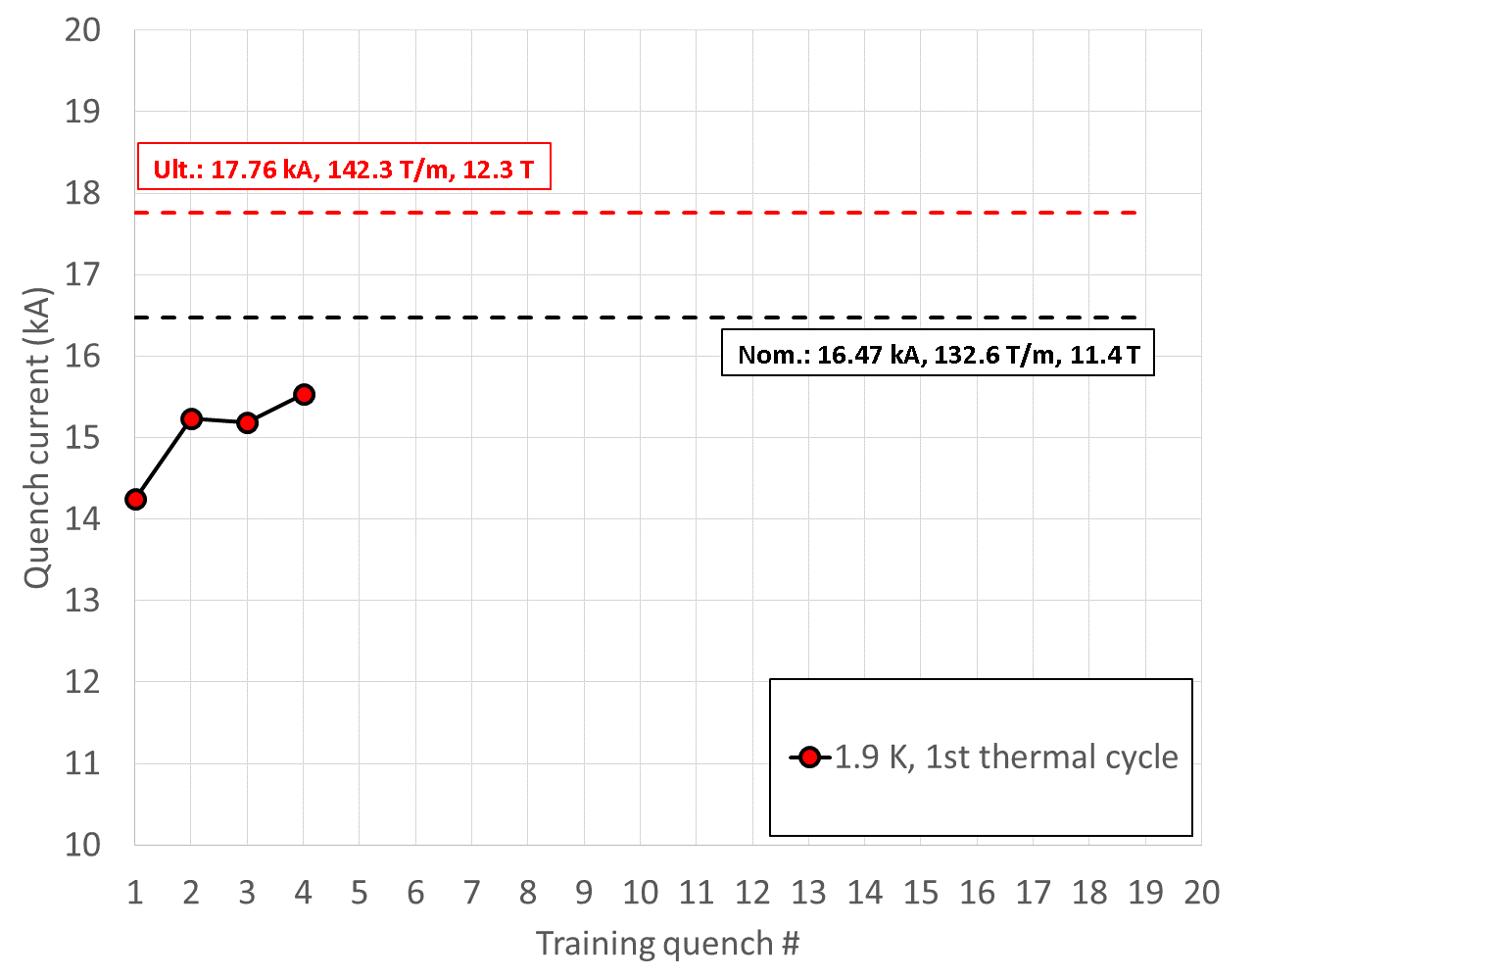
MQXFS01 test
First test of HiLumi Nb₃Sn IR quadrupole

Slide 41
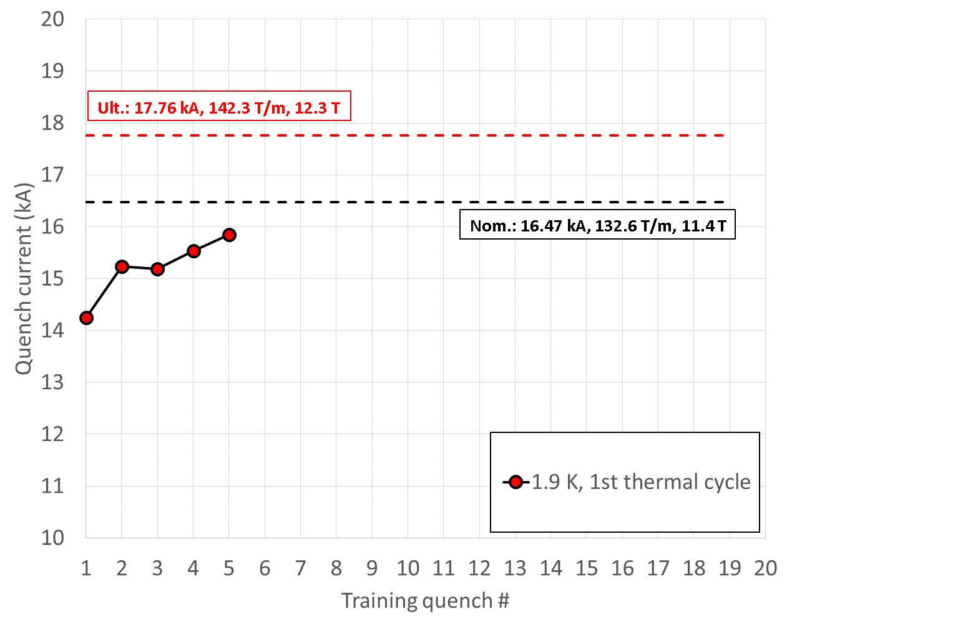
MQXFS01 test
First test of HiLumi Nb₃Sn IR quadrupole

Slide 42
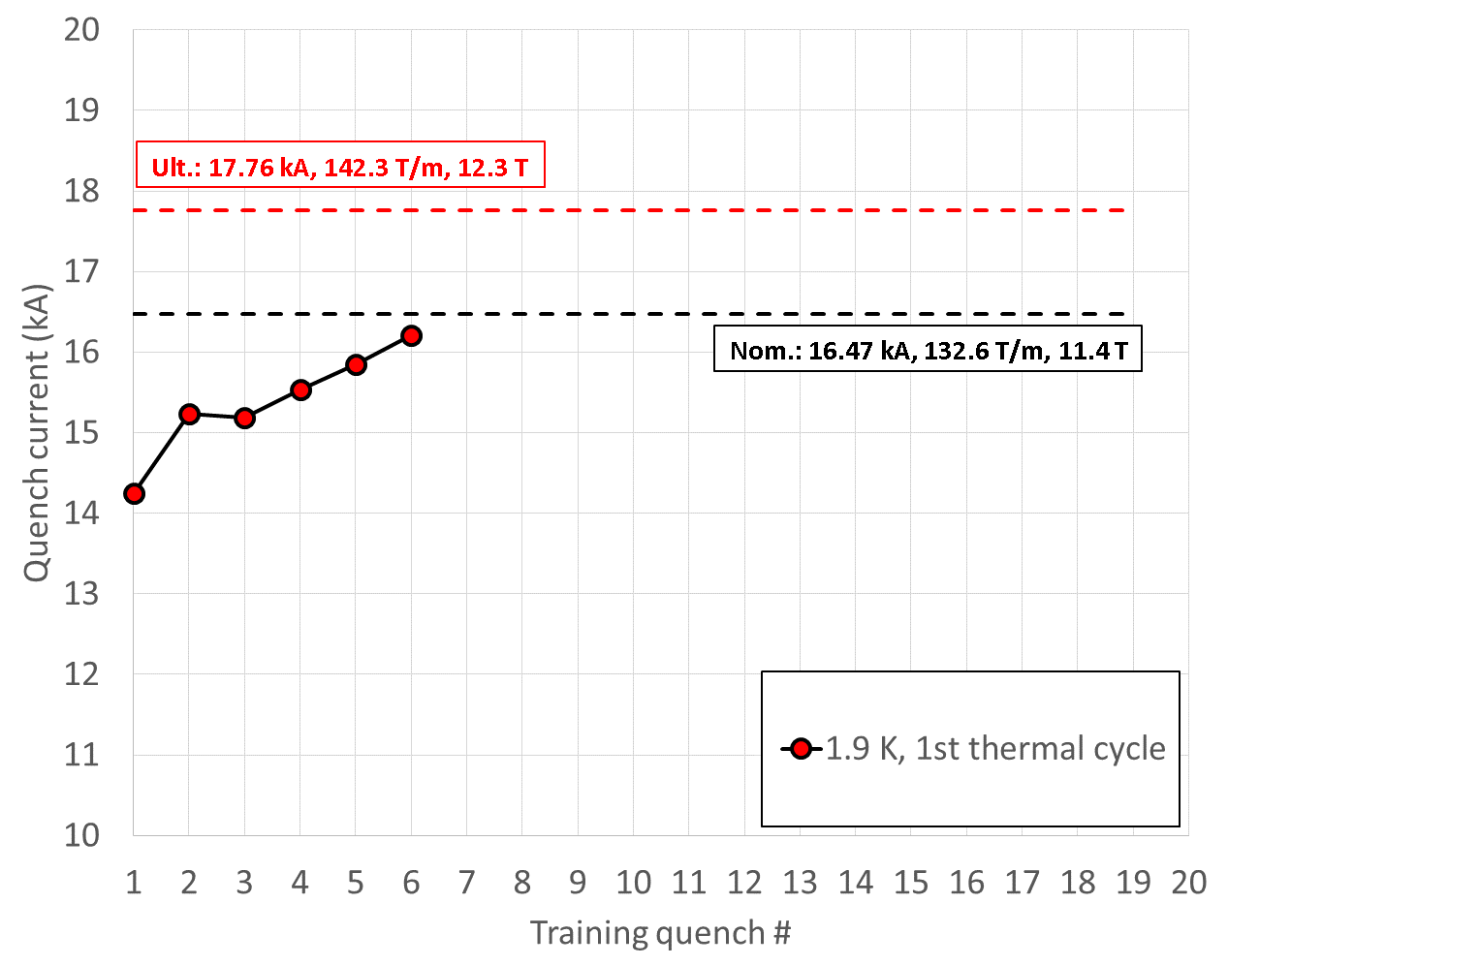
MQXFS01 test
First test of HiLumi Nb₃Sn IR quadrupole

Slide 43
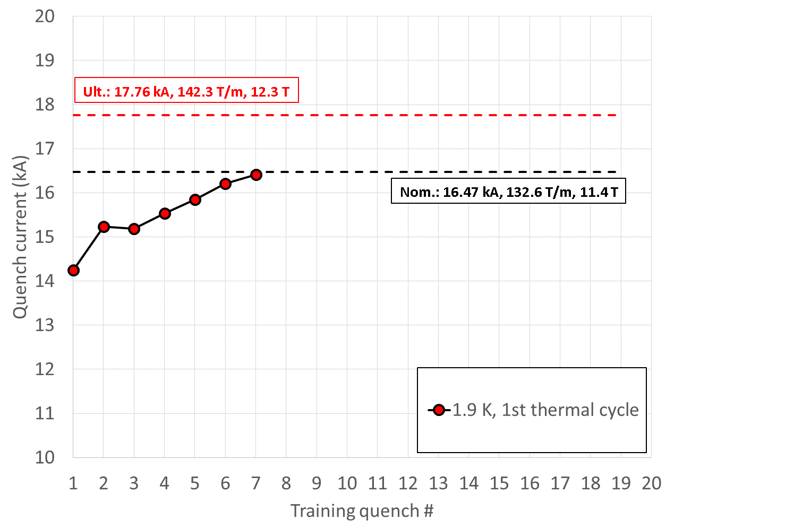
MQXFS01 test
First test of HiLumi Nb₃Sn IR quadrupole

Slide 44
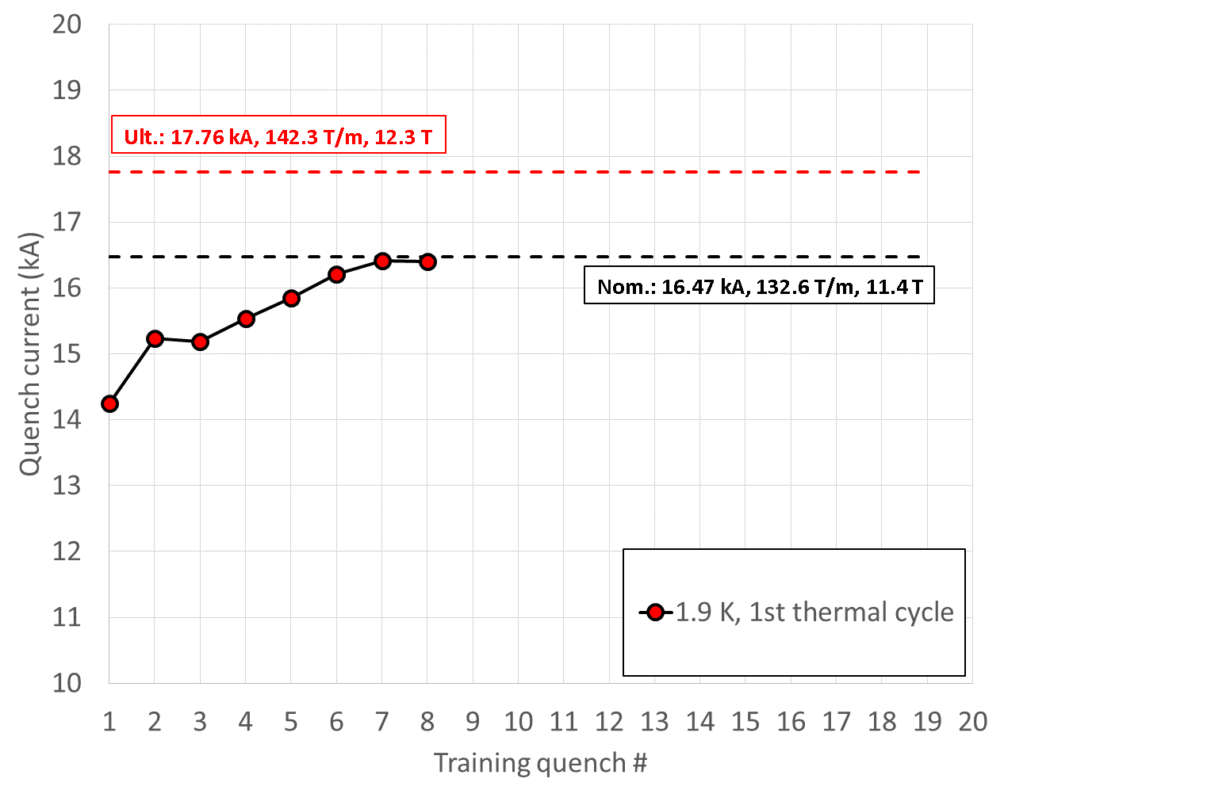
MQXFS01 test
First test of HiLumi Nb₃Sn IR quadrupole

Slide 45
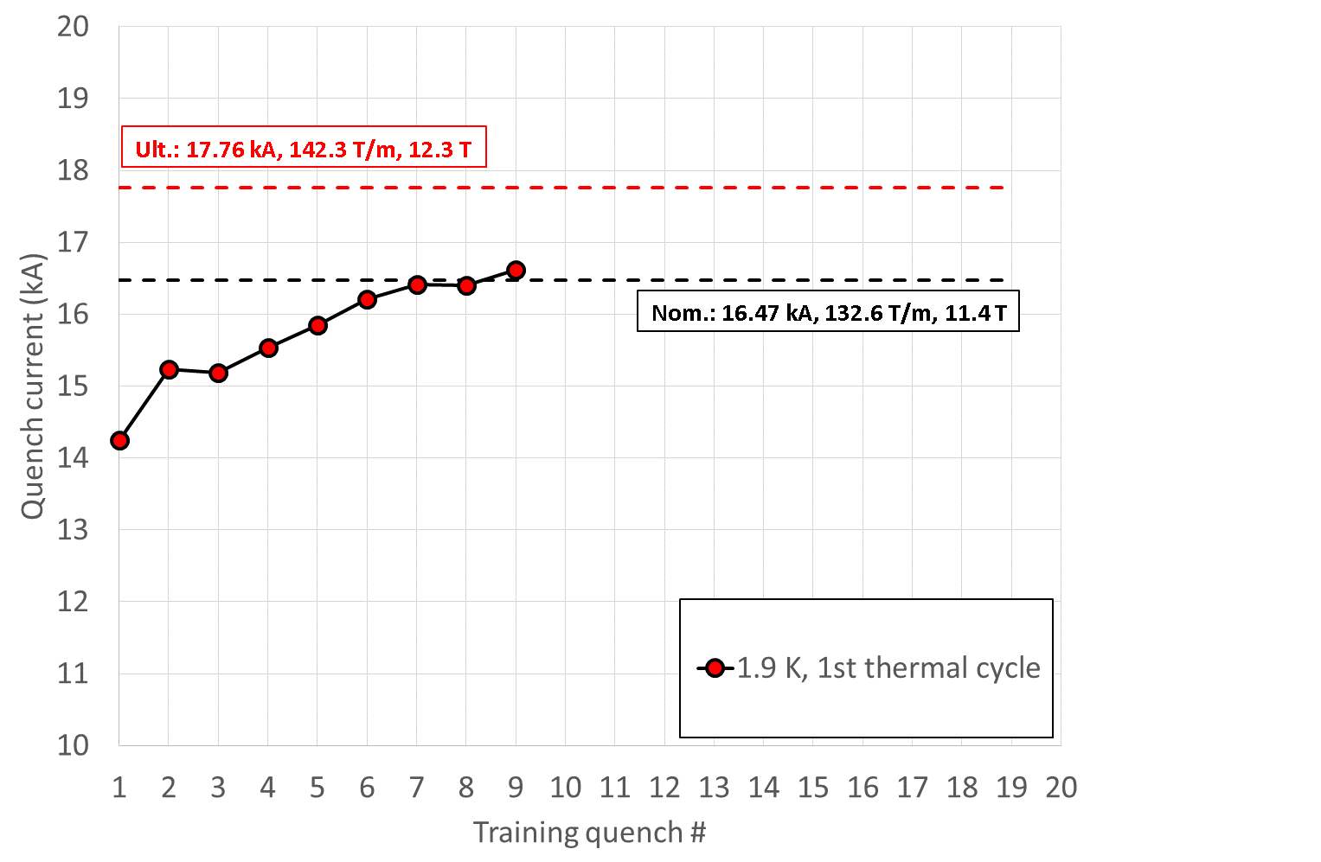
MQXFS01 test
First test of HiLumi Nb₃Sn IR quadrupole

Slide 46

MQXFS01 test
First test of HiLumi Nb₃Sn IR quadrupole

Slide 47
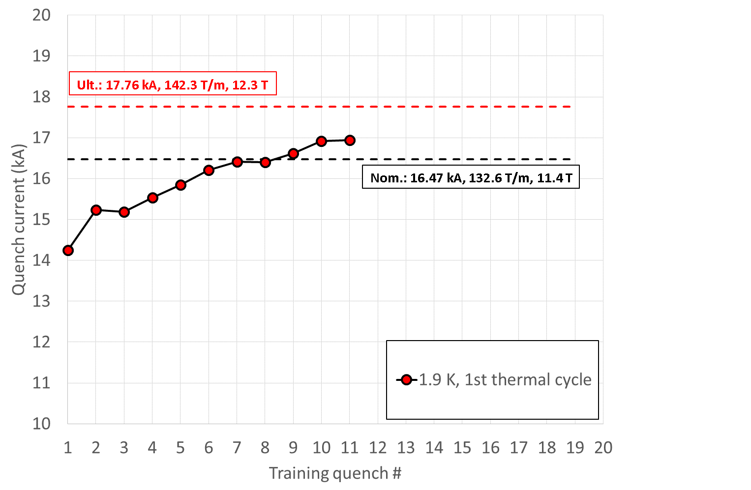
MQXFS01 test
First test of HiLumi Nb₃Sn IR quadrupole

Slide 48
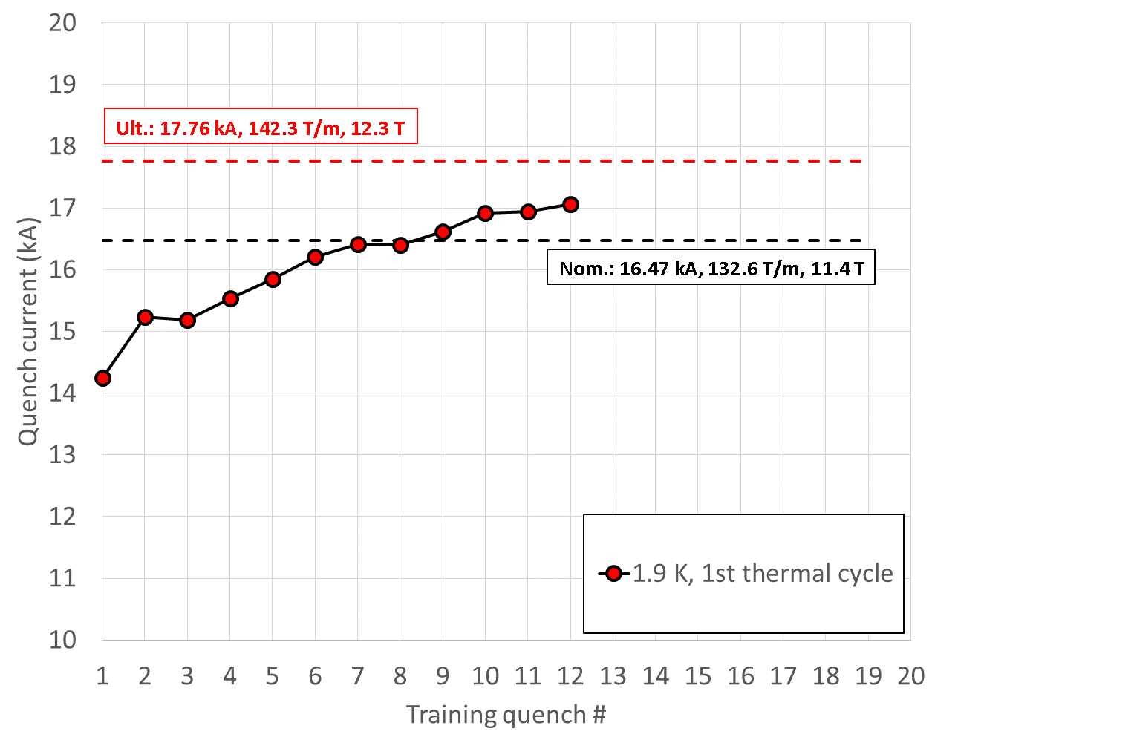
MQXFS01 test
First test of HiLumi Nb₃Sn IR quadrupole

Slide 49
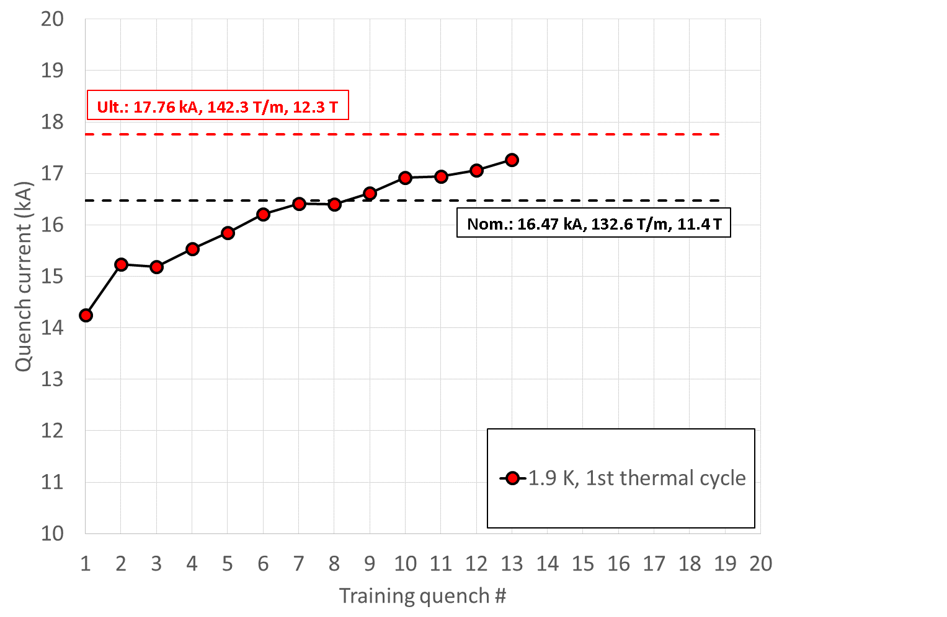
MQXFS01 test
First test of HiLumi Nb₃Sn IR quadrupole

Slide 50
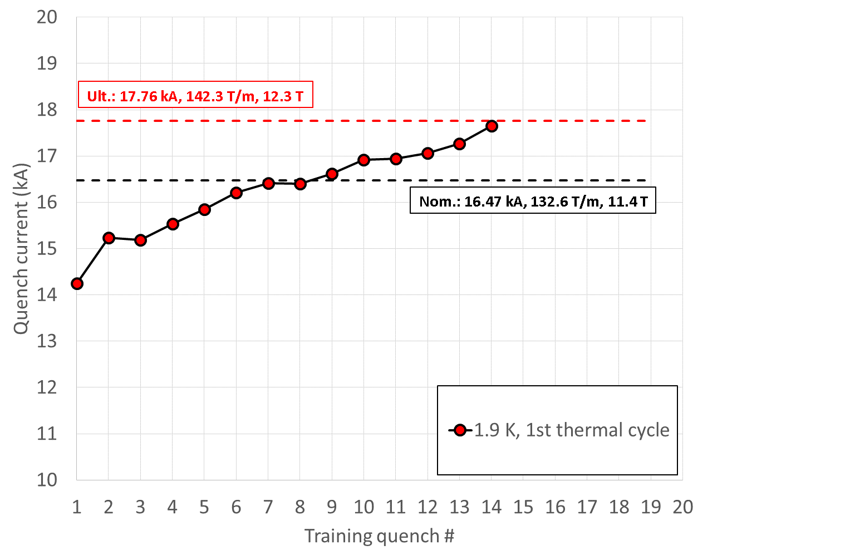
MQXFS01 test
First test of HiLumi Nb₃Sn IR quadrupole

Slide 51

MQXFS01 test
First test of HiLumi Nb₃Sn IR quadrupole

Slide 52

MQXFS01 test
First test of HiLumi Nb₃Sn IR quadrupole

Slide 53

MQXFS01 test
First test of HiLumi Nb₃Sn IR quadrupole

Slide 54

MQXFS01 test
First test of HiLumi Nb₃Sn IR quadrupole

Slide 55

Detraining…degradation

Slide 56

Erratic training…..loss of memory

Slide 57






Erratic training…..loss of memory…but significant improvement with wax

Slide 58
Quench and protection
Training of LHC sectors to 6.5 TeV

Slide 59

Quench and protection
Training of LHC sectors to 6.8 TeV

Slide 60
7. Conclusions
The training phenomenon can be defined as
  The occurrence of premature quenches
  The progressive increase of quench current
Both characteristics can be explained by frictional motion and epoxy fracture.
Superconducting accelerator magnets usually operate with a sufficient current margin (with respect to short sample current), so that nominal current is reached with very few quenches.

Slide 61
Appendix

Slide 62





Training of Epoxy-Impregnated Superconductor Windings
Advances in Cryogenic Engineering Materials, pp 677-683
J. W. Ekin, R. E. Schramm, and M. J. Superczynski

Slide 63


Dynamic stress effects in technical superconductors and the ’’training’’ problem of superconducting magnets
G. Pasztor and C. Schmidt
The acoustic activity involves two significant components: (i) A stress-irreversible component within the whole range of the stress-strain curve which appears in all loading cycles in Fig. 7 for stresses exceeding the previous maximum stress value. In an experiment characterized by a higher amplifier gain, irreversible emission was found to start immediately upon the application of stress. 14 (ii) A stress-reversible part starting at a stress of about 5 x 108 N/m² (corresponding to a strain of about 0.4%) which is seen for the first time in cycle 7. The stress necessary to induce the reversible emission showed the tendency to decrease with increasing number of cycles.

Slide 64


A cure against training of superconducting magnets
C. Schmidt and B. Turck
Cryogenics, p. 695 Dec 1977

Slide 65
A model for correlating 4.2-K performance with room-temperature mechanical
characteristics in superconducting test dipole magnets for the Superconducting
Super Collider (SSC)
O. O. Ige, R. H. Lyon, and Y. lwasa
J. Appl. Phys. 71 (6), 2971, 15 March 1992
In this study, a link was sought between characteristics of the magnet that could be measured at room temperature with the-4.2-K performance of the magnets. To this end, the longitudinal attenuation of acoustic pulses in ten FNAL research dipoles were measured.
It was found that the higher the attenuation in a particular magnet, the greater the number of quenches required to train the magnet.

Slide 66


https://publications.lbl.gov/islandora/object/ir%3A80921/datastream/PDF/download/citation.pdf

Slide 67

The effect of adhesion between turns on the training of superconducting magnets
V.W. Edwards and M.N. Wilson
CRYOGENICS. Volume 18, Issue 7, JULY 1978, p. 423
We have demonstrated that strong training effects can be caused by inter-turn adhesion. A reasonable hypothesis is that the training quenches were caused by energy released when the adhesive bond failed under the electromagnetic forces. Other experiments have shown the need to prevent wire movement. We are thus lead to conclude that training will only be avoided if wire movement is prevented by an impregnant which either does not crack at all under the electromagnetic forces or which cracks so easily as to release only small amounts of energy.

Slide 68

New proposal to reduce training for potted superconductive coil in relation to composite stress/strain effects
S. Nishijima, T. Okada, N. Yabuta, T. Horiuchi, K. Matsumoto, M. Hamada
IEEE TRANSACTIONS ON MAGNETICS, VOL. MAG-17, NO. 5, SEPTEMBER 1981, 2055
(1) Wire movement causes the training in solenoidal coils and the degradation in race tracks shaped coils. The complicated shaped coil will be hard to attain the expected performances.
(2) Unloading at LHeT greatly reduces training of epoxy potted racetrack coils. One of possible causes of training is the release of strain energy at stress concentrated regions between wires and potting materials. Unloading after loading at LNT is not effective to reduce the training.
(3) Reversible current degradation

