Slide 1
Mitigating Friction in Superconducting Magnet Interfaces
Michael Kifarkis
01/15/2025

Slide 2
Goal
Goal is to mitigate frictional contact between conductor interfaces by leveraging ultrasonic vibrations
Depending on the frequency and amplitude of the vibrations applied, we can effectively decouple the contacting surfaces​
Reduce the normal force between them, reduces friction and the associated energy dissipation​
Minimize stress concentrations and mitigate the build-up of energy that commonly occurs from slip-stick conditions within contact interfaces​
Enhance magnet performance by avoiding or reducing quench occurrence

Slide 3
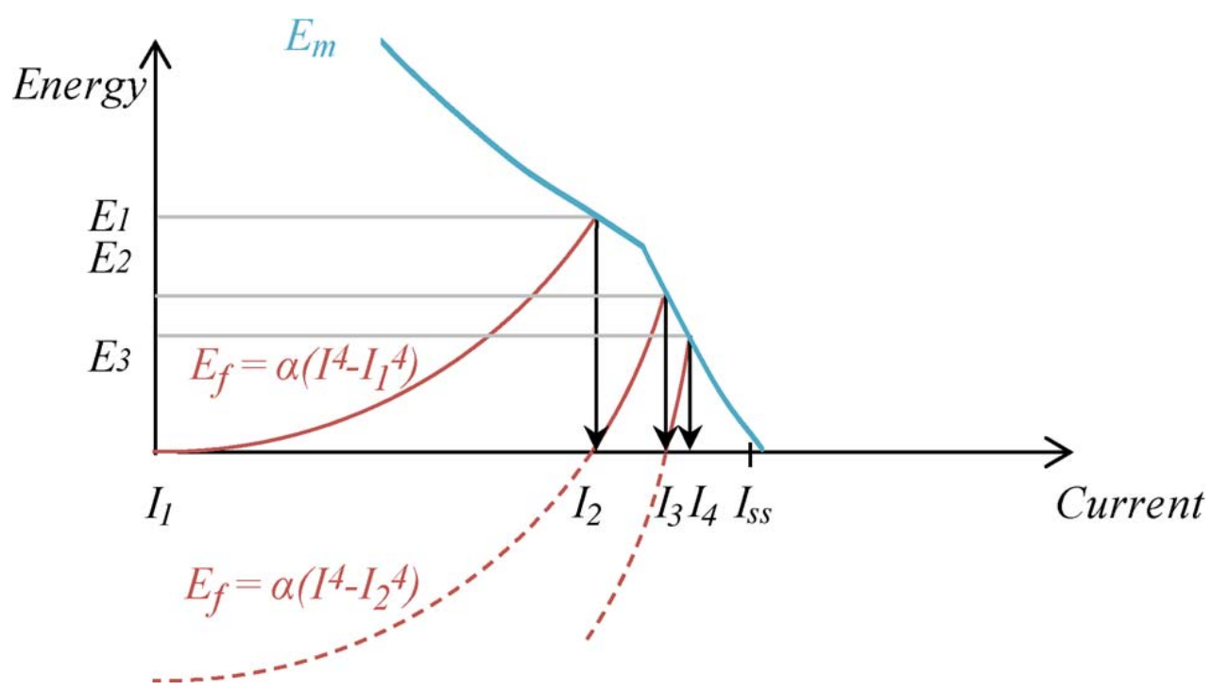
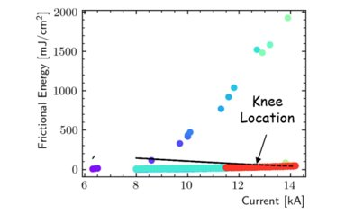
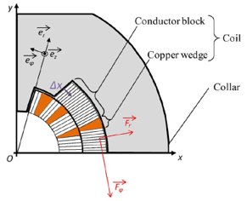
Magnet (Quench) Training and Friction
Training can be described through slip-stick models
Other models don't explicitly rely on slip-stick but still the friction is key component
CERN
LBNL
https://ieeexplore.ieee.org/abstract/document/10333992
https://ieeexplore.ieee.org/document/6007058
Dynamic system based on slip-stick motion – training in superconducting magnets
Peak debonding (top) and frictional (bottom) energy release during the ramps at any location (markers), and minimum enthalpy margin in the coil (line). Each color is associated to a different training ramp.
Em is the energy margin
Ef is frictional energy
Magnet performance is directly related to friction
Both models describe training data through friction - higher the friction higher the quench count

Slide 4
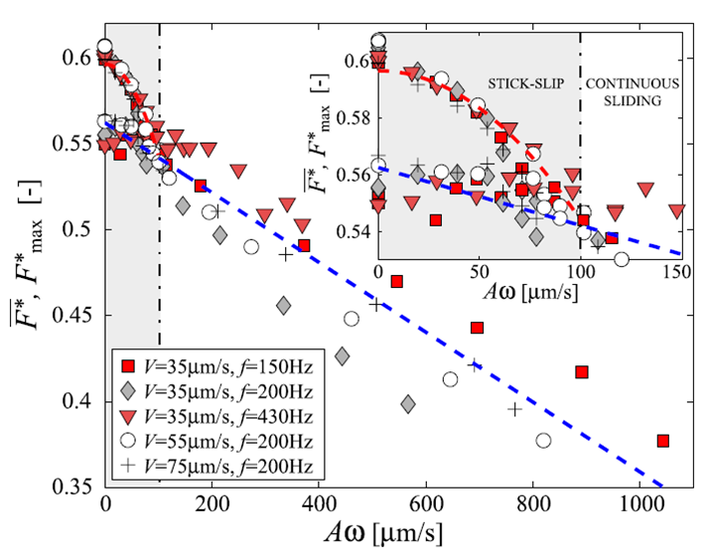
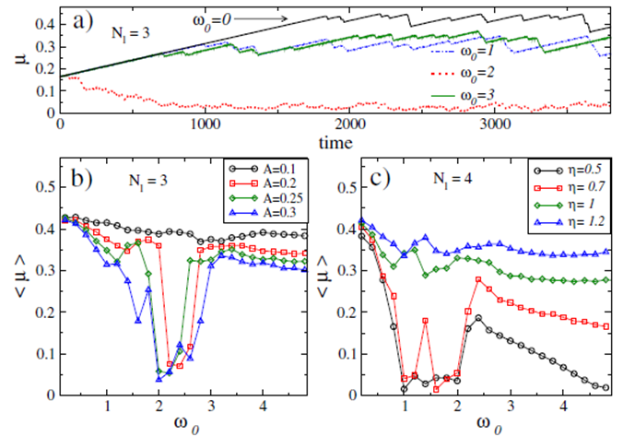
Affecting Friction with Vibrations
Well established field with extensive research
Depending on power and frequency, there's an optimal range to influence friction with vibrations
F* is frictional force
https://harvest.aps.org/v2/journals/articles/10.1103/PhysRevLett.103.085502/fulltext
V is velocity
https://www.nature.com/articles/srep13455
friction is suppressed if w₁<w₀<w₂
A and w are vibration parameters
Beyond V slip-stick transitions to continuous sliding.
The velocity dependence is direct
(no hidden dependences to other parameters).

Slide 5
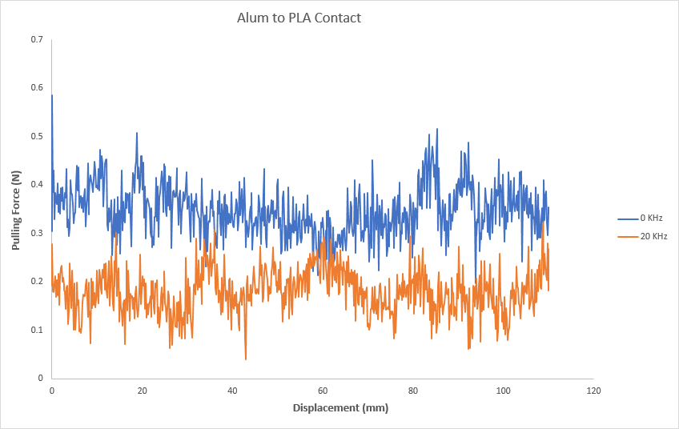
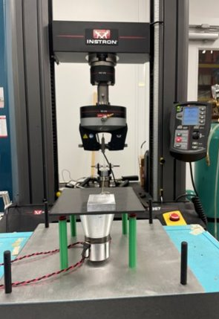
Proof of Concept on Simple Study
Study showing friction mitigation between contact surfaces of Tough PLA and aluminum
When 20 kHz of vibration was applied at 50 W, friction was reduced by 1/2

Slide 6
Milestones (next 5 years)
We know affecting friction with vibration is possible
We also know that reducing frictional contact within impregnated coils enhances magnet performance
Constructed milestones for the next 5 years to carry out this study
Starting with simple low-cost experiments
Gather enough knowledge and expertise to ultimately apply into an actual magnet design (10 years timeline)

Slide 7
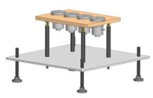
Milestones (next 5 years) cont.
1. Setting Baseline Techniques to Affect Friction with Vibrations
Mechanical oscillations can affect friction, and mathematical models exist
Set foundation for influencing the frictional interaction among surfaces by incorporating vibrations
Introduce established methods and validate published results
Ultrasonic transducers will be utilized along with power drive
Using acoustic and accelerometer sensors to measure vibrations at contact surfaces and ensure adequate calibration of experiment

Slide 8
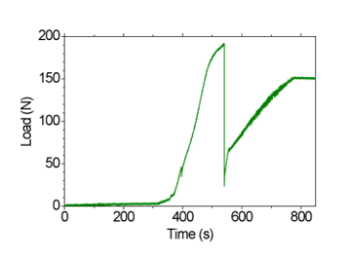
Milestones (next 5 years) cont.
2. Developing Samples with Proper Magnet Interfaces
Develop variety of sample interfaces associated with SC magnets to conduct an in-depth investigation into the distinct friction properties across multiple interfaces
Understand how friction coefficients fluctuate in the different interfaces commonly found in magnets, at room and cryogenic temperatures
Explore energy dissipation within magnet conductors and the frictional properties between contact surfaces
Experimental Approach:
Existing tensile test will be used along with 3D printers to assist with sample preparation such as creating molds, and other support needed
Developed samples will have materials such as CTD-101K, Mix 61, Stycast 2850FT, Paraffin-wax, and Araldite, as well as fiber-reinforced epoxies containing glass fibers, Nb-Ti and Nb3Sn
Subjecting test samples to various forces and measure max. force, study behaviour after crack is initiated.
Temperature sensors, strain gauges, and acoustic sensors will be used determine the energy release from epoxy cracking and heat dissipation
This study will provide a deeper understanding of friction coefficient dynamics in superconducting material interfaces and the energy dissipation resulting from conductor motion under varying forces
Ensure experiment is meticulously calibrated to achieve measurable, reproducible outcomes
This foundational work will provide a basis for further analysis in subsequent work for incorporating vibrational methods
Single Fiber Pull-Out Test
LBNL
https://ieeexplore.ieee.org/abstract/document/10435705

Slide 9
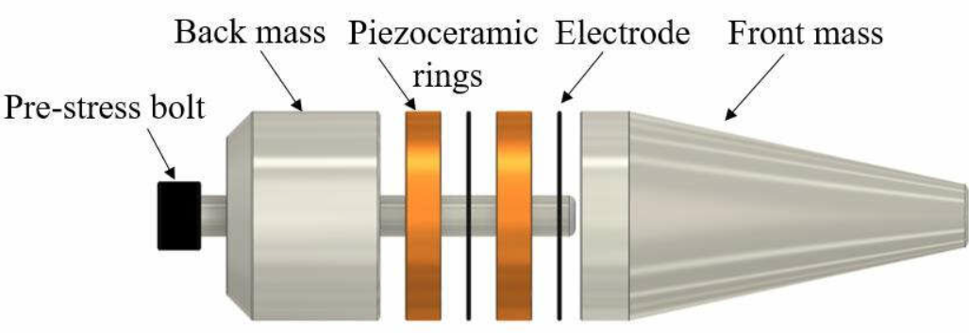
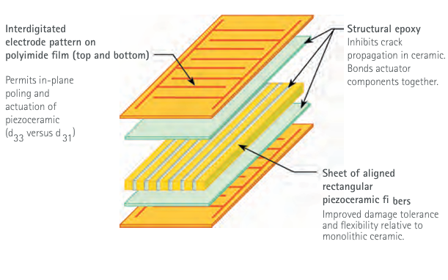
Milestones (next 5 years) cont.
3. Designing and Commissioning Ultrasonic Vibration Machine for Operations in Ambient and Cryogenic Temperatures
Design and execute the development of an Ultrasonic Vibration Machine
Capacity to operate within a spectrum of frequencies, power levels
Adapt to various surfaces to allow efficient transfer of vibrations
Able to transfer vibrations at room and cryogenic environments
Experimental Approach:
key components of the device will be:
Power supply amplifier
Impedance matching parts transducer, such as feedback loop
Ultrasonic transducers, ceramic piezoelectric, and power drive
Commissioning of such a machine is the pinnacle of introducing vibrations within the experimental setup
At present, there is no machine capable of adjusting its amplitude, and frequency to accommodate different sample designs while delivering vibrations in cryogenic/room temperatures

Slide 10
Milestones (next 5 years) cont.
4. Determining Friction Dependencies of Magnet Interfaces on Vibration
After carefully considering the impact of parameters such as temperature, specific material properties, applied forces, and energy release:
Investigate the vibrational effect on previously prepared samples at room/cryogenic environments
Explore relationships between friction and vibration parameters - power, frequency, amplitude, damping ratio, mass, etc.
By effectively managing these parameters, we anticipate that the friction challenges in magnets can be minimized, consequently reducing energy dissipation in the form of heat
Experimental approach
Same experimental setup as from our earlier studies, but with added modifications to incorporate effect of vibrations
Integrate multiple sensors to determine energy release and heat dissipation
Comparing the friction coefficient and heat dissipation measurements from the current and previous setups
Validating the results will involve rigorous statistical analysis, repeatability and reproducibility of the experiments
Direct path for drastically improving magnet performance

Slide 11
Milestones (next 10 years)
5. Incorporating vibrations to a magnet design
Ultimate goal is to use knowledge from previous studies and implement into magnet design
Implementing ultrasonic vibrations to an actual magnet design
Test/obtain results and evaluate affect of vibrations on magnet performance

Slide 12
Short Term Achievements
Aiming to achieve in short term:
Conduct initial data collection and analysis of material characteristics and their responses, along with basic model validation
Some sample design and preparation will be prepared and tested
Immerse conductors in epoxy and break it in tensile test machine, study frictional behavior after fracture
Evaluate energy release due to epoxy cracking and energy dissipation in form of heat
Similar to BOX experiment and Fiber pull-out test
Ensure experiment is repeatable and reproducible
Preliminary optimization of vibration parameters will be implemented on samples and compare results to tests without vibrations
Vibrations with different frequency and power
Observe how results are changing

