Slide 1
The 17th US MDP 2212 WG meeting, Jan 2025
US MDP 2212 WG meeting, Jan 2025
2025/01/28
Meeting series: https://conferences.lbl.gov/category/100/

Slide 2
Status of each lab’s 2212 MDP program
News from ARDAP project.
News from LBNL CCT program.
(1) BIN5-CCT5 fully assembled. Test targeted March 2025.
(2) Bi-CCT2 winding with a 12 mm wide cable ongoing. Initial experience indicates further optimization needed for winding long length coils.
News from FNAL SMCT program.
SMCT 2212 3D printed mandrels arrived, passed QA/QC.
Alessio is moving to LBNL to complete winding at LBNL, and will coordinate the first prototype coil fabrication. Mandrels at FNAL machine shop. More parts to fabricate – 1) splice box support, 2) keys, 3) pins, CAD models available. Drawings?
CPRD request. 1) 0.16 mm, single-stack 36 filaments Alex Otto wire. Pure Ag sheath. 1 bar HT solenoid – no leakage – no-insulation. What length is available? Purchase ~20 (or a length that makes sense) meters first. 2) Rutherford cable?

Slide 3
Status of each lab’s 2212 MDP program
Facilities: (1) RENEGADE OP furnace (Reach desired T and pressure. More tuning coming. 85 cm long CCT dummy mandrel used) . (2) DELTECH OP furnace (zone #1 failed. Heating element). O
OP Furnace Update Renegade 2.0 Shakedown (D. Davis, 2024/11/06), 1.5 zone homogeneity zone.
Plug at the cold end didn’t improve homogeneity zone length. Will check radial homogeneity. Will run again without baffle tube. Will run with 100% power input to the top four zones, instead of 85%. Dense TCs at the top three zones.e Update Renegade 2.0 Shakedown
News from NHMFL solenoid program (NIH funding – 28T NMR magnets, HTS inserts in OI outserts).

Slide 4
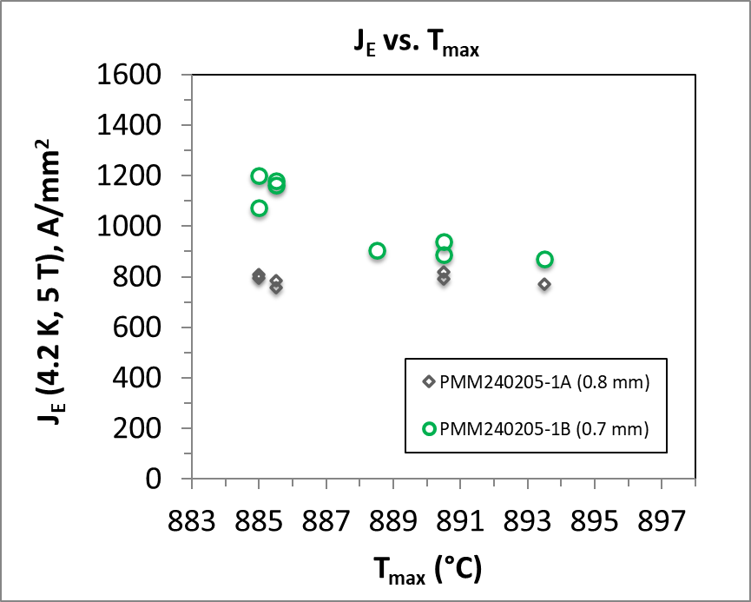
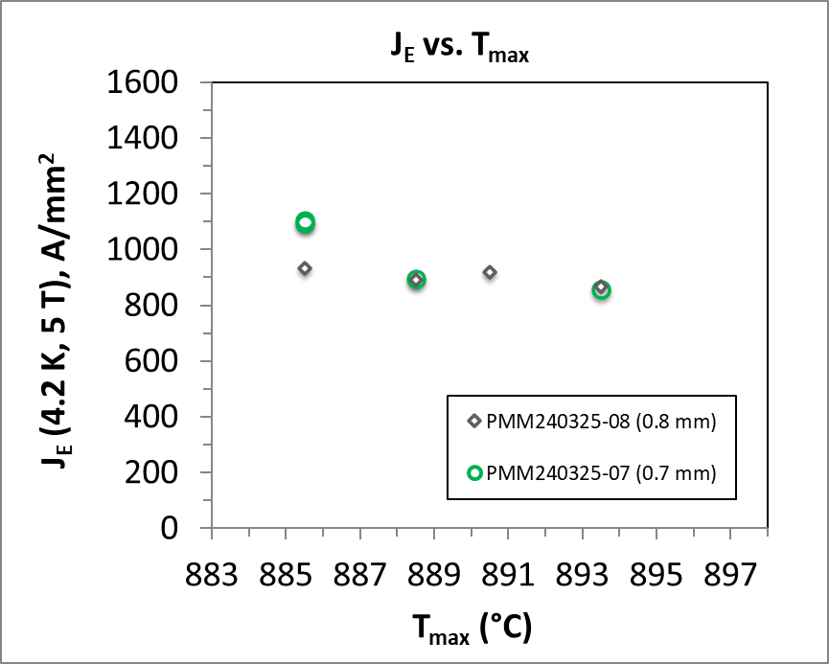
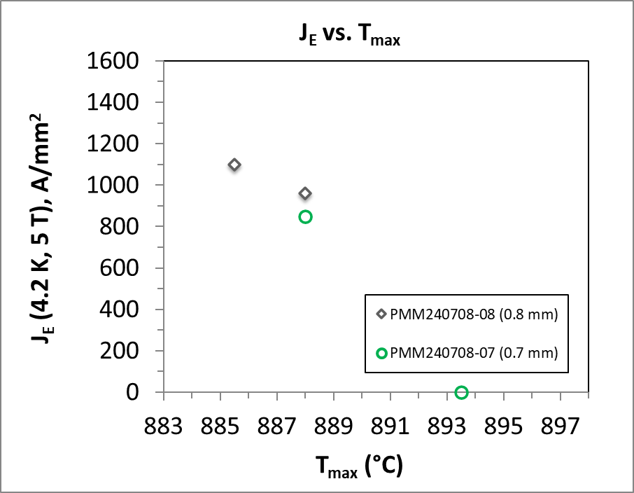
Three wire billets have been produced, with okay performance.
The 3rd billet has respectable performance. The 4th billet is under evaluation with good microstructure. The 5th billet fabrication to start with additional Ag-0.2wt. % Mg thickness.
November meeting.
ARDAP billet #1
(505 m in 0.7 mm)
ARDAP billet #2
(510 m in 0.7 mm)
ARDAP billet #3
(0.8 mm)
Performance Target
Performance Target
Performance Target
All 37 x 18.
J. Jiang, NHMFL, leads heat treatment and I_{c} characterization

Slide 5
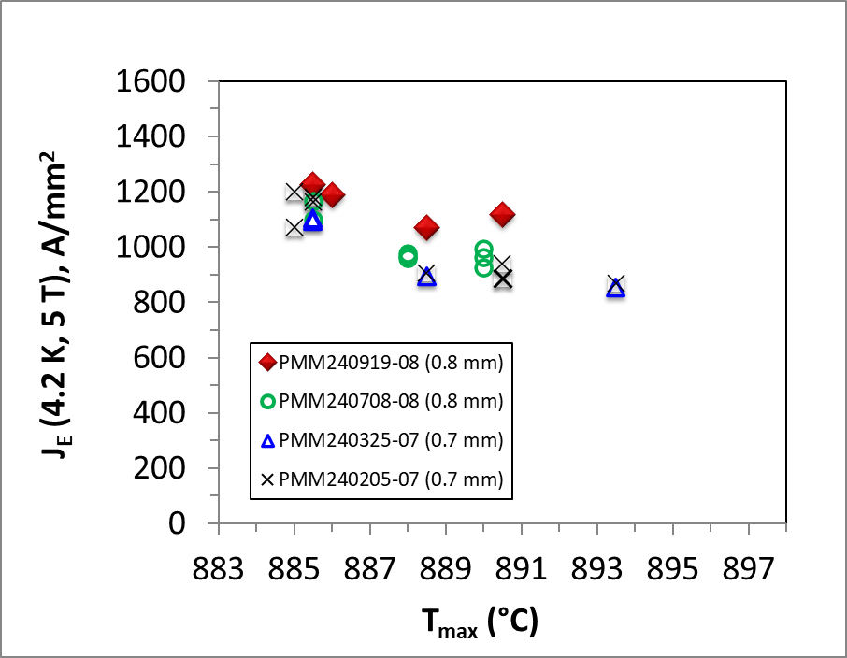
Five billets have been produced and four billets have been characterized, with increased performance
The key production powder – wire performance relationship identified?
Billet #5 with thicker Ag-Mg sheath.
Billet #6 goes into production this week.
Target of this project
ARDAP billet #4
ARDAP billet #3
ARDAP billet #2
ARDAP billet #1
J. Jiang, NHMFL, leads heat treatment and I_{c} characterization

Slide 6
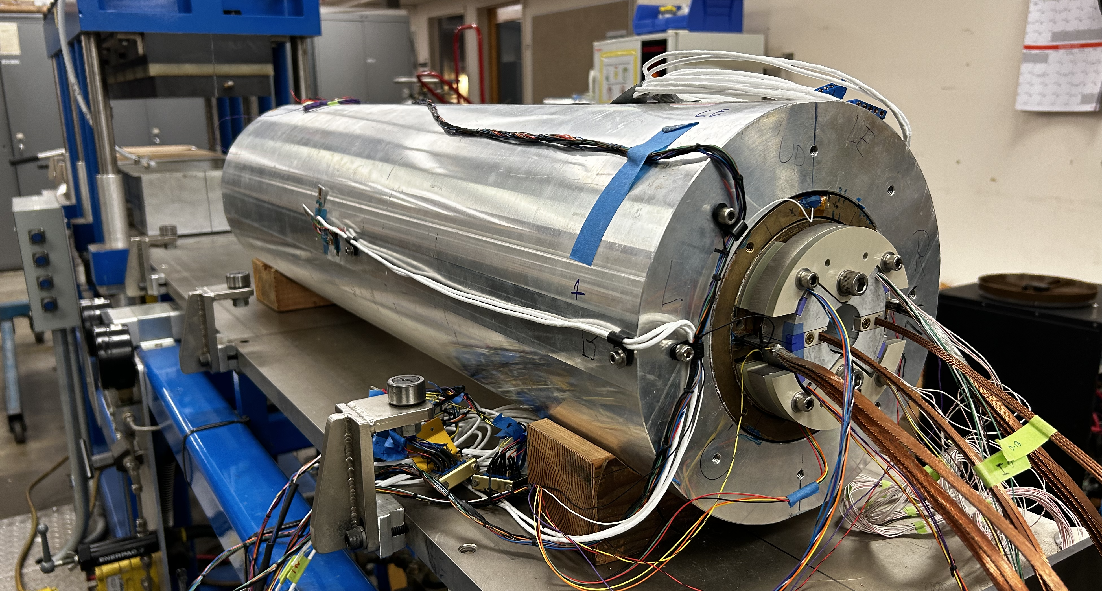
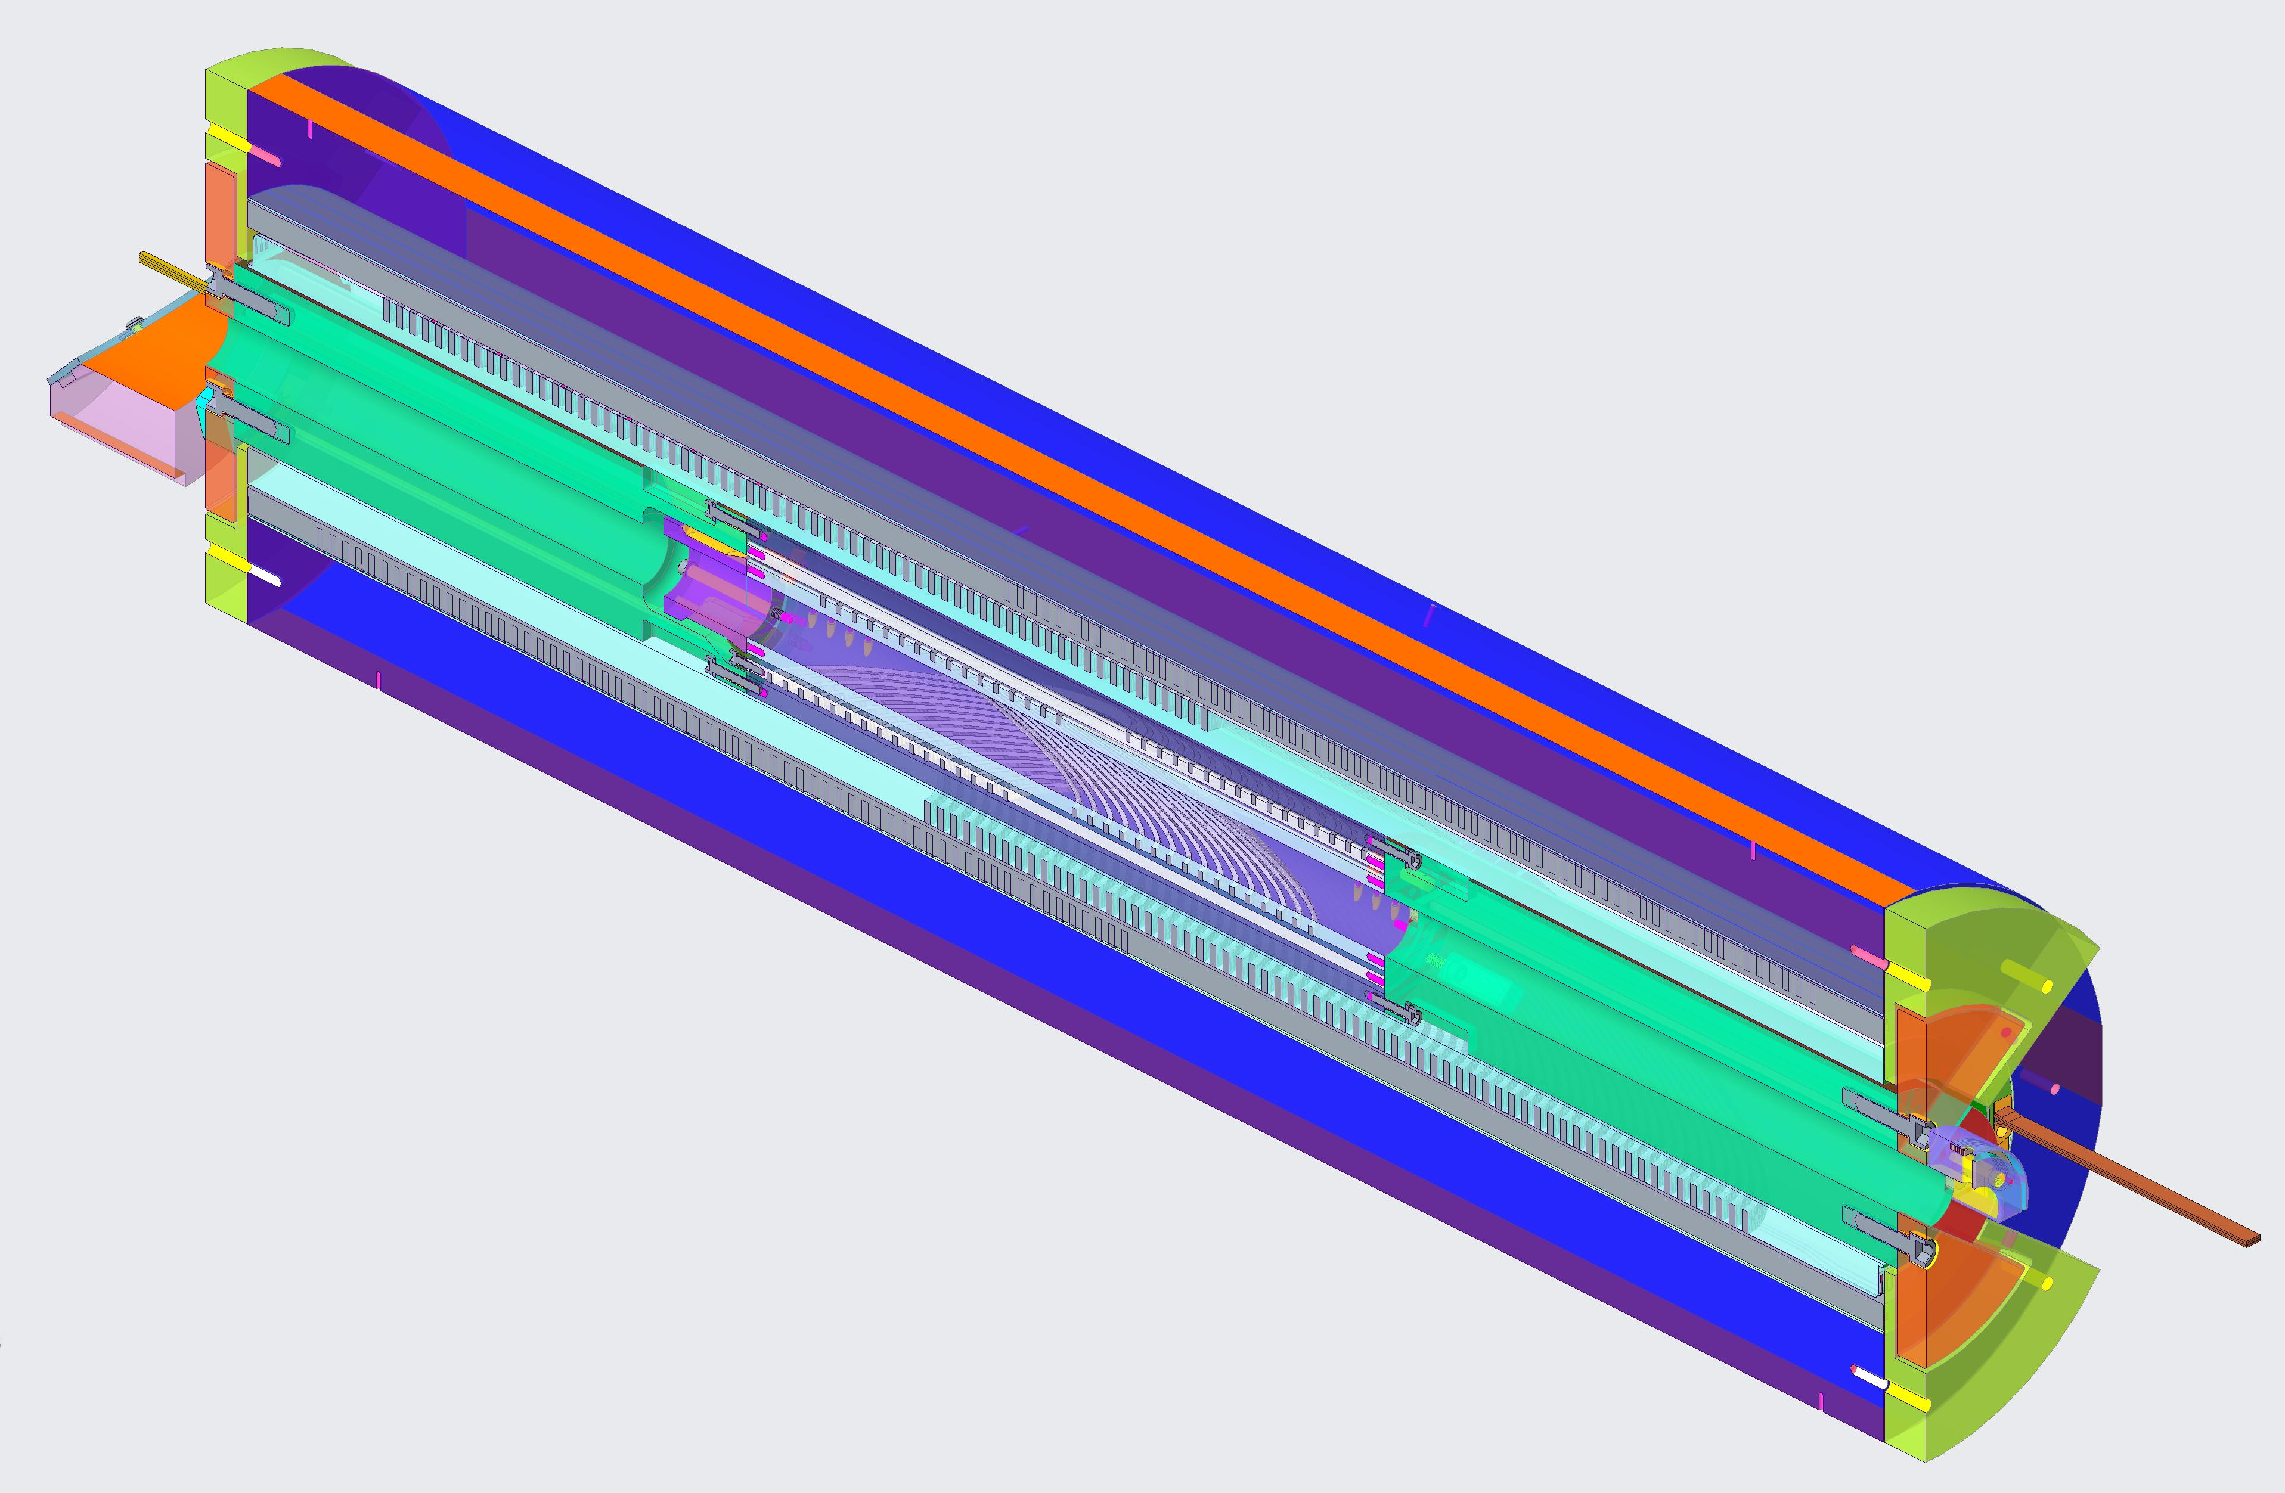
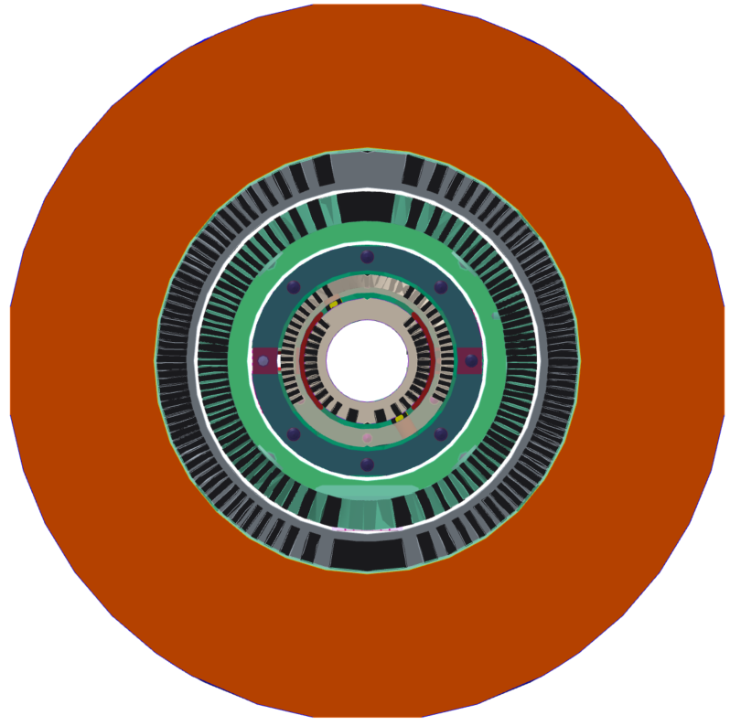
Hybrid Nb₃Sn/Bi-2212 dipole magnet CCT5-BIN5 assembled and ready for test
CCT5/BIN5 hybrid dipole magnet
CCT5
BIN5
BIN5 insert assembly

Slide 7
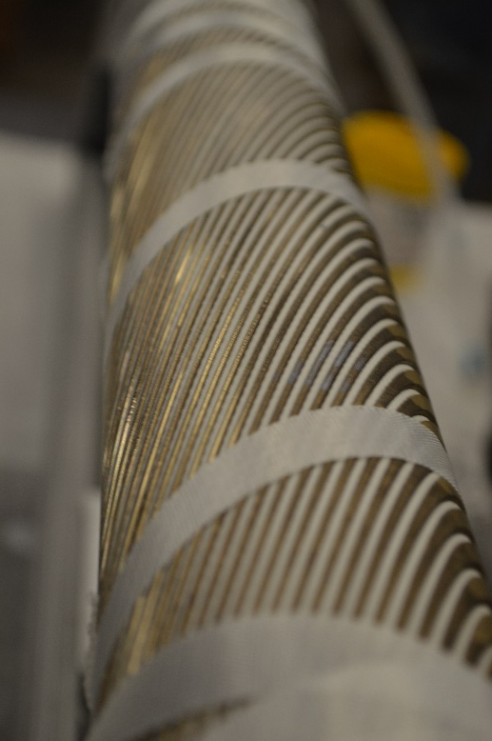
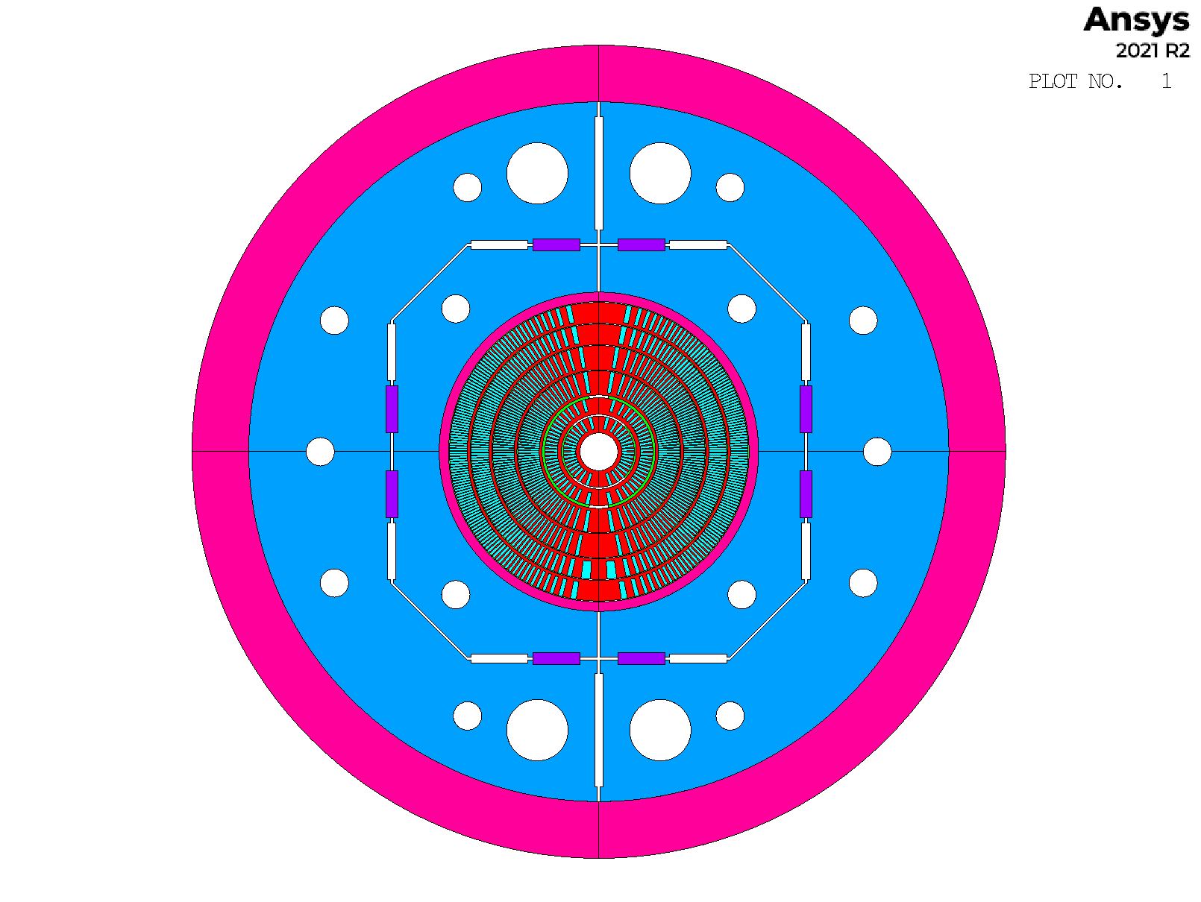
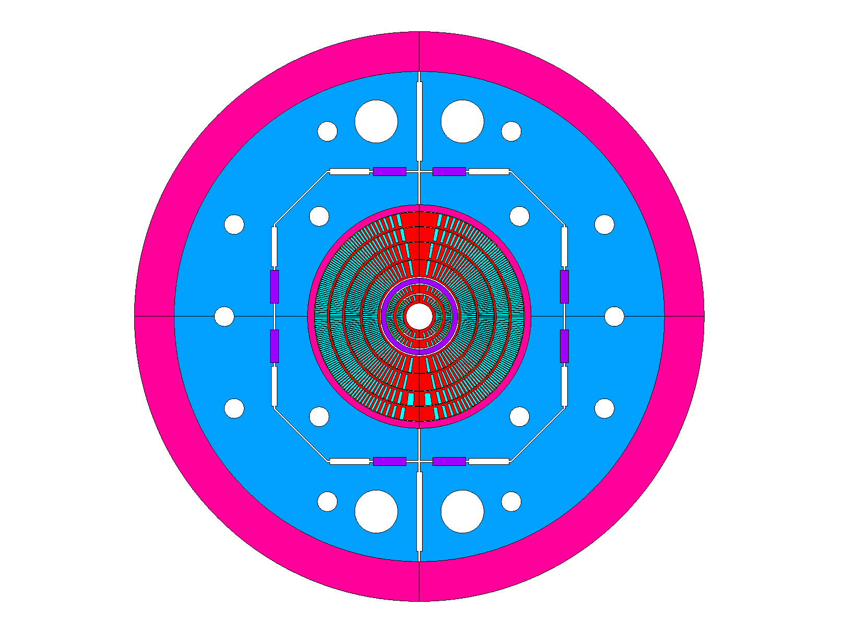
Bi-CCT1 and Bi-CCT2 are an integrated element of US MDP’s hybrid dipole magnet development
Bi-CCT1
Three coils fabricated
Heat treatment@NHMFL’s
RENEGADE furnace
Bi-CCT2 in CCT6
Bi-CCT1 in CCT6
Mandrel | IL (Inner Layer) | OL (Outer Layer)
Material | Aluminum Bronze 954 | Aluminum Bronze 954
Mandrel ID (mm) | 40 | 70
Mandrel OD (mm) | 66.2 | 96.2
Mandrel length (mm) | 850 | 850
BiCCT1
Target: ~5 T in 40 mm aperture
Coils wound and ready for reaction
BiCCT2
Target: ~7 T in 40 mm aperture
Cable fabricated.
Winding test in progress

Slide 8
CPRD conductor request
On Thu, Jan 23, 2025 at 7:02 PM Ian Pong <ipong@lbl.gov> wrote:
Dear Tengming and Vadim,
Hello. I am writing to you regarding the conductors needs from MDP Area Ib and Ic.
Could you collect from the MDP BI-2212 and REBCO insert dipoles (Area I.b and I.c), for which you are the sub-Area coordinators, any conductor needs and communicate with me please? I am including Paolo here so that he can coordinate and provide input on the hybrid integration.
I would like to have your input before the MDP Collaboration Meeting (end of May). When assessing your conductor needs, please consider:
The lead time. The lead time for orders to deliver has been long and growing. 2 years is what we might need to expect from PO signature to receiving strands. Quotation, negotiations, and approvals for large dollar value orders, and cabling and insulation will easily add several months on either side of the lead time.
The time period. CPRD would like to encourage you to consider your needs into the future (in line with the revised MDP roadmap) as far as you can. Please indicate your needs accordingly.
Where you can, indications on the specification, however general, will be welcomed.
This can be your Area's initial view. Please do not feel you will be bound by it.
The Area plan for conductor usage should be presented at MDP general meetings and/or the annual collaboration meeting. CPRD is preparing the planning of our upcoming portfolio and strategy on conductor procurement. Your input would be very valuable to us.
Please let us know. We look forward to hearing from you.
With best wishes,
Ian.

Slide 9
MDP roadmap
From Velev’s email, 2025/01/28
Additionally, we would like to draw your attention to the MDP Roadmap document, which is currently out for collaboration review. Please send any comments, suggestions, or corrections to Soren and me. The goal is to approve the document in two weeks during the MDP general meeting.

Slide 10
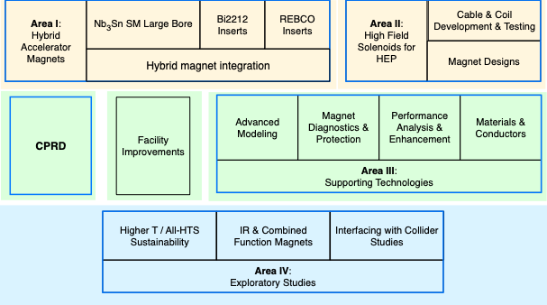
US MDP plan update – need your critical inputs
From US MDP Vision, Goals, and Structure-version 1.docx

Slide 11
US MDP plan update – need your critical inputs
Develop the following:
a) identify a few (say ~3-6) near term challenges and/or driving questions that further guide and focus your area’s plans. Our new roadmaps should be looking out about 10 years, but the near term challenges should identify research that you think can be at least partially addressed in the next 4-5 years.
b) draft Area thrusts and associated milestones; here we want to be both aggressive yet also “realistic” in terms of the investment required. Of course the stronger the impact you feel a development can/will have, the more aggressive you can be in the proposes development plan. In all cases, plans should envision reasonable development steps that are quantitative, so they can act as gates to justify further investments. Again, we want more detail and specifics on the 4-5 year timeline, but identifying a few major milestones on the 10 year scale are also helpful.
c) you are welcome to suggest edits to the synopsis in order to improve the framing of the area/sub-area. Identifying relevant references would also be helpful, as this document will become the foundation for the final new Roadmap document, and for that we will want some critical references that help frame the program.

Slide 12
US MDP plan update – need your critical inputs
Sub-area I.b: Bi2212 insert dipoles
The DOE-OHEP has invested significantly in Bi2212, an isotropic, round-wire conductor with built-in current sharing, over the last decade. Bi2212 performance continues to evolve based on deeper understanding of the conductors, which has encouraged and enabled new powder suppliers and wire manufacturers to appear. The accelerator dipole technology has advanced, with multiple magnets demonstrating overcoming of key challenges, e.g. insulation, overall Jc, over-pressure reaction, etc. that encourage advance to the next stages. MDP is poised to perform the first hybrid test using a Bi2212 insert in a 90mm bore Nb₃Sn magnet, and coils have been fabricated in preparation for testing in the flagship 12-14T, 120mm bore dipoles currently under development. The program will now focus on the development and testing of Bi2212 dipoles in high-field, where challenges of quench protection and strain management will need to be addressed.
Near term challenges:
Resolve the leakage issue that plagues Bi2212 Rutherford cables
Commissioning of the large furnace
Arresting the recent degradation of Jc from BOST wire using EnGimat powder
…

Slide 13
A draft: https://docs.google.com/document/d/1E1XpcVGKRfbqQHO6hv5jr7Tt83Xs74JyvrOzus2ImOI/edit?tab=t.0#heading=h.gnax877thgv0
Timeline: December 10th, 2024 for a decent version to be sent to MDP management.

Slide 14
Near term challenges
Understand the industrial process and wire performance relationships to push the industrial wire plateau J_{E}(4.2 K and 5 T) to be consistently greater than 1100 A/mm². Currently, there are many billets with J_{E}(4.2 K and 5 T) to be in the range of 800 – 1000 A/mm².
Understand causes of leakage in the Bi-2212 Rutherford cable based coils, factors that control it, and develop methods to remove it. This includes the external leakage that is visible after a chemical reaction with insulation materials and internal leakage that has Bi-2212 leak into the interface between Ag-0.2wt.Mg% sheaths and is not visible but nonetheless is harmful to wire performance.
Work with industry to address the recent wire degradation issues that arise from wire twisting.
Understand the science and technology of Bi-2212 Rutherford cables and optimize their fabrication.
Commission the overpressure processing facility RENEGADE furnace to react solenoids relevant for NMR and industry and the 85 cm long canted cosine theta Bi-CCT1 and Bi-CCT2 coils to be tested as insert coils in the 120 mm bore, 12 T CCT6 Nb₃Sn dipole magnet.
Fabricate and test the 85 cm long canted cosine theta Bi-CCT1 and Bi-CCT2 coils. Examine their performance in the standalone situation.
Explore fabrication of canted-cosine-theta Bi-2212 coils with 3D printed Inconel mandrels to prepare their use in a high stress environment such as a 20 Tesla dipole magnet. Measure materials properties of the Aluminum Bronze 954 (now being used to build canted cosine theta Bi-2212 cols) and Inconel 718, after Bi-2212 heat treatments at low temperatures. It is known that materials would have their yielding stress reduced due to high temperature annealing.
Integrate Bi-CCT1 and Bi-CCT2 coils as insert coils in the 120 mm bore, 12 T CCT6 Nb₃Sn dipole magnet.
Build prototypes of stress-management cosine-theta Bi-2212 coils to establish fabrication know-hows and benchmarked performance.

Slide 15
Longer term challenges
Understand the industrial process and wire performance relationships to push the industrial wire J_{E}(4.2 K and 5 T) to be consistently greater than 1400 A/mm². Key to this will be the drive to understand the underlined materials science that underpins the critical current density of the round multifilamentary round wires. This research is being led by NHMFL with support from the US DOE OHEP through GARD university grant.
Retire magnet challenges from coil fabrication to protection to enable a healthy market for Bi-2212 conductors.

Slide 16
Possible milestones coupled with hybrid magnet program
Paolo Ferracin, US-MDP General Meeting, 11/20/2024

