Slide 1

CAD in SMP
The future of SCCAD | News and Added Features from CAD / EG Division
P. Mallon
11 February 2025

Slide 2
Table of contents
01
Context
02
Quick overview of wtParts and Category Codes
03
News from EG / CAD
04
Summary, Discussion, and Action Items

Slide 3
Table of contents
01
Context
02
Quick overview of wtParts and Category Codes
03
News from EG / CAD
04
Summary, Discussion, and Action Items

Slide 4
Context
SCCAD is overloaded, and contains numerous duplicate items with hard-to-decipher names
Traceability is becoming more important in MDP
  Reuse of existing parts is a tradition
  Starting/stopping/restarting projects with new team members occurs occasionally
Necessity of change management is variable in MDP but generally increasing
wtParts opens the door to change management and creation of BOMs for projects that need it
  This feature must be activated in SCCAD

Slide 5
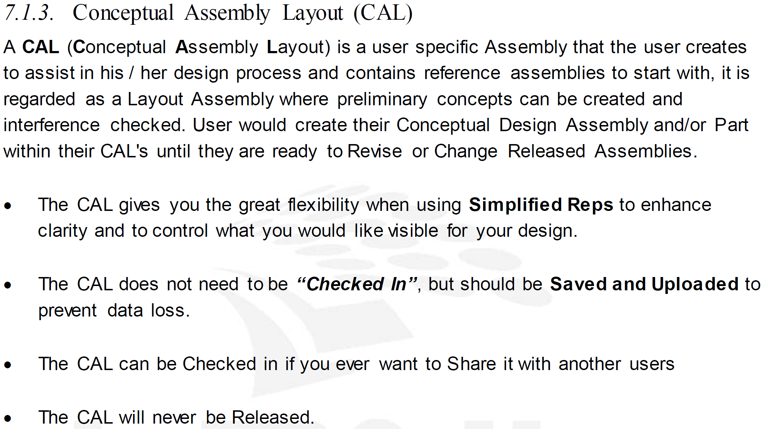
Design work in SCCAD is mostly “Sandbox” design
“Conceptual Assembly Layouts” (Sandboxes) are critical to our work
These mock-ups should be followed and complemented by a single “official” released assembly that serves as a reference for all of SMP
LBNL Creo Parametric Modeling Standards EG-1000-0824A §7.1.3 provides guidance
Example: A sandbox of the released 36” header model may be created exclusively to test fit CCT6 structure, and named appropriately
Other options exist, but lead to cluttered assembly perpetually in “working” state:
  Representations
  Groups

Slide 6
Table of contents
01
Context
02
Quick overview of wtParts and Category Codes
03
News from EG / CAD
04
Summary, Discussion, and Action Items

Slide 7



Quick overview of wtParts (wt = Windchill Technology)
Concept originated from Change Management II (CMII) in 1970s
PTC implemented this concept into Windchill 7 (2000s)
Implemented at the Lab in 2019, initially CAD-centric
  Can also link MS Office, PDF, image, video, and zip files
Primary benefits:
  Allows implementation of Change Management
  Links all related objects together
  Offers controlled, managed BOMs, which allows reporting and serialization
  CAD group is more likely to help us if wtParts is activated
wtPart
3D Part
2D Drawing
Source: engtraining.lbl.gov 201-02

Slide 8
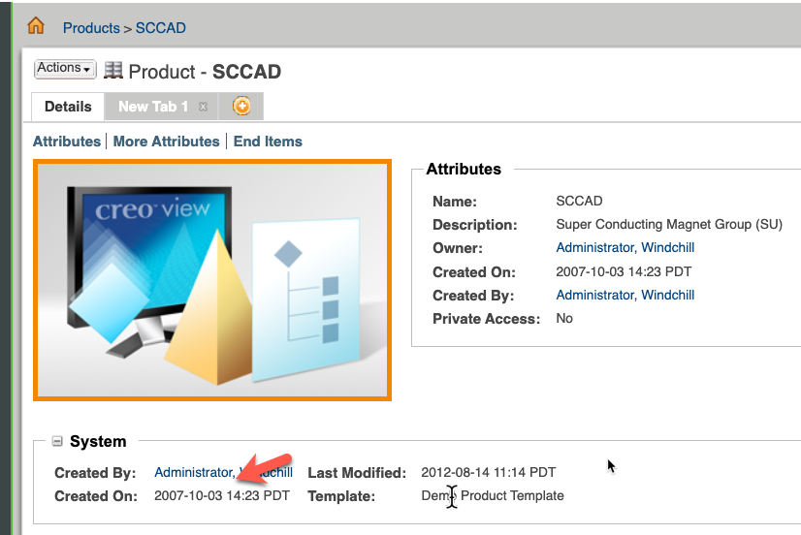
Of the active BCMT Windchill Products,
SCCAD is the only one not using wtParts by default
SCCAD is the oldest active Windchill product at the lab (created 2007)
  6974 CAD objects, 4769 of which use the SU- prefix
  169 released CAD objects, as of 2 Dec. 2024
It is time to activate wtParts in SCCAD
Windchill product | Unique ID / Category prefix | wtParts on?
High Field Test Facility Dipole | DF | Yes
LCLS-II | LC | Yes
MARS Demonstrator | MR | Yes
Superconducting Magnet Group (SCCAD) | SU | No
FRIB Magnets | SU | Yes
LARP QXF | SU | Yes
SC Gantry | SU | Yes
SMP Cabling Facility | SU | Yes
SCU R&D (ended 2017) | SX | No
Category code prefix is independent from Windchill product

Slide 9
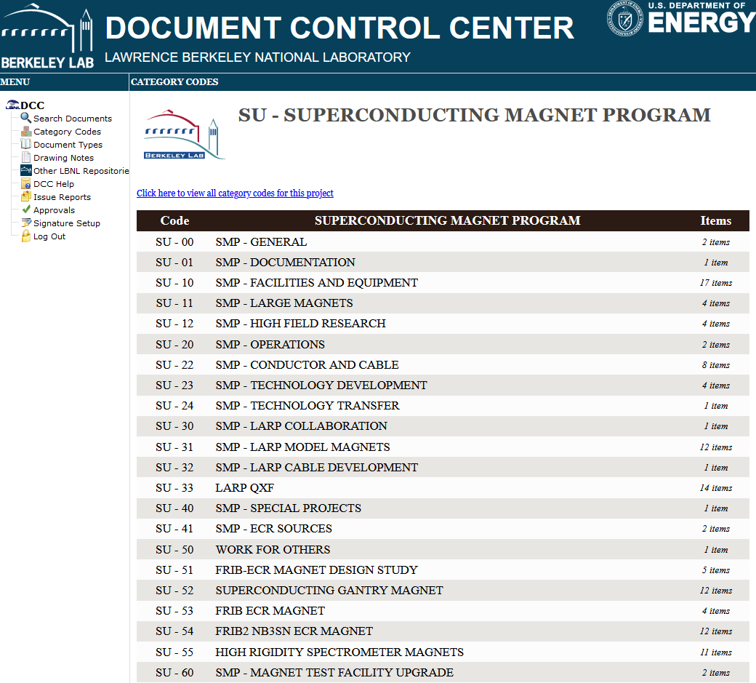
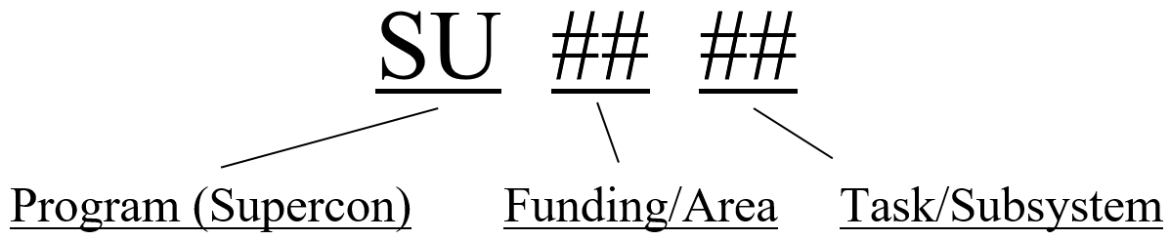
Category Codes and DCC
Six-digit category codes are used to organize drawings and documents (Eng’g notes, specifications, work instructions) in the DCC
They are used as parameters in Creo Parametric that auto-fill the title blocks in drawings (as long as the template is used)
SU:
54:
Funding (Title1)
14:
Subsystem (Title2)
Name (Detail_Title)

Slide 10
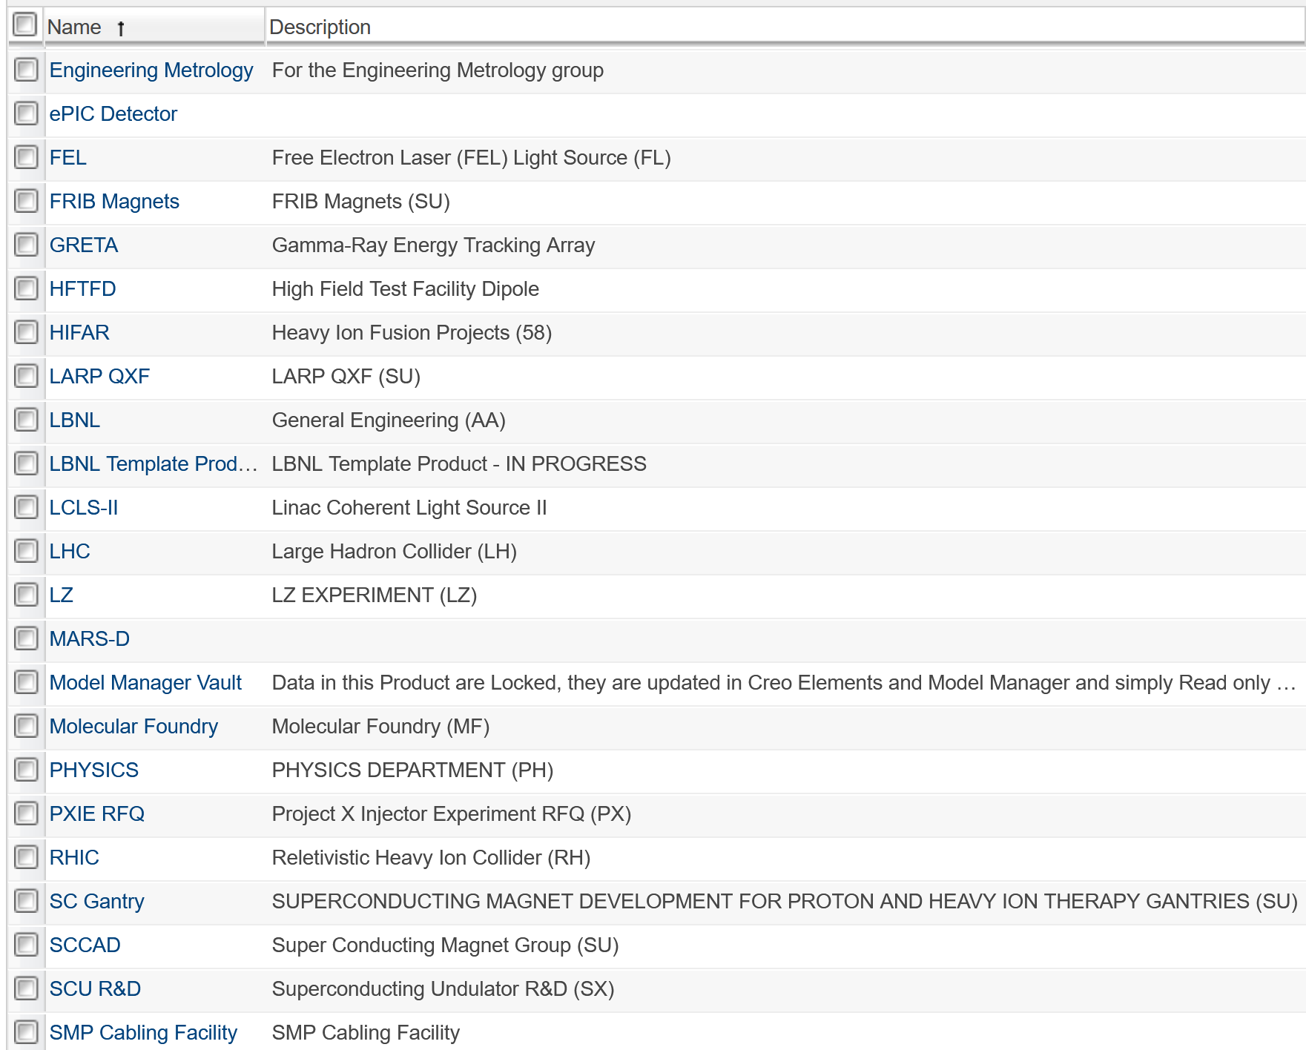
Category Codes and Windchill
Category codes and Windchill products are independent
  SU (SMP) numbers/projects are used outside of the SCCAD Windchill product
  Therefore, SU numbers can be used in a potential new “SCCAD2” product

Slide 11
Table of contents
01
Context
02
Quick overview of wtParts and Category Codes
03
News from EG / CAD
04
Summary, Discussion, and Action Items

Slide 12
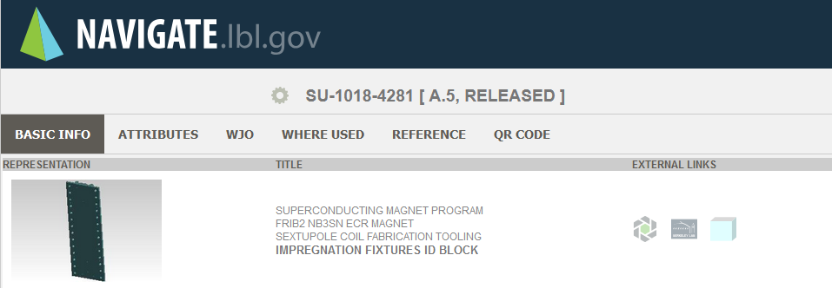
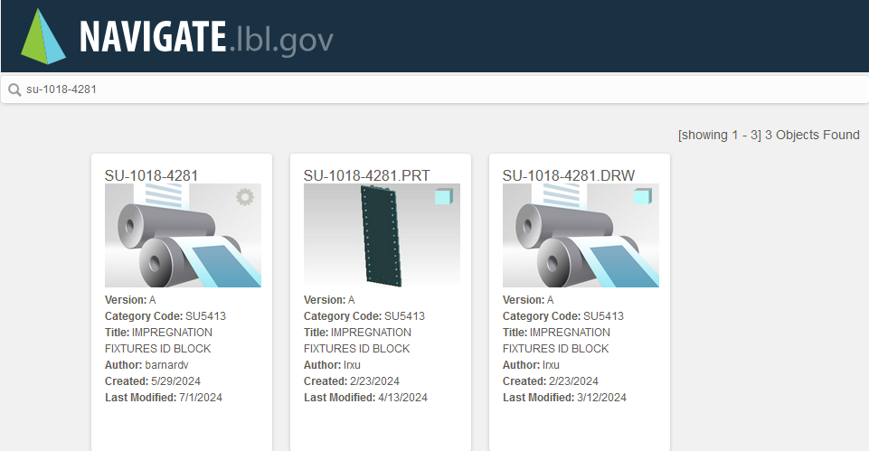
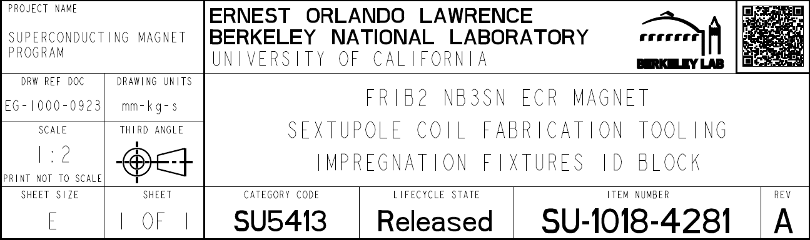
Navigate.lbl.gov and QR Codes
Links to:
  Windchill object
  DCC page
  .PRT and .DRW objects

Slide 13
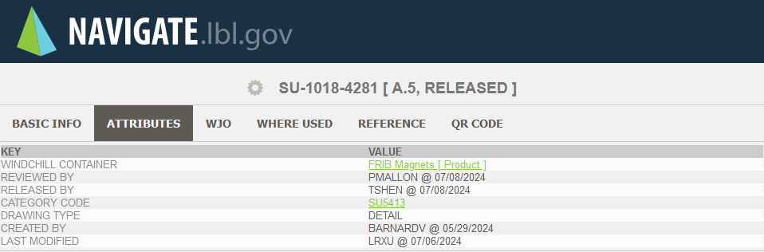
Navigate.lbl.gov and QR Codes

Slide 14
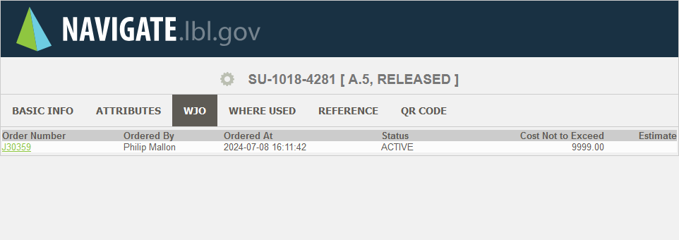
Navigate.lbl.gov and QR Codes

Slide 15
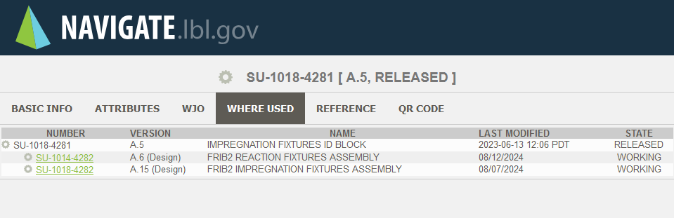
Navigate.lbl.gov and QR Codes

Slide 16
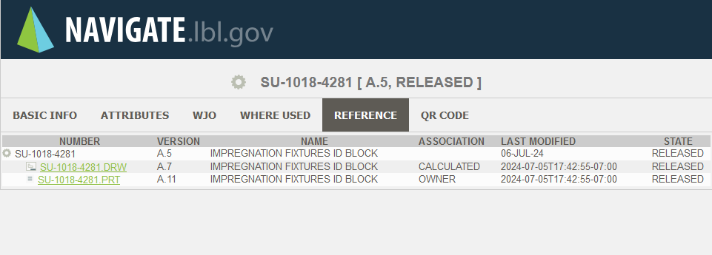
Navigate.lbl.gov and QR Codes

Slide 17
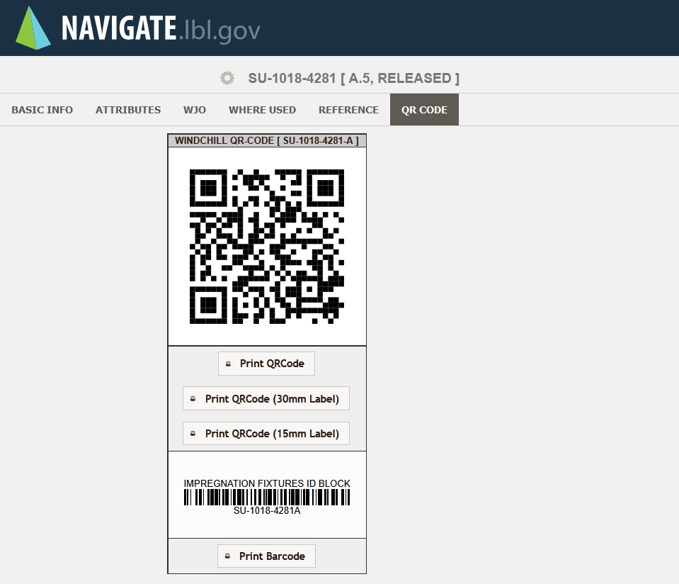
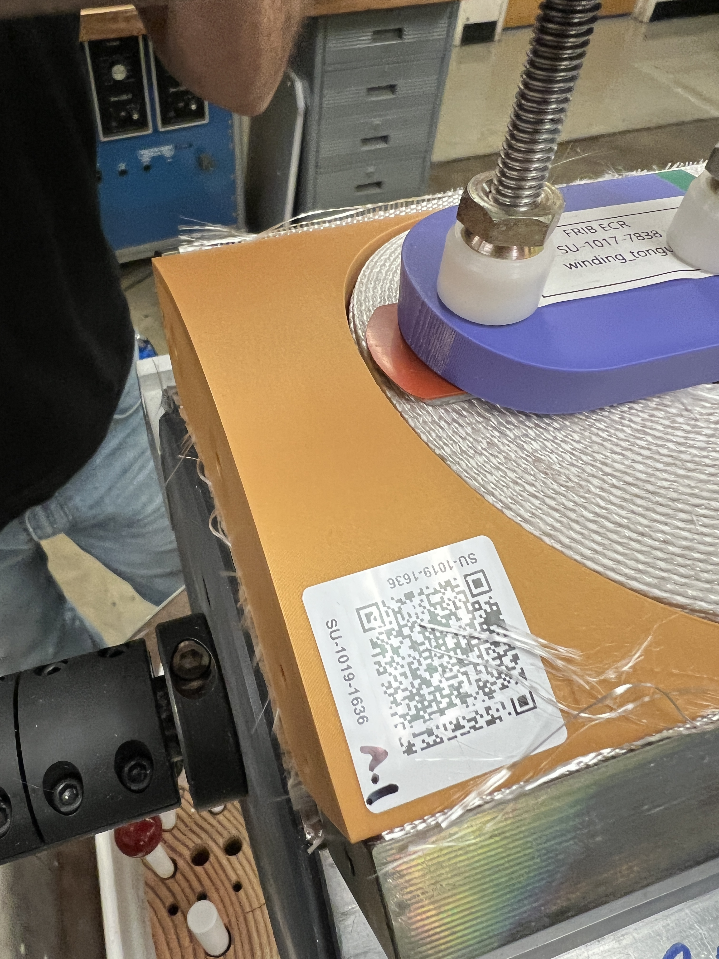
Navigate.lbl.gov and QR Codes
Code can be printed with label maker or laser-etched on physical part

Slide 18
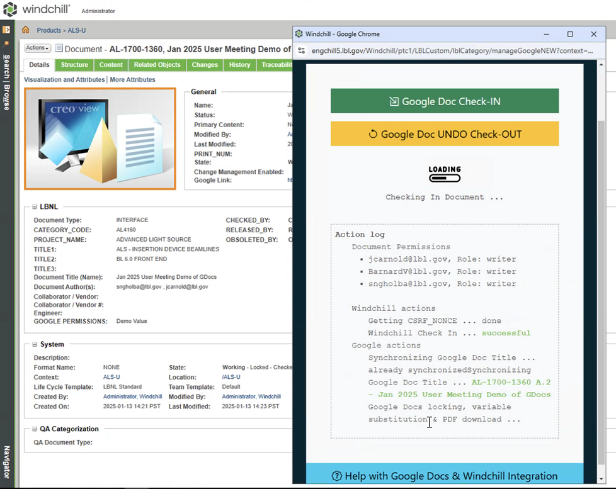
Google Drive integration into Windchill
Check in/check out and promotion features are in development
Documents retain the usual Google features
  Simultaneous editing
Templates under development include Windchill cover sheets

Slide 19
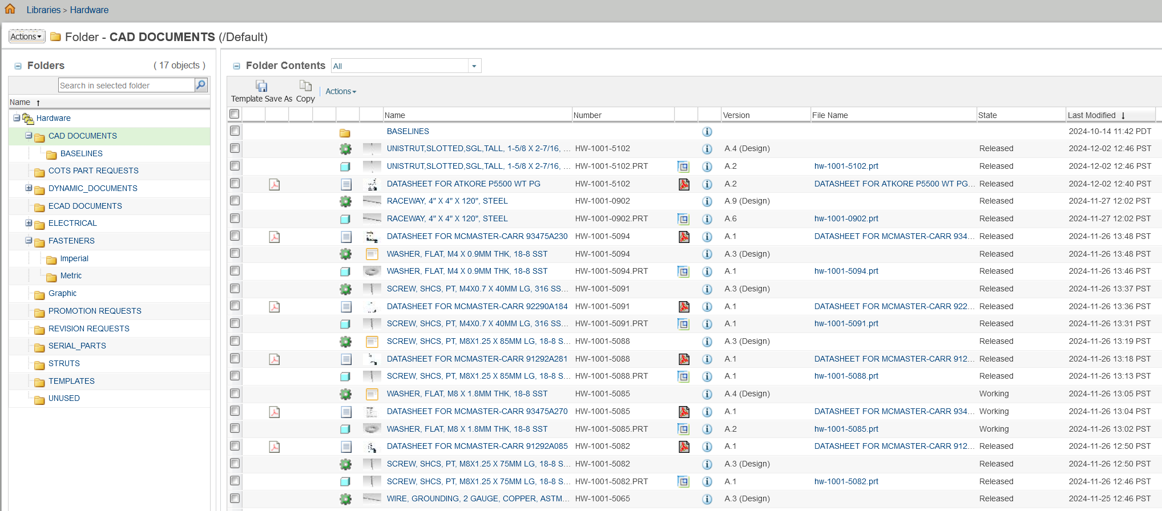
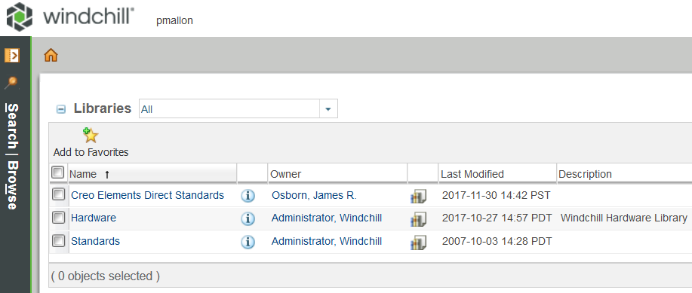
Commercial off-the-shelf (COTS) part library is becoming well developed
This allows us to keep our own products (SCCAD, SC Gantry, FRIB Magnets, HFTFD, etc.) free of COTS parts by keeping them in the Windchill “Hardware” library
This is largely hardware, but can be any commercially available part
We can add to the library quickly (Ryan is our COTS expert)
A search utility exists

Slide 20
CAD group at LBNL has been “promoted” to department level entity
Drawing “Checkers” Bill Holmquist & Gordon Lyall provide last check in all ALS-U drawings
  This could become a required part of promotion process for the entire lab
We could go either of two ways:
  Stop releasing parts/drawings
  Embrace the opportunity to create models/drawings that reflect what we need

Slide 21
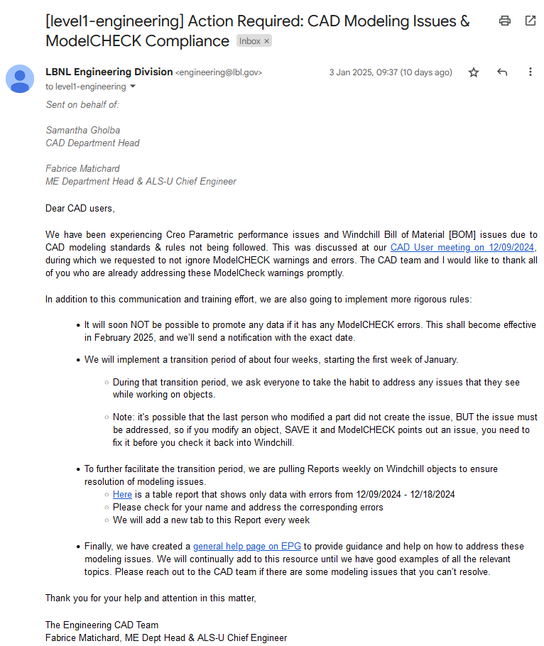
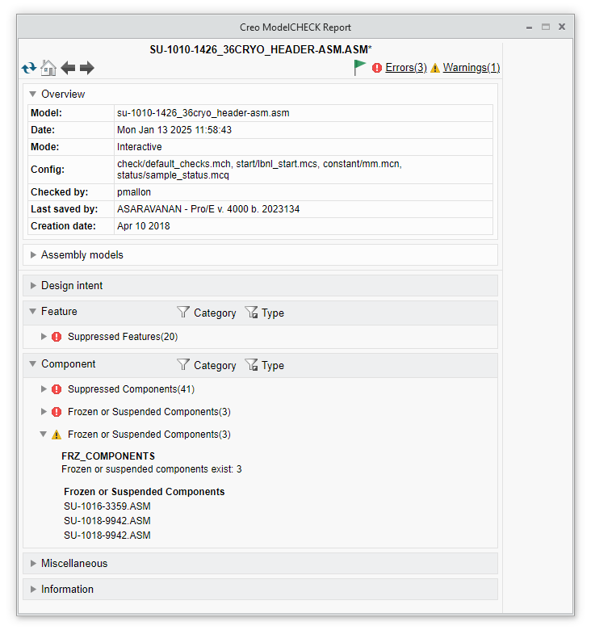
CAD Department enforcing compliance with modeling standards effective Feb. 2025
Creo Parametric and Windchill BOM performance issues in ALS-U are prompting this change, which will affect Creo Parametric users Lab-wide.

Slide 22
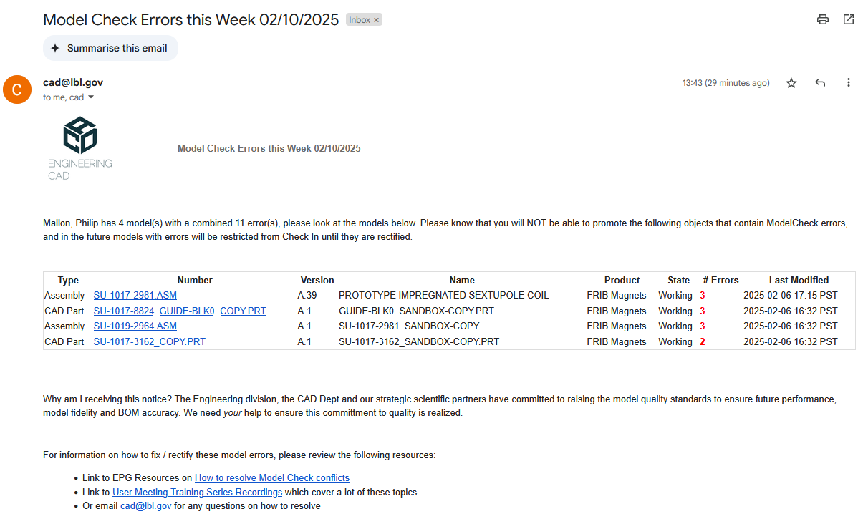
CAD Department enforcing compliance with modeling standards effective Feb. 2025

Slide 23
Table of contents
01
Context
02
Quick overview of wtParts and Category Codes
03
News from EG / CAD
04
Summary, Discussion, and Action Items

Slide 24
Summary: Impacts and Action to Take
Using wtParts and releasing more parts is a natural progression
  It may not be applicable/desirable for all projects
  We will not use all aspects of wtParts – this is too heavy for MDP
  Our designers are already taking advantage of this system in other contexts
Formally releasing parts for fabrication:
  Enforces rigor and helps catch mistakes
  Helps us trace our property and what’s been purchased
  Protects us during procurement
  Reduces the risk of needing rework
Actions:
  Turn on wtParts in SCCAD
  Be more deliberate and organized with our use of sandboxing
  Release parts before fabrication and revise before re-work
  Consider requesting a “SCCAD2” product for new MDP projects, keeping SU- numbers and category codes

Slide 25
Thank You

Slide 26
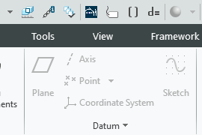
Bonus: best practice reminders for efficient promotion
Always use the LBNL template (either metric or imperial) when creating new parts
  Always create a new drawing using the LBNL parameters button from the .prt file
Part numbers must conform to the SU-XXXX-XXXX format, and names must be names
External references are not allowed and will prevent promotion starting in February
Do not use duplicate assemblies (only one “official” assembly)
  “Sandbox” assembly copies for mockup should be labeled as such and are not meant to be released (see EG-1000-0824A §7.1.3)
  In check-in comments, note which version of original was used (e.g. A.37, B.17)
wtPart must created if it doesn’t already exist, and must be in promotion package
Use custom check-in to log your changes in the comment box
Use commercial off-the-shelf (COTS) parts from the HW- library to keep our Windchill products uncluttered
In assembly drawings, use mfr./vendor BOM to cross-reference vendor part with HW- number

