Slide 1
Boundary Gaussian Process modeling
Yen-Chun Liu, Simon Mak
Department of Statistical Science Duke University

Slide 2
Outline
Motivating example
Gaussian Processes modeling
Boundaries as prior information
Boundary GP
Simulation

Slide 3
Motivating example
Boundary information on $f$ often available from scientific models or physical considerations
Navier-Stokes (Pope 2001):
Highly complex PDE system governing fluid flow (solution $f$ very time-consuming to solve)
Under simplifications, e.g., zero viscosity ($ζ=0$) or incompressibility ($λ=0$), closed-form solution!
Viscosity
Low
High
We should make use of this boundary information!
https://en.wikipedia.org/wiki/Viscosity

Slide 4
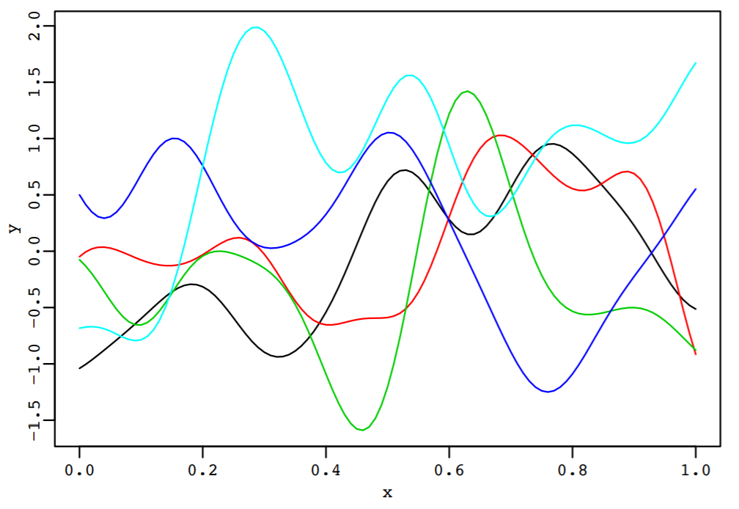
Gaussian processes
Assume $f\left(⋅\right)$ follows a Gaussian process (GP) prior (Santner et al. 2003; Rasmussen & Williams 2006):
$$f\left(⋅\right)∼GP\left(μ\left(⋅\right),k\left(⋅,⋅\right)\right)$$
Mean function:
$$E\{f(x)\}=μ(x)$$
Covariance function:
$$\text{Cov}\{f(x_{1}),f(x_{2})\}=k(x_{1},x_{2})$$

Slide 5
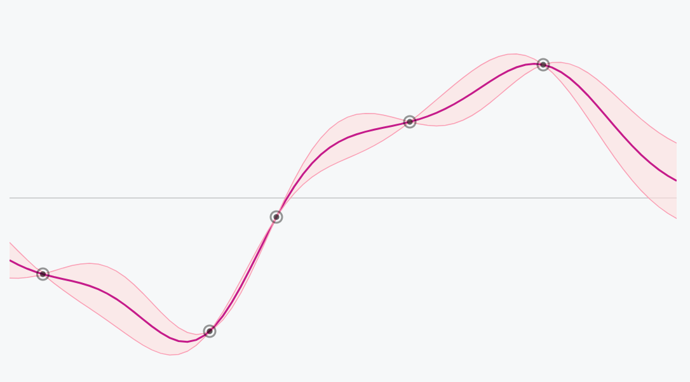
Gaussian processes
Prediction
$$\overset{^}{f_{n}}(x_{new})$$
Output
Data
Uncertainty
$$s_{n}\left(x_{new}\right)$$
$$x_{new}$$
Input
There are information other than data points!

Slide 6
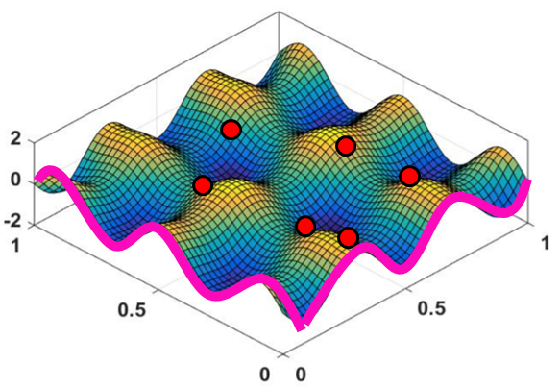
Boundaries as prior information
This boundary information informs our prior beliefs on $f$
… so it should be integrated into the prior $f∼GP\left\{μ\left(⋅\right),k\left(⋅,⋅\right)\right\}$
Improved predictions & faster posterior contraction
More interpretable model for users

Slide 7
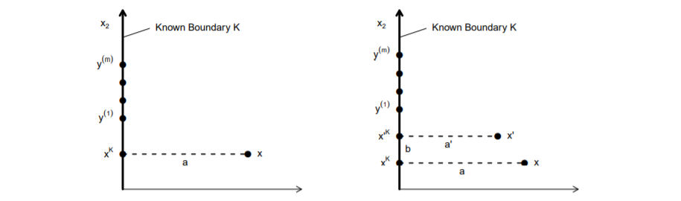
Vernon et al (2019), JUQ
Projection-based GP model
Flexible boundary forms: $\{x∈R^{p}∣x_{j}=α_{j},j∈J_{K}\}$
Not straightforward to derive closed forms for integrating multiple boundaries

Slide 8
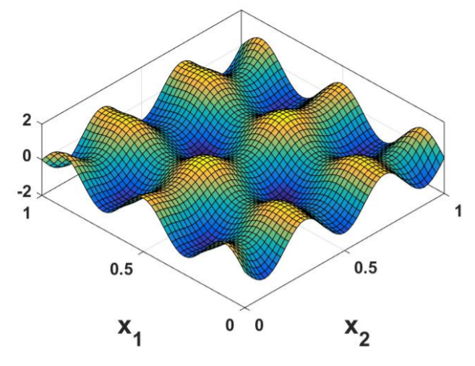
Boundary assumptions
To address this, we need to make some assumptions on boundaries:
Dirichlet boundaries of $f$ (known values of $f$ along $∂{\left[0,1\right]}^{d}$)
Assume boundaries of the form
$\{f\left(x\right):x_{j}=0\}$ or $\{f\left(x\right):x_{j}=1\}$
$$x_{1}=0$$
$$x_{2}=0$$
Known boundaries

Slide 9
1-d BdryMatérn covariance (Ding et al. 2019)
Definition: 1-d BdryMatérn covariance (smoothness $ν=1/2$):
Definition: BdryMatérn covariance (smoothness $ν=1/2$):
$$k_{D}(x,x^{′})=\overset{p}{\underset{j=1}{∏}}k_{ω_{j}}(x,x^{′}),$$
Benefits: simple closed forms for high-dimensional setting with multiple boundaries

Slide 10
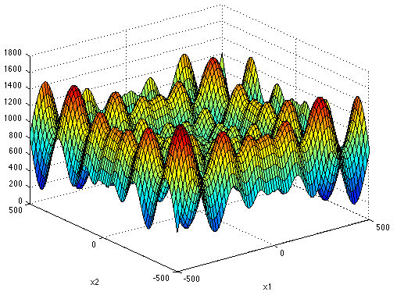
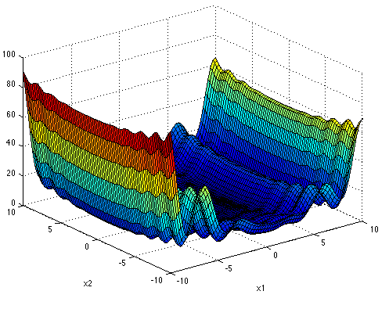
BdryGP - Numerical experiments (Ding et al. 2019)
Test functions (illustration of the case $d=2$):
Griewank
Schwefel
Levy

Slide 11
BdryGP - Numerical experiments (Ding et al. 2019)
Dimension $d=$30:

Slide 12
Thank you!
Questions?

